Slide 1


Overview of QoE Models for Adaptive Streaming Services
Presented By: Syed

Slide 2
Standardizing Opportunities
QoE Models for Low-Latency Streaming
QoE Metrics for ABR Stability
Real-Time QoE-Aware Control Standards
Subjective Methodologies for Low-Latency Streaming
Context-Aware QoE Modeling
QoE Evaluation Datasets

Slide 3
Standardizing Opportunities
QoE Models for Low-Latency Streaming
White paper include:
Traditional HAS
Adaptive Streaming approaches
Low-latency streaming
Does not include:
Low-latency QoE Model
Latency-aware ABR QoE metrics
Chunk-based streaming
vqeg.github.io/doi/10.66537/OLKA7578/

Slide 4
Standardizing Opportunities
QoE Evaluation Datasets
Standardized QoE datasets required
CMAF/DASH streams datasets

Slide 5
Existing Datasets
Title | Focus | Limitations
LIVE-NFLX Video QoE Database | Bitrate Buffering Compression artifacts | Traditional adaptive streaming Limited Bandwidth Profiles
Waterloo Streaming QoE Database | Network-induced quality variations Stalling MOS | Focus on Traditional ABR Controlled impairment
ITEC – DASH Datasets | Bitrate Buffering | Traditional ABR algorithms
DashReStreamer Dataset | Buffering Bitrate MOS | Limited Low-latency Scenarios Limited CMAF-based LL

Slide 6
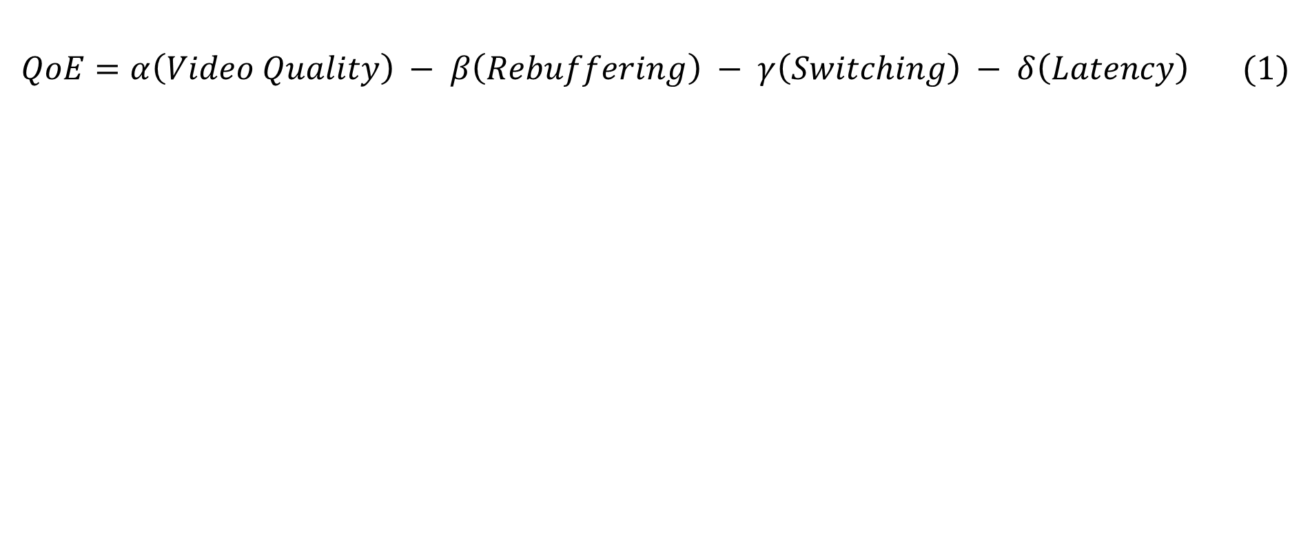
QoE Model Formulation
$$QoE=α\left(Video Quality\right) − β\left(Rebuffering\right) − γ\left(Switching\right) − δ\left(Latency\right) (1)$$
Variable | Meaning | From Dataset
QoE_{i} | Predicted QoE for video/session i | Model output
Q_{i} | Normalized average bitrate | dash.js logs
R_{i} | Rebuffering duration | dash.js logs
S_{i} | Bitrate switching frequency | dash.js logs
L_{i} | Latency | dash.js logs
α,β,γ,δ | Weights | fitted using MOS

Slide 7
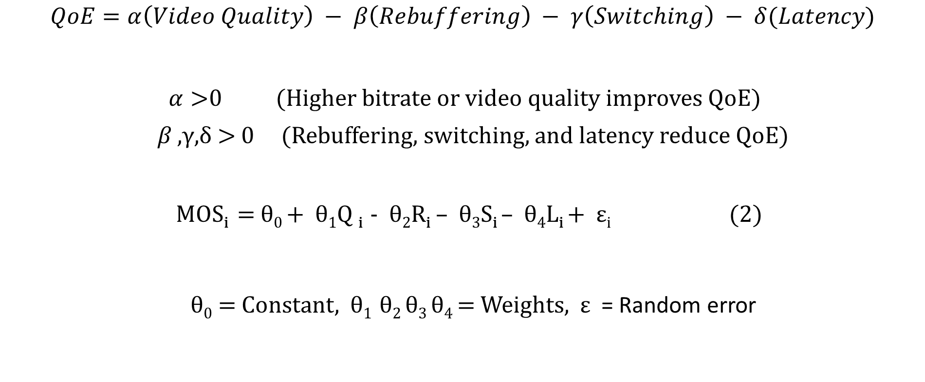
QoE Model Formulation
$$QoE=α\left(Video Quality\right) − β\left(Rebuffering\right) − γ\left(Switching\right) − δ(Latency)$$
$α>$0 (Higher bitrate or video quality improves QoE)
𝛽 ,γ,δ > 0 (Rebuffering, switching, and latency reduce QoE)
MOS_{i} = θ₀ + θ₁Q _{i} - θ₂R_{i} – θ₃S_{i} – θ₄L_{i} + ε_{i} (2)
θ₀ = Constant, θ₁ θ₂ θ₃ θ₄ = Weights, ε = Random error

