Slide 1
From Underwater Enhancement
to Practical Quality Evaluation
Doğukan Öztürk
AGH University of Krakow
VQEG introductory presentation | AGH University of Krakow

Slide 2


The simple problem
For humans
color, contrast and visibility decide whether the scene is interpretable.
Quality is not only “does it look nicer?”
It is also “is it still useful and reliable?”
For systems
poor visual quality can hide objects, distort distance cues, and weaken recognition.
visibility
naturalness
task value
VQEG introductory presentation | AGH University of Krakow

Slide 3
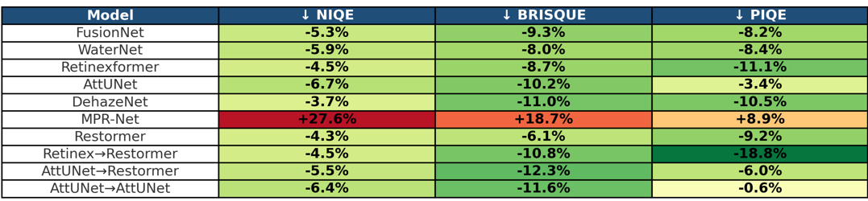
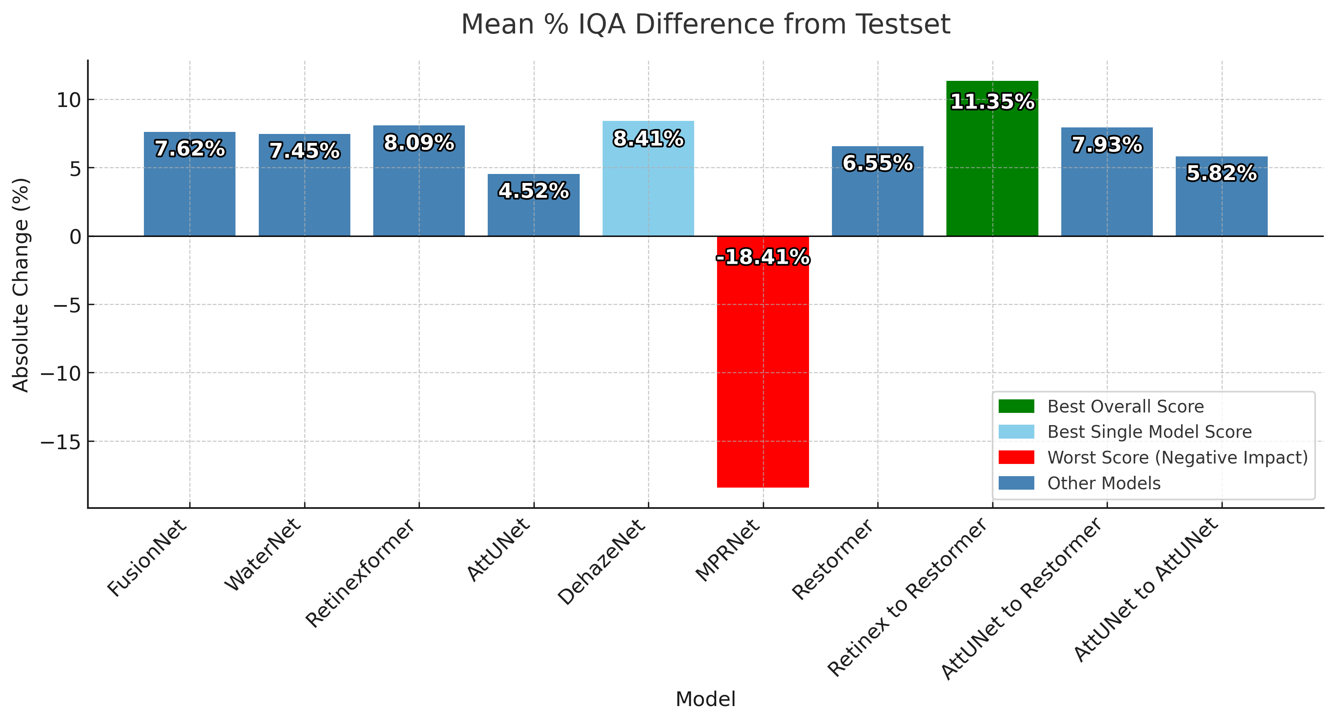
Starting point
A compact experiment: several enhancement models, several no-reference quality metrics, and cascaded outputs.
Main result to keep:
cascaded designs improved the combined metric score, but metric agreement was not perfect.
Published in Przegląd Telekomunikacyjny / KRiT 2025, DOI: 10.15199/59.2025.4.96
Source: KRiT 2025 presentation and BaDAP bibliographic record.
VQEG introductory presentation | AGH University of Krakow

Slide 4


Progress Since the First Research
Metric-driven design
Use quality indicators as feedback, not only as a final table.
Goal: avoid overfits & outputs that score well but feel visually wrong or reduce scene understanding.
Context-aware correction
Control color, contrast and sharpness differently depending on object visibility and distance cues.
VQEG introductory presentation | AGH University of Krakow

Slide 5
Auto-Learning Loss Function
No constant coefficient
ready for subjective validation
Input
Enhance
Check
Correct
Accept
underwater image
first restoration
quality + objects
color / distance
balanced output
VQEG introductory presentation | AGH University of Krakow

Slide 6
Cascade training plan
1
Visibility first
2
Naturalness second
3
Task cues last
recover basic contrast and reduce haze so the scene becomes readable.
avoid excessive blue removal, oversharpening, or artificial color shifts.
protect objects, boundaries and distance cues important for interpretation.
Evaluation after each stage: not just “better score”, but “better and still believable”.
VQEG introductory presentation | AGH University of Krakow

Slide 7
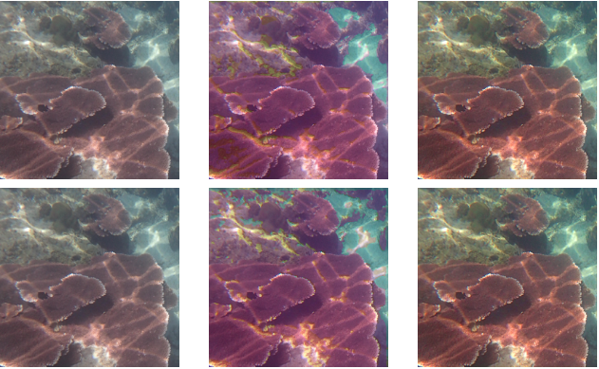

Slide 8
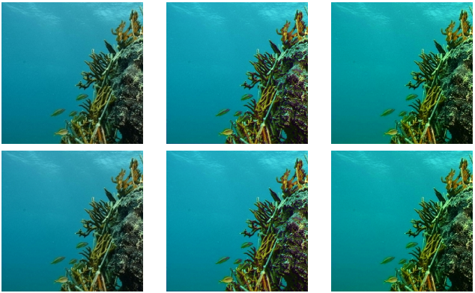

Slide 9
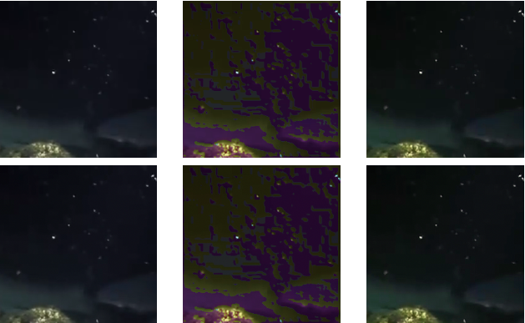

Slide 10



What I would like to discuss
1. Metric selection and UIQM
Which metrics should be trusted for enhanced underwater images, and which should be treated only as warnings?
2. Subjective protocol
Should viewers rate naturalness, visibility, preference, confidence, or task usefulness separately?
3. Real-time limits
How much quality control is acceptable when the target system is an underwater robot or online monitoring pipeline?
VQEG introductory presentation | AGH University of Krakow

Slide 11
Where VQEG fits
A
Subjective side
B
Objective side
C
QoE side
How do observers judge underwater enhancement: visibility, naturalness, confidence, or usefulness?
Which quality indicators agree with human judgement, and when do they fail?
How does the enhanced image support practical decisions in robotics, mapping, and exploration?
The value of VQEG is the bridge: methods, validation, and discussion with quality experts.
VQEG describes its forum as a place for video-quality experts to exchange information and work together; its mission covers subjective methodology, objective tools and QoE-oriented evaluation.
VQEG introductory presentation | AGH University of Krakow

Slide 12

Closing message
Underwater enhancement should be evaluated as a quality-control problem:
metric-driven, context-aware, and validated with human judgement.
Thank you
Doğukan Öztürk | AGH University of Krakow | dozturk@agh.edu.pl
References: VQEG Home; Öztürk & Leszczuk, KRiT 2025 / Przegląd Telekomunikacyjny, DOI: 10.15199/59.2025.4.96.
VQEG introductory presentation | AGH University of Krakow

