Slide 1
ITU-T SG12
Q19 Interim Meeting
Objective and subjective methods for evaluating perceptual audiovisual quality in multimedia and television services
December 17 (Wednesday) 14:00 CET

Slide 2
      Agenda
        Extension of P.1199: One contribution
        J.noref
          SRC selection
          HRC design
          Subjective test
          Players
          Schedule

Slide 3
      Extension of P.1199

Slide 4
      Extension of P.1199: The group reviewed the contribution from NTT and agreed to produce a TD.

Slide 5
      J.noref

Slide 6
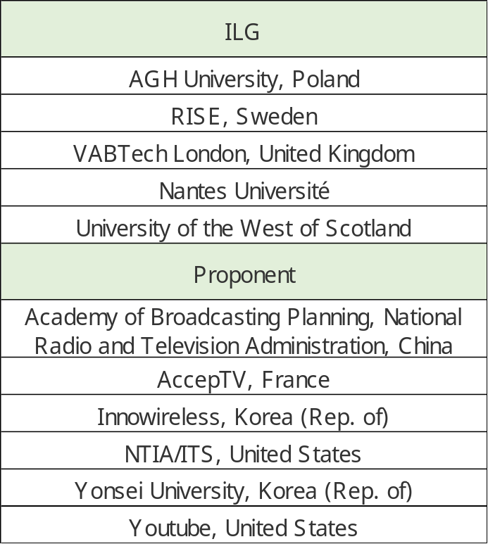
      Proponents and ILGs
      TU Ilmenau / RWTH Aachen will provide a subjective test and have access to all the subjective data (PVSs & MOS DB).

Slide 7
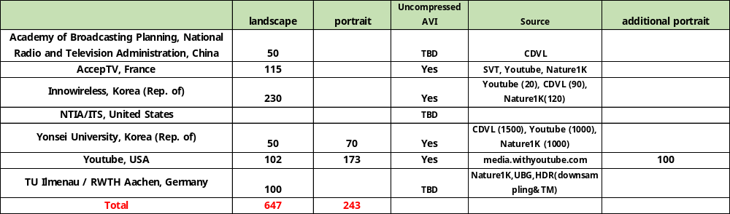
SRC selection
    AccepTV: 52+63 (all landscape)
    Innowireless: 49+61 (all landscape)
    Youtube: 102 in landscape (index 52 ~ 102) and 173 in portrait (index 59 ~ 173).
      still have 100+ portrait candidates
    Yonsei University: (all landscape)
      over 1500 from CDVL
      About 1000 from Nature1K
    ABP: (landscape:??)
    TU Ilmenau / RWTH Aachen: (landscape: 100)
    NOTE: All SRCs should be in the lossless AVI format.

Slide 8
SRC requirement
    No time limit.
    Can be used for future projects (non-commercial)
    CDVL: https://www.cdvl.org/license/
    UBG license: https://creativecommons.org/licenses/by-nc/3.0/deed.en

Slide 9
Null impairment SRC (reference, pristine)
    How many pristine SRCs (5 second clips) per test: >5% (10)
    How many pristine SRCs (5 second clips) do we need? ( 7 tests)
      100 candidates
      [To Do] The 5 proponents need to submit 20 candidate pristine SRCs.
    Different pristine set for each test or use the same pristine set?
      Different set preferred, overlap allowed.

Slide 10
HRC Design (preliminary)
  2200 PVS: 5% of total PVSs=110
  SRC-HRC pairing (preliminary proposal)
    Full-matrix is not allowed (sparse matrix including unique SRC for PVS)
      >50 SRCs: 4 tests
      200 SRCs (each PVS has a different SRC): 2 test
      ~20 SRCs: 1 test
      Total: about 650 (7 tests)
    NTIA HRC design 1: 400 SRCs (4 codecs except for VVC)
    NTIA HRC design 2: 400 SRCs (4 codecs except for VVC)
    ABP
      ~10% VVC (20)
    Yonsei: >50 HRCs
      20% VVC (40)
    AccepTV: 16 HRCs
      ~10% VVC (20)
    Innowireless: > 50 HRCs
      ~10% VVC (20)
    TU
      ~10% VVC (20)
    Youtube design 1 &2: 10 HRCs
      AV1, VP9, H264

Slide 11
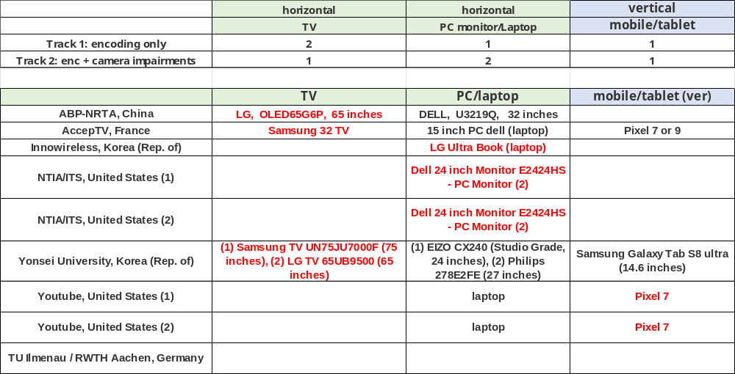
Display availability and subjective test allocation
    Preliminary survey

Slide 12
Overview of SRC & HRC designs
Encoding software
  Innowireless, Yonsei, and YouTube do not specify which encoder software will be used:
    HW codec: NTIA partially,
    Codec (Non-FFMPEG): NTIA, Yonsei,
  This may lead to over-emphasis of one particular software, especially FFMPEG
Encoding resolution:
  Innowireless, Yonsei, and YouTube either only encode the videos at 1920×1080 resolution or do not specify encoding resolution
    Recommendation: Reduce the resolution for low bitrates (e.g., <300Kbps)
Bitrates
  Only two datasets include the null impairment (reference) 5-10% of PVS should be the null impairment (highest quality: MOS>4.5)
  With the addition of the YouTube scene pools, the proposed datasets show a nice variety of bitrate ranges (i.e., different ranges)
  Only one HRC design focuses on higher bitrates, which may limit our analyses for broadcast applications
ABS and TU Ilumenau have not proposed SRC pools or HRC designs
Therefore, we would benefit from:
+2 SRC pools
Clarity on whether HRC designs will reduce resolution for lower bitrates
Information on encoding software
  And probably more variety of encoding software packages
+1 SRC pool with pristine SRC
+1 dataset with pristine SRC and bitrates >= 900 Mbps (or maybe >= 512)
  Without such a datset, broadcasters may ignore J.noref as ignoring their needs
Null impairment added to all datasets
  I think the null impairment (or a very high bitrate) will be important for accurately assessing NR metric performance
  Without the null impairment, I am concerned that correlations will be artificially low

Slide 13
Codec
    H.264, H.265, VP9, AV1, VVC (>5% of PVSs for every codec)
    SW codec:
      FFMPEG
      commercial: NTIA, Yonsei
    HW codec
      Camera codec

Slide 14
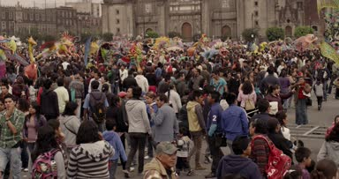
Subjective test ( See “Test plan Section 4”)
    Common sets: (tentatively) will not be used.
    Anchor video set: 6 clips.
      Will be shown at the beginning
    Non-experts: 24 viewers
      Requirement: non-expert viewers
      Independent non-expert viewers are preferred. but non-expert viewers from the same lab/company are allowed.
      A viewer may skip a clip. The clip will still be used in data analysis.
    Vision tests: Recommended, but not required.
    Viewing distance:
      TV monitor: 1.5-3H
      PC monitor: 1.5-3H
      Mobile phone/Tablet: 4-5H
      where H = Picture Height (picture is defined as the size of the video window, not the physical display.)
    Subjective Test Method: ACR
    The subject screening method shall be used.
      The minimum correlation threshold (0.7? or maybe lower) for encoding impairment only
      The minimum correlation threshold for encoding & camera impairment may be 0.7? or lower.
    Time for evaluating: ?? Seconds3
    Input method: evaluation paper?
      Display preparation message for 2? seconds with index
      Display 5s PVS
      Display evaluate message for ?? seconds with index
Evaluate
Video #23
Video #23
2 seconds 5 seconds 7 seconds

Slide 15
TBD: Player
Subjective test guidance (e.g., randomization for each viewer or minimum number of randomization)
Solutions
  TV/PC: python program
    AccepTV: https://www.acceptv.com/en/products_acr_mushra_test_interface.php
    Python SW
  tablet/mobile phone
    Option 1: Concatenate the PVSs into a single extended sequence and encode it at a near-lossless bitrate.
    Option 2: Use the internal decoder for display, but the uncompressed AVI will be inputted to models.
    Option 3: Use small FHD displays
Player issue (TBD)
  Some SW
    https://www.cdvl.org/members-section/view-file/?videoid=3043
    https://vqeg.github.io/software-tools/subjective%20test%20software/avrateng/
    https://github.com/Telecommunication-Telemedia-Assessment/avrateNG
    https://vqeg.github.io/software-tools/subjective%20test%20software/west/
  Player program (PC, e.g., python)
    TU SW
    RICE SW
      https://vqeg.github.io/software-tools/subjective%20test%20software/subjectiveplayer/
      https://vqeg.github.io/software-tools/subjective%20test%20software/vqegplayer/
  Encode the 5s clips into a long sequence with very high bitrates.
  Players for tablet/mobile phone
    Option: Concatenate the PVSs into a single extended sequence and encode it at a near-lossless bitrate.
  To Do
    Nantes Université may have a player for mobile phone (Andreas Pastor)

Slide 16
Schedule Rev4
Model submission (proponents) November 12, 2025 (17:00 Geneva)
SRC selection & HRC design Dec, 17, 2025 (Q19 interim meeting with VQEG)
Test PVS review (All) December 23, 2025 (Tuesday)
Test PVS review (All) December 30, 2025 (Tuesday)
Player January 7, 2026 (Wednesday)
AOB January 14, 2026 (Wednesday)
AOB January 14, 2026 (Wednesday)
Subjective & Objective data submission (Proponents) February 25, 2026 (Geneva 17:00)
Subjective and objective data distribution to Proponents/ILGs March 2, 2026
Objective data verification VQEG Spring meeting or June SG12 meeting
Final Report May, 2026 (or VQEG Spring meeting)
2026 SG12 meeting 9-17 June 2026

Slide 17
THE END

