Slide 1
ITU-T SG12
Q19 Interim Meeting
Objective and subjective methods for evaluating perceptual audiovisual quality in multimedia and television services
May 8, 2025
Menlo Park, CA, USA

Slide 2
Draft Agenda
P.obj-recog
  C0001: Draft Recommendation P.obj-recog
  C0002: Validation experiment result of IPP encoding
  C0003: Draft Supplement of P.obj-recog
P.PV-OQAM
  P.PV-OQAM: Proposal for updating clauses 4, 6, 7, 8 and 9
J.noref
AOB

Slide 3
Work item J.obj-recog

Slide 4
Work item J.P.PV-OQAM

Slide 5
Work item J.noref
Base Text: SG12-TD109R1

Slide 6
Table of Content
Introduction
  ILGs
  Proponents
Review of the test plan
Role of ILGs
Monthly audio call schedule
  June 12 (Thursday) 16:00 CET , 8:00AM Denver
  July 15 (Tuesday) 16:00 CET , 8:00AM Denver
  September (SG12 meeting, Q19 sessions)
AOB

Slide 7
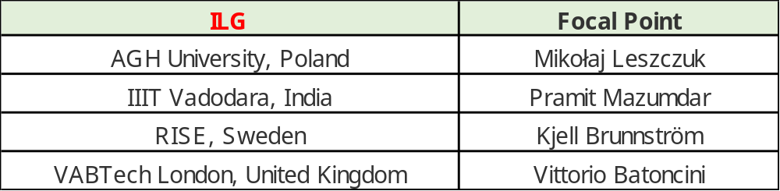
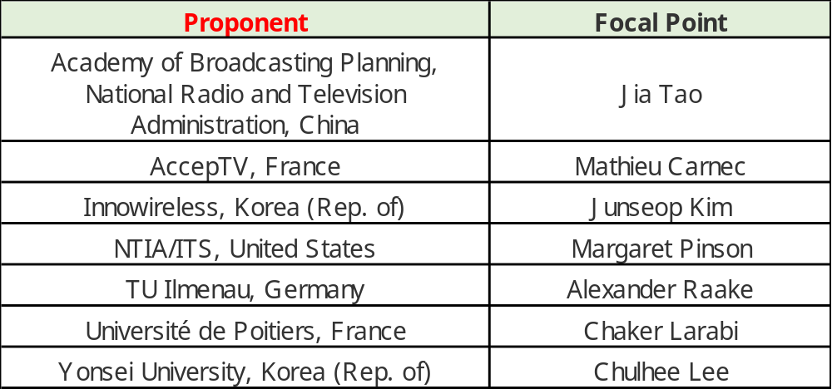
ILGs
Proponents

Slide 8
Resolution
FHD only (horizontal/vertical) with vertical format applicable only to mobile display
Display
Decision: TV monitors, PC monitors, mobile display
(Display resolutions should exceed or equal to FHD)

Slide 9
PVS duration
Decision: 5 sec (no transmission errors)
  Constant quality recommended.
  No artificial impairments (details in pre/post processing).
  No scene cut is preferred with maximum one scene change, which should be minimum (scene cuts allowed if the scenes cover the same objects). The scene cut should not occur in the first and last one seconds and be preferably located in the middle.

Slide 10
Codec and bitrates
DECISIONS
Codec: H.264, H.265, VP9, AV1, VVC.
Camera impairments (live capture) are allowed.
Bitrates (FHD)
  1080p SRC: 0.1–30 Mbps

Slide 11
Subjective Test Method
Decision: ACR.

Slide 12
HRC design
Decision
Number of PVSs of subjective test: >=200
Number of viewers: 24 (P.910)
A subject may skip a clip. The clip will still be used in data analysis.

Slide 13
Model Types in Recommendations
Decision: A model should handle horizontal/vertical FHD with vertical format applicable only to mobile display.
The NR model is expected to handle coding artefacts and camara impairments.
The evaluation will be performed in two tracks:
  NR models without camera impairments
  NR models with camera impairments.
  Subjective tests will be evenly divided among the two tracks.
The proponent may submit two models:
  one to handle coding artefacts
  the other to handle coding artefacts and camara impairments.
  A proponent may submit a single model to handle both tracks.
In the Recommendation, NR models will have different scope:
  coding artefacts only (the coding artefacts include downscaling/upscaling)
  coding artefacts and camera impairments
TBD: dividing the subjective tests between the two tracks & horizontal/vertical.

Slide 14
Release of Subjective Data, Objective Data, and the Official Data Analysis
The subjective data (MOSs and individual subject ratings) and the official data analysis will be released to ensure verifiable evaluation.
The objective data of winning models that are included in Recommendations will be released to ensure the model reliability.
The objective data of all other models will not be released unless the proponent specifically requests that their data is released.

Slide 15
Ownership and Release of Subjective Tests (Section 2.4)
The laboratory that creates PVSs and performs a subjective test owns the subjective data and the corresponding PVSs, assuming that the laboratory has access to the corresponding SRC. The laboratory may also design the subjective test.
The owners of subjective tests will decide whether to release or not release video sequences (SRCs and PVSs). They can distribute the subjective data and the PVSs as long as the recipient has access to the SRCs and PVSs.
The laboratory that creates PVSs and performs subjective tests can also share the subjective data and the PVSs with another laboratory that creates PVSs and performs a subjective test.
Those that perform test design review and source selection have no right to the subjective test (subjective data and PVSs).
The dataset owners will make their dataset’s SRCs and PVSs available to the ILG and other proponents involved for this validation effort.
It is preferable that all the datasets are permanently available to the proponents and ILG and can be reused for other purposes.

Slide 16
Submission of Executable Model (Section 3.1)
Proponents may submit one model (in each track) and should perform one subjective test.
A proponent may submit additional subjective tests if the proposal is approved by the ILG and other proponents.

Slide 17
Proponents & ILG
  Potential Roles of ILG:
  Design HRCs or review HRC design
  Select SRCs and assigns them to HRCs (SRC-HRC pairing)
  Make decisions on issues (e.g., admissibility of PVSs)
  Benefits of ILG (should be agreed among proponents):
  Fee
  May have access to subjective data and PVSs so that they can be used for other purposes after the successful completion of J.noref. (IIIT)
  Research collaboration possibility using the subjective data and PVSs (possibility to co-author academic papers with proponents) (IIIT)
SRC preparation | [proponents] | produce 5s candicate clips
SRC selection | [ILG]
HRC selection | [ILG]
PVS generation | proponents
PVS reviews | ILGs & proponents
Subjective test | proponents

Slide 18
Allowing ILGs to access subjective data and PVSs (e.g., to use them for other purposes after the successful completion of J.noref)
Proponents may submit one model and should perform one subjective test. A proponent may submit additional subjective tests if the proposal is approved by the ILG and other proponents. (Section 3.1)
Proponent | Allowing ILGs to access the subjective DB
Academy of Broadcasting Planning, National Radio and Television Administration, China | Yes
AccepTV, France | Yes (non-commercial with citation)
Innowireless, Korea (Rep. of) | Yes (non-commercial with citation)
NTIA/ITS, United States | Yes (both ILG and public; non-commercial with citation)
TU Ilmenau, Germany | Yes (non-commercial with citation)
Université de Poitiers, France | Yes (non-commercial with citation)
Yonsei University, Korea (Rep. of) | Yes

Slide 19
The scope of ILG roles
Proponents may submit one model and should perform one subjective test. A proponent may submit additional subjective tests if the proposal is approved by the ILG and other proponents. (Section 3.1)
SRC preparation | [proponents] | produce 5s candidate clips
SRC selection | [ILG]
HRC selection | [ILG] | Proponents may propose HRC candidates and ILGs can select or approve the design.
SRC-HRC pairing | ILG
PVS generation | proponents
PVS reviews | ILGs & proponents
Subjectieve test | proponents

Slide 20
Requirements on SRC/PVS
Decision
1920x1080 only (or higher resolution that will be resized to FHD
Different aspect would be allowed as long as the resolution is close to FHD. Admissibility will be determined by ILGs and proponents.
TBD: interlaced source

Slide 21
Model Evaluation
Metric: RMSE, Pearson.

Slide 22
Viewing Distance & Conditions
P.910, BT.500
Decision
TV monitor: 1.5-3H
PC monitor: 1.5-3H
Mobile phone/Tablet: 4-5H

Slide 23
Color space, Frame rates & Calibrations
4:2:2, 4:2:0
Frame rates: 25 fps above
Decision
PVS: 4:2:0
Maximum frame rate (PVS & SRC): 60 fps
PVS & SRC frame rates: 23.9 fps or above
PVS frame rates: 23.9 fps or above
HDR will not be considered in this project.

Slide 24
Pre-processing
Frame rate conversion: allowed or not allowed
Down-upscaling (e.g., 1080p->720p->encoding->decoding0->1080p)
  720p, 540p, 360p

Slide 25
Schedule
Model submission: November 12, 2025 (17:00 CET)
Test (HRC) Design & SRC review December 3, 2025
Test PVS generation December 23, 2025
Subjective tests February 25, 2026
Objective data submission March 25, 2026
Final Report April 22, 2026

Slide 26
Schedule Rev1
Model submission (proponents) November 12, 2025 (17:00 Geneva)
Candidate HRC design (ILG or Proponents) November 26, 2025
Candidate SRC (ILG or Proponents) November 26, 2025
HRC design & candidate SRC review (All) December 3, 2025
HRC & SRC pairng (ILG) December 10, 2025
Test PVS generation and analyses (Proponents) December 17, 2025
Test PVS review (All) December 23, 2025
Subjective tests (Proponents) February 25, 2026
Objective data submission (Proponents) March 25, 2026
Final Report April 22, 2026

Slide 27
TBD
ILG roles (p.17)
Subjective test assignment (total number of subjective tests: 7)
  no camera impairments:
  with camara impairments:
Any proponent offering more than one subjective test (Section 3.1)
Uncompressed file format and test vectors (Section 6.1)
  Test vectors
  Uncompressed file format
  Failure handling
Model submission method (Section 3.1)
Interlaced source
Test design guidance (e.g., uniform MOS distribution)
Subjective test guidance (e.g., randomization for each viewer or minimum number of randomization)
  Player issue
Schedule
Review of test plan

Slide 28
TBD
ILG roles (p.17)

Slide 29
TBD
Subjective test assignment (total number of subjective tests: 7)
  no camera impairments:
  with camara impairments:

Slide 30
TBD
Any proponent offering more than one subjective test (Section 3.1)

Slide 31
TBD
Uncompressed file format and test vectors (Section 6.1)
  Test vectors
  Uncompressed file format
  Failure handling

Slide 32
TBD
Model submission method (Section 3.1)

Slide 33
TBD
Interlaced source

Slide 34
TBD
Test design guidance (e.g., uniform MOS distribution)

Slide 35
TBD
Subjective test guidance (e.g., randomization for each viewer or minimum number of randomization)
  Player issue

Slide 36
TBD
Schedule

Slide 37
TBD
Review of test plan

Slide 38
THE END

