Slide 1


IRG-AVQA
Intersector Rapporteur Group Audiovisual Quality Assessment
VQEG, Menlo Park, 8 May 2025
Chulhee Lee, Yonsei University, Korea
Alexander Raake, Audiovisual Technology (AVT), I3TC, TU Ilmenau

Slide 2
IRG-AVQA Overview
IRG-AVQA studies topics related to video and audiovisual quality assessment among
ITU-R SG6 and ITU-T SG12
IRG-AVQA aims to:
coord​inate progress of specific topics of mutual interest restricted to area of video and audiovisual quality assessment, both subjective and objective;
identify potential work items that may be progressed as joint text Recommendations;
benefit from colocation with meetings of Video Quality Experts Group (VQEG)​​ where video/audiovisual quality experts meet and execute technical work;
encourage collaboration between ITU-T SG12 and ITU-R SG6 on work items unique to each study group.

Slide 3
IRG-AVQA allows Rapporteurs to
exchange information faster, using email and joint meetings;
seek participation from a broader range of ITU members;
invite input from non-member experts (e.g., from academia);
keep people informed at the early stage of work;
set up a joint edit session on a Recommendation;
socialize work items that approach maturity;
Participants who can contribute technology proposals are invited and encouraged to join the group.

Slide 4
IRG-AVQA Co-chairs
Chulhee Lee (Korea, Rep. of)
Alexander Raake (Germany)

Slide 5
ITU-R WP6C

Slide 6
ITU-R WP6C: Status of texts under development
Ultra-High Definition Television
WD-PDNR: HDR Ultra High Definition Television Reference Test Patterns
PNDReport: Experiences of ultra-high definition and high dynamic range television
High dynamic range television (HDR-TV)
WD-PDNR ITU-R BT.[REQ-IL]: Requirements and applications for Image Level meters
Quality Evaluation Methods
WD-PDNR ITU-R BT.[MF3]: A measurement framework for broadcasters to assess their Scope 3 impact of televisions displaying a television programme

Slide 7
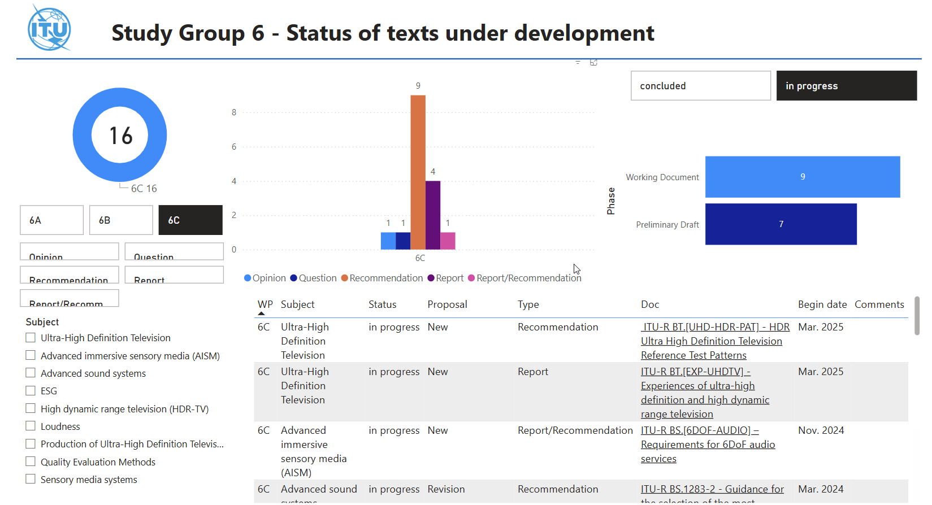
ITU-R WP6C Status of texts under development

Slide 8
ITU-R – Some contributions related to quality (March 2025)
C90: Working document towards a preliminary draft revision of Recommendation ITU-R BS.1770-5 - Algorithms to measure audio programme loudness and true-peak audio level
C91: Performance analysis of no-reference video quality assessment methods
C86: Progress report on high dynamic range television
C87: Working document towards a preliminary draft revision of Recommendation ITU-R BS.1770-5 - Algorithms to measure audio programme loudness and true-peak audio level

Slide 9
ITU-T SG12

Slide 10
ITU-T – Overview of Last Meetings
ITU-T SG12 (Geneva, Switzerland)
  SG12 organized as Questions (cf. previous overviews by Raake in VQEG)
  Covered meetings
  SG12 Meeting: 14-23 January 2025

Slide 11
ITU-T SG12 – Q7
Rapporteur: Ludovic Malfait
Methodologies, tools and test plans for the subjective assessment of speech, audio and audiovisual quality interactions
Wortk items
  P.835ref: Subjective test methodology for evaluating speech communication systems that include noise suppression algorithm
  P.Supp GRAS: Gender-related aspects of speech transmissions quality analysis
  PSTR.Noise-RTC: Subjective test methodology for noise suppression performance in Internet Real-Time Communication services
  PSTR.OUTLAB: Conducting subjective tests outside of the lab
Contributions (January 2025)
C14 - PSTR.Noise-RTC: Newly drafted proposal

Slide 12
ITU-T SG12 – Q9
Rapporteur: Jens Berger
Perceptual-based objective methods and corresponding evaluation guidelines for voice and audio quality measurements in telecommunication services
Wortk items
  P. SAMD: Single-ended perceptual approaches for multi-dimensional analysis
  Rev. A of P.863, P.863.1 and P.863.2: Extending scope of ITU-T P.863 to very low bitrate codecs
  Rev. B of P.863, P.863.1 and P.863.2: Extending ITU-T P.863 to multi-channel audio representation
  Rev. C of P.863, P.863.1 and P.863.2: Characterizing and extending ITU-T P.863 for reverberation and de-reverberation techniques
  Rev. D of of P.863, P.863.1 and P.863.2: Developing a test scenario for real-field speech signals and their application to ITU-T P.863
Contributions (January 2025)
SG12-C4 - New subjective database for the P.SAMD study item
SG12-C35 - P.SAMD Model Description and Performance
SG12-C37 - Cross-Lingual Performance of the NISQA Speech Quality Assessment Model

Slide 13
ITU-T SG12 – Q10
Rapporteurs: Gunilla Berndtsson, Janto Skowronek
Conferencing and telemeeting assessment
Wortk items
  P.IXC: Interactive test methods for subjective assessment of extended reality communications
  → collaboration with VQEG IMG
  P.UXV: User experience of multimedia in videotelephony and videoconferencing services
  P.XRT: Quality evaluation framework of extended reality terminal
Contributions (January 2025)
SG12-C11 - Updated base text for P.UXV: User experience of multimedia in videotelephony and videoconferencing services
SG12-C15 - P.XRT: Proposal for latency and jitter related network security evaluation methods for extended reality terminals
SG12-C16 - First draft of P.XRT "Quality evaluation framework of extended reality terminal“
SG12-C17 - Updated draft of P.IXC "Interactive test methods for subjective assessment of extended reality communications“ → cf, VQEG IMG
SG12-C1 - Title, mandate, lead roles, points of guidance and Questions for ITU-T Study Group 12 in the study period 2025-2028

Slide 14
ITU-T SG12 – Q13
Rapporteur: Kazuhisa Yamagishi
Quality of experience (QoE), quality of service (QoS) and performance requirements and assessment methods for multimedia applications
Wortk items
  P.SMAR: Subjective Tests for Evaluating the User Experience for Mobile AR Applications
  G.MF-VR: Measurement of quality influencing factors for virtual reality services
Contributions (January 2025)
SG12-C5r1 - Proposed edits to P.SMAR(Test Method and Test Procedure)
SG12-C9 - Information about VQEG 5G-KPI working group white paper on QoS-QoE management for CAPs and CSPs → cf. VQEG 5G KPI work item
SG12-C1 - Title, mandate, lead roles, points of guidance and Questions for ITU-T Study Group 12 in the study period 2025-2028

Slide 15
ITU-T SG12 – Q14
Rapporteurs: Jörgen Gustafsson, Alexander Raake
Development of models and tools for multimedia quality assessment of packet-based video services
Wortk items
  P.1204.1 Extend P.1204 recommendations with support for new codecs
  P.1204.2 Video quality assessment of streaming services over reliable transport for resolutions up to 4K with access to video frame information
  P.BBQCG Parametric bitstream-based Quality Assessment of Cloud Gaming Services
  P.NATS-Codec-Ext Parametric Non-intrusive Bitstream Assessment for High Efficiency Video Coding (HEVC) and 4K Media Streaming Quality over UDP
  P.NATS-ph3 Quality integration module for adaptive video streaming QoE in the context of P.120X-Recommendation series
  PSTR-OQMXR Objective quality modelling for XR services
  P.OQAI: Objective Quality Assessment of AI-enhanced Video Content
Contributions (January 2025)
C9 - Information about VQEG 5G-KPI working group white paper on QoS-QoE management for CAPs and CSPs
C21r1 - P.NATS Phase 2 Bitstream Mode 0 (P.1204.1) and Mode 1 (P.1204.2) - Proposal for Next Steps
C22 - Evaluation of No-Reference Video and Image Quality Models for Passive Gaming Video Quality Assessment
C31 - Results on Subjective Testing of Casual Game Type in Virtual Reality Cloud Gaming
C34 - Scoping for Objective quality modelling for XR services, Requirement specification and Terms of Reference

Slide 16
ITU-T SG12 – Q14 (ctd.)
P.1204.X Codec extension
P.1204.4 and P.1204.5 have been extended to AV1, cf. Recommendations
P.1204.3 is ongoing, to be finished Q1/2024
Further extensions desirable, e.g., VVC
New work items HDR, 8K, ...
  collaboration VQEG, e.g., AVHD?
  (following successful P.NATS Phase 2 work)
P.NATS Phase 3
Overarching long-term (up to 5min) and a/v integration module
Initial work stream including “quitting” not currently pursued (subjective test method, previously: MOSQUITO)

Slide 17
ITU-T SG12 – Q14 (ctd.)
P.BBQCG - Parametric bitstream-based Quality Assessment of Cloud Gaming Services
“Active” and “passive” work streams
Regular sub-group meetings Mon 16-17 CET, Wed 14-15h CET
“Passive”
  Tests mostly concluded, report and paper in preparation
“Active”
  Currently work for pre-tests and initial tests underway. specifically addressing possible test environment candidates
Work group expands beyond typical Q14 collaborations, good collaborations with VQEG
Contributions
C22 - Evaluation of No-Reference Video and Image Quality Models for Passive Gaming Video Quality Assessment
C31 - Results on Subjective Testing of Casual Game Type in Virtual Reality Cloud Gaming

Slide 18
ITU-T SG12 – Q14 (ctd.)
PSTR-OQMXR - Objective quality modelling for XR services
Still under specification
  Rather wide landscape of services and solutions
  Technology not as mature as for, e.g., video streaming
Links with Q10/12 (interactive services) and VQEG IMG
Request for interested parties from VQEG?
Contributions
C34 - Scoping for Objective quality modelling for XR services, Requirement specification and Terms of Reference

Slide 19
ITU-T SG12 – Q19
Rapporteur: Chulhee Lee
Objective and subjective methods for evaluating perceptual audiovisual quality in multimedia and television services
Wortk items
  J.noref: Perceptual video quality measurement techniques for digital cable television in the absence of a reference
  J.src-vq: Objective Assessment Methods for Source Video Quality at the Headend
  J.q-uhd: Quality measurement methods for UHD services
  P.obj-recog: Estimation techniques of object-recognition rate in surveillance video of autonomous driving
  P.PV-OQAM: Objective quality assessment methods for panoramic video
Contributions (January 2025) → cf. also Interim Meeting Q19/12 during current VQEG meeting
SG12-C7 - Performance of proposed model for validation data
SG12-C8 - Draft Recommendation P.obj-recog
SG12-C10 - Development of perceptual video quality measurement techniques in the absence of a reference
SG12-C20 - New: P.PV-OQAM: Proposed new work item on the objective quality assessment methods for panoramic video
SG12-C22 - Evaluation of No-Reference Video and Image Quality Models for Passive Gaming Video Quality Assessment

Slide 20
Upcoming ITU Meetings
2025 ITU-R SG6 WP6C Meeting
  1-12 September 2025 (Geneva)
2025 ITU-T SG12 WP2 Meeting
  9-18 September 2025 (Geneva)
2025 ITU-T SG12 Q14/12 Interim Meeting
  14-16 May 2025 (Stockholm, Sweden; Host: Ericsson)

Slide 21
Selected Details

Slide 22
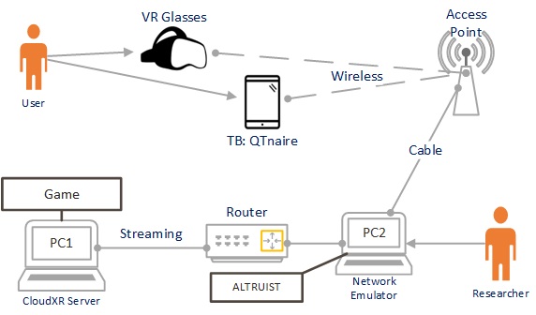
C31, Infovista SAS
Preliminary results of an investigation on effect of network performance metrics on commercial Nvidia CloudXR service and impact on QoE while playing game Angry Birds VR: Island of Pigs.
Results regarding impact of server location.
Complements previous first-person shooter (FPS) game type subjective test shared in ITU-T SG12-C155.
Figure 1 - Test setup of the VR Cloud Gaming over Mobile experiment (VRCMoG)

Slide 23
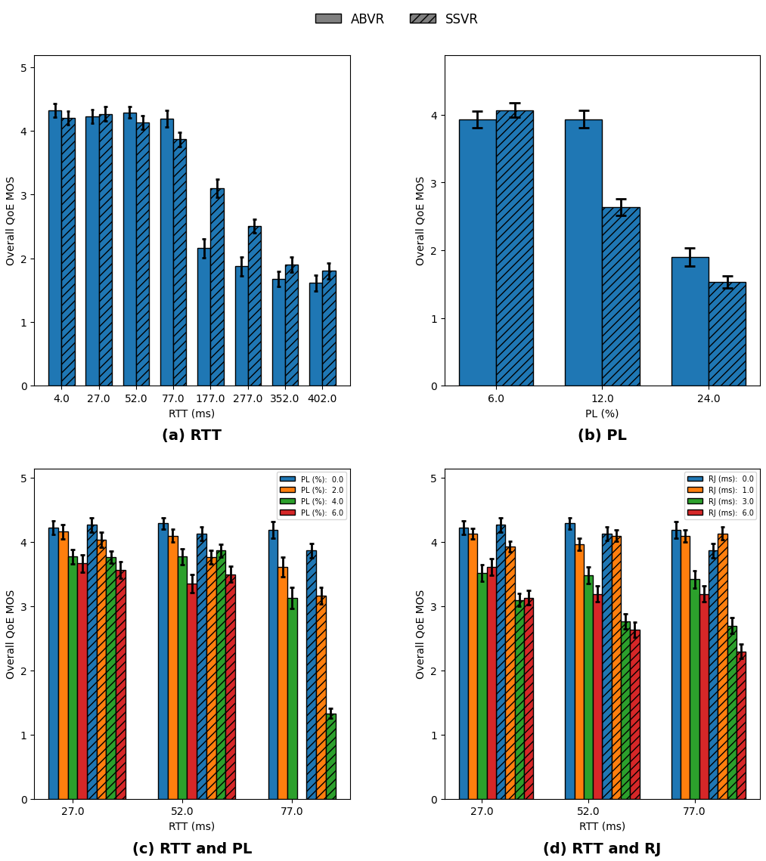
C31, Infovista SAS
Figure 2 Overall QoE MOS vs network conditions

Slide 24
C22, TU Ilmenau, Telefon AB – LM Ericsson
Evaluation of three no-reference video quality models (DOVER, FasterVQA, and Q-ALIGN) and one image quality model (MUSIQ) for passive gaming video quality.
Performance of pixel-based models compared with ITU-T Rec. P.1204.3, the retrained version of which is candidate model used in P.BBQCG work item.
Data from P.BBQCG work item.

Slide 25
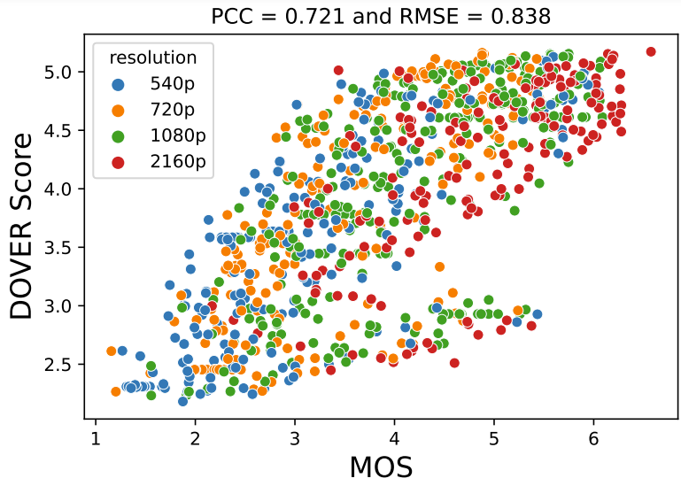
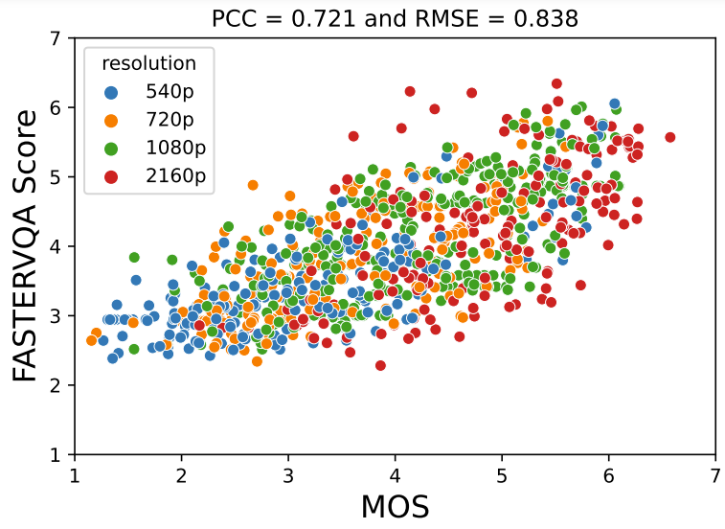
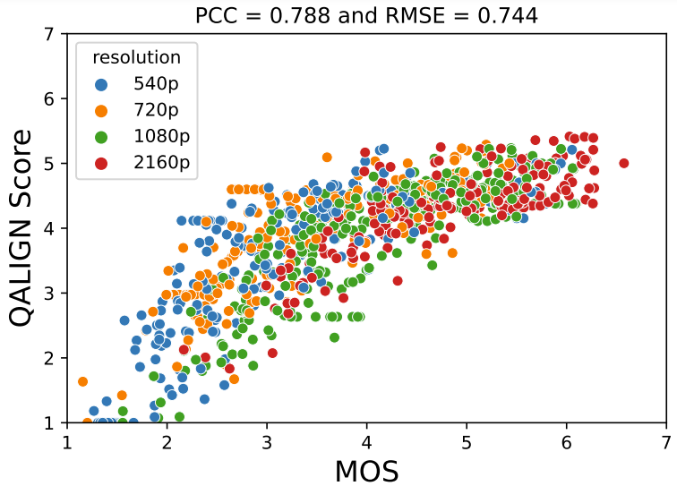
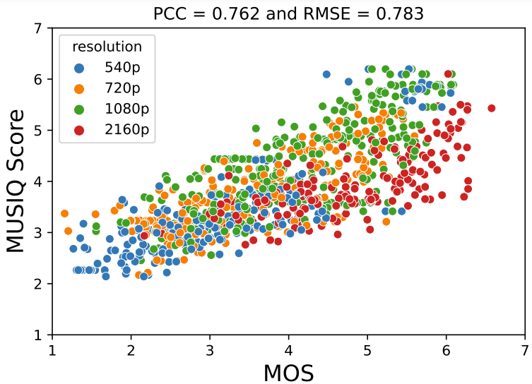
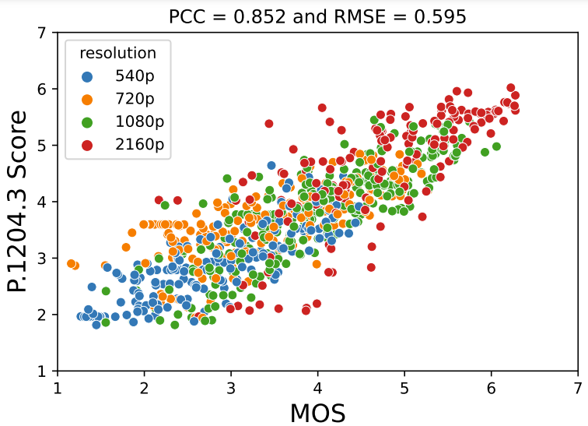
C22, TU Ilmenau, Telefon AB – LM Ericsson

