Slide 1

ITU Recommendations for
Interactive Experiments
Lucjan Janowski, Margaret Pinson

Slide 2

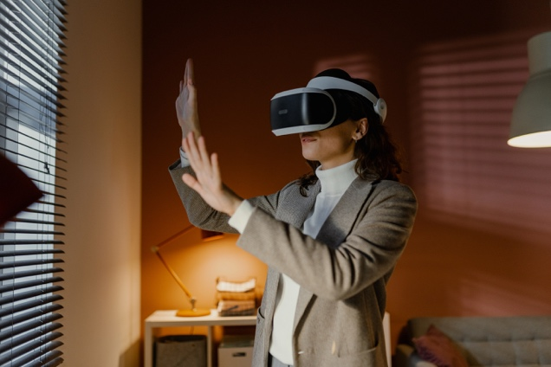

What Do We Measure?

Slide 3
What Do We Measure?
User + Application

Slide 4
What Do We Measure?
User + Application
User + Network

Slide 5
Consequence
What we measure
How we measure

Slide 6
Scenario Development: General Goal – P.1301
Naturalness (subject and environment), i.e., natural conversation tasks, a natural beginning and end of the conversation, and a natural, limited distraction from the quality-perception and -judgement task.
Balance (conversation flow), i.e., no fixed sender- and receiver-roles, short periods of monologues, realistic amount of double- or triple-talk, same repartition of speech activity between participants, and a limited overall duration.
Comparability (between scenarios), i.e., similar instructions, comparable dialogue-structures, similar overall durations.

Slide 7
Scenario Development: Scenario Validation – P.1301
Duration deviations of scenarios: Error bar plots (means and 95% confidence intervals) showing the conversation durations for the individual scenarios
Deviations between interlocutor groups: Error bar plots showing conversation durations as a function of the subject groups that participated in the text (test?)
Duration and interlocutor groups: Two-factorial analysis of variance (ANOVA) using interlocutor group and the scenario as fixed factors
Experiment conditions: One-factorial ANOVA with condition as fixed factor (?)

Slide 8
Suitable Task – P.1301 Appendix V
The task should be designed so that, during their conversation, the subjects primarily maintain their attention on the audiovisual terminal;
The task must resemble real-life audiovisual communication to a sufficient degree.
It is preferable that the task is, in itself, sufficiently rewarding for the subjects. This has several advantages: the subjects learn the task faster and they are less susceptible to fatigue and loss of motivation.
Familiarity between pairs of conversing participants is highly desirable, if not essential.
A wide range of subjects should be able to perform the task.
In addition, for each tested condition, the conversation should last at least five minutes. (?)

Slide 9
Testing Scenario
Naturalness
Balance
Comparability –> Regeneration
Attention
Rewarding
Easy
Length stability

Slide 10
P.1301 - Leavitt task
Task: Find a shape which all participants have (each participant has an image with shapes)
Problems: It is a short task, especially for few participants
Property | Our MOS | Description
Naturalness | 3.0 | We can imagine such task in real life
Balance | 4.5 | All participants should share the information
Regeneration | 5.0 | Easy, also to extend, make similar shapes etc.
Attention | 2.5 | Interlocutors are distracted by the image
Rewarding | 3.5 | We have clear goal
Easy | 5.0 | Cannot imagine easier task
Length stability | 4.5 | I guess it should take similar time

Slide 11
P.1301 - Brainstorming task
Task: Brainstorming an idea. Participants should find as many as possible solutions to specific problem
Problems: Probably topic and interlocutors have strong influence on the results
Property | Our MOS | Description
Naturalness | 4.8 | Brainstorm is a typical task
Balance | 4.0 | We will have balance, but we have to control it
Regeneration | 4.5 | We need general topics
Attention | 5.0 | No additional distractions
Rewarding | 4.5 | It should be fun
Easy | 4.0 | For some people it can be challenging
Length stability | 2.5 | No data, but I think it depends on task and group

Slide 12
P.1301 - Survival task + Extended survival tasks
Task: interlocutors are invited to imagine themselves in a survival situation based on an accident (plane, space rocket, etc.).
Problems: Regeneration + length stability are the main problems
Property | Our MOS | Description
Naturalness | 3.0 | We can imagine such task in real life
Balance | 2.5 | If a group has an expert, it will be difficult to balance
Regeneration | 1.0 | We need new situation and objects
Attention | 4.5 | List of objects can be distracting
Rewarding | 2.5 | We have seen that interlocutors did not agree with sorting
Easy | 3.0 | The goal is not clear
Length stability | 1.0 | Our test shows from 2 minutes to 25 minutes

Slide 13
P.1301 - Celebrity name guessing task
Task: In each round, each player is a celebrity and each player needs to find out which celebrity he or she is.
Problems: Probably high variance between participants and celebrity selection
Property | Our MOS | Description
Naturalness | 5.0 | It is a real game
Balance | 5.0 | By design
Regeneration | 3.0 | We need new celebrities + information
Attention | 3.5 | “Celebrity” has to find an information on paper or other source
Rewarding | 3.0 | Interlocutor interest in celebrity is important
Easy | 3.0 | Strongly depends on person
Length stability | 3.0 | No data available ☹ I have no idea what if we cannot guess

Slide 14
P.1305
Describes conversation
General description about how to make a task
Provided tasks are examples

Slide 15
P.1305 - 'Holiday' task
Task: a. Create a list of features that their ideal holiday would include (5 minutes). b. List them in order of importance (5 minutes).
Problems: Regeneration is real issue here
Property | Our MOS | Description
Naturalness | 5.0 | It could be a topic to discuss
Balance | 4.5 | We need some control, but it should be ok
Regeneration | 1.0 | After discussion we cannot plan new vacations
Attention | 5.0 | No distractions
Rewarding | 5.0 | It should be pleasant to plan vacation
Easy | 4.5 | Probably easy
Length stability | 4.0 | We have to control time

Slide 16
P.1305 - Role-playing games
Task: In this the test subjects take part in a role in a fictitious scenario.
Problems: We probably need to select people playing those games. We need to have one game master for all groups
Property | Our MOS | Description
Naturalness | 5.0 | Real game
Balance | 3.5 | But I am not sure
Regeneration | 4.5 | We need expert(s) to be the game master
Attention | 5.0 | No distractions
Rewarding | 5.0 | It should be pleasant for players
Easy | 4.5 | Only for professional gamers
Length stability | 4.0 | Assuming we pausing the game every X minutes

Slide 17
P.1305 - Navigation tasks
Task: Each subject has a partially complete map of the same area, and take turns to explain to the other participants a route.
Problems: Maps are not used much now so it can be a difficult task.
Property | Our MOS | Description
Naturalness | 4.5 | We could fix some information
Balance | 5.0 | Ok
Regeneration | 3.0 | Challenging but possible
Attention | 3.0 | Each person has to follow the map
Rewarding | 5.0 | ok
Easy | 4.0 | Can depends on interlocutor’s familiarities with maps
Length stability | 4.0 | Should be ok

Slide 18
P.1305 - Story with missing parts
Task: In this task the test subjects each get a paper with the same story but with various small sections missing.
Problems: Focuses on the text – nearly audio only
Property | Our MOS | Description
Naturalness | 3.5 | But it is not a big problem
Balance | 4.0 | Depends on details
Regeneration | 5.0 | Easy
Attention | 1.0 | Each person has to follow the text
Rewarding | 5.0 | Stories are fun
Easy | 4.5 | Most people should be able to do so
Length stability | 4.5 | Should be ok

Slide 19
P.1305 - Building blocks task – variation
Task: This is an extension of the small building blocks task described in [ITU-T P.920] for small groups.
Problems: It is skill dependent. Did not test video aspect.
Property | Our MOS | Description
Naturalness | 4.0 | But it is not a big problem
Balance | 4.0 | We have strong asymmetry – this could be advantage
Regeneration | 4.0 | Possible
Attention | 3.5 | Some distraction from instruction and blocks
Rewarding | 3.0 | From Margaret’s experience
Easy | 4.0 | Building skills can influence
Length stability | 4.0 | Probably some skills influence

Slide 20
P.1305 - Information exchange tasks
Task: take turns in counting; 2) take turns reading random numbers aloud as quickly as possible; 3) take turns verifying random numbers aloud as quickly as possible; 4) words with missing letters are completed with letters supplied by the other talker; 5) take turns verifying city names as quickly as possible.
Property | Our MOS | Description
Naturalness | 1.5 | Number verification is an option
Balance | 5.0 | Ok
Regeneration | 5.0 | Easy
Attention | 1.0 | Each person has to follow the text
Rewarding | 3.0 | Probably more fun at the start
Easy | 4.5 | Most people should be able to do so
Length stability | 4.5 | Should be ok

Slide 21
P.1312
Method for the measurement of the communication effectiveness of multiparty telemeetings using task performance
We have task, no quality question
We have preliminary data!
The purpose of the Recommendation is to enable multiparty conversational tests of voice-only communication systems that are sensitive to subtle changes of system parameters, to produce results that are repeatable in different laboratories with predictable test duration.

Slide 22
P.1312 - Information exchange tasks
Task: You will be paired into teams to perform the tasks which consist of conveying sequences of letters or words to your partner. In turns, one participant of each team will be the Reader while the other team member(s) will be the Responders.
Property | Our MOS | Description
Naturalness | 1.5 | Number verification is an option
Balance | 5.0 | Ok
Regeneration | 5.0 | Easy
Attention | 2.0 | Each person has to follow the text
Rewarding | 5.0 | Based on Ludo experience
Easy | 4.5 | Most people should be able to do so
Length stability | 4.5 | Should be ok

Slide 23
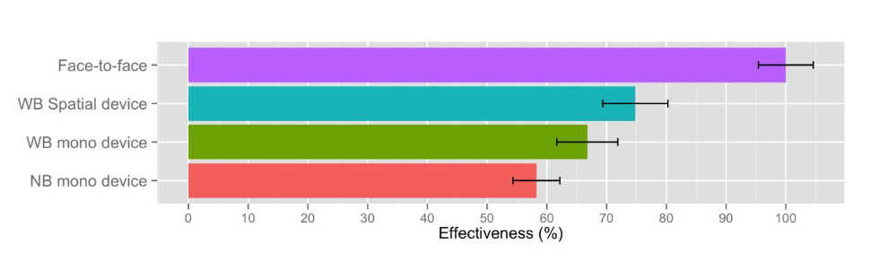
P.1312 - Stability of the Test

Slide 24
Conclusions
We should systematically examine tasks for IMG
We should follow 1301 with time and other factor stability tests
We should describe some tasks as not recommended
Positive tasks characteristics:
  Option for easy regeneration
  Not asking about quality
  Engaging
  Natural way to control time
Consider internal and external validity of your task

