Slide 1

Ecological Validity – why you should not use this term but use others
Lucjan Janowski, Margaret Pinson

Slide 2
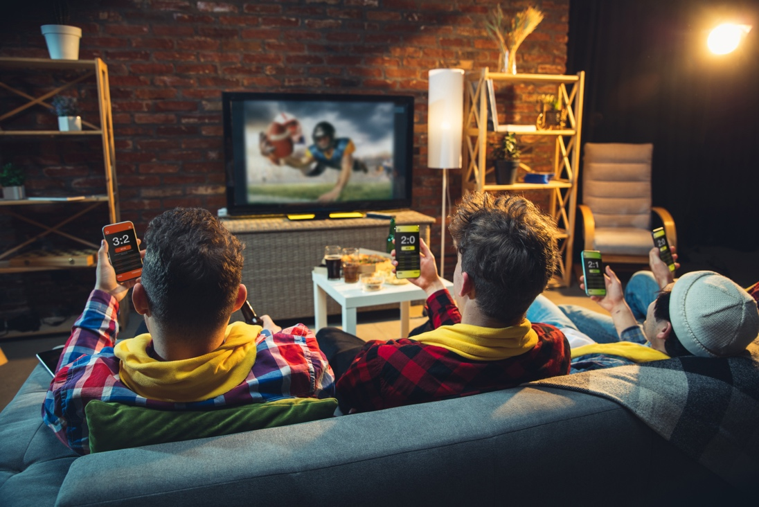
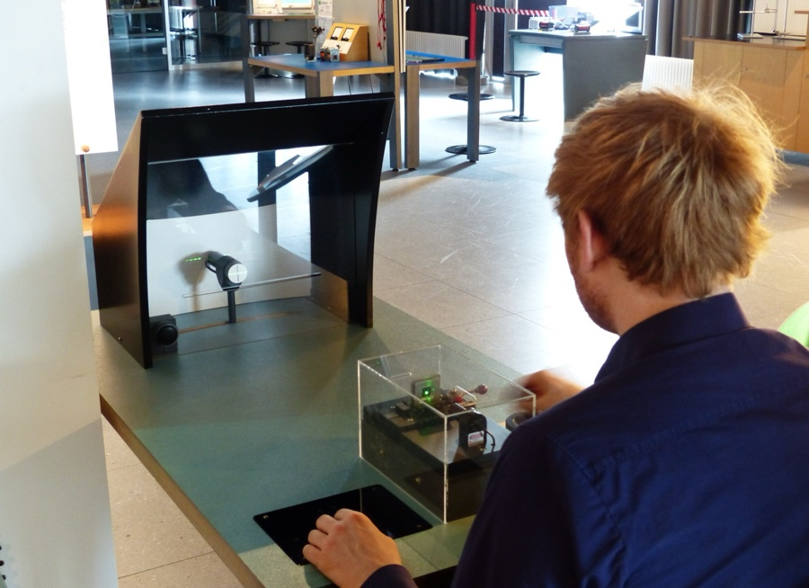

Different Experiments

Slide 3



My Explanation VQEG 2023. WRONG!
Internal Validity
External Validity
Ecological Validity
Lab study,
high internal validity
Real life situation,
difficult to get score
Lab or similar settings,
We try to mimic real life situation

Slide 4

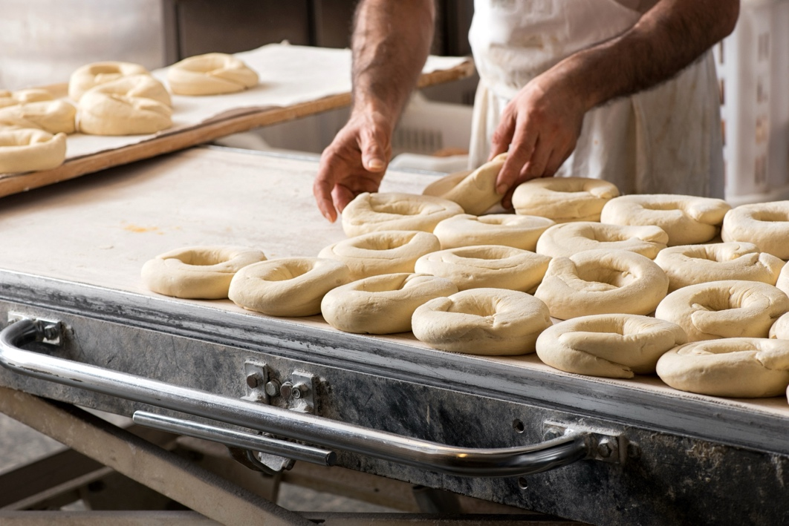
Experiment Phases
Preparation
Results + conclusions

Slide 5
Experiment Fazes
Realism –
any part of an experiment which is
made on the preparation phase, from
lab setup to questions we ask.
Validity –
Aspects of the results we obtained.
Comparing results to specific aspects of reality

Slide 6
Taxonomy
Mundane realism: Qualitative similarity between experimental conditions and everyday conditions experienced by the subject
Psychological realism: The extent to which psychological states or processes elicited by an experimental task are similar to those that occur during comparable tasks outside the laboratory

Slide 7
Taxonomy
Mundane realism: Qualitative similarity between experimental conditions and everyday conditions experienced by the subject
Psychological realism: The extent to which psychological states or processes elicited by an experimental task are similar to those that occur during comparable tasks outside the laboratory
Internal validity: the degree to which a study or experiment is free from flaws in its internal structure and its results can therefore be taken to represent the true nature of the phenomenon
External validity: The extent to which results obtained in one context can be generalized to another context.
Population validity: the degree to which study results from a sample can be generalized to a larger target group of interest (the population)

Slide 8
How Are the Terms Used?
Term | # publications (full text + meta data)
External validity | 10,501
Internal validity | 52
Population validity | 33
Psychological realism | 26
Mundane realism | 16

Slide 9
How Are the Terms Used?
Term | # publications (full text + meta data)
External validity | 10,501
Ecological validity | 1,625
Internal validity | 52
Population validity | 33
Psychological realism | 26
Mundane realism | 16

Slide 10
Problem 1: No Clear Definition

Slide 11
Definition of Ecological Validity
American Psychological Association (APA)
  Primary definition: The degree to which results obtained from research or experimentation are representative of conditions in the wider world.
  Second definition: The trustworthiness or ambiguity of a cue available to a perceiver in relation to some object or event in the environment ~1960
https://helpfulprofessor.com/ecological-validity-psychology/ (+ 4 other sources)
  Ecological validity is a subset of external validity, specifically focusing on whether behaviors observed and recorded in a study can be expected to occur in real-world settings.
https://en.wikipedia.org/wiki/Ecological_validity
  In the behavioral sciences, ecological validity is often used to refer to the judgment of whether a given study's variables and conclusions (often collected in lab) are sufficiently relevant to its population (e.g. the "real world" context). … Ecological validity can be considered a commentary on the relative strength of a study's implication(s) for policy, society, culture, etc.
  This term was originally coined by Egon Brunswik[1] and held a specific meaning. …
  Due to the evolving and broad definition of ecological validity, problematic usage of this term in modern scientific studies occurs because it is often not clearly defined. …

Slide 12
How Ecological Validity Is Used
the extent to which an experiment reproduces the situation and environment in which the technology will be used, and hence the extent to which the research findings generalize
ecological validity [is] characterized as whether or not one can generalize from observed behavior in the laboratory to natural behavior in the world
the extent to which a study comprises “real-world” use of a system
(the relevance or similarity that a test or training system has relative to the real world, and it’s value for predicting and improving daily functioning
the extent to which the environment experienced by the subject in a scientific investigation has the properties it is supposed or assumed to have by the investigator
represents the constraints between the values of proximal information and distal event
To summarize, the classic emotion induction paradigm lacks sufficient ”ecological validity”, resulting in a lackluster emotional response.....VR could provide ecological validity scenarios that fully engage the psychological and physiological components of the subject.

Slide 13
How Ecological Validity Is Used
the extent to which an experiment reproduces the situation and environment in which the technology will be used, and hence the extent to which the research findings generalize – False
ecological validity [is] characterized as whether or not one can generalize from observed behavior in the laboratory to natural behavior in the world – External validity
the extent to which a study comprises “real-world” use of a system – Mundane realism
(the relevance or similarity that a test or training system has relative to the real world, and it’s value for predicting and improving daily functioning – Mundane realism and External validity
the extent to which the environment experienced by the subject in a scientific investigation has the properties it is supposed or assumed to have by the investigator – Internal validity
represents the constraints between the values of proximal information and distal event – Ecological validity
To summarize, the classic emotion induction paradigm lacks sufficient ”ecological validity”, resulting in a lackluster emotional response.....VR could provide ecological validity scenarios that fully engage the psychological and physiological components of the subject. – Psychological realism

Slide 14
Statistics From 118 IEEE Papers
Definition | Number
Not used in the paper | 44
Undefined | 37
Mundane Realism | 15
External Validity | 11
Ecological Validity (original definition) | 4
False Assumption | 2
Psychological Realism | 2
Mundane Realism and External Validity | 2
Mundane Realism and Internal Validity | 1

Slide 15
Problem 2: False Assumption

Slide 16
This is Ideal Procedure
Testing External validity
Data
Experiment
Data
Real world

Slide 17
This is the Problem
??? External validity
Data
Experiment
No data
Real world

Slide 18
How Ecological Validity Is Implemented
Assume External validity
Data
Experiment
No data
Real world
Realistic Environment

Slide 19
How Ecological Validity Is Implemented
Assume External validity
Data
Experiment
No data
Real world
Realistic Environment

Slide 20
Improving an Experiment Design
Internal validity
Data
Experiment
Data
Conventional Experiment
Improved experiment methods

Slide 21
Conclusions
Do not use Ecological validity
Use other terms
Report about:
  Mundane realism
  Psychological realism
  Population validity
Reporting External validity
  To report it you have to compare measurements to real world
  It means you need real world measurements
  If you know how to measure real world why bother with an experiment?

