Slide 1


Acceptability and Annoyance of Video Quality in Context
Ali Ak, Patrick Le Callet
Nantes University
Abhishek Gera, Denise Noyes, Francois Blouin, Hassene Tmar, Ioannis Katsavounidis
META
VQEG
December 2023

Slide 2
Acceptance / Annoyance
Video quality alone is not enough to define Quality of Experience
User expectations has a major impact on user satisfaction
Acceptance/Annoyance is a measure of user satisfaction for video streaming services, online social media platforms, etc., and it takes user expectations and user profile into account.

Slide 3
Previously on Acceptance / Annoyance
Li et al.
Basic vs Premium subscription
Viewing on TV vs Tablet
2) Ak et al.
Remaining Data
Remaining Battery
Signal Strength
etc.,
1 - Jing Li, Lukas Krasula, Yoann Baveye, Zhi Li, and Patrick Le Callet, “Accann: A new subjective assessment methodology for measuring acceptability and annoyance of quality of experience,” IEEE Transactions on Multi-media, vol. 21, no. 10, pp. 2589–2602, 2019
2 - Ali Ak, Anne Flore Perrin, Denise Noyes, Ioannis Katsavounidis, and Patrick Le Callet, “Video consumption in context: Influence of data plan consumption on qoe,” in Proceedings of the 2023 ACM International Conference on Interactive Media Experiences, New York, NY, USA, 2023, IMX ’23, p. 320–324, Association for Computing Machinery.

Slide 4
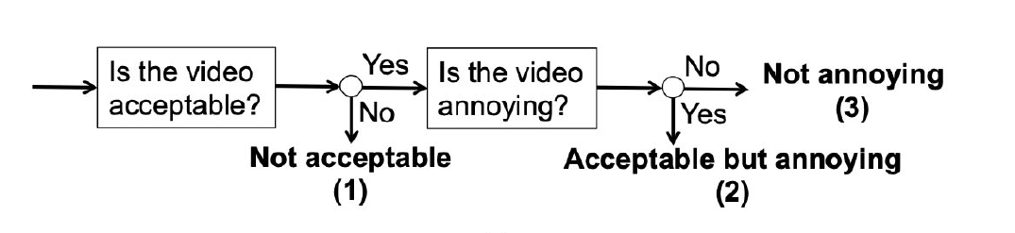
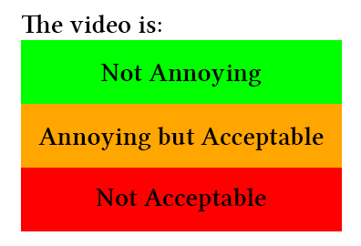
Acceptance/Annoyance: Multi-Step vs Single-Step
Multi Step
Single Step

Slide 5
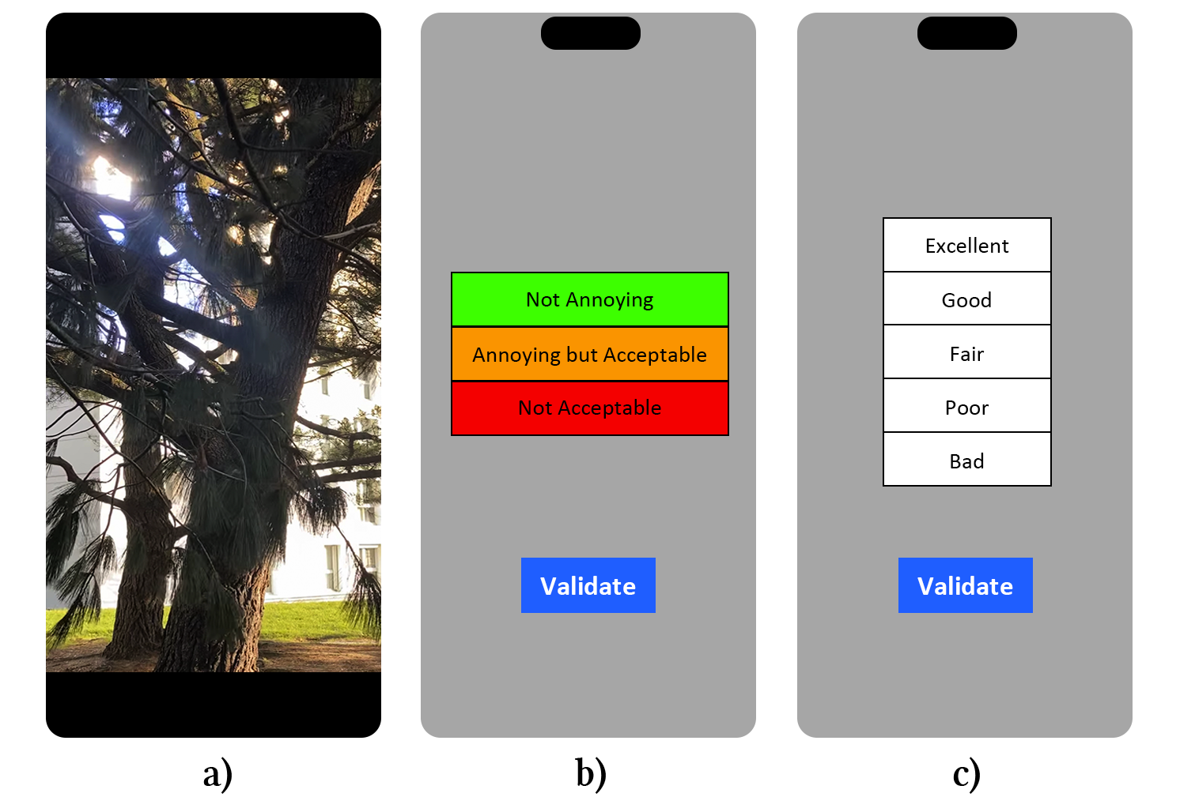
Subjective experiment details
Two experiments with the same content: AccAnn and ACR-HR
On Iphone 14 pro, in lab.
48 SRCs
  1080p resolution
  5 seconds
  Varying fps (15-60)
  Vertical orientation
  Encoded with h264
CRF:24 & Resolution: 512 × 288
CRF:23 & Resolution: 640 × 360
CRF:26 & Resolution: 960 × 540
CRF:29 & Resolution: 960 × 540
CRF:31 & Resolution: 1280 × 720
CRF:34 & Resolution: 1920 × 1080

Slide 6
Determining Acceptance / Annoyance Categories
Fisher’s Exact Test True
NAnn
Not annoying
AccAnn-MOS >= 2
Fisher’s Exact Test False
UAnn
Unsure about annoyance
But acceptable
Fisher’s Exact Test True
AA
Annoying but acceptable
AccAnn-MOS < 2
Fisher’s Exact Test False
UAcc
Unsure about acceptance
But not annoying
Fisher’s Exact Test True
NAcc
Not acceptable

Slide 7
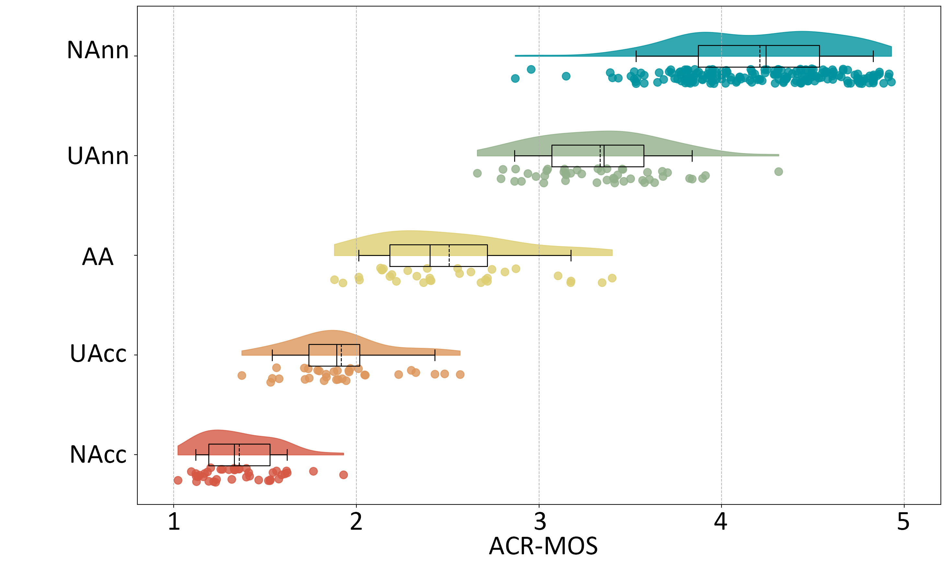
Determining Acceptance / Annoyance Categories

Slide 8
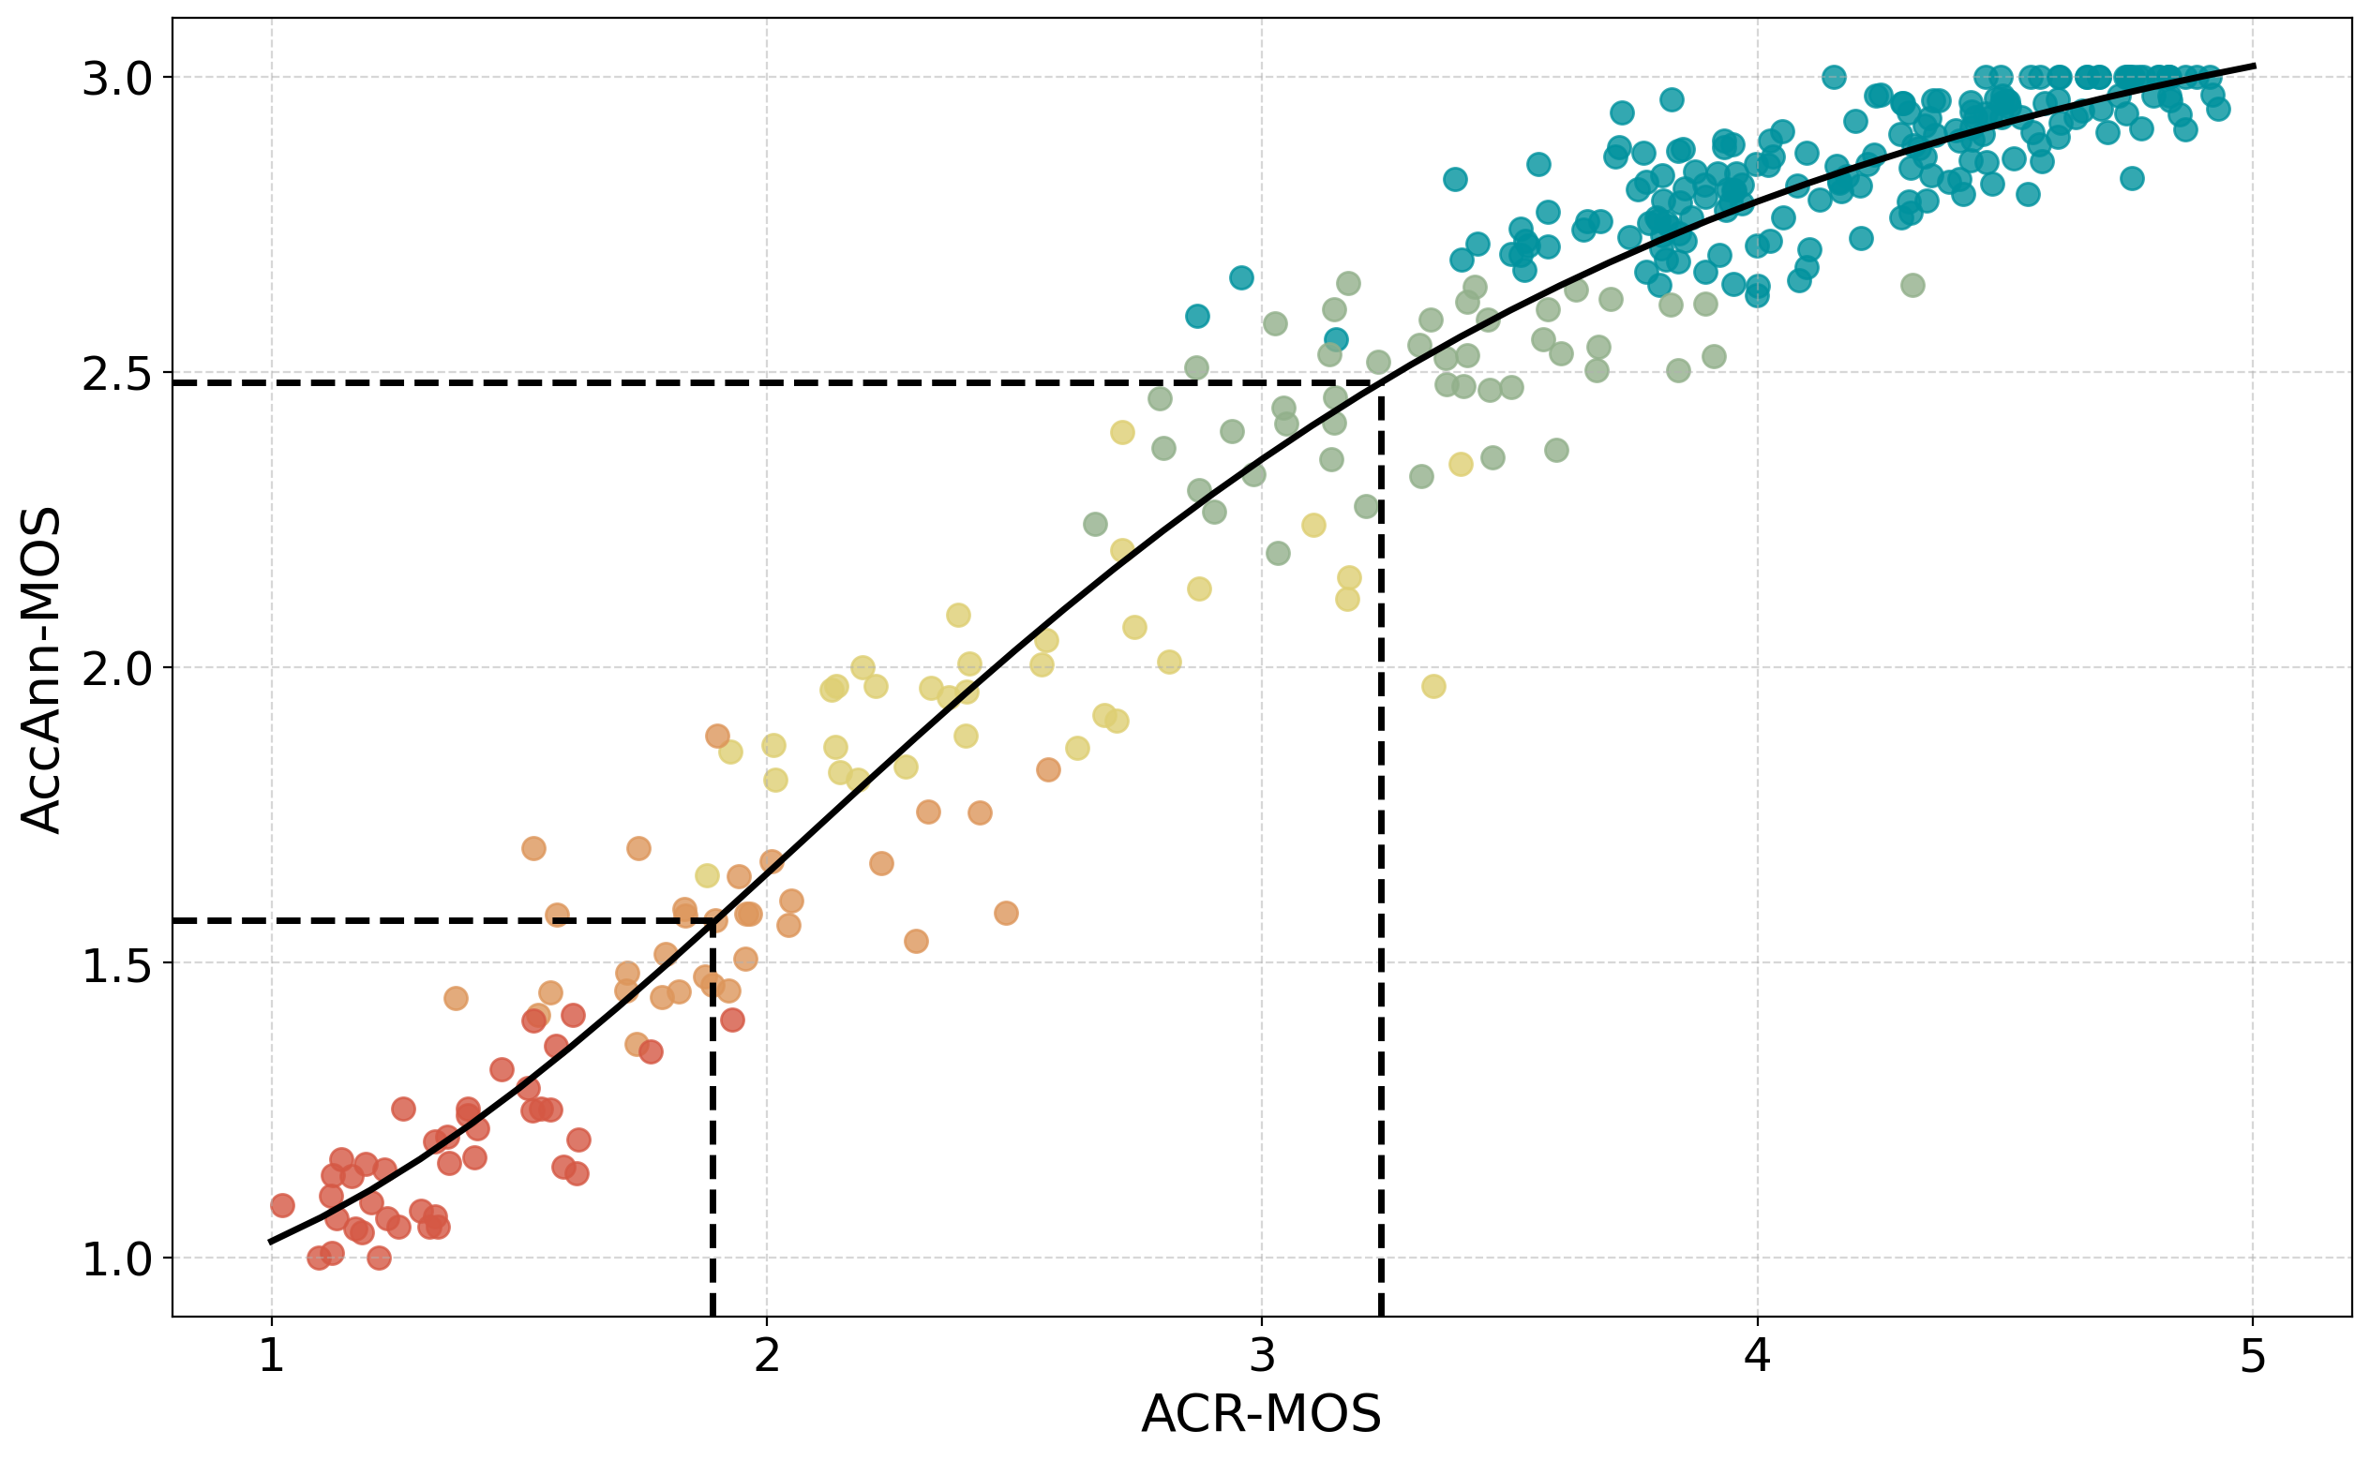
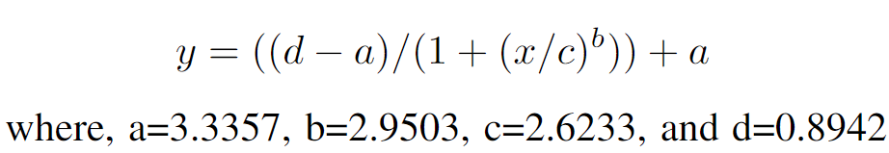
Mapping ACR-MOS to AccAnn-MOS

Slide 9
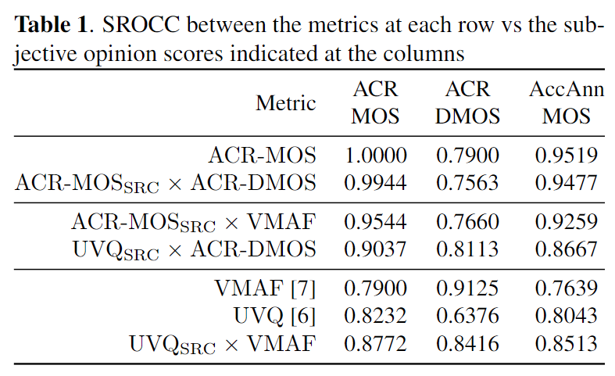
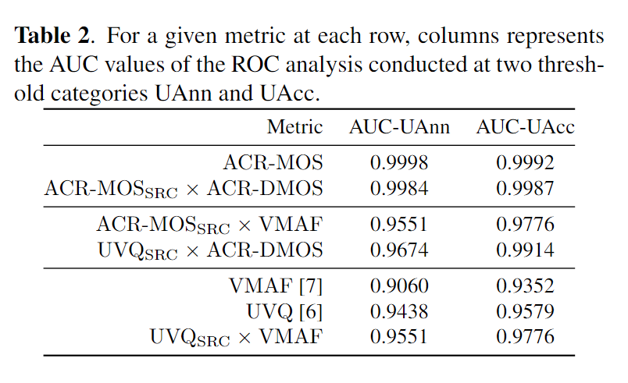
Predicting Acceptance / Annoyance Categories

Slide 10
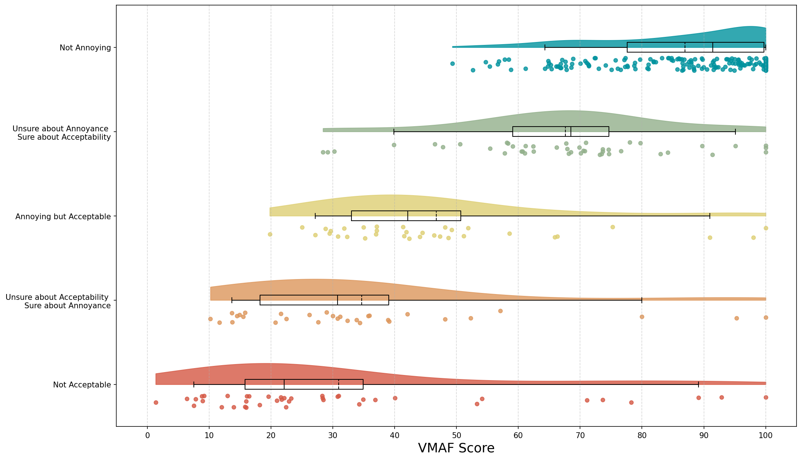
Predicting Acceptance / Annoyance Categories - VMAF

Slide 11
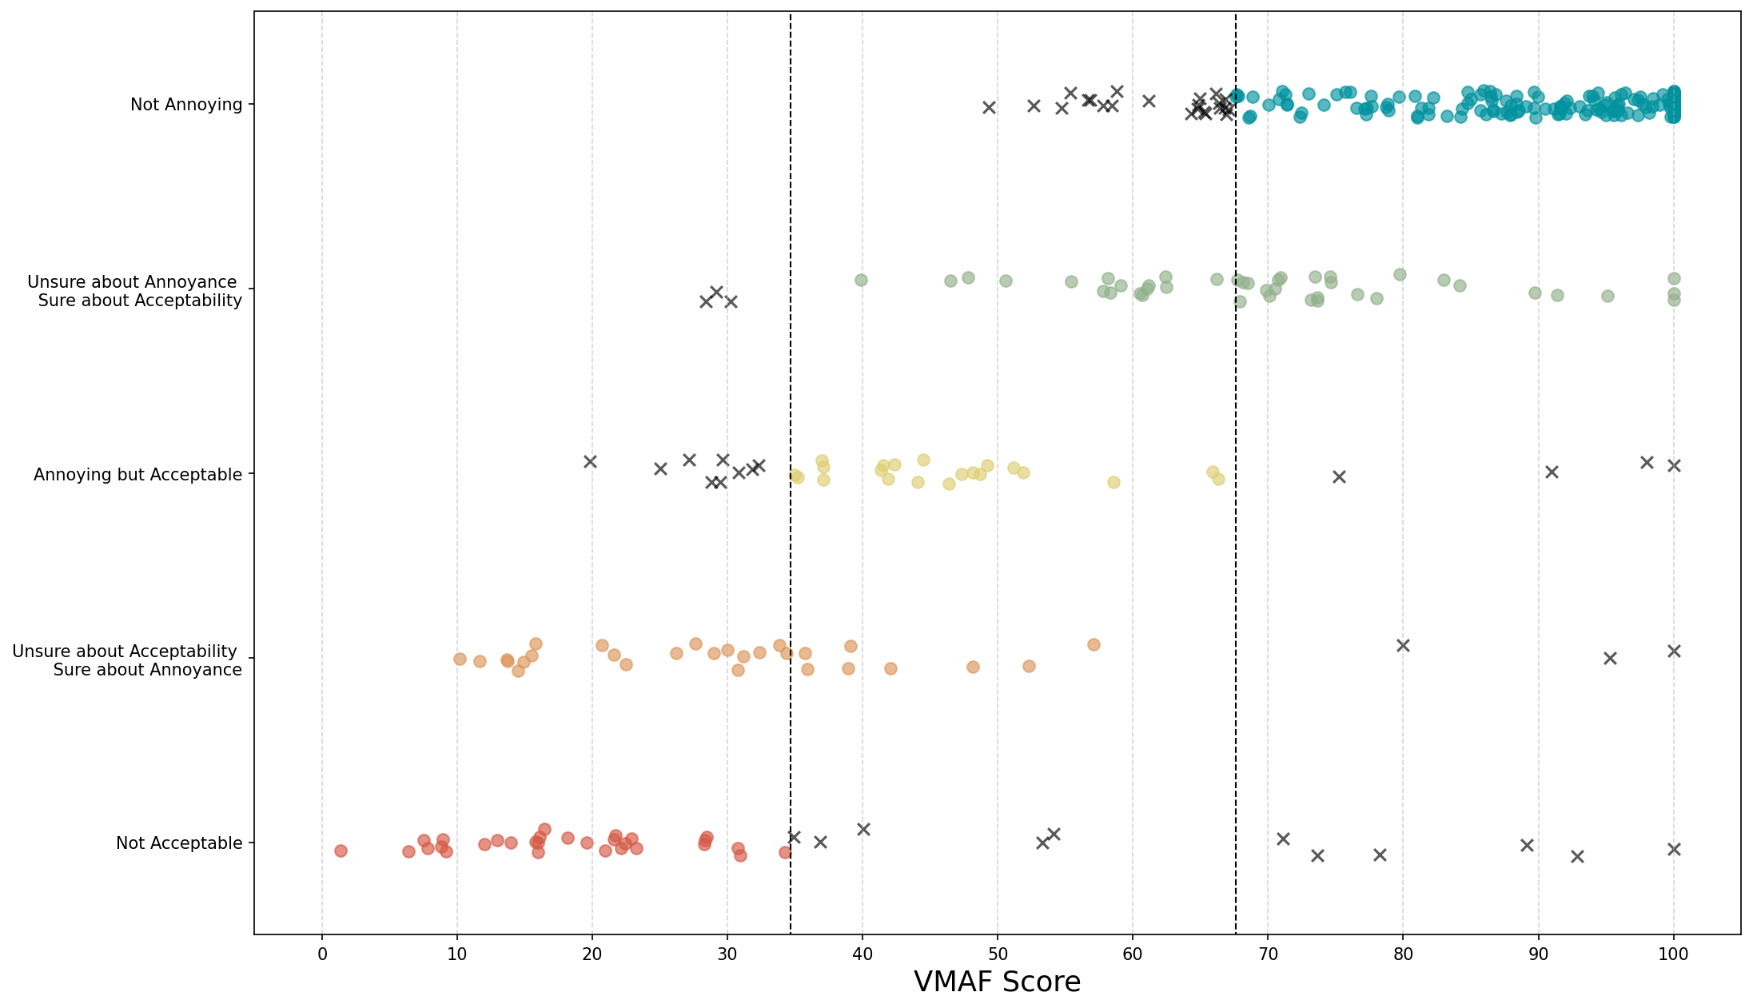
Predicting Acceptance / Annoyance Categories - VMAF

Slide 12
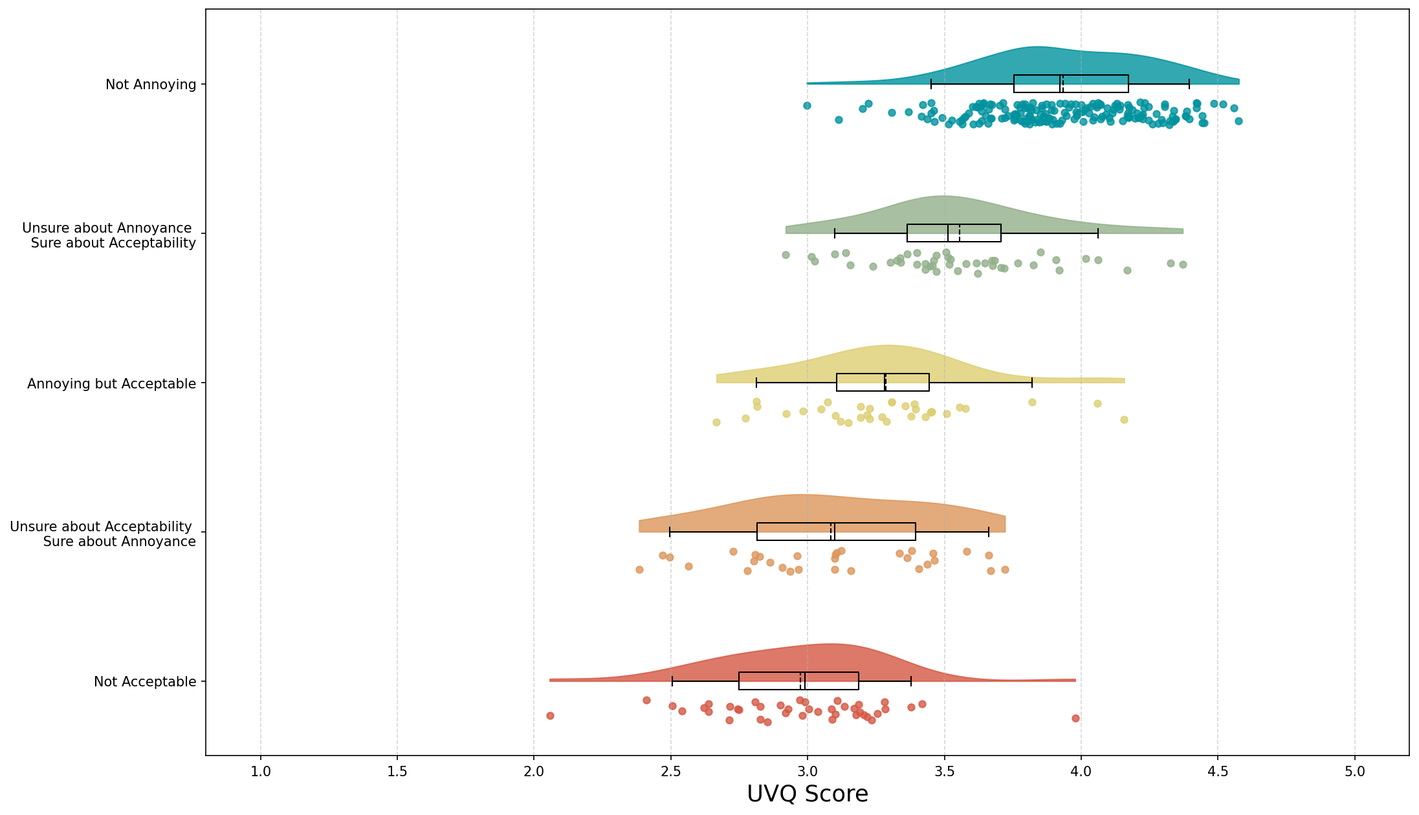
Predicting Acceptance / Annoyance Categories - UVQ

Slide 13
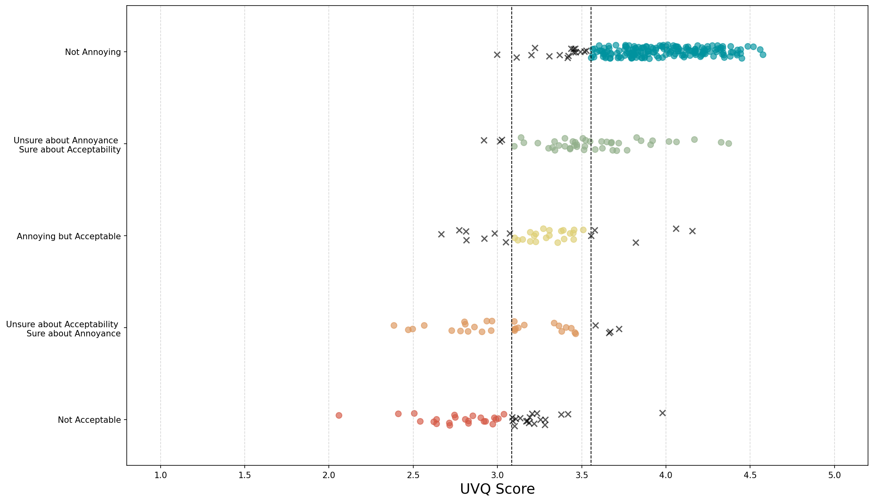
Predicting Acceptance / Annoyance Categories - UVQ

Slide 14
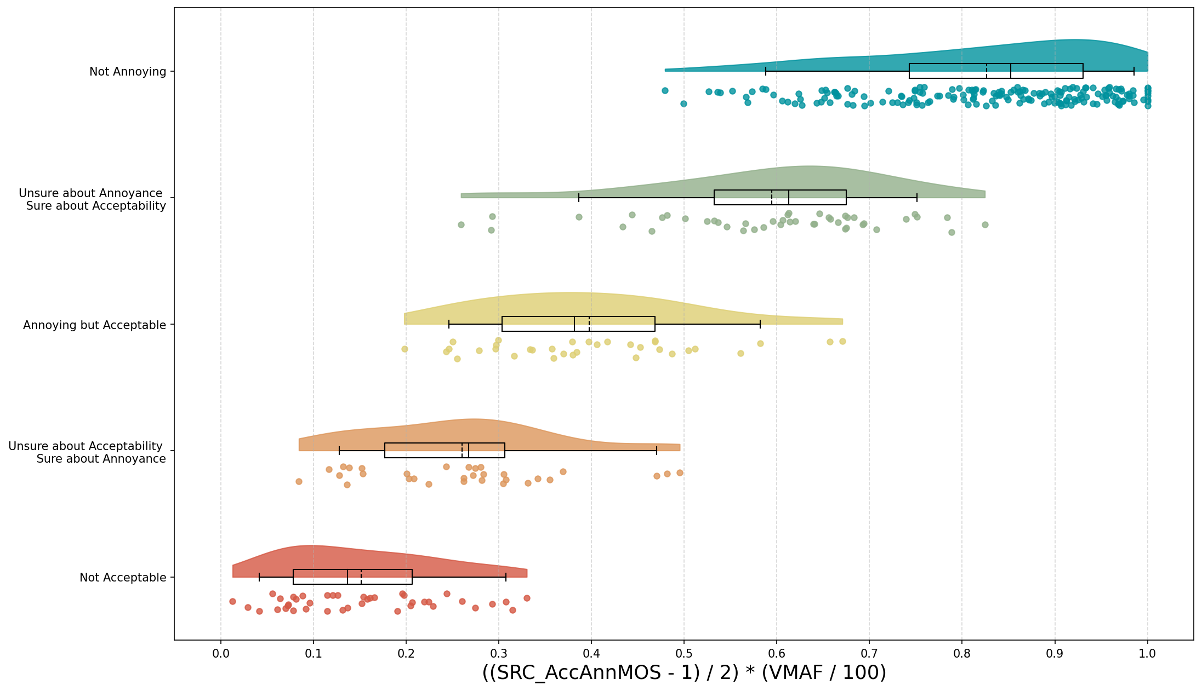
If we know AccAnn-MOS of the SRC, VMAF is enough for the rest

Slide 15
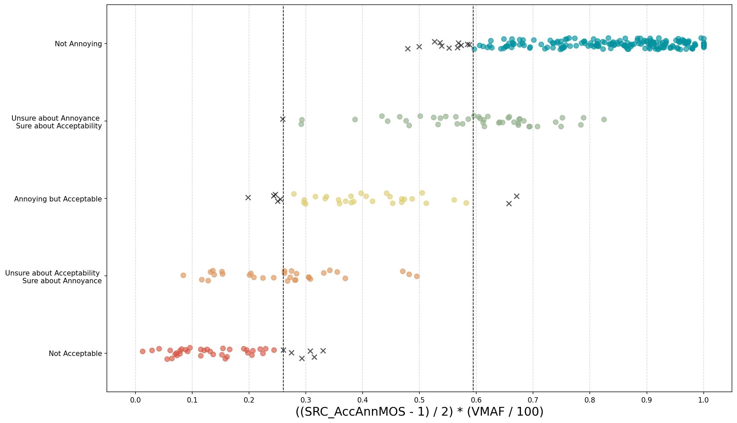
If we know AccAnn-MOS of the SRC, VMAF is enough for the rest

Slide 16
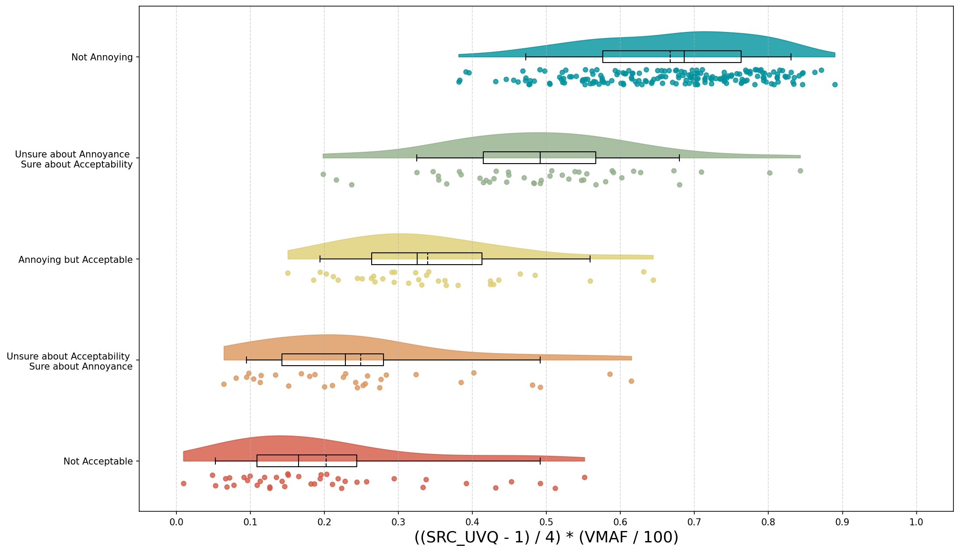
If we use UVQ score of the SRC instead of SRC’s AccAnn-MOS

Slide 17
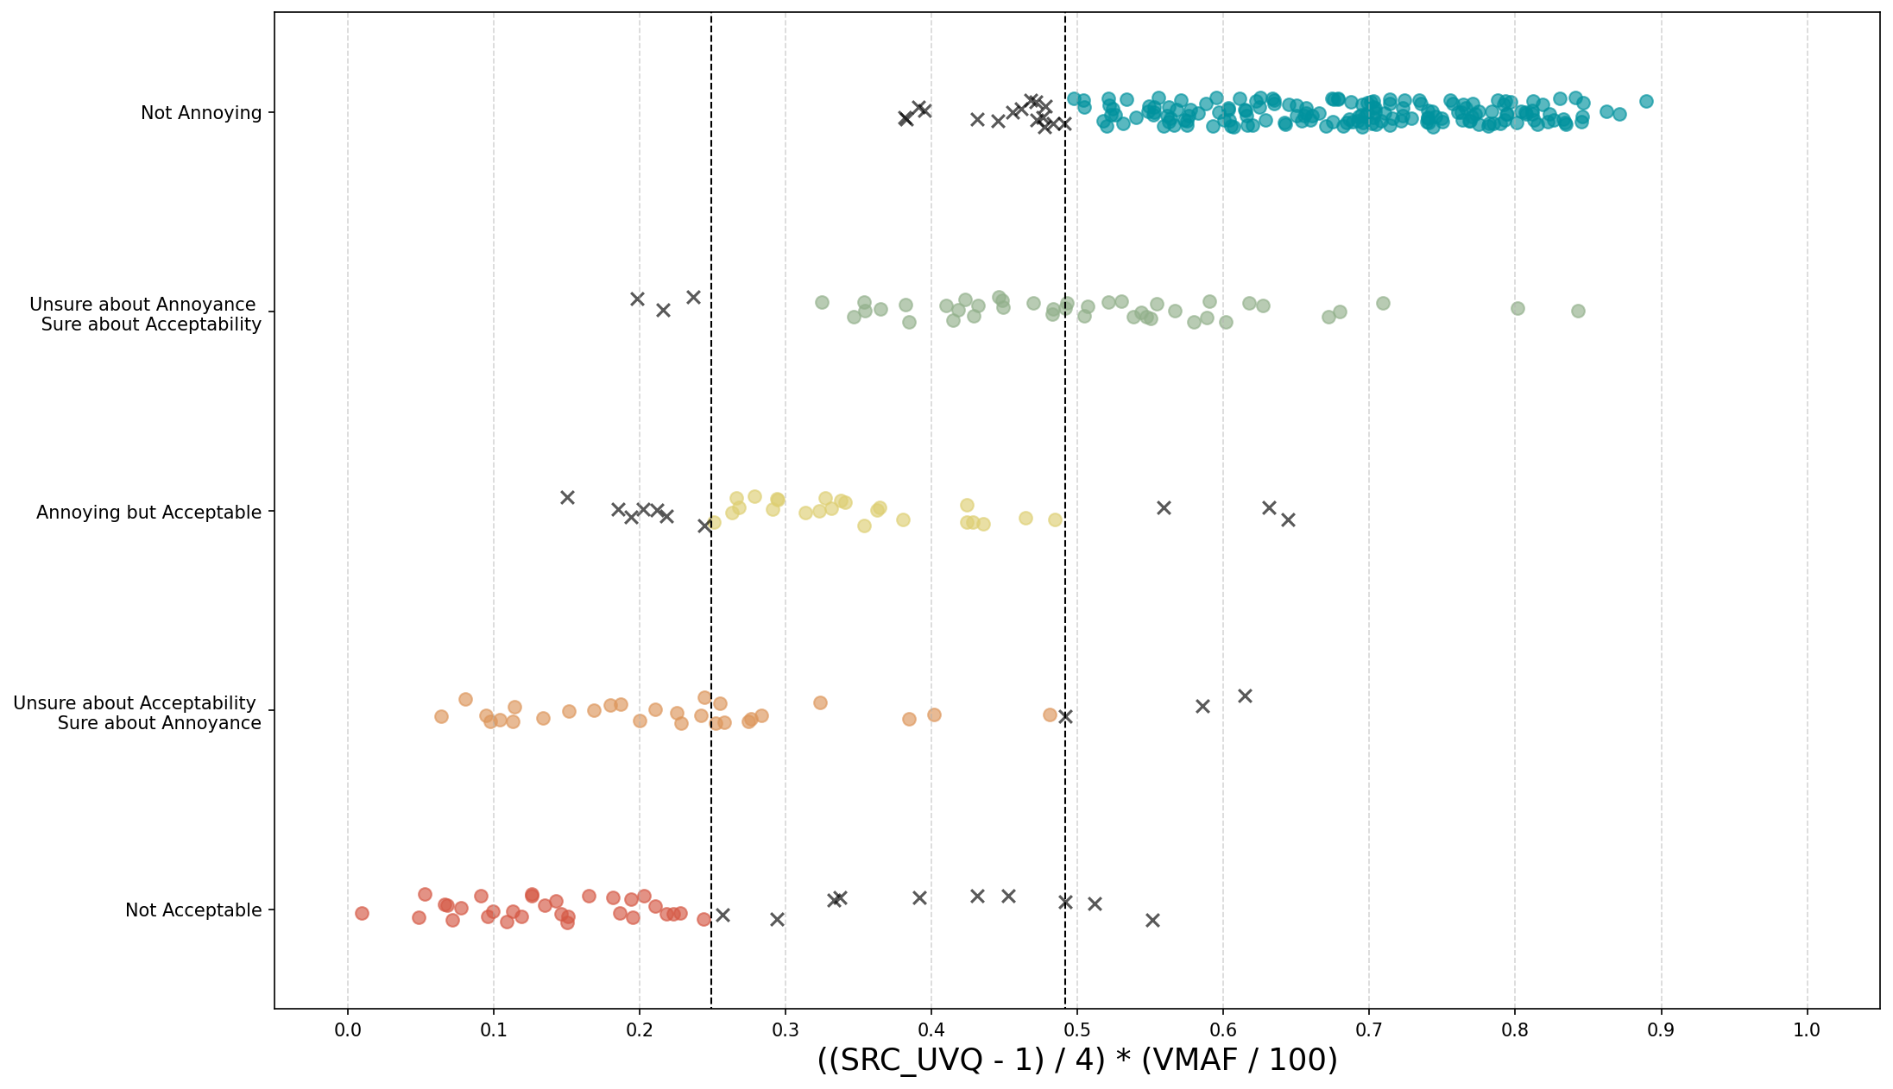
If we use UVQ score of the SRC instead of SRC’s AccAnn-MOS

Slide 18
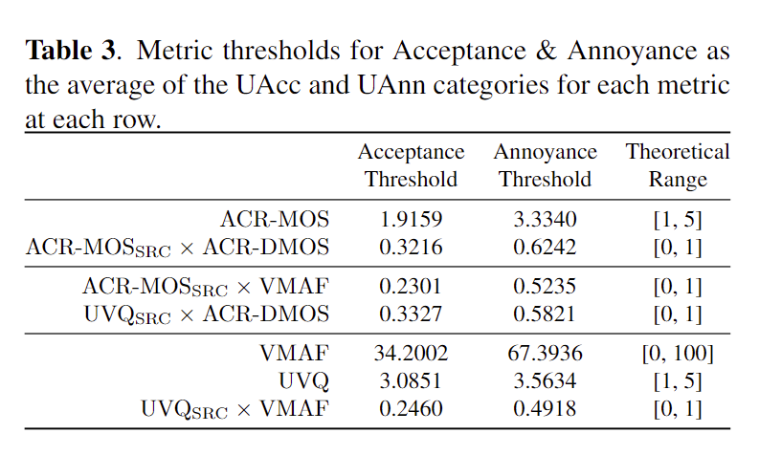
Metric Thresholds for Acceptance / Annoyance

Slide 19
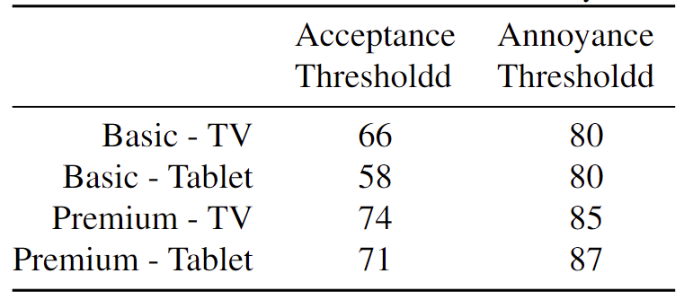
Metric Thresholds for Acceptance / Annoyance
VMAF thresholds for Basic and Premium subscription profiles
on Tablet and TV [1]
1 - Jing Li, Lukas Krasula, Yoann Baveye, Zhi Li, and Patrick Le Callet, “Accann: A new subjective assessment methodology for measuring acceptability and annoyance of quality of experience,” IEEE Transactions on Multi-media, vol. 21, no. 10, pp. 2589–2602, 2019

Slide 20
Conclusion
We used acceptance/annoyance paradigm to measure QoE in an online social media platform context.
Acquired VMAF thresholds differs greatly from the previous studies, especially for acceptance.
Combining UVQ with VMAF presents slight improvement on predicting acceptance/annoyance categories.
  Larger room for improvement in predicting source content quality
  VMAF seems sufficient when we have access to the source content quality as ground truth.
Next step: User generated HDR content and AV1

