Slide 1

Experiment Precision Measures and Methods for Experiment Comparisons
Lucjan Janowskiª, Jakub Nawała^{b}, Tobias Hoßfeld^{c}, Michael Seufert^{c}
AGH University of Science and Technology, Poland
University of Bristol, Department of Electrical & Electronic Engineering, Bristol, UK
University of Würzburg, Chair of Communication Networks, Würzburg, Germany
Notes:
Presentation outline:
Validity
Experiment setup
Results
Conclusions

Slide 2
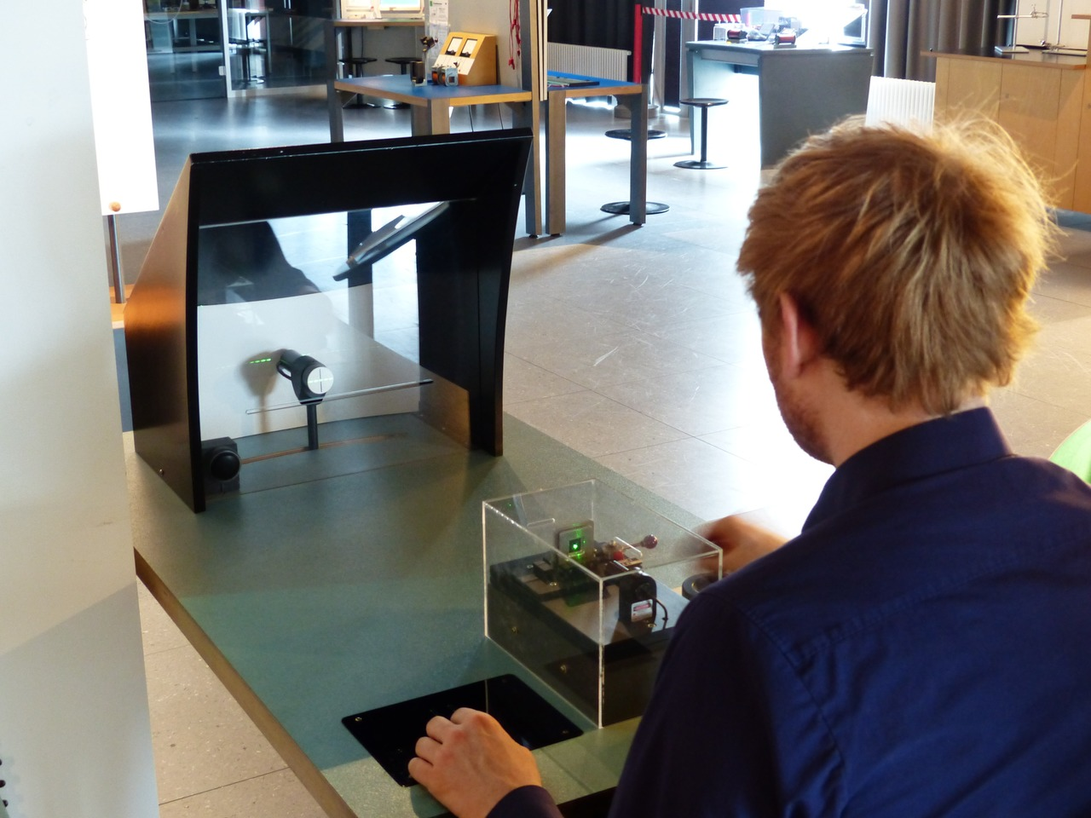

Subjective Experiment

Slide 3
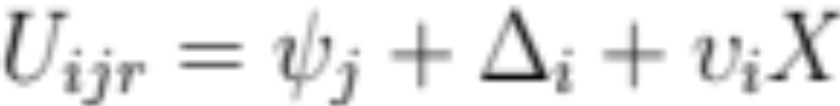
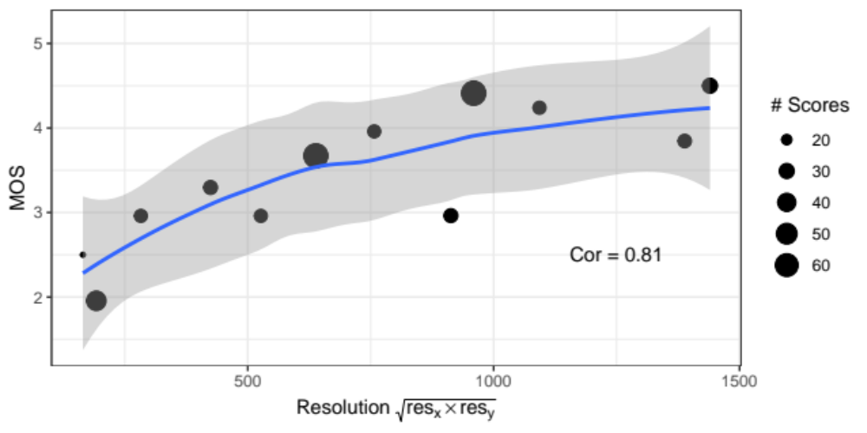
Data Analysis
ITU-T P.913
Appendix III
Reference code for clause 12.6
Zhi Li, Christos G. Bampis, Lucjan Janowski, Ioannis Katsavounidis, "A Simple Model for Subject Behavior in Subjective Experiments" in Proc. IS&T Int’l. Symp. on Electronic Imaging: Human Vision and Electronic Imaging, 2020, pp 131-1 - 131-14

Slide 4

Experiments

Slide 5
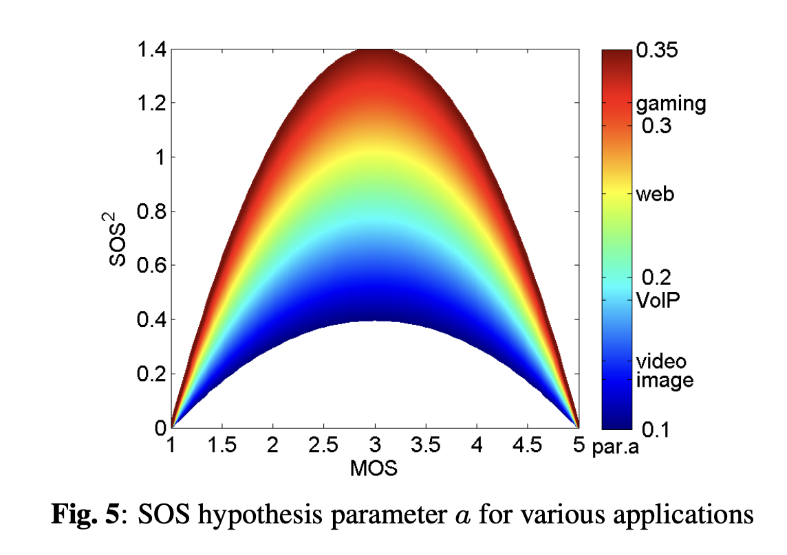
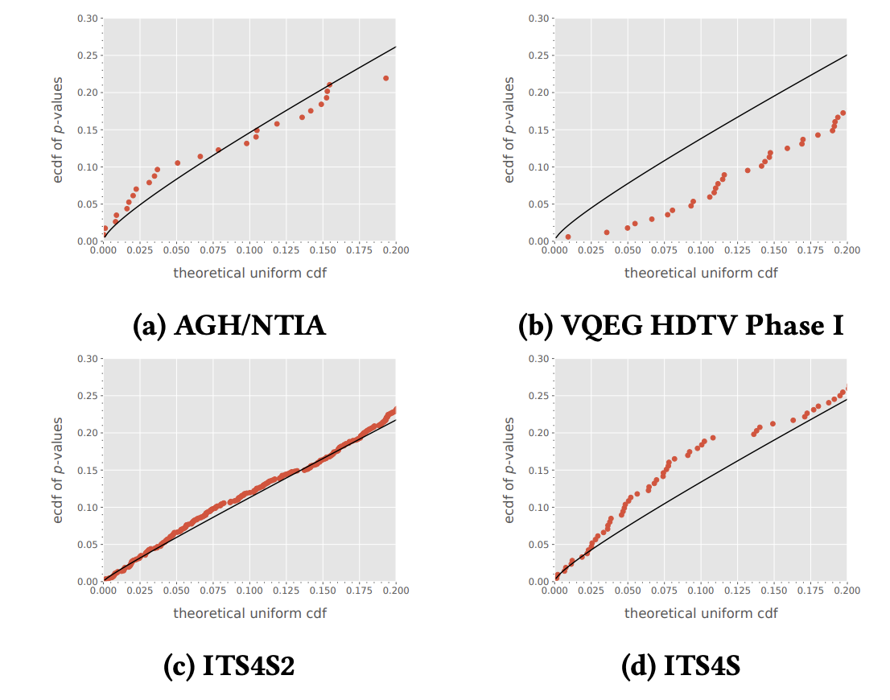
Existing Solutions
SOS
pp-plot
T. Hoßfeld, R. Schatz and S. Egger, "SOS: The MOS is not enough!,"
2011 Third International Workshop on Quality of Multimedia Experience,
Mechelen, Belgium, 2011, pp. 131-136
Nawala, J., Janowski, L., Cmiel, B., & Rusek, K. (2020, October).
Describing Subjective Experiment Consistency by p-Value P--P Plot.
In Proceedings of the 28th ACM International Conference
on Multimedia (pp. 852-861).
Notes:
Due to the limited number of results, we aggregate them. The higher the resolution, the higher the quality rating. The overall resolution has a correlation of 0.81. This means that as the resolution increases, there is a strong positive correlation with the quality ratings given by the participants. However, it's worth to note that correlation does not imply causality, other factors such as network conditions, device capabilities, and personal preferences may also affect the quality rating.

Slide 6
Do We Need Something More?
We have:
Precision estimation
Experiment stability
We miss:
Statistical significance test
Using subject model(s)
Extensive simulation study

Slide 7
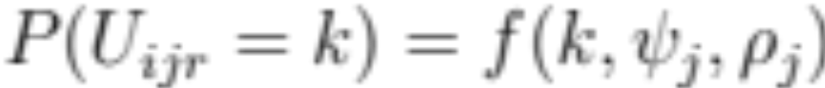
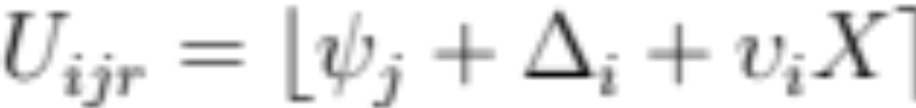
Subject Models
GSD
(General Score Distribution)
Zhi2020

Slide 8
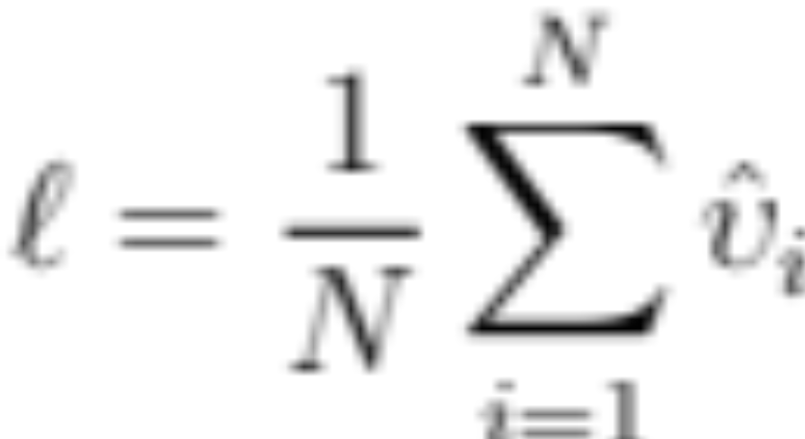
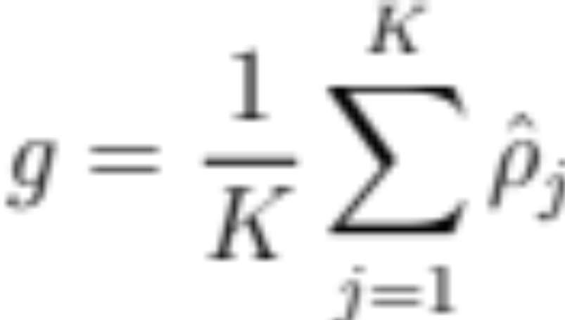
Subject Models Precision Parameters
GSD
(General Score Distribution)
Zhi2020
Precision for Zhi2020 model is average precision
of subjects taking part in the experiment.
Precision for GSD model is average
precision per each stimuli
Logic behind: The test was easier, subjects
answered more precisely.
Logic behind: Experiment was easier so
the spread for each stimuli is lower

Slide 9
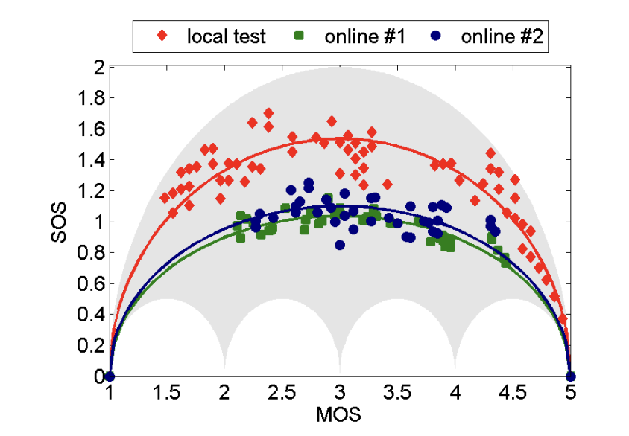
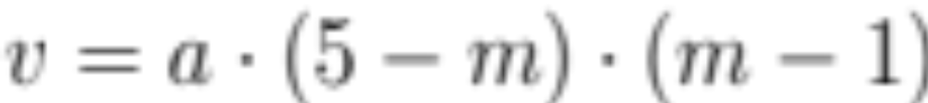
SOS

Slide 10
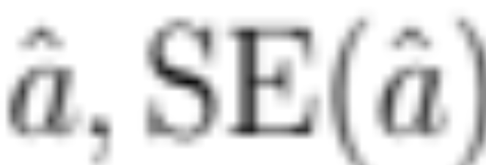
Significance Test
t-test
t-test
t-test

Slide 11
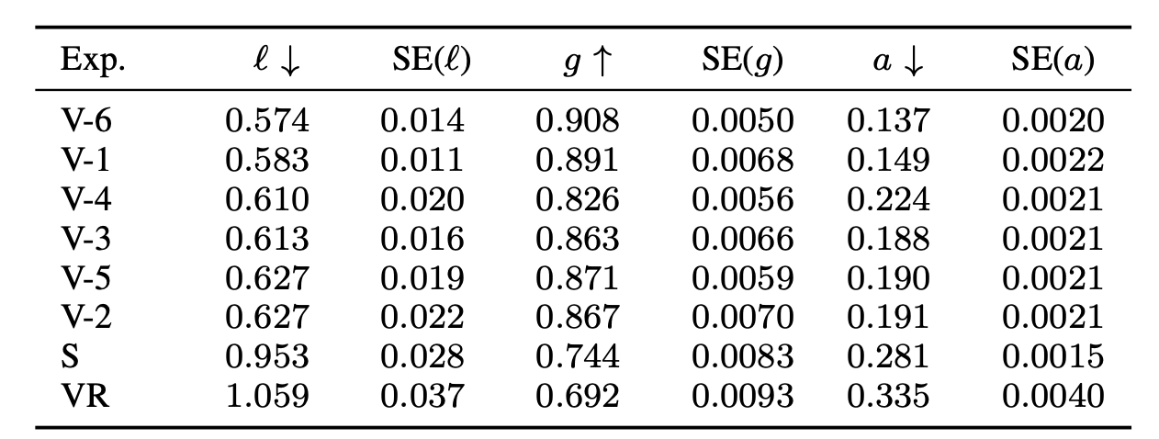
Obtained Results

Slide 12
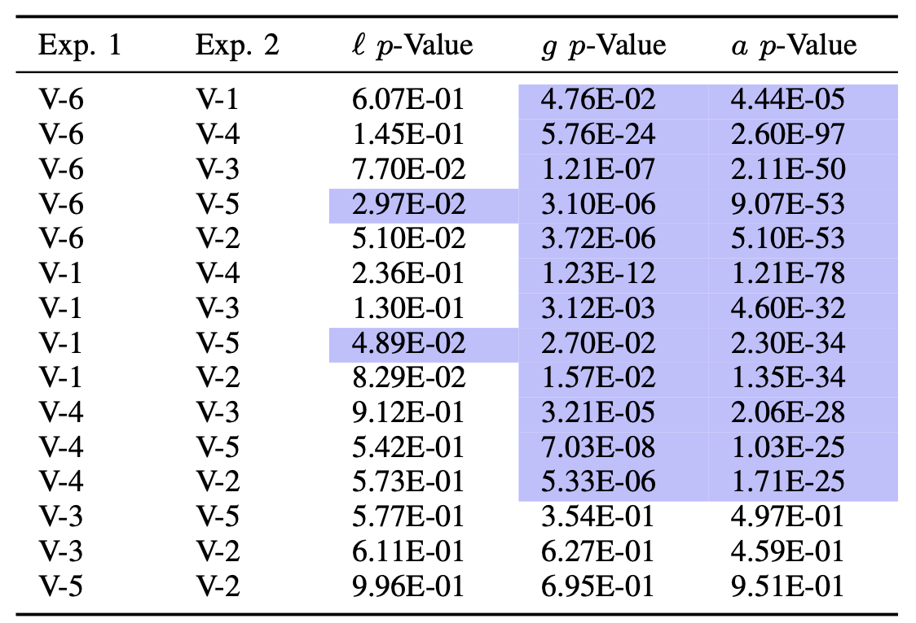
Obtained Results - Comparison

Slide 13
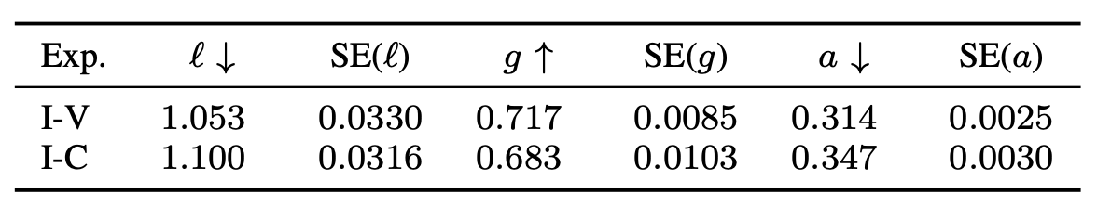
Error Detection

Slide 14
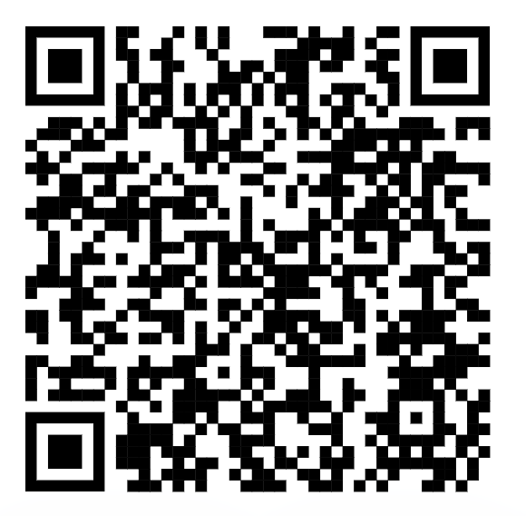
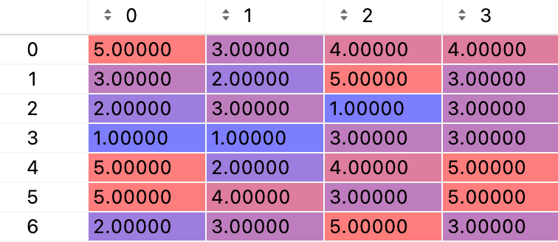
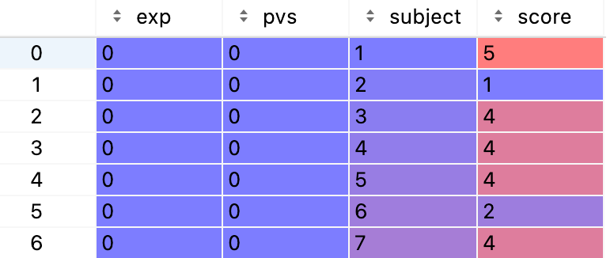
How to Calculate the Metrics
https://github.com/Qub3k/qoe-experiment-precision
Subjects
precision_? where ? can be l, a, or g
l = precision_l(scores)
l is a dictionary: {
'l’: mean l value
'std’: variance for l
‘n’: number of subjects/stimuli for g and a
}
Stimuli
precision_? where ? can be l, a, or g
comp_l = compar_by_l(data_frame, experiment_id, score, pvs, subject)
comp_l is a dictionary: {
't_stat’: t test statistics,
'p_value': p_value
}

Slide 15
Summary
We propose a notion of experiment precision.
We also define and test three experiment precision measures and related experiment precision comparison methods.
We do so by using real data from subjective experiments on VR, speech, image, and video QoE.
We provide guidelines regarding reporting experiment precision measures as well.
At last, our results suggest that the Li2020 model~\cite{Li2020simple} based $\ell$ measure performs best in assessing experiment precision.
We hope that our notion of experiment precision will help MQA practitioners differentiate between subjective experiments and develop new subjective experiment methods.
We make available a source code implementing the experiment precision measures and experiment comparison methods presented in this paper at https://github.com/Qub3k/qoe-experiment-precision.

Slide 16
Thank you!
www.eeagrants.org
Facebook, Twitter, LinkedIn, Instagram
YouTube: EEANorwayGrants
Mail: info-fmo@efta.int

