Slide 1

Low complexity No-Reference Image Quality Assessment Based on Multiscale Attention Mechanism With Natural Scene Statistics*
* This presentation is based on our recent paper in IEEE Signal Processing Letters, vol. 30, pp. 588-592, 2023, doi: 10.1109/LSP.2023.3276645.
Li Yu, Junyang Li, Farhad Pakdaman, Miaogen Ling, and Moncef Gabbouj
Nanjing University of Information Science and Technology
Tampere University
This work has received funding from the European Union’s Horizon 2020 research and innovation programme under the Marie Skłodowska-Curie grant agreement No 101022466, from National Natural Science Foundation of China under Grant 62002172, and from Business Finland AMALIA-2023 under Grant 97/31/2023.

Slide 2
No Reference Quality Assessment
Commonly used in many multimedia and vision applications
  When the pristine image is not available
Deep learning-based methods are dominant. Examples are:
Complex models → usually higher computational complexity
Fixed sized input needs cropping or resizing → loss of information
W. Sun et al. | Blind quality assessment for in-the-wild images via hierarchical feature fusion and iterative mixed database training | IEEE JSTSP 2023 | CNN
A. Golestaneh, et al. | No-reference image quality assessment via transformers, relative ranking, and self-consistency | IEEE/CVF WCACV 2022 | Transformer
Z. Pan, et al. | VCRNet: Visual compensation restoration network for no reference image quality assessment | IEEE TIP 2022 | CNN
J. You, et al. | Transformer for image quality assessment | IEEE ICIP 2021 | Transformer
M. Zhu, et al. | Saliency-guided transformer network combined with local embedding for no-reference image quality assessment | IEEE/CVF ICCV 2021 | Transformer

Slide 3
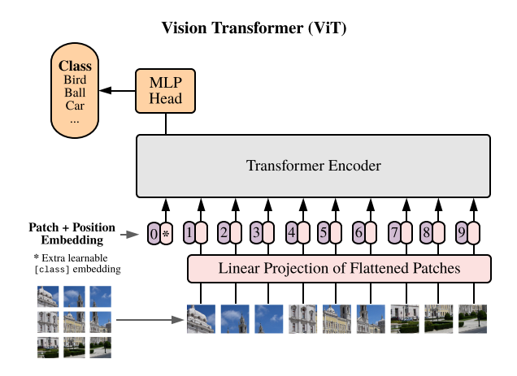
Transformer complexity and alternatives
HVS can be simulated by introducing the attention mechanism
Fixed sized input needs cropping or resizing
  Loses some features of the original image
High computational complexity
  1-D operation on a 2-D input
Image source: A. Dosovitskiy, et al. "An Image is Worth 16x16 Words: Transformers for Image Recognition at Scale." ICLR 2021.

Slide 4
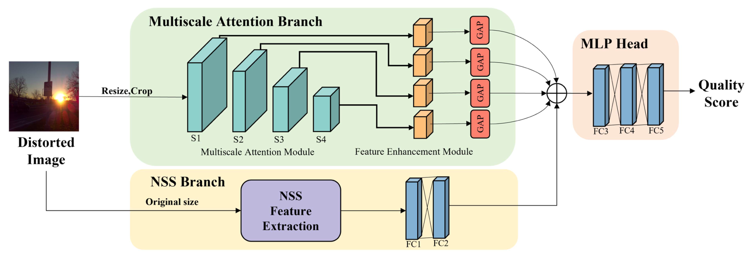
Overall Framework of MAMIQA
Top branch: Large Kernel Convolution (LKC) for attention
  Decomposed into lower complexity modules
Lower branch: Natural Scene Statistics (NSS) to compensate for resizing or cropping

Slide 5
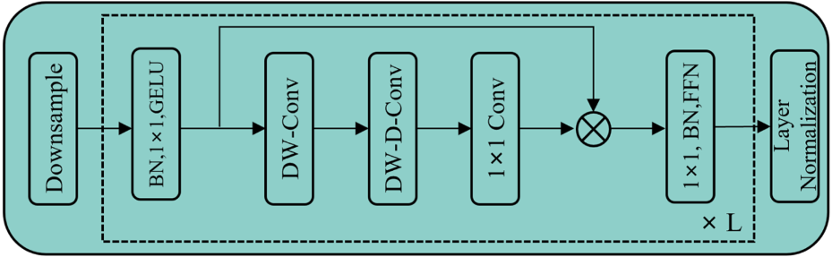
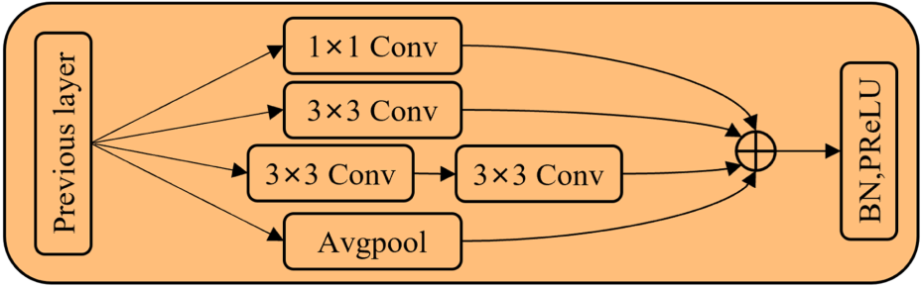
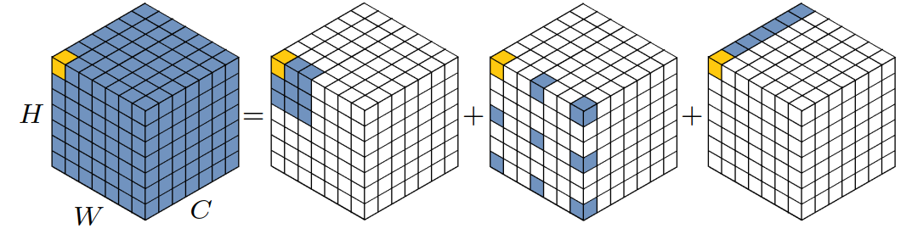
Attention Mechanism
Large kernel is costly
Decomposed LKC for low complexity
  Channel-wise conv, Depth-wise conv, and Depth-wise dilation conv
HVS views images at multiple scales
  Multiscale feature extraction
  Feature enhancement in multiple scales
Image source: M.-H. Guo, et al, “Visual attention network,” 2022, arXiv:2202.09741.

Slide 6
Experimental setup and Datasets
Implemented in PyTorch
Tested on 5 datasets
  Synthetically distorted datasets, LIVE II, TID2013, and CSIQ
  Authentically distorted datasets LIVE-C, and KonIQ-10K
Training process
  Random crops of 224 × 224
  Batch size of 64
  Adam with weight decay 5×10⁻⁴
  Learning rate 2×10⁻⁵
Evaluated based on the widely used metrics
  Spearman rank-order correlation coefﬁcient (SRCC)
  Pearson linear correlation coefﬁcient (PLCC)

Slide 7
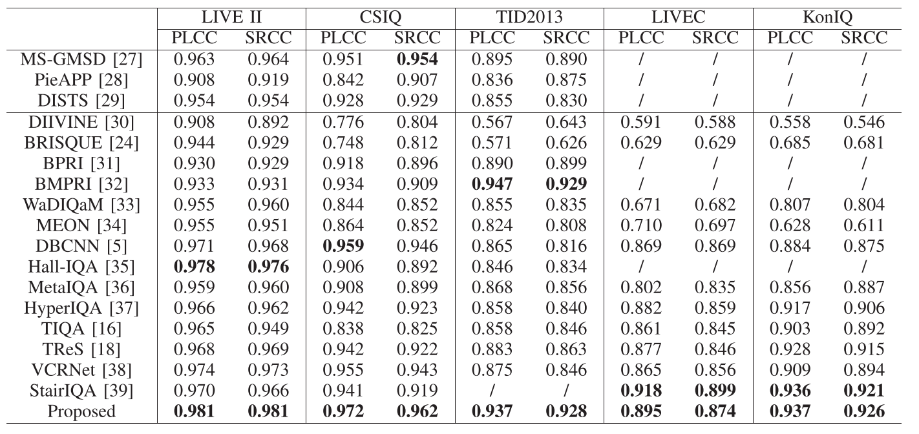
Overall Performance
Improved performance compared to several methods, e.g. CNN based, and Transformer based methods
Best or second best in all datasets

Slide 8
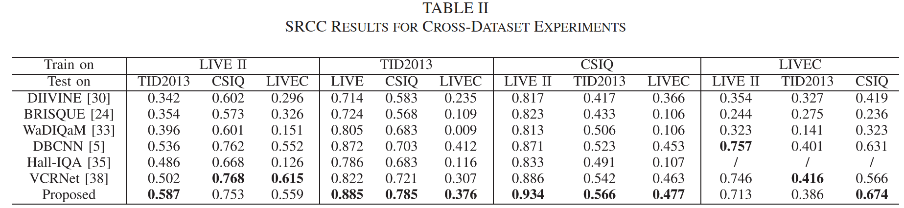
Cross Dataset Performance
Trained on one dataset, tested on others
Best in 8/12

Slide 9
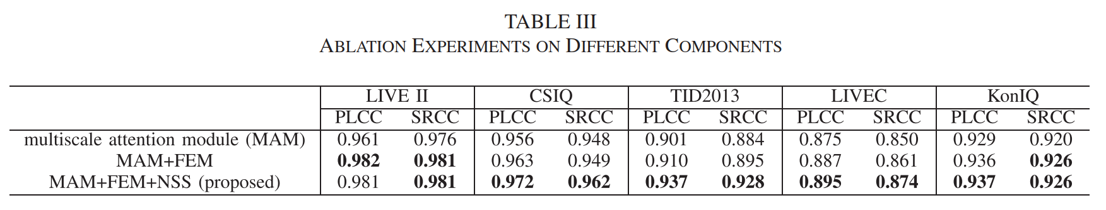
Ablation Study
0.01 to 0.02 improvement from FEM
Up to 0.02 improvement from NSS

Slide 10
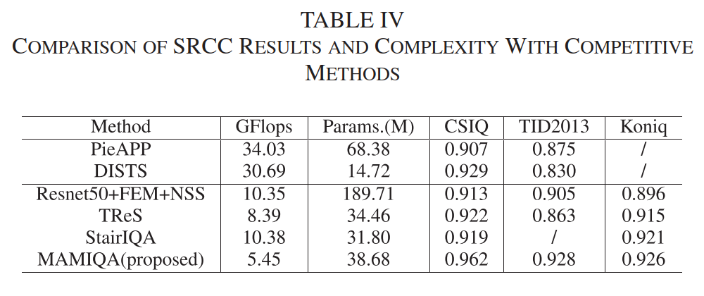
Computational Complexity
35% lower complexity compared to TReS (Transformer-based)
  But still significantly better
50% lower than StairIQ (CNN based)

Slide 11

Remarks
Transformers (and perhaps other complex DNNs) can be replaced by lower complexity structures
  large convolution kernels
Decomposed large kernel convolution works just as good (and even better) as Transformer
Natural scene statistics can be successful to compensate the image info lost in cropping
Codes available on GitHub:
https://github.com/Vencoders/MAMIQA

