Slide 1
Generative Compression
& Challenges for Quality
Assessment
David Minnen, Ph.D.
Staff Research Scientist
VQEG Spring 2023 Meeting

Slide 2
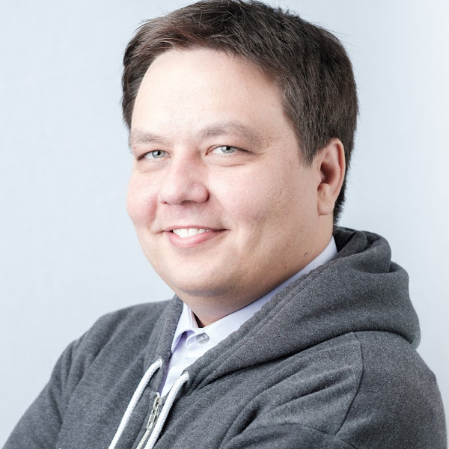
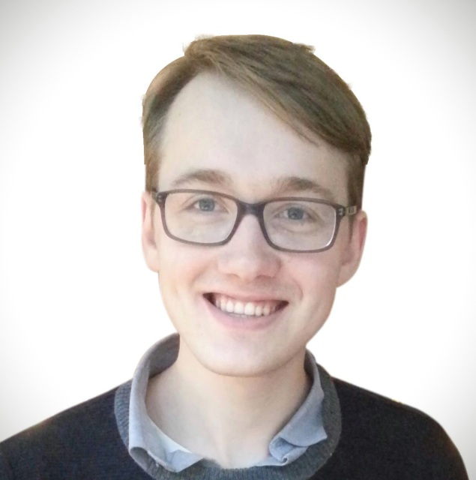

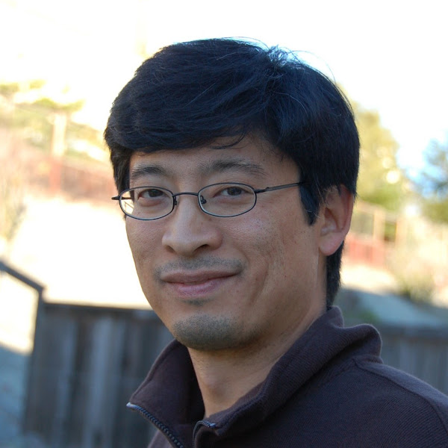
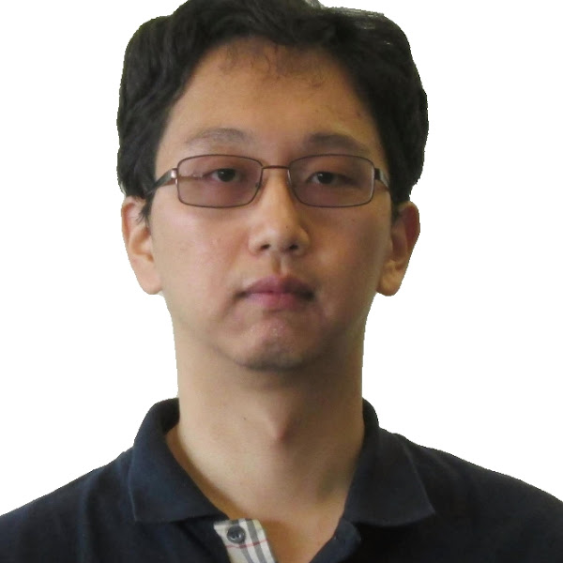


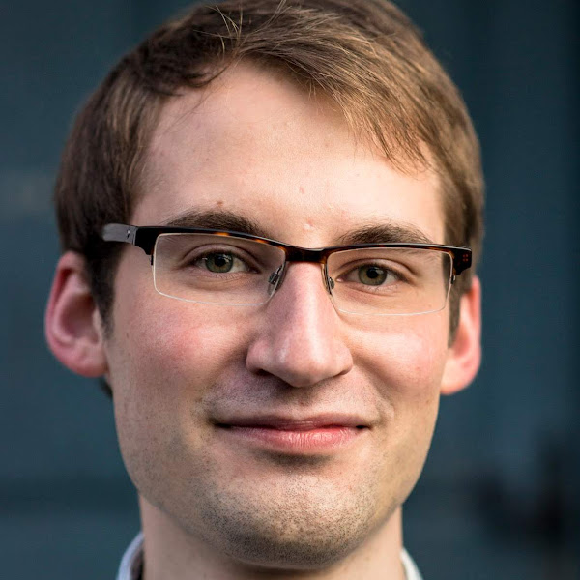
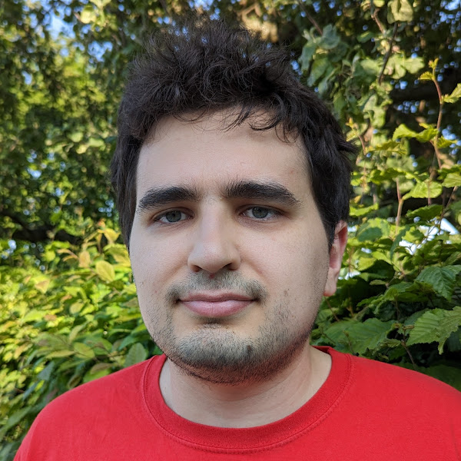
Colleagues &
Collaborators
George Toderici
Eirikur Agustsson
Johannes Ballé
Troy Chinen
Sung Jin Hwang
Nick Johnston
Fabian Mentzer
Lucas Theis
Luca Versari

Slide 3
Agenda
Visual Examples
01
Learned Image Compression
02
Generative Compression
03
Concluding Remarks
04

Slide 4
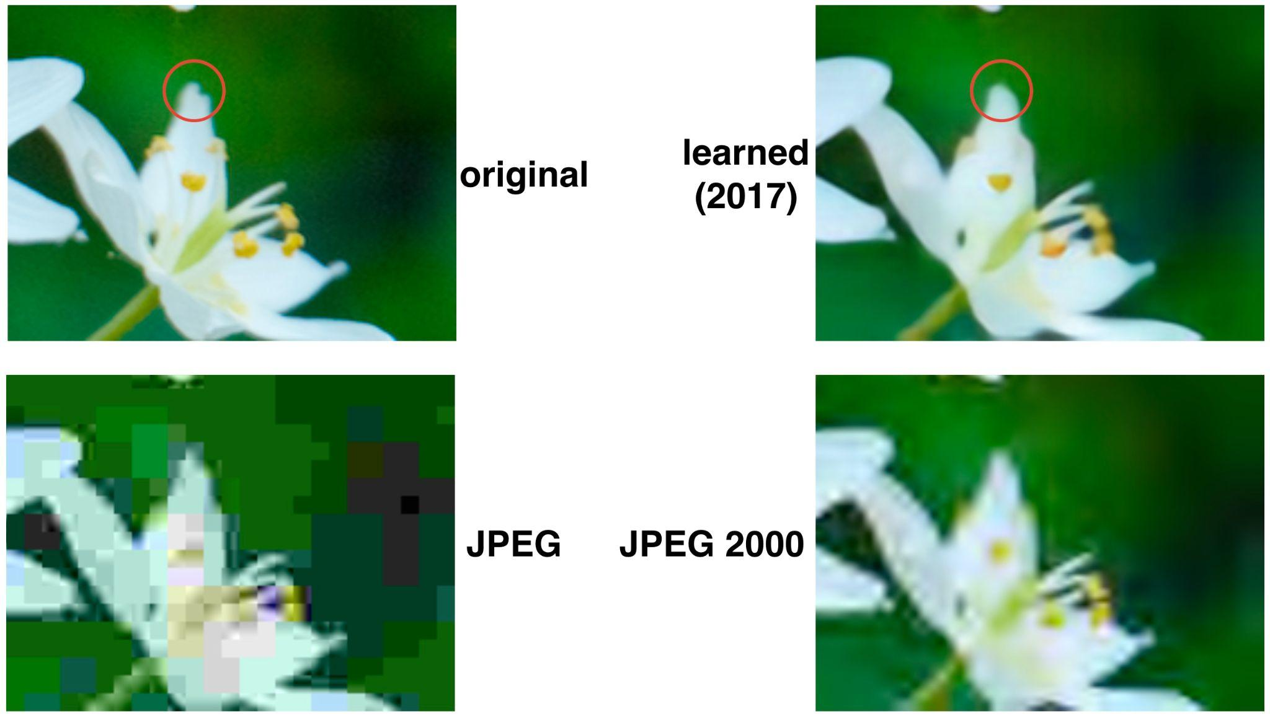
Learned result from Ballé 2017 (1611.01704)
More information from Dr. Ballé: youtu.be/Y3ySwIhwvTE

Slide 5
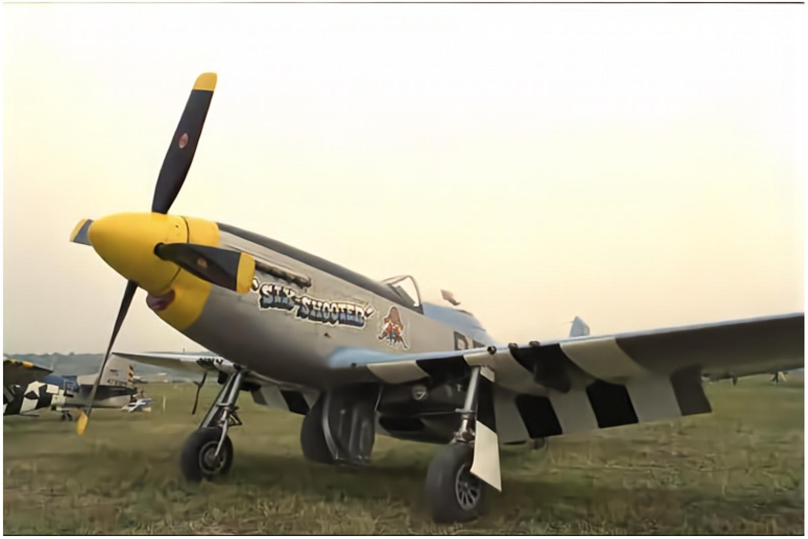
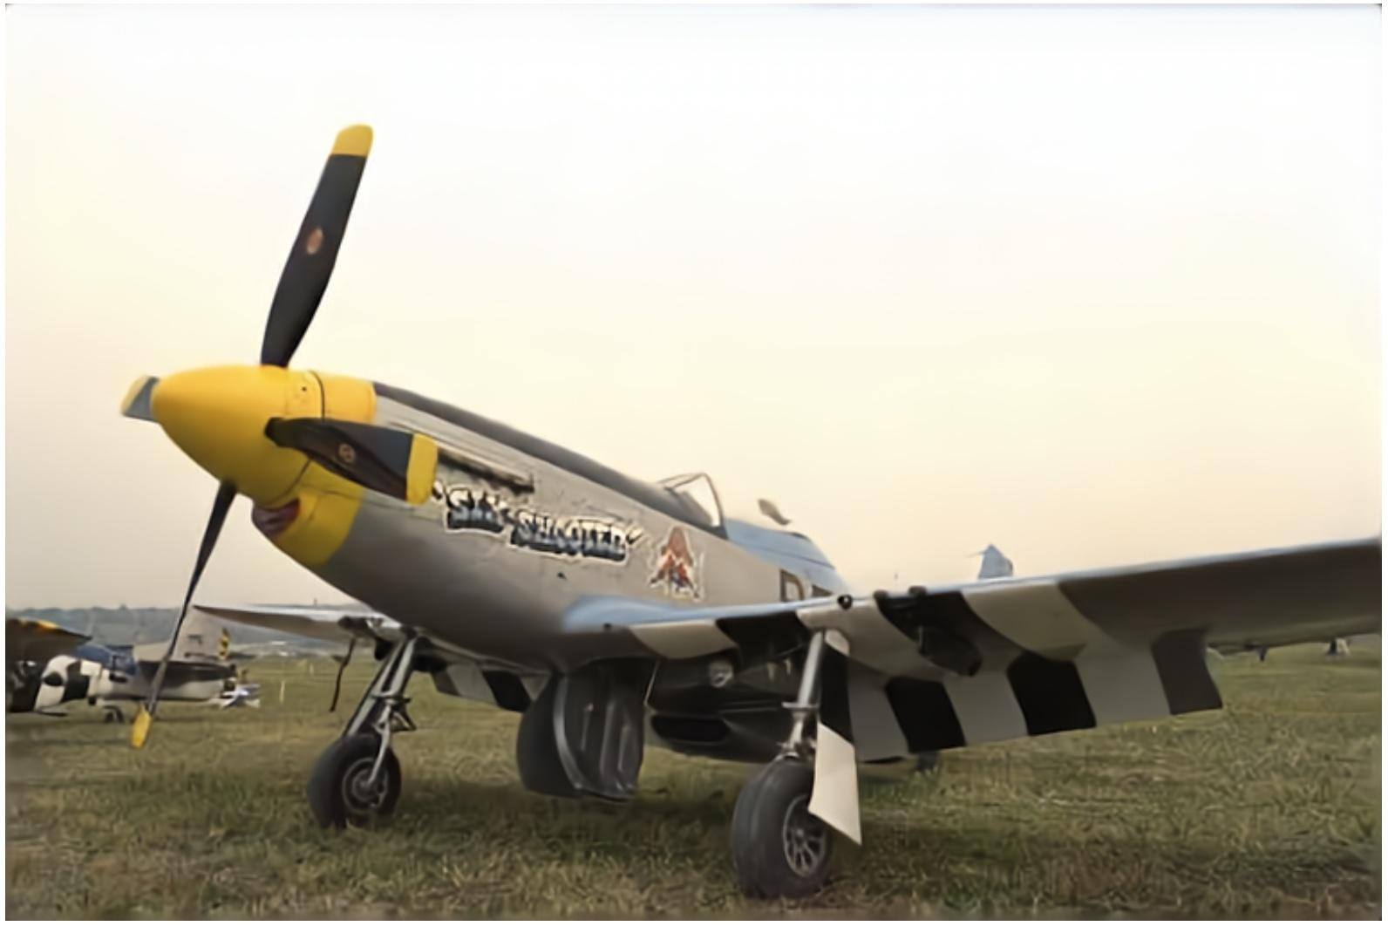
Optimized for MSE (0.194 bpp)
Optimized for MS-SSIM (0.187 bpp)
Learned result from Ballé 2018 (1802.01436)
More information from Dr. Ballé: youtu.be/Y3ySwIhwvTE

Slide 6
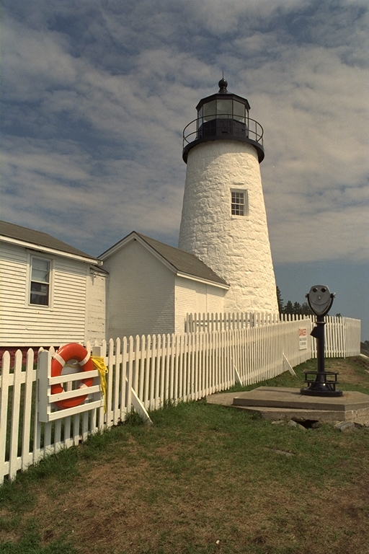
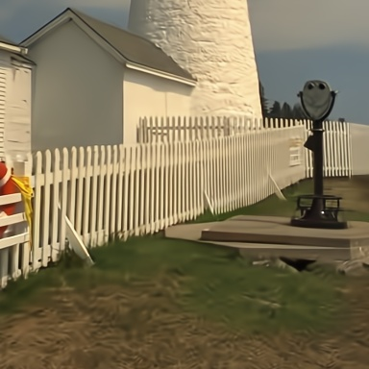
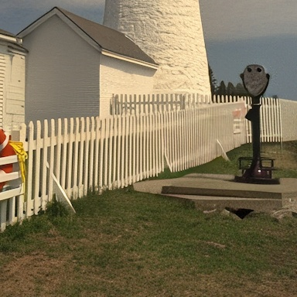
Optimized for MSE
0.14 bpp 30.4 dB
Includes adversarial loss
0.11 bpp 28.1 dB
Original: kodim19
MSE reconstruction from He 2022 (arxiv:2203.10886)
GAN reconstruction from Agustsson 2023 (arxiv:2212.13824)
Notes:
Optimizing for MSE => max PSNR, but leads to overly smooth, “plasticky” reconstructions.
Including an adversarial loss dramatically improves perceptual quality at the expense of fidelity (PSNR)

Slide 7
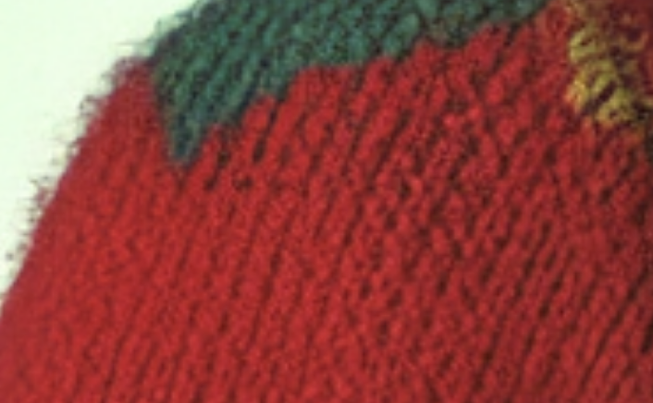
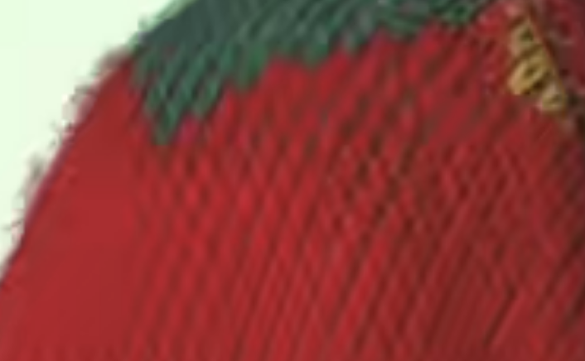
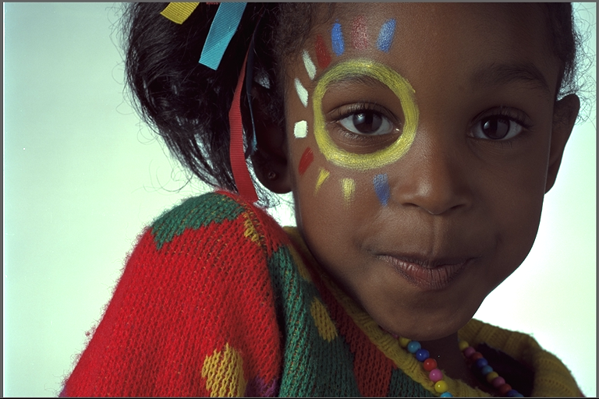
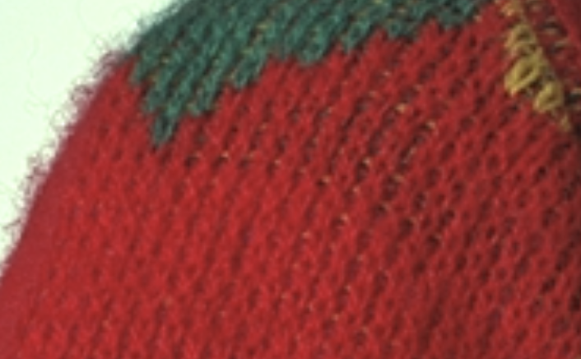
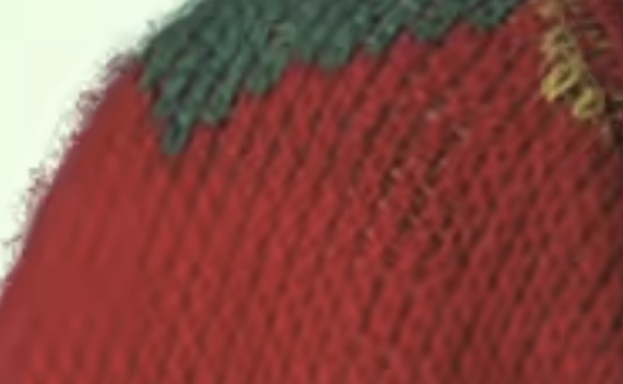
HiFiC (Generative @ 7kB)
BPG @ 8 kB (~1x)
Image 15 from the Kodak image dataset
Original
BPG @ 15 kB (~2x)
HiFiC results from Mentzer 2020 (arxiv:2006.09965)

Slide 8
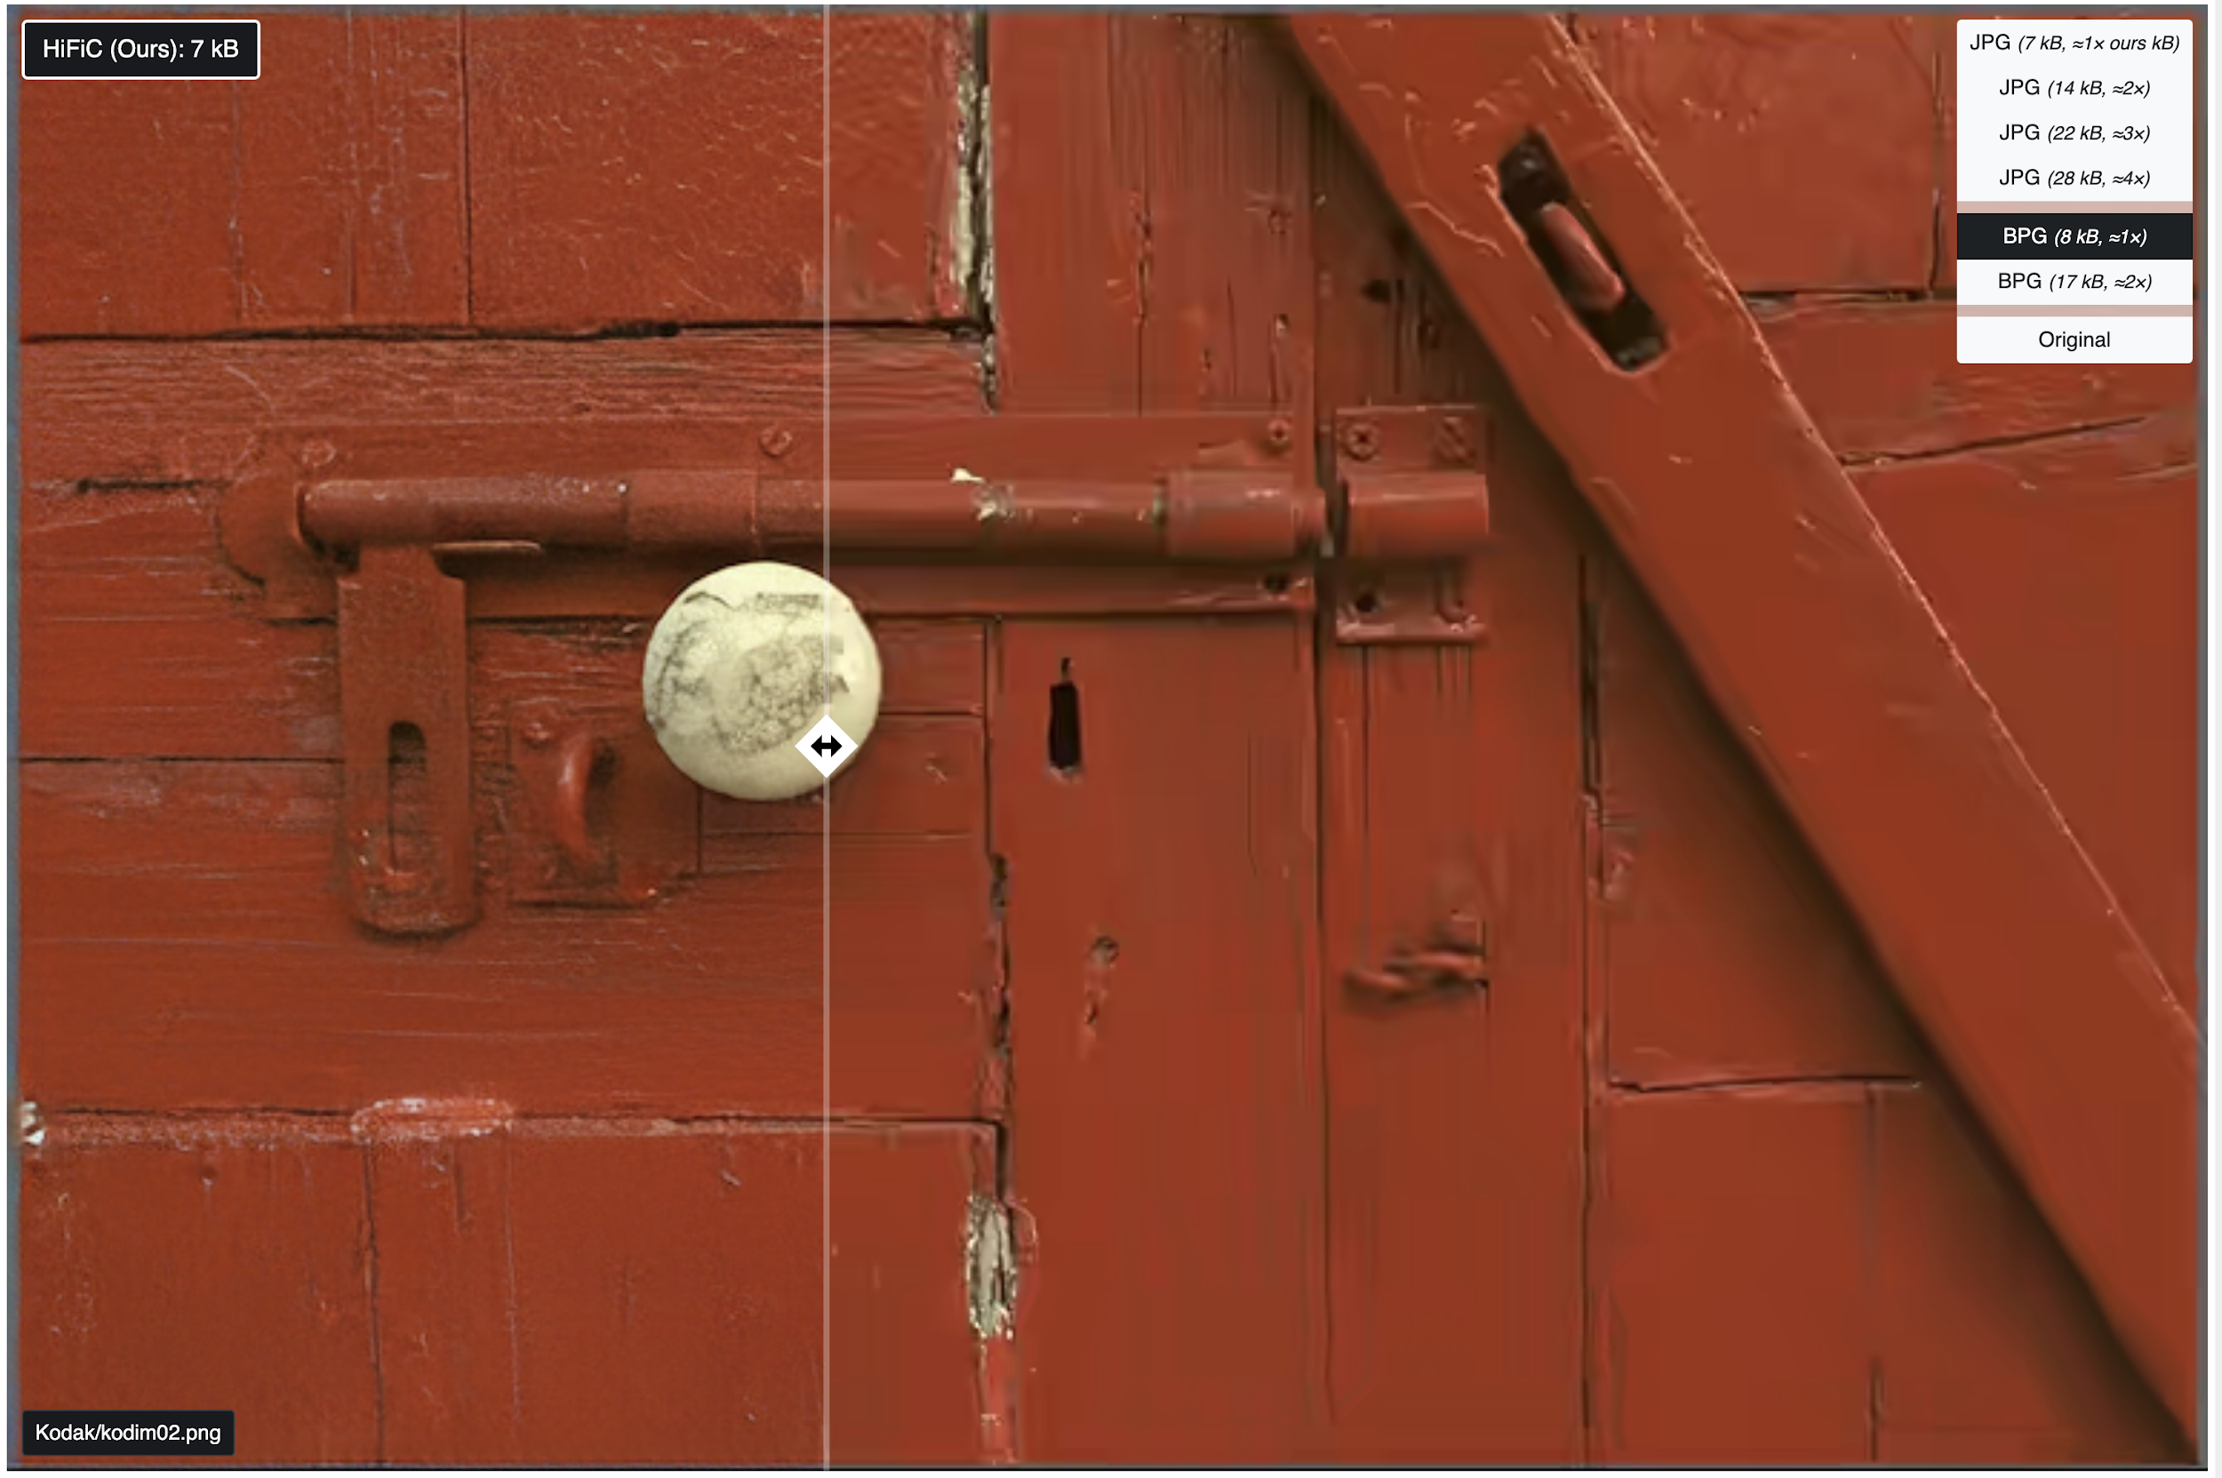
Interactive demo @ hific.github.io

Slide 9
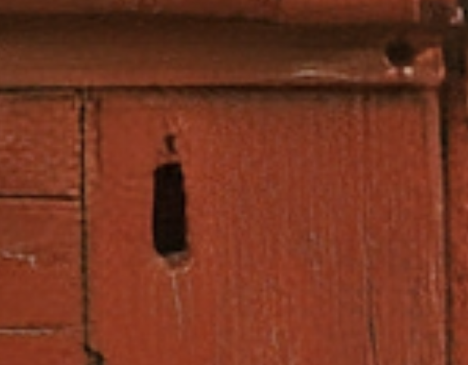
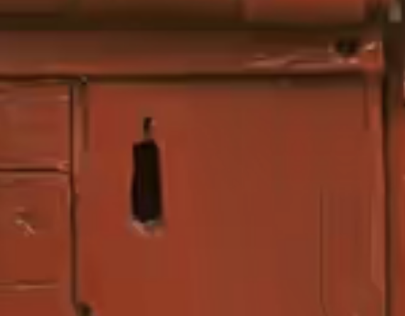
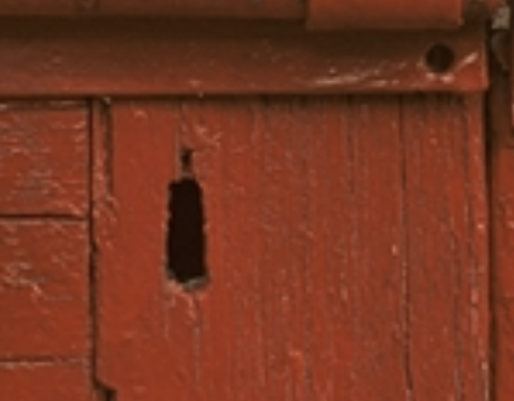
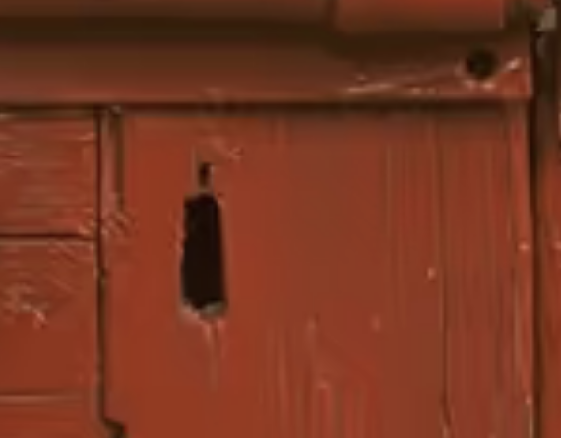
HiFiC @ 7kB
BPG @ 8 kB (~1x)
Original
BPG @ 17 kB (~2x)

Slide 10
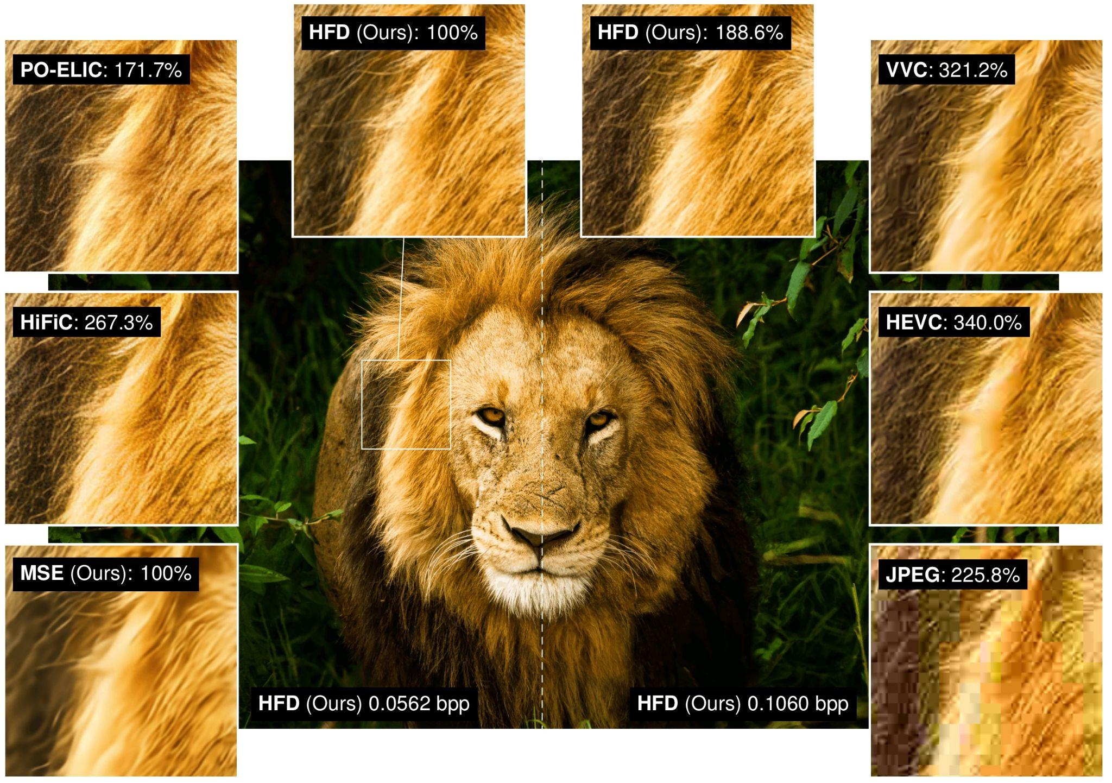
PO-ELIC results from He 2022 (arxiv:2205.14501)
HFD results from Hoogeboom 2023 (arxiv:2305.18231)

Slide 11
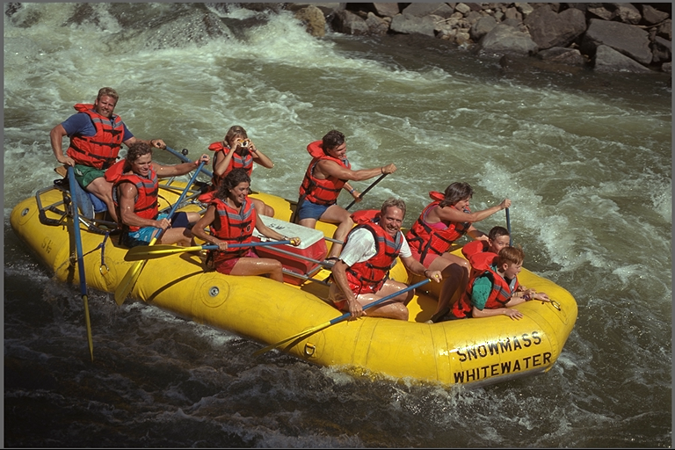
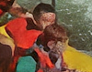
HiFiC Failure Cases: small faces
HiFiC results from Mentzer 2020 (arxiv:2006.09965)

Slide 12
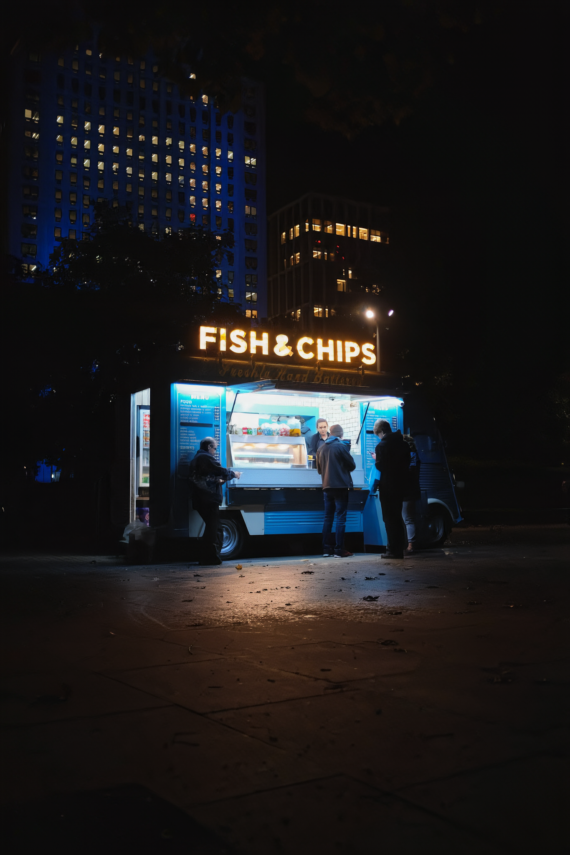
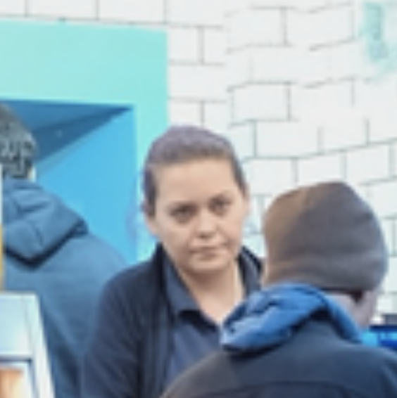
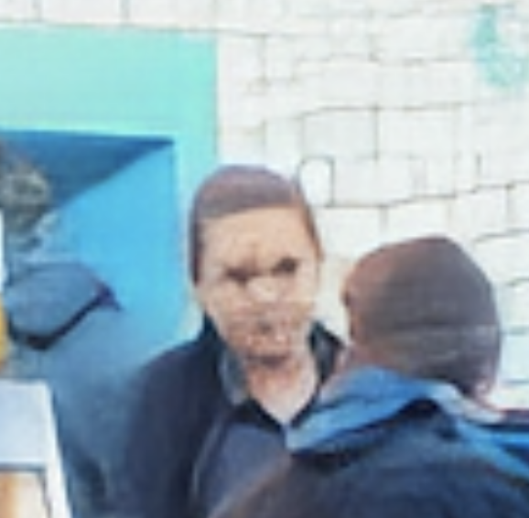
HiFiC Failure Cases: small faces
← still a problem with more
powerful GAN-based models
Original
HiFiC
HiFiC results from Mentzer 2020 (arxiv:2006.09965)

Slide 13
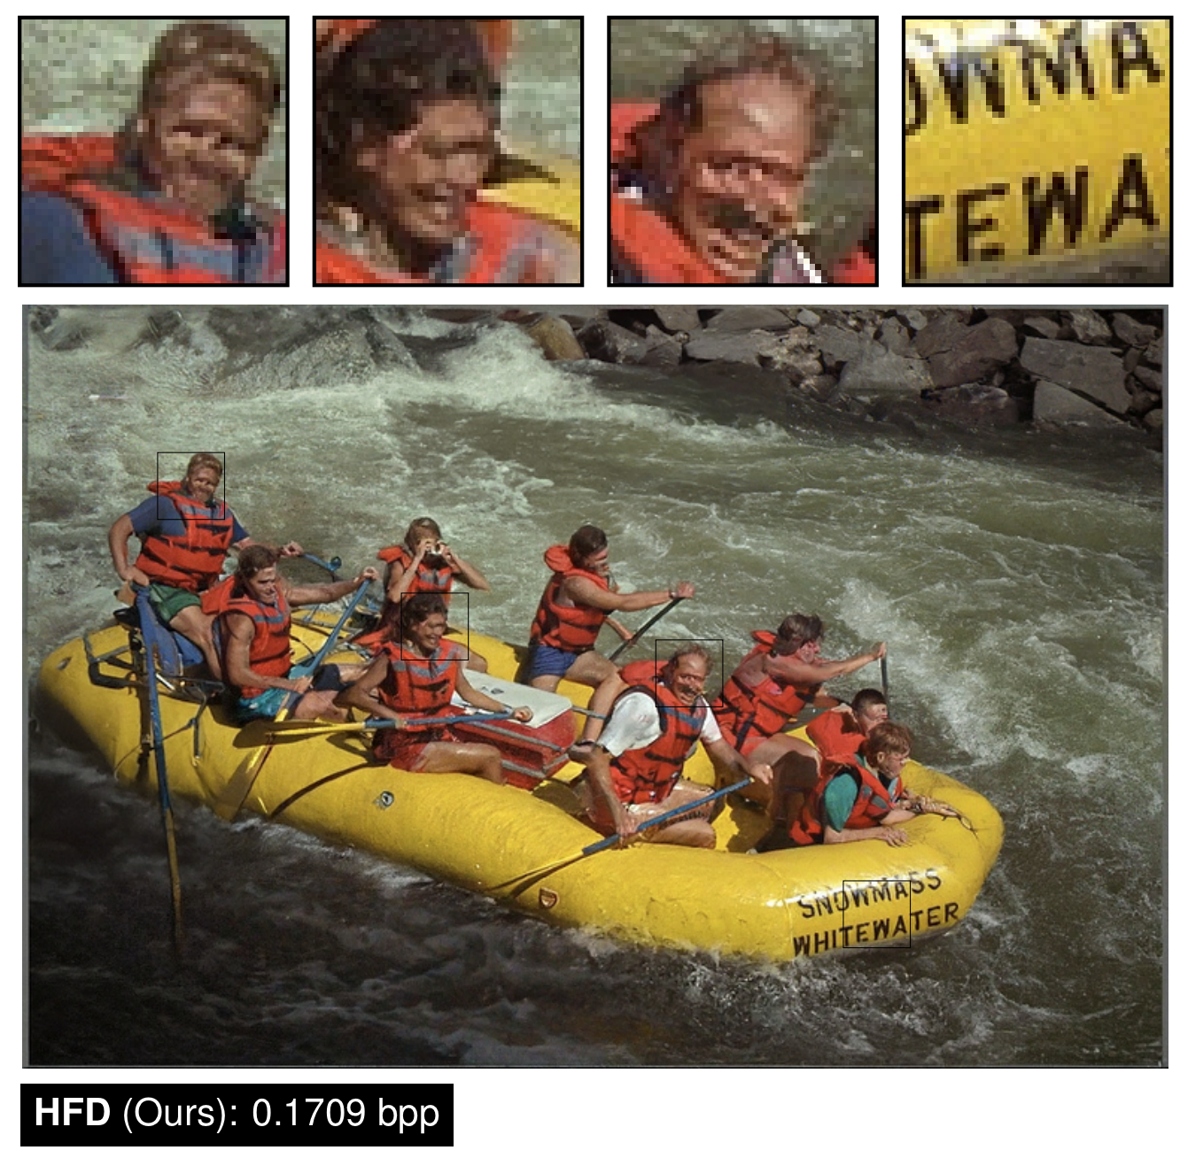
Visual quality looks better in diffusion- based reconstructions of small faces, but this is an ongoing area of research.
HFD results from Hoogeboom 2023 (arxiv:2305.18231)

Slide 14
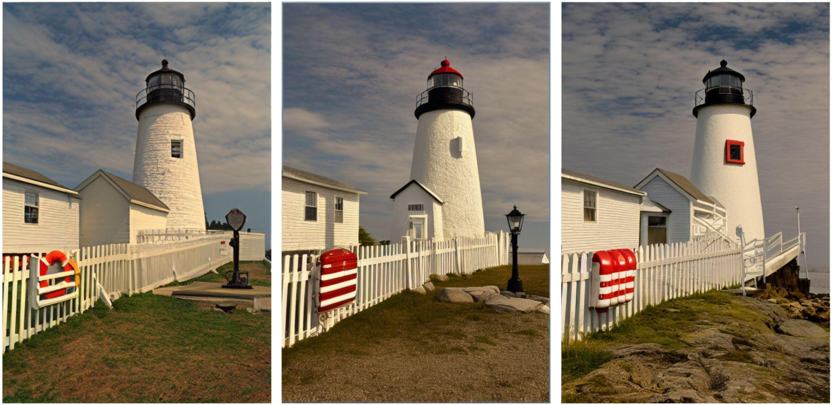
Original: kodim19
Generated images conditioned on text + low-res image
Text-to-image results generated with Stable Diffusion (Rombach 2022, arxiv:2112.10752)

Slide 15
Learned Image Compression
A high-level overview
01
Visual Examples
02
Learned Image Compression
03
Generative Compression
04
Concluding Remarks

Slide 16
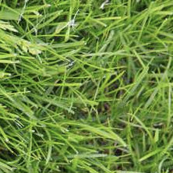
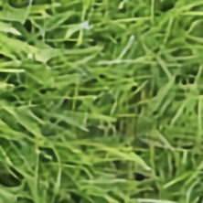
Learned Image Compression
01101...00101
Q
input image
reconstruction
Coder / Decoder (codec)

Slide 17
Learned Image Compression
01101...00101
Q
input image
reconstruction
encoder
decoder

Slide 18
Learned Image Compression
01101...00101
Q
input image
reconstruction
encoder
decoder
sender
receiver

Slide 19
Quantization
Since entropy coding requires discrete symbols
Quantized Latents
In a neural network, this is an integer-valued tensor
01101...00101
Q
input image
reconstruction
encoder
decoder

Slide 20
Quantized Latents
In a neural network, this is an integer-valued tensor
01101...00101
Q
input image
reconstruction
encoder
decoder

Slide 21
01101...00101
Entropy Coding
Huffman, arithmetic,
range coding, ANS, etc.
Requires a distribution over the latents shared by the sender and receiver
Q
Bits produced by entropy coding
Saved to disk, transmitted over a network, etc.
input image
reconstruction
encoder
decoder

Slide 22





01101...00101
Q
input image
reconstruction
analysis
transform
synthesis
transform
encoder
decoder

Slide 23
01101...00101
Q
analysis
transform
synthesis
transform

Slide 24


01101...00101
Q

Slide 25


Our research is focused on
lossy image compression
d(x, x) is the distortion between the input and the reconstructed image.
Any (differentiable) image quality metric can be used: MSE, SSIM, Butteraugli, LPIPS, etc.
^
01101...00101
Q

Slide 26


The learned distribution over ŷ used as an entropy model to code ŷ.
The standard rate-distortion formula
01101...00101
Q
rate
distortion
Notes:
-\log_2 p_{\hat{y}}(\lfloor g_a(x) \rceil) + \lambda \cdot d(x, g_s(\lfloor g_a(x) \rceil)
http://latex2png.com

Slide 27
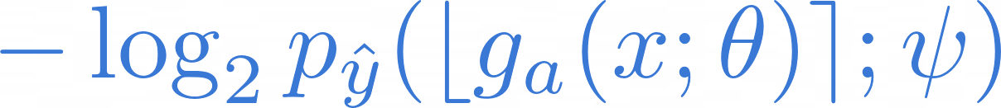
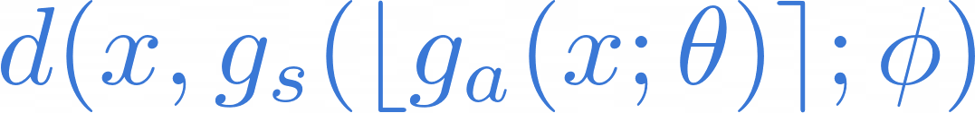
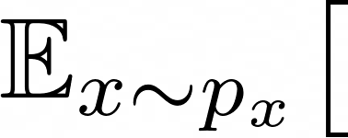
01101...00101
Q
rate
distortion
Ballé et al. IEEE STSP 2020
Notes:
All of (NTC-based) neural image compression deals with specifying the architecture of p_y, g_a, g_s, selecting d(), and figuring out how to minimize this loss function.
-\log_2 p_{\hat{y}}(\lfloor g_a(x) \rceil) + \lambda \cdot d(x, g_s(\lfloor g_a(x) \rceil)
\mathbb{E}_{x \sim p_x} \big[ -\log_2 p_{\hat{y}}(\lfloor g_a(x; \theta) \rceil; \psi) + \lambda \cdot d(x, g_s(\lfloor g_a(x; \theta) \rceil; \phi) \big]
http://latex2png.com

Slide 28
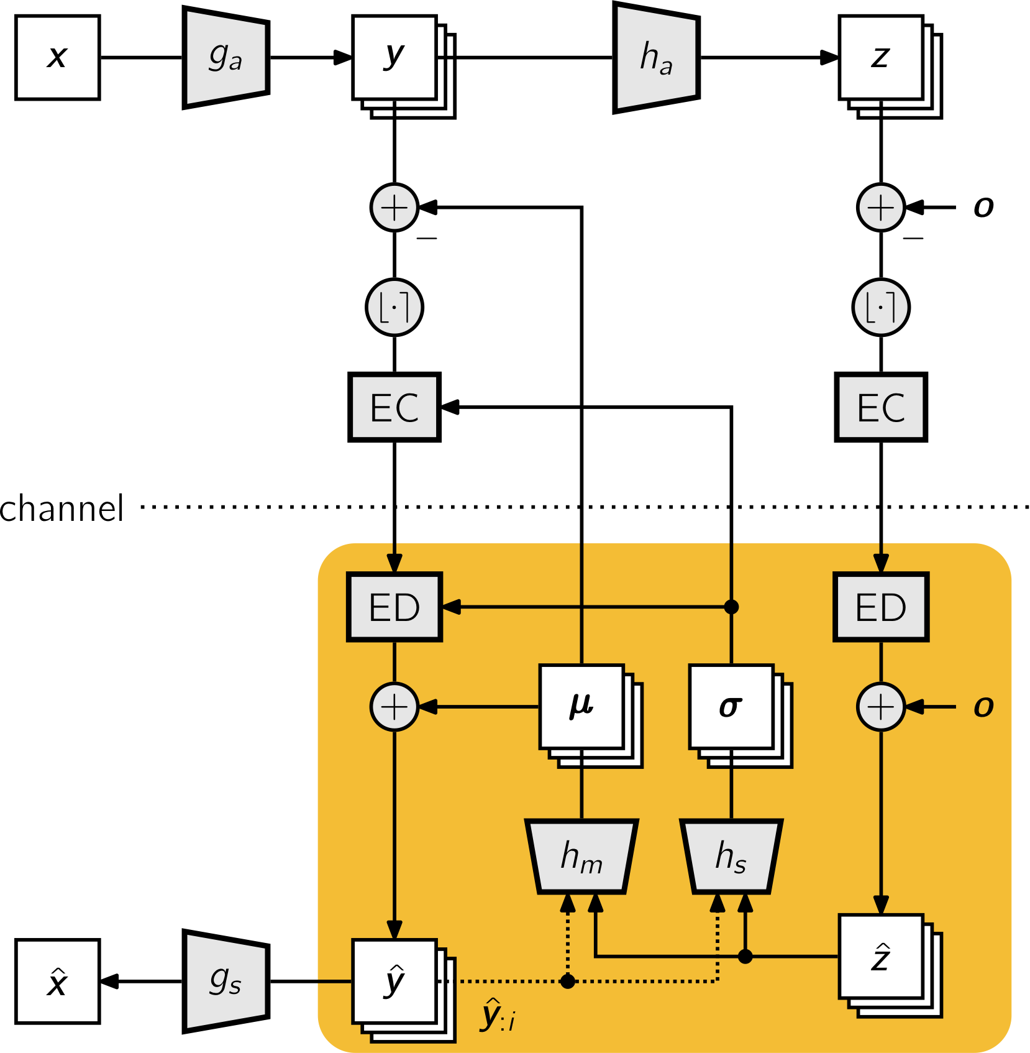
How do we model p_{ŷ}?
Many research papers on this topic:
factorized priors
fixed rate (uniform distribution)
hyperprior (shown here)
spatial autoregressive models
channel-wise autoregressive models
checkerboard decomposition
3D AR (spatial + channel-wise)
etc.
Ballé et al. IEEE STSP 2020

Slide 29
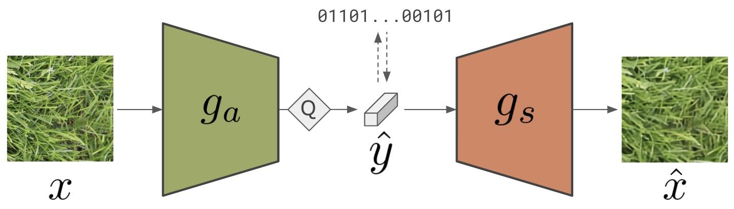
How do we model p_{ŷ}?
Many research papers on this topic:
factorized priors
fixed rate (uniform distribution)
hyperprior
spatial autoregressive models
channel-wise autoregressive models
checkerboard decomposition
3D AR (spatial + channel-wise)
etc.
same model
Ballé et al. IEEE STSP 2020

Slide 30
How do we model p_{ŷ}?
Many research papers on this topic:
factorized priors
fixed rate (uniform distribution)
hyperprior
spatial autoregressive models
channel-wise autoregressive models
checkerboard decomposition
3D AR (spatial + channel-wise)
etc.
Ballé et al. IEEE STSP 2020

Slide 31
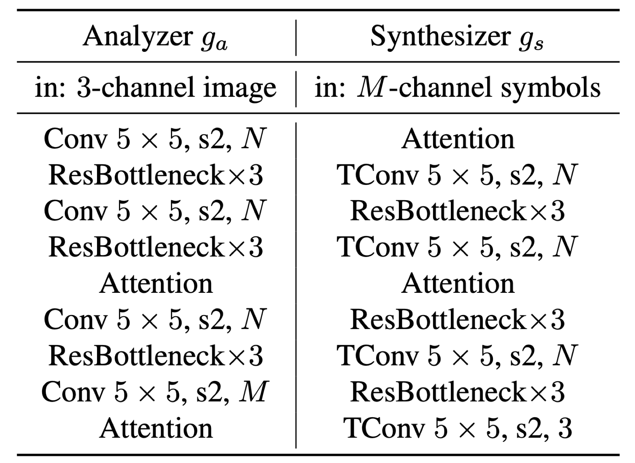
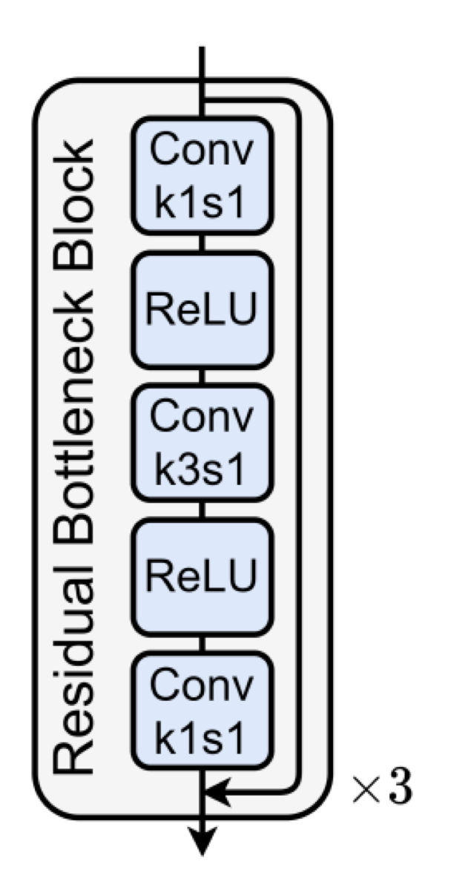
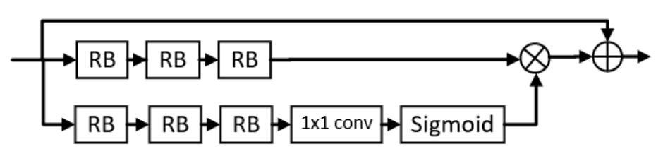
Architecture for the analysis & synthesis transforms
He et al. ELIC @ CVPR 2022
Notes:
The analysis/synthesis transforms used by ELIC.
Many architectures have been developed: conv-based, transformer-based, local attention, non-local attention, residual blocks, etc.

Slide 32
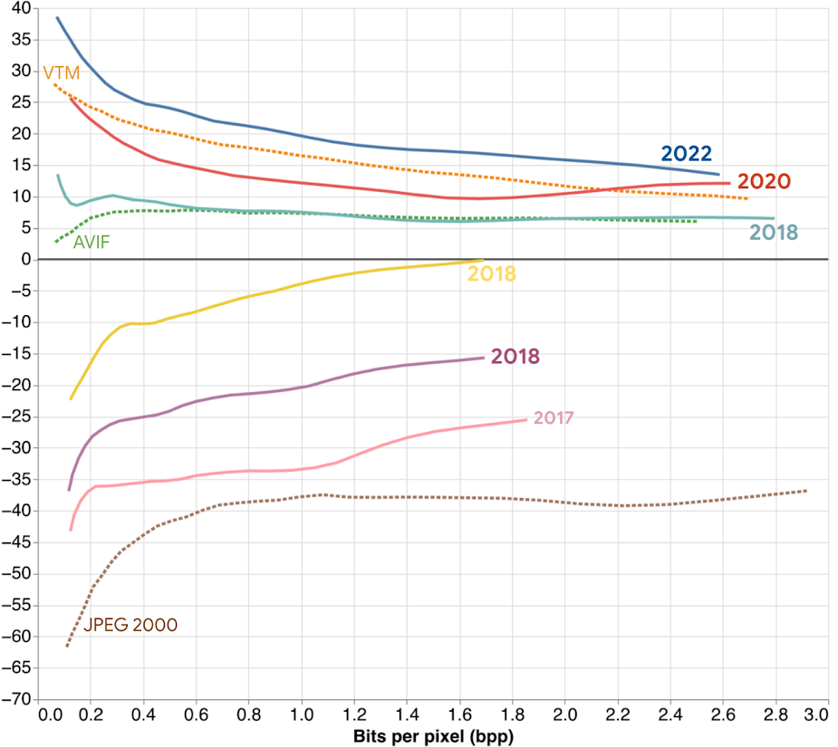
Progress in neural image compression
(Quality measured by PSNR)
He et al. @ CVPR
Minnen et al. @ ICIP
Minnen et al. @ NeurIPS
BPG (baseline)
Ballé et al. @ ICLR
Rate savings percent (higher is better)
Minnen et al. @ ICIP
Ballé et al. @ ICLR

Slide 33
Generative Compression
Realism vs. fidelity
01
Visual Examples
02
Learned Image Compression
03
Generative Compression
04
Concluding Remarks

Slide 34
Why can’t we directly optimize for a perceptual metric?

Slide 35
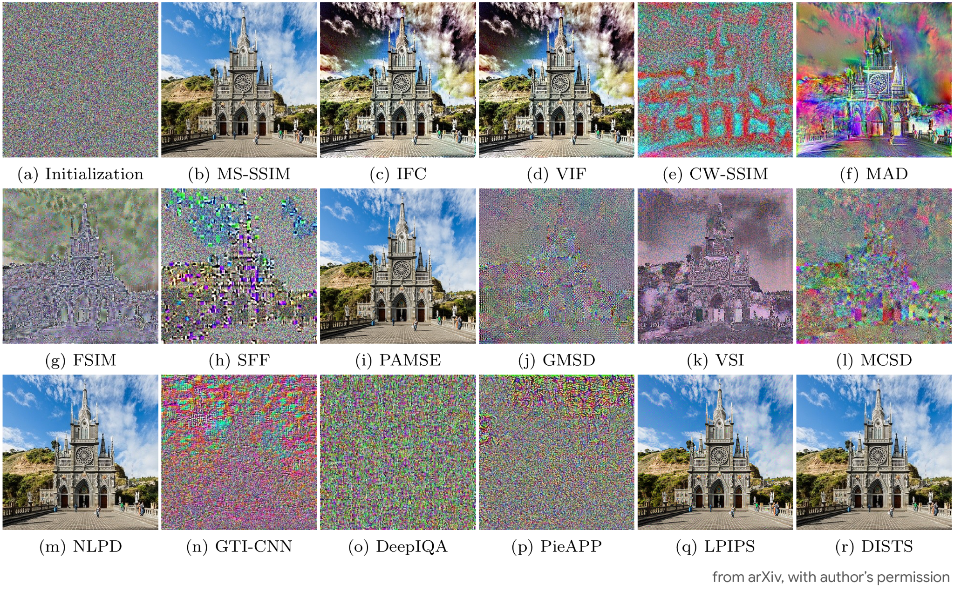
Ding et al. IJCV 2021. Comparison of full-reference image quality models for optimization of image processing systems
Notes:
Here we start with a random image (a) and then directly optimize the pixels according to each perceptual metric.
Most metrics don’t lead to recognizable or high-quality images. A few do, though they may introduce artifacts (e.g., LPIPS leads to a faint checkerboard pattern).
In general, even the metrics that look good here may not work for all images or account for unusual distortions that may arise with neural transforms (especially during training).

Slide 36
In practice we do use perceptual metrics (mainly LPIPS) along with a pixel-level distortion (typically MSE or MAE) and an adversarial loss.
We can optimize for a perceptual metric, but most won’t lead to a reconstruction with high visual quality.
The metric also needs to be differentiable and have sensible gradients even far from natural images (e.g., for random images generated by randomly initialized networks).
Ding et al. IJCV 2021. Comparison of full-reference image quality models for optimization of image processing systems

Slide 37
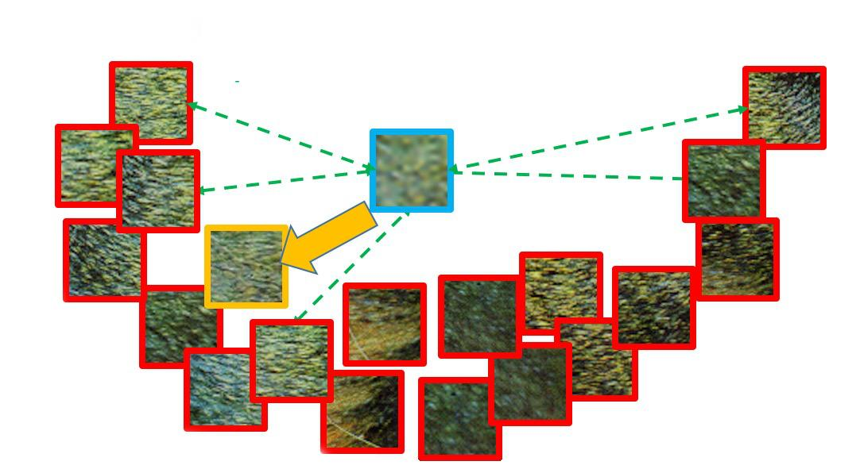
Seeking “realism” with generative methods
(aka the problem with MSE and other distortions)
Natural images
MSE solution
Generative solution
With MSE at low rates:
We get the mean!
Cannot afford to store more details
Might not be part of the data distribution
=> unrealistic image reconstruction
Image adapted from Ledig et al. (arxiv:1609.04802)

Slide 38
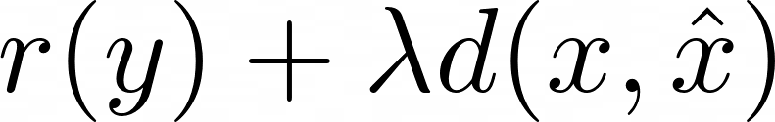
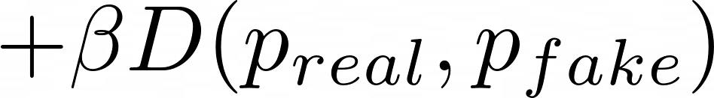
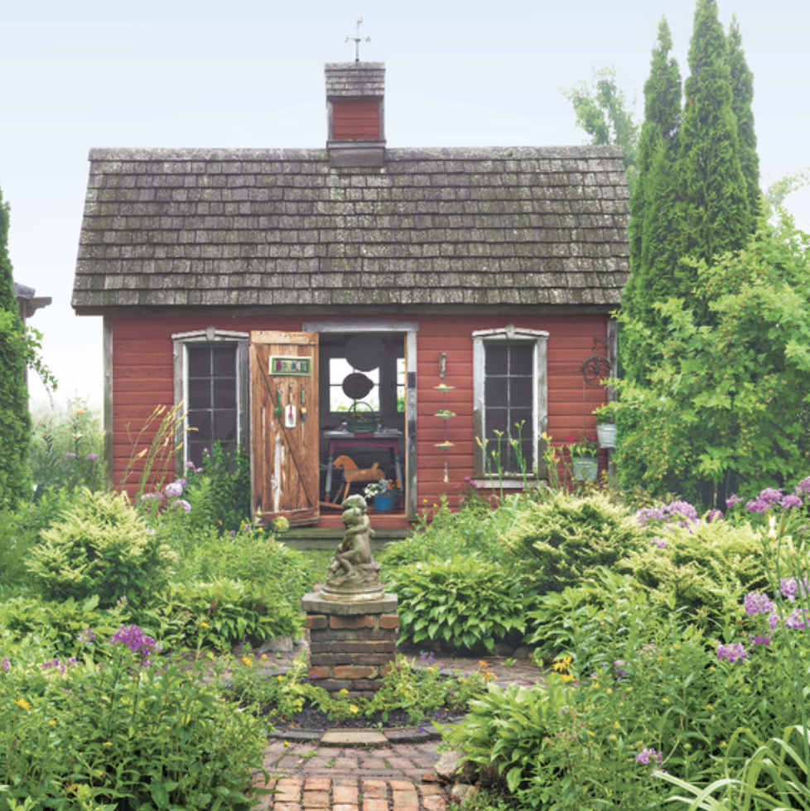
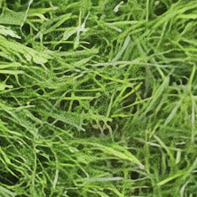




distortion
realism
Distortion: very good
Realism: very bad
Distortion: very bad
Realism: very good
Distortion: good
Realism: good
Notes:
r(y) + \lambda d(x, \hat{x}) + \beta D(p_{real}, p_{fake})

Slide 39
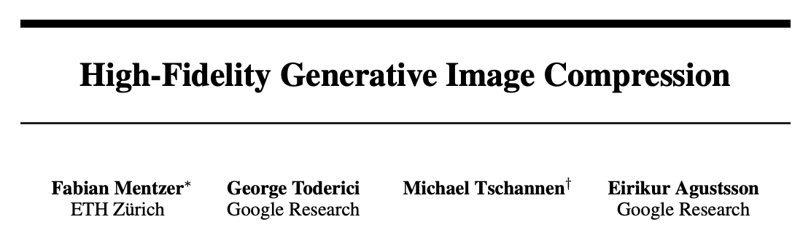

Demo: hific.github.io

Slide 40
Discriminator is conditioned on the quantized latent
Q
D
real?
fake?
rate
distortion
perceptual quality
Blau & Michaeli. Rethinking Lossy Compression: The Rate-Distortion-Perception Tradeoff (ICML 2019)

Slide 41
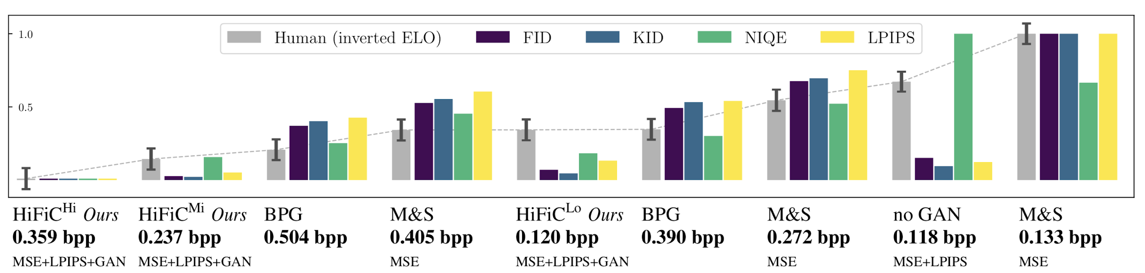
↓ Lower is better for all metrics
GAN results from Mentzer et al., 2020 (arxiv:2006.09965)
M&S from Minnen et al., 2018 (arxiv:1809.02736)

Slide 42
HiFiC at 0.237 bpp prefered to:
- BPG at 2.1⨉ the bitrate
- Mean & Scale hyperprior
(trained for MSE at 1.7⨉ the bitrate)
GAN results from Mentzer et al., 2020 (arxiv:2006.09965)
M&S from Minnen et al., 2018 (arxiv:1809.02736)

Slide 43
Adding GAN loss boosts subjective quality
GAN results from Mentzer et al., 2020 (arxiv:2006.09965)
M&S from Minnen et al., 2018 (arxiv:1809.02736)

Slide 44
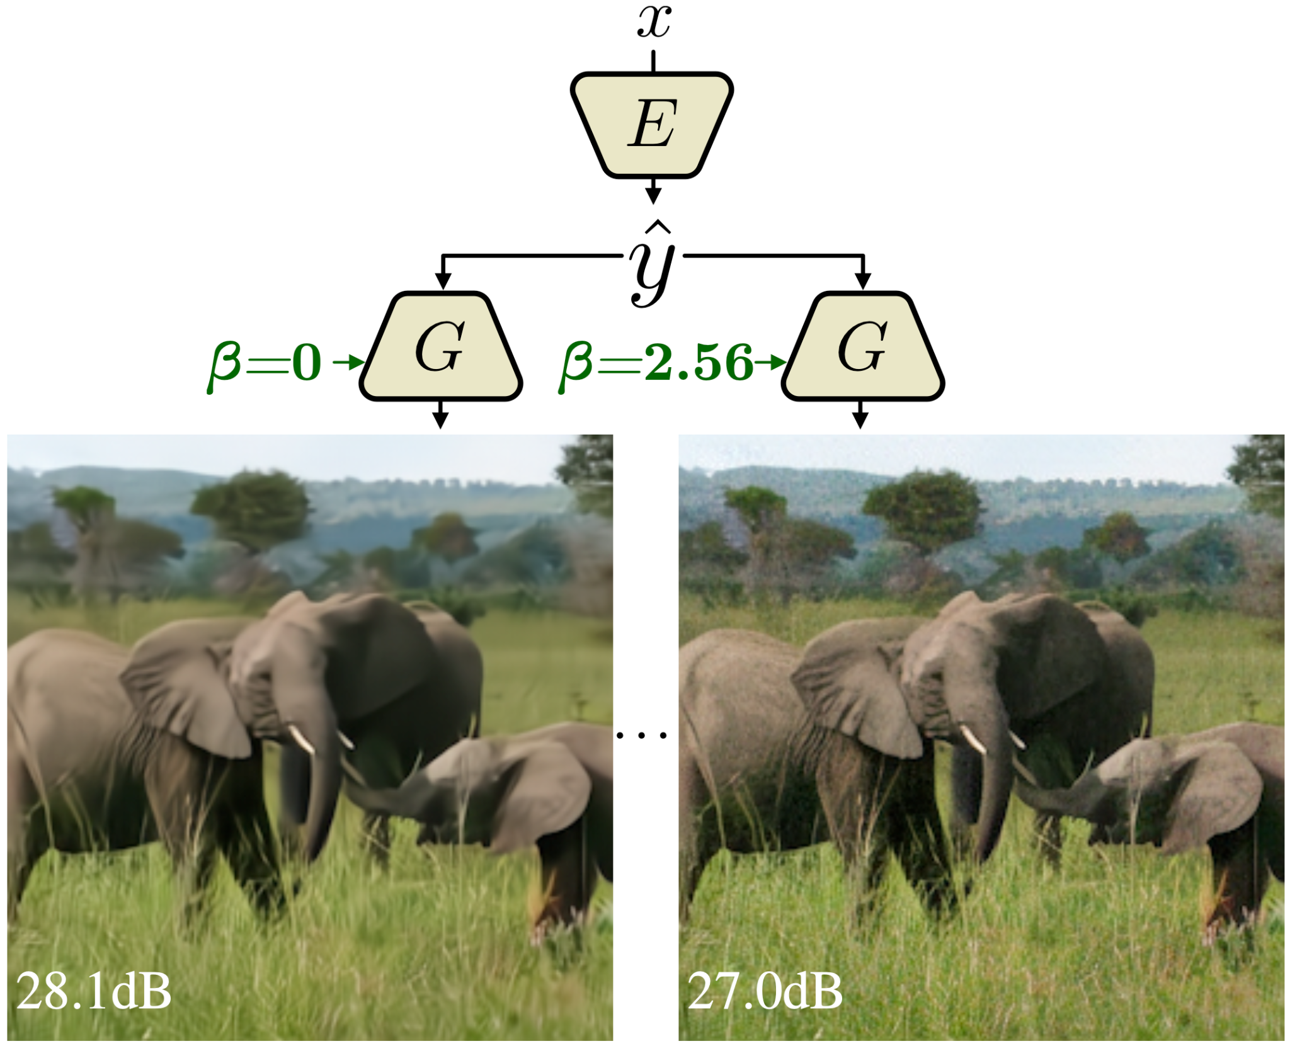

Decoder G is conditioned on realism parameter β
Better PSNR
Worse FID score
Worse PSNR
Better FID score
Agustsson et al. @ CVPR 2023 Multi-Realism Image Compression with a Conditional Generator
Notes:
Example of the visual impact of adversarial loss.
This model is a successor to HiFiC and allows “multi-realism” meaning a single representation can be transformed into a reconstruction with high fidelity (high PSNR, low realism) or high perceptual quality (lower PSNR but higher realism). This “knob” is tunable at decode time (not encode time).

Slide 45

arxiv.org/abs/2305.18231

Slide 46


A convolutional compression model optimized for MSE encodes the global structure of the image
The bitrate is fully determined by the convolutional compression model.
The diffusion process acts as a refinement step and adds no additional bits.
A diffusion process conditioned on the MSE-optimized reconstruction iteratively recovers details
HFD results from Hoogeboom 2023 (arxiv:2305.18231)

Slide 47


To avoid artifacts, diffusion is applied in stages. Iteratively, each of the four patch groups is partially denoised conditioned on the other groups.

Slide 48



Slide 49

To improve high-frequency detail and avoid over-denoising, HFD+ encodes a low-resolution error map (|x^{mse}-x|) and uses it as additional context during the diffusion stage.

Slide 50



Slide 51



Slide 53


Slide 59
Detail Synthesis & Propagation

Slide 60
Detail Synthesis & Propagation

Slide 61

Notes:
Finer Detail

Slide 62

Results: User Study

Slide 63

Metrics vs. User Study
Do metrics predict the user study?
No metric predicts all,
FID predicts neural
Our
SSF
RLVC
DVC
No-GAN
H264
H265

Slide 64
Concluding Remarks
Workshop on Challenge on Learned Image Compression (CLIC)
01
Visual Examples
02
Learned Image Compression
03
Generative Compression
04
Concluding Remarks

Slide 65

Neural codecs, and generative models in general, introduce new kinds of distortions which may change with each new architecture and approach.
Much of the neural compression field is now focused on generative methods that target high realism & perceptual quality at the expense of fidelity.
Most humans are highly sensitive to errors in faces and text. This creates a challenge for generative models and quality assessment methods that don’t detect and adapt to these classes.

Slide 66



Generative video is a growing research area, and quality assessment (metrics & protocols) need to improve. Temporal consistency is a major problem.
Machine learning may also be able to help on the assessment side, e.g., LPIPS, PIM, UVQ, FAVOR, but current methods are insufficient on their own both as metrics and training objectives.
Moving beyond compression, we may see high-quality pixel-level output that has mid-level semantic errors, e.g., current text-to-image methods are notoriously bad at cardinality and fingers.
Text-to-image results from: Chang et al. Muse: Text-To-Image Generation via Masked Generative Transformers (ICML 2023)

Slide 67
References
Ballé et al. 2017. End-to-end Optimized Image Compression
Ballé Presentation @ DCC 2023. Perception: the Next Milestone in Learned Image Compression
Ballé et al. 2018. Variational image compression with a scale hyperprior
Agustsson et al. 2022. Multi-Realism Image Compression with a Conditional Generator
HE et al. 2022. ELIC: Efficient Learned Image Compression with Unevenly Grouped Space-Channel Contextual Adaptive Coding
Mentzer et al. 2020. High-Fidelity Generative Image Compression
He et al. 2022. PO-ELIC: Perception-Oriented Efficient Learned Image Coding
Hoogeboom et al. 2023. High-Fidelity Image Compression with Score-based Generative Models
Rombach et al. 2022. High-Resolution Image Synthesis with Latent Diffusion Models
Ballé et al. IEEE STSP 2020. Nonlinear Transform Coding
Ding et al. IJCV 2021. Comparison of Image Quality Models for Optimization of Image Processing Systems
Ledig et al. 2016. Photo-Realistic Single Image Super-Resolution Using a Generative Adversarial Network
Blau & Michaeli. ICML 2019. Rethinking Lossy Compression: The Rate-Distortion-Perception Tradeoff
Minnen et al. NeurIPS 2018. Joint Autoregressive and Hierarchical Priors for Learned Image Compression
Agustsson et al. CVPR 2023. Multi-Realism Image Compression with a Conditional Generator
Bhardwaj et al. NeurIPS 2020. An Unsupervised Information-Theoretic Perceptual Quality Metric
Chang et al. ICML 2023. Muse: Text-To-Image Generation via Masked Generative Transformers

Slide 68
Questions?
David Minnen, Ph.D.
Staff Research Scientist @ Google
VQEG Spring 2023 Meeting

Slide 69
Bonus Slides

Slide 70

UVQ: Universal Video Quality Model
Following the quality-related categories summarized from the subjective VQA, we develop the UVQ model with four novel subnetworks. The first three subnetworks, which we call ContentNet, DistortionNet and CompressionNet, are used to extract quality features (i.e., content, distortion and compression), and the fourth subnetwork, called AggregationNet, maps the extracted features to generate a single quality score.
Wang et al. CVPR 2021. Rich Features for Perceptual Quality Assessment of UGC Videos
blog post | github

Slide 71


Slide 72
PIM: An Unsupervised Information-Theoretic Perceptual Quality Metric
Learn an image representation, imposing principles/constraints borrowed from computational neuroscience:
Slowness: relevant visual features tend to be persistent in time
(Földiák, 1991; Mitchison, 1991; Wiskott, 2003)
Efficient coding: brain “compresses” sensory information
(Attneave, 1954; Barlow, 1961)
Approximate translation and scale equivariance:
well-known properties of representations in human visual system

Slide 73

An implementation of slowness
Let representation Z (in some vector space) capture mutual information I(X;Y) between image X and temporally close image Y (e.g., two frames in a video)

Slide 74


Slide 75


Slide 76


Slide 77


