Slide 1
No Reference Metrics (NORM) Group Acitvity Summary
June 27, 2023
Margaret H Pinson
mpinson@ntia.gov

Slide 2
NR Metric Design Goal
Root cause analysis (RCA)
  Identify impact of specific visual impairments
  Most industry use cases require RCA
  Overall quality (MOS) less important
Broad scope
  Camera capture, encoding, decoding, transcoding, scaling, transmission, aesthetic,s artistic intent, image enhancement, monitor, and display device
Users can modify the scope
  Ignore specific impairments
Open collaboration toward public, royalty free NR metrics
Performance goals
  Robust accuracy
  Minimum of operational restriction
Use cases
  Video on Demand (VoD)
  Live broadcast services
  Social media
  First responder video
  Medical
  AI vision systems (autonomous vehicles)
Access to the bitstream is beneficial, but not required.

Slide 3
NRMetricFramework GitHub Repository
Tools
  Run NR metric on datasets of images, videos
  Analyze NR metric performance
NR metric code
  ITS metric Sawatch version 3, with RCA
  32 metrics from other organizations
List of datasets suitable for NR metric development/evaluation
Performance analyses
MATLAB
https://github.com/NTIA/NRMetricFramework
New datasets
  COCRID, optical character recognition
  CalAster, object recognition
  VCRDCI, VSF ratings in lieu of MOS
New NR metric code
  Motion_search from https://github.com/facebookresearch/motion-search

Slide 4
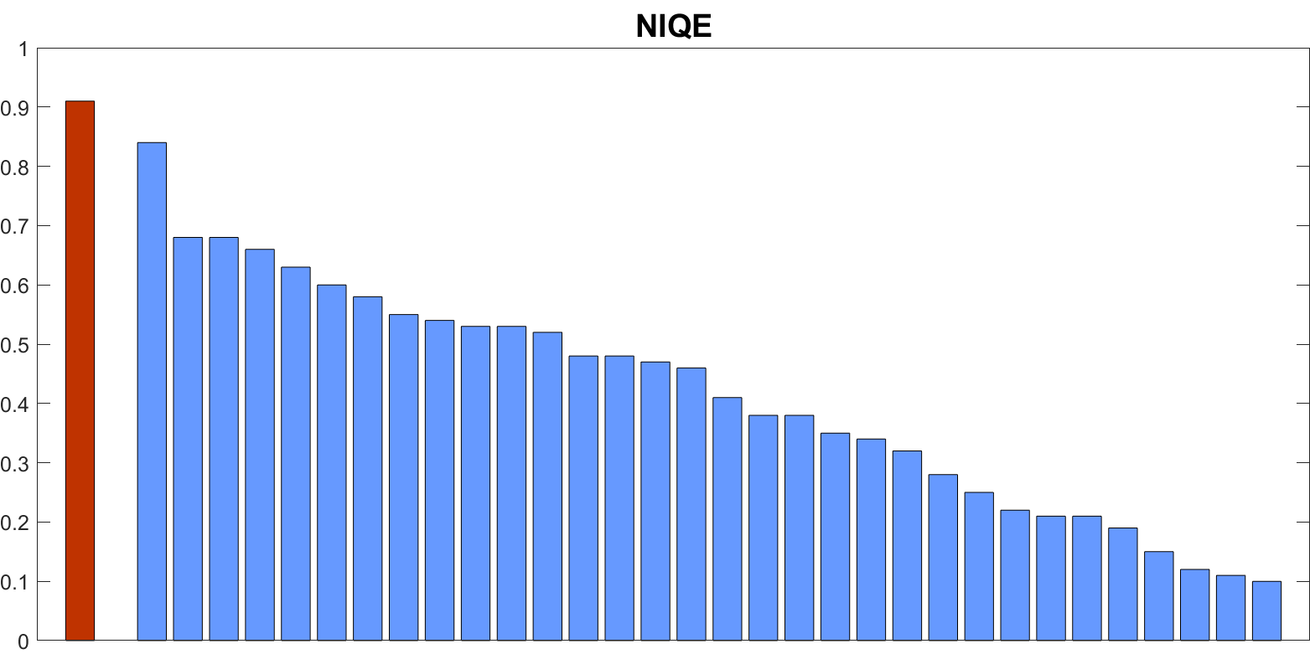
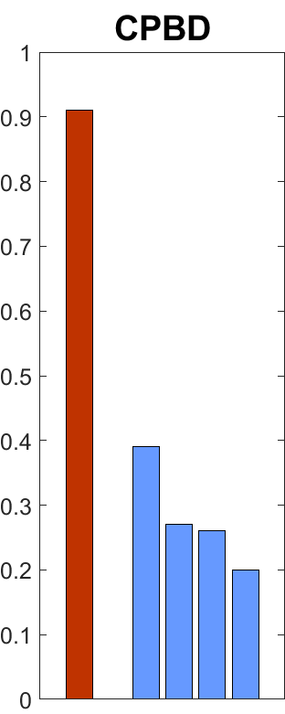
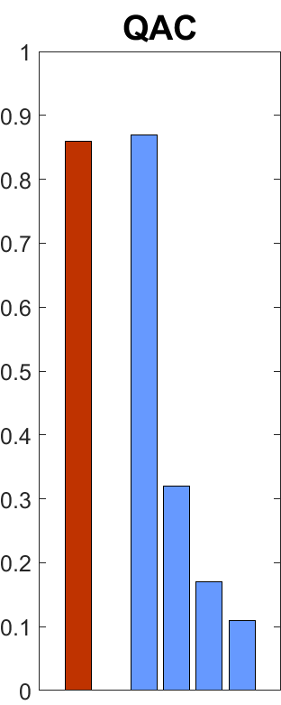
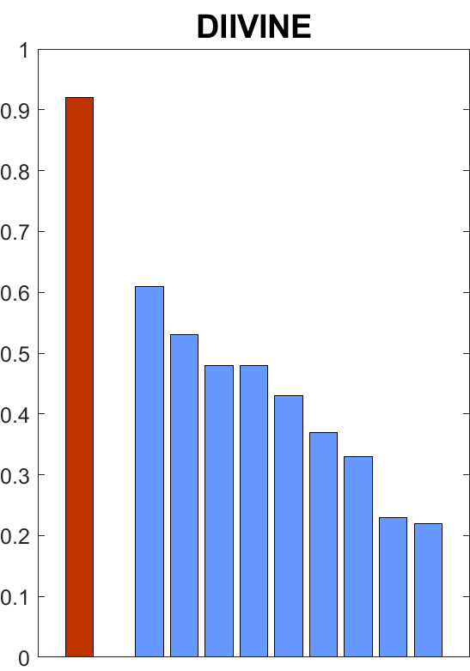
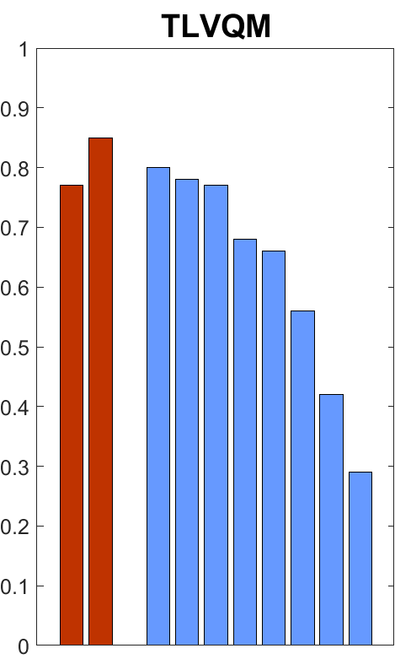
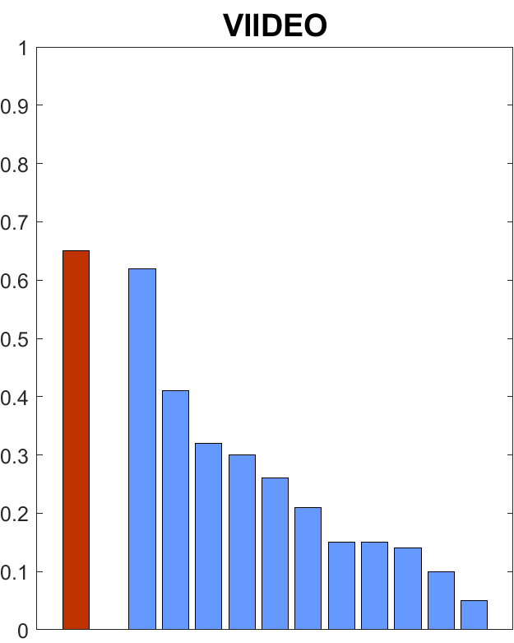
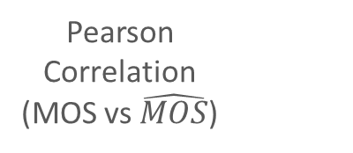
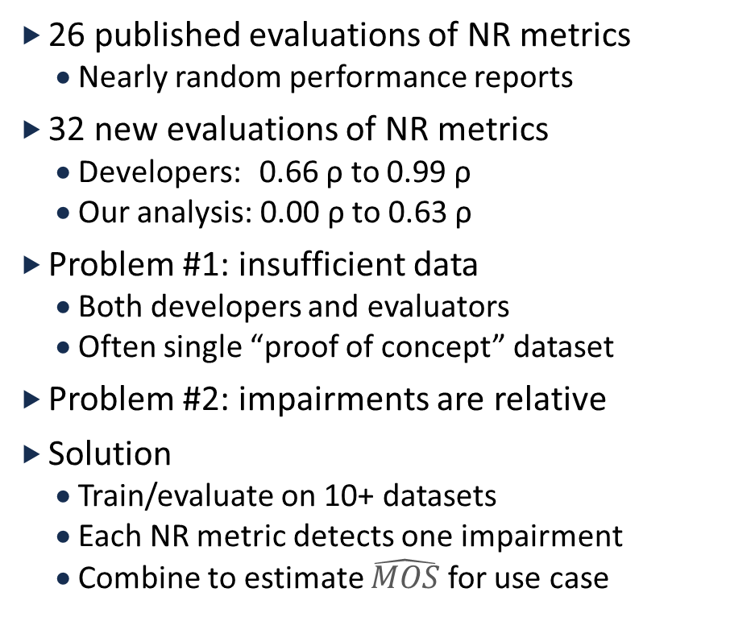
Why NR Metrics Lack Accuracy and Reproducibility
26 published evaluations of NR metrics
  Nearly random performance reports
32 new evaluations of NR metrics
  Developers: 0.66 ρ to 0.99 ρ
  Our analysis: 0.00 ρ to 0.63 ρ
Problem #1: insufficient data
  Both developers and evaluators
  Often single “proof of concept” dataset
Problem #2: impairments are relative
Solution
  Train/evaluate on 10+ datasets
  Each NR metric detects one impairment
  Combine to estimate $\hat{MOS}$ for use case
Published Performance Analyses
Pearson
Correlation
(MOS vs $\hat{MOS}$)
Developer
Evaluations

Slide 5
Video Quality Metadata Standard
FR metrics available in most modern transcoding pipelines
Including FR metrics as metadata in compressed bitstreams
Establish a standard format using T.35
MPEG turned down our Liaison statement on protocol/bureaucratic reasons
AOM has accepted, but we haven’t received the final, counter-signed agreement

Slide 6
Clarifying SI and TI in ITU-T Rec. P.910
Spatial information (SI)
Temporal information (TI)
Resolve ambiguities
  Technology changes
  Implementation differences
ITU-T Rec. P.910 updated
https://github.com/VQEG/siti-tools
Video with limited (16-235) vs. full range (0-255)
Specify applicable range of input bit depths (bits per channel)
  How to handle content with different bit depths
  Comparing sequences of varying bit depth
High dynamic range (HDR) content
  Luminance information might be encoded differently compared to standard dynamic range (SDR)
One less TI value than SI value?

Slide 7
Improved Video Complexity Metric
Very light weight algorithm
Estimate a curve that relates coding complexity to bit-rate
Choose optimal resolution and bitrate
  Given an original video predict bit-rate Y (MBit/s) where VMAF = 80
  Assume the original and processed video have the same resolution
  We are at bitrate X and we want to reduce the bitrate to X/2. How much will the quality drop?
A few open-source alternatives to consider:
  VCA (Hadi et al.)
  Motion search (Ioannis & Cosmin)
Understand the impact of increasing or decreasing bandwidth allocations
  Managed network, access to compressed videos
  How much would the quality change?
Vision: training libraries to enable research
  Videos without no scene cuts,
  FR metric ratings (e.g., VMAF)
  Training features (e.g., from Motion search repository)
  Variety of resolutions and bitrates of interest to modern paid video services (VMAF 60 to 95)
  Access to the source content is optional

