Slide 1

Exploring the Relationship Between VQA Metric Accuracy
and Bitrate Saving
Hojat Yeganeh, Ph.D, SMIEEE - Principal Video Architect and Research Lead
June 2023
® IMAX Corp.

Slide 2
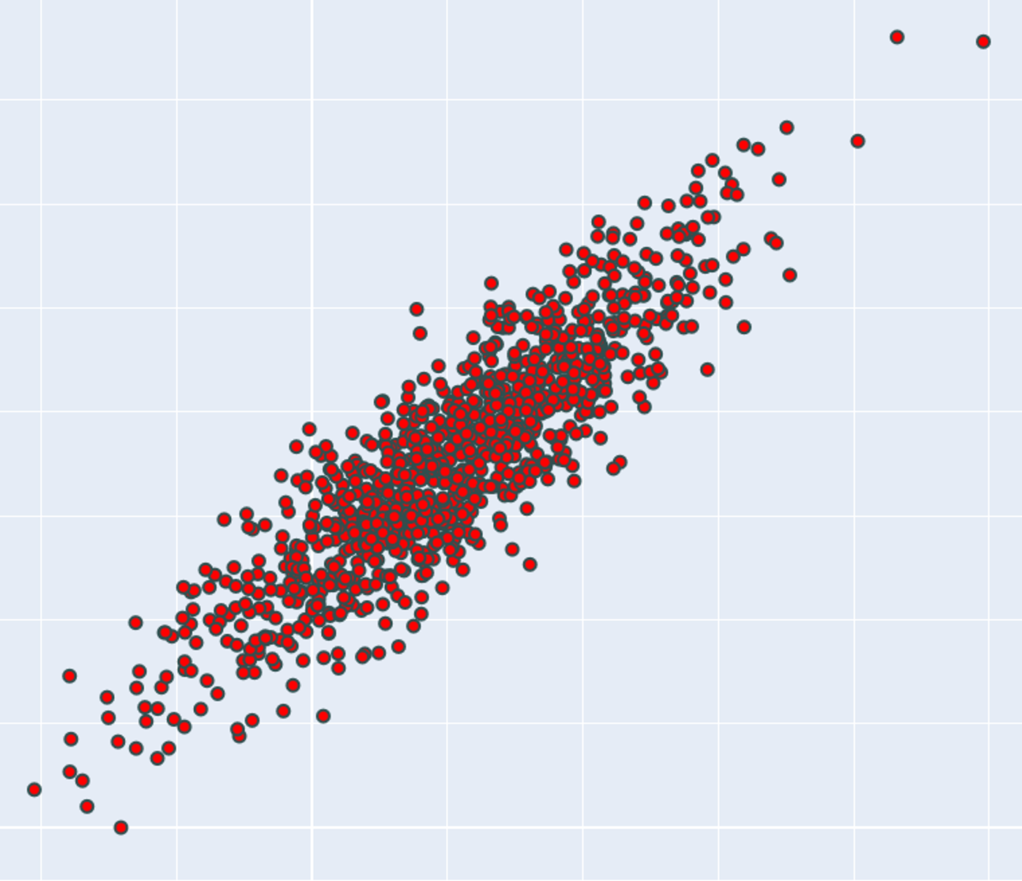

Established success criteria for designing or selecting an objective VQA metric
When designing an objective IQA/VQA metric, the goal is to have maximum possible agreement between the metric and the subjective data (MOS) using the following criteria:
Linear correlation (PLCC)
Rank order correlation (SRCC, KRCC)
Mean Absolute Error (MAE)
Root Mean Square Error (RMSE)
Objective VQA Model
MOS

Slide 3

Questions
What is the purpose of selecting an objective VQA metric?
Is a high correlation with subjective results a necessary or sufficient condition for a given use case?
Specifically, for the encoding optimization use case, is having a high correlation with subjective results a necessary or sufficient condition?

Slide 4

Big decision
In the video industry, it is a common practice to optimize bandwidth usage by decreasing the quality of videos, resulting in lower bit consumption. There’s always a cost to compression.
Achieving this goal is facilitated by employing any objective video quality metrics. VQA metrics are used as a threshold when reducing bitrate.
This scenario remains applicable regardless of whether the optimization is performed per-segment, per-shot, per-scene, or per-asset.
The crucial question lies in determining the acceptable extent of quality reduction and how an objective VQA model can predict such level of quality degradation.

Slide 5
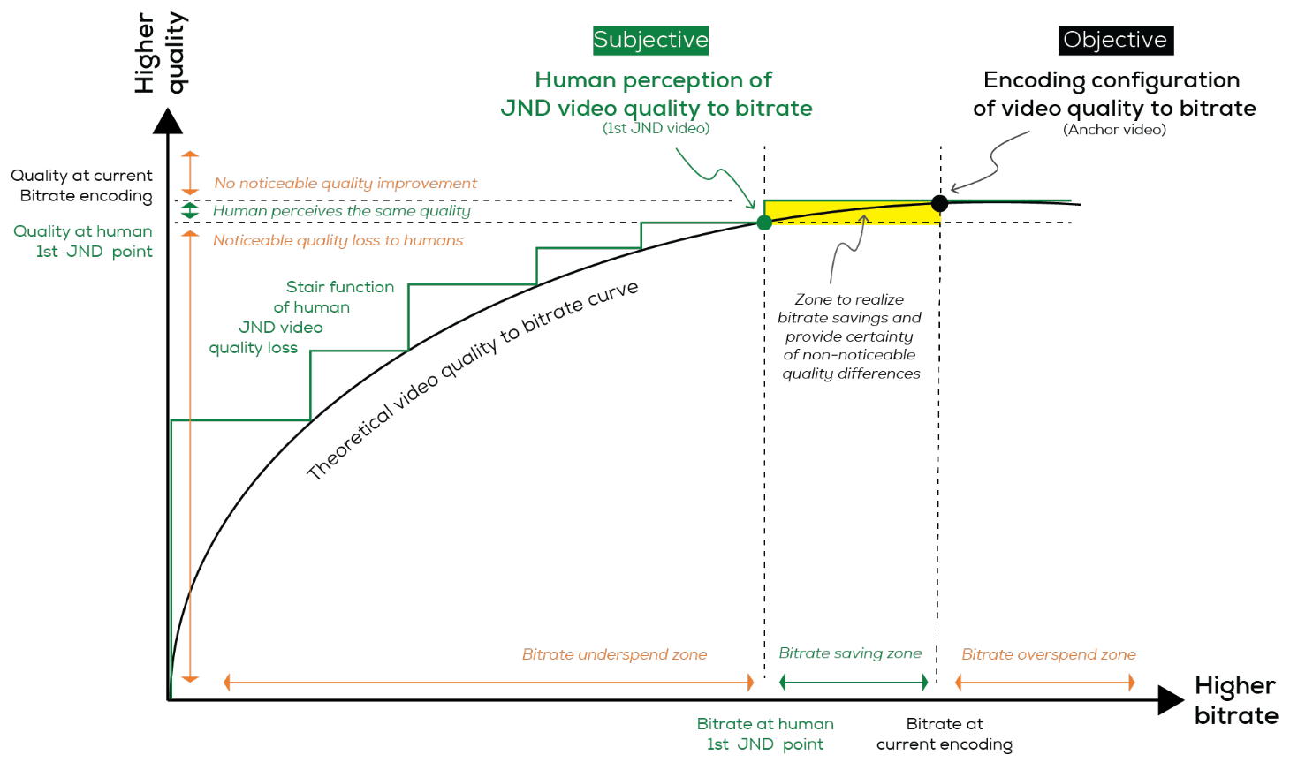

Slide 6
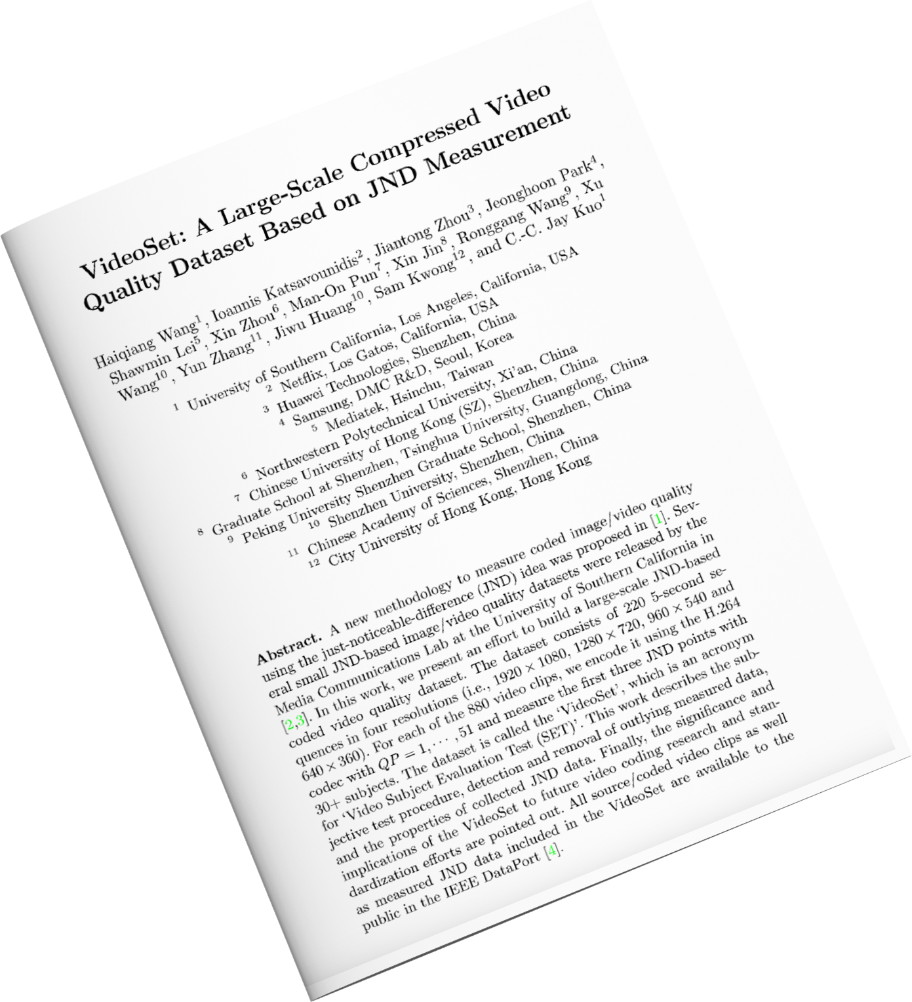

Identifying JND for a wide range of videos
VideoSet: A Large-Scale Compressed Video Quality DataSet Based on JND Measurement

Slide 7
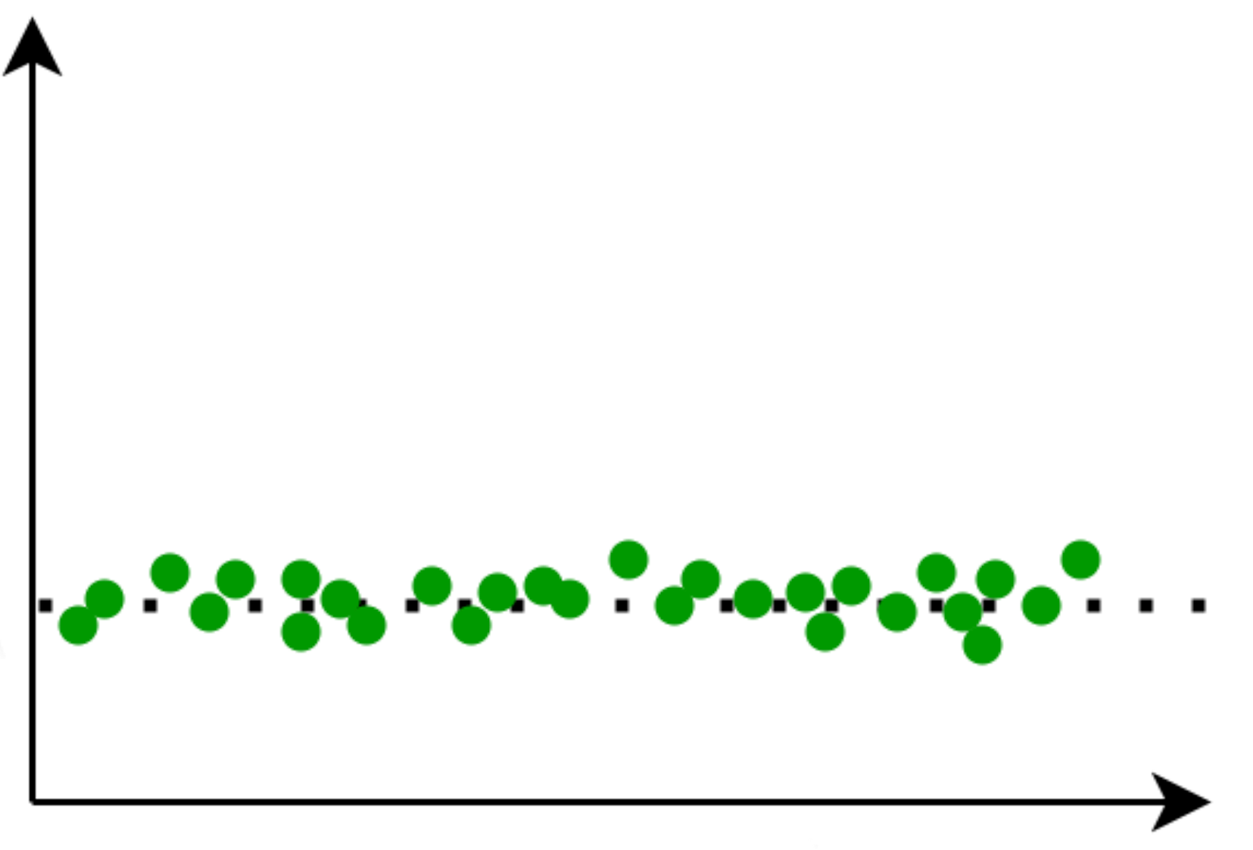
The expected response of a hypothetical perfect VQA metric to a JND dataset
Delta THE VQA metric =
metric (ref, anchor) - metric (ref, JND videos)
JND videos are the videos that exhibit
Just Noticeable Difference compared
to the anchor videos
Delta THE VQA Metric
Video Content

Slide 8
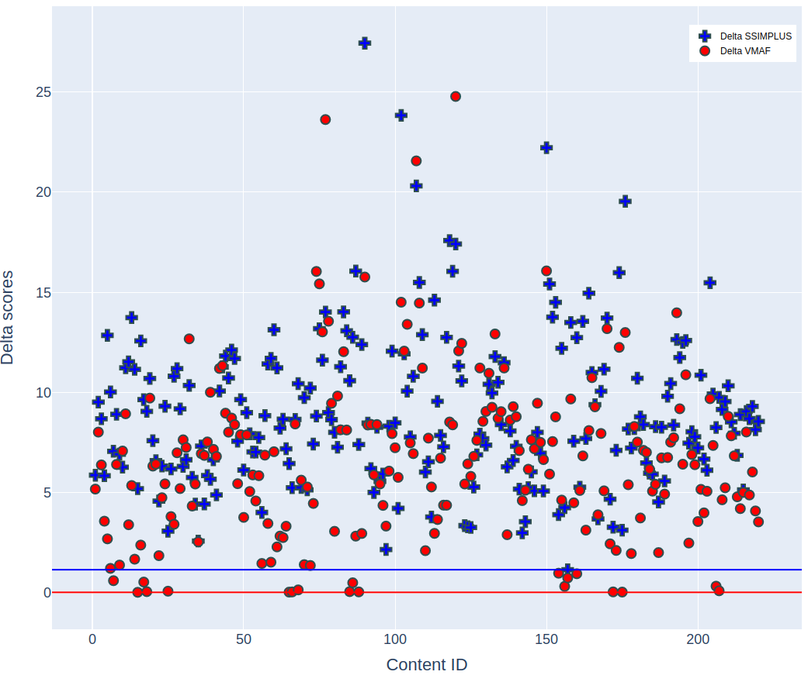
This figure illustrates the difference in SSIMPLUS (IMAX SSIMPLUS Viewer Score) and VMAF (developed by Netflix) scores between the anchors and the videos identified as the 1st Just Noticeable Difference (JND) in the VideoSet dataset.
Minimum Delta SSIMPLUS = 1.16
Minimum Delta VMAF = 0.03

Slide 9
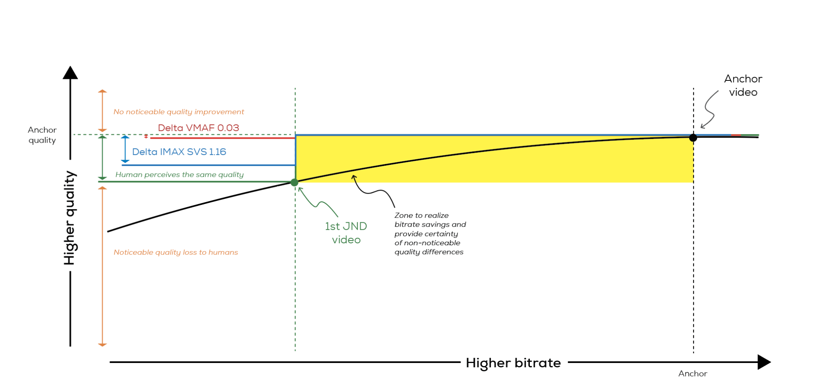

Slide 10
Significance of the minimum delta VQA with JND dataset
The minimum delta VQA helps making a crucial decision when performing an encoding optimization
Essentially, the minimum delta VQA metric using a JND dataset determines the level of quality degradation that can be tolerated without perceptible loss across a diverse range of video content
Identifying this threshold is very important if the user cares about the quality of their content

Slide 11
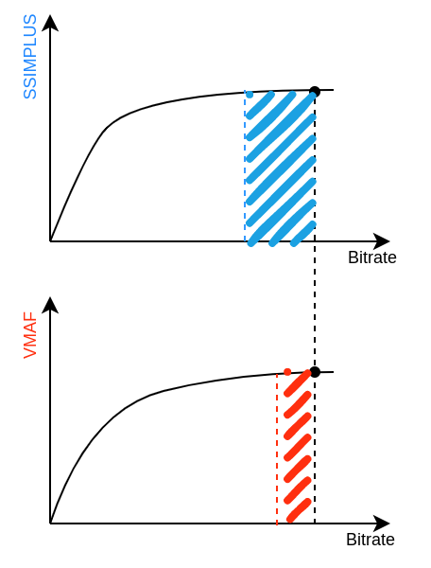
Metrics and savings
Anchor (current encoding configuration)
Assumptions:
Both VMAF and SSIMPLUS satisfy necessary conditions, i.e.
a) Have high correlations with MOS
b) Have low MAE
c) Linear enough
Meaning: They give us more or less the same Q-D curves
Using JND data, there is lower room for quality reduction based on VMAF compared to SSIMPLUS

Slide 12
Metrics and savings
Anchor (current encoding configuration)
By specifically examining the first Just Noticeable Difference (JND) and gathering the corresponding bitrate values for those videos from the VideoSet dataset, it is possible to estimate the potential bandwidth savings using the two metrics with different anchor bitrate values.
Anchor bitrate (1080p) | Delta IMAX SVS 1.16 | Delta VMAF 0.03
~8.5Mbps | Save 28.94% | Save 2.92%
~7.0Mbps | Save 25.80% | Save 1.91%
~6.5Mbps | Save 24.09% | Save 1.62%

Slide 13
Conclusion
PLCC, SRCC, KRCC, MAE, RMSE, etc. serve as necessary conditions in selecting an objective VQA metric for encoding optimization use cases but are not sufficient on their own
For making better encoding decisions, exploring the performance of an objective VQA model against a subjectively collected JND dataset is of utmost importance
Understanding the minimum acceptable reduction in the objective VQA metric, which corresponds to just noticeable difference (JND) quality, becomes imperative when preserving the level of perceptual quality is a priority
A higher value for the minimum acceptable reduction based on an objective VQA metric can potentially result in greater bitrate savings, as it provides more flexibility to optimize encoding parameters and achieve significant reductions in bitrate

Slide 14
Thank you
Hojat Yeganeh
hojat.yeganeh@ssimwave.com

