Slide 1


Acceptability and Annoyance of Video Quality in Context
Ali Ak, Anne Flore Perrin, Patrick Le Callet
Nantes University
Denise Noyes, Ioannis Katsavounidis
META
VQEG
July 2023

Slide 2
Acceptability/Annoyance
Perceived quality does not necessarily need to directly express the Acceptability/Annoyance of the video
Acceptability/Annoyance is a measure of user satisfaction for video streaming services.
Acceptability/Annoyance takes user expectations and user profile into account

Slide 3
Acceptability/Annoyance with a Context
A context can be provided through instructions before/during the experiment to simulate a user profile and to set user expectations [1]
[1]: compares the impact of Basic or Premium subscription to a video streaming service on the acceptability-annoyance of the video content
[1] AccAnn: A New Subjective Assessment Methodology for Measuring Acceptability and Annoyance of Quality of Experience, Jing Li , Lukáš Krasula , Yoann Baveye, Zhi Li, and Patrick Le Callet

Slide 4
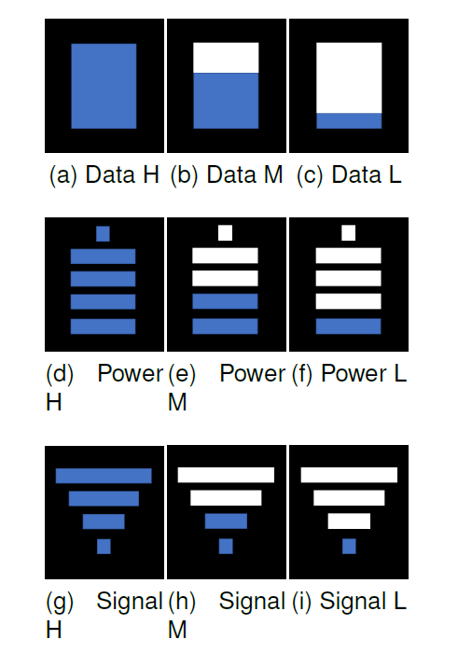
Acceptability/Annoyance with a Context
High
Medium
Low
We explored several contexts:
  Remaining Data Plan
  Remaining Battery
  Signal strength
Contexts were presented to participants with Instructions or Logos during the experiment.
Remaining
Data Plan
Remaining
Battery
Signal
Strength

Slide 5
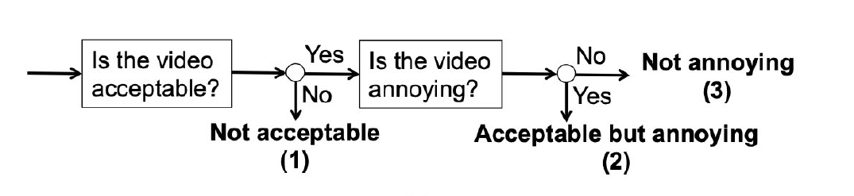
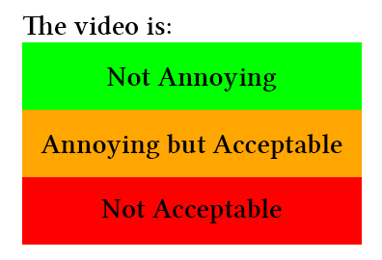
Acceptability/Annoyance: Multi-Step vs Single-Step
Multi Step
Single Step

Slide 6
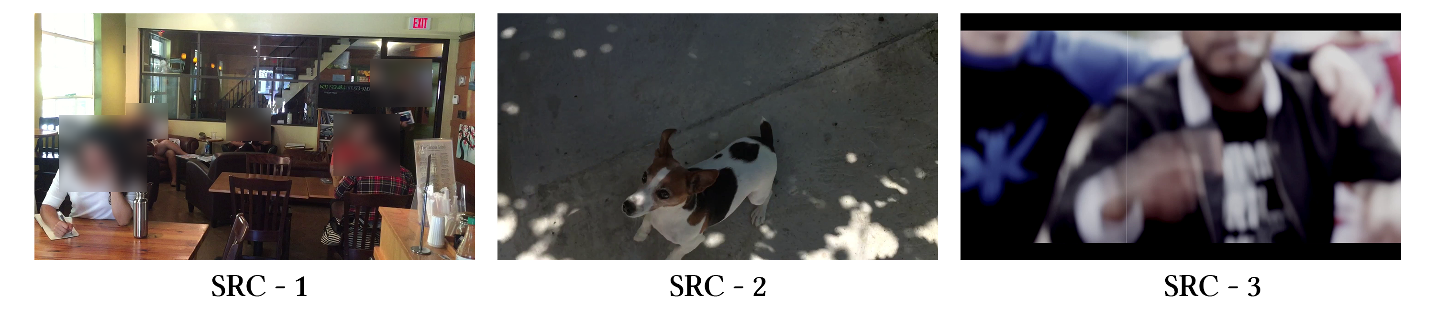
Subjective experiment details
An Absolute Category Rating (ACR) experiment was conducted to collect Mean Opinion Scores (ACR-MOS).
AccAnn experiments with different contexts and three context levels per context were conducted to collect Acceptability and Annoyance Opinion Scores (AccAnn-MOS).
3 SRCs (as shown above) with 1080p resolution and 5 seconds duration.
Each encoded at 6 different bitrates with VP9.

Slide 7
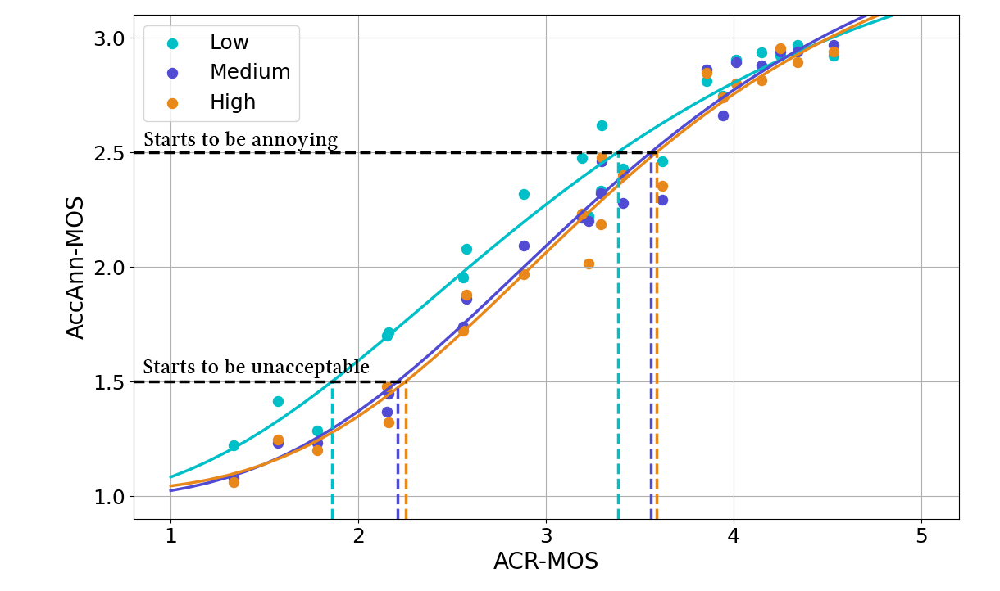
Remaining Data Plan: Mapping AccAnn-MOS to ACR-MOS

Slide 8
Elimination by Aspects (EBA) Analysis
According to the EBA model, in a perceptual quality test, a subject considers one stimulus better than another is because of a certain attribute this stimulus has that the other one does not have.
In other words, the measured QoE of a stimulus can be expressed as the sum of different attributes. e.g. context, context level, display device, etc.
EBA model is a generalized version of Bradley-Terry model.

Slide 9
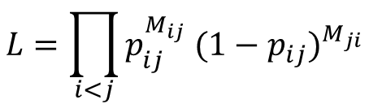

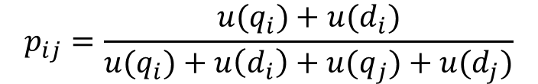

Elimination by Aspects (EBA) Analysis
More formally, let $V_{i}$ be the measured QoE of the stimulus $i$.
In a standard scenario, $V_{i}$ can be expressed as follows:
$$V_{i}={log⁡(u(q}_{i}))$$
Let $d_{i}$ be the attribute we are aiming to measure and $q_{i}$ is the quality of the stimulus $i$ independent of $d_{i}$.
$$V_{i}={log⁡(u(q}_{i})+u(d_{i}))$$
With EBA model, we follow this expression in terms of the probability that the observers prefer stimulus $i$ over $j$. And the following likelihood function is used to estimate the individual components, i.e. attribute ($d_{i}$) and attribute independent quality ($q_{i}$).
$$p_{ij}=\frac{{u(q}_{i})+u(d_{i})}{{u(q}_{i})+u\left(d_{i}\right)+{u(q}_{j})+u(d_{j})}$$
$$L=\prod_{i<j}^{ }{p_{ij}^{M_{ij}} {(1−p_{ij})}^{M_{ji}}}$$
Then, the influence of $u(d_{i})$ (represented as $Q_{i}$) can be estimated as follows:
$$Q_{i}={log⁡(u(q}_{i})+u(d_{i})) −{log⁡(u(q}_{i}))$$

Slide 10
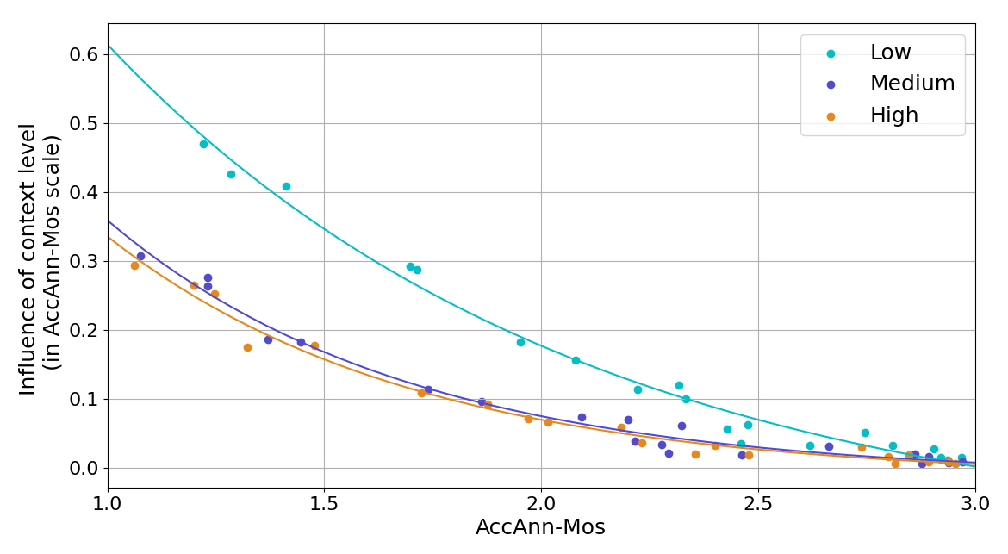
Elimination by Aspects (EBA) Analysis

Slide 11
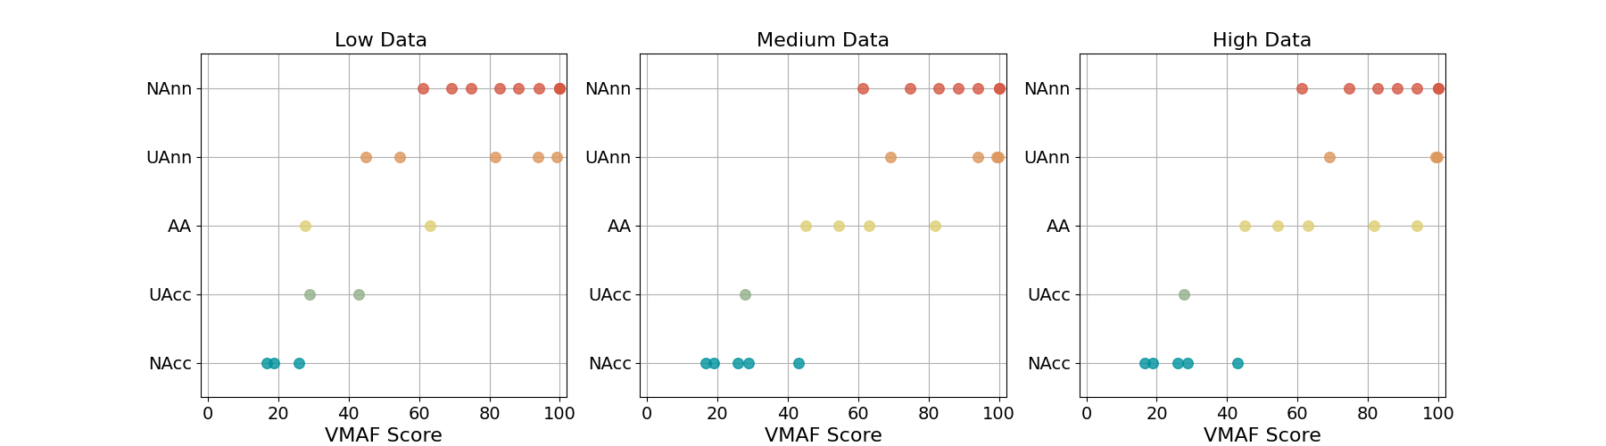
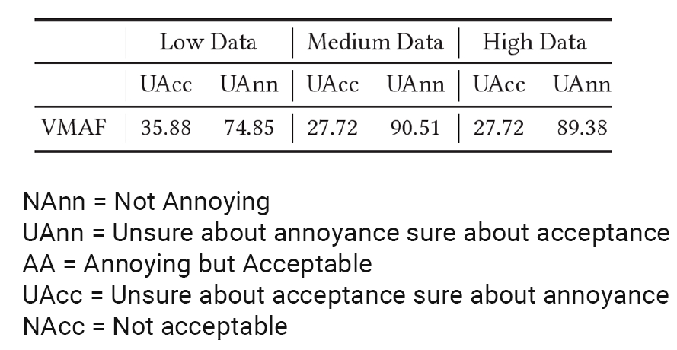
Metric Thresholds for Acceptability and Annoyance

Slide 12
Conclusion
User expectations can be altered and certain contexts can be triggered before/during a subjective study
User expectations has a major impact on user satisfaction
Impact of context on acceptability/annoyance of video content can be quantified through controlled experiments and advanced statistical analysis.
Thresholds of acceptability/annoyance for objective quality metric predictions can be derived for different contexts.

