Slide 1

Proposing More Ecologically-Valid Experiment Protocol Using YouTube Platform
Gabriela Wielgus, Lucjan Janowski, Mikołaj Leszczuk, Kamil Koniuch, Rafał Figlus
AGH University of Science and Technology, Poland
Notes:
Presentation outline:
Validity
Experiment setup
Results
Conclusions

Slide 2
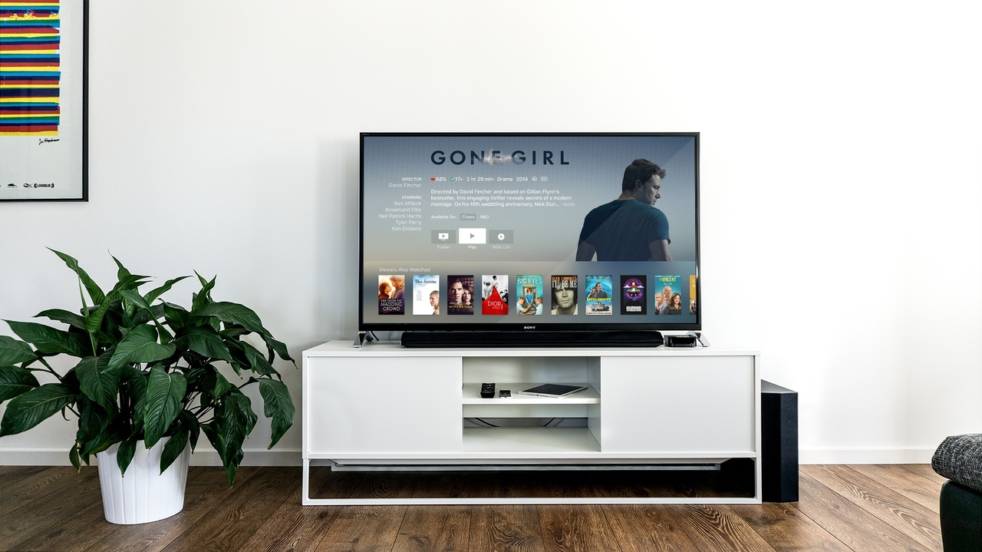

Different Measurement Points
Quality of Pixels
HVS Human Visual System
Quality of Experience
User Experience
Notes:
Measurement can be done in many ways. The differences between the methods shown on the slide are:
HVS stands for the human visual system, and refers to the way in which the human eye and brain process visual information. Research on the HVS can be used to inform the design of visual displays and images, as well as to evaluate the quality of visual content.
Quality of pixels refers to the clarity, sharpness, and accuracy of the individual pixels that make up a display or image. Factors that can affect the quality of pixels include the resolution of the display, the quality of the optics used to capture an image, and the processing applied to an image.
Quality of experience (QoE) is a measure of how well a user perceives a product or service to perform. It takes into account factors such as the speed and stability of a service, as well as how easy it is to use and how well it meets the user's needs. It goes beyond just technical measurements, it includes user satisfaction and perceived value.
User experience (UX) refers to the overall experience of a user as they interact with a product or service. It encompasses all aspects of the end-user's interaction with a company, its services, and its products, which includes the design, usability, and overall satisfaction.

Slide 3


External and Internal
Validity
Notes:
Internal validity refers to the degree to which a study accurately measures what it is intended to measure. In other words, it is the extent to which the study can establish causality between the independent and dependent variable. A study with high internal validity has a strong design that controls extraneous variables and eliminates alternative explanations. In research, we test for internal validity by studying specific, small groups, as illustrated by the photograph of children in a classroom.
External validity refers to the degree to which the results of a study can be generalized to other populations, settings, times, or measures. It is the extent to which the results of the study can be extrapolated to other populations, contexts or settings. A study with high external validity has a sample that is representative of the population of interest and a design that allows the results to be generalized. As shown by the second photograph illustrating a crowd.
The main difference between internal and external validity is that internal validity concerns the ability to draw causal inferences within a study, while external validity concerns the ability to generalize study findings to other populations, settings, times, or measures.

Slide 4
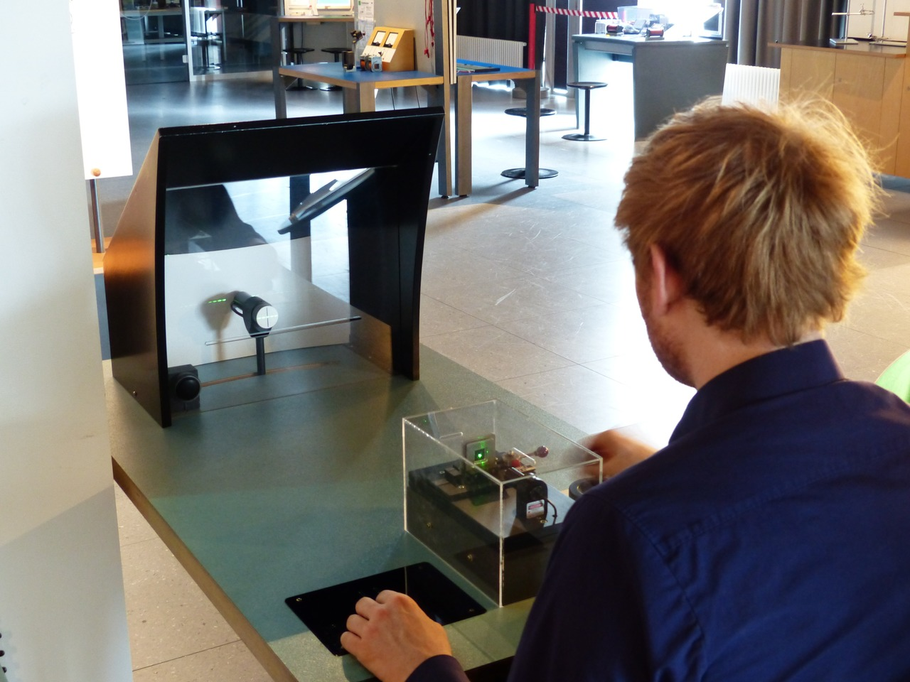

Ecologicall Validity
Internal Validity
External Validity
Ecological Validity
Lab study,
high internal validity
Real life situation,
difficult to get score
Lab or similar settings,
We try to mimic real life situation
Notes:
Typical experiments focus on showing pre-imposed content, where one video sequence often lasts 10 seconds imposing restrictions on the tester related to video playback. A typical experiment assumes that the tester is watching the video without any interaction such as seeking or pausing. To meet the expectations, we have developed an experimental protocol that allows keeping the objective metrics measured so far, such as resolution, bandwidth, and network status, additionally giving the freedom of choosing content and over the player.
To generalize the results obtained from studies of internal validity to external validity, it is helpful to use ecological validity. It is a type of external validity which is the extent to which the findings of a study can be generalized to natural settings or real-life contexts. This way researcher can consider how the results would translate to a more realistic and general population rather than just a specific small group.
This type of external validity is important because it allows researchers to consider how their findings would translate to a more realistic and general population. A study with high ecological validity will use real-world scenarios and settings as opposed to laboratory settings, simulating the environment and population in which the researcher will generalize the results. This can help to ensure that the results of a study are generalizable to the population of interest, which makes them more applicable to real-life settings.

Slide 5

Experiment Design
ITU-R BT.500-14:
Peak luminance
Screen illuminance
Viewing distance
ACR Scale
Data generated/captured
Network manipulation
Screen recording
YouTube extension
Mouse clicks
Real life settings:
Selecting content
Interaction with the service
Rare questions (~2.5 minutes)
Notes:
When designing an ecologically valid experiment, we aimed to combine conditions from a typical video quality research experiment and add aspects that reflect real-life conditions.
The laboratory environment was prepared according to ITU-R BT.500-14. We specified peak luminance, screen illuminance, and viewing distance from the screen and from ITU- T: ACR Scale.
We have developed software in the form of a Chrome Extension for simulating the experiment. The plugin allows for network bandwidth manipulation, thus altering the quality and collecting objective metrics such as resolution, bandwidth, buffer health, and subjective quality evaluations from the users. This way we can gather data in real-life conditions and settings, that is easy to reproduce and validate by others.
The scenario created allows for the acquisition of data from various sources such as: network manipulation, screen recordings, YouTube extension, and mouse clicks. It provides a way to mimic the real life usage of videos over different network conditions, recording of the users' behavior and experience, and tracking the clicks and engagement of a large group of users.
So how did our developed experimental scenario look like?
The experiment scenario allows the subject to freely use YouTube while software is disturbance the network, aditionally we record screen. The duration of the experiment is approximately 90 minutes, during which subjects watch videos according to their preferences without any restrictions. During playback, we ask for interest and quality on a 5-point scale every 2.5 minutes by displaying a transparent window. The interest rating levels relate to the question `` To what extent are you interested in the content? ", where 1 is "boring" and 5 is "interesting". The Absolute Category Rating (ACR) scores describe quality as: 1 -- ``bad'', 2 -- ``poor'', 3 -- ``fair'', 4 -- ``good'' , 5 -- ``excellent''. At the end of the experiment, subjects are asked to complete a questionnaire.

Slide 6



Is Our Experiment Ecologically Valid?
Experiment | Our | ACR
Answer time | ~150 sek | 10+5 sek
Total for 15 sub. 90 min. | 406 | 5,400
13 subjects declared in the questionnaire that the experiment differed from their everyday experiences with the platform:
7/13 Room settings
6/13 Lack of multitasking
different use case
2/13 Using headphones
6/13 Other
  no distractions (1),
  larger screen (1),
  drowsiness (1),
  no changes in video quality settings (1),
  logging out of personal account /lack of personalized content (2),
  not using the video acceleration option(1))
Lorin Dole and Wendy Ju. 2019. Face and Ecological Validity in Simulations: Lessons from Search-and-Rescue HRI.
In Proceedings of the 2019 CHI Conference on Human Factors in Computing Systems (CHI '19). Association for Computing Machinery, New York, NY, USA, Paper 451, 1–8.
Notes:
Ecological validity comes at a cost, as we rarely ask (every 2.5 minutes) for a quality assessment. We obtained 406 scores for 15 subjects during a 90-minute study. During a typical ACR experiment, where the video lasts 10 seconds, and 5 seconds are allocated for voting, we would have obtained 5400 scores. This illustrates that while ecological validity allows for a more realistic assessment of user experience, it also leads to a lower number of data points.
Based on the questionnaire, 13 out of 15 subjects responded to the question: "List everything that made the experiment different from your everyday experiences." 7/13 people pointed out room settings, 6/13 people referred to multitasking/ different use case, 2/13 people use YouTube platform with headphones and 6/13 people showed other deviations such as: no changes in video quality settings (1), drowsiness (1), logging out of personal account /lack of personalized content (2), no distractions (1), larger screen (1), not using the video acceleration option(1). This suggests that the ecologically valid experimental design, while more reflective of real-life usage, may introduce extraneous variables that may not be present in traditional laboratory experiments.
Nice sentence: Ecological validity is a goal but not a destination.)

Slide 7
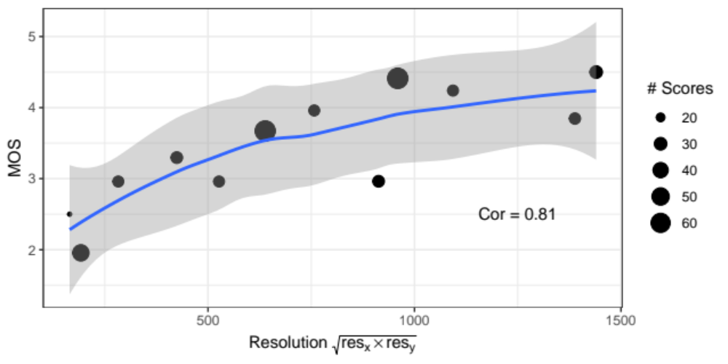
Resolution is Enough
Notes:
Due to the limited number of results, we aggregate them. The higher the resolution, the higher the quality rating. The overall resolution has a correlation of 0.81. This means that as the resolution increases, there is a strong positive correlation with the quality ratings given by the participants. However, it's worth to note that correlation does not imply causality, other factors such as network conditions, device capabilities, and personal preferences may also affect the quality rating.

Slide 8
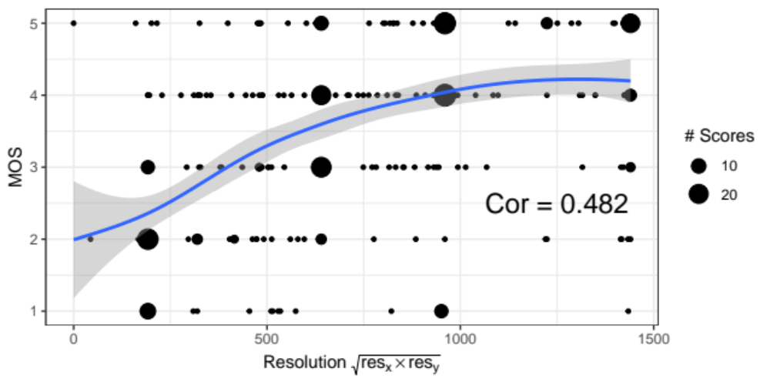
All Scores
Notes:
Instead, we focus on the behavior of individual users. We aim to include as many different types of behaviors as possible. However, this further decreases the number of responses we are able to collect. As a result, correlation decreases and subsequent correlation calculations will be different because we are not aggregating the data. This approach allows us to have a more detailed understanding of the relationship between different variables but it also requires more data to be able to make more general conclusions.

Slide 9


Behavior
User
Net
Seeking forward/backword
Pause
Viewport Change
Manual Change of Resolution
Reading Comment/ Description Section
Searching
Scrolling
Playback speed
Stalling
Initial Buffering
Notes:
As previously mentioned, we used screen recordings to collect data on user behavior. This allowed us to accurately determine which behaviors occurred during the experiment. The behaviors we captured were divided into two categories: "user" behaviors and "net" behaviors. The "user" category contains behaviors generated by the users such as seeking forward/backward, pausing, changing the viewport, manually changing the resolution, viewing the comment/description section, searching, and scrolling. The "net" category contains behaviors related to network performance, such as stalling and initial buffering. This approach allows us to have a detailed understanding of user behavior and how it is affected by both user actions and network conditions.

Slide 10
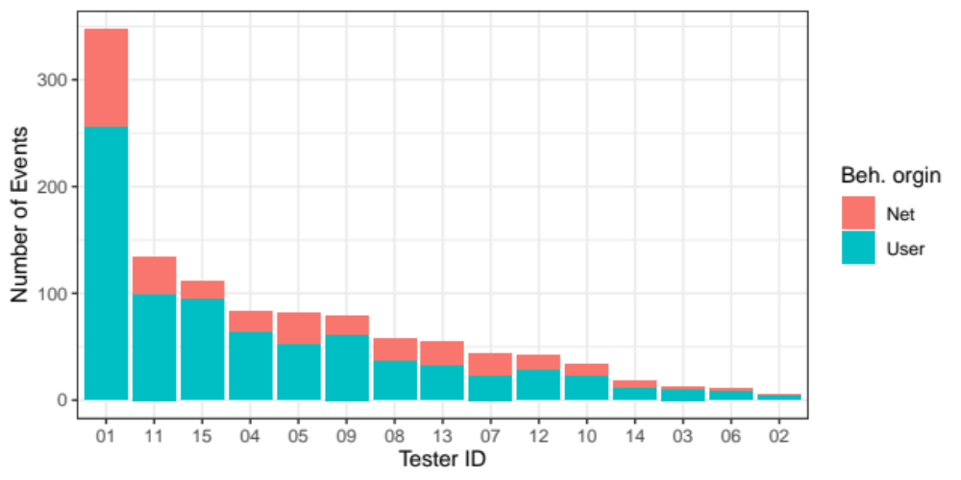
Behaviors: User vs Network
Notes:
The chart illustrates the number of behaviors for each of the series for both the "net" and "user" categories presented. As can be seen, the number of behaviors generated by the user is significantly higher than the number of network events. Interestingly, it appears that some of the behaviors generated by the user can directly affect the number of network events. For example, a subject experienced a stalling event caused by the Chrome extension, which led to increased frustration, so they decided to manually change the quality in the YouTube platform menu, which resulted in another stalling event. A similar situation occurred when the subject fast-forwarded the video beyond the loaded buffer - this also led to a stalling event. This illustration shows that user behaviors are not only important to measure in terms of user experience but also they can have an impact on the network events and in general on the overall quality of the experience.

Slide 11
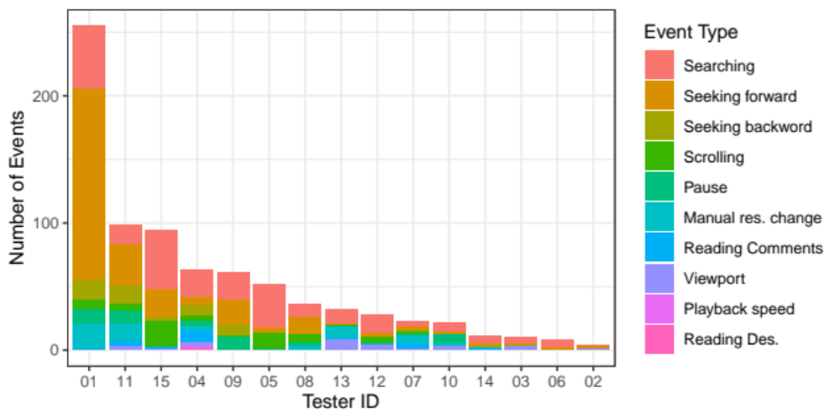
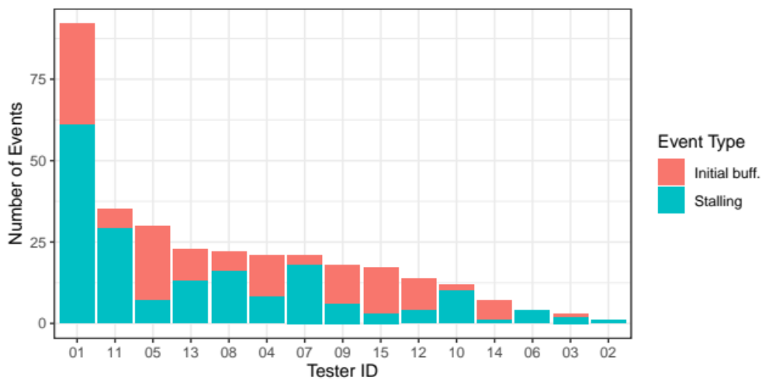
Behaviors: Details
User
Network
Notes:
So, what does behavior in detail look like? Both charts illustrate the number of behaviors for each of the testers. The chart on the left side illustrates the behaviors generated by the user, while the chart on the right side illustrates the network events that occurred. As seen on the "USER" chart, the behaviors generated by the users varied. Subject ID 1 was clearly the most active user among the whole sample. The most frequently occurring behaviors include: searching for the next video to watch, and scrolling forward or backward in the same video. The "Net" chart illustrates the number of stalling events and initial buffering events that occurred, and also it can be seen that Tester ID 1 experienced the most network events. It is important to note that this type of detailed behavior analysis allows to understand how users interact with the system and how network events affect their experience. This can be useful for identifying specific areas that need improvement and fine-tuning the system to provide a better user experience.

Slide 12
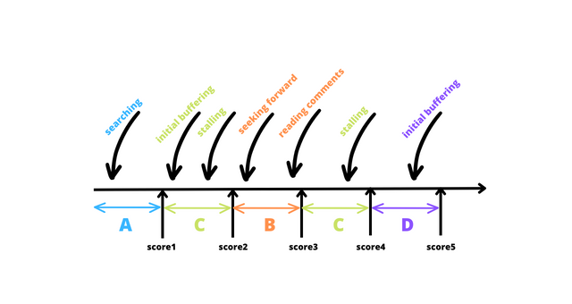
Groups
We distinguished different groups of testers on the basis of the indicated behaviors such as:
  A: only watching (with searching)
  B: other behaviors (e.g. seeking, pausing, change of resolution)
  C: stalling (with other behaviors)
  D: initinal buffering (without stalling with other behaviors)
Notes:
Based on the collected behaviors, we decided to divide the collected data (including objective metrics) into corresponding groups. Group A refers to pure watching, and thus to the absence of any generated behaviors. Group B illustrates the occurring behaviors such as scrolling, pausing, or manual resolution change. Group C refers to data during which stalling occurred but may include other behaviors, and Group D containing initical buffering along with other behaviors. This approach allows for a more detailed analysis of the data and to see how different behaviors affect the user experience and the objective metrics. Furthermore, it allows to identify specific behaviors that may be causing issues or impacting the user experience, and target those behaviors for improvement.

Slide 13
Three
If there isn't any behavior?
Group A
T
F
Is it stalling?
Group C
T
F
Is it initial buffering?
Group D
T
F
Is scoring the only behavior?
Group A
T
F
Group B

Slide 14
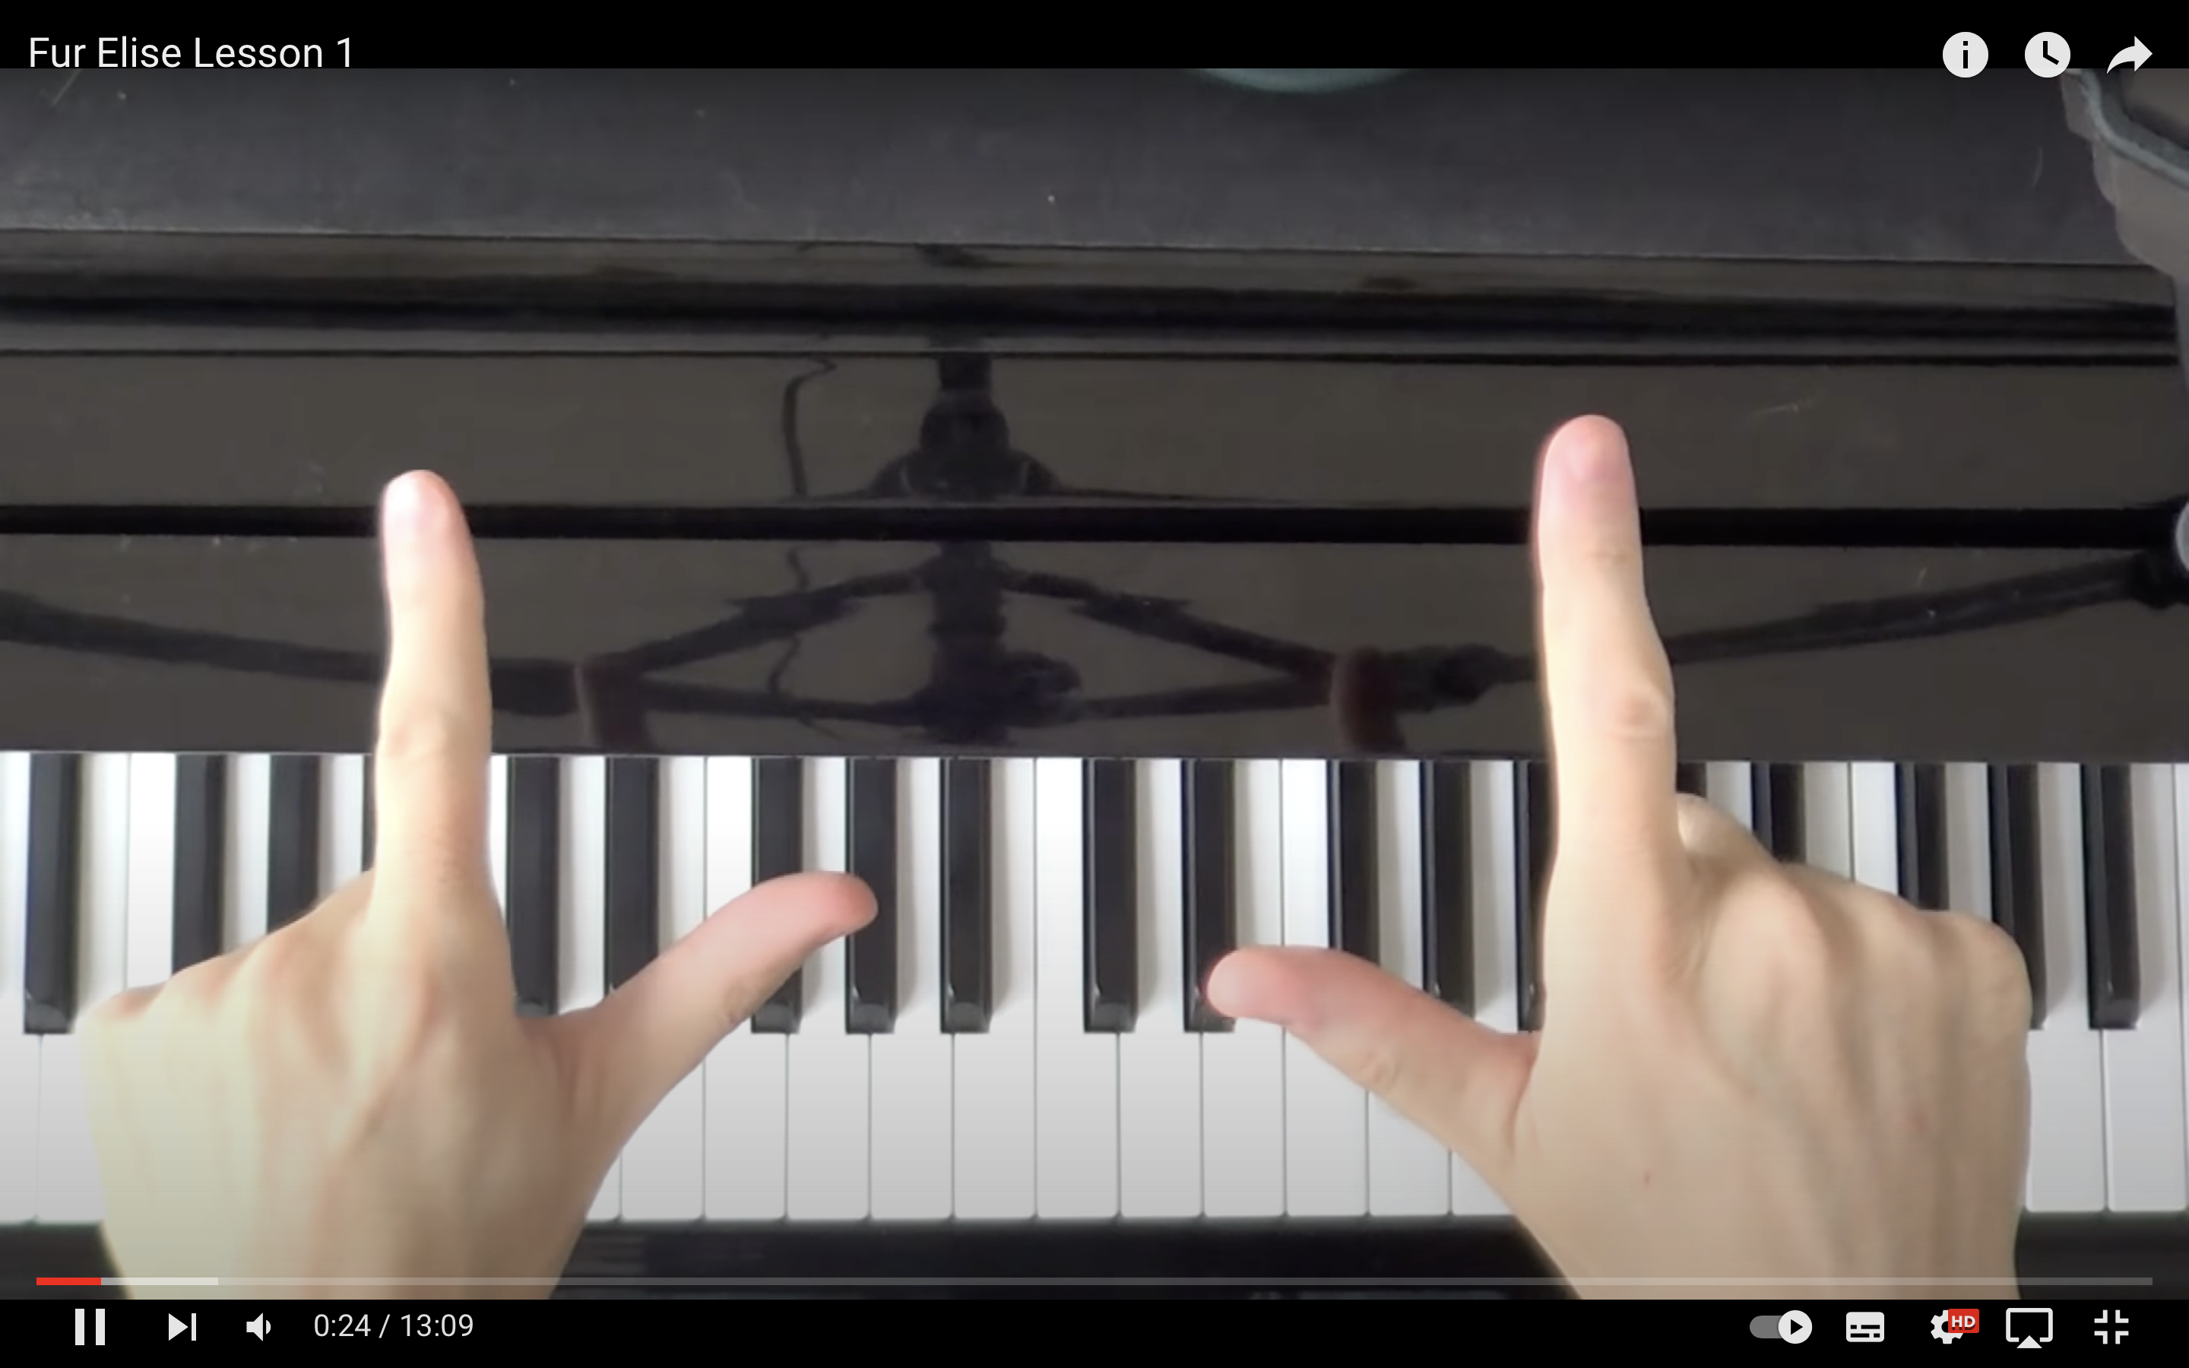
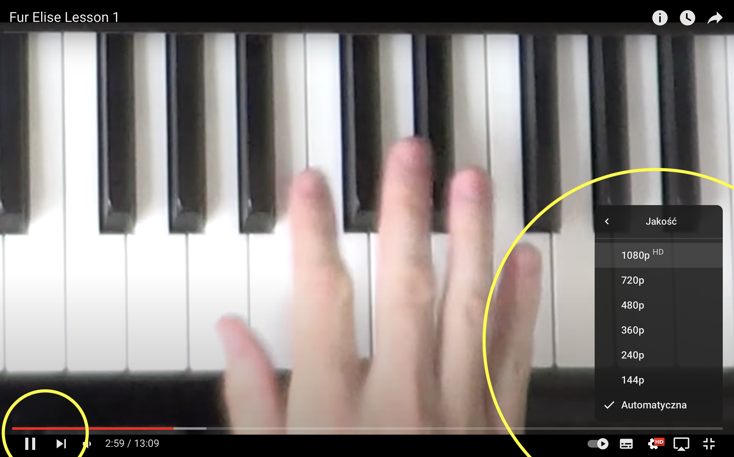
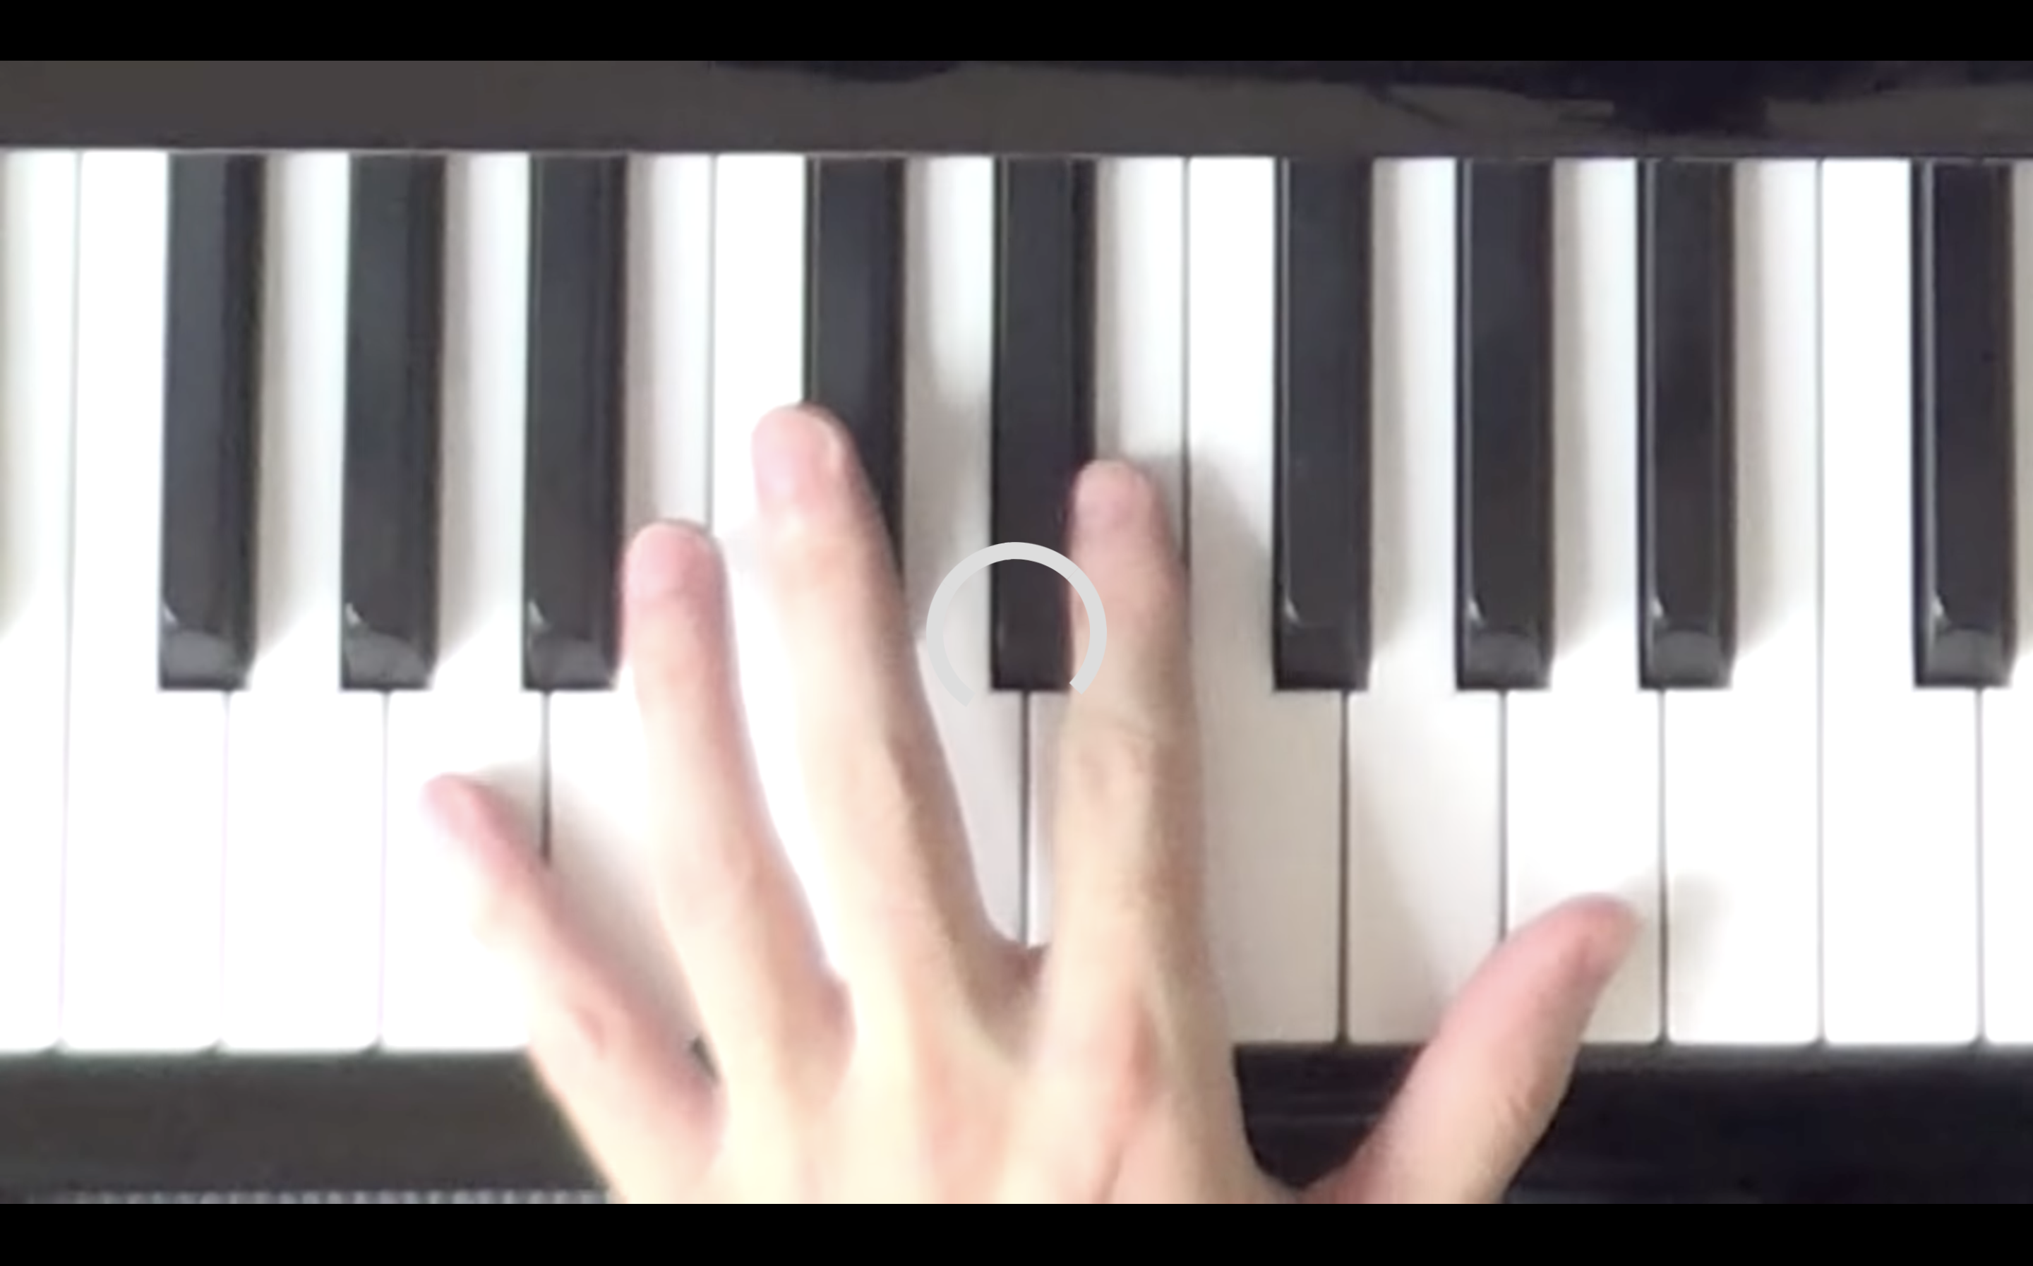
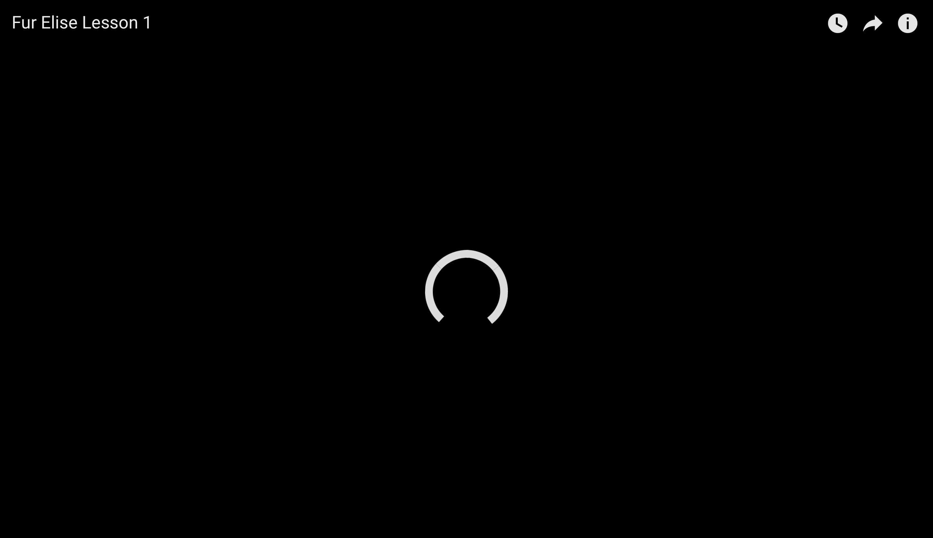
A: only watching (with searching)
Groups in details
B: other behaviors
(e.g. seeking, pausing, change of resolution)
C: stalling (with other behaviors)
D: initinal buffering without stalling with other behaviors)

Slide 15
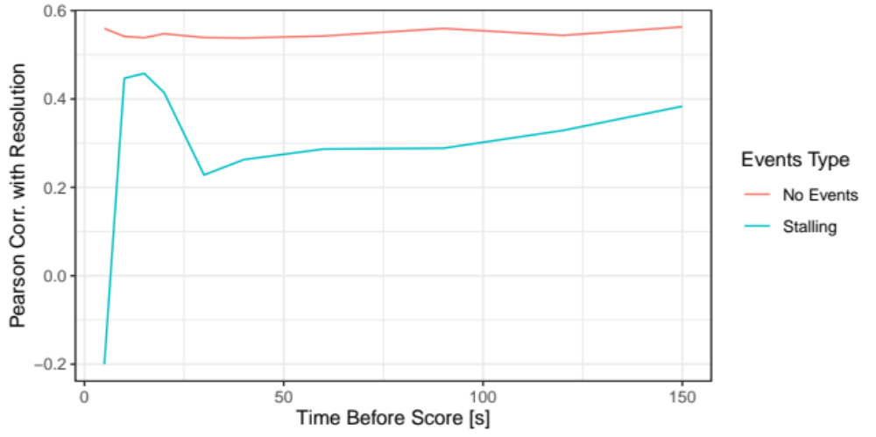
Correlation with Resolution as a Function of Time

Slide 16
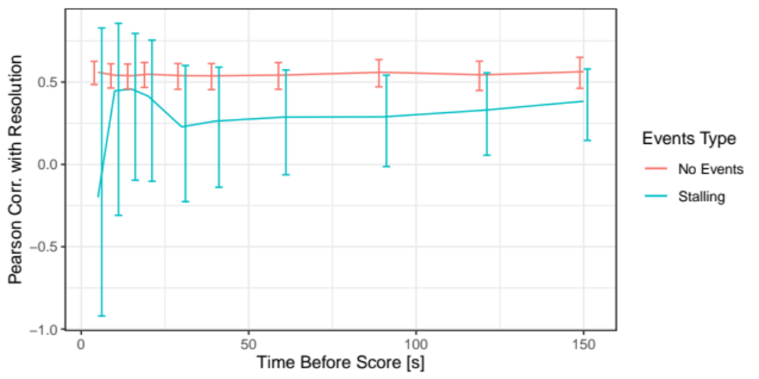
Correlation with Resolution as a Function of Time

Slide 17
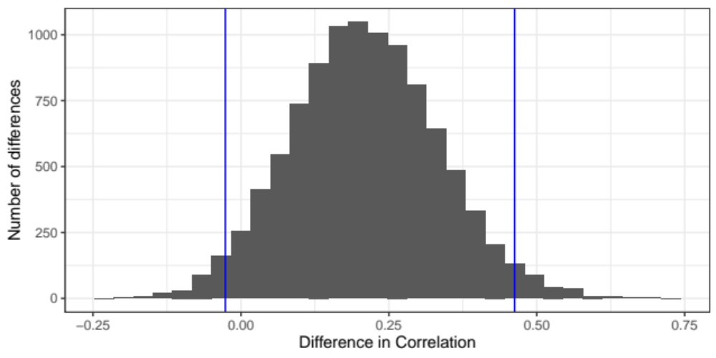
Difference in Correlation with Resolution with/without Stalling

Slide 18
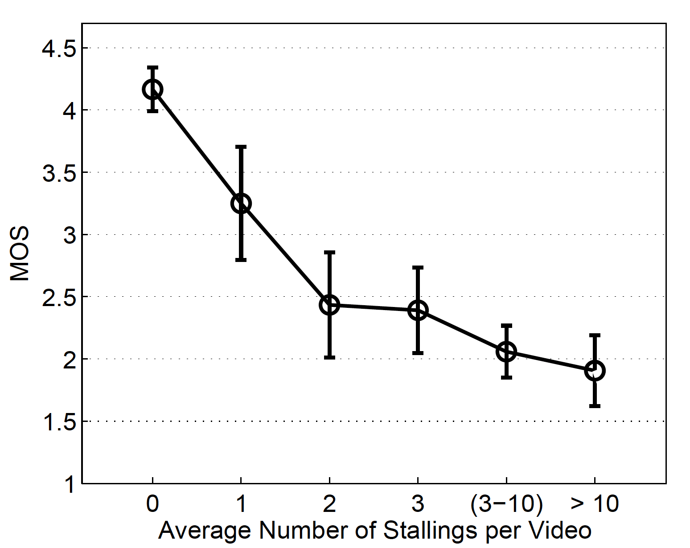
Casas, P., Sackl, A., Egger, S., & Schatz, R. (2012, December). YouTube & Facebook Quality of Experience in mobile broadband networks. In 2012 IEEE Globecom Workshops (pp. 1269-1274). IEEE.

Slide 19
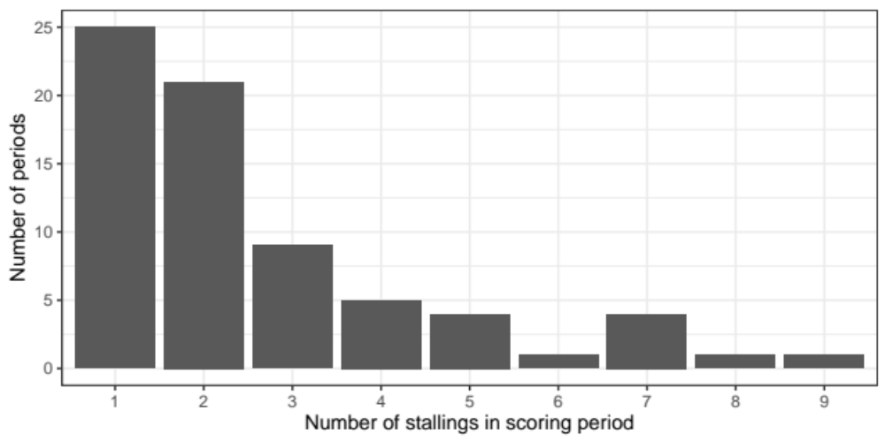
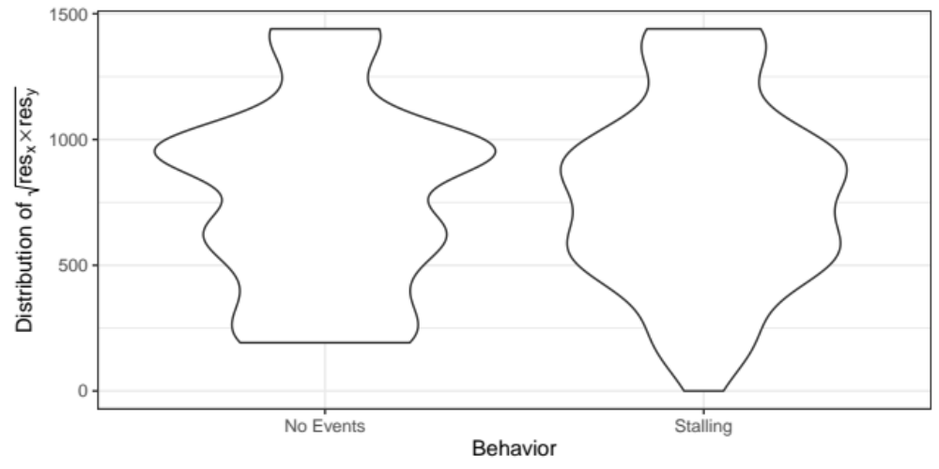
Stalling Statistics

Slide 20
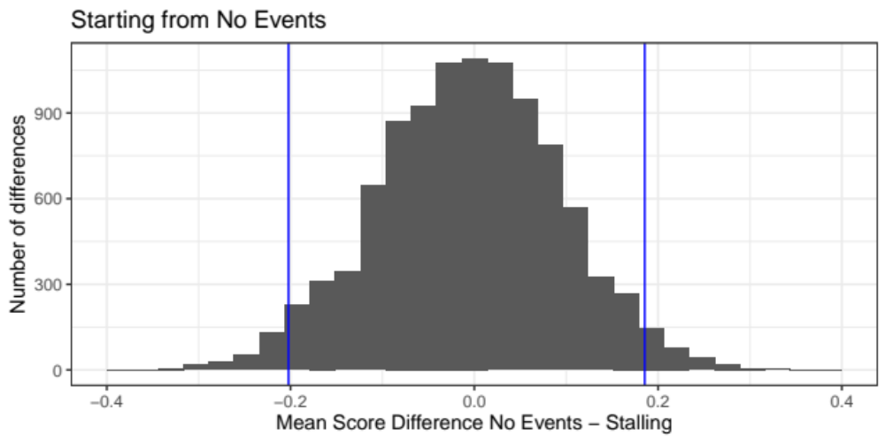
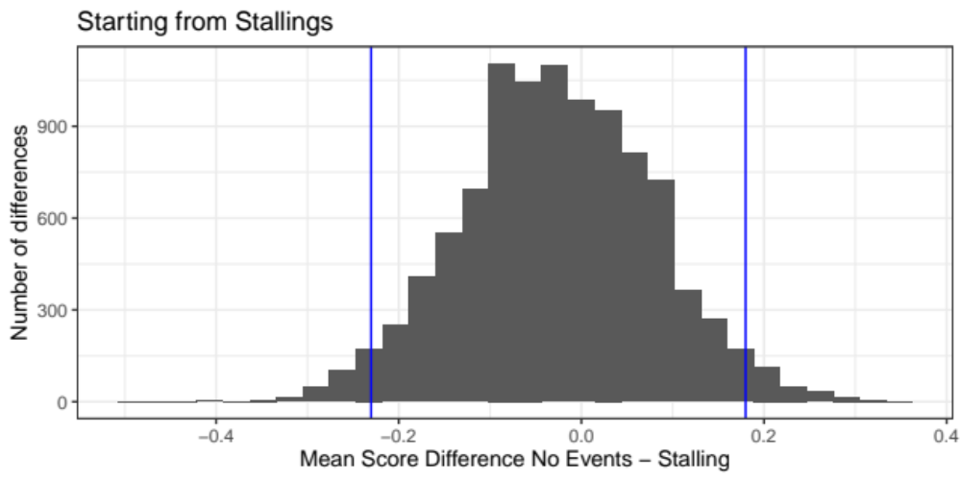
Mean Score Difference

Slide 21
Summary
We can propose more Ecologically Valid experiments
The results from our experiment are stable – we have internal validity
The correlation with resolution is quite high
The influence of stalling is weaker than in the lab study
Ecologically Valid experiments are challenging
This experiment should be repeated, the code will be available
As the community we should consider different scenarios to better understand real use cases

Slide 22
Thank you!
www.eeagrants.org
Facebook, Twitter, LinkedIn, Instagram
YouTube: EEANorwayGrants
Mail: info-fmo@efta.int

