Slide 1
ToR and Test Plan for P.obj-recog
June. 2023
NTT Network service systems laboratories, NTT Corporation
Masanori Koike, Kazuhisa Yamagishi, Noritsugu Egi

Slide 2
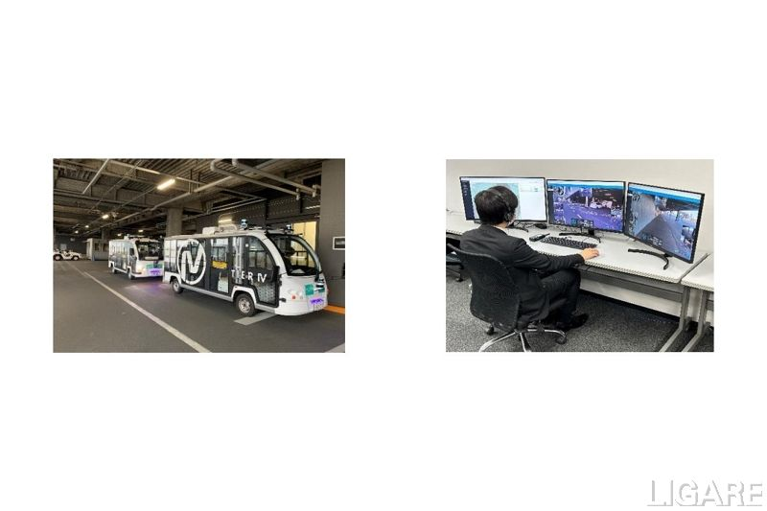








Purpose of monitoring
Current autonomous driving systems are challenging to use on local streets because there are various objects, remote monitoring is needed.
To use the current autonomous driving systems on local streets, a remote monitoring system has been studied in which an observer at a monitoring center recognizes objects and brakes remotely.
In Germany, Japan and France, remote monitoring in unattended autonomous driving systems is necessary.
Radio access network (RAN)
Monitoring center
Surveillance
camera
Observer
Example of remote monitoring
autonomous car
https://www.ntt-east.co.jp/release/detail/20221215_01.html

Slide 3
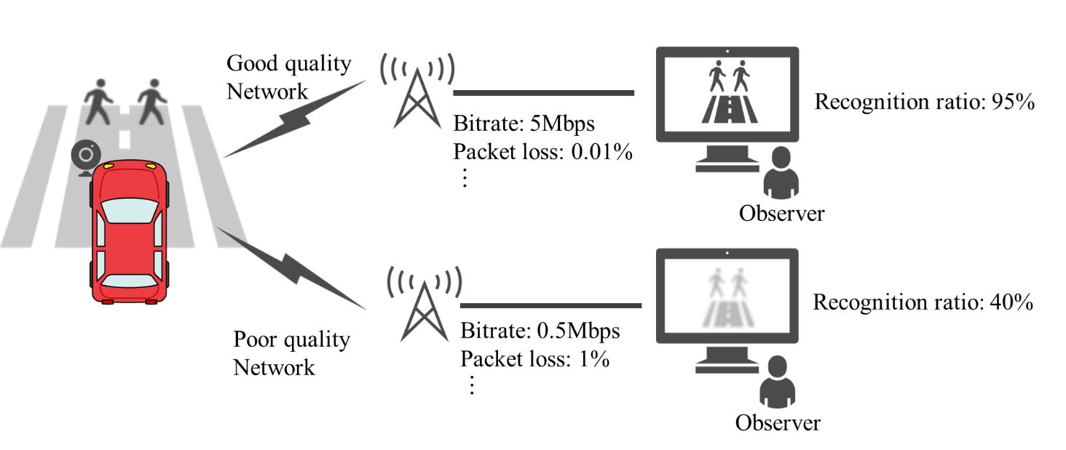
Primary application for P.obj-recog
To monitor in monitoring center, a surveillance video with a high object-recognition ratio have to be always being provided.
For safe autonomous driving, an object-recognition-ratio estimation model needs to be developed to estimate the object-recognition ratio of surveillance video at the remote monitoring center.
Autonomous driving is continuable
Autonomous driving is not continuable

Slide 4
Definition of object recognition ratio (1/2)
Since the object recognition ratio depends on the distance from the surveillance camera to the object, it is necessary to set the target distance.
Considering the purpose of the monitoring, the target distance is the distance at which the autonomous car can be stopped short of the object after detection. (Stopping distances)
Target distance is short
Object-recognition ratio
Target distance is long
Observer
Target distance
(= Stopping distances)

Slide 5
Definition of object recognition ratio (2/2)
Even at the same target distance, object recognition ratio differ between cases where the object is always on the road (case 1) and cases where it suddenly appears on the road from a blind spot (case 2).
Since it is desirable to consider it on the safety side, case 2 should be covered by P.obj-recog.
Case1
the object is always on the road
Only need to recognize the object somewhere in this range
Target distance
Case2
the object suddenly appears on the road
Target distance
Need to recognize the object in this range
(e.g., Mileage per second)

Slide 6

Case 1 and Case 2 in packet loss situation
the object is always on the road
Case1
Only need to recognize the object somewhere in this range
Target distance
Packet Loss
Packet Loss
Observer can recognize in this range
In the Case1, it may be possible to recognize if the packet loss is occurred.
!
Case2
the object suddenly appears on the road
Target distance
Need to recognize the object in this range
Packet Loss
Packet Loss
In the Case2, it is difficult to recognize the object if the packet loss is occurred.

Slide 7
Calculation of object recognition ratio
The object-recognition ratio is calculated on the basis of the recognition percentage at target distance (X meter).
Target distance (X meter)
Need to recognize the object in this range
The example of calculation (20 Subjects)
Object-recognition ratio
X meter
100%
80%
Object-recognition ratio: 80%
distance
Subjects who can recognize the objects before X meter: 16
Subjects who can recognize the objects after X meter: 4

Slide 8
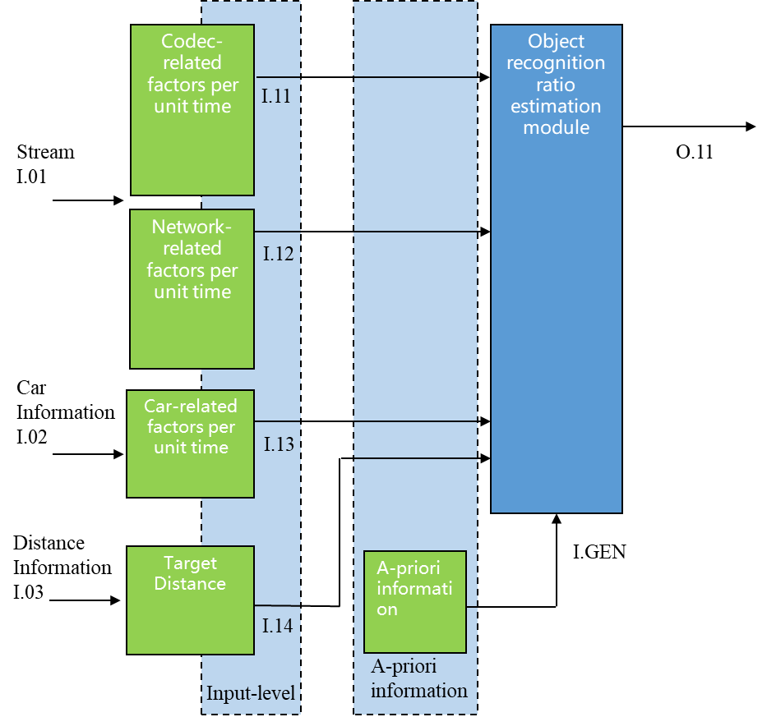
Building Blocks (Input and output)
Even when there is no object in the surveillance video, it is necessary to monitor whether or not it is safe for the object to appear at any time.
Therefore, it is important to use a parametric model to understand the state of the surveillance video, rather than using pixel-based model to recognize an object.
Object-recognition ratio: 40 %
Bitrate
Object-recognition ratio: 80 %
Packet loss rate
Object-recognition ratio: 40 %
No object
Car velocity
It is important to always assume the case where an object suddenly appears and to understand the state of the surveillance video.
⇒Recognition by pixel-based analysis is not sufficient.
Target distance
(X meter)
A priori information (e.g. object type, weather, etc.)

Slide 9
Important points for this contribution
1. To make sure that the surveillance video transmitted to the surveillance center is recognizable.
2. Surveillance video must look good even when objects are not really in the video.
3. The surveillance video is analyzed by a parametric model rather than a video pixel-based model.
4. This object-recognition-estimation model should be designed for the risky cases, while safer cases can be handled by tuning in this contribution.

Slide 10
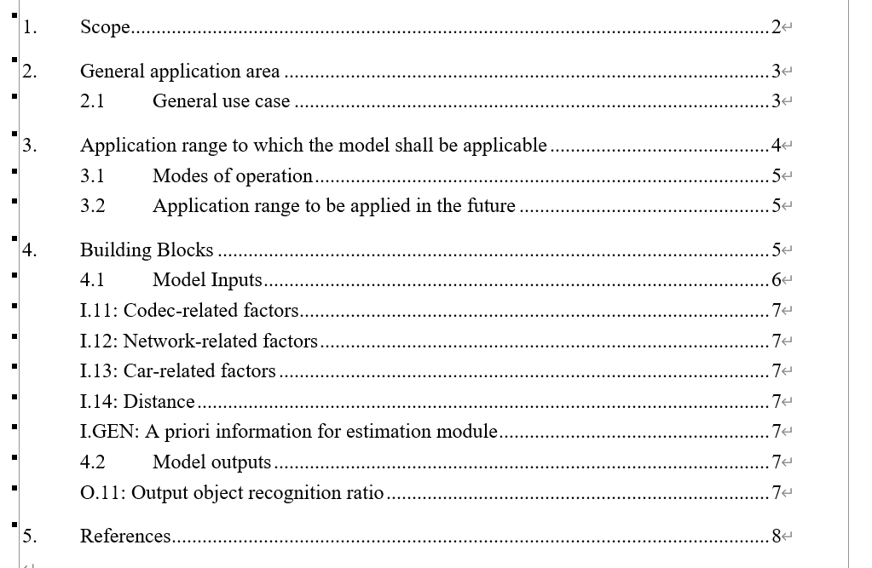
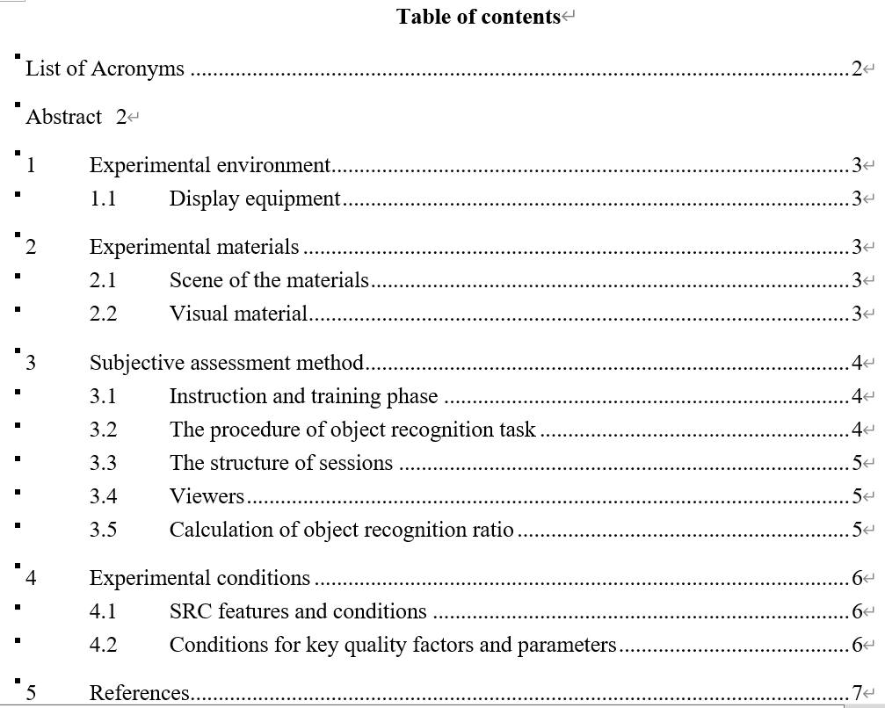
Section organization
ToR
Test plan

