Slide 1
ITU-T SG12
Q19 Interim Meeting
Objective and subjective methods for evaluating perceptual audiovisual quality in multimedia and television services
June 26-27, 2023
Hosted by Sony Interactive Entertainment (SIE)
San Mateo, CA, USA

Slide 2
Agenda
Merging work item (P.910rev): .913, P.911, and P.910
  P.910 Subjective video quality assessment methods for multimedia applications
  P.911 Subjective audiovisual quality assessment methods for multimedia applications
  P.913 Methods for the subjective assessment of video quality, audio quality and audiovisual quality of Internet video and distribution quality television in any environment
Work item P.obj-recog
AOB

Slide 3
C-77 - Proposal to merge P.913, P.911, and P.910
Summary:
ITU-T Rec. P.910 and P.911 refer to obsolete technologies and methods such as CRT monitors. ITU-T Rec. P.913 was originally proposed to address video quality assessment for novel technologies, such as laptops and mobile devices. These technologies have become mainstream. Since the scope of P.913 includes both video-only and audiovisual subjective tests, there remains no logical factor by which we could differentiate between the scope of these three Recs. The logical solution is to merge these three documents into a single Recommendation.
Although P.910 is the most widely referenced of these three ITU-T Recs., the P.913 reference would encourage people to read the updated Recommendation instead of assuming its contents based on previously published subjective tests. P.913 is the most up to date, so using this as the baseline text will require the least changes.
In addition, P.913 needs to be updated to reflect advances in improved subjective methods, video technologies, and ITU Recommendations.
The group reviewed the proposal to merge the three Recommendations (P.913, P.911, and P.910) and agreed that merging the Recommendations on subjective testing methods would be beneficial to the video quality community. On the other hand, it is stated that P.910 is the most widely referred ITU-T Recommendation on subjective testing methods by the community and it would be better to keep P.910 and update it by reflecting recent advances in subjective methods, video technologies, etc. It is agreed that Q19 will launch the merging work item and schedule Q19 interim meetings (in-person or online) to expedite the project.
Editor P.910rev: Margaret Pinson

Slide 4
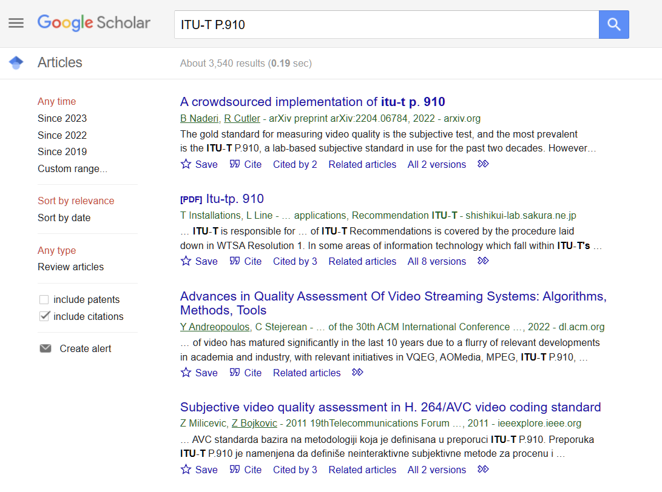
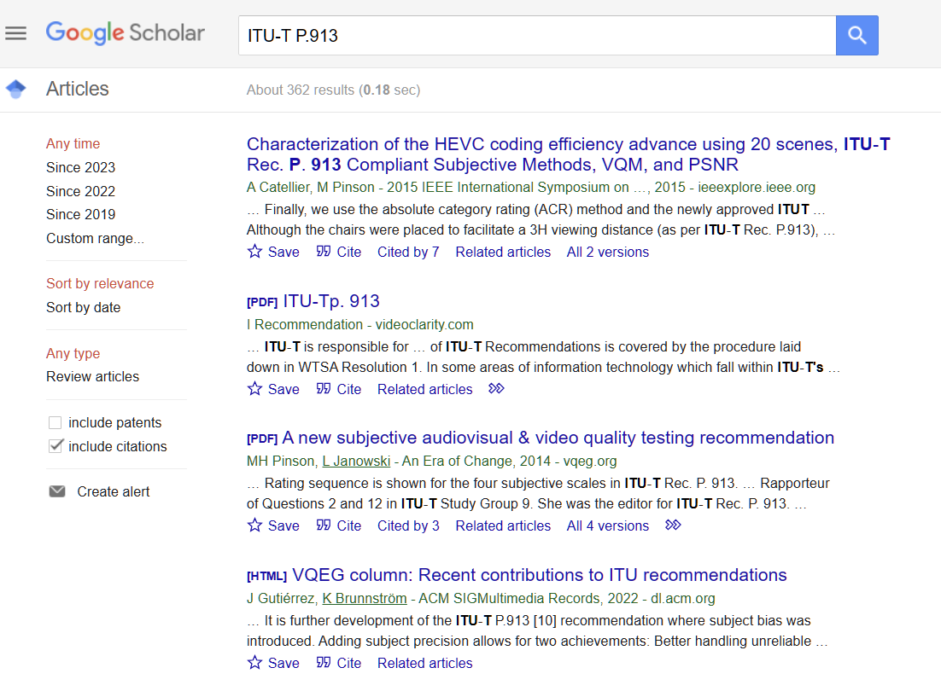
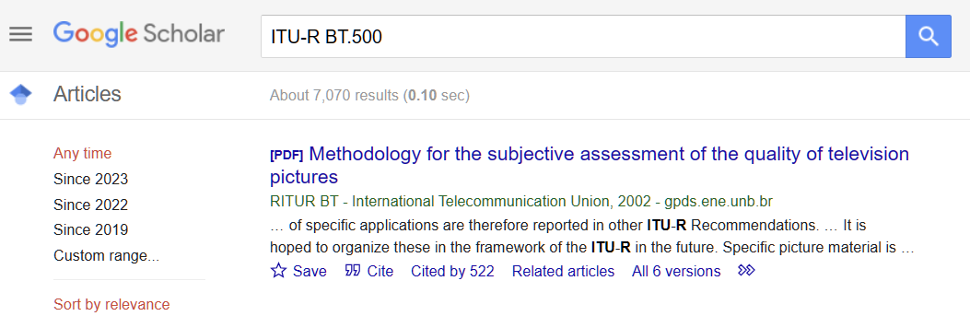
ITU-T P.910 vs P.913

Slide 5
ITU-R WP6C
Revised BT.500-14: Scope
  This Recommendation provides methodologies for the assessment of image quality including, general testing methods, the grading scales used during assessments and the viewing conditions recommended for carrying out assessments. The Recommendation consists of three parts.
  Part 1 describes the overall requirements for carrying out subjected assessment of television images and guidance on the circumstances for the use of particular methodologies.
  Part 2 describes the various recommended assessment methodologies that can be used when performing subjective image quality assessments.
  Part 3 describes methodologies specific to image formats and applications based on the specifications given in Parts 1 and 2.

Slide 6
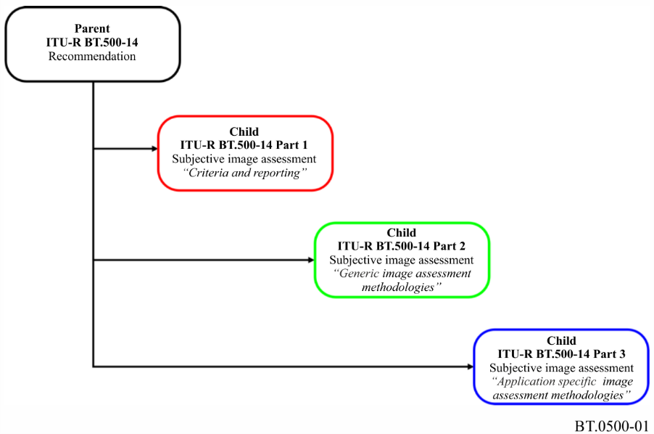
ITU-R WP6C
Revised BT.500-15

Slide 7
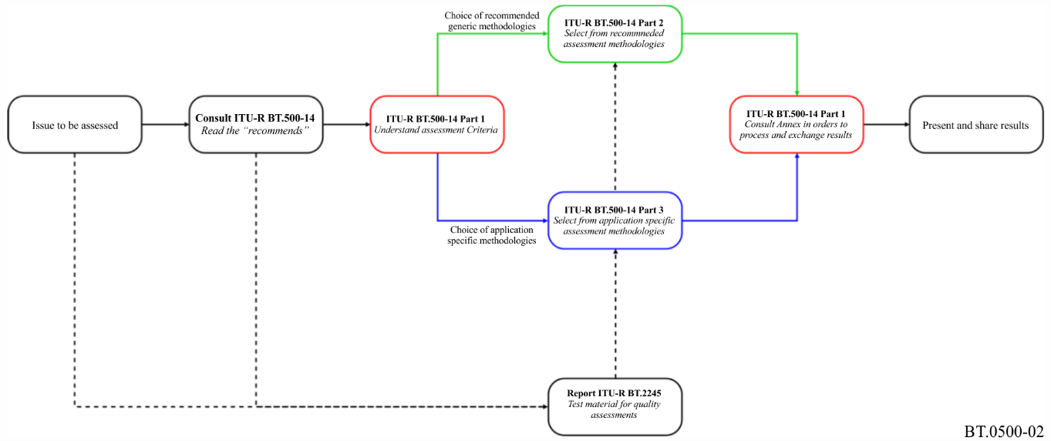
ITU-R WP6C
Revised BT.500-15

Slide 8
Revised BT.500-15: Recommended image assessment methodologies
Annex 1 Double-stimulus impairment scale (DSIS)
Annex 2 Double-stimulus continuous quality-scale (DSCQS)
Annex 3 Single-stimulus (SS) methods
Annex 4 Stimulus-comparison methods
Annex 5 Single stimulus continuous quality evaluation (SSCQE)
Annex 6 Simultaneous double stimulus for continuous evaluation (SDSCE)
Annex 7 Subjective assessment of multimedia video quality (SAMVIQ)
Annex 8 Expert viewing protocol (EVP) for the evaluation of the quality
of video material

Slide 9
ITU-R WP6C
Revised BT.500: Annex
Annex 1 Subjective assessment of standard definition digital television (SDTV) systems
based on Recommendation ITU-R BT.1129: Subjective assessment of standard
definition digital television (SDTV) systems
Annex 2 Subjective assessment of the image quality of high-definition television (HDTV) systems based on Recommendation ITU-R BT.710: Subjective assessment methods
for image quality in high-definition television
Annex 3 Subjective assessment of the quality of alphanumeric and graphic pictures in
Teletext and similar services based on Recommendation ITU-R BT.812: Subjective
assessment of the quality of alphanumeric and graphic pictures in Teletext and
similar services
Annex 4 Subjective assessment of the picture quality of multi-programme services based on
Recommendation ITU-R BT.1382: Assessment of the picture quality of multi-
programme services
Annex 5 Expert viewing of the image quality of systems for the digital display of large
screen digital imagery in theatres based on Recommendation ITU-R BT.1663:
Expert viewing methods to assess the quality of systems for the digital display of
large screen digital imagery in theatres
Annex 6 Subjective assessment of the image quality of multimedia applications based on
Recommendation ITU-R BT.1788: Methodology for the subjective assessment of
video quality in multimedia applications
Annex 7 Subjective assessment of stereoscopic 3DTV systems based on Recommendation
ITU R BT.2021: Subjective methods for assessment of stereoscopic 3DTV systems

Slide 10
C-81 - The estimation techniques of object-recognition rate in surveillance video of autonomous driving
Summary:
This contribution proposes launching a work item for estimation techniques of the object-recognition rate in surveillance video of autonomous driving.
Although an autonomous driving system is highly required, it is assumed that observers at a monitoring center will assist the autonomous driving until the full autonomous driving system is developed. To do that, the video streamed from an autonomous car needs be have a high object-recognition rate. Therefore, a new technique needs to be developed that can estimate the object-recognition rate.
The group reviewed the proposal and agreed that Q19 will start the work item (P.obj-recog). Currently, NTT and ERICSSON committed to contributing to this work item, and more labs and companies are expected to join the project. .
Editor P.obj-recog: Masanori Koike (NTT)
Kazuhisa Yamagishi (NTT)
Noritsugu Egi (NTT)
Companies/Labs: NTT, ERICSSON

Slide 11
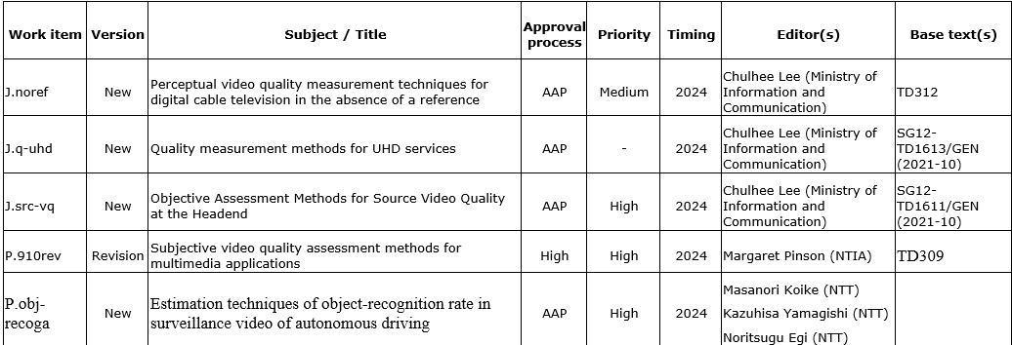
Work Items of Q19

Slide 12
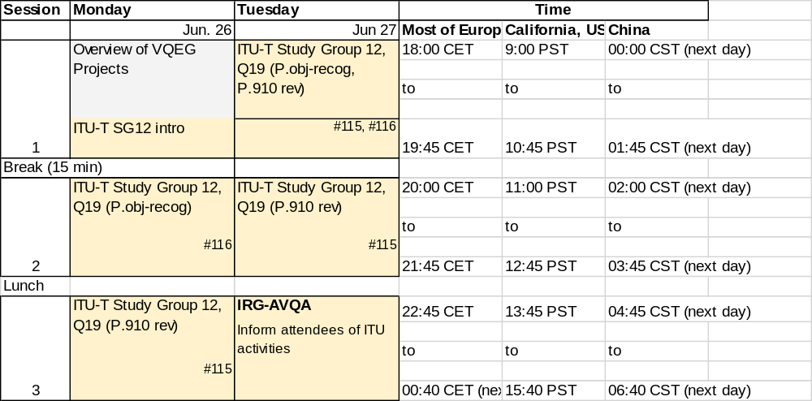
Q19 Interim Meeting (June 26-27, 2023)

Slide 13
Work item P.obj-recog

Slide 14
“P.obj-recog” Input Documents
Draft Terms of Reference (ToR) P.obj-recog
Draft Test plan of P.obj-recog
https://www.itu.int/ifa/t/2022/sg12/exchange/wp2/q19/SanMateo_June2023/

Slide 15
Revision of P.910

Slide 16
ITU-T P.910
1 Scope
2 References
3 Definitions
  3.1 Terms defined elsewhere
  3.2 Terms defined in this Recommendation
4 Abbreviations and acronyms
5 Conventions
6 Source signal
  6.1 Recording environment
  6.2 Recording system
  6.3 Scene characteristics
7 Test methods and experimental design
  7.1 Absolute category rating
  7.2 Absolute category rating with hidden reference
  7.3 Degradation category rating
  7.4 Pair comparison method
  7.5 Comparison of the methods
  7.6 Reference conditions
  7.7 Experimental design
8 Evaluation procedures
  8.1 Viewing conditions
  8.2 Processing and playback system
  8.3 Viewers
  8.4 Instructions to viewers and training session
9 Statistical analysis and reporting of results
ITU-T P.913
1 Scope
  1.1 Limitations
2 References
3 Definitions
  Terms defined elsewhere/Terms defined in this Recommendation
4 Abbreviations and acronyms
5 Conventions
6 Source stimuli
Source signal recordings/Video considerations/Audio considerations Audiovisual considerations/Duration of stimuli/Number of source stimuli
7 Test methods, rating scales and allowed changes
  List of methods/Acceptable changes to the methods/Discouraged but acceptable changes to the methods
8 Environment
  Controlled environment/Public environment/Viewing distance
9 Subjects
Number of subjects/Subject population/Sampling subject/Sampling techniques
10 Experimental design
  Size of the experiment and subject fatigue/Special considerations for transmission error, rebuffering and audiovisual synchronization impairments/Special considerations for longer stalling events/Pre-pilot testing and pilot testing/Study design
11 Experiment implementation
  Informed consent/Overview of subject screening/Optional pre-screening of subjects/Post-screening of subjects/Instructions and training/Study duration, sessions and break/Stimuli play mechanism/Voting/Questionnaire or interview
12 Data analysis
  Documenting the experiment/Calculate MOS or DMOS/Evaluating objective metrics/Significance testing, subject bias and standard deviation of scores/Ratings from multiple laboratories/Improve MOS or DMOS data quality under challenging test conditions
13 Elements of subjective test reporting
  Documenting the test design/Documenting the subjective testing/Data analysis/Additional information

Slide 17
ITU-T P.910
6 Source signal
  6.1 Recording environment
  6.2 Recording system
  6.3 Scene characteristics
7 Test methods and experimental design
  7.1 Absolute category rating
  7.2 Absolute category rating with hidden reference
  7.3 Degradation category rating
  7.4 Pair comparison method
  7.5 Comparison of the methods
  7.6 Reference conditions
  7.7 Experimental design
ITU-T P.913
6 Source stimuli
  6.1 Source signal recordings
  6.2 Video considerations
  6.3 Audio considerations
  6.4 Audiovisual considerations
  6.5 Duration of stimuli
  6.6 Number of source stimuli
7 Test methods, rating scales and allowed changes
  7.1 List of methods
  7.2 Acceptable changes to the methods
  7.3 Discouraged but acceptable changes to the methods
8 Environment
  8.1 Controlled environment
  8.2 Public environment
  8.3 Viewing distance
9 Subjects
  9.1 Number of subjects
  9.2 Subject population
  9.3 Sampling subjects
  9.4 Sampling techniques
10 Experimental design
  10.1 Size of the experiment and subject fatigue
  10.2 Special considerations for transmission error, rebuffering and audiovisual synchronization impairments
  10.3 Special considerations for longer stalling events
  10.4 Pre-pilot testing and pilot testing
  10.5 Study design

Slide 18
ITU-T P.910
8 Evaluation procedures
  8.1 Viewing conditions
  8.2 Processing and playback system
  8.3 Viewers
  8.4 Instructions to viewers and training session
9 Statistical analysis and reporting of results
ITU-T P.913
12 Data analysis
  12.1 Documenting the experiment
  12.2 Calculate MOS or DMOS
  12.3 Evaluating objective metrics
  12.4 Significance testing, subject bias and standard deviation of scores
  12.5 Ratings from multiple laboratories
  12.6 Improve MOS or DMOS data quality under challenging test conditions
13 Elements of subjective test reporting
  13.1 Documenting the test design
  13.2 Documenting the subjective testing
  13.3 Data analysis
  13.4 Additional information

Slide 19
Revision of P.910
Current working document: TD309 (Editor: Margaret Pinson)
Other subjective testing methods (3D, crowdsourcing?, etc.)

Slide 20
THE END

