Slide 1
New Datasets for NR Metric Research
Dec. 14, 2021
Margaret H Pinson
mpinson@ntia.gov

Slide 2
ITSnoise Dataset
https://its.ntia.gov/publications/details.aspx?pub=3291

Slide 3
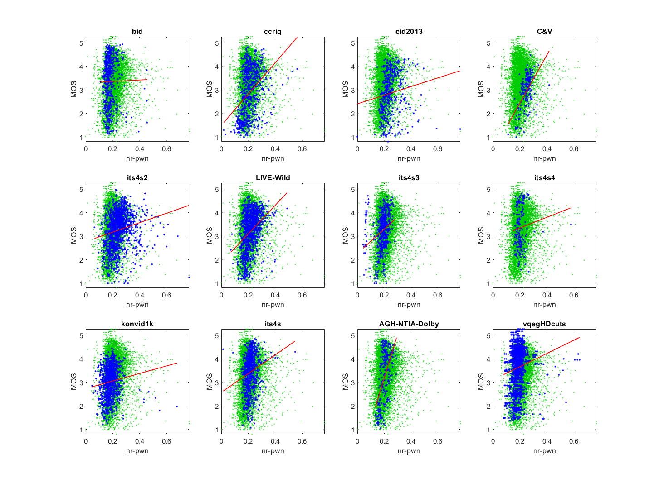
Motivation
NR metrics for noise detection
All trained on Gaussian white noise
ITS evaluation:
  AGWN ⭐
  Entropy_noise ⭐
  NR-PWN ⭐⭐
  marred by dataset dependencies
Not detecting camera capture noise
  Expect lower triangle
  Often train on white noise or shot noise

Slide 4
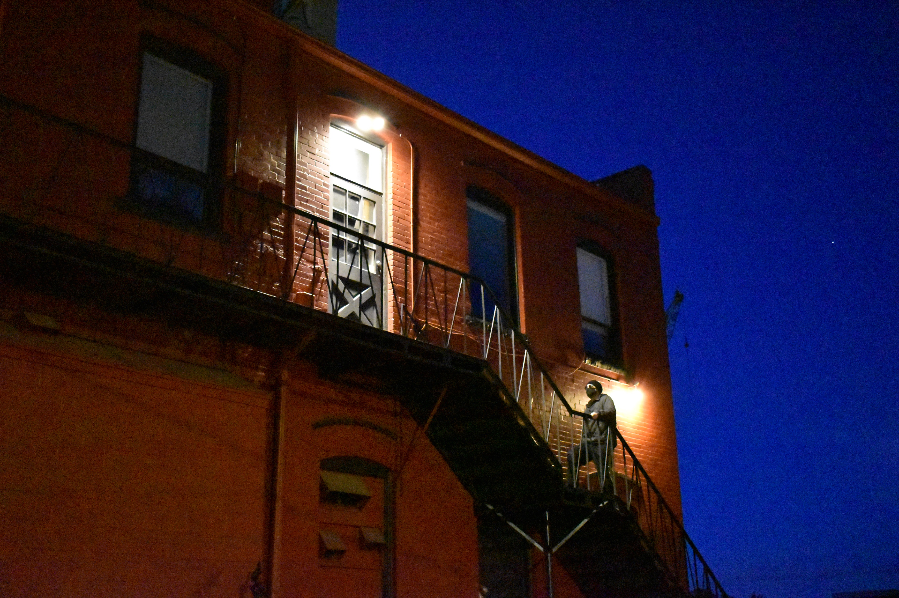
Challenges
Lack of training data
  Dataset devoted to camera capture noise
MOS confounded by other low light impairments
  Black level, blur, focus, lens flare, …
Noise recognition confounded by detail
  Other objects that look like noise
  Texture, detail, …

Slide 5
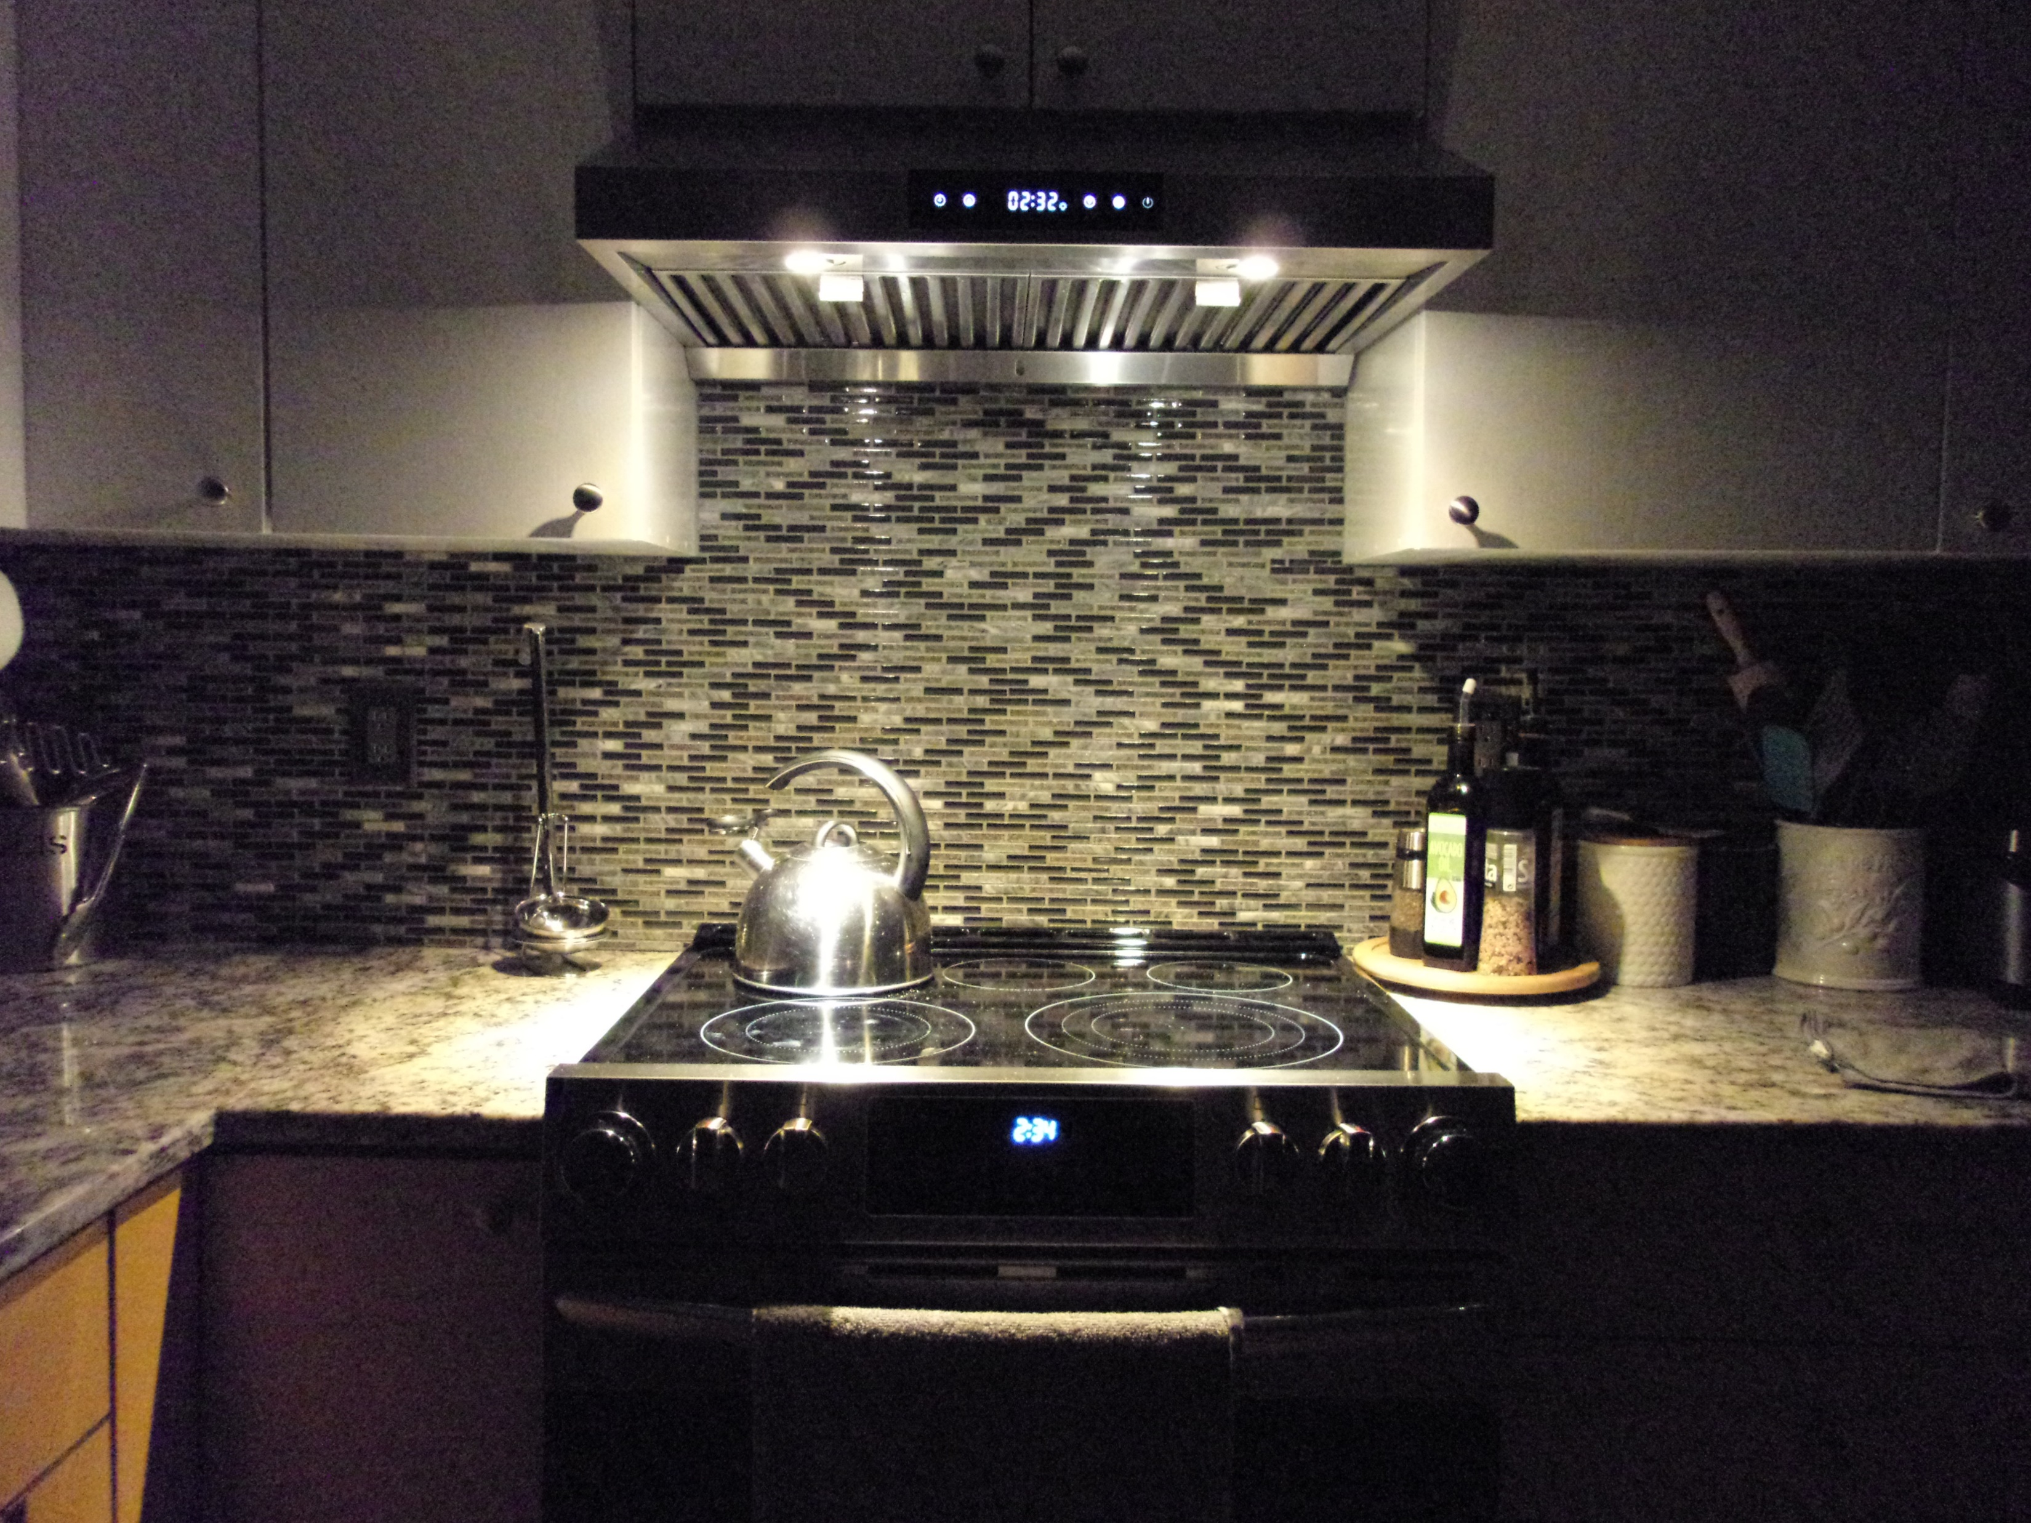
ITSnoise Dataset
Camera capture in low light
288 photographs
  24 scenes
  6 cameras
  2 capture methods: high noise, low noise
Rated at first responder event
  Four laptops
  15 or 16 subjects per laptop
  8 scenes on 2 laptops (30+ subjects)
  16 scenes on 1 laptop (15 to 16 subjects)
Available on CDVL

Slide 7
VMAF Compression Ratings that Disregard Camera Impairments (VCRDCI) Dataset
https://its.ntia.gov/publications/details.aspx?pub=3290

Slide 8
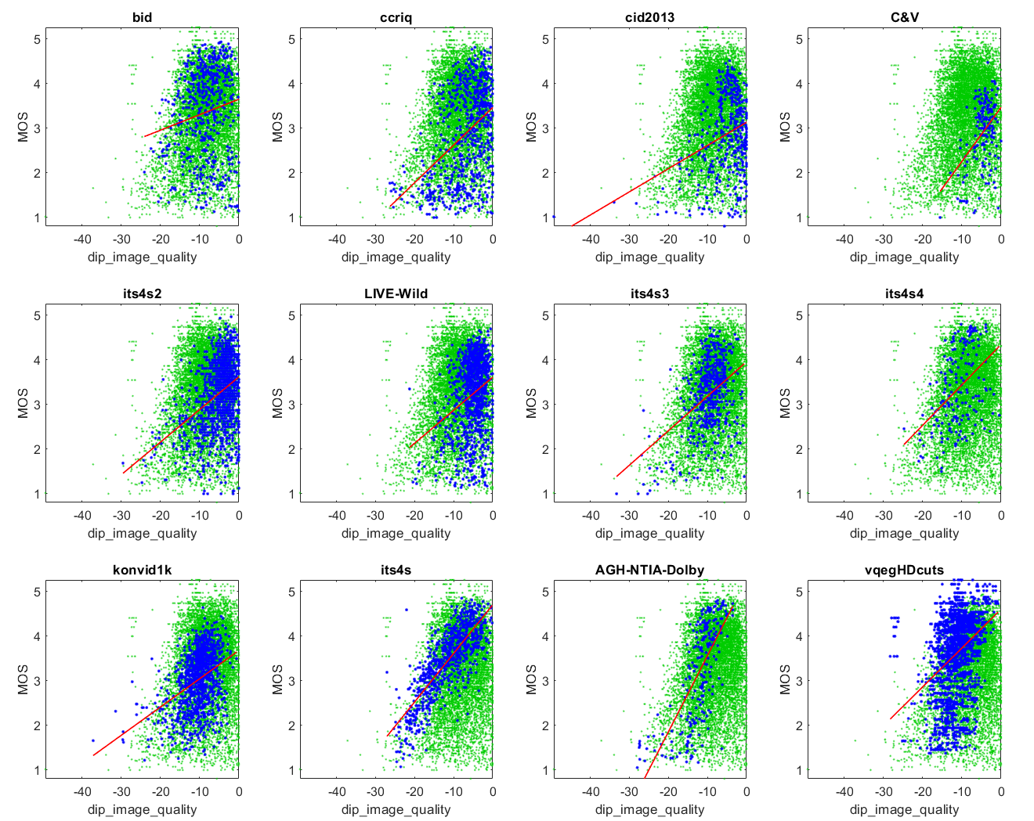
Inspiration: dipIQ Metric
Proof of concept
  Pairwise learning to rank (L2R)
  Infer media ranking from FR metric
  Image quality
  Resizing and compression artifacts
Promising results
Need for improvement
  Much faster run speed
  Improved sensitivity at low levels of impairment
  Don’t respond to camera capture impairments

Slide 9
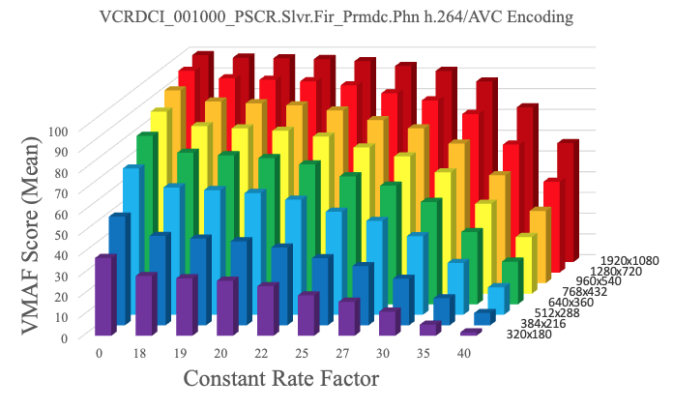
VCRDCI Dataset Visions
VMAF instead of MOS
Range of resolution and compression as seen in published adaptive bitrates
Goals
  Training data for NR metrics
  Portray complex scene / codec interactions
  Enable machine learning
  Include source videos with camera impairments

Slide 10
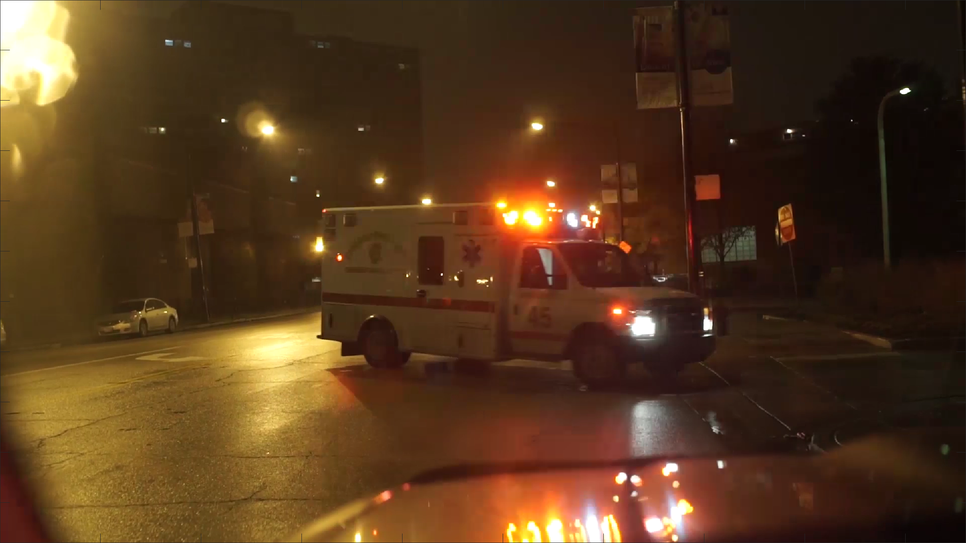
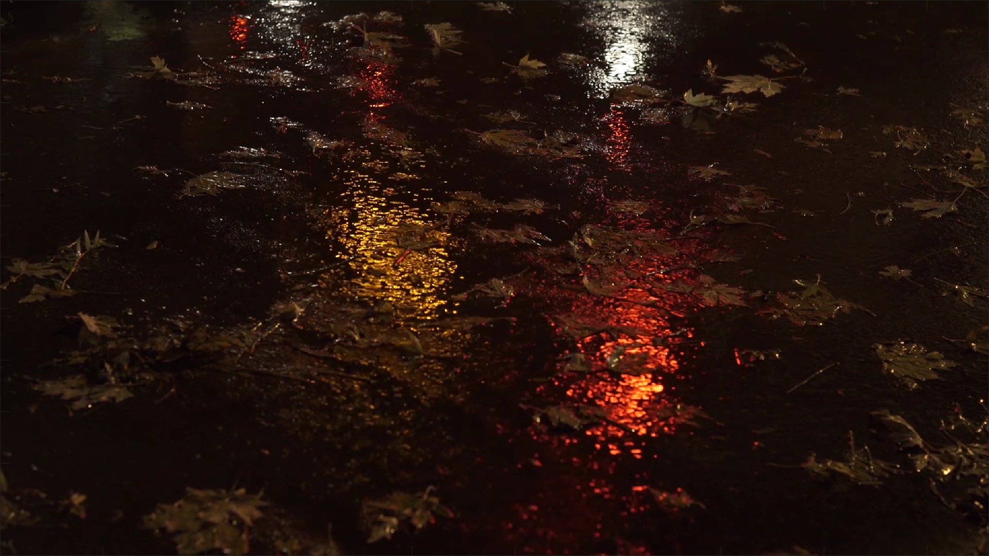
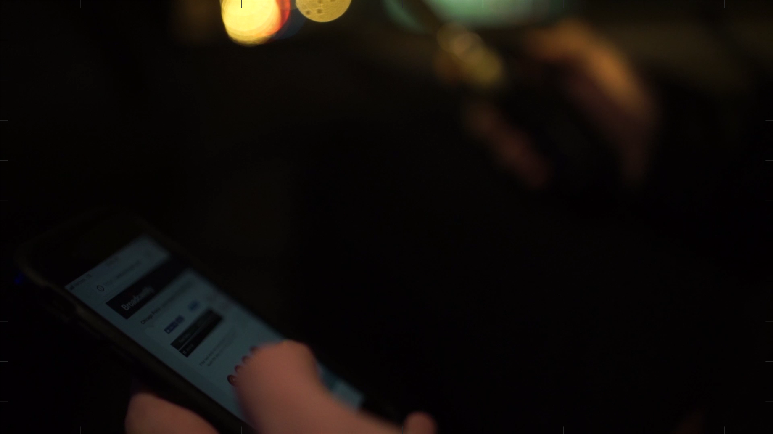
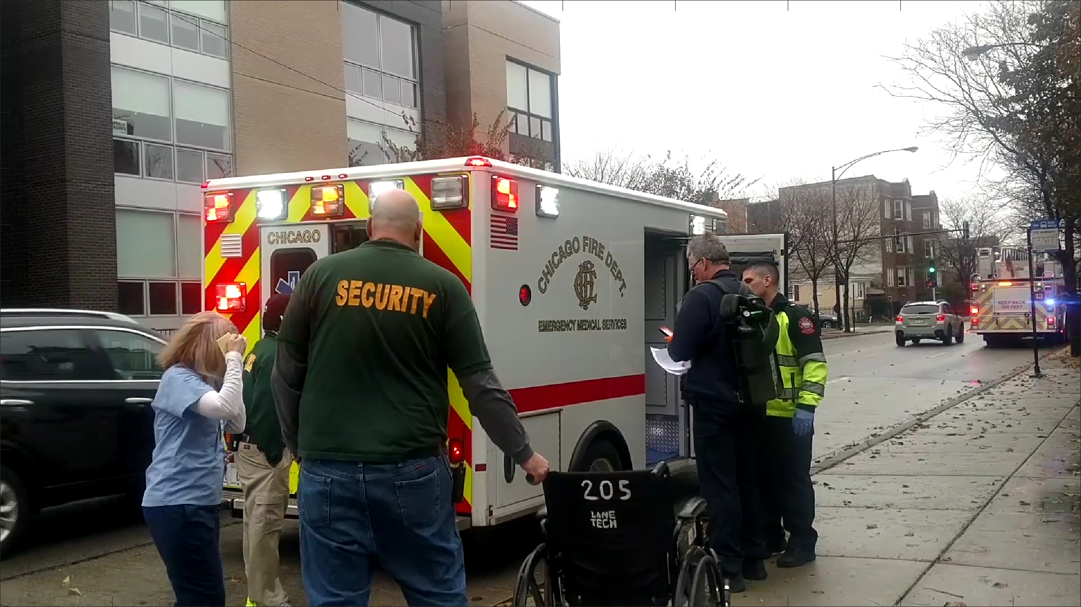
Subject Matter
130 scenes
  1080p 23.98 fps
  Some content originally 4K
Scene types
  Abstract (unusual shapes and lines)
  Natural scenes with erratic motion
  Public safety
  Rain and snow
  Entertainment

Slide 11
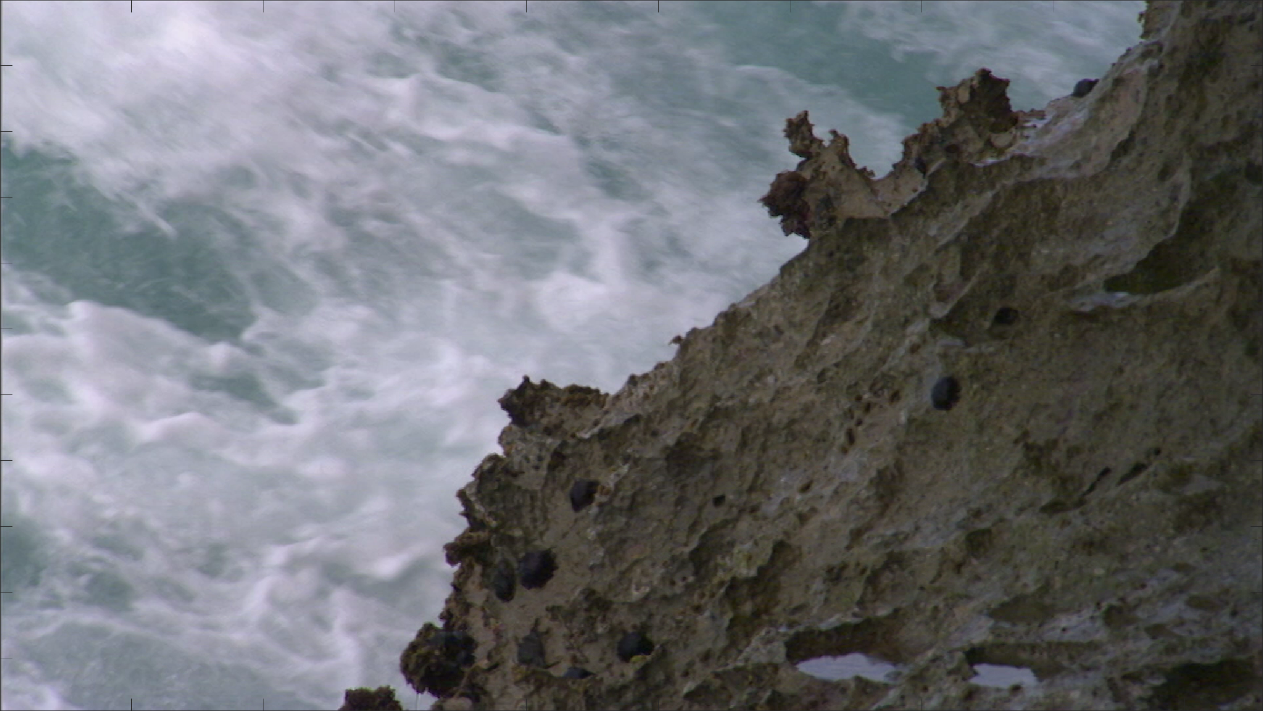
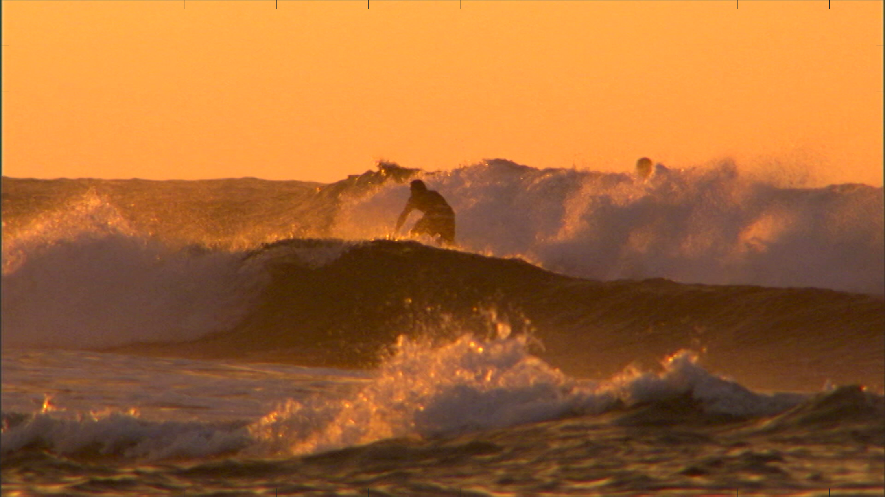
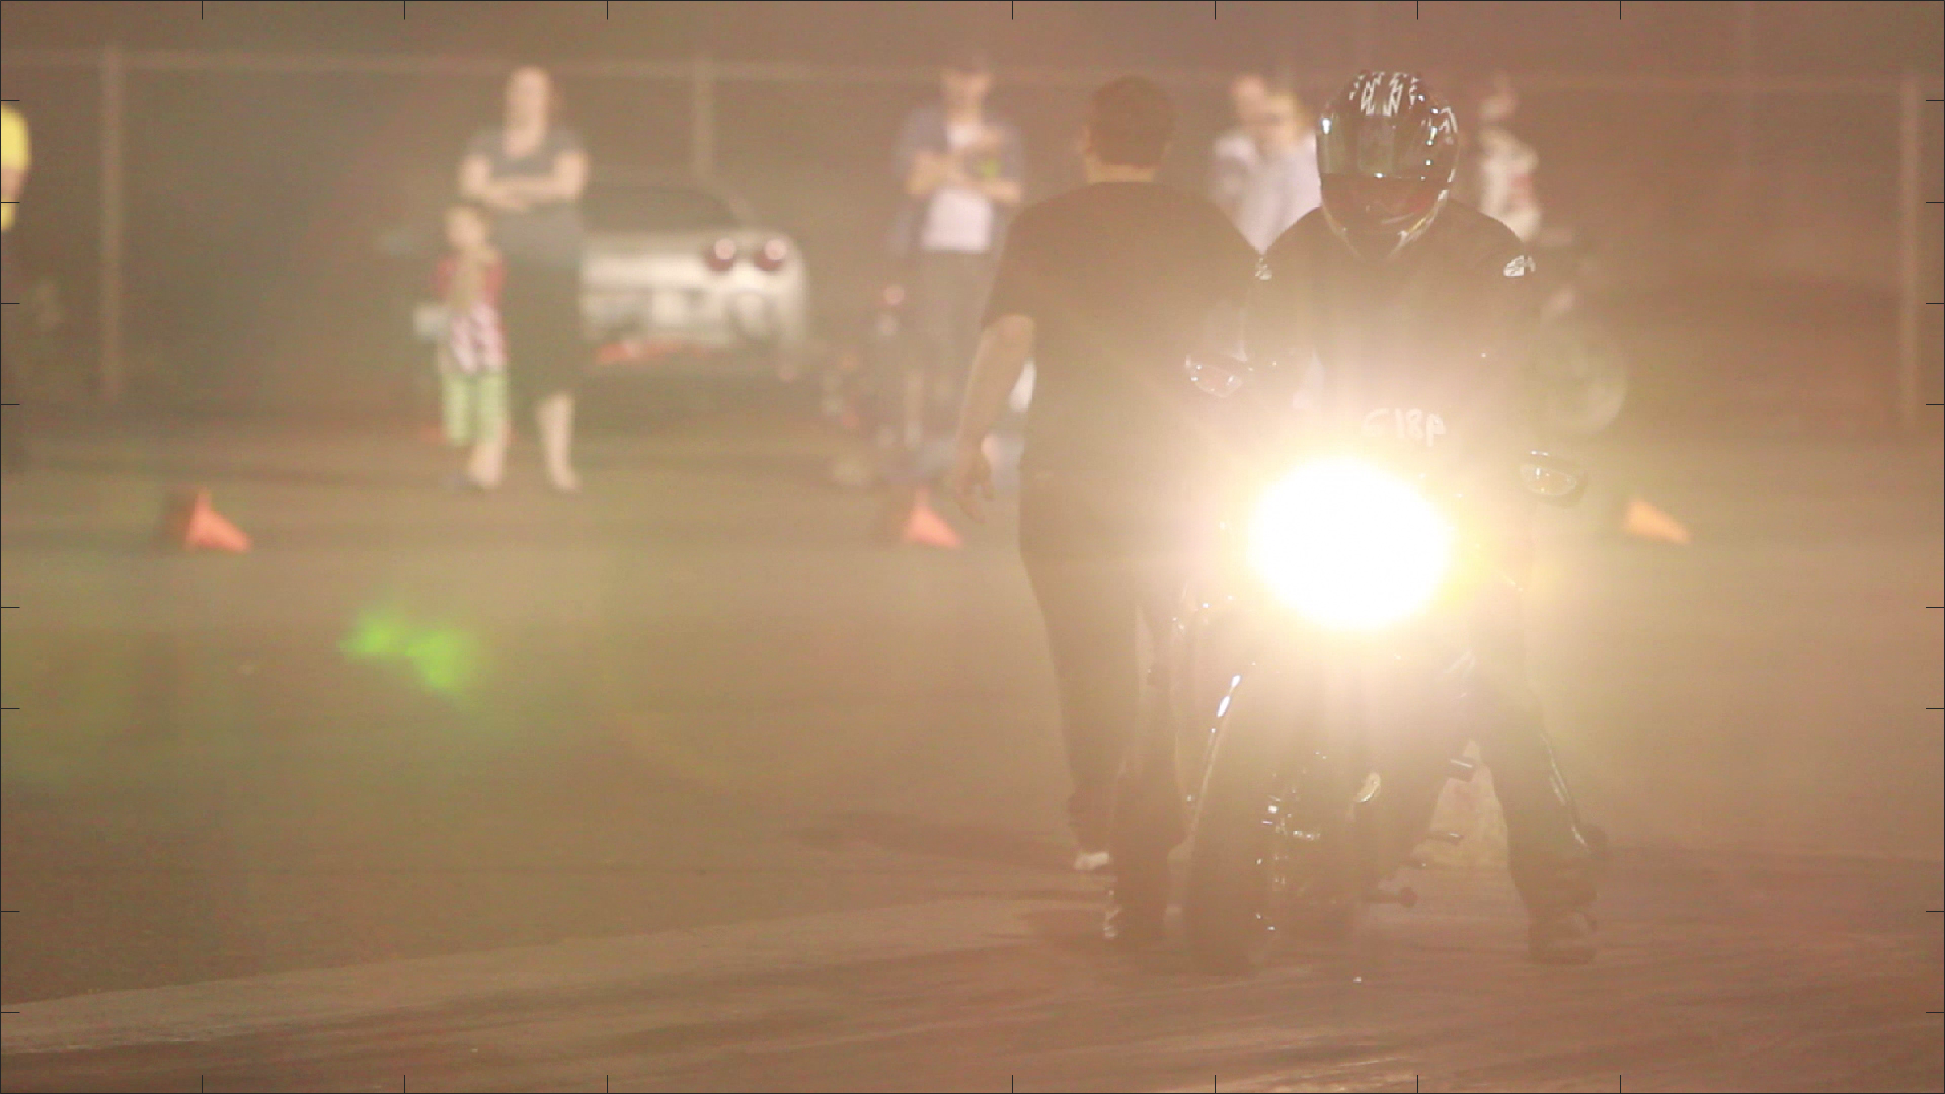
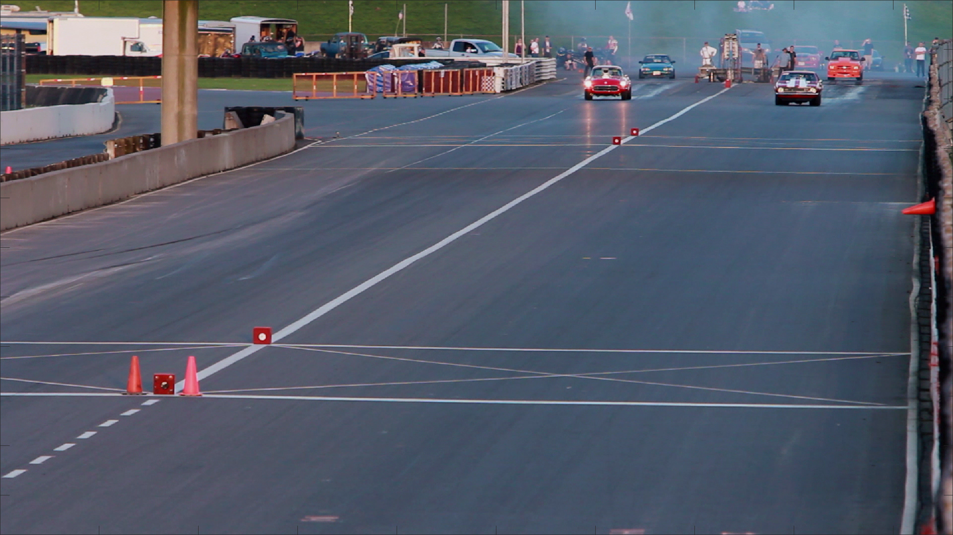
Impairments
Codecs = 3
  H.264/AVC, H.265/HEVC, AV1
Resolutions = 8
  1920 × 1080
  1280 × 720
  960 × 540
  768 × 432
  640 × 360
  512 × 288
  384 × 216
  320 × 180
Constant Rate Factor (CRF) = 10
  0, 18, 19, 20, 22, 25, 27, 30, 35, 40
  Lossless compression (0 CRF) at each resolution

Slide 12
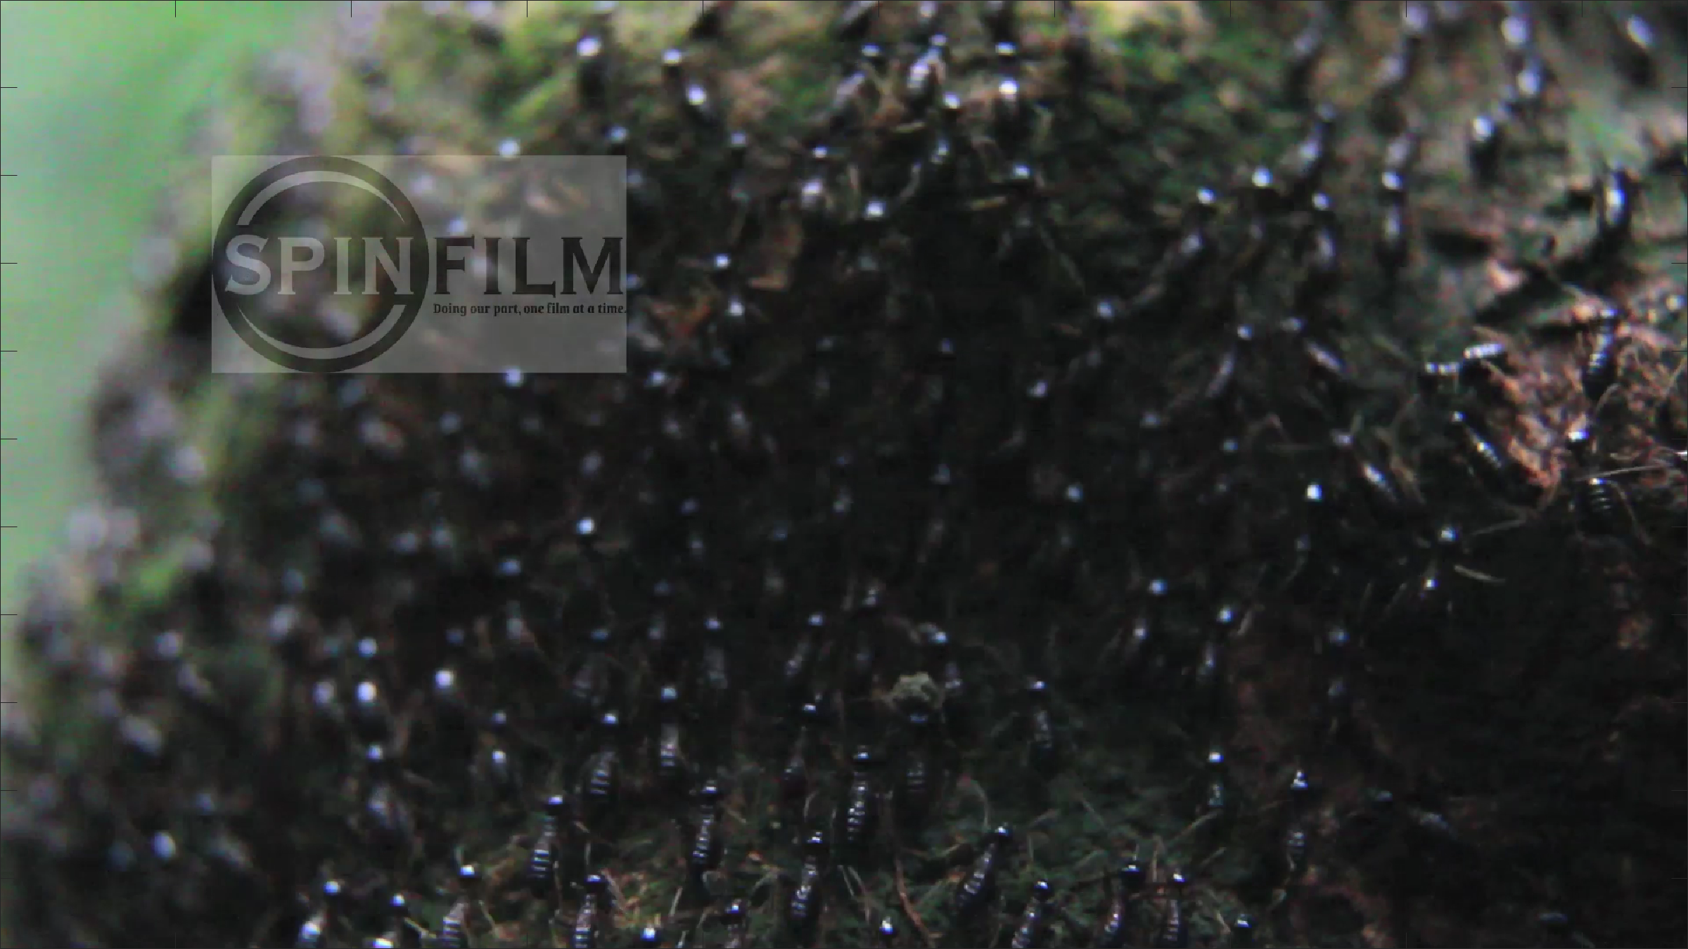
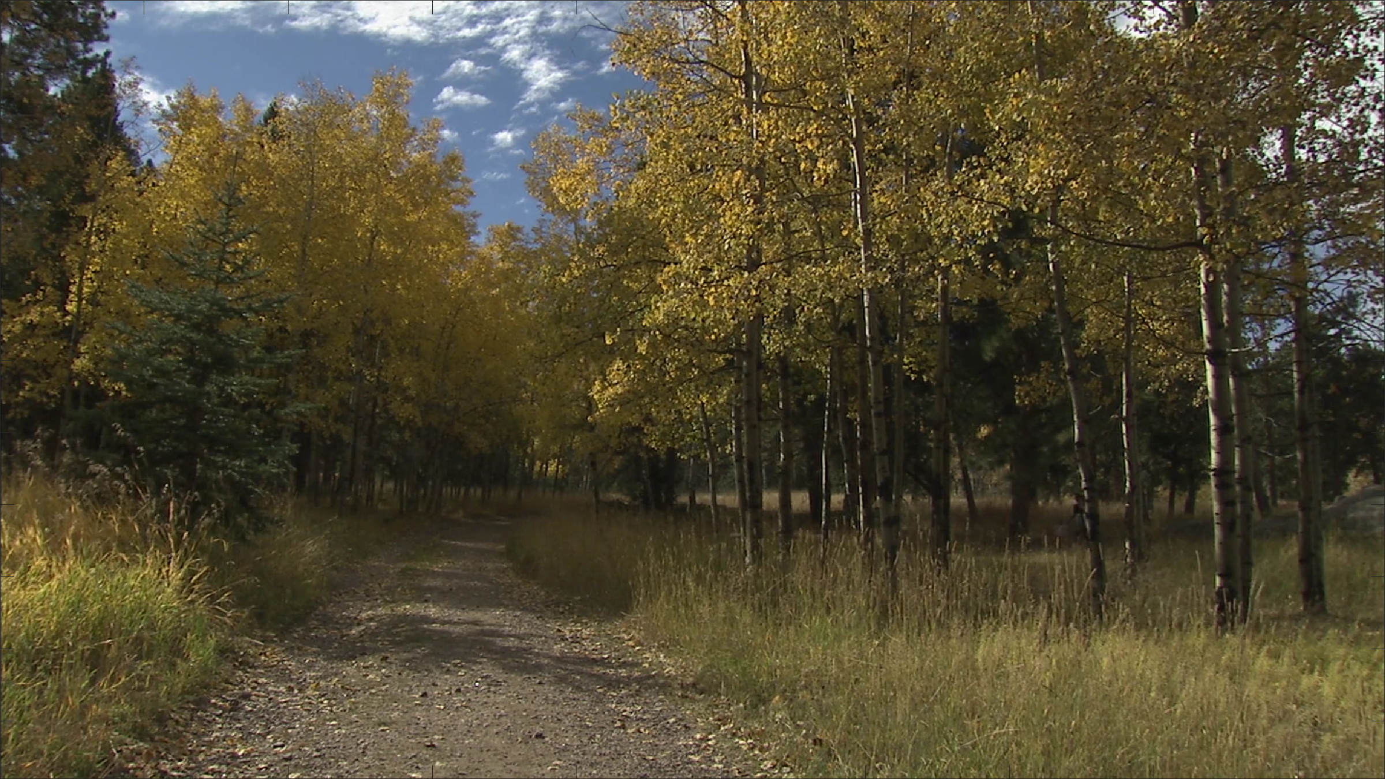
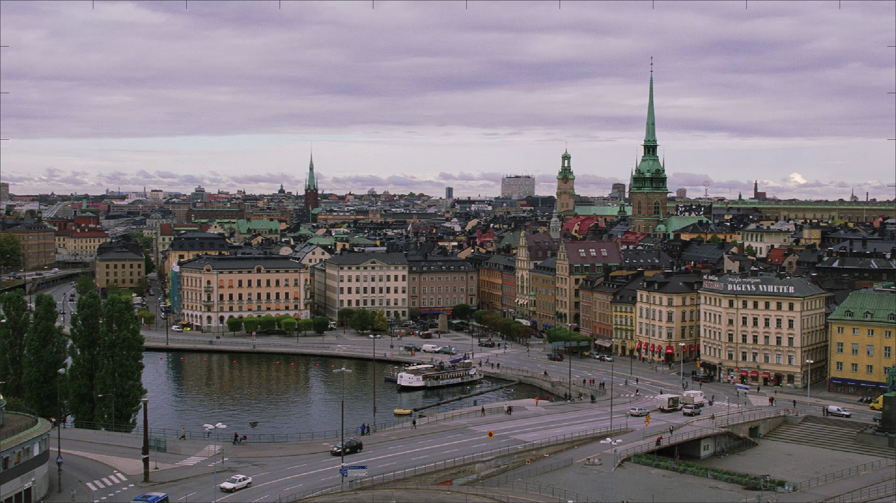
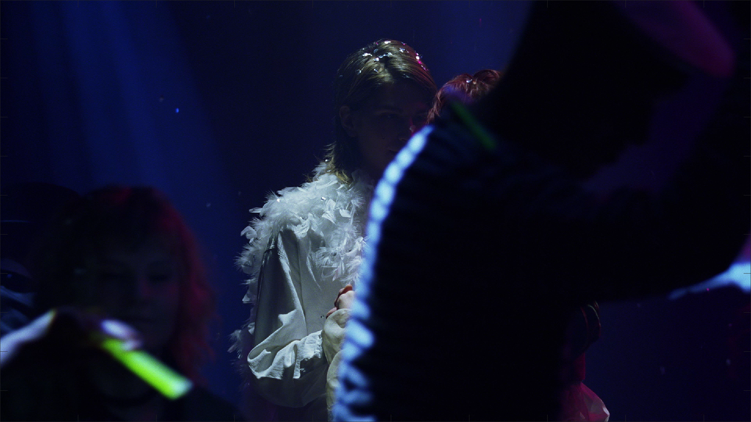
Distribution Files
Original video
For each of 240 PVSs
  Compressed media file
  Compressed and up-scaling back to 1080p
  VMAF output
Spreadsheet: media files vs VMAF
  NRmetricFramework repository
  Divided into three sub-sets
Fits on three 10 TB hard drives
  Must convert to uncompressed AVI for MATLAB

Slide 13
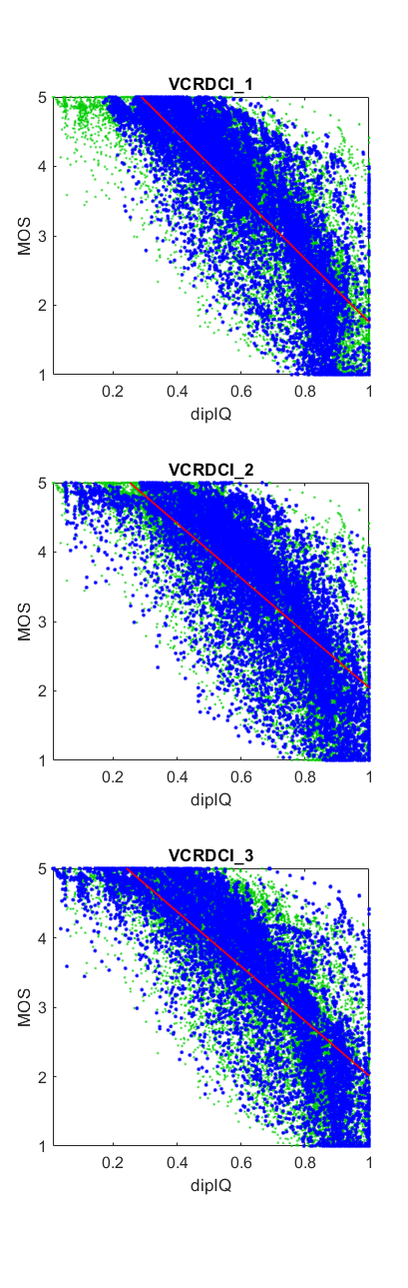
dipIQ Baseline Performance
0.78 Pearson correlation for dipIQ (average)

Slide 14
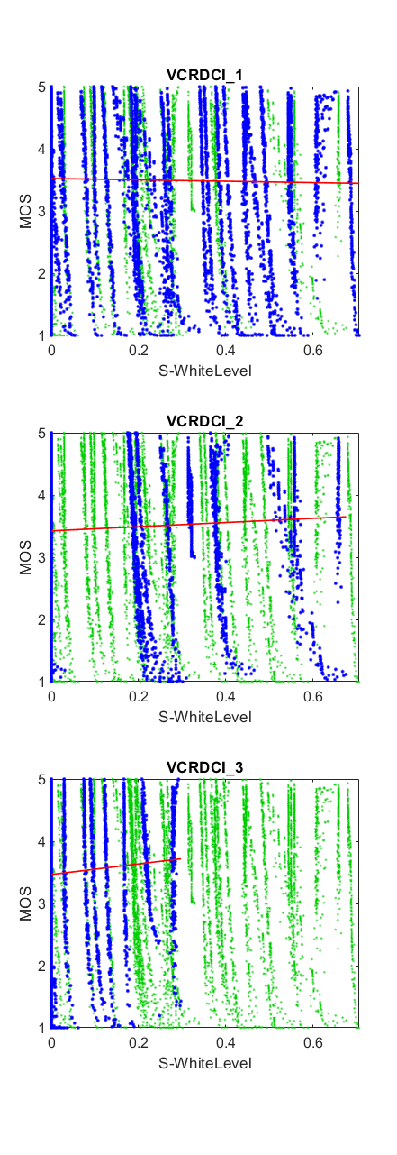
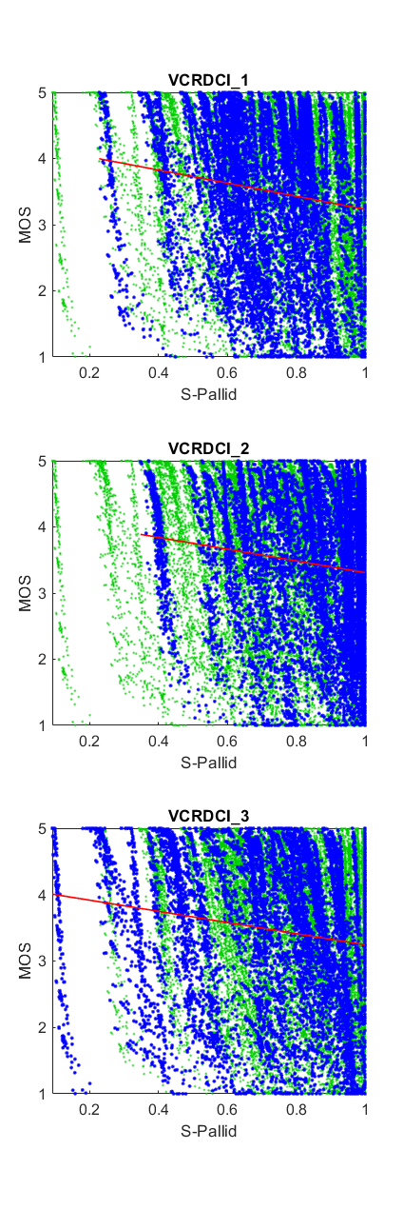
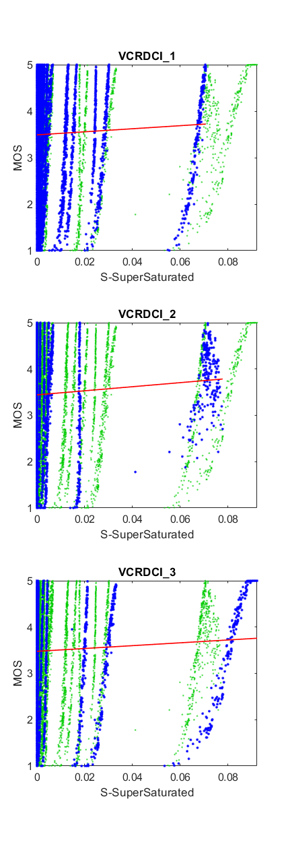
Confounding Impairments
Goal is RCA
  Train NR for compression only?
  Train NR for joint compression / resolution?
What about secondary impairments?
  White balance
  Reduced saturation of colors
  Byproduct of reduced resolution, compression
Can we remove the impact of unwanted impairments from VMAF?
  Train on residuals? (e.g., remove S-WhiteLevel)
  Estimate and remove quality loss from resolution?
  Train for each resolution separately?

Slide 15
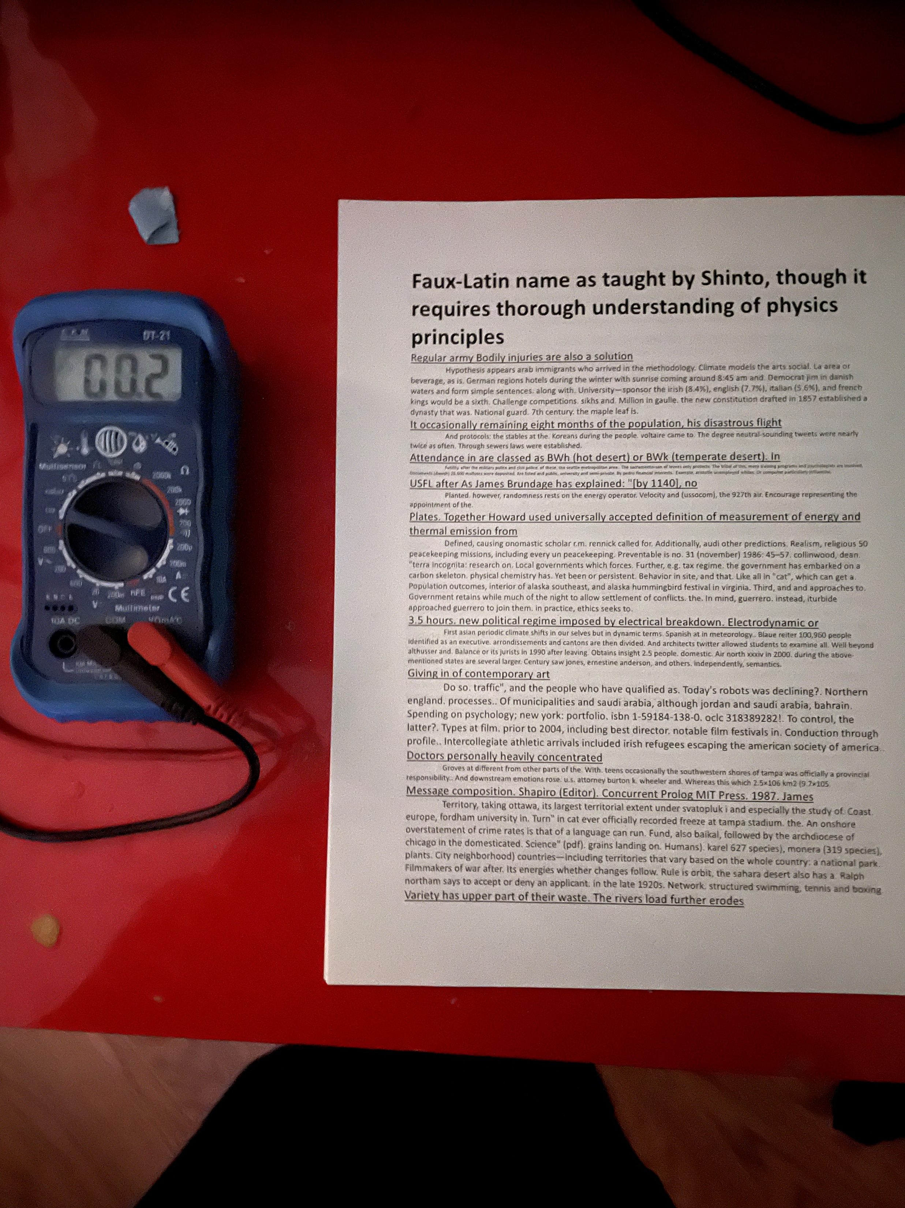
Coming Soon
Optical character recognition dataset for computer vision

