Slide 1
Why No Reference Metrics for Image and Video Quality Lack Accuracy and Reproducibility
December 13, 2022
Margaret H Pinson
mpinson@ntia.gov

Slide 2
Datasets and Subjective Testing
Upper limit on NR metric performance

Slide 3
Dataset are Noisy and Biased
Media sampling
  Systematic criteria (CCRIQ)
  Convenience sampling (VIME1)
  Maximum variety (KoNViD-1K)
System sampling
  Systematic sampling (CCRIQ)
  Convenience sampling (ITS4S3)
  Real application (ITS4S)
Use case
  User generated content
  Specific task (e.g., medical, public safety, gaming)
  Demand ≠ supply
    Broadcast video scarce
    Computer vision none
Single dataset cannot span all impairments
  Limited subject matter
  Limited impairments
  Expensive content typically omitted
Huge variety of camera capture impairments
  Some common (white level)
  Some rare (black level)
  Some not characterized

Slide 4
Upper Bound on Accuracy
Subjective Testing
Random process
VQEG lab-to-lab
  15 subjects 0.90 to 0.99 correlation
  24 subjects 0.95 to 0.99 correlation
Subjective test confidence intervals
  24 subjects ΔS_{CI} ≈ 0.5 to 0.7
  15 subjects ΔS_{CI} ≈ 0.7 to 1.0
  9 subjects ΔS_{CI} ≈ 1.1 to 1.4
  6 subjects ΔS_{CI} ≥ 1.5

Slide 5
Upper Bound on Accuracy
Subjective Testing
Metrics
Random process
VQEG lab-to-lab
  15 subjects 0.90 to 0.99 correlation
  24 subjects 0.95 to 0.99 correlation
Subjective test confidence intervals
  24 subjects ΔS_{CI} ≈ 0.5 to 0.7
  15 subjects ΔS_{CI} ≈ 0.7 to 1.0
  9 subjects ΔS_{CI} ≈ 1.1 to 1.4
  6 subjects ΔS_{CI} ≥ 1.5
0.96 < ρ ≤ 1.0 overtrained
0.90 < ρ ≤ 0.96 extraordinary claim,
extraordinary proof
Pearson correlation (ρ)
  Depends on rage of MOSs
  Potentially misleading
Scatter plots

Slide 6
Scope Limitations
Do they help or harm?

Slide 7
Scope Limitations to Simplify Research
Focus on specific impairments
  Intentional
  Unintentional
  Simulated impairments (Gaussian noise)
Specific subject matter
  VIQET: flat surface, landmark at night,
  landscape with good lighting, still life
Specific use case
  DIQA dataset: optical character recognition
  AMD metric: dermoscopy images (skin lesions)
  NIQE-K: ultrasound images
Single training dataset
  Proof of concept
  Show improvement for this dataset
LIVE 2006
  Single outdated dataset
  10+ year old camera systems

Slide 8
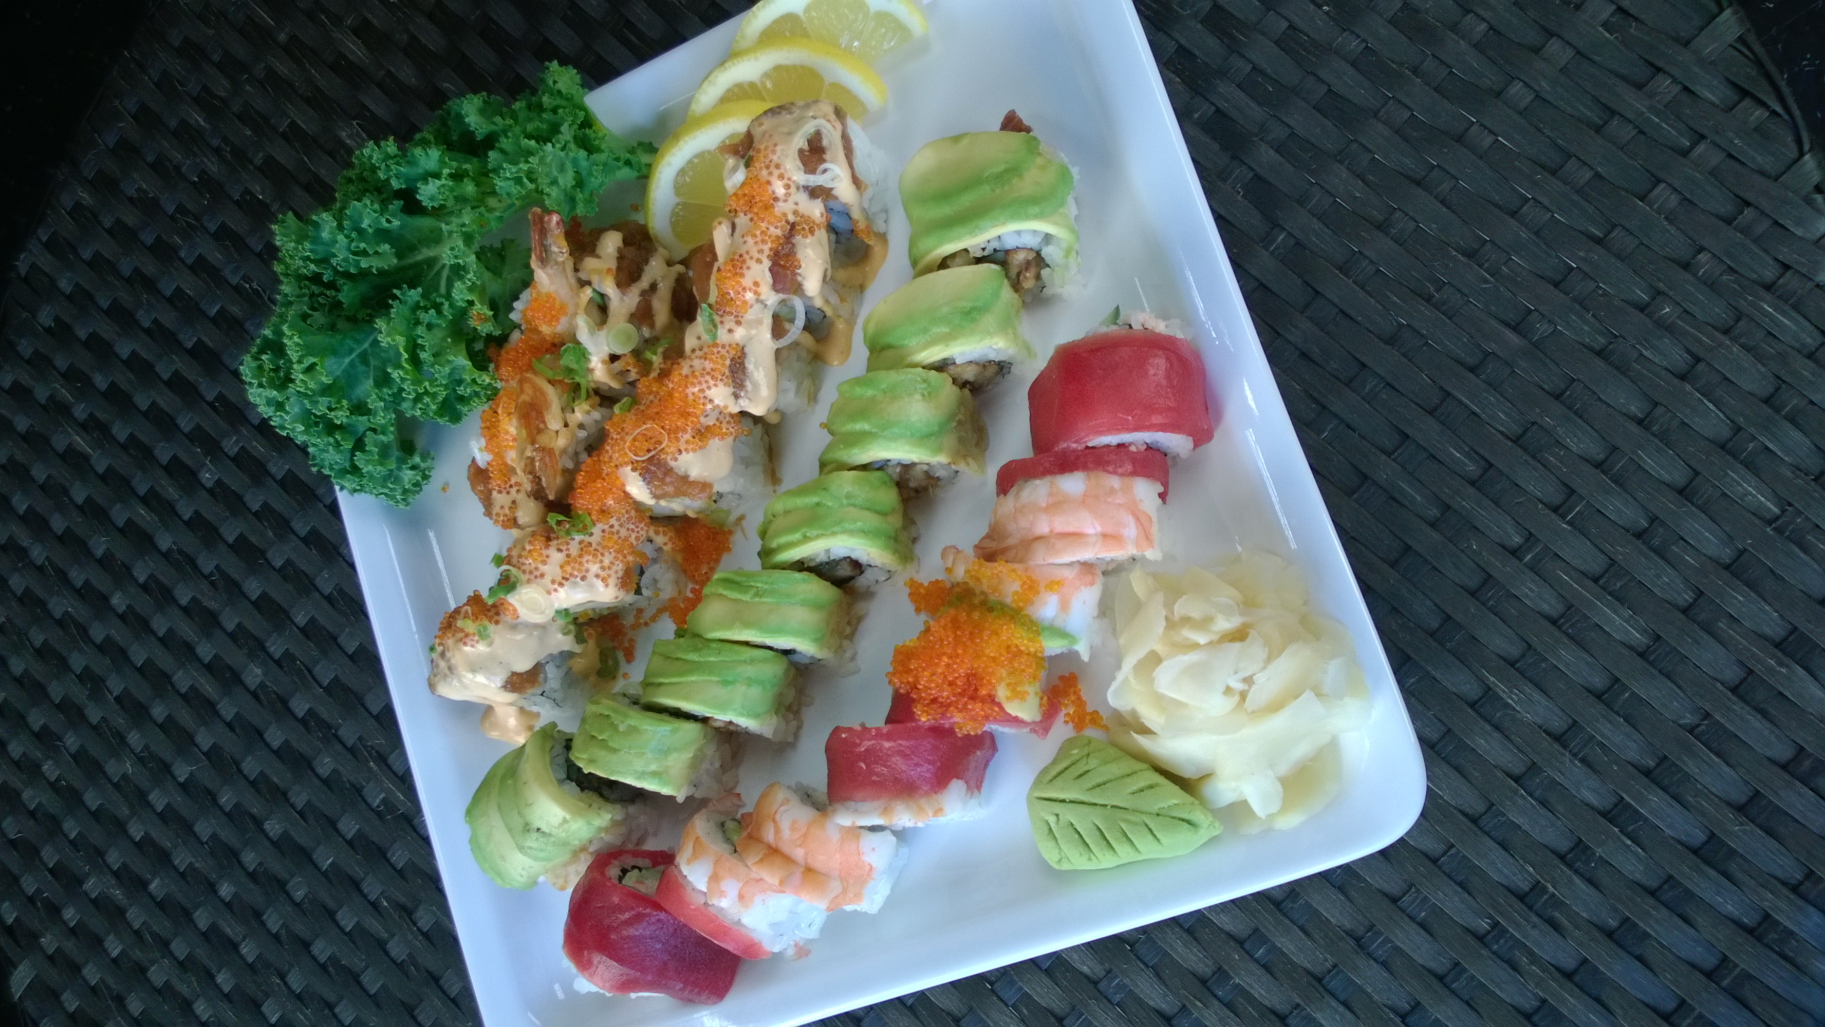
Scope Limitations to Simplify Research
Experts differentiate between
  Aesthetics
  Subject matter
  Camera capture impairments
  Format (e.g., resolution, fps)
  Compression
  Transmission errors
But non-experts don’t differentiate
  Ignore scope limitations
  MOS influenced by out-of-scope impairments
How much of the impairment is caused by the angle?
MOS = 3.4

Slide 9
Literature Search
Developer vs. Evaluator
Performance data available from developer and multiple independent evaluators

Slide 10
Accuracy Claims from Peer Reviewed Publications
Developer
Evaluators
Developer’s ρ
  Usually, a single dataset
  Extraordinary developer claims (ρ > 0.9)
  without extraordinary evidence
Multiple evaluator’s ρ
  Unforeseen dataset
  Modern camera systems
  Usually, a single dataset
Ignore
  Metric’s intended scope
  Retraining and fitting may differ
  Logistic fit hides nonlinearity problems

Slide 11
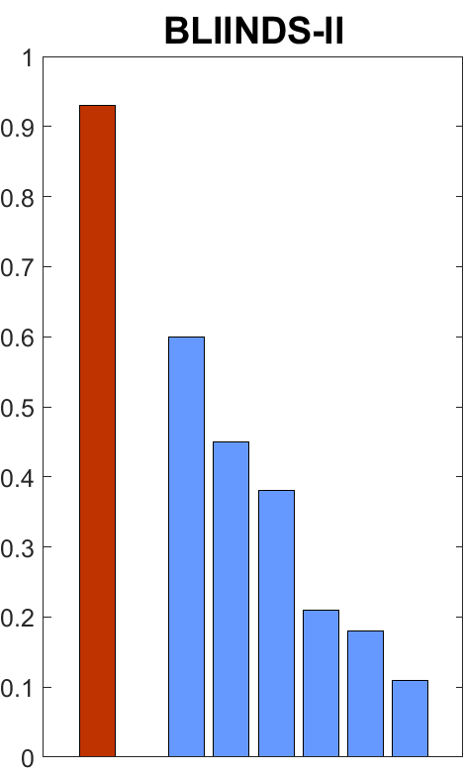
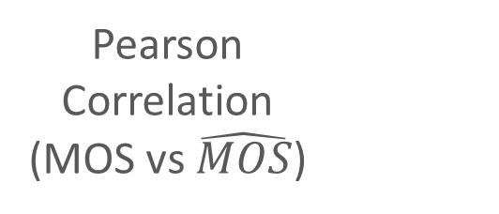
Published Performance Analyses
Pearson
Correlation
(MOS vs $\hat{MOS}$)
Developer
Evaluations

Slide 12
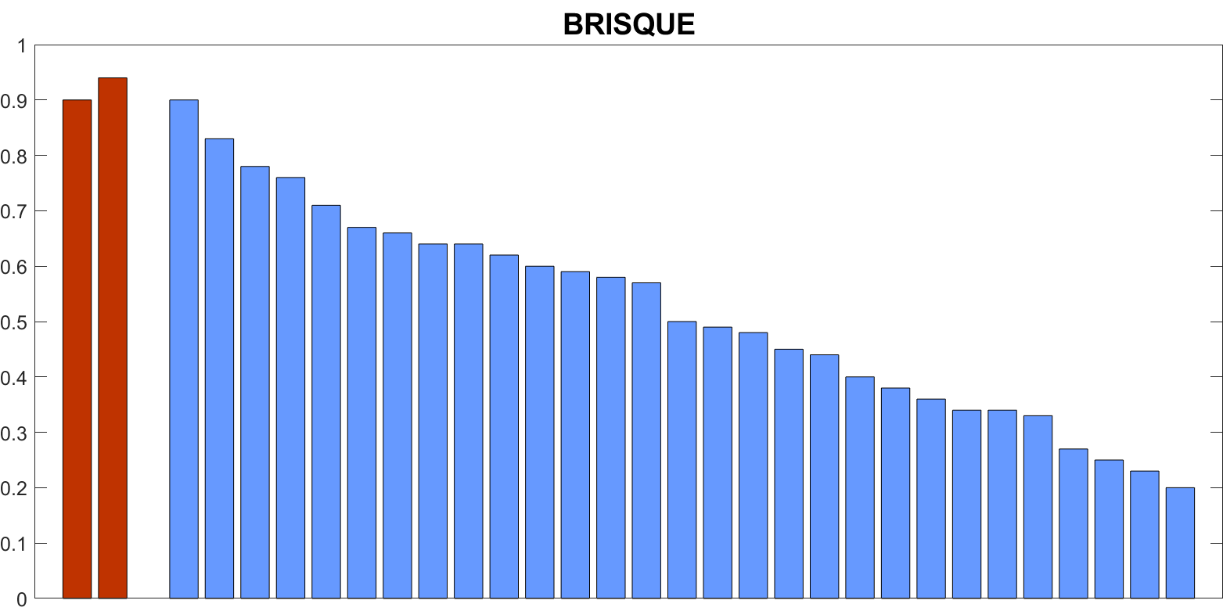
Published Performance Analyses
Pearson
Correlation
(MOS vs $\hat{MOS}$)
Developer
Evaluations

Slide 13
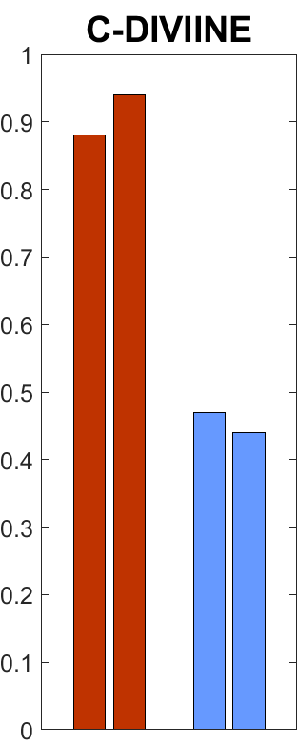
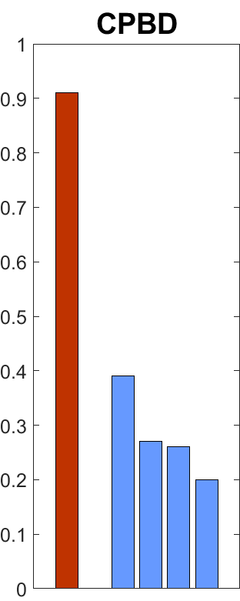
Published Performance Analyses
Pearson
Correlation
(MOS vs $\hat{MOS}$)
Developer
Evaluations
Developer
Evaluations

Slide 14
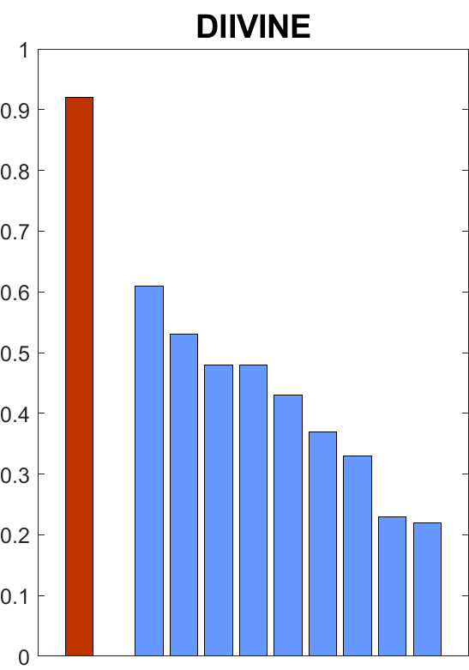
Published Performance Analyses
Pearson
Correlation
(MOS vs $\hat{MOS}$)
Developer
Evaluations

Slide 15
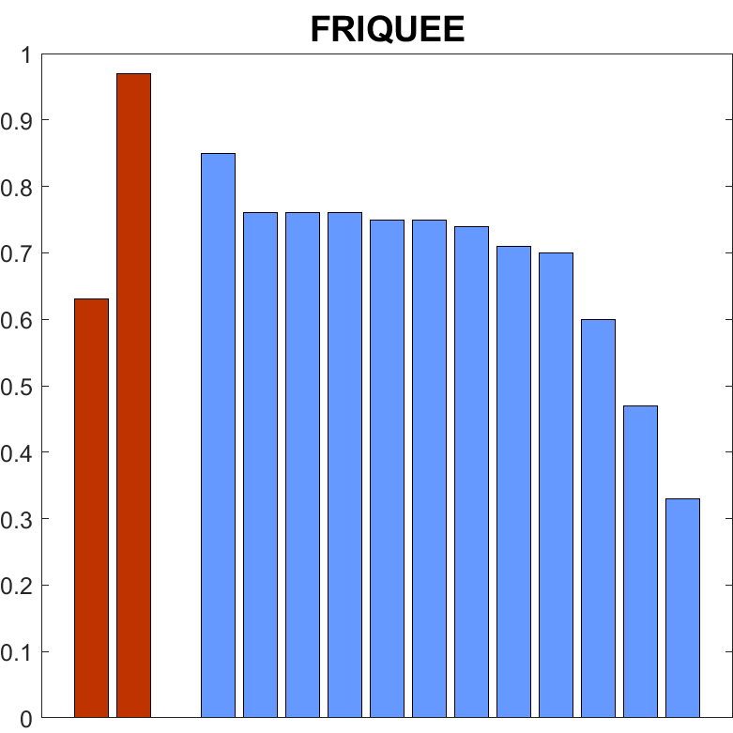
Published Performance Analyses
Pearson
Correlation
(MOS vs $\hat{MOS}$)
Developer
Evaluations

Slide 16
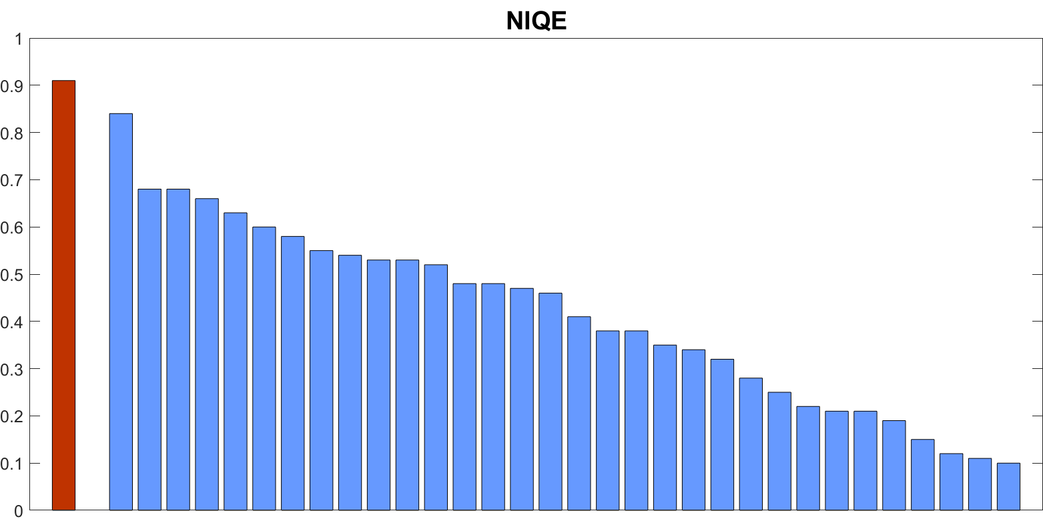
Published Performance Analyses
Pearson
Correlation
(MOS vs $\hat{MOS}$)
Developer
Evaluations

Slide 17
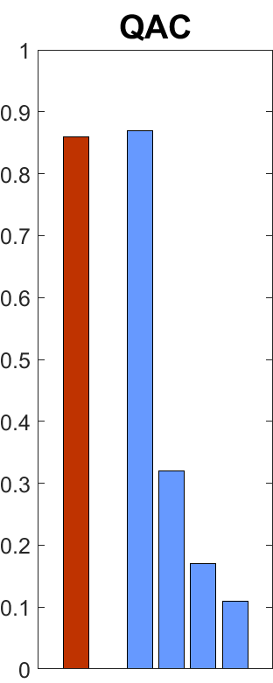
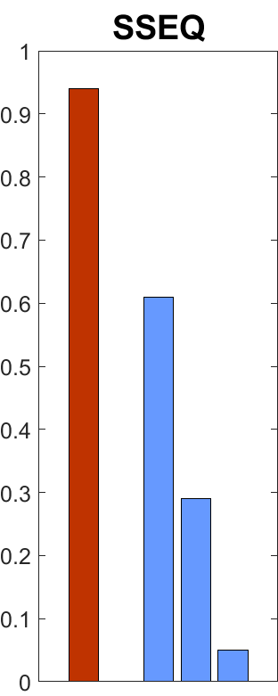
Published Performance Analyses
Pearson
Correlation
(MOS vs $\hat{MOS}$)
Developer
Evaluations
Developer
Evaluations

Slide 18
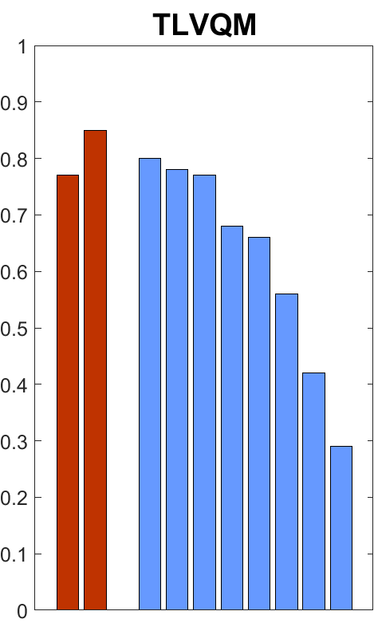
Published Performance Analyses
Pearson
Correlation
(MOS vs $\hat{MOS}$)
Developer
Evaluations

Slide 19
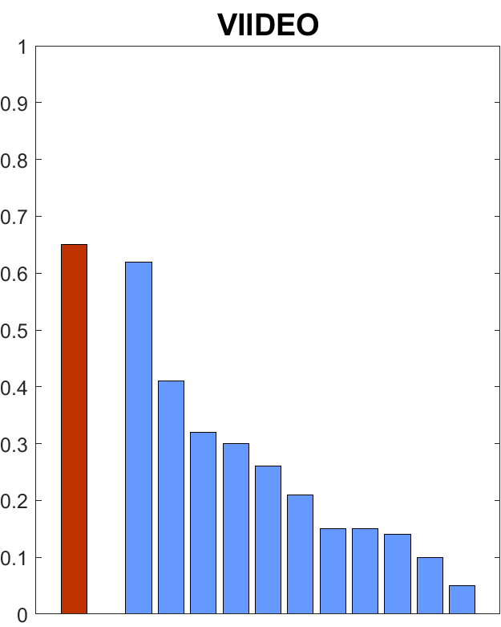
Published Performance Analyses
Pearson
Correlation
(MOS vs $\hat{MOS}$)
Developer
Evaluations

Slide 20
Conclusions
Sufficient data
Single dataset
Insufficient data
  Developers and evaluators
  “Proof of concept” dataset
  Imply results will extend
Widespread misinformation
  Accuracy of specific metrics
  Merit of various development strategies
Single dataset strategy cannot be justified

Slide 21
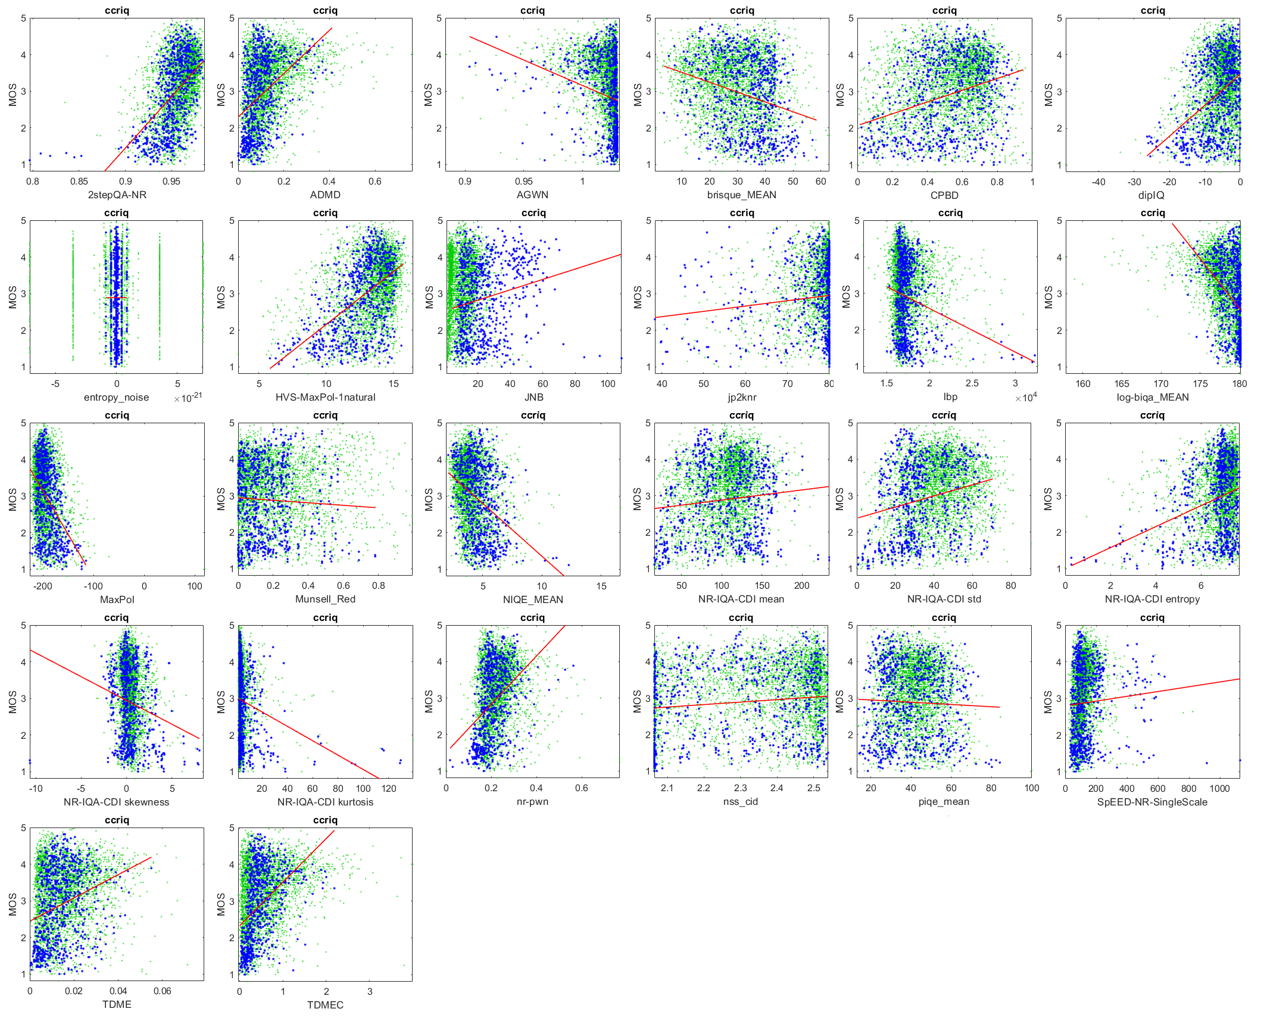
RCA
Our Analysis of NR Metrics
Evaluator role
12 datasets
Easily available metrics
Doesn’t take forever to run

Slide 22
Our Analysis of NR Metrics
My Evaluation
Response to unforeseen content
  Camera capture
  Modern video streaming systems
12 datasets
  6 IQA with camera capture
  3 VQA with camera capture
  3 VQA with compression, broadcast use case
Scatter plot

Slide 23
My Rating Scale
Rating Scale for RCA Metrics
Ideal Scatter Plot
⭐ | Very inaccurate
⭐ ⭐ | Promising results
⭐ ⭐ ⭐ | Consistent performance for 10+ datasets. Valid for all media.
⭐ ⭐ ⭐ ⭐ | To be determined
⭐ ⭐ ⭐ ⭐ ⭐ | To be determined
minor factor
(impairment)
major factor
MOS
MOS
Metric
minor factor (enhancement)
major factor
MOS
MOS
Metric
Metric

Slide 24
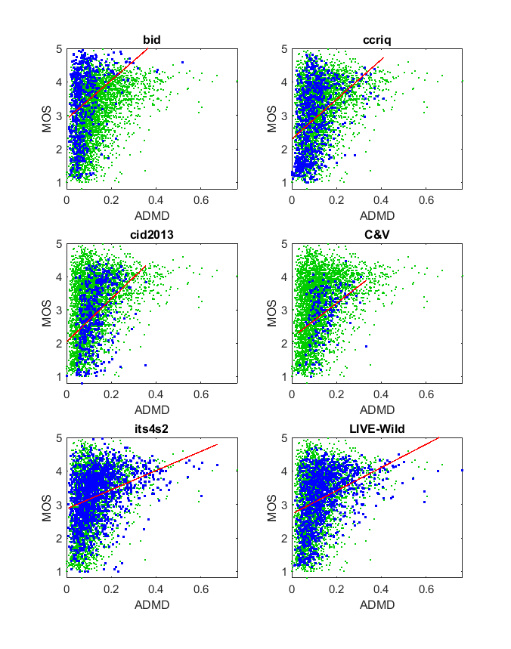
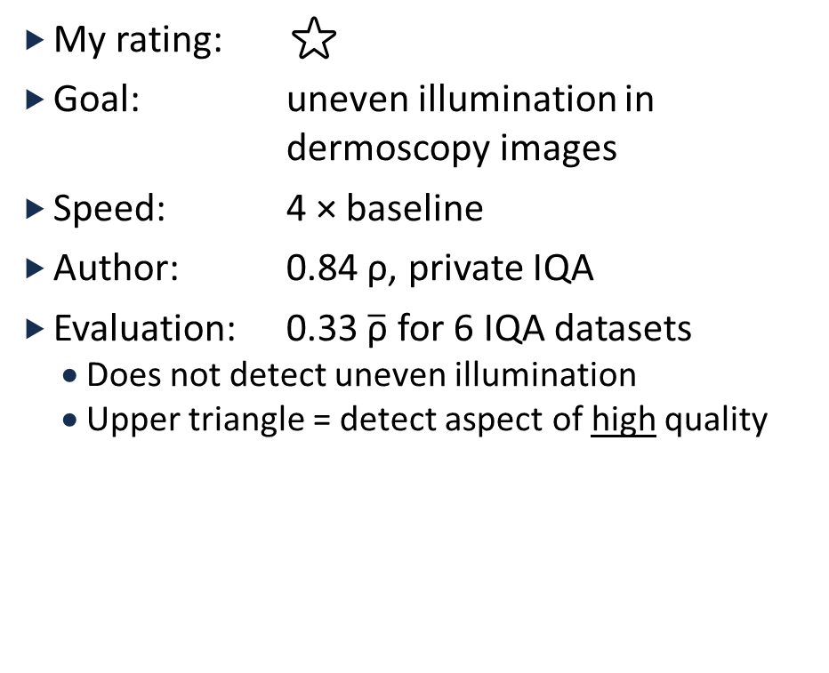
ADMD
My rating: ⭐
Goal: uneven illumination in
dermoscopy images
Speed: 4 × baseline
Author: 0.84 ρ, private IQA
Evaluation: 0.33 $\overline{\text{ρ}}$ for 6 IQA datasets
  Does not detect uneven illumination
  Upper triangle = detect aspect of high quality

Slide 25
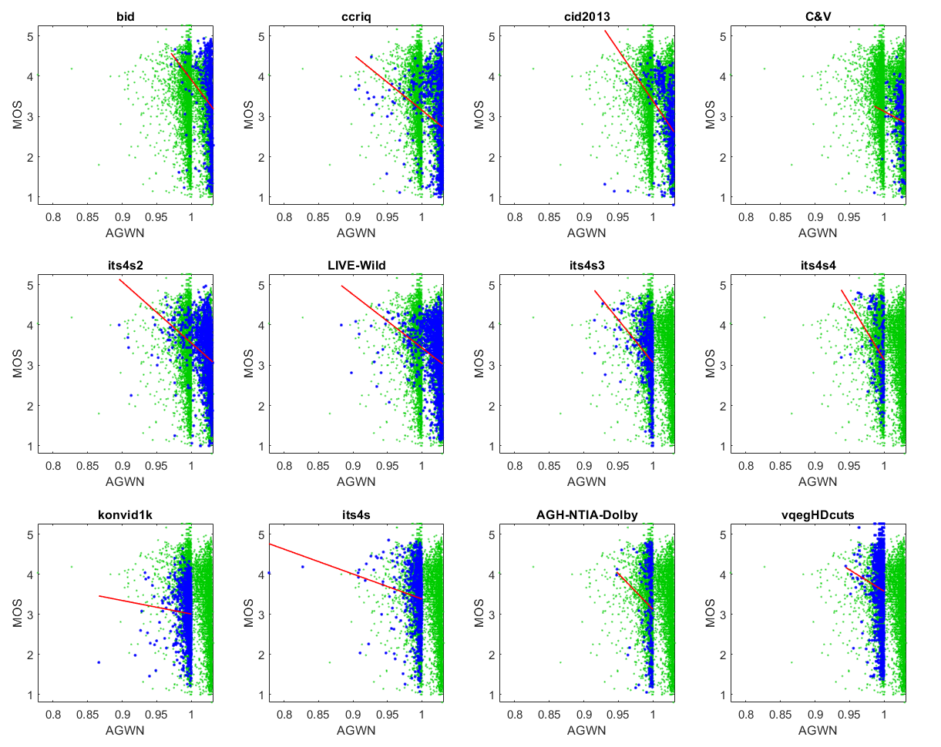
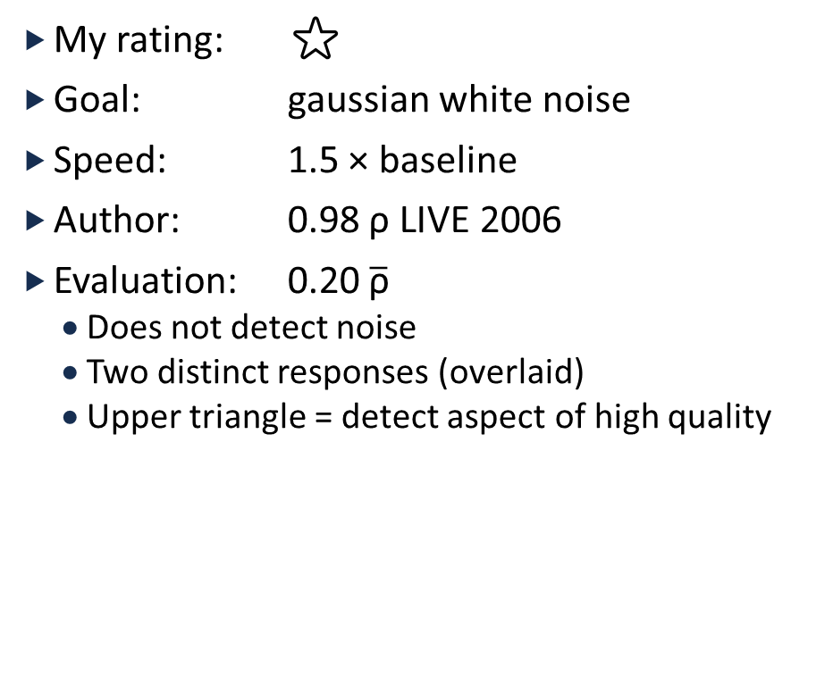
AGWN
My rating: ⭐
Goal: gaussian white noise
Speed: 1.5 × baseline
Author: 0.98 ρ LIVE 2006
Evaluation: 0.20 $\overline{\text{ρ}}$
  Does not detect noise
  Two distinct responses (overlaid)
  Upper triangle = detect aspect of high quality

Slide 26
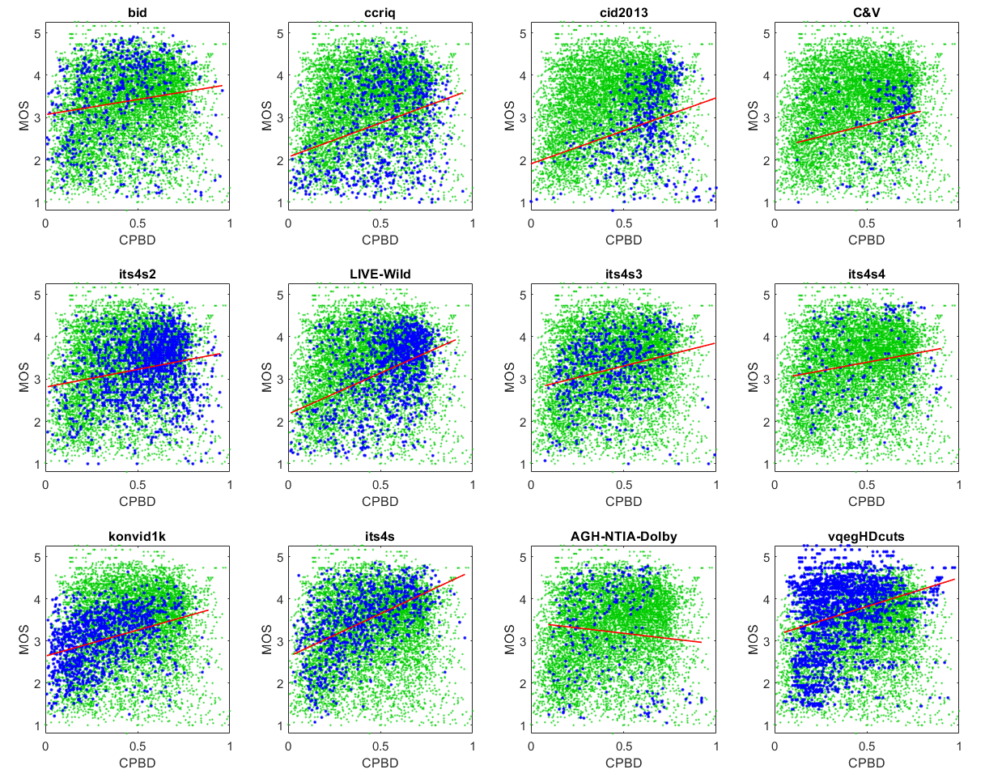
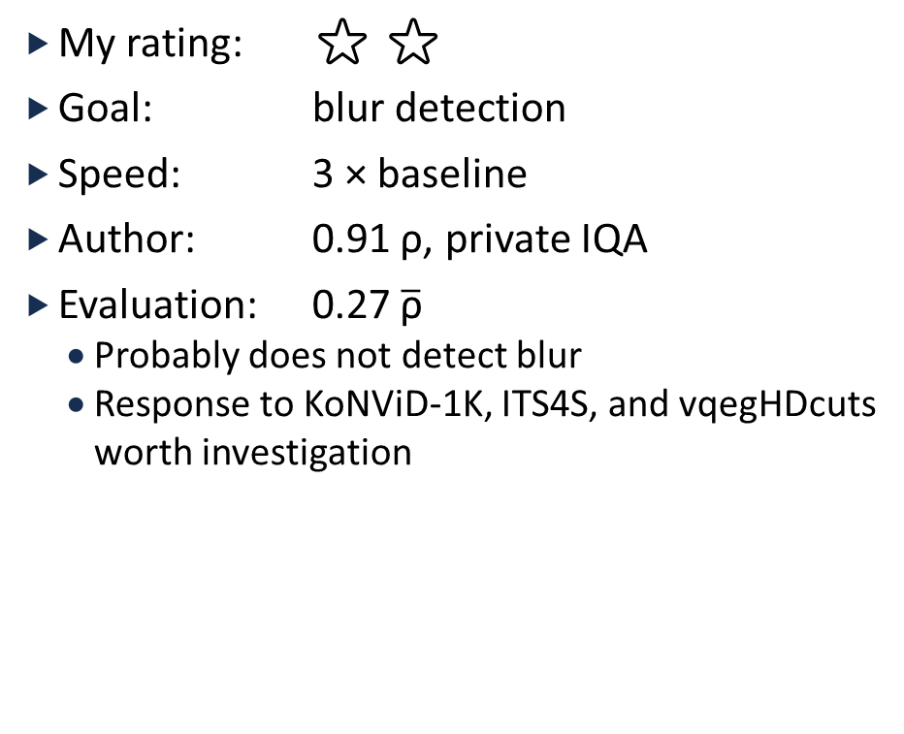
CPBD
My rating: ⭐ ⭐
Goal: blur detection
Speed: 3 × baseline
Author: 0.91 ρ, private IQA
Evaluation: 0.27 $\overline{\text{ρ}}$
  Probably does not detect blur
  Response to KoNViD-1K, ITS4S, and vqegHDcuts worth investigation

Slide 27
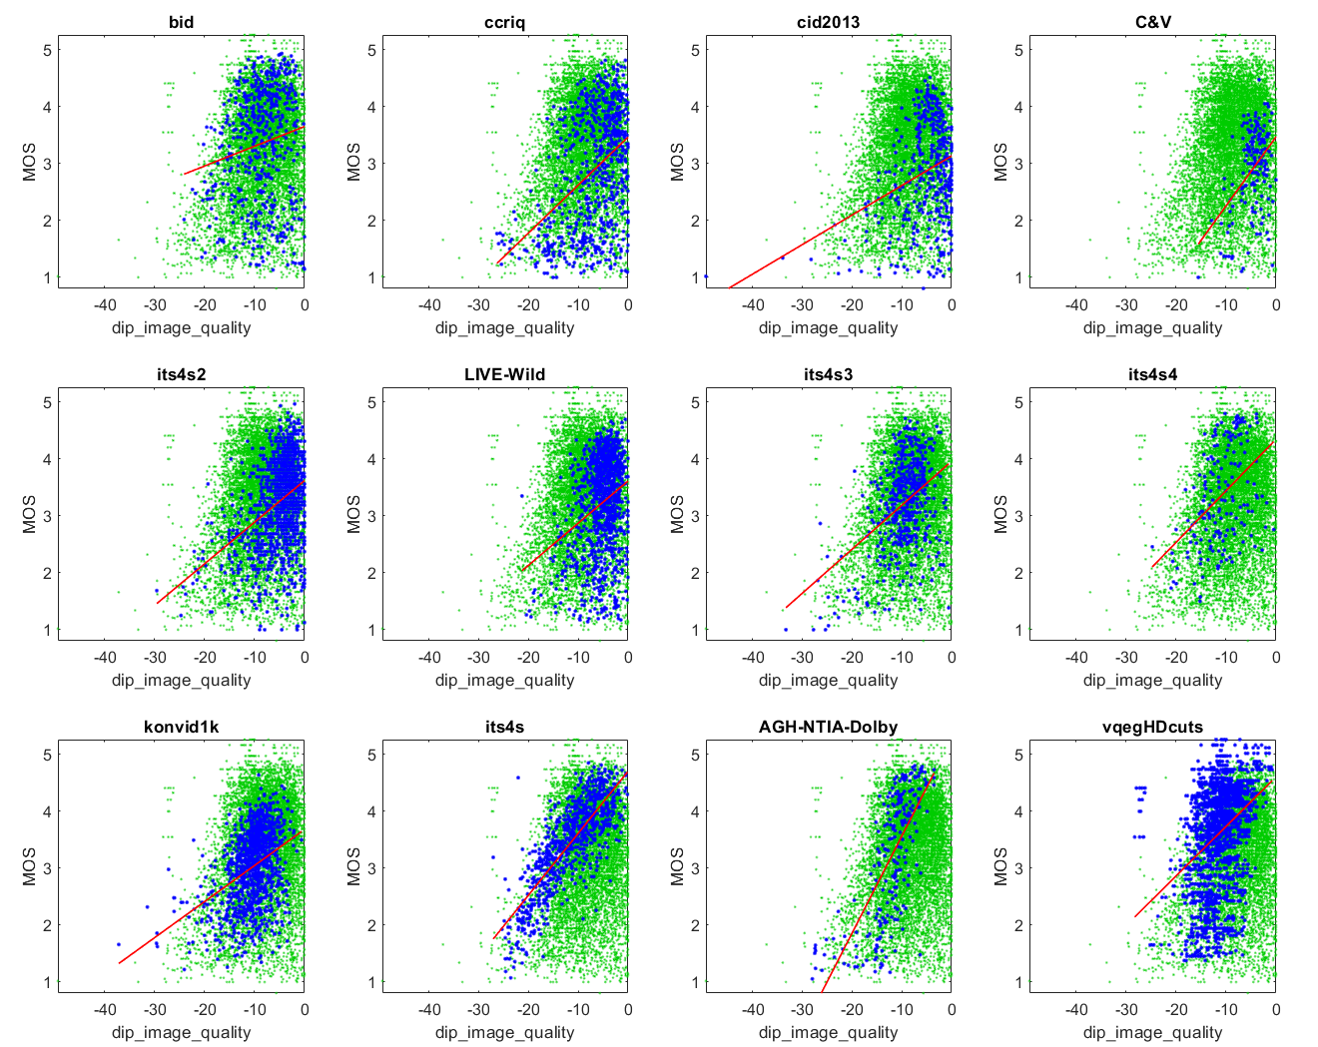
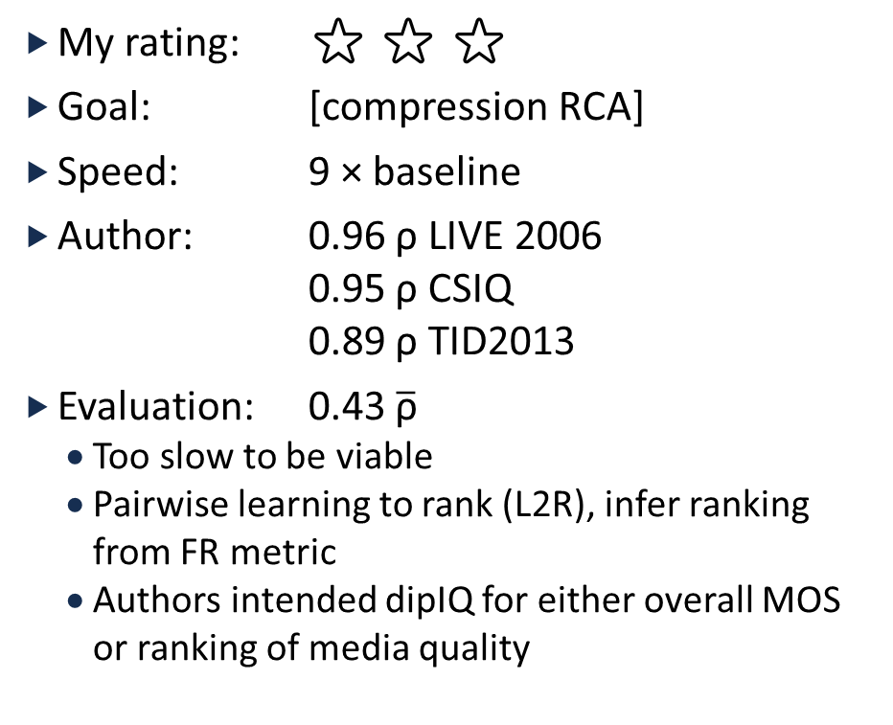
dipIQ
My rating: ⭐ ⭐ ⭐
Goal: [compression RCA]
Speed: 9 × baseline
Author: 0.96 ρ LIVE 2006
0.95 ρ CSIQ
0.89 ρ TID2013
Evaluation: 0.43 $\overline{\text{ρ}}$
  Too slow to be viable
  Pairwise learning to rank (L2R), infer ranking from FR metric
  Authors intended dipIQ for either overall MOS or ranking of media quality

Slide 28
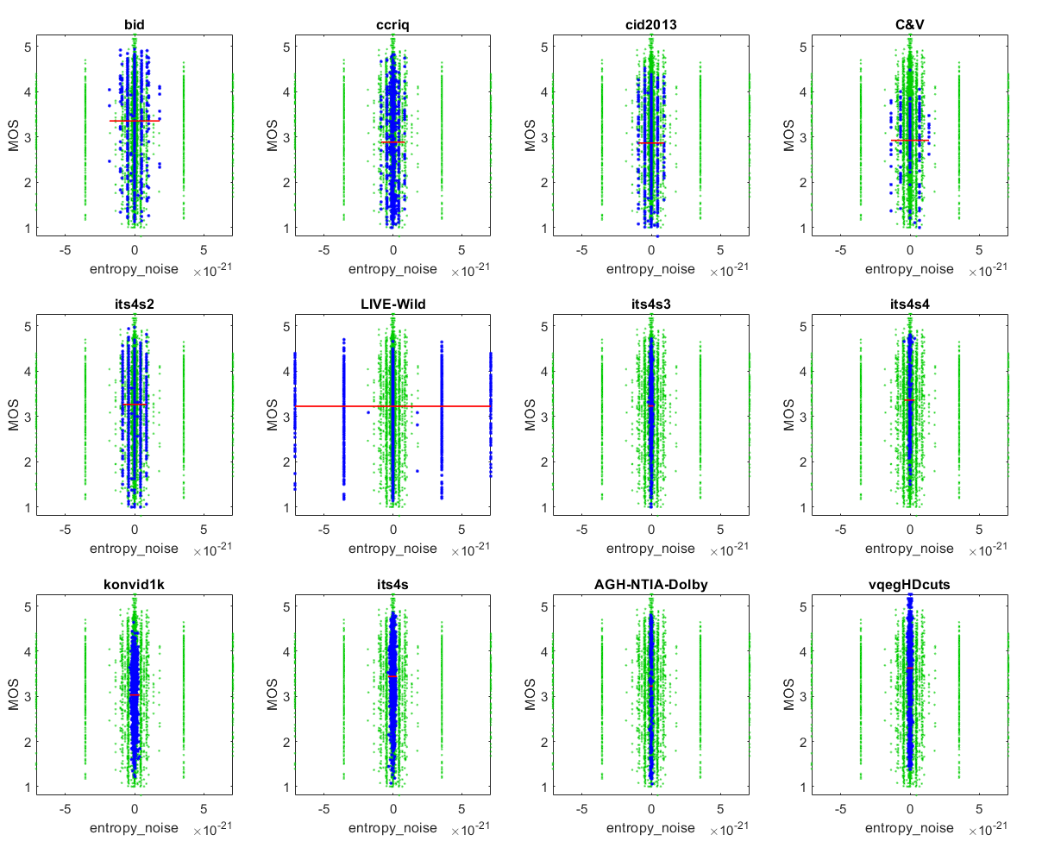
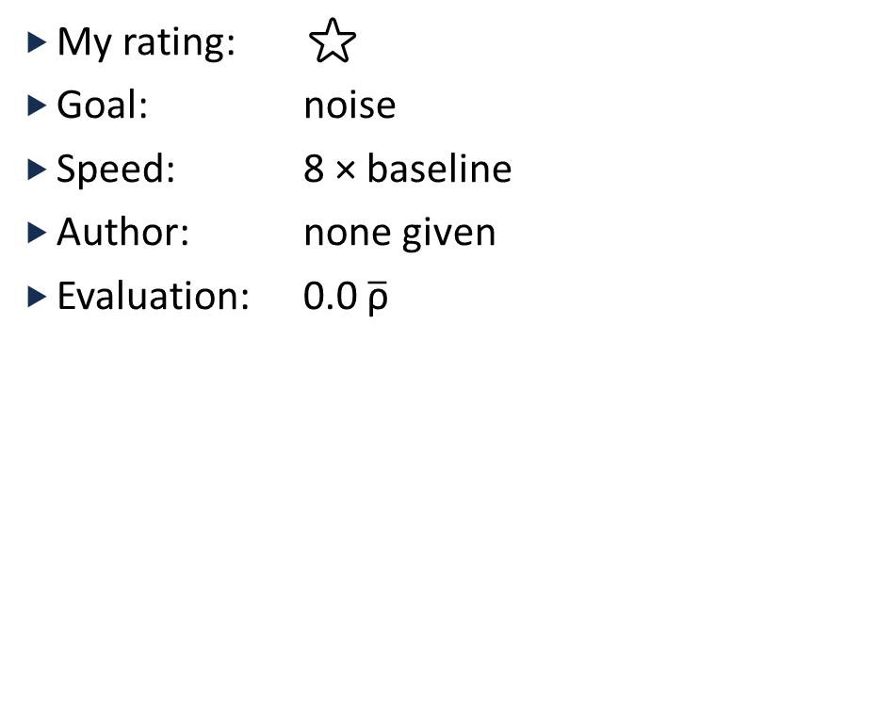
Entropy Noise
My rating: ⭐
Goal: noise
Speed: 8 × baseline
Author: none given
Evaluation: 0.0 $\overline{\text{ρ}}$

Slide 29
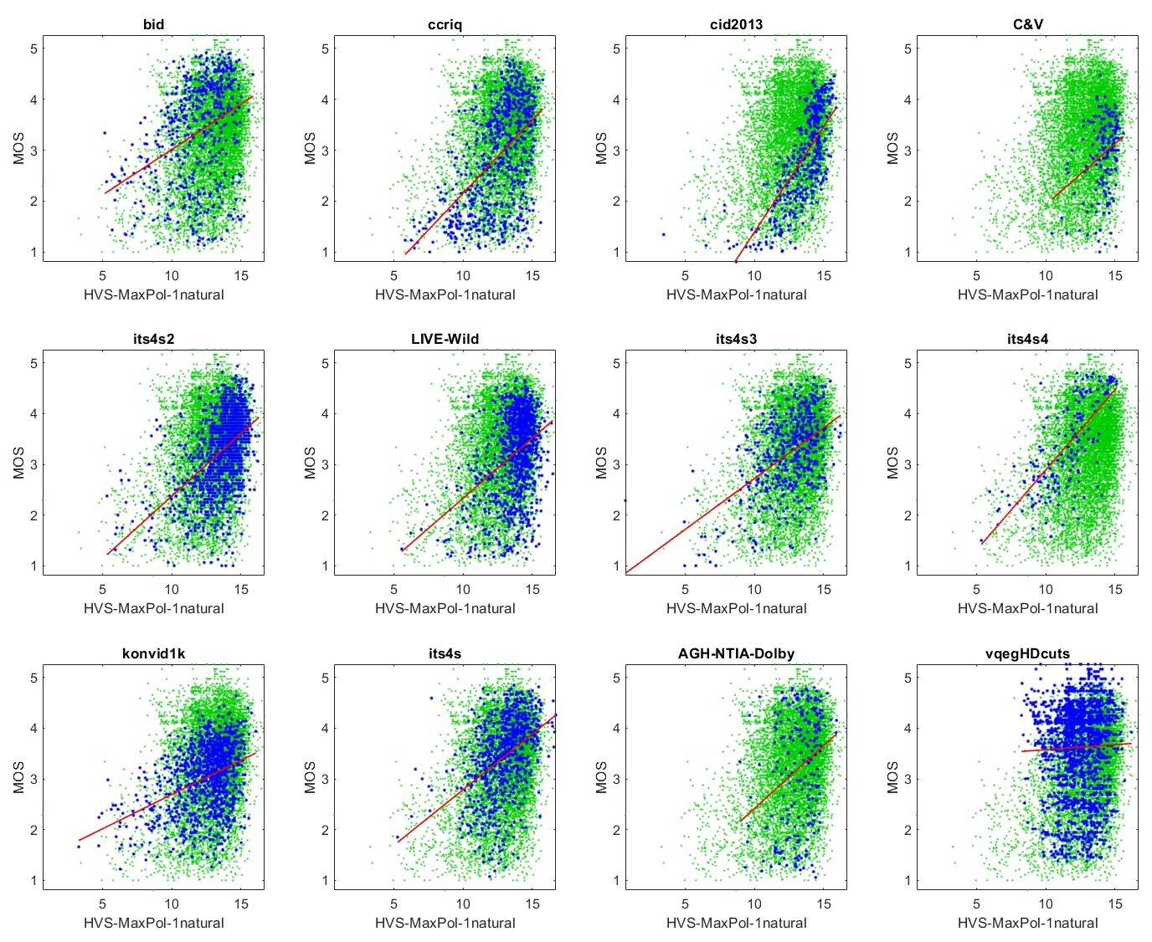
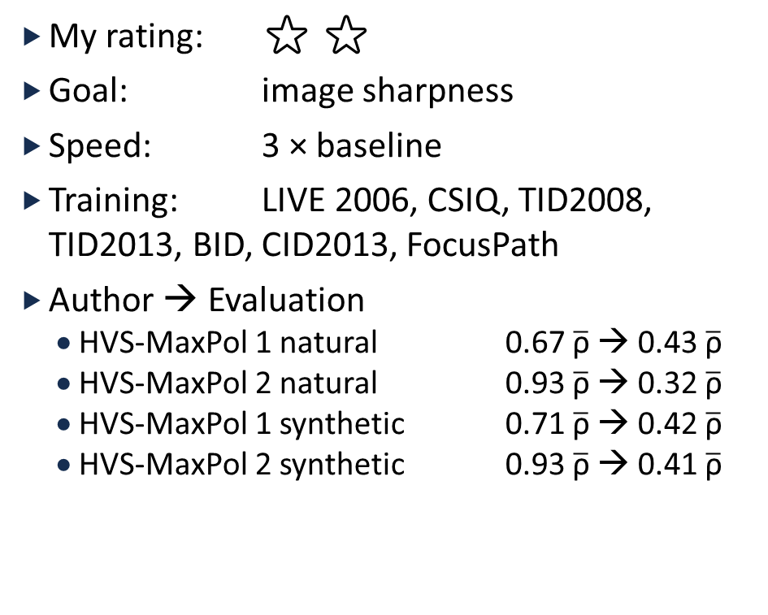
HVS-MaxPol
My rating: ⭐ ⭐
Goal: image sharpness
Speed: 3 × baseline
Training: LIVE 2006, CSIQ, TID2008, TID2013, BID, CID2013, FocusPath
Author → Evaluation
  HVS-MaxPol 1 natural 0.67$\overline{\text{ρ}}$ → 0.43$\overline{\text{ρ}}$
  HVS-MaxPol 2 natural 0.93$\overline{\text{ρ}}$ → 0.32$\overline{\text{ρ}}$
  HVS-MaxPol 1 synthetic 0.71$\overline{\text{ρ}}$ → 0.42$\overline{\text{ρ}}$
  HVS-MaxPol 2 synthetic 0.93$\overline{\text{ρ}}$ → 0.41$\overline{\text{ρ}}$

Slide 30
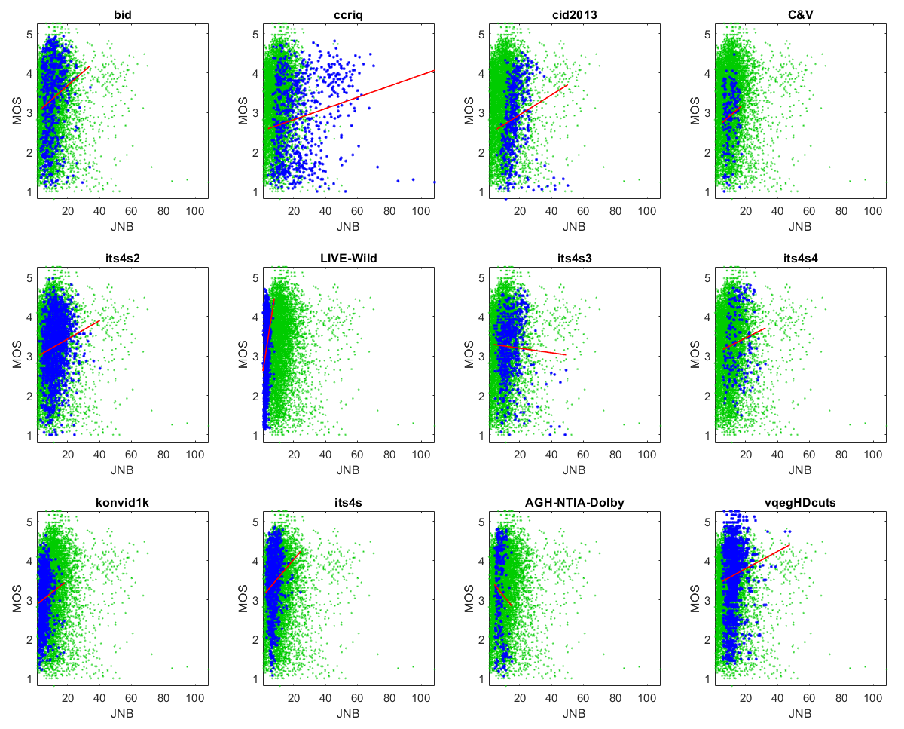
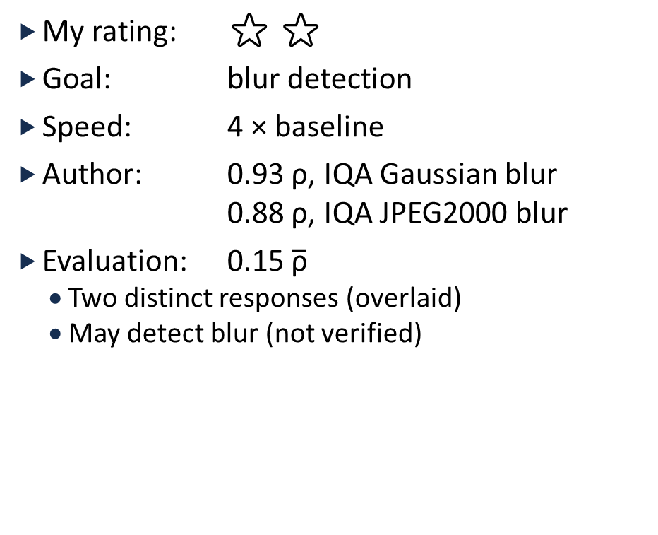
JNB
My rating: ⭐ ⭐
Goal: blur detection
Speed: 4 × baseline
Author: 0.93 ρ, IQA Gaussian blur
0.88 ρ, IQA JPEG2000 blur
Evaluation: 0.15 $\overline{\text{ρ}}$
  Two distinct responses (overlaid)
  May detect blur (not verified)

Slide 31
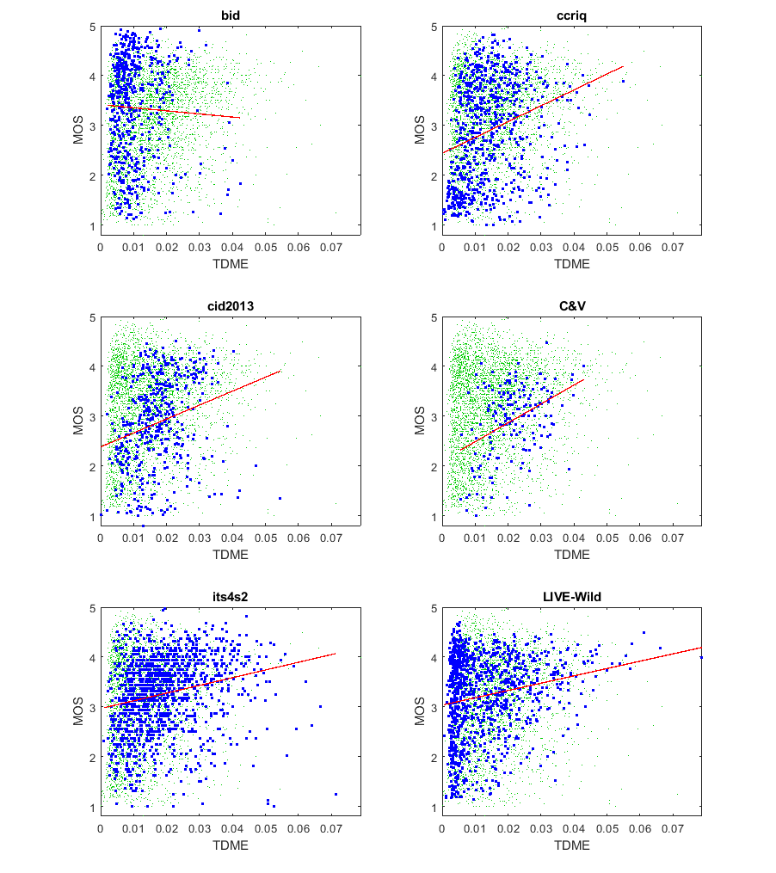
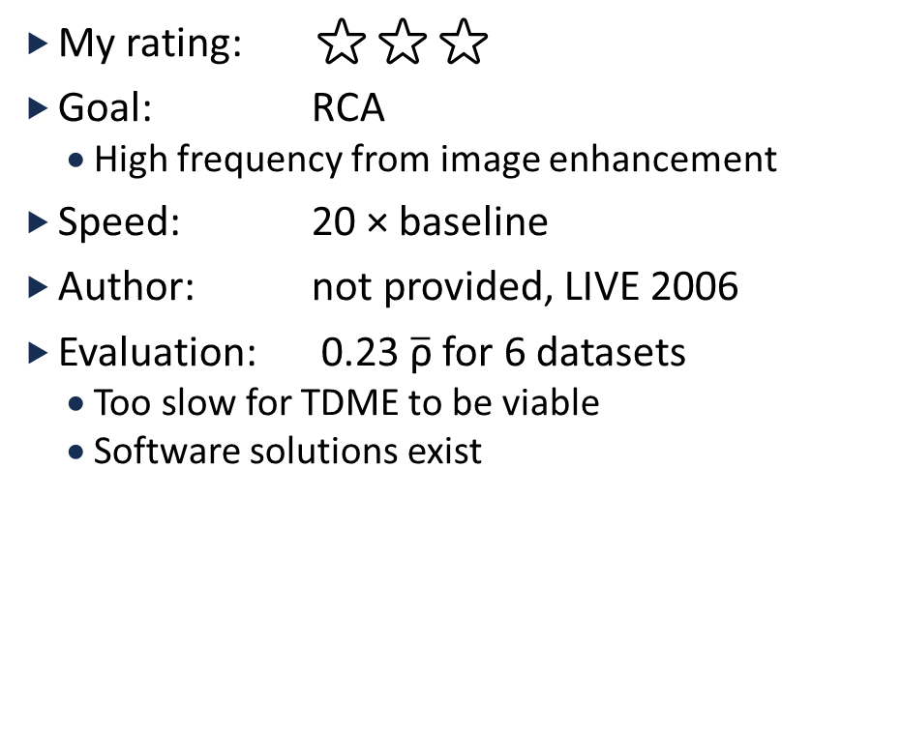
TDME
My rating: ⭐⭐⭐
Goal: RCA
  High frequency from image enhancement
Speed: 20 × baseline
Author: not provided, LIVE 2006
Evaluation: 0.23 $\overline{\text{ρ}}$ for 6 datasets
  Too slow for TDME to be viable
  Software solutions exist

Slide 32
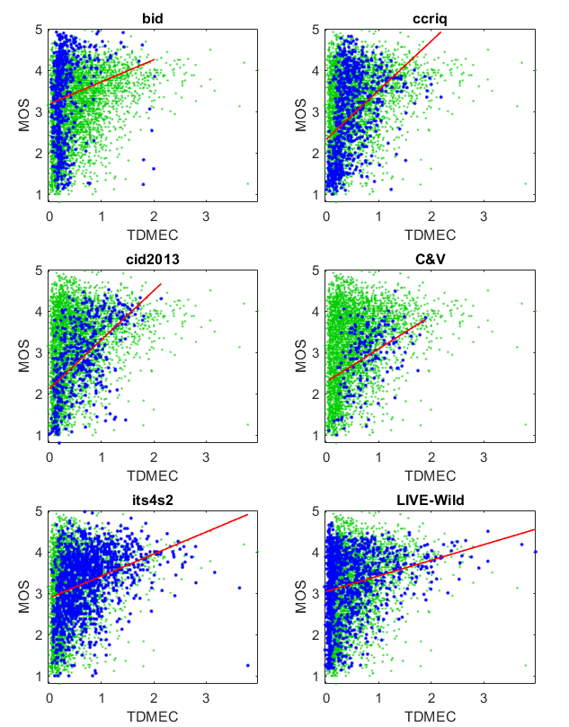
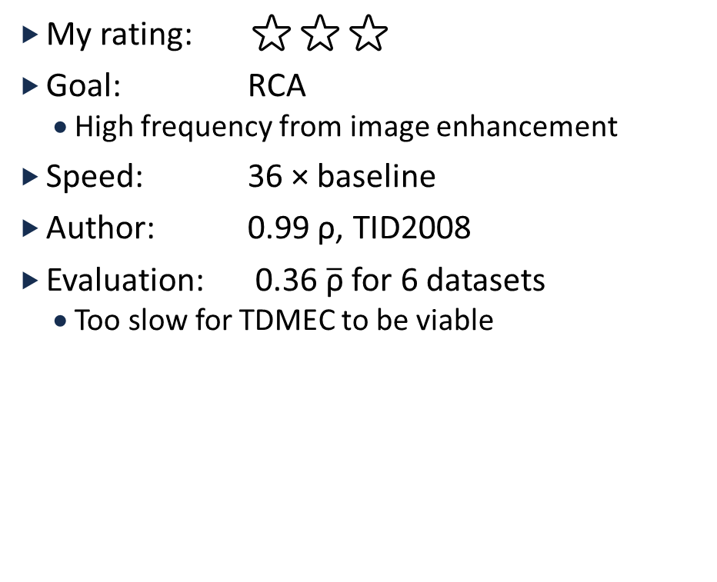
TDMEC
My rating: ⭐⭐⭐
Goal: RCA
  High frequency from image enhancement
Speed: 36 × baseline
Author: 0.99 ρ, TID2008
Evaluation: 0.36 $\overline{\text{ρ}}$ for 6 datasets
  Too slow for TDMEC to be viable

Slide 33
Overall MOS
Our Analysis of NR Metrics
Evaluator role
12 datasets
Easily available
Doesn’t take forever to run

Slide 34
My Rating Scale
Rating Scale for MOS
Ideal Scatter Plot
⭐ | Very inaccurate
⭐⭐ | Promising results
⭐⭐⭐ | Consistent performance for 10+ datasets. Valid for all media. Equivalent to 1-person ad-hoc test for 1+ dataset
⭐⭐⭐⭐ | As accurate as a 1-person ad-hoc test across 10+ datasets
⭐⭐⭐⭐⭐ | As accurate as a 6-person pilot test across 10+ datasets
MOS
NR Metric
NR Metric

Slide 35
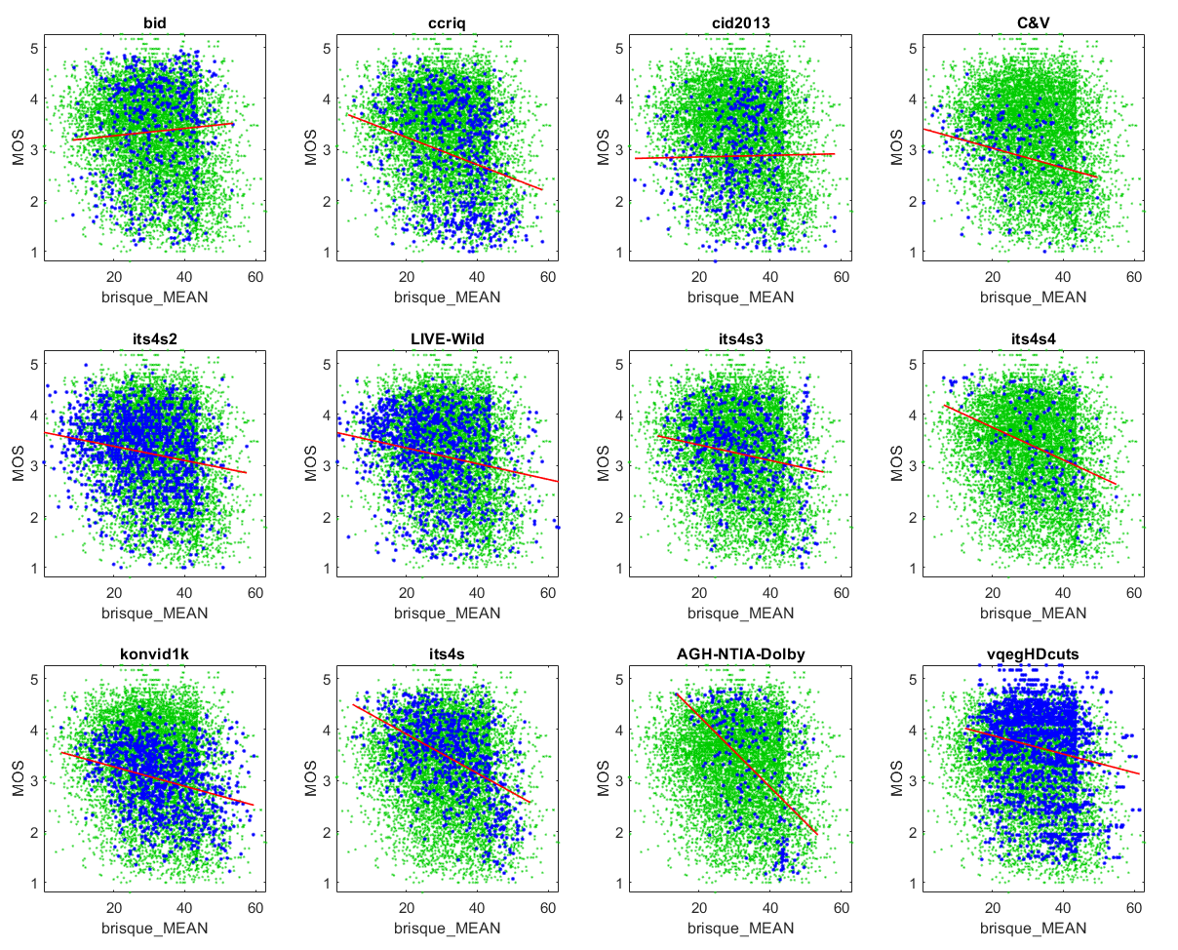
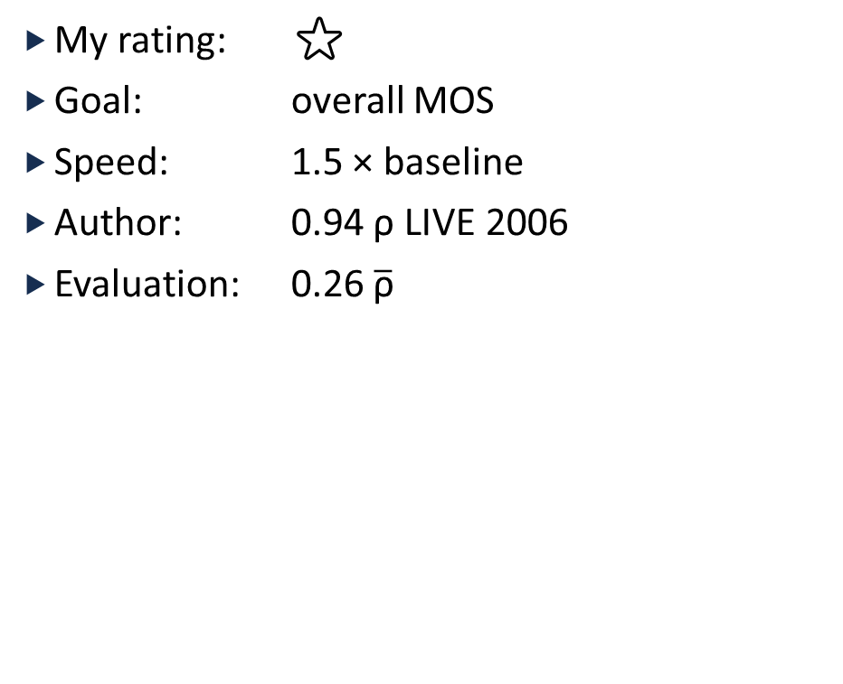
BRISQUE
My rating: ⭐
Goal: overall MOS
Speed: 1.5 × baseline
Author: 0.94 ρ LIVE 2006
Evaluation: 0.26 $\overline{\text{ρ}}$

Slide 36
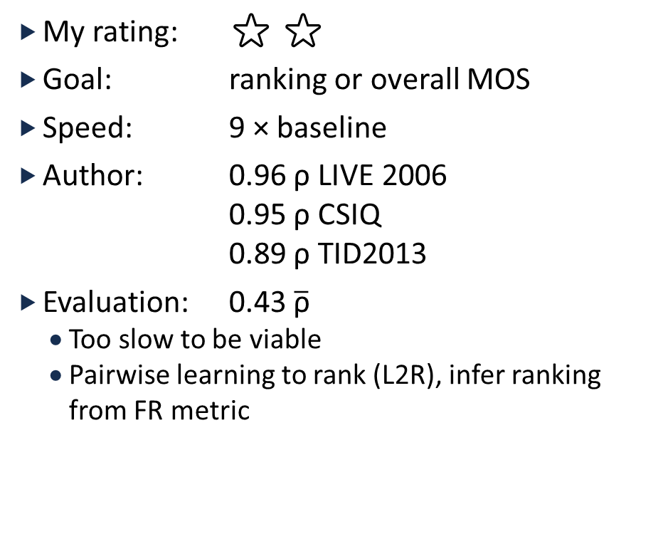
dipIQ
My rating: ⭐ ⭐
Goal: ranking or overall MOS
Speed: 9 × baseline
Author: 0.96 ρ LIVE 2006
0.95 ρ CSIQ
0.89 ρ TID2013
Evaluation: 0.43 $\overline{\text{ρ}}$
  Too slow to be viable
  Pairwise learning to rank (L2R), infer ranking from FR metric

Slide 37
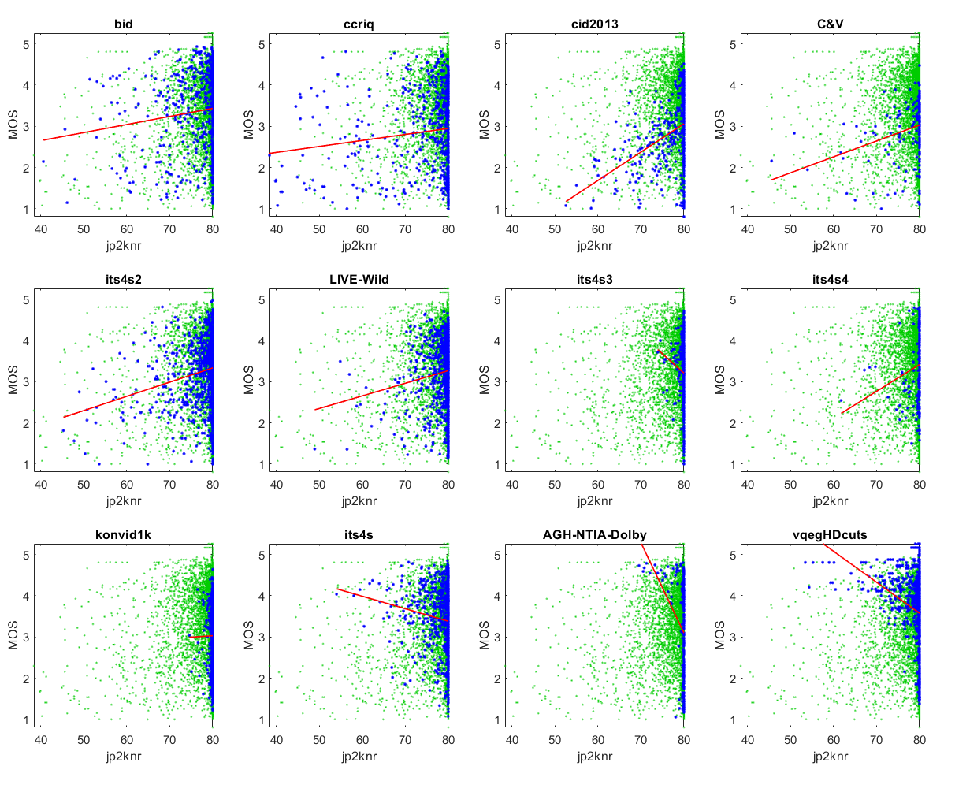
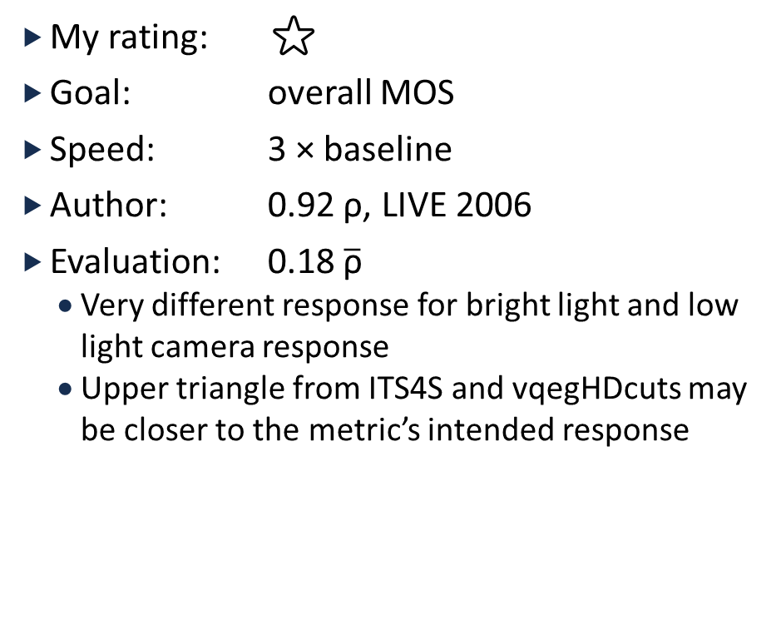
Jp2KNR
My rating: ⭐
Goal: overall MOS
Speed: 3 × baseline
Author: 0.92 ρ, LIVE 2006
Evaluation: 0.18 $\overline{\text{ρ}}$
  Very different response for bright light and low light camera response
  Upper triangle from ITS4S and vqegHDcuts may be closer to the metric’s intended response

Slide 38
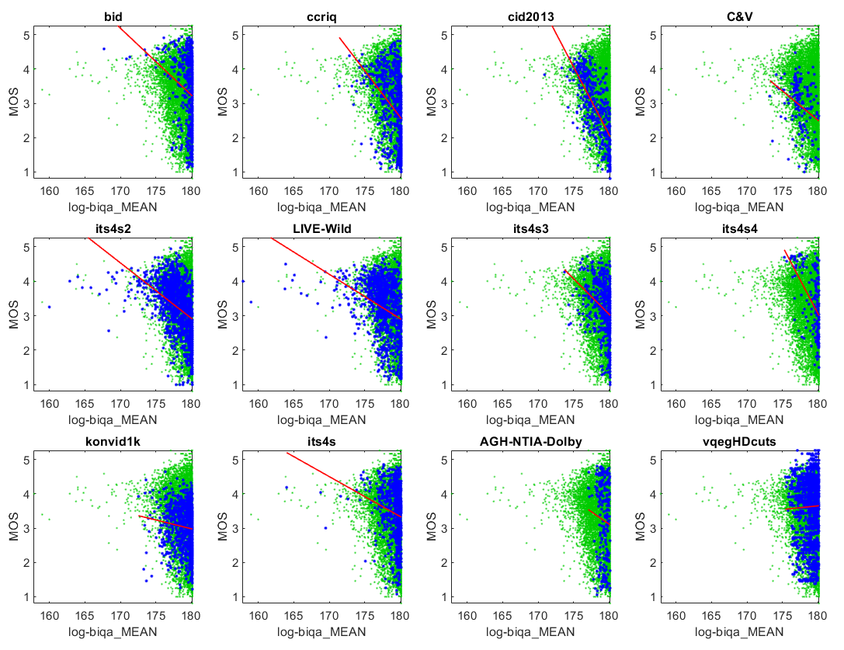
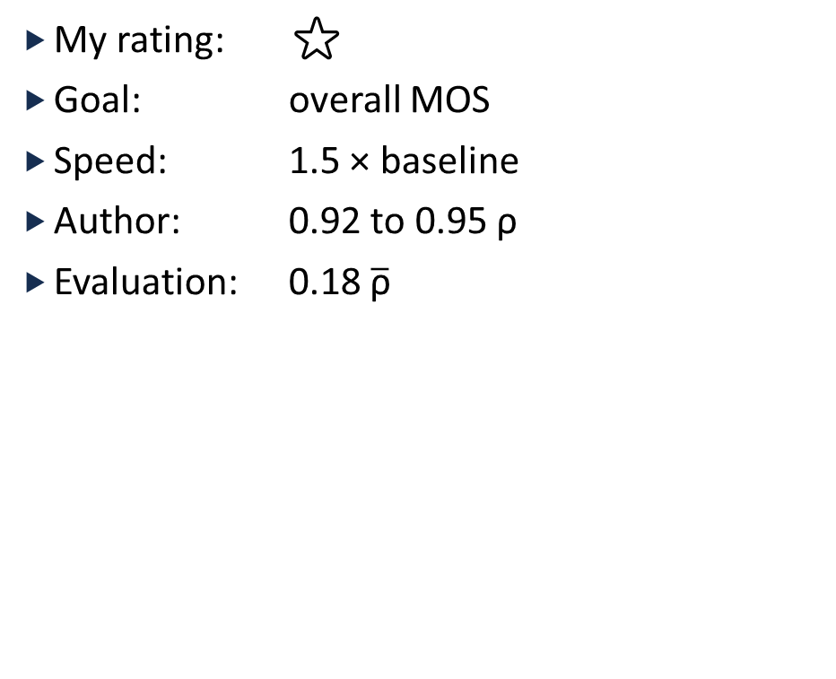
Log-BIQA
My rating: ⭐
Goal: overall MOS
Speed: 1.5 × baseline
Author: 0.92 to 0.95 ρ
Evaluation: 0.18 $\overline{\text{ρ}}$

Slide 39
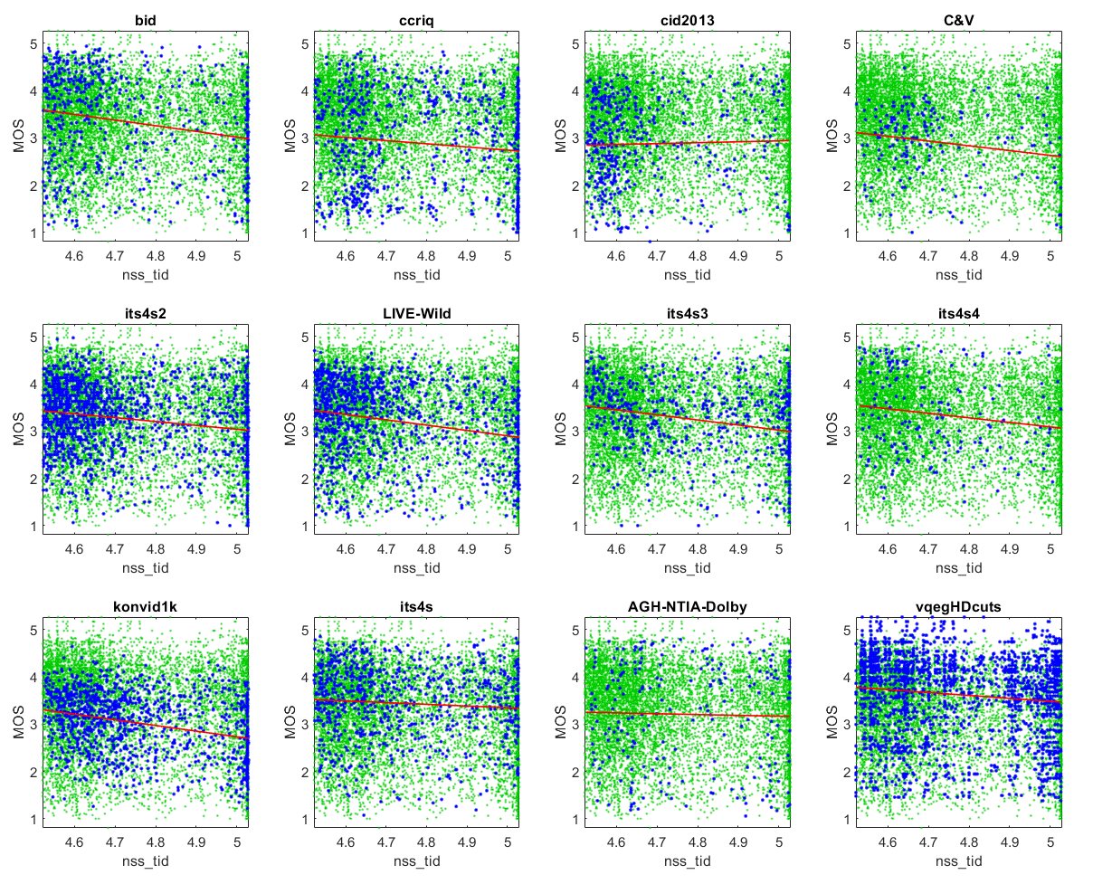
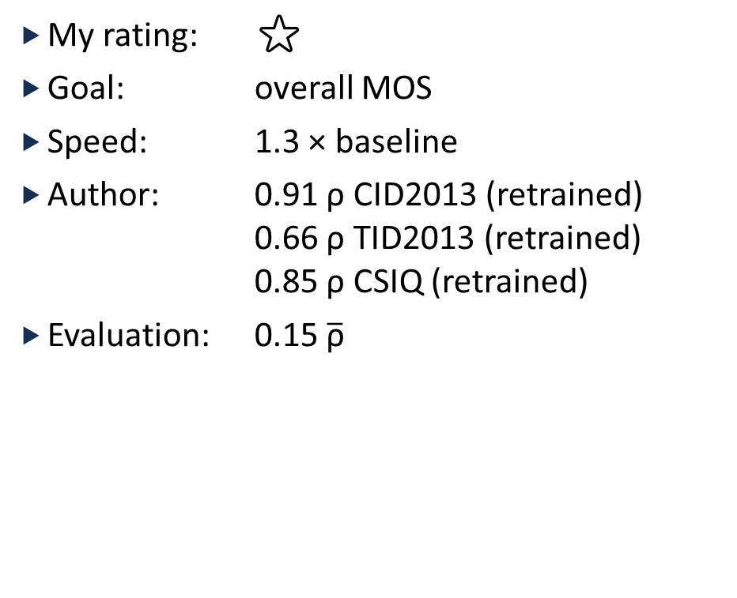
NSS
My rating: ⭐
Goal: overall MOS
Speed: 1.3 × baseline
Author: 0.91 ρ CID2013 (retrained)
0.66 ρ TID2013 (retrained)
0.85 ρ CSIQ (retrained)
Evaluation: 0.15 $\overline{\text{ρ}}$

Slide 40
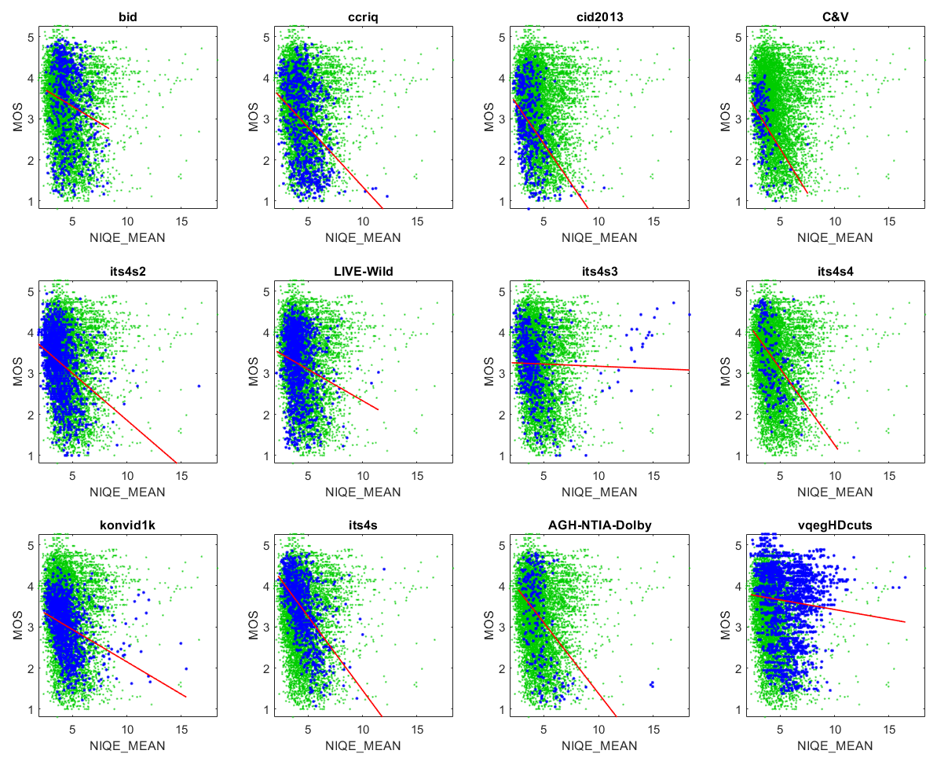
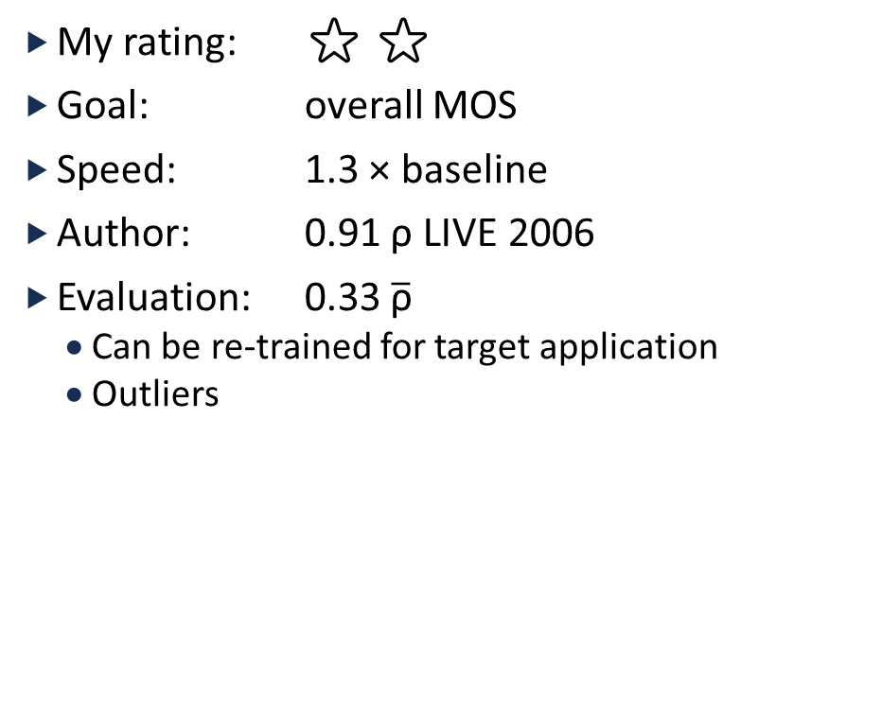
NIQE
My rating: ⭐ ⭐
Goal: overall MOS
Speed: 1.3 × baseline
Author: 0.91 ρ LIVE 2006
Evaluation: 0.33 $\overline{\text{ρ}}$
  Can be re-trained for target application
  Outliers

Slide 41
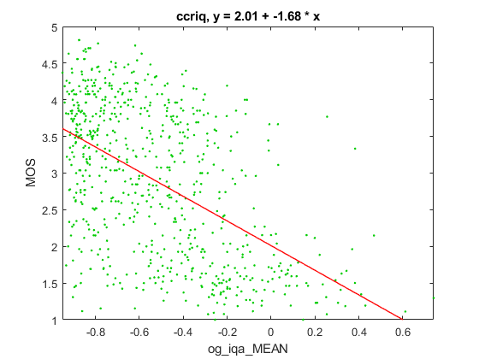
OG-IQA
My rating: ⭐ ⭐
Goal: overall MOS
Speed: 2 × baseline
Author: 0.95 ρ LIVE 2006
Evaluation: 0.53 ρ for CCRIQ
  Requires fuzzy logic toolbox
  RCA pattern, not overall MOS

Slide 42
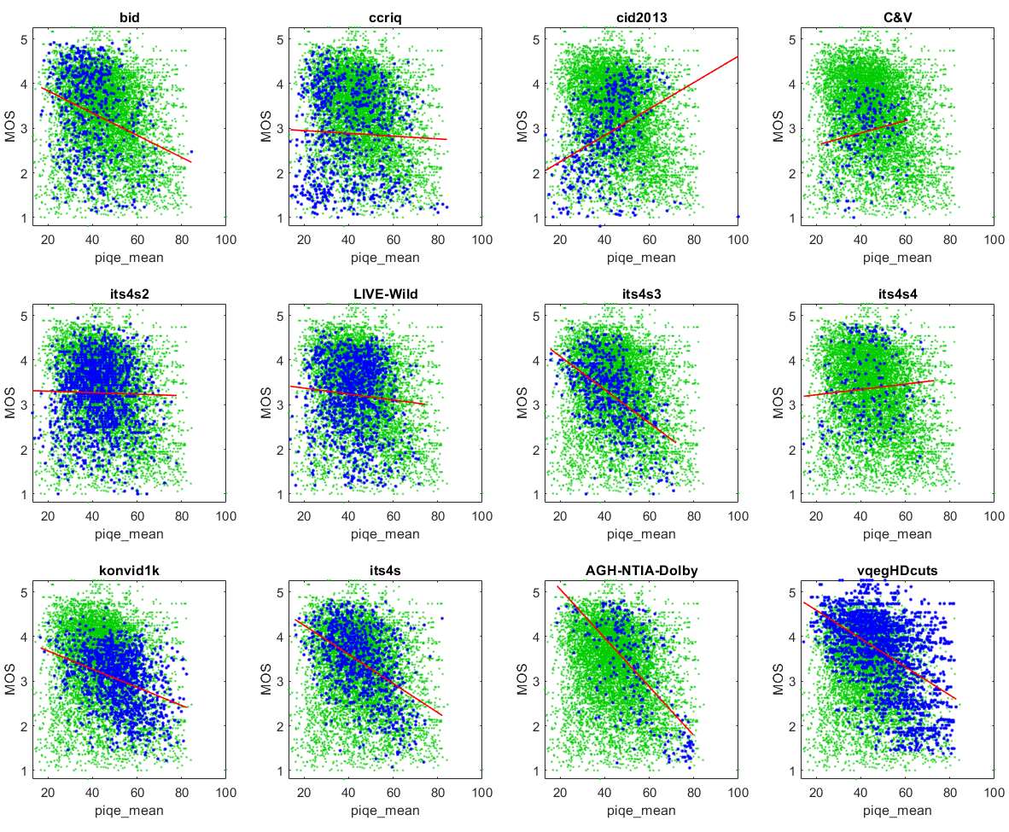
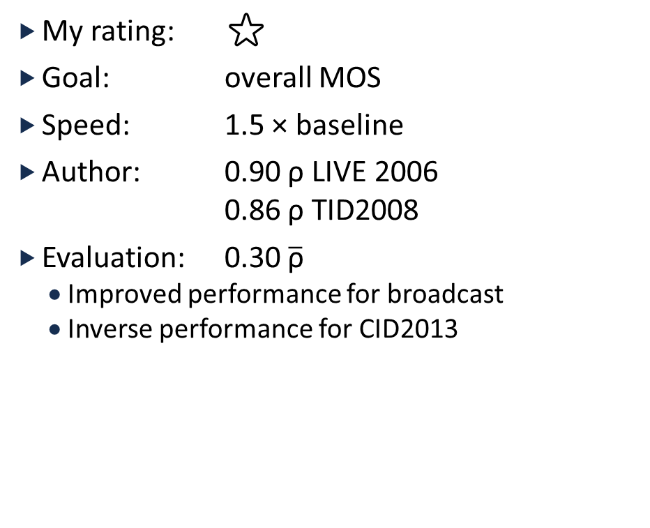
PIQE
My rating: ⭐
Goal: overall MOS
Speed: 1.5 × baseline
Author: 0.90 ρ LIVE 2006
0.86 ρ TID2008
Evaluation: 0.30 $\overline{\text{ρ}}$
  Improved performance for broadcast
  Inverse performance for CID2013

Slide 43
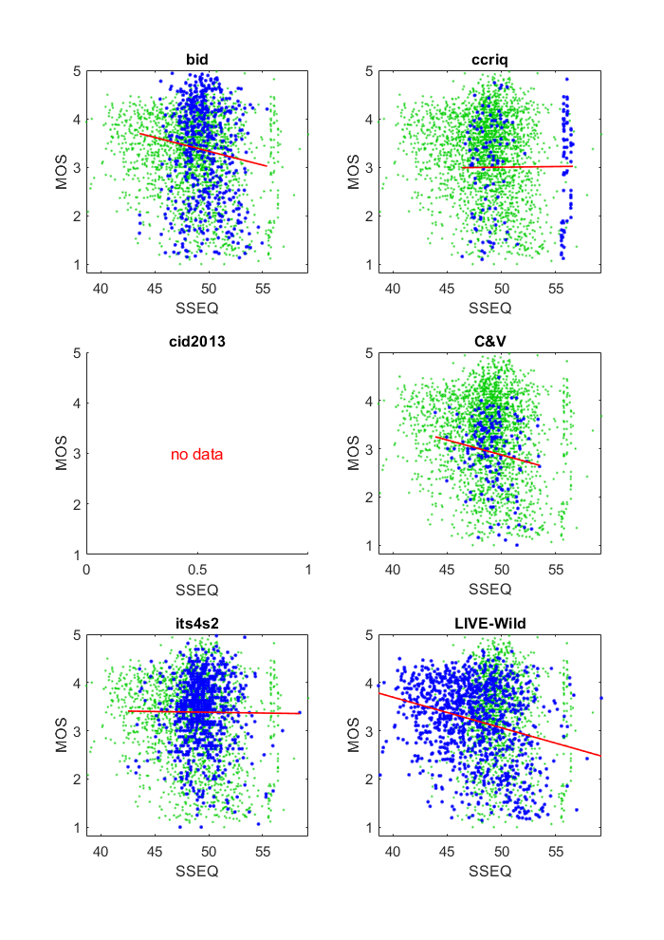
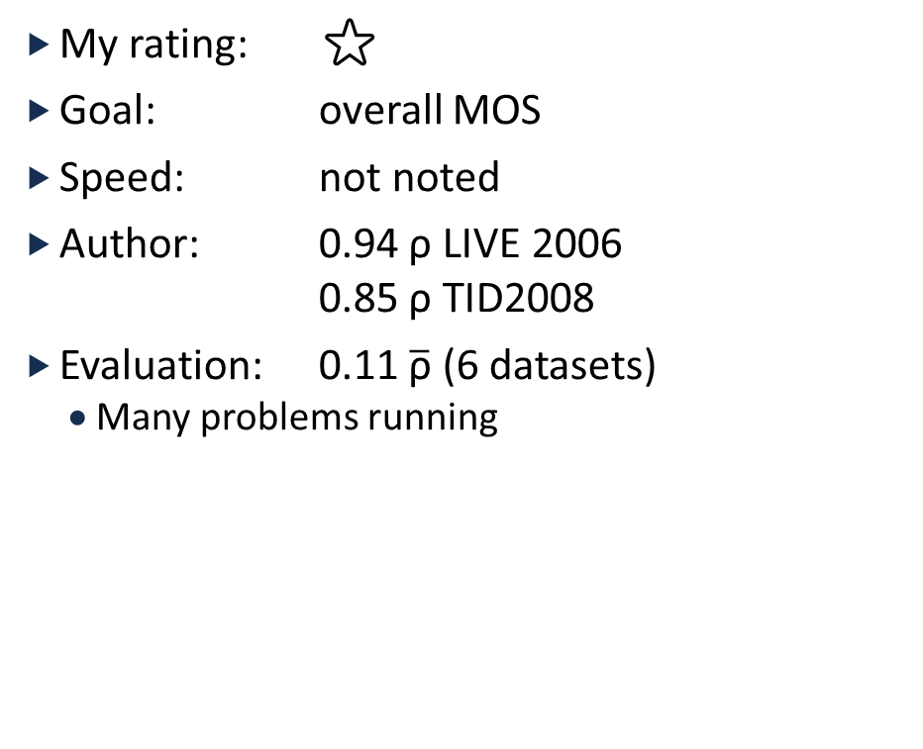
SSEQ
My rating: ⭐
Goal: overall MOS
Speed: not noted
Author: 0.94 ρ LIVE 2006
0.85 ρ TID2008
Evaluation: 0.11 $\overline{\text{ρ}}$ (6 datasets)
  Many problems running

Slide 44
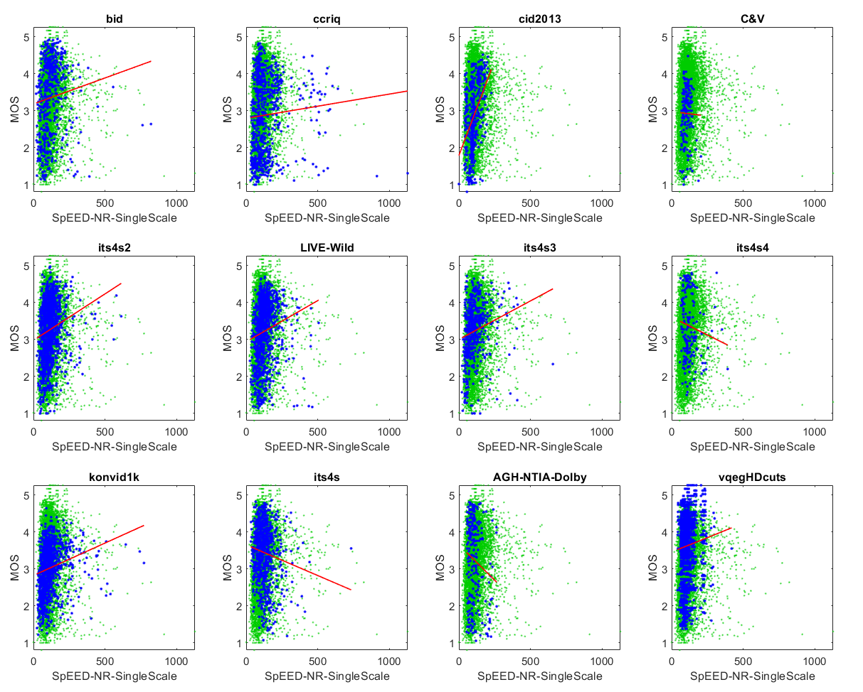
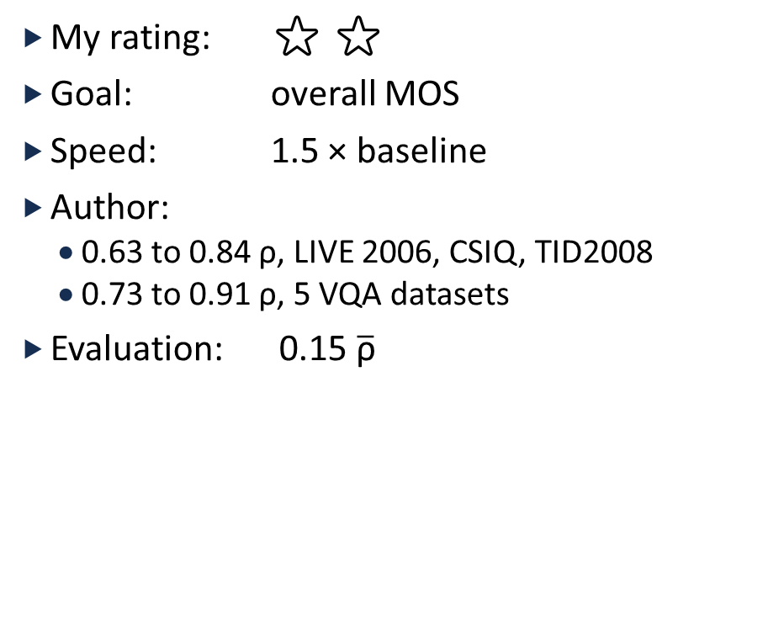
SpEED-QA
My rating: ⭐ ⭐
Goal: overall MOS
Speed: 1.5 × baseline
Author:
  0.63 to 0.84 ρ, LIVE 2006, CSIQ, TID2008
  0.73 to 0.91 ρ, 5 VQA datasets
Evaluation: 0.15 $\overline{\text{ρ}}$

Slide 45
Our Analysis of NR Metrics
Sufficient data
Single dataset
Scope limitations produce fragile metrics,
not suitable for industry deployment
Single dataset training
  Misleading
  Deceptive
Misidentification errors
  Wanted noise, detected sharp edges
  Wanted MOS, detected aspect of high quality

Slide 46
These are smart people.
Why is this happening?

Slide 47
Impairments have a relative impact on perceptual quality
Past performance is no guarantee of future results

Slide 48




“Red” can be good or bad
Red Improves Aesthetics
Red Camera Impairments

Slide 49



Impairment Quality Perception is Relative (not Absolute)
Use Case vs Impairment Perception
Professional videography
First responders
Digital pathology
Optical character recognition
lost hiker, drone
search and rescue
Broadcaster (ElFuente)
art

Slide 50

Impact of Pan Speed on MOS
Only pans (ITS4S4) ρ = 0.81
Occasional plans ρ = 0.38, 0.34
No pans (IQA) ρ = NA
Broadcast ρ = 0.04, 0.08, 0.09
The broadcaster problem
  Highly skilled photographers and videographers
  Break the rules without MOS penalty

Slide 51
Impairment Quality Perception is Relative (not Absolute)
VQEG HD
H.264
Resize
MPEG2
Datasets
LIVE 2006
JPEG
Gaussian blur
White noise
JPEG2000
Fast-fading Rayleigh
Genuinely different response to impairments
Single use case focus does not solve this problem
Major dataset factors
  Use case
  Camera capture vs compression
  Omitted impairments
  Dominant impairment
  Type of subject matter
Dilemma for overall MOS assessment
BID
Out of focus
Simple motion
Unblurred
Complex motion
Other
CCRIQ
Lighting
Phone
Compact
DSLR
Focal distance

Slide 52


Relative Impact on Metric Training
Philosophy #1
Philosophy #2
$\hat{MOS}$ explains compression, network errors
  Omit aesthetics, subject matter, camera capture
Goal:
  Estimate overall MOS
$\hat{MOS}$ explains everything
  Match user’s ad-hoc assessment
Goal:
  Provide RCA
  Metric user ignores irrelevant factors

Slide 53

Relative Impact on Metric Training
Philosophy #1
Philosophy #2
$\hat{MOS}$ explains compression, network errors
  Omit aesthetics, subject matter, camera capture
Goal:
  Estimate overall MOS
Challenges
  How to handle relative impact of impairments? Disparate dataset responses?
  How teach metric to ignore aesthetics and camera capture?
Advantages
  Popular industry use case
$\hat{MOS}$ explains everything
  Match user’s ad-hoc assessment
Goal:
  Provide RCA
  Metric user ignores irrelevant factors

Slide 54

Relative Impact on Metric Training
Philosophy #1
Philosophy #2
$\hat{MOS}$ explains compression, network errors
  Omit aesthetics, subject matter, camera capture
Goal:
  Estimate overall MOS
Challenges
  How to handle relative impact of impairments? Disparate dataset responses?
  How teach metric to ignore aesthetics and camera capture?
Advantages
  Popular industry use case
$\hat{MOS}$ explains everything
  Match user’s ad-hoc assessment
Goal:
  Provide RCA
  Metric user ignores irrelevant factors
Challenges
  RCA metrics must not respond to other impairments
  Very large number of impairments
Advantages
  Solves the “impairments are relative” problem
  Train on residuals (MOS - $\hat{MOS}$) and outliers

Slide 55
Root Cause Analysis as
NR Metric Development Strategy
Moving from problems to solutions
https://github.com/NTIA/NRMetricFramework

Slide 56
Root Cause Analysis
Desired response
  0 = impairment not present
  1 = maximum impairment
Scatter plots
  Scatter around line
  Lower triangle
  Upper triangle (rare)
Visual examination of images
Challenge
  Can’t just regress to MOS
  Confounding factors
  Separate effort for each impairment
Develop
  6 IQA datasets, camera capture
  3 VQA datasets, camera capture
  3 VQA datasets, compression
Evaluation
  ITSnoise
  KoNIQ-10K → problem with MOSs > 4.0
  MUI2018
  KoNVID 150K part B
  YouKuv-1K

Slide 57




Sawatch, S-WhiteLevel
My rating: ⭐⭐⭐
Goal: RCA, white level issues
Speed: 2 × baseline
Author: 0.20 $\overline{\text{ρ}}$
Evaluation: 0.12 $\overline{\text{ρ}}$
  Lower triangle
S-WhiteLevel = 0.0
S-WhiteLevel = 0.95

Slide 58




Sawatch, S-BlackLevel
My rating: ⭐⭐
Goal: RCA, black level issues
Speed: 2 × baseline
Author: 0.09 $\overline{\text{ρ}}$
Evaluation: 0.02 $\overline{\text{ρ}}$
  Lower triangle, blurred by KonIQ10K clipping
S-BlackLevel = 0.0
S-BlackLevel = 0.81

Slide 59


Sawatch, S-Blockiness
My rating: ⭐⭐
Goal: RCA, blockiness
Speed: 1.15 × baseline
Author: 0.21 $\overline{\text{ρ}}$
Evaluation: 0.15 $\overline{\text{ρ}}$
  Lower triangle

Slide 60


Sawatch, S-Blur
My rating: ⭐⭐⭐
Goal: RCA, overall blur
Speed: baseline
Author: 0.46 $\overline{\text{ρ}}$
Evaluation: 0.53 $\overline{\text{ρ}}$
  Major factor for most datasets
  Loose scatter around line
  Need to investigate ITSnoise, MUI2018

Slide 61


Sawatch, S-FineDetail
My rating: ⭐⭐⭐
Goal: RCA, missing fine details
Speed: 1 × baseline
Author: 0.39 $\overline{\text{ρ}}$
Evaluation: 0.52 $\overline{\text{ρ}}$
  Major factor for most datasets
  Loose scatter around line
  Need to investigate ITSnoise, MUI2018

Slide 62



Sawatch, S-ColorNoise
My rating: ⭐⭐
Goal: RCA, color noise
Speed: 1 × baseline
Author: 0.18 $\overline{\text{ρ}}$
Evaluation: 0.23 $\overline{\text{ρ}}$
  Loose lower triangle
  NaN for MUI2018,
  black-and-white medical images

Slide 63



Sawatch, S-SuperSaturated
My rating: ⭐⭐
Goal: RCA, super saturated color
Speed: 1 × baseline
Author: 0.08 $\overline{\text{ρ}}$
Evaluation: 0.03 $\overline{\text{ρ}}$
  Relative importance (usually Bad?)
  Very minor factor, confounds scatter plot

Slide 64



Sawatch, S-Pallid
My rating: ⭐⭐
Goal: RCA, pallid
Speed: 1 × baseline
Author: 0.13 $\overline{\text{ρ}}$
Evaluation: 0.24 $\overline{\text{ρ}}$
  Loose upper triangle
S-Pallid = 1.0

Slide 65


Sawatch, S-PanSpeed
My rating: ⭐⭐
Goal: RCA, pan speed
Speed: 1.6 × baseline
Author: 0.29 $\overline{\text{ρ}}$
Evaluation: 0.27 $\overline{\text{ρ}}$
  Lower triangle

Slide 66


Sawatch, S-Jiggle
My rating: ⭐⭐
Goal: RCA, camera jiggle
Speed: 1.6 × baseline
Author: 0.23 $\overline{\text{ρ}}$
Evaluation: 0.31 $\overline{\text{ρ}}$
  Lower triangle

Slide 67


Sawatch
My rating: ⭐⭐⭐
Goal: MOS
Author: 0.61 $\overline{\text{ρ}}$
Evaluation: 0.66 $\overline{\text{ρ}}$
  0.68 ρ ITSnoise
  0.69 ρ KonIQ10k
  0.56 ρ MUI2018
  0.68 ρ KoNViD-150K part B
  0.77 ρ YoukuV1K

Slide 68
Call to Action
What does this mean for NR metric research?

Slide 69
Call to Action
Develop on 10+ datasets
Developer tools: https://github.com/NTIA/NRMetricFramework
NR metrics for RCA
  Assess a single impairment
  No response to other impairments
Combine multiple RCA metrics to assess overall MOS
New datasets for RCA impairments
  ITSnoise for camera noise
  VCRDCI for compression
  https://www.cdvl.org

