Slide 1





Video Complexity Dataset (VCD)
Hadi Amirpour, Vignesh V Menon, and Christian Timmerer
All rights reserved. ©2021

Slide 2
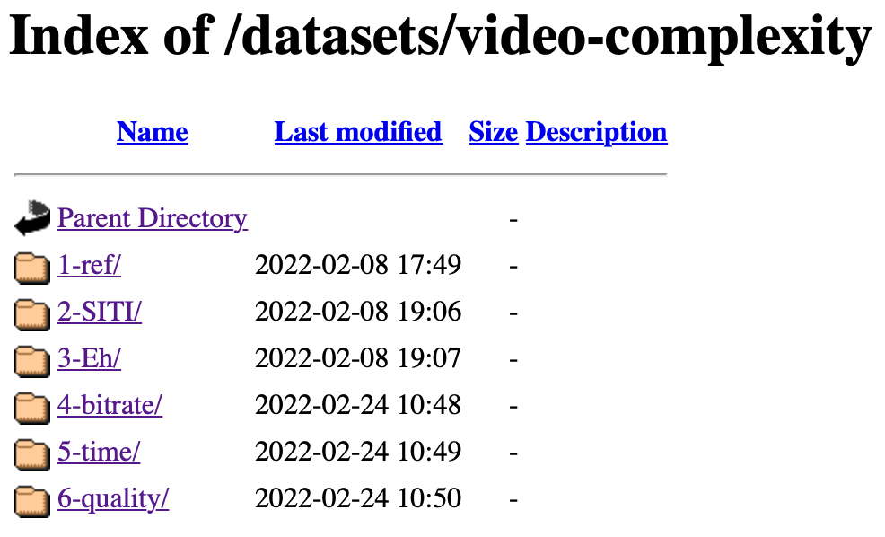
Video Complexity Dataset (VCD)
It comprises 500 video sequences with:
          2160p resolution
          23.98 fps
          4:2:0 format
          5s duration
All rights reserved. ©2021

Slide 3
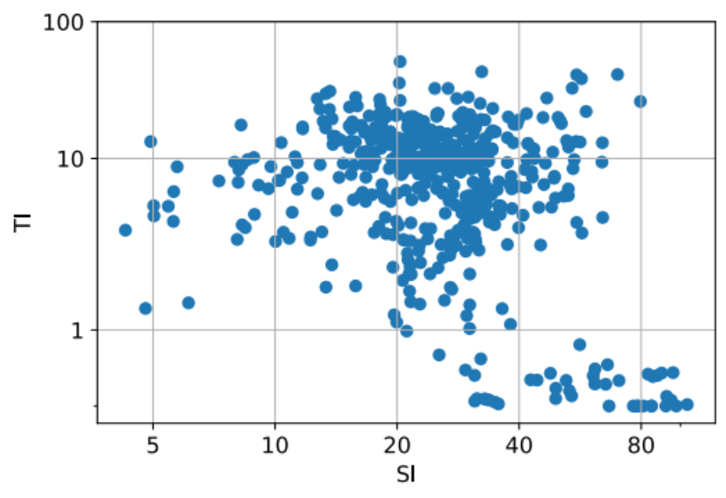
Features

Slide 4
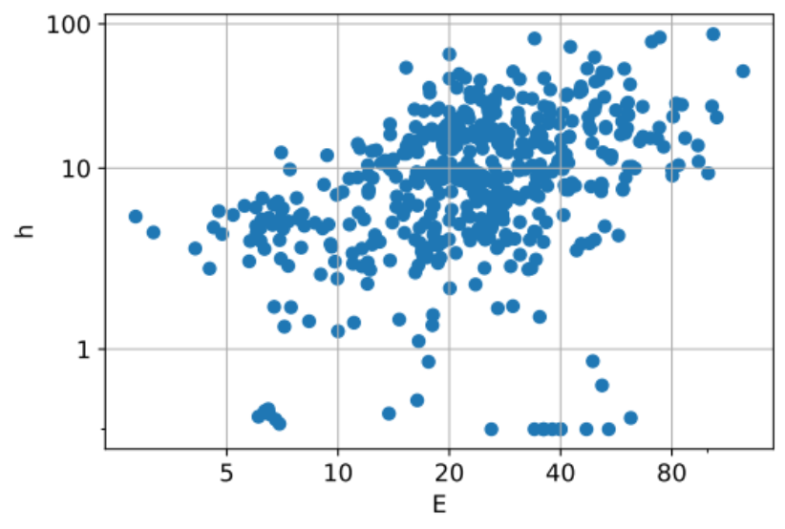
Features

Slide 5
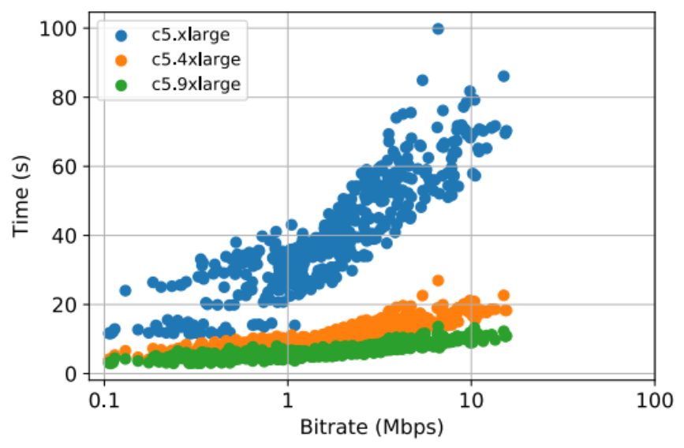
Encoding Bitrate
Various rate-control modes: cqp, crf, cbr
Various Amazon EC2: c5.xlarge, c5.4xlarge,…
Various presets: veryslow, medium, ultrafast
Various codecs: x264, x265, …

Slide 6
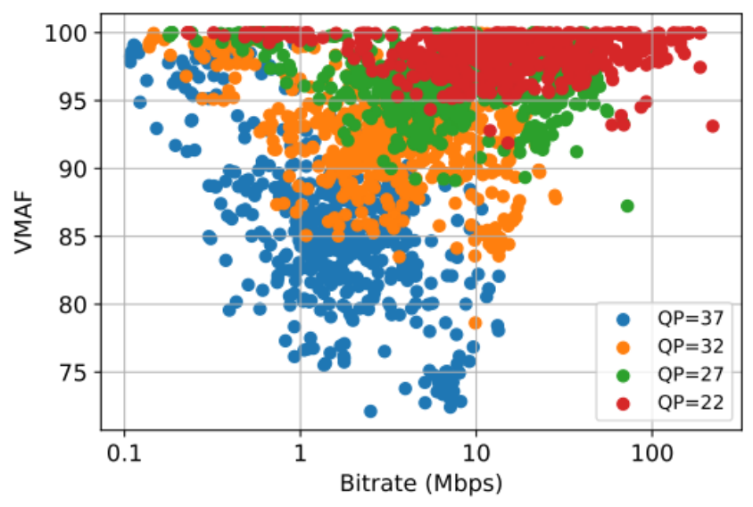
Encoding Bitrate
Various rate-control modes: cqp, crf, cbr
Various metrics: VMAF, PSNR, SSIM, ….
Various presets: veryslow, medium, ultrafast
Various codecs: x264, x265, …

Slide 7
Dataset: https://ftp.itec.aau.at/datasets/video-complexity/
Online documentation: https://vcd.itec.aau.at

