Slide 1






The Effect of Temporal Sub-Sampling on the Accuracy of Volumetric Video Quality Assessment
Ali Ak, Emin Zerman, Suiyi Ling, Patrick Le Callet, Aljosa Smolic
VQEG Meeting
11 May 2022
This work has received funding from the European Union's Horizon 2020 research and innovation programme under the Marie Sklodowska-Curie Grant Agreement No. 765911 (RealVision) and from Science Foundation Ireland (SFI) under the Grant Number 15/RP/27760.

Slide 2
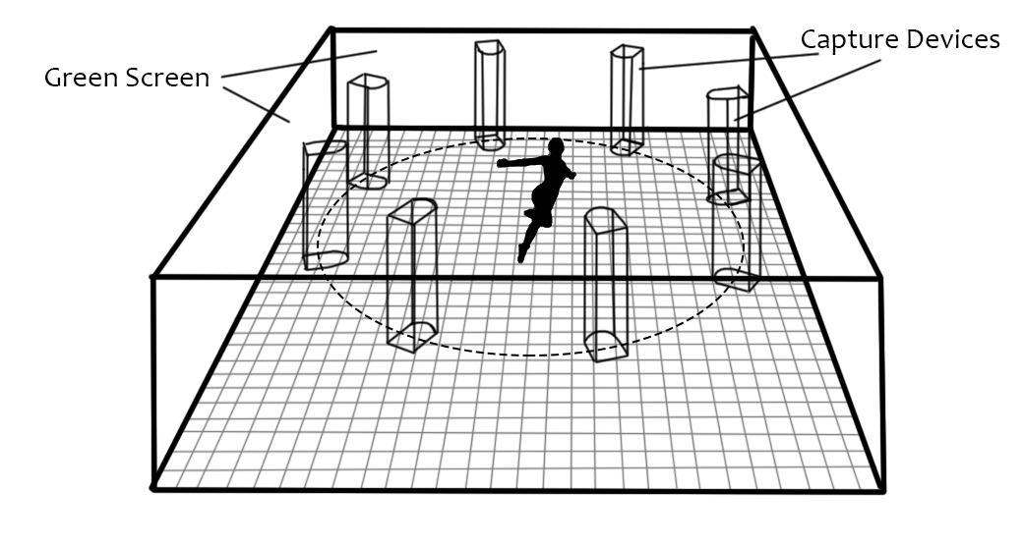
Volumetric Video

Slide 3
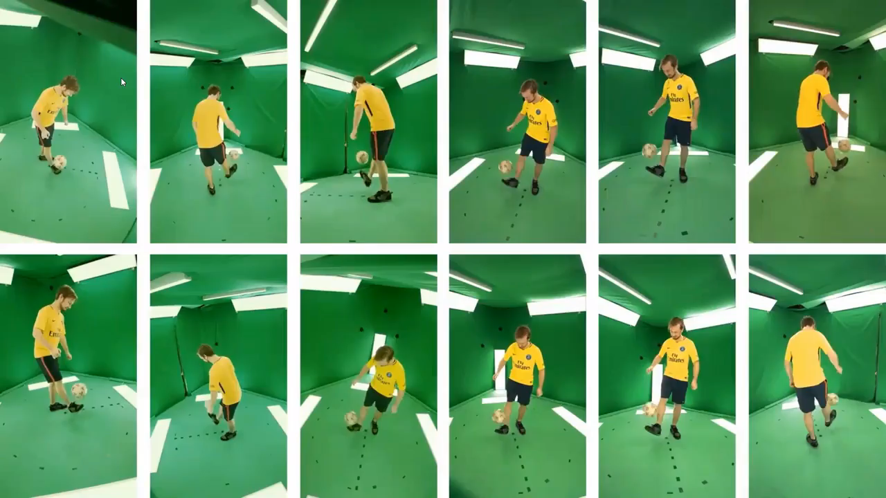
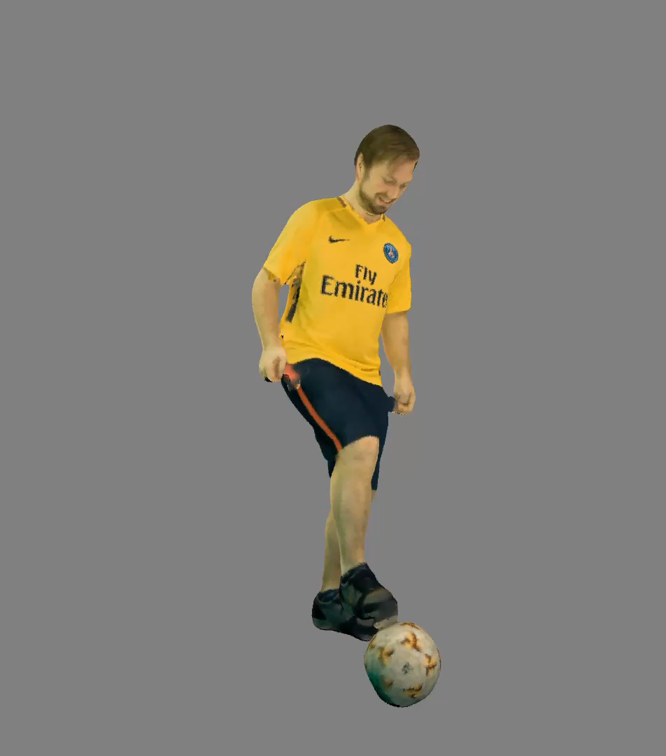
Volumetric Video

Slide 4
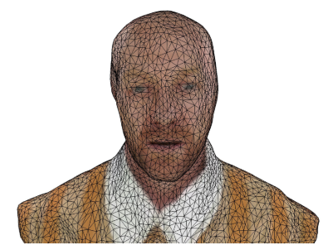
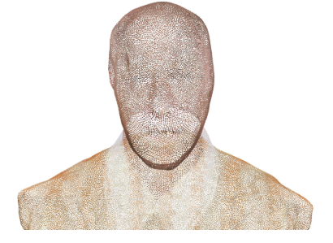
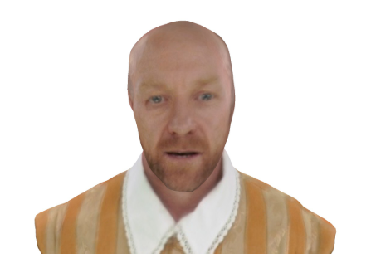
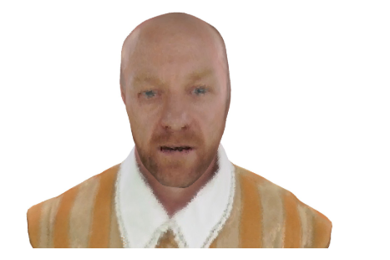
3D Mesh vs Point Cloud

Slide 5
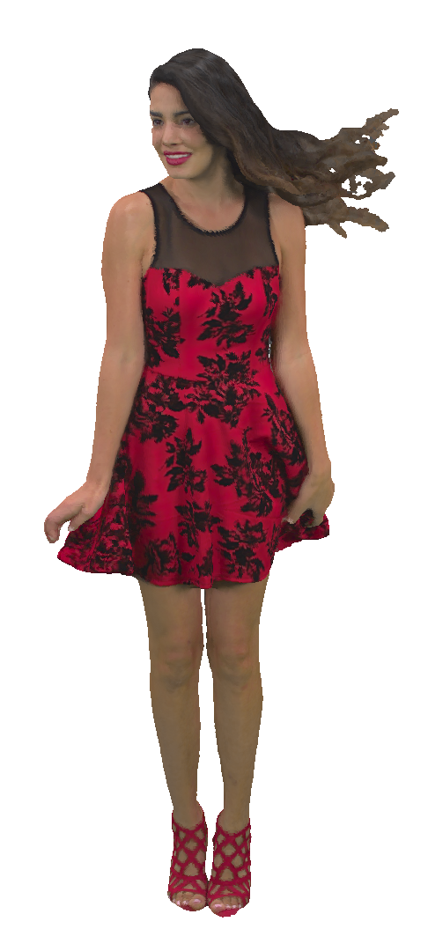
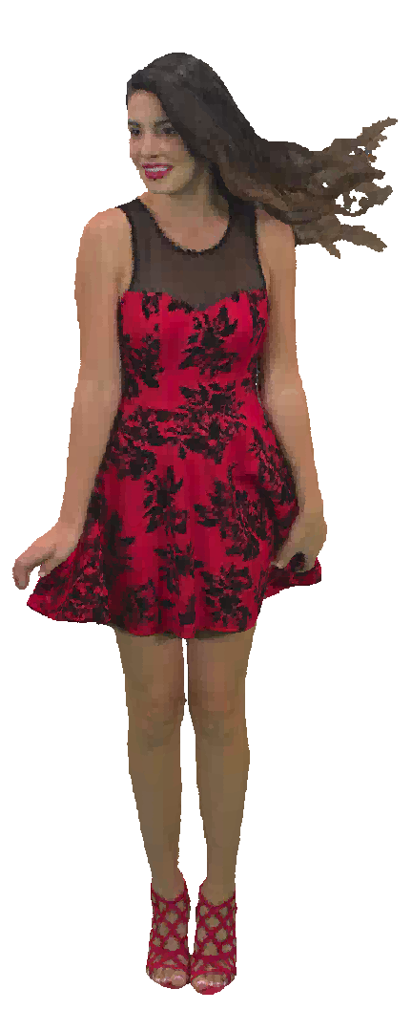
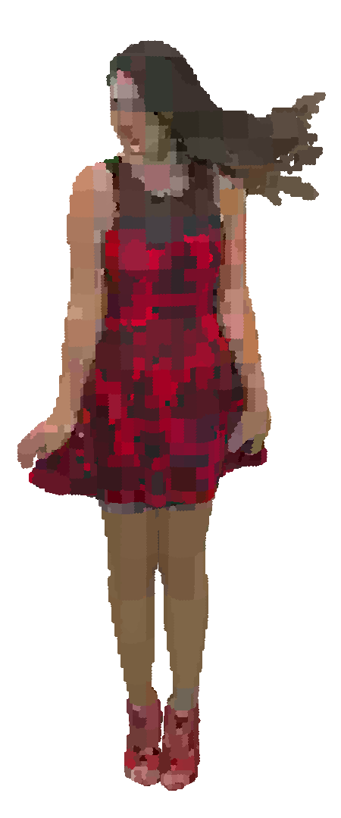
Volumetric Video Compression
+Bit-rate reduction
++Bit-rate reduction
Compression
Compression
-Loss of Quality
--Loss of Quality

Slide 6
Research Question
Can we speed up the metric computation for volumetric video quality assessment
without sacrificing the accuracy?
How does the temporal methodologies and sub-sampling rates affect metric performances?
Which objective quality metrics perform better?

Slide 7
Objective Quality Evaluation of Volumetric Video Content
Point Based
Color Based
Image Based

Slide 8
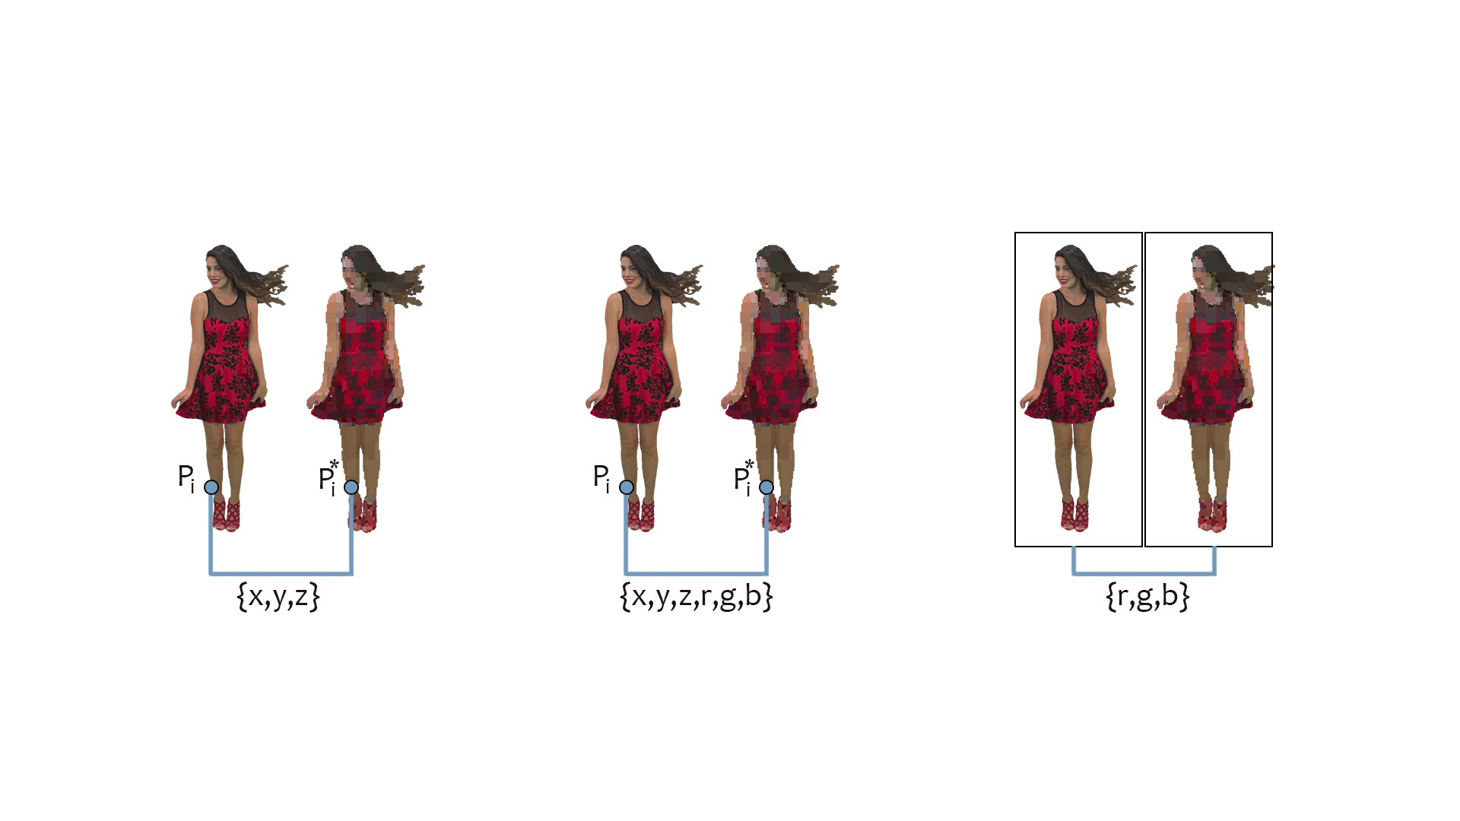
Objective Quality Evaluation of Volumetric Video Content
Point Based
Color Based
Image Based

Slide 9
Objective Quality Evaluation of Volumetric Video Content
Point Based
Color Based
Image Based

Slide 10
Objective Quality Evaluation of Volumetric Video Content
Point Based
Color Based
Image Based

Slide 11
Objective Quality Metrics
Point Based
Color Based
Image Based
p2point-Haus
p2point-Haus-PSNR
p2point-RMS
p2point-RMS-PSNR
p2plane-Haus
p2plane-Haus-PSNR
p2plane-RMS
p2plane-RMS-PSNR
pl2plane-MSE
pl2plane-RMS
pl2plane-Mean
pl2plane-Median
pl2plane-Min
Color-Y
Color-Y-PSNR
Color-U
Color-U-PSNR
Color-V
Color-V-PSNR
MP-PSNR-FR
MP-PSNR-RR
MW-PSNR-FR
MW-PSNR-RR
PSNR
SSIM
NIQSV
NIQSV+
APT
EM-IQM
SI-IQM

Slide 12
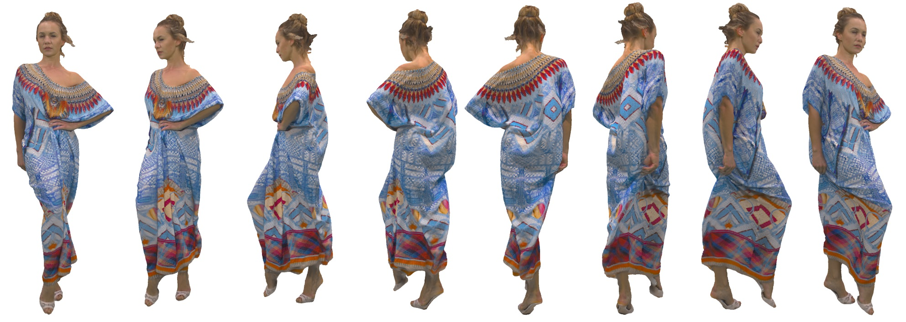



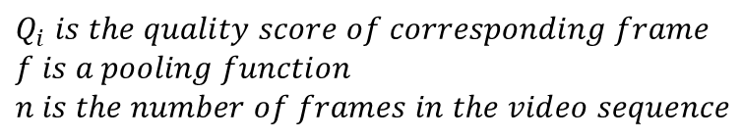





Objective Quality Evaluation of Volumetric Video Content
$$Q_{1}$$
$$Q_{2}$$
$$Q_{3}$$
$$Q_{4}$$
$$Q_{5}$$
$$Q_{6}$$
$$Q_{7}$$
$$Q_{8}$$
$Q_{seq}$=$f(Q\{1,n\})$,
$$Q_{i} is the quality score of corresponding frame$$
$$f is a pooling function$$
$$n is the number of frames in the video sequence$$

Slide 13
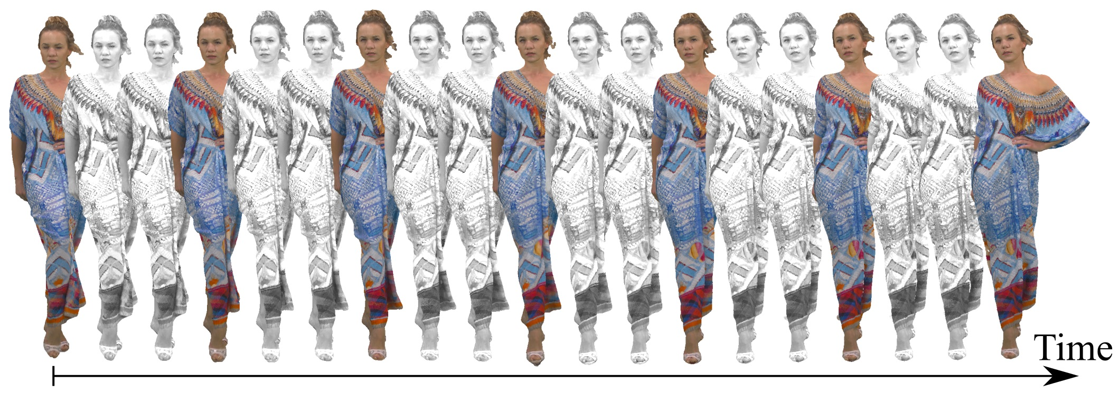
Temporal Sampling Rate
Original sequence frame-rate: 30 fps
$$\text{Tested} \text{frame}\text{−}\text{ra}\text{tes}:\{1, 2, 3, 5, 6, 10, 15, 30\}$$

Slide 14
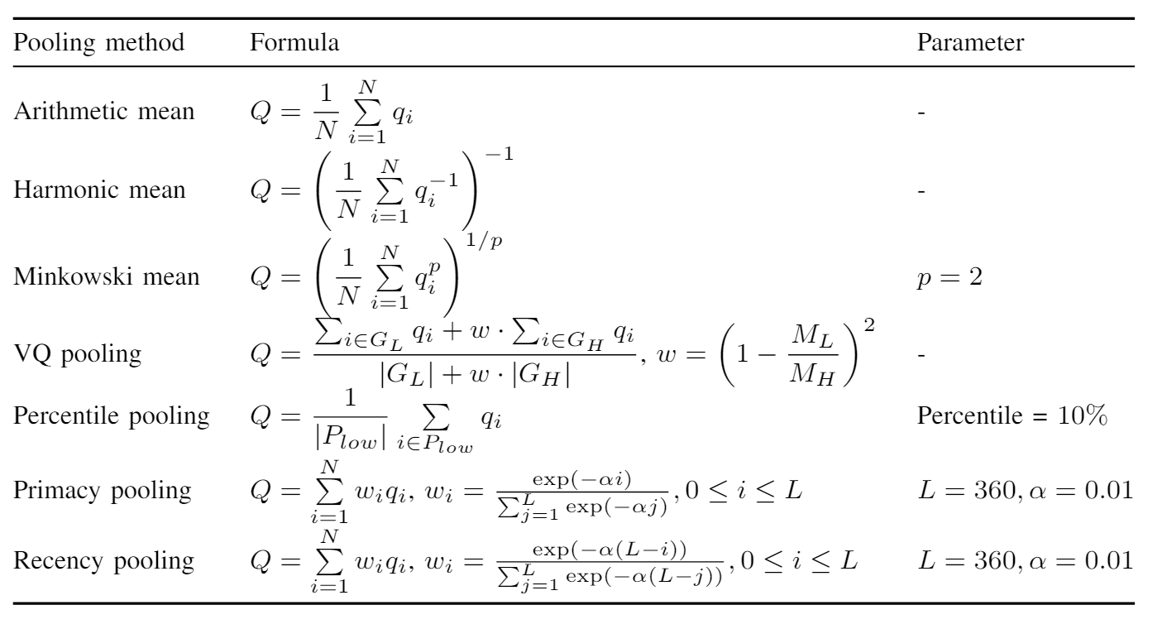
Temporal Pooling Methods

Slide 15
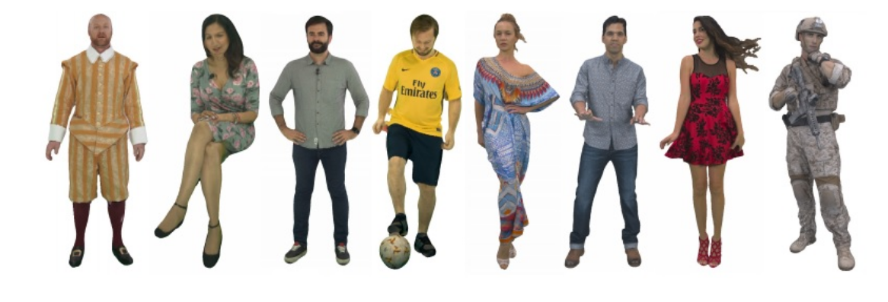
VSense-VVDB2 Dataset
8 point cloud sequences (10 seconds with 30 fps)
3 different coding algorithm (16 compression levels in total)
  G-PCC (RAHT) – 6 levels
  V-PCC (All-intra) – 5 levels
  V-PCC (Random-access) – 5 levels
Orbital rendering
MOS scores collected with ACR-HR methodology on a 2D display

Slide 16
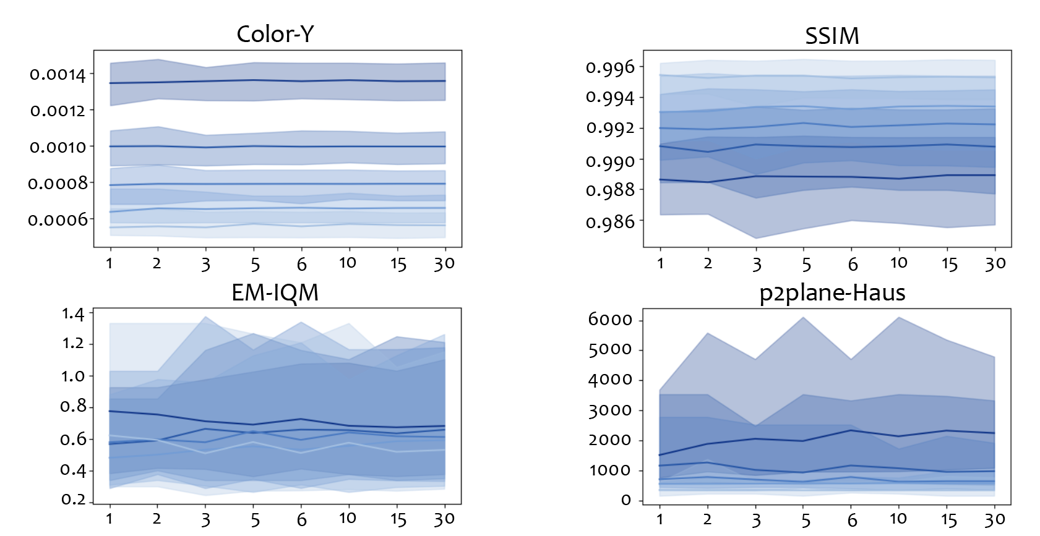
Impact of temporal sub-sampling rate
95 % percentile range and the median values of the selected metric scores for 5 levels of V-PCC coding at different frame rates.

Slide 17
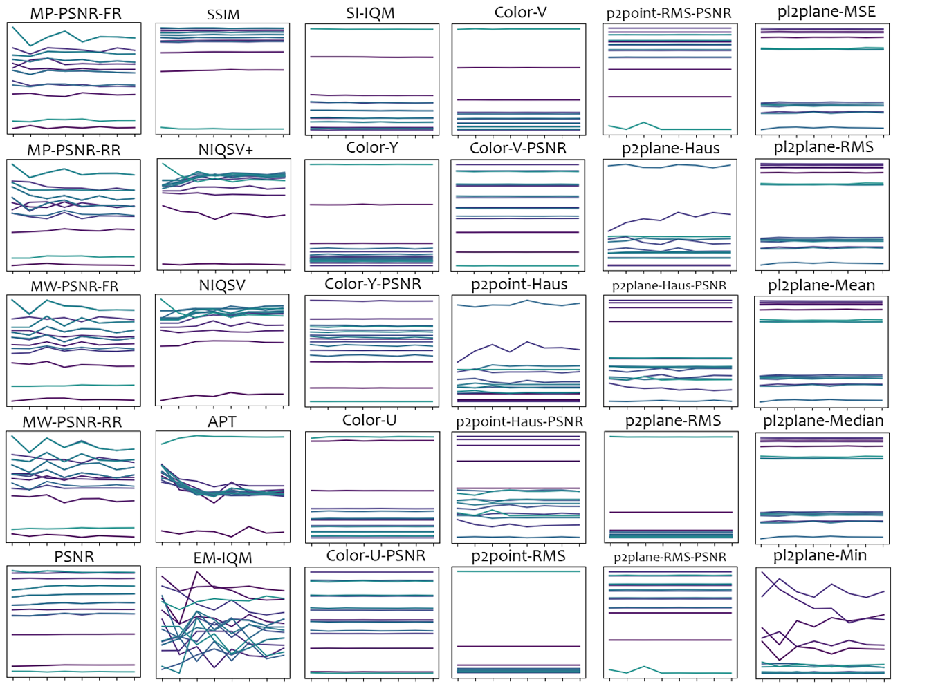
Impact of temporal sub-sampling rate
Each line is the median metric score changes across 8 temporal sub-sampling rate.
Horizontal axis is the frame rate, increasing from left to right.
Vertical axis is the metric scores.

Slide 18
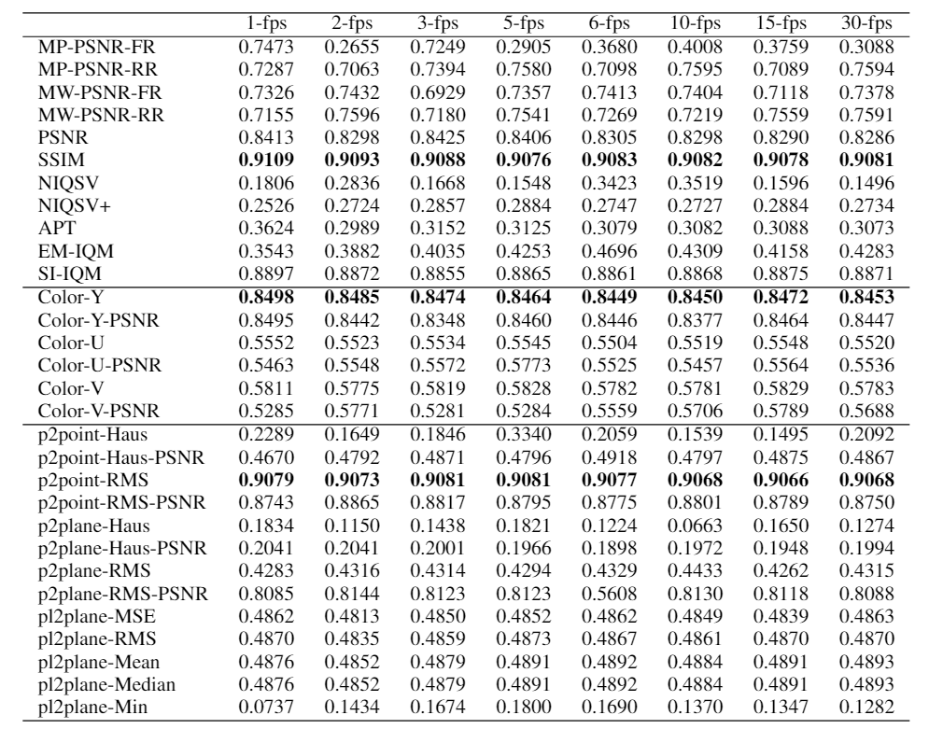
Impact of temporal sub-sampling rate
Pearson Correlation Coefficient (PCC) between the metric scores and DMOS
with arithmetic mean pooling
with varying frame rates at the columns

Slide 19
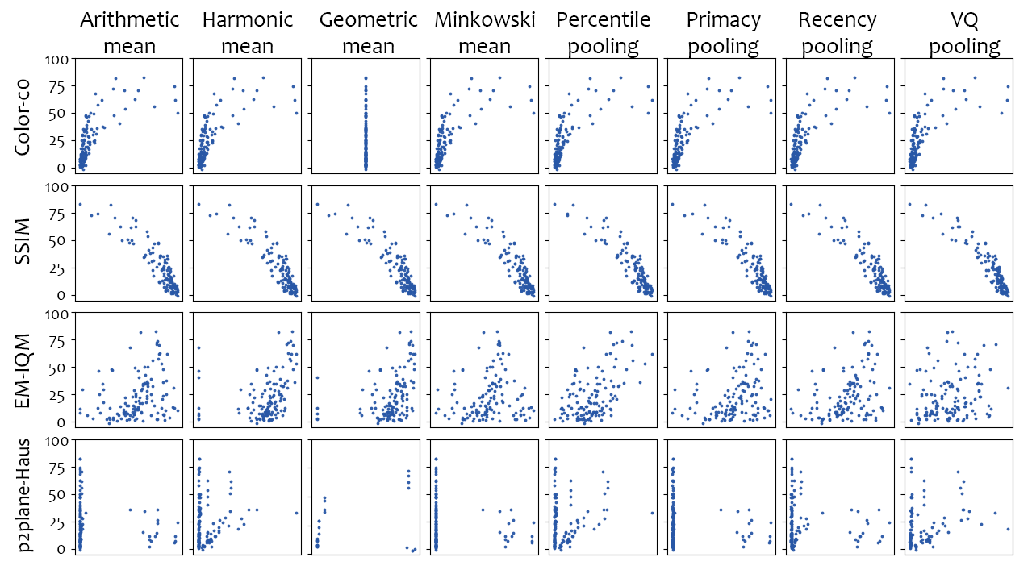
Impact of temporal pooling method
Scatter plots of selected metric scores vs. the DMOS with varying pooling method at each column

Slide 20
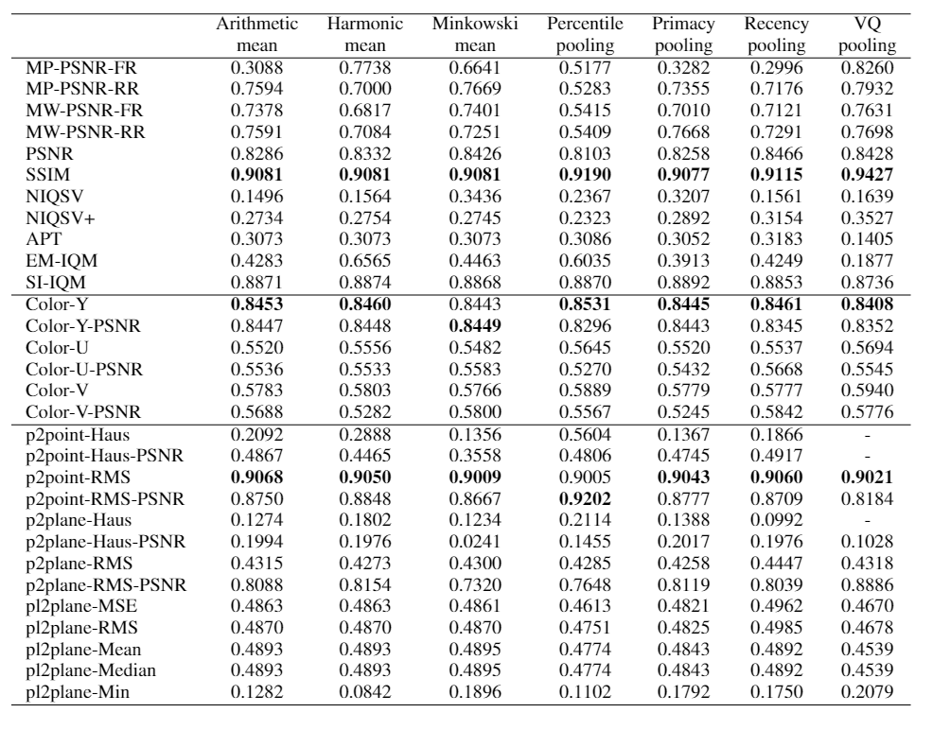
Impact of temporal pooling method
Pearson Correlation Coefficient (PCC) between the metric scores and DMOS
with 30 fps
with varying pooling methods at the columns

Slide 21
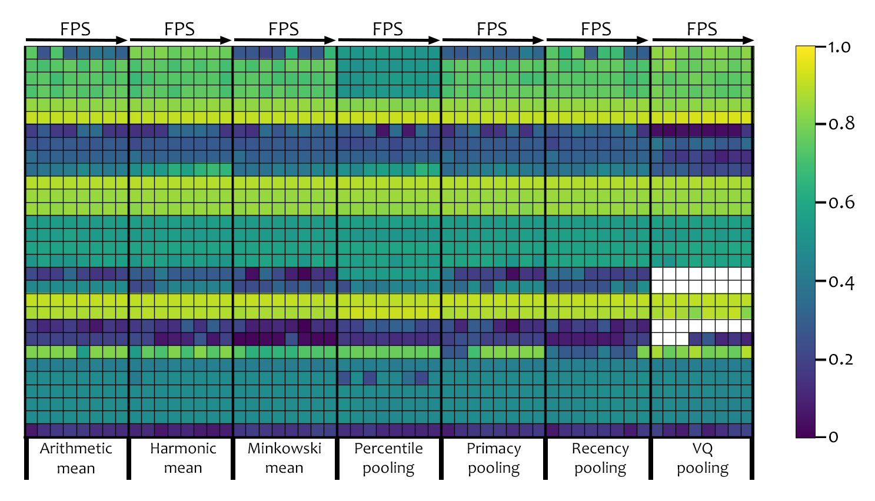
Combined impact of temporal sub-sampling and pooling methods
PCC

Slide 22
Conclusion
Minimal effect of temporal sub-sampling on metric performances
Minimal effect of temporal pooling methods on metric performances.
Metric score calculations can be sped up to 30 times without a significant loss in performance.
Further research is required to extend our conclusions for other type of distortions.

Slide 23
Supplementary Slides

Slide 24
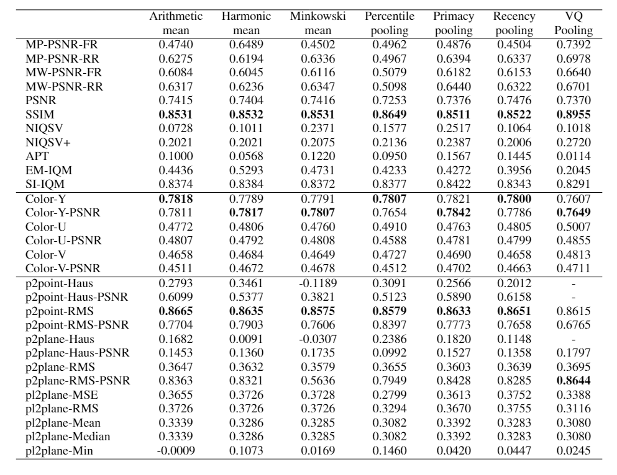
Impact of temporal pooling method
Spearman Rank-Ordered Correlation Coefficient (SROCC) between the metric scores and DMOS
with 30 fps
with varying pooling methods at the columns

Slide 25
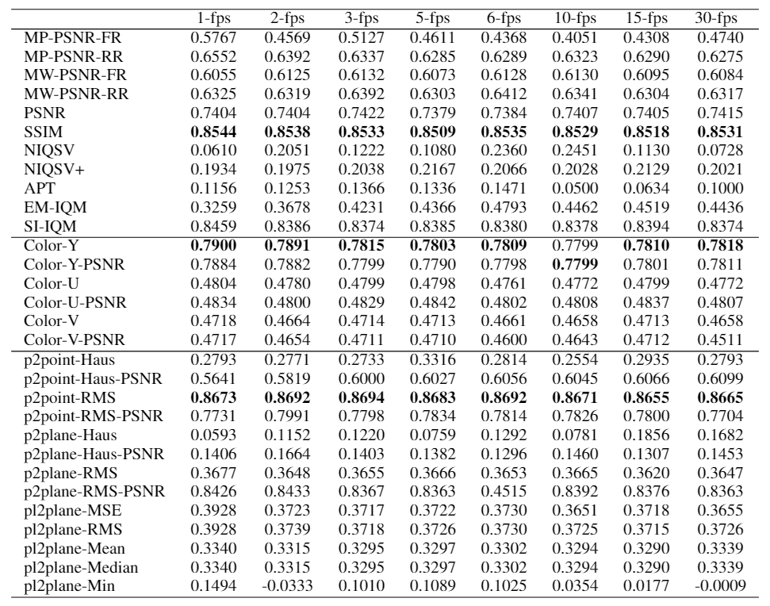
Impact of temporal sub-sampling rate
Spearman Rank-Ordered Correlation Coefficient (SROCC) between the metric scores and DMOS
with arithmetic mean pooling
with varying frame rates at the columns

