Slide 1


Quality Assessment of
User-Generated-Content Gaming Videos
Jerry (Xiangxu) Yu
ADVISOR: Dr. ALAN BOVIK
May 9th, 2022

Slide 2
Outline
Introduction
Subjective and Objective Study of UGC Gaming Video Quality Assessment
  LIVE-YT-Gaming and online study
  GAME-VQP
  Performance Evaluation
Conclusion
Future Work

Slide 3
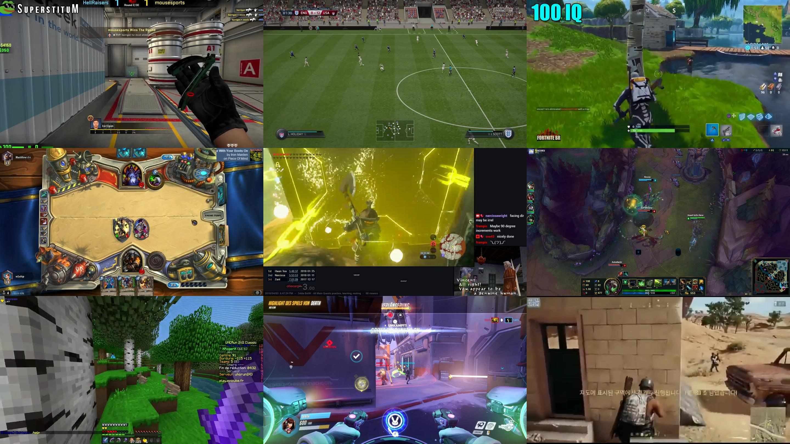
User-Generated-Content (UGC) Gaming Video
Video Game:
  interactive games that run on electronic media platforms (computers, play consoles, mobile devices...)
Gaming Video:
  actual gameplay that is recorded, synthetic and artificial,
  Professional-Generated-Content (PGC) gaming videos:
    professional-grade screen recording software
    in-game graphic settings adjusted to a high level
    Powerful and professional hardware equipment
    extremely high quality
  UGC gaming videos:
    generally recorded by casual users
    various types of recording software
    diverse game graphics settings
    ordinary computers or consoles
    mixtures of distortions (limited hardware resources, different game settings, recording software, internet condition...)

Slide 4
Outline
Introduction
Subjective and Objective Study of UGC Gaming Video Quality Assessment
  LIVE-YT-Gaming and online study
  GAME-VQP
  Performance Evaluation
Conclusion
Future Work
Notes:
我会先介绍GAME-VQP算法，然后介绍为了学习和开发算法以及评估的新数据库，最后是在新数据上的性能测试

Slide 5
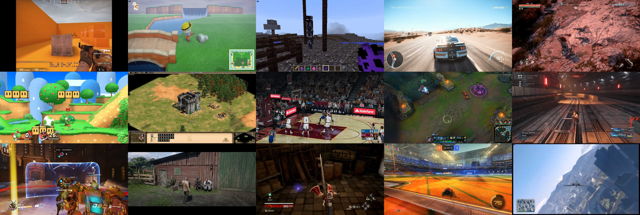
LIVE-YouTube Gaming Video Quality Database (LIVE-YT-Gaming)
The largest UGC gaming video quality database
600 gaming videos recorded from 59 different games
Four resolutions: 360p (360x640), 480p (480x854), 720p (720x1280), and 1080p (1080x1920)
Two frame rates: 30 fps and 60 fps
Duration: 8 ~ 9 sec

Slide 6

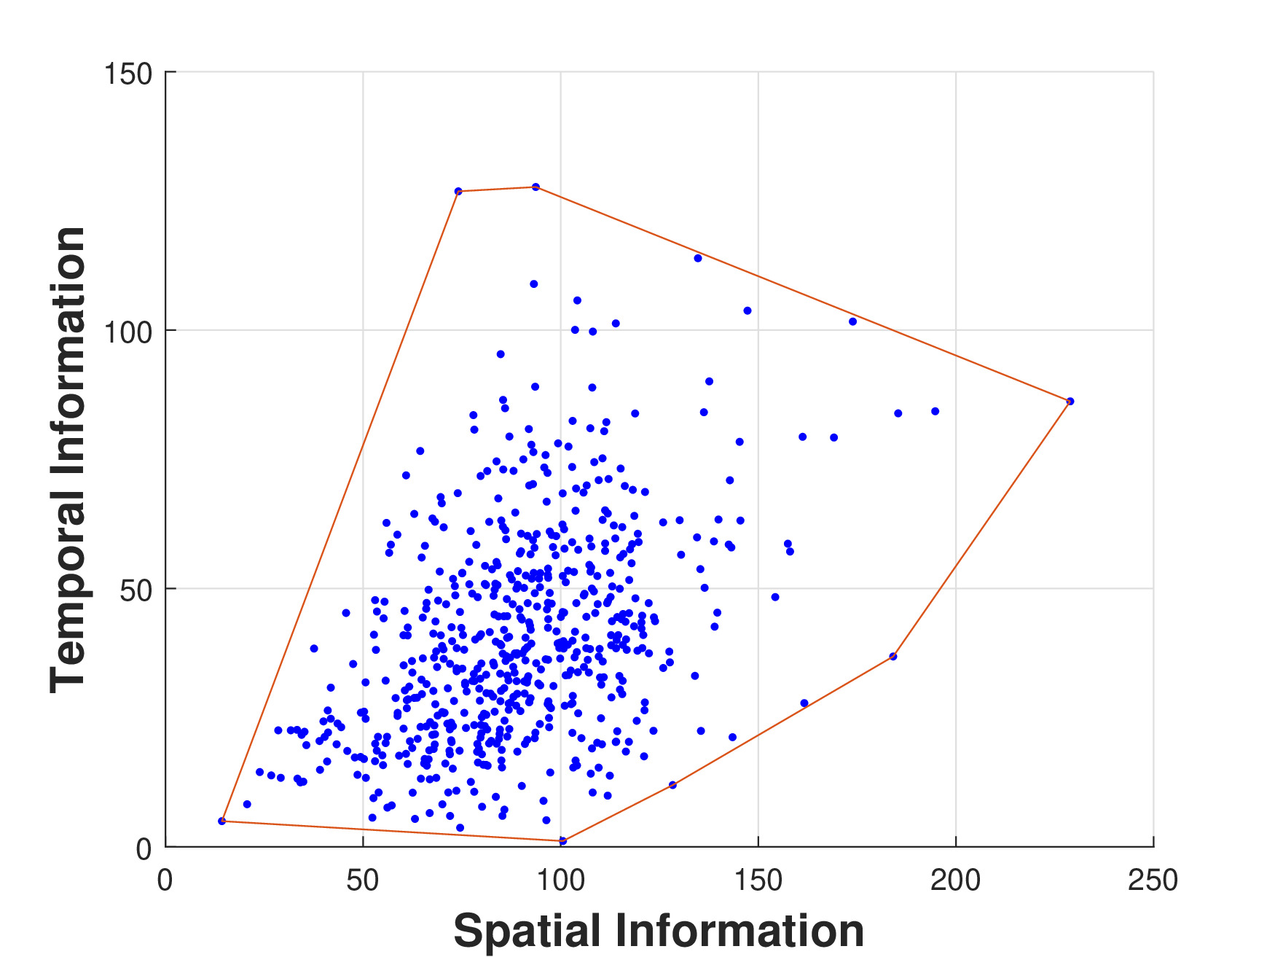
Video Collection & Selection
Source: Internet Archive (IA), a free digital library, upload by users
Selection Criteria: popularity of games on YouTube, the wide variety of types of games, to ensure the diversity of sources and to reduce bias
IA
Criteria
3000 clips
Source
Original video downloading
video clip extraction
Randomly sampling
600 videos

Slide 7
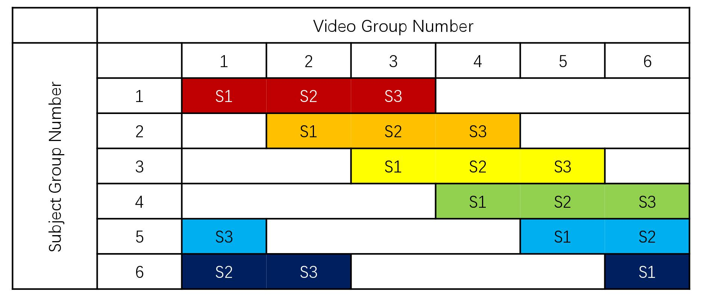
Subjective Quality Assessment
An online study having 61 participated subjects
  Subjects completed study sessions remotely on webpages using their computers
Arrange subjects and videos in groups using Round-Robin method
  Avoid bias
  30 ratings/video

Slide 8

Online Study Flow Chart
Training Session:
  provide introduction
  familiarize subjects with study procedures
  ensure that the remote study environment meets specifications
Test Sessions:
  3 sessions
  30 min/session
  100 videos/session

Slide 9
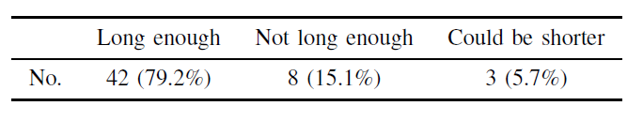
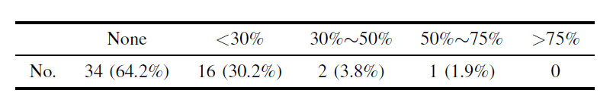
Post Questionnaire
Video Duration
Dizziness
The video durations were generally deemed to be satisfactory.
Dizziness should be considered in other subjective studies of gaming.

Slide 10
Challenges
Video Stalls
Rescaling Effects
Delays or stalls due to poor Internet conditions.
Solution:
  8-9 sec duration
  less than 20 Megabytes (MB)
  preload next videos
  record subject video playback information
Automatic rescaling by the client device.
Solution:
  set system resolution to 1080x1920 full screen mode
  record subject resolution information

Slide 11
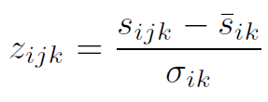
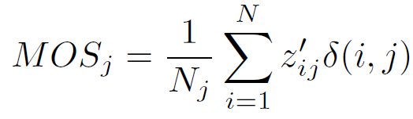
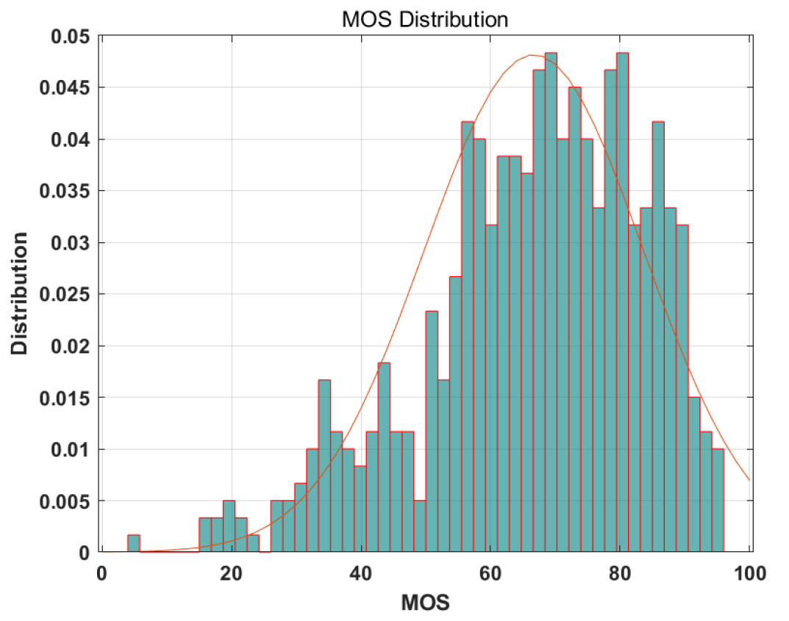
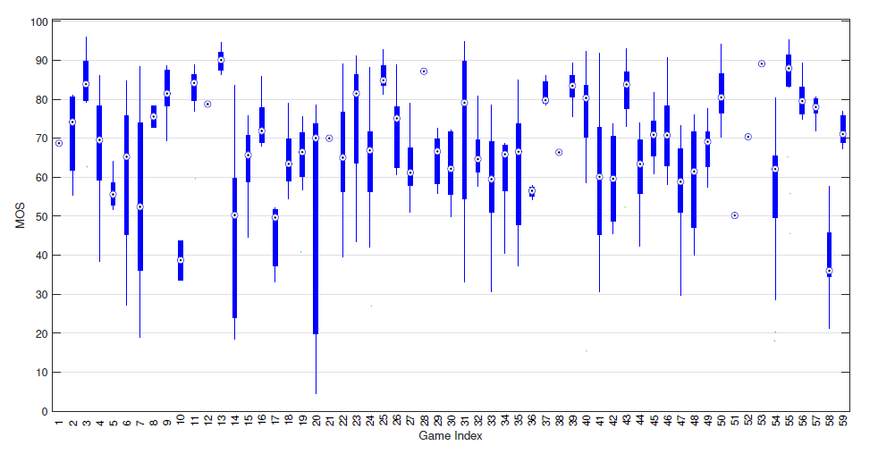
Data Processing
Raw Score
Z-Score
Rescale to [1, 100]
MOS: Mean Opinion Score

Slide 12
Outline
Introduction
Subjective and Objective Study of UGC Gaming Video Quality Assessment
  LIVE-YT-Gaming and online study
  GAME-VQP
  Performance Evaluation
Conclusion
Future Work
Notes:
我会先介绍GAME-VQP算法，然后介绍为了学习和开发算法以及评估的新数据库，最后是在新数据上的性能测试

Slide 13
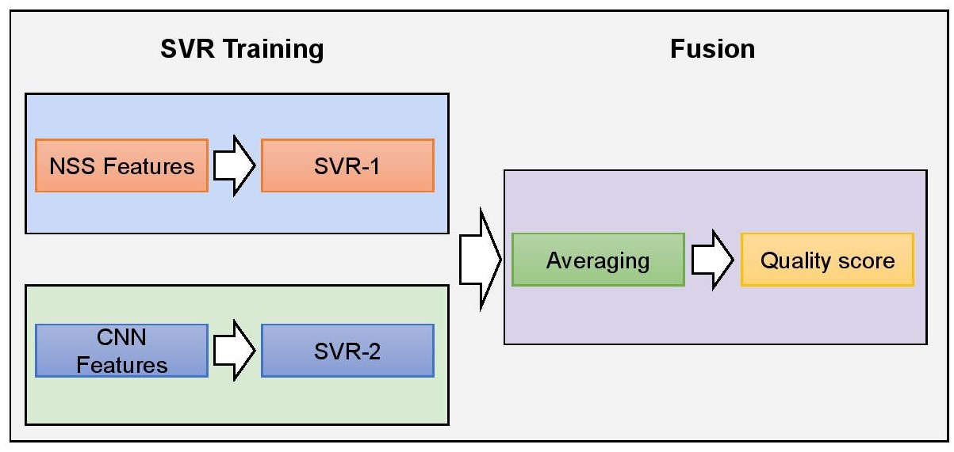
Game Video Quality Predictor (GAME-VQP)
GAME-VQP is
  designed to analyze and predict the quality of UGC gaming videos.
  a novel fusion method that combines features drawn from two sources:
    natural scene statistics (NSS) models
    deep learning features

Slide 14
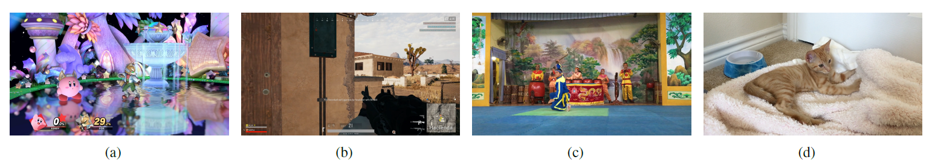
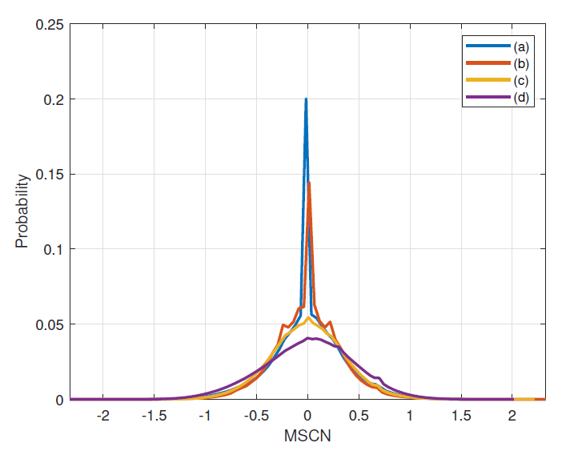
NSS Module
(a)(b): high quality UGC gaming videos (c)(d): high quality general UGC videos
General NSS:
  the distributions of normalized coefficients of natural images tends towards a gaussian characteristic.
  being predictably changed when distortions occur
Gaming Video Statistics (GVS):
  high quality gaming videos do not fit a Gaussian distribution.
  but deviation caused by distortions is still predictable
normalized coefficient distribution of gaming videos and non-gaming videos

Slide 15
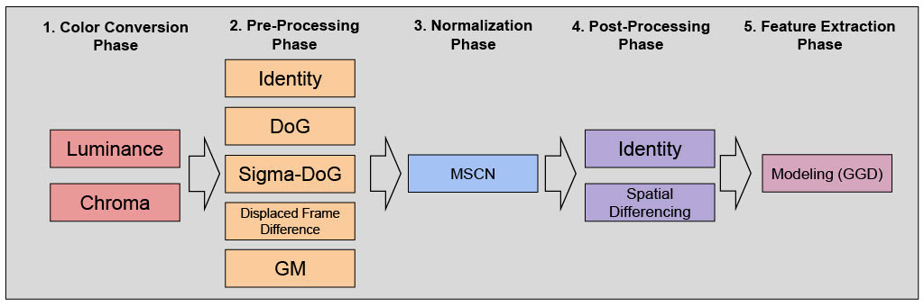
Five-Phase NSS Feature Extraction
Color Conversion
Pre-Processing
Normalization
Post-Processing
Feature Extraction

Slide 16

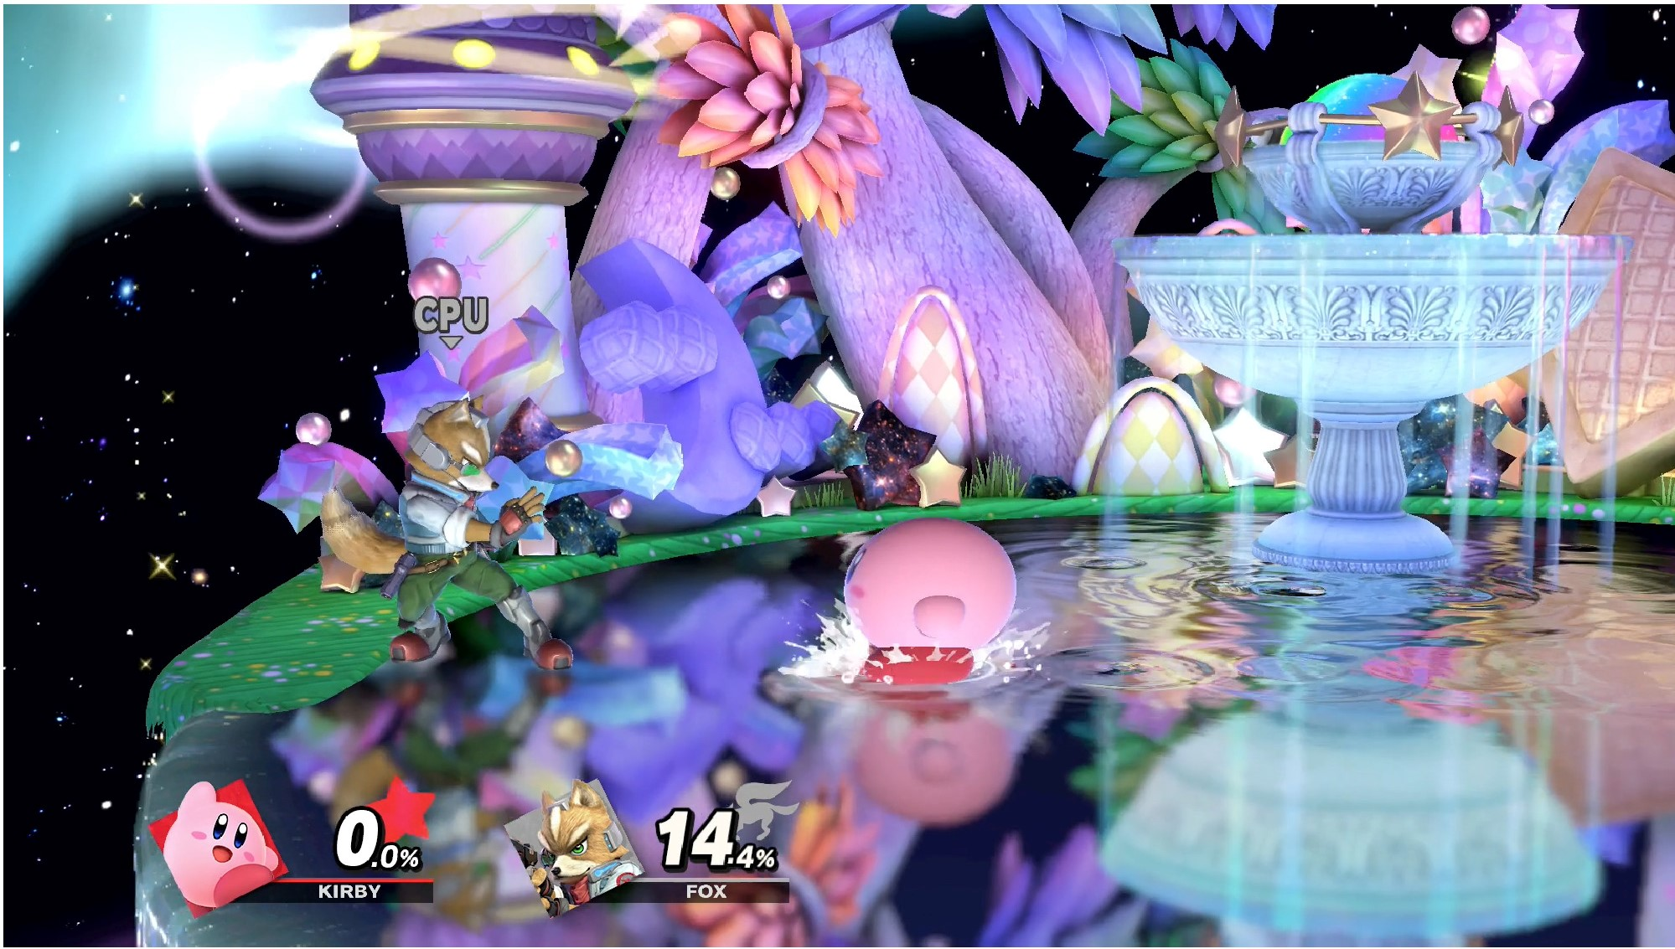
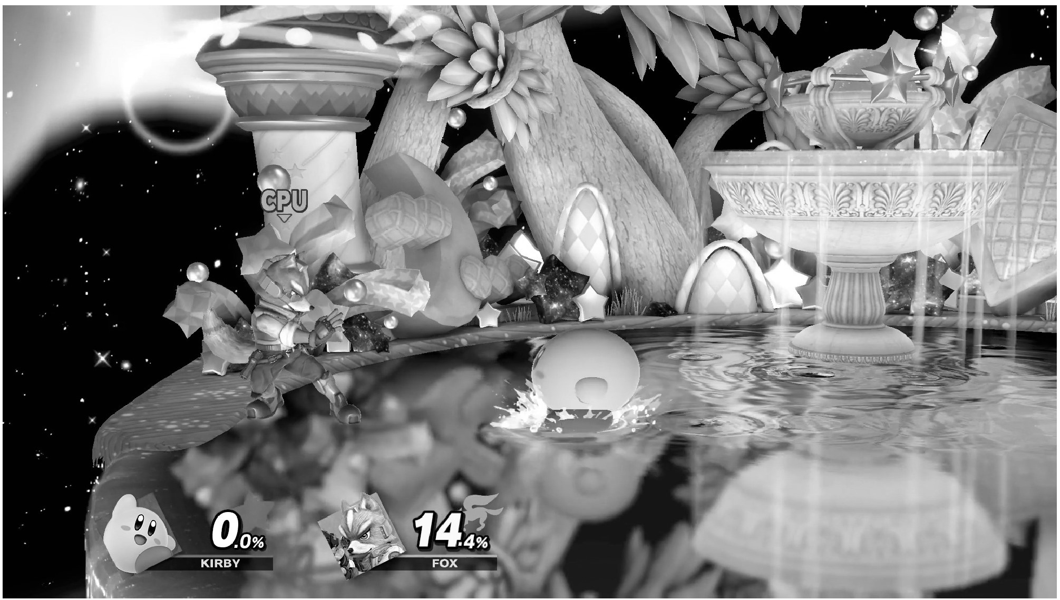
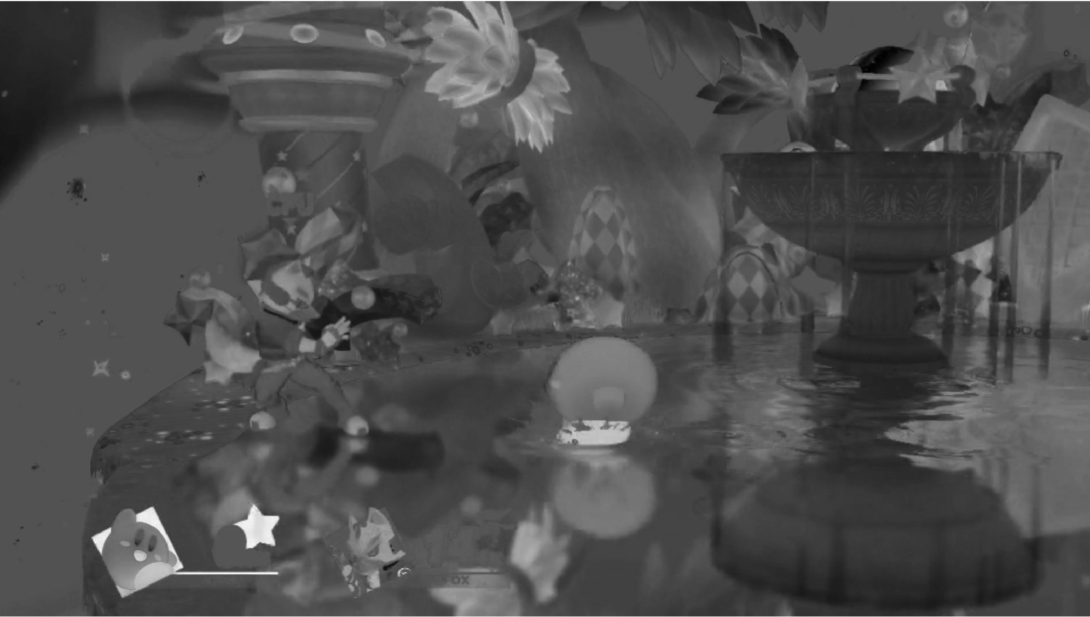

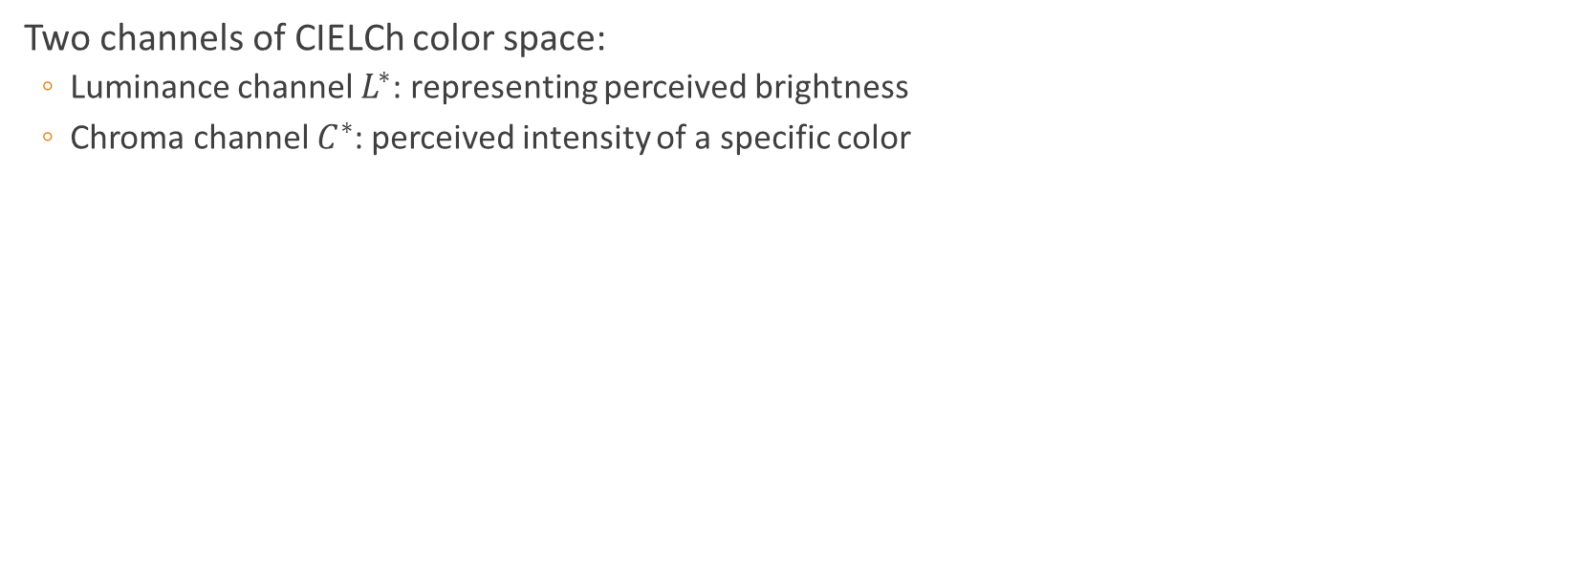



Color Space/Map Phase
Two channels of CIELCh color space:
  Luminance channel $L^{∗}$: representing perceived brightness
  Chroma channel $C^{∗}$: perceived intensity of a specific color
$a^{∗}, b^{∗}$: chromatic channels of CIELAB color space
An example frame$I$
Luminance map $L^{∗}$
Chroma map $C^{∗}$
Color Conversion
Pre-Processing
Normalization
Post-Processing
Feature Extraction

Slide 17

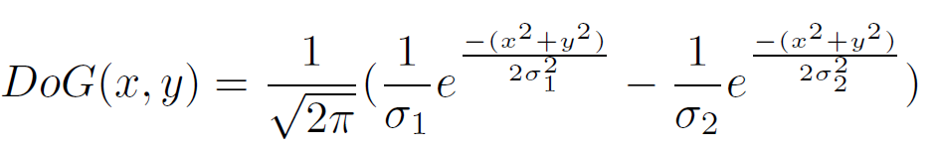
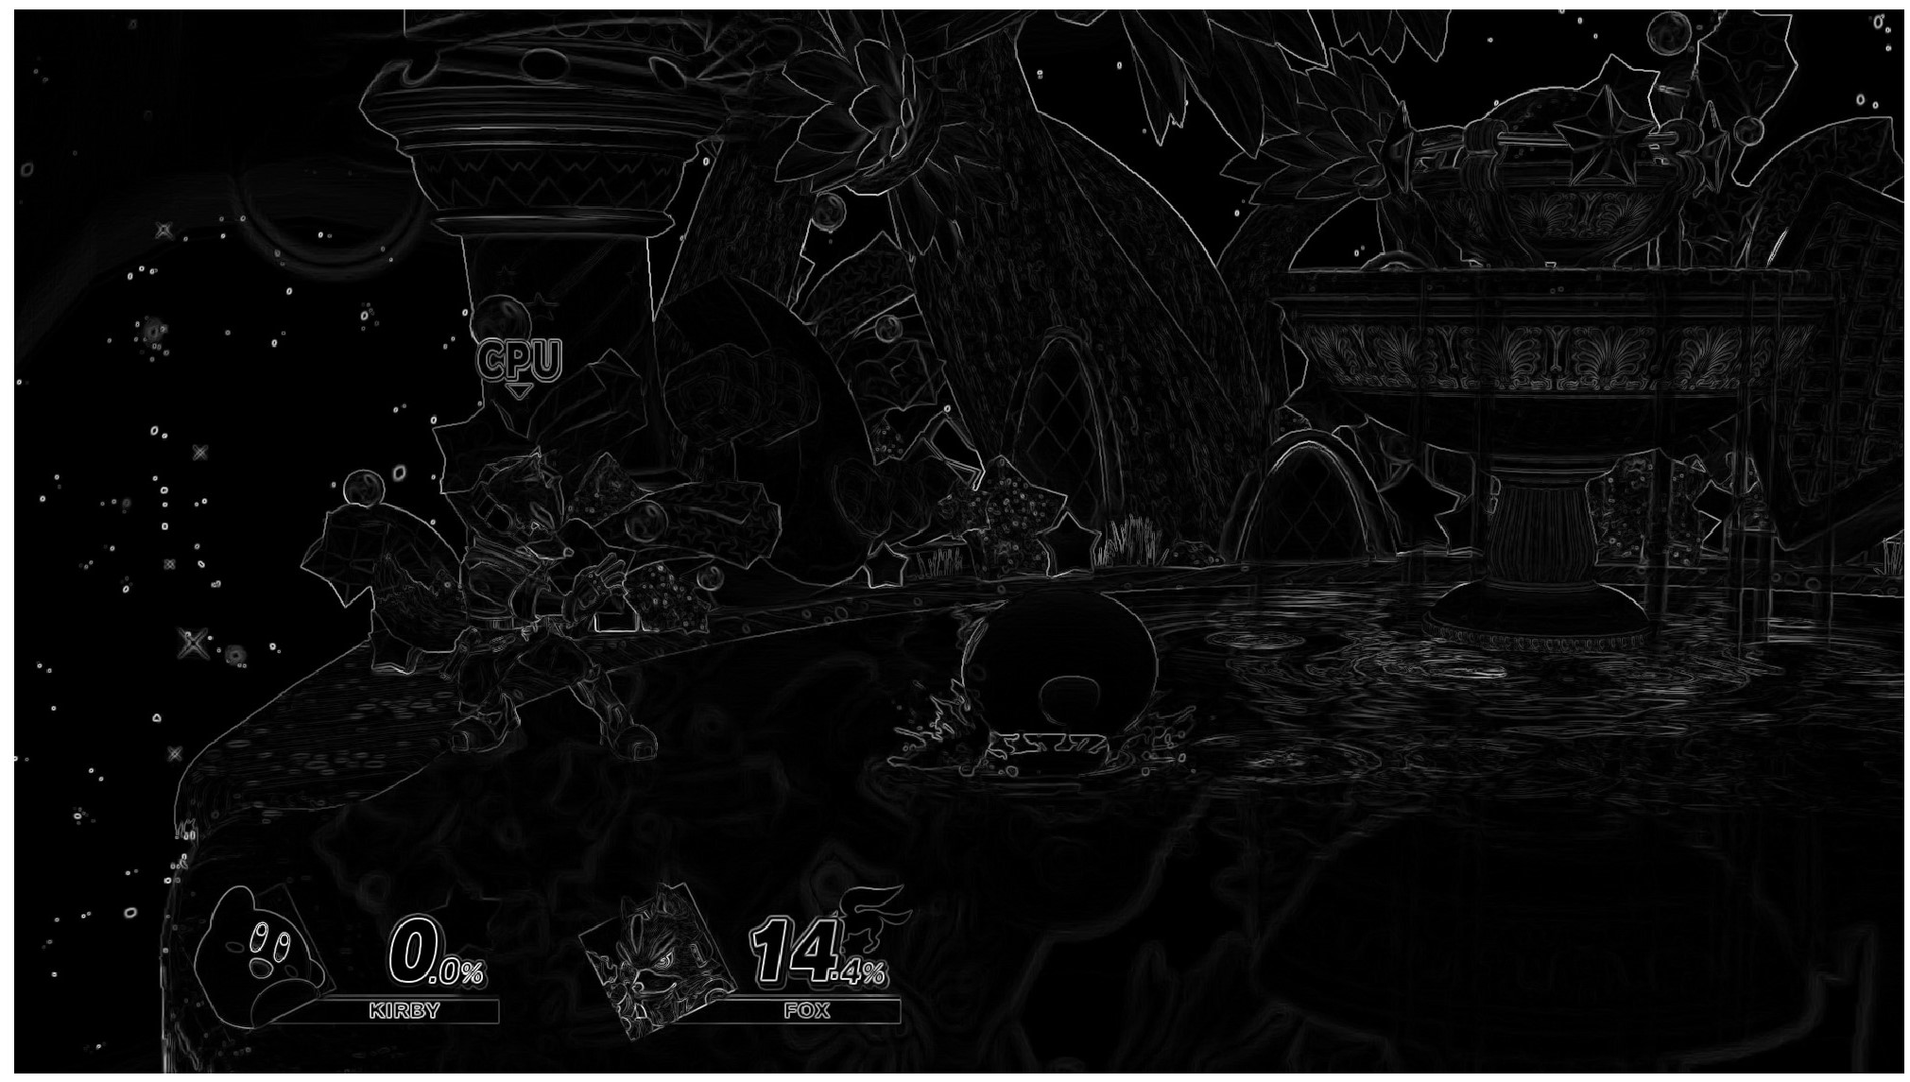

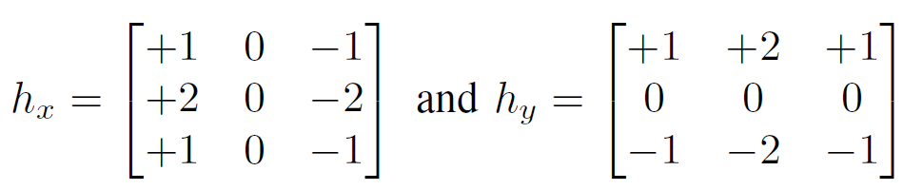

Pre-Processing Phase
Identity: Do-nothing; Passed through without modification
Difference of Gaussian (DoG) filtering:
Gradient Magnitude (GM) estimation:
DoG map
$${ σ}_{1}=1.16, σ_{2}=1.5σ_{1}$$
GM map
Color Conversion
Pre-Processing
Normalization
Post-Processing
Feature Extraction

Slide 18
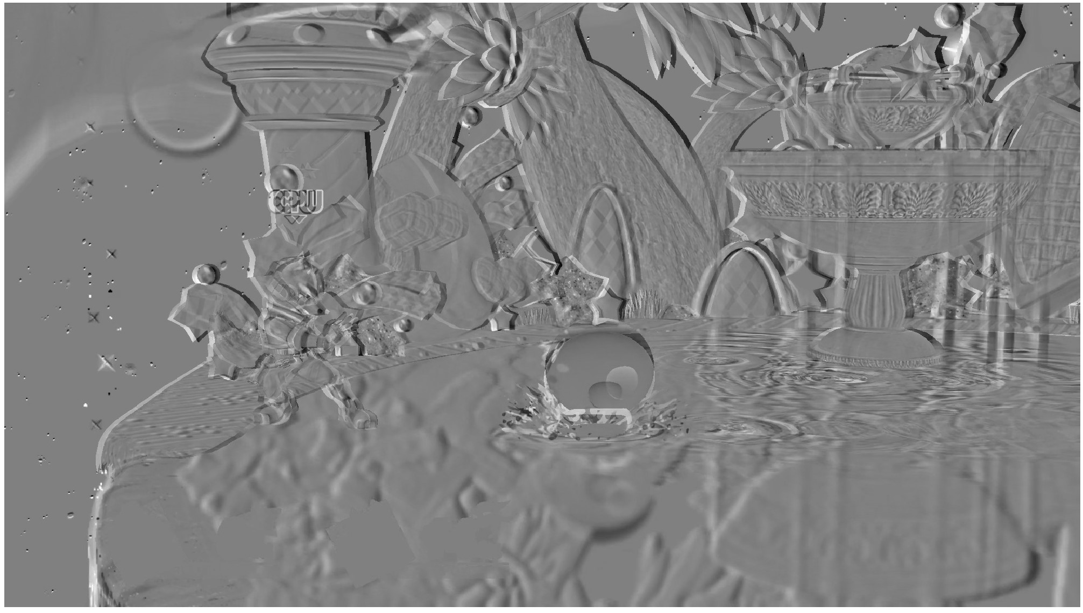

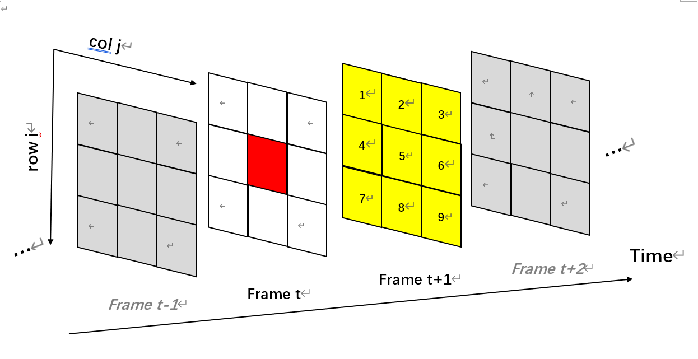
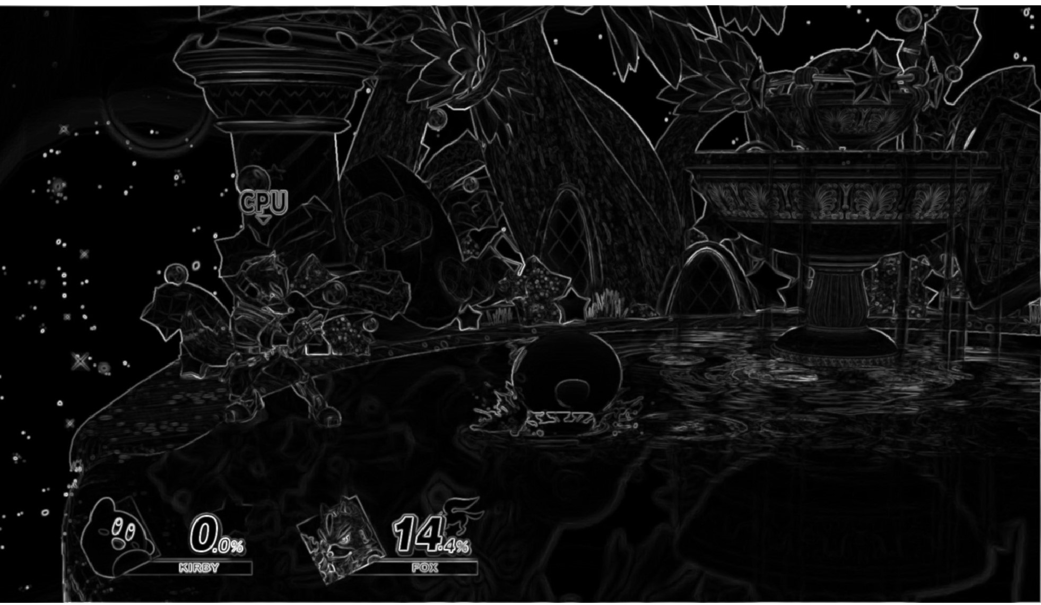
Pre-Processing Phase
Displaced Frame Differencing (DFD):
Sigma Field (SF): defined in normalization phase
DFD map
SF map
Color Conversion
Pre-Processing
Normalization
Post-Processing
Feature Extraction

Slide 19
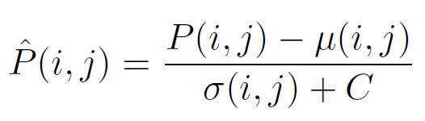
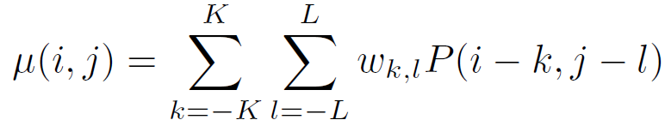
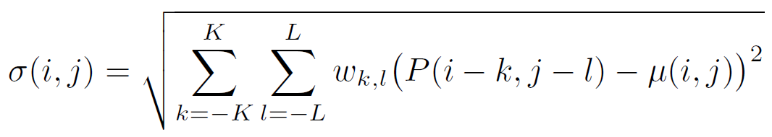
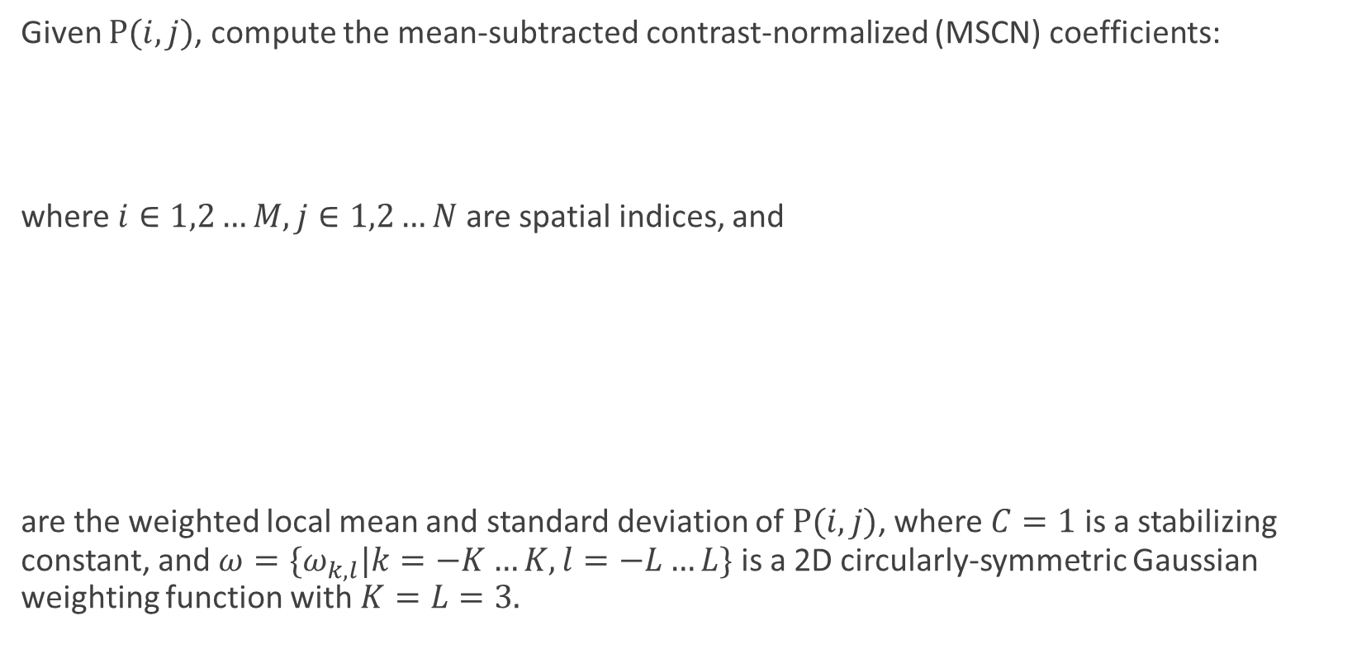
Normalization Phase
Given $P(i,j)$, compute the mean-subtracted contrast-normalized (MSCN) coefficients:
where $i∈1,2…M, j∈1,2…N$are spatial indices, and
are the weighted local mean and standard deviation of $P(i,j)$, where $C=1$ is a stabilizing constant, and ${ω=\{ω}_{k,l}|k=−K…K,l=−L…L\}$ is a 2D circularly-symmetric Gaussian weighting function with $K=L=3.$
sigma field
Color Conversion
Pre-Processing
Normalization
Post-Processing
Feature Extraction

Slide 20
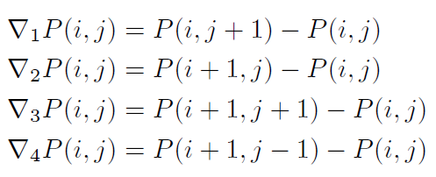
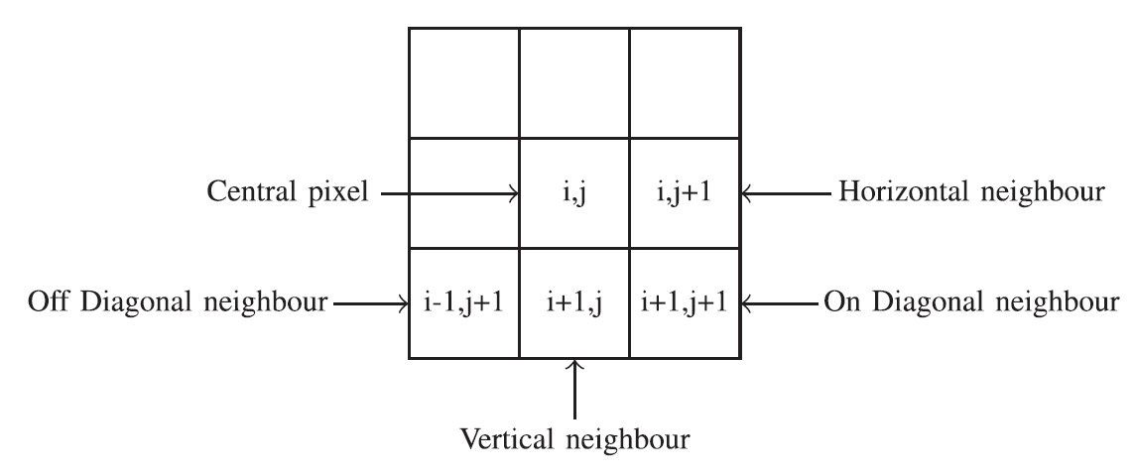
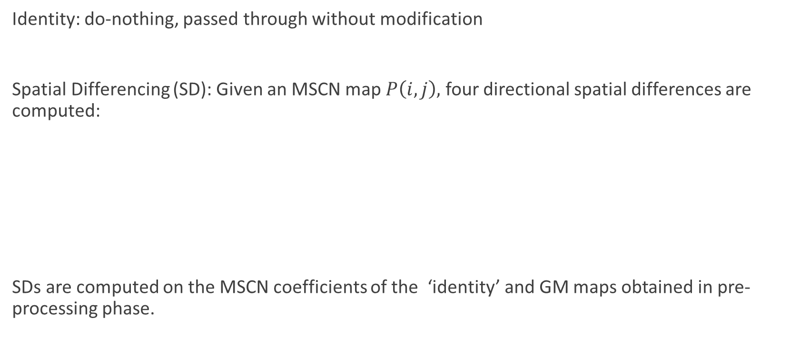
Post-Processing Phase
Identity: do-nothing, passed through without modification
Spatial Differencing (SD): Given an MSCN map $P\left(i, j\right),$ four directional spatial differences are computed:
SDs are computed on the MSCN coefficients of the ‘identity’ and GM maps obtained in pre-processing phase.
Color Conversion
Pre-Processing
Normalization
Post-Processing
Feature Extraction

Slide 21

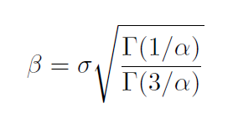

Feature Extraction Phase
Fitting model: Generalized Gaussian Distribution (GGD)
Output: two parameters, the shape parameter α and the spread parameter σ
Color Conversion
Pre-Processing
Normalization
Post-Processing
Feature Extraction

Slide 22
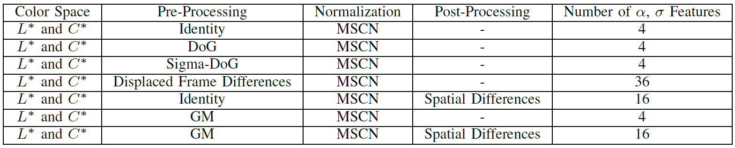
NSS Feature Summary

Slide 23
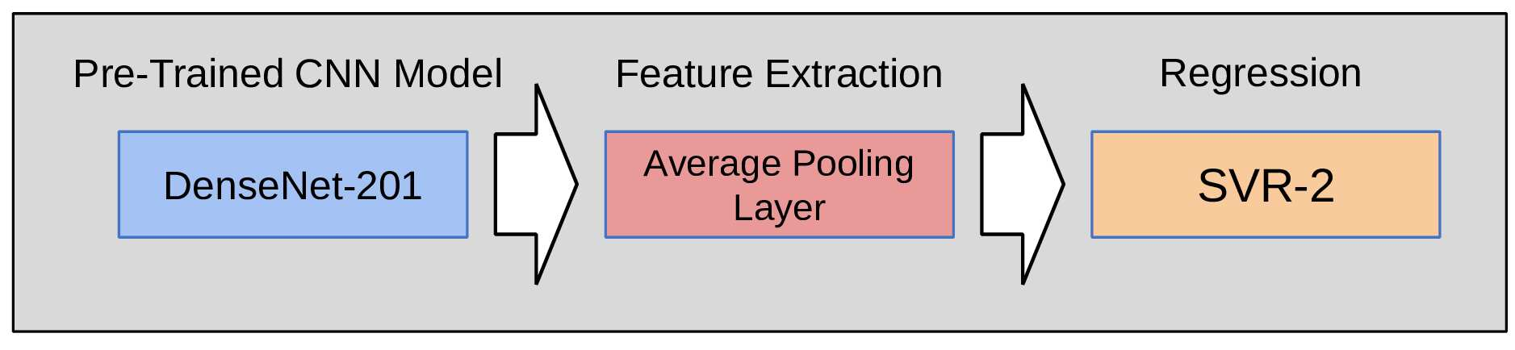

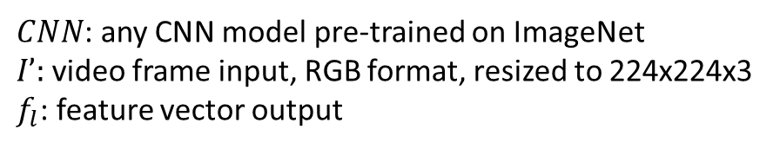
CNN Module
$CNN$: any CNN model pre-trained on ImageNet
$I’:$video frame input, RGB format, resized to 224x224x3
$f_{l}$: feature vector output

Slide 24
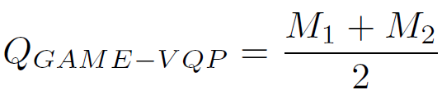
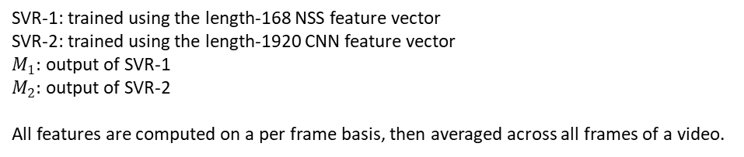
Fusion
SVR-1: trained using the length-168 NSS feature vector
SVR-2: trained using the length-1920 CNN feature vector
$M_{1}:$ output of SVR-1
$M_{2}:$ output of SVR-2
All features are computed on a per frame basis, then averaged across all frames of a video.

Slide 25
Outline
Introduction
Subjective and Objective Study of UGC Gaming Video Quality Assessment
  LIVE-YT-Gaming and online study
  GAME-VQP
  Performance Evaluation
Conclusion
Future Work
Notes:
我会先介绍GAME-VQP算法，然后介绍为了学习和开发算法以及评估的新数据库，最后是在新数据上的性能测试

Slide 26
Performance Evaluation
Evaluation Metric
  Spearman’s rank order correlation coefficient (SROCC)
  Pearson’s (linear) correlation coefficient (LCC)
  Root Mean Squared Error (RMSE)
  Statistic Significant Test: Wilcoxon Rank Sum Test
Experiment Setting
  Support Vector Regressor (SVR)
  random non-overlapping 80%/20% training/test splits
  100 iterations
  report median value of SROCC, LCC and RMSE

Slide 27
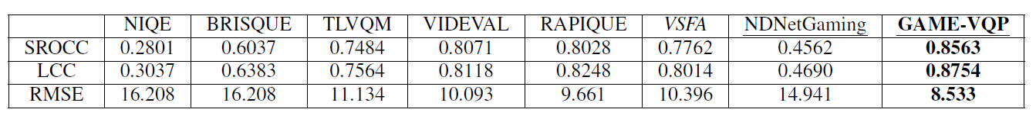
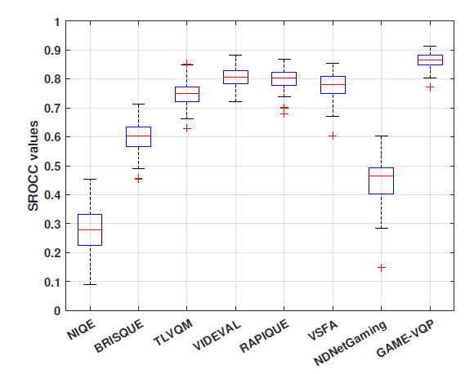
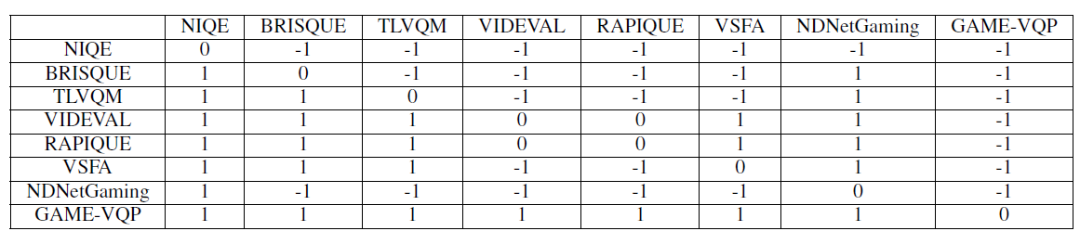
Performance on LIVE-YT-Gaming
Second best
best
Statistical test results (SROCC)
NIQE: non-training IQA model
VSFA: a deep learning based VQA model
NDNetGaming: a gaming VQA model
Boxplot of performance (SROCC)

Slide 28
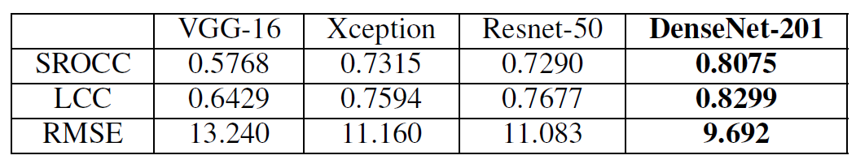
Pre-Trained CNN Model
Performed similar to VIDEVAL and RAPIQUE
Experiment Setting:
  Extract feature vector of the last average pooling/fully connected layer
  Train SVR
GAME-VQP model uses Densenet-201 as CNN module

Slide 29
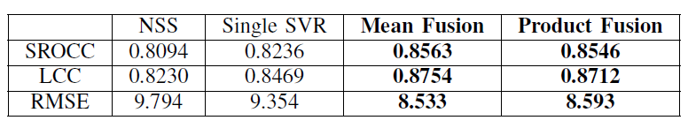
Fusion Method
best
Performed similar to VIDEVAL and RAPIQUE
  NSS: an NSS-only SVR model.
  Single SVR: Stitch the extracted NSS and CNN features into a feature vector and train a single SVR model.
  Mean Fusion: the mean of the predictions produced by SVR-1 and SVR-2 (GAME-VQP).
  Product Fusion: the product of the predictions produced by SVR-1 and SVR-2.

Slide 30
Non-Gaming UGC Videos
best
second best
second best
The LIVE Video Quality Challenge Database (LIVE-VQC)
Sinno, Zeina, and Alan Conrad Bovik. "Large-scale study of perceptual video quality." IEEE Transactions on Image Processing 28.2 (2018): 612-627.

Slide 31
Outline
Introduction
Subjective and Objective Study of UGC Gaming Video Quality Assessment
  LIVE-YT-Gaming and online study
  GAME-VQP
  Performance Evaluation
Conclusion
Future Work
Notes:
我会先介绍GAME-VQP算法，然后介绍为了学习和开发算法以及评估的新数据库，最后是在新数据上的性能测试

Slide 32
Conclusion
LIVE-YT-Gaming²:
  a new UGC gaming video quality database
    600 unique content from 59 games
    360p, 480p, 720p, and 1080p
    30/60 fps
    8~9 sec
  a new online study¹
    61 subjects
    18,600 subjective ratings
GAME-VQP²:
  a new VQA model specifically designed for UGC gaming videos
  a fusion of predictions from:
    SVR-1 trained using NSS features
    SVR-2 trained using CNN features
  excellent performance on LIVE-YT-Gaming
¹The human study was approved by the Institutional Review Board of UT-Austin.
²This research was supported by a gift from YouTube, and by grant number 2019844 for the National Science Foundation AI Institute for Foundations of Machine Learning (IFML).

Slide 33
Outline
Introduction
Subjective and Objective Study of UGC Gaming Video Quality Assessment
  LIVE-YT-Gaming and online study
  GAME-VQP
  Performance Evaluation
Conclusion
Future Work
Notes:
我会先介绍GAME-VQP算法，然后介绍为了学习和开发算法以及评估的新数据库，最后是在新数据上的性能测试 metaverse

Slide 34
Future Work
YouTube project:
  completed
Facebook Gaming project:
  on going
  PGC gaming videos

Slide 35
Thank you and Q & A?
Yu, X., Tu, Z., Ying, Z., Bovik, A. C., Birkbeck, N., Wang, Y., & Adsumilli, B. (2022). Subjective Quality Assessment of User-Generated Content Gaming Videos. In Proceedings of the IEEE/CVF Winter Conference on Applications of Computer Vision (pp. 74-83).
Yu, X., Ying, Z., Birkbeck, N., Wang, Y., Adsumilli, B., & Bovik, A. C. (2022). Subjective and Objective Analysis of Streamed Gaming Videos. arXiv preprint arXiv:2203.12824.
Yu, X., Tu, Z., Birkbeck, N., Wang, Y., Adsumilli, B., & Bovik, A. C. (2022). Perceptual Quality Assessment of UGC Gaming Videos. arXiv preprint arXiv:2204.00128.
Jerry (Xiangxu) Yu, yuxiangxu@utexas.edu

