Slide 1
On subjective evaluation of video quality with the crowdsourcing approach
Babak Naderi
TU-Berlin
Ross Cutler
Microsoft

Slide 2
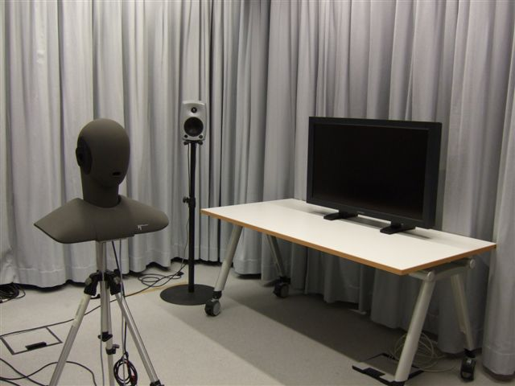
Introduction
P.CrowdV is a work item in ITU-T SG12 Q7 aiming to draft counterpart of P.910/11 for crowdsourcing
Crowdsourcing
  Unknow participants
  Working at own environment
  Using own devices
  No moderator
We introduce an open-source framework with participant eligibility tests, environment and setup tests and reliability checks

Slide 3
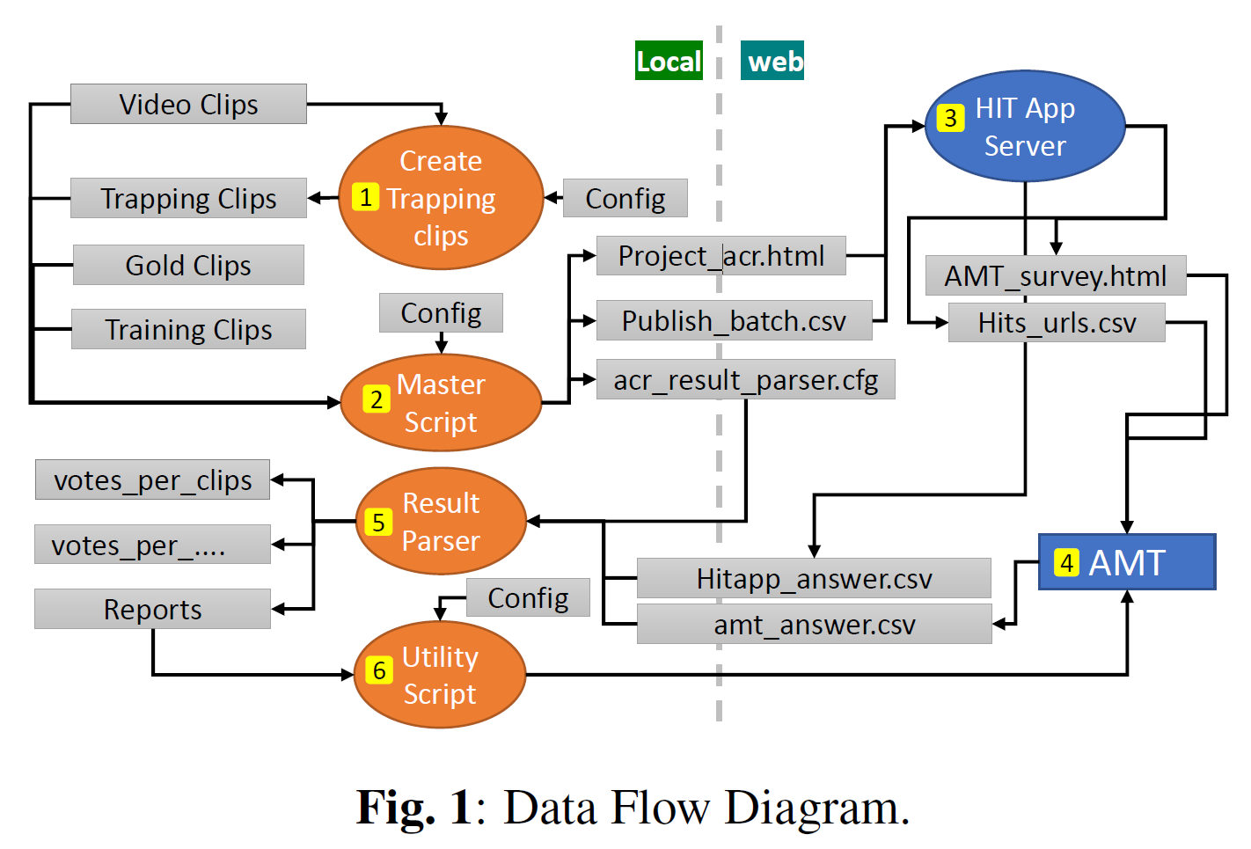
Framework
Multiple scripts to automate the process
Test methods
  ACR
  ACR – Hidden reference
  DCR
Scales
  5 and 9 points Likert scale
It can be used with any crowdsourcing platform or dedicated panel

Slide 4
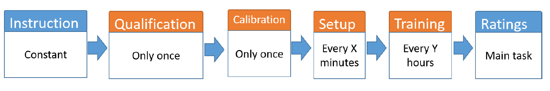
Test components
The test is designed in different sections from participants perspective
Rating sections: 10-12 clips to be rated
Background hardware/network checks:
  Resolution
  Screen refresh rate
  PC or Mobile
  Network test
Video playback component:
  Full-screen (with/-out scaling)
  Record playback duration
  Force to watch until the end

Slide 5

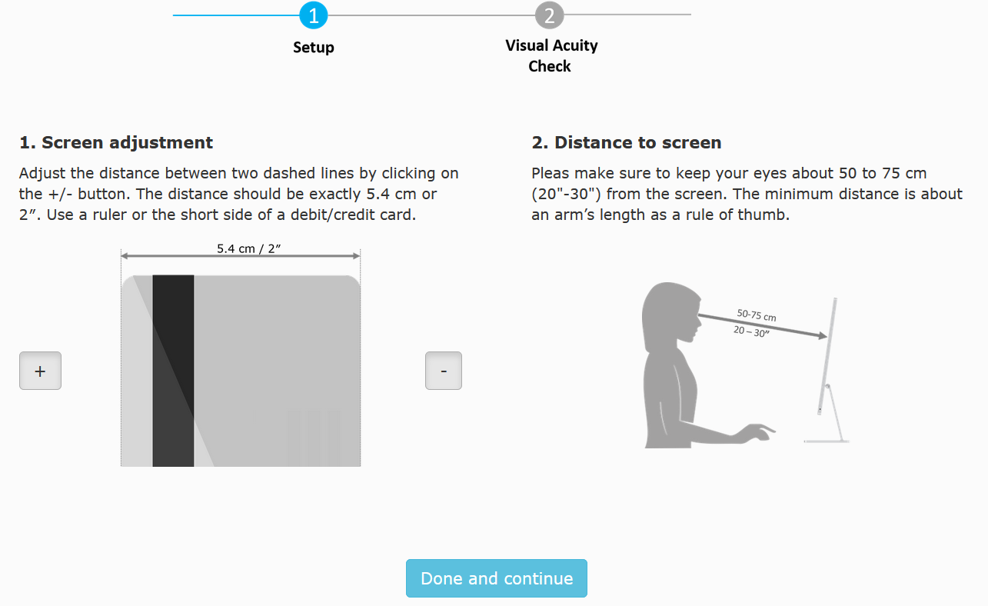
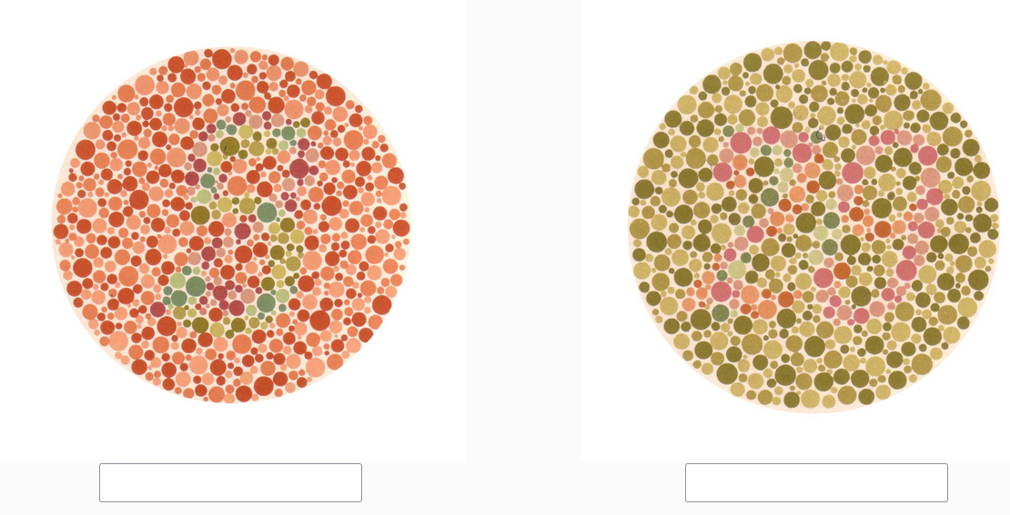
Qualification
Normal color vision Test
  2 plates from Ishihara test
Pretest:
300 AMT and 191 from online color-blind communities
Decision tree: 98% accuracy (sensitivity 0.996, specificity 0.95)
Normal or corrected-to-normal Visual Acuity
No error on the 20/30 line of a standard chart:
5 Landolt ring optotypes

Slide 6
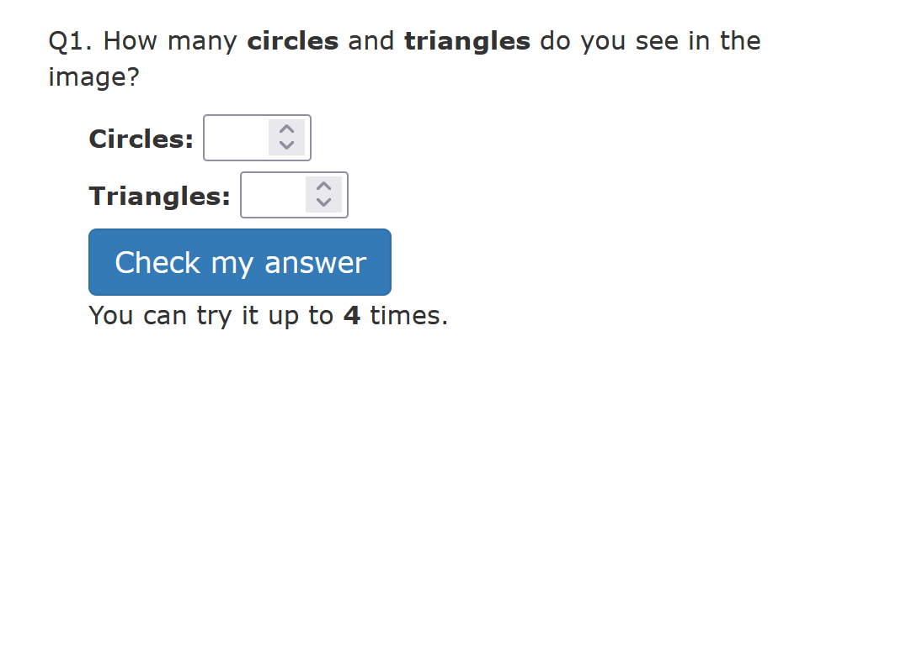
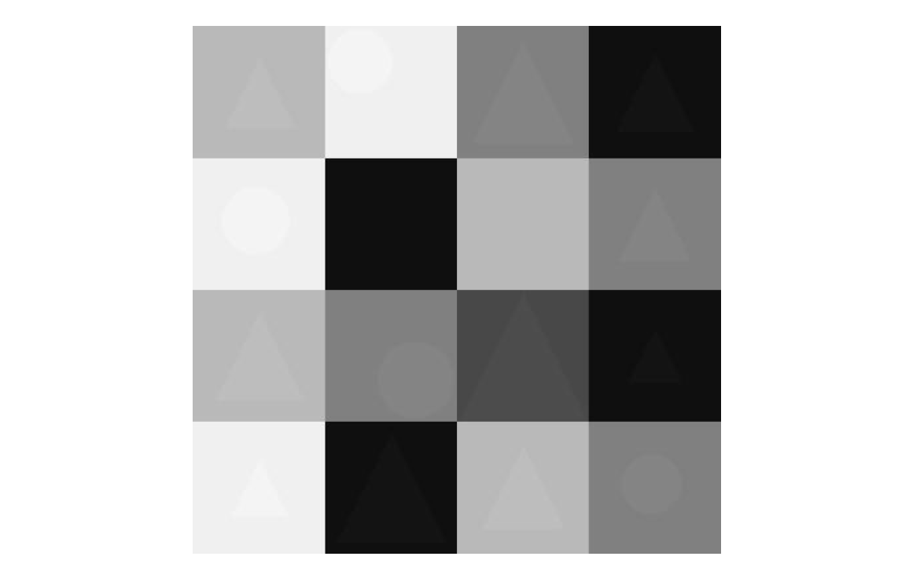
Setup I
Ask to perform Resolution, Color and Brightness Calibration
4 circles
10 triangles

Slide 7
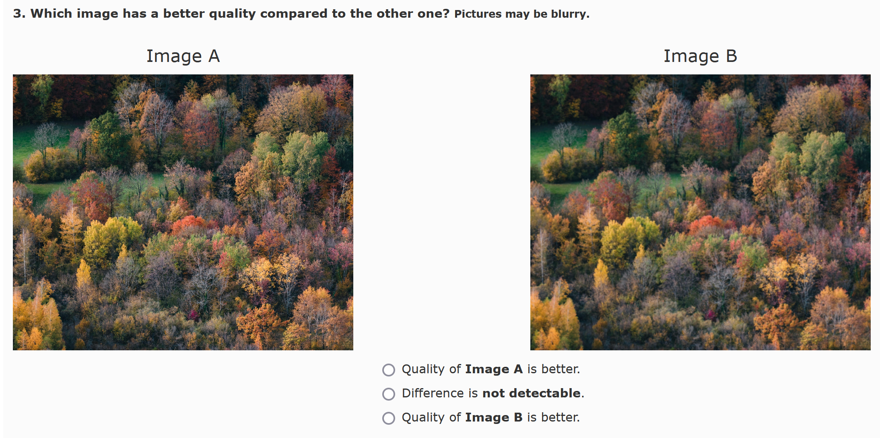
Setup II
Viewing distance test
3x image pairs
Blur effect, detected if
  Too close
  In proper distance
  Even if too far
Custom feedback asking to adjust their distance

Slide 8
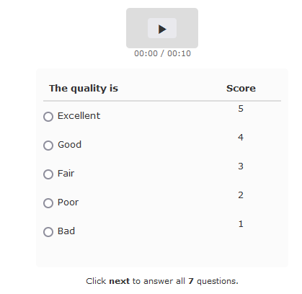
Training + Rating
Training
Every 60 minutes
Anchoring
One trapping question with feedback
Ratings
10 clips + 1 gold question + 1 trapping

Slide 9
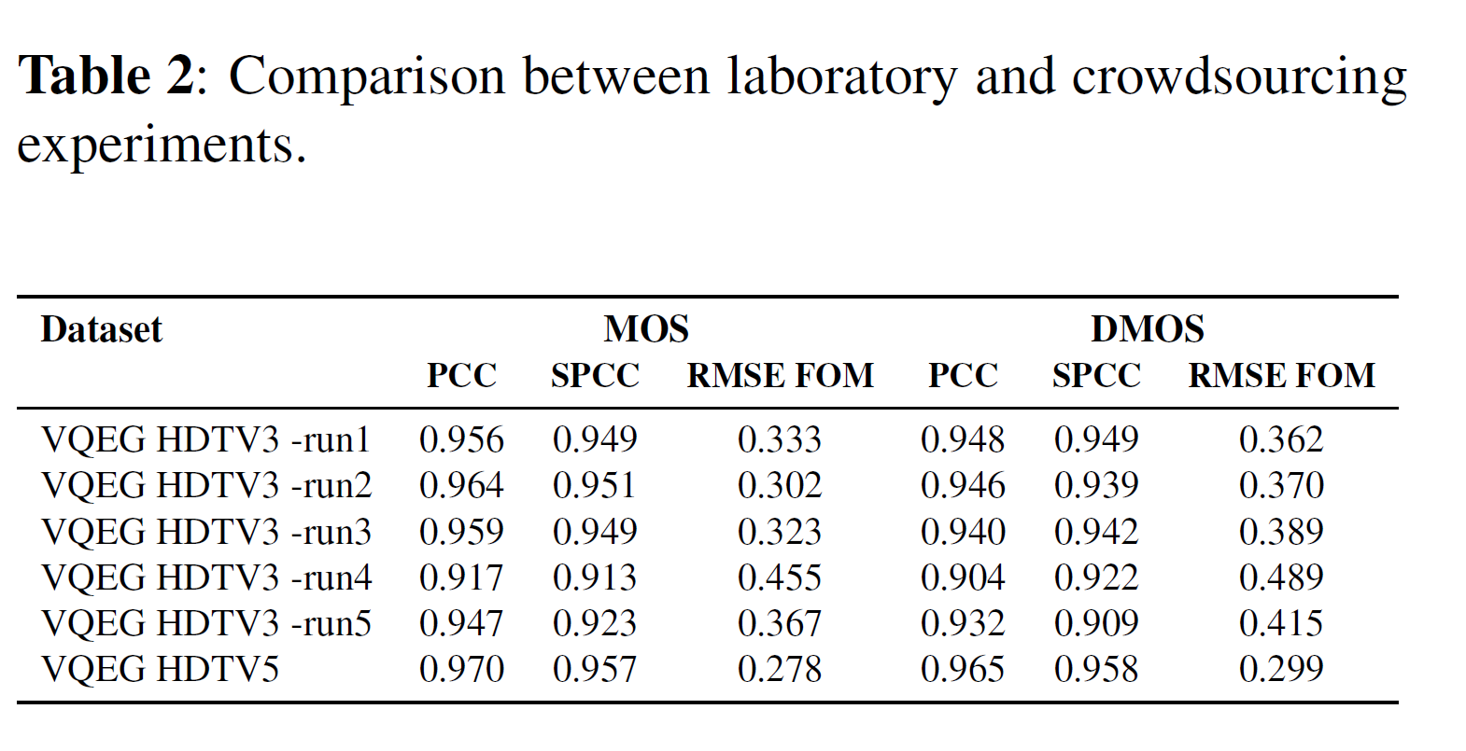
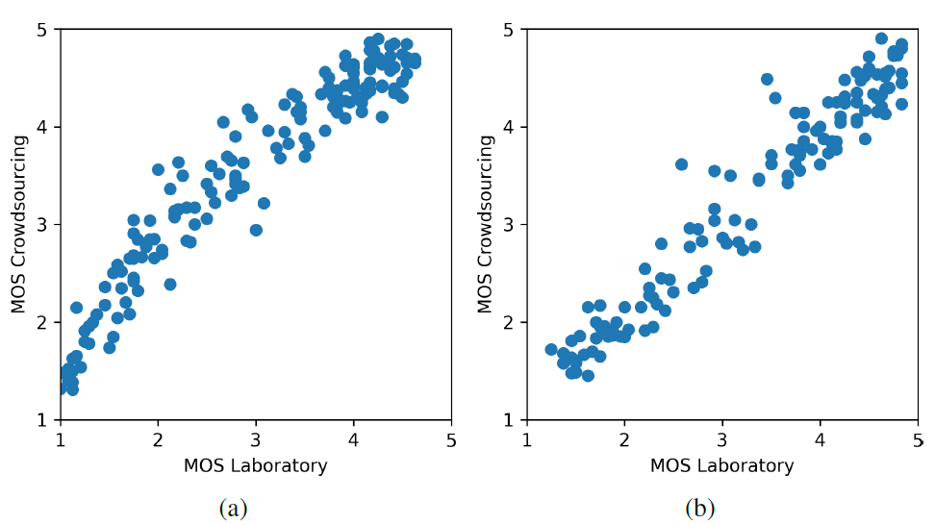
Validation
VQEG HD3 and VQEG HD5
  168 sequences
Videos re-encoded using x264, CRF 17
On average PCC 0.952
VQEG-HD3
VQEG-HD5

Slide 10
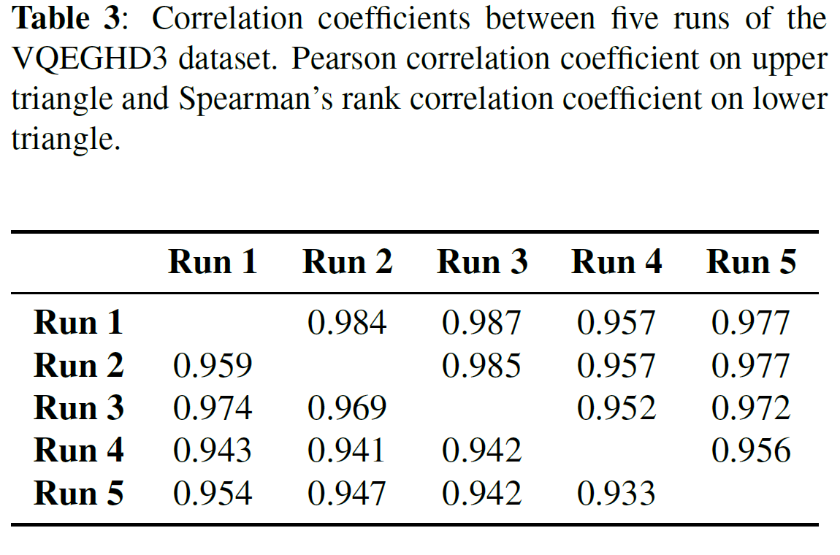
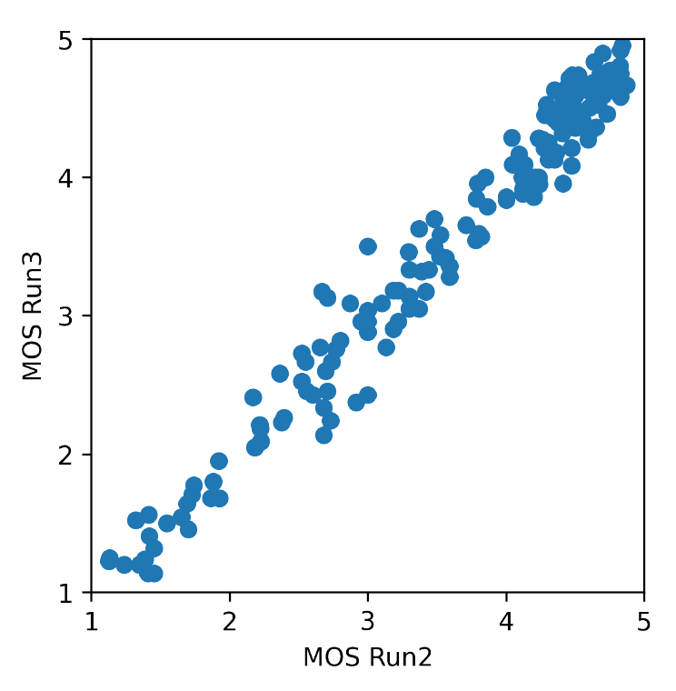
Reproducibility
5 repetitions

Slide 11
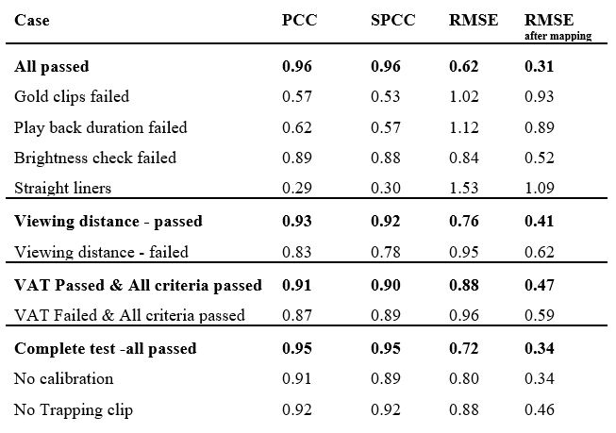
Ablation study

Slide 12
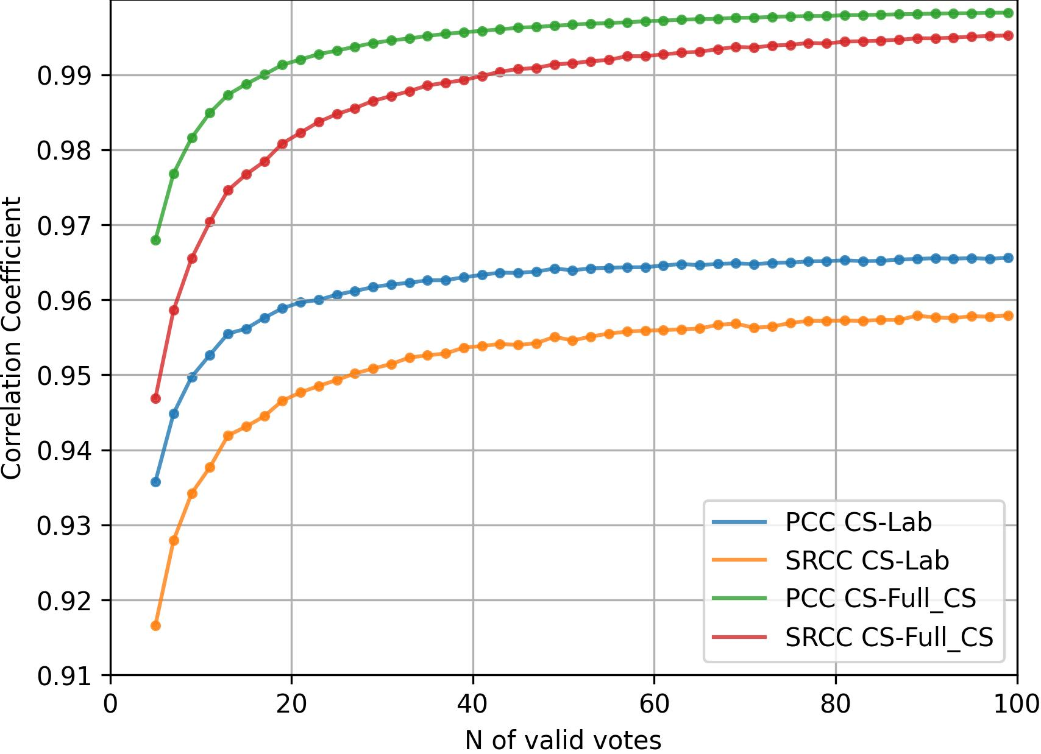
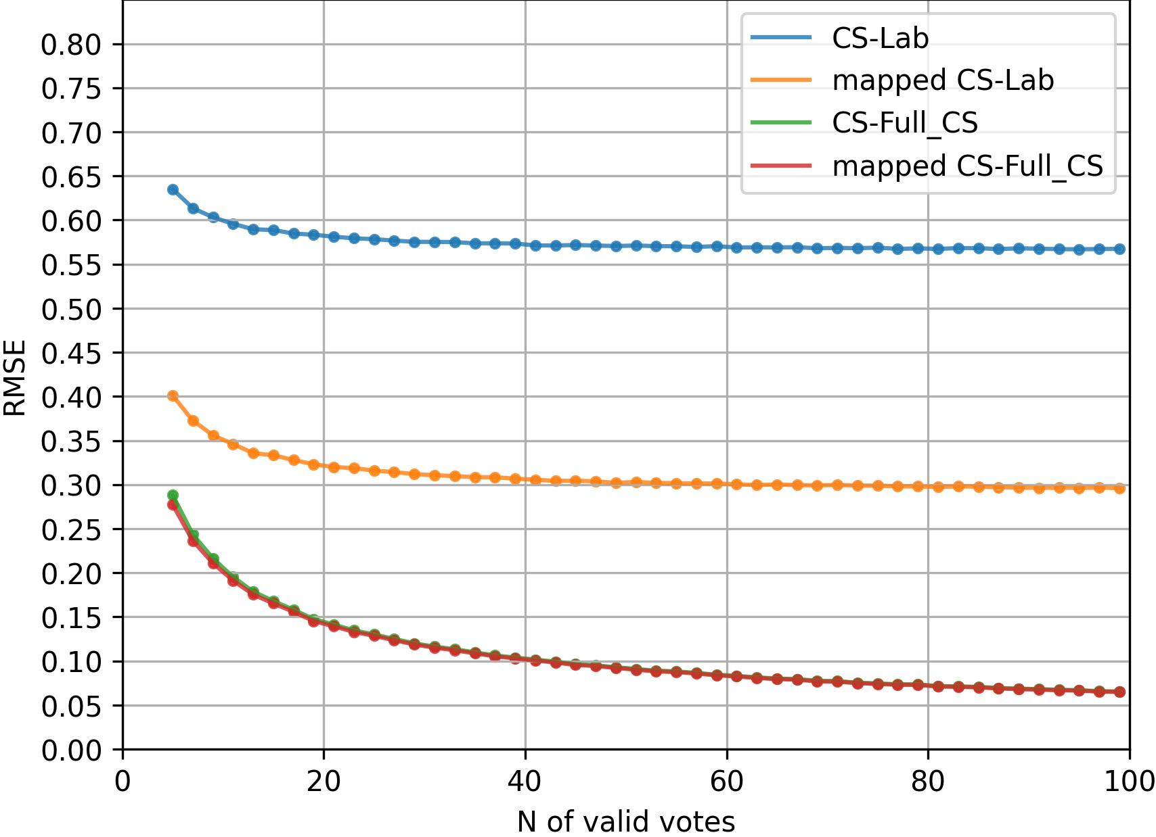
Number of votes
* CS-Lab: statistic between subset of CS and Lab
* CS-Full_CS: statistic between subset of CS and Full CS

Slide 13
Next steps…
Implementation
  Annex E: advanced data Cleansing
  Simultaneous presentation of sequence pairs
Testing
  Other datasets (?)
  Crowdsourcing vs expert viewing
  Perceptually lossless CRF for H.264 (and other codecs supported by modern browsers)
Drafting the recommendation text
  Evaluating the draft text

Slide 14
Thank you
How can we improve it?
Q & A?
Open-sourced platform:
https://github.com/microsoft/P.910
Details:
https://arxiv.org/pdf/2204.06784.pdf

Slide 15
Filtering
Pass the hardware and network test
Qualification/Setup are checked online but also partly in data cleansing
Ratings will be Accepted if:
  Played all videos, brightness test (at least one), trap question,
  (optional): gold question, minimum acceptance rate
Ratings will be Used if:
  Be accepted
  Variance in ratings, gold question, viewing duration, brightness test (both), minimum acceptance rate, outliers

