Slide 1
The KonVid-150k Video Quality Assessment Dataset & Objective Metrics
Understanding and Improving the Creation and
Annotation of Multimedia Databases
Franz Götz-Hahn
VQEG Meeting 13th-17th Dec, 14.12.2021

Slide 2




Conventional Video Databases
Sources:
Artificial degradations:
Subjective annotation in lab
Controlled degradations
Little content diversity
Ecologically invalid
Slow and costly annotation

Slide 3




Alternative Approach
Flickr/Youtube/Vimeo:
Videos „in the wild“
Annotations from crowd
High content diversity
Ecologically valid
Fast, cheap, and diverse annotations
Uncontrolled degradations

Slide 4




KonViD-150k
YFCC 100M
KonVid-150k
~ 800.000
Videos
~ 155.000
5 sec Videos
Emphasis on diversity of
Quality
Distortions
Contents

Slide 5


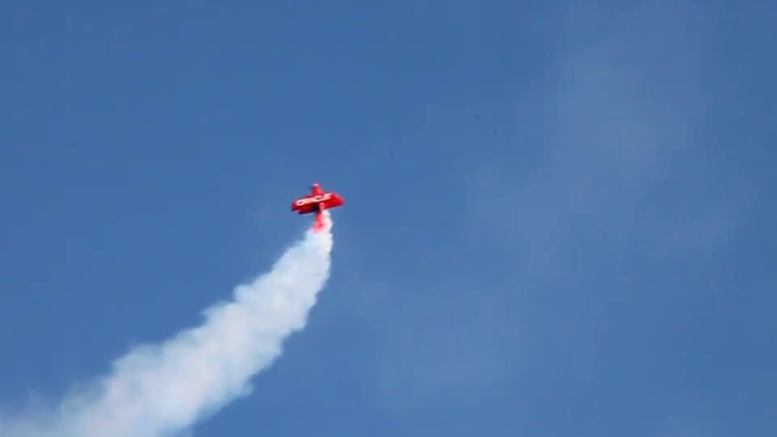

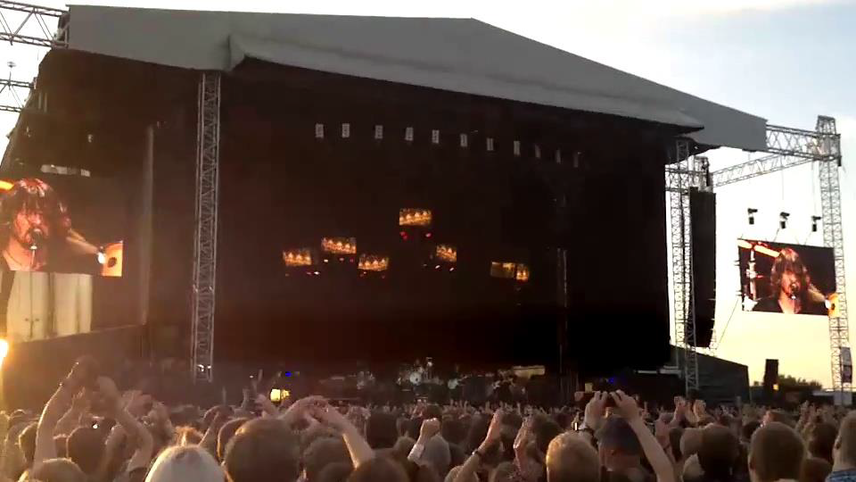
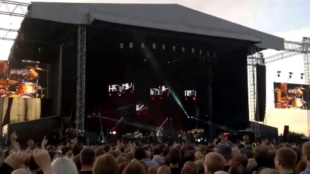
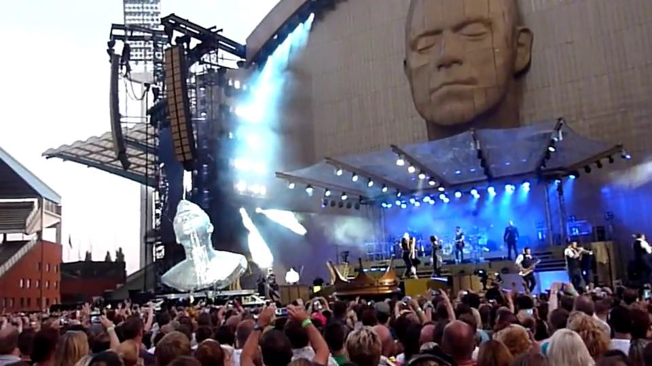
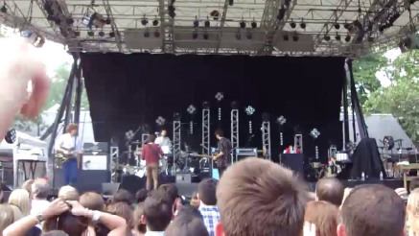
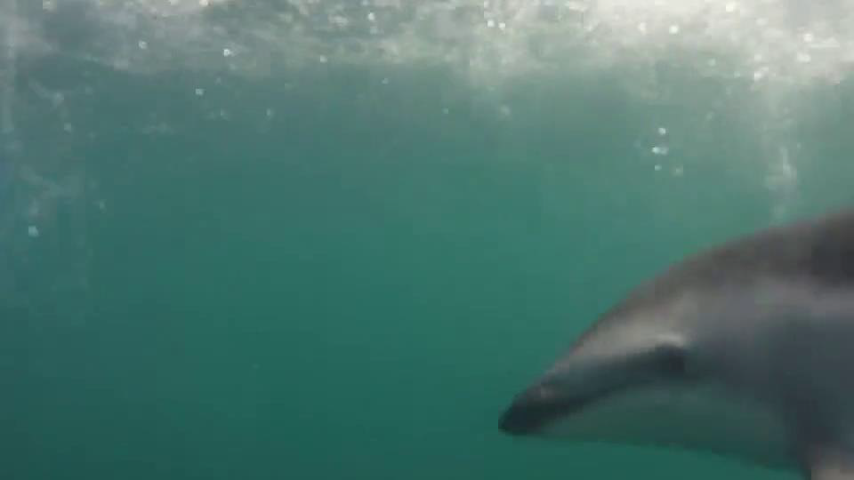
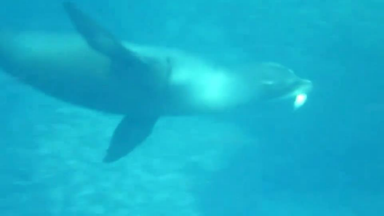
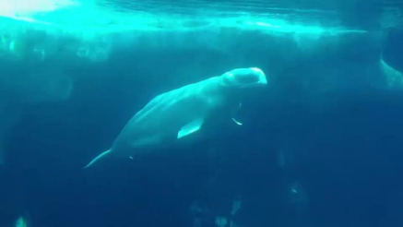










Content Diversity
Distance of top-level Inception-ResNet-v2 features
Query
Closest
2nd Closest
3rd Closest
$$d=1.23$$
$$d=2.06$$
$$d=2.62$$
$$d=1.94$$
$$d=3.84$$
$$d=3.92$$
$$d=2.08$$
$$d=2.56$$
$$d=2.89$$

Slide 6
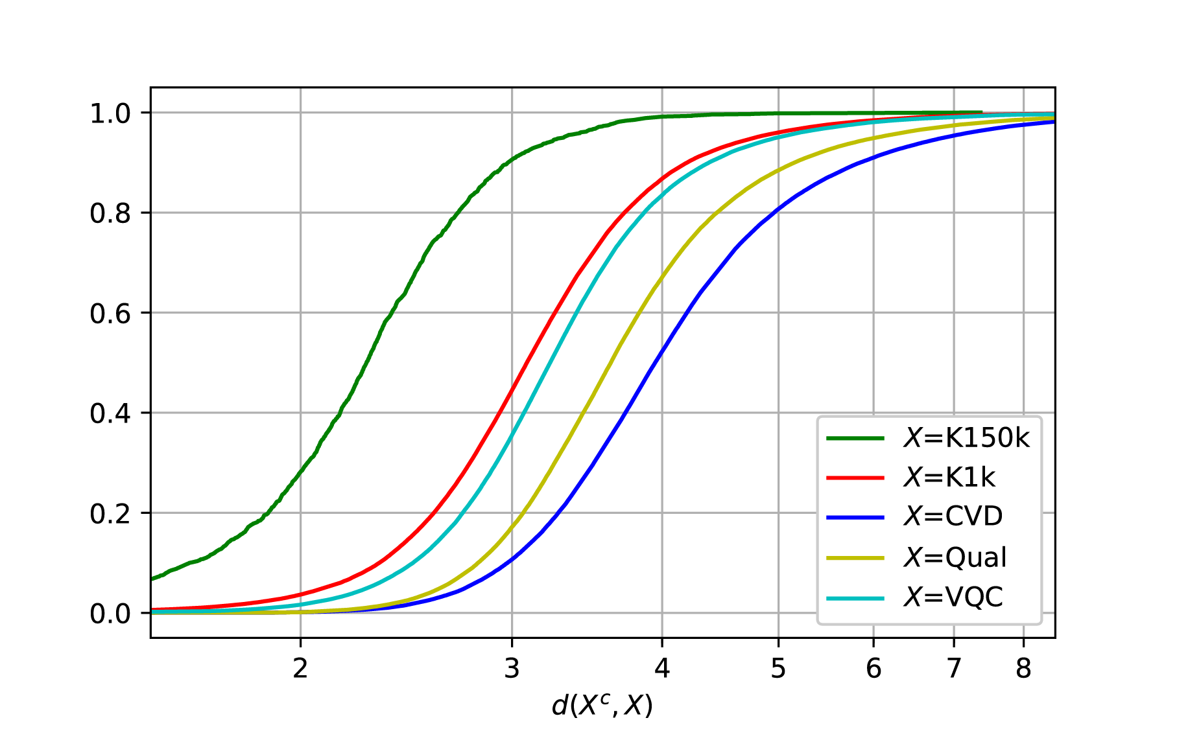



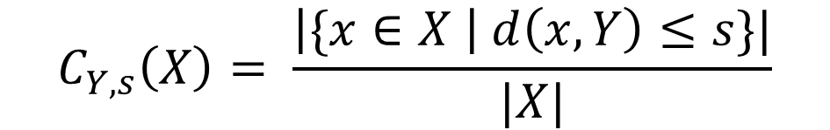
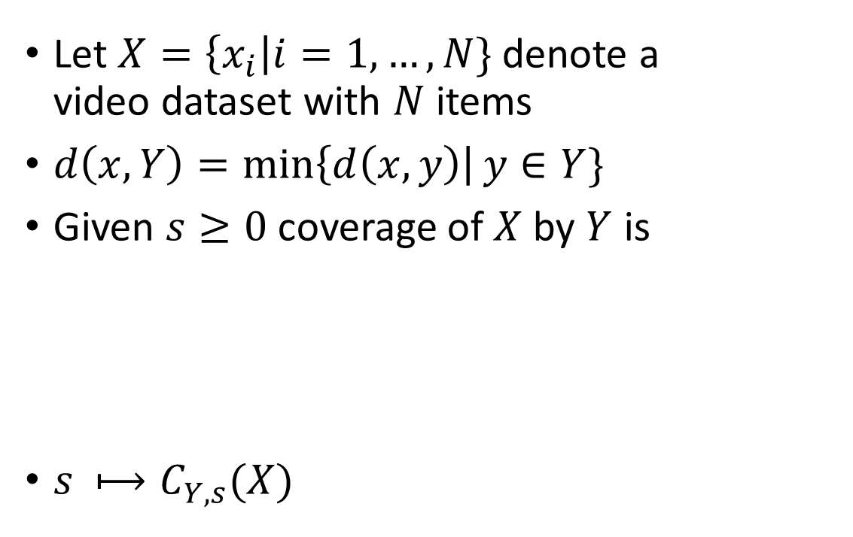
Dataset Coverage
$$C_{Y,0}\left(X\right)=1$$
X
$$C_{Y,1}\left(X\right)=0.8$$
Let $X=\left\{x_{i}\right|i=1,…,N\}$ denote a
video dataset with $N$ items
$d\left(x,Y\right)=\min\left\{d\left(x,y\right)\right|y∈Y\}$
Given $s≥0$ coverage of $X$ by $Y$ is
$s ⟼C_{Y,s}(X)$
Y
$$C_{Y,s}\left(X\right)= \frac{\left|\{x∈X \right| d\left(x,Y\right)≤s\}|}{|X|}$$
$$1$$
2.25
3.6

Slide 7
Challenges in Visual Quality Assessment
What considerations besides size and diversity affect generalizability?

Slide 8
Visual Quality Database Challenges
Lack of data
Lack of annotations budget
l
l

Slide 9
Visual Quality Assessment Databases
VQA
IQA
AQA

Slide 10

Visual Quality Database Challenges
Lack of data
Lack of annotations budget
l
l

Slide 11


Datasets
>$300,000 US
$7.25 US/hour
3 second decision time
VQA
IQA
AQA

Slide 12
Visual Quality Database Challenges
Lack of data
Lack of annotations budget
Lack of powerful models
transient meaning of quality scale

Slide 13
Deep Feature-based Prediction
Inception-ResNet-v2 body
video frame
Stem
10 Inception-A
Reduction-A
20 Inception-B
Reduction-B
10 Inception-C
GAP
GAP
GAP
GAP
GAP
GAP
concatenated multi-level spatially pooled features (16928-dimensional)
concatenated multi-level spatially pooled features (16928-dimensional)
concatenated multi-level spatially pooled features (16928-dimensional)

Slide 14


Deep Feature-based Prediction
MOS
FC 1
MOS
Dropout 0.25
MOS
FC 32
Batch Norm
ReLU
FC 64
FC 1
Concatenate
Dropout 0.25
Time Dist
Batch Norm
FC 128
LSTM 128
ReLU
FC 256
LSTM 128
FC 512
LSTM 256
Dropout 0.25
LSTM 256
Batch Norm
ReLU
FC 1024
LSTM 256
FC 512
LSTM 256
avg feature vector
$n$ feature vectors
$n$ feature vectors

Slide 15
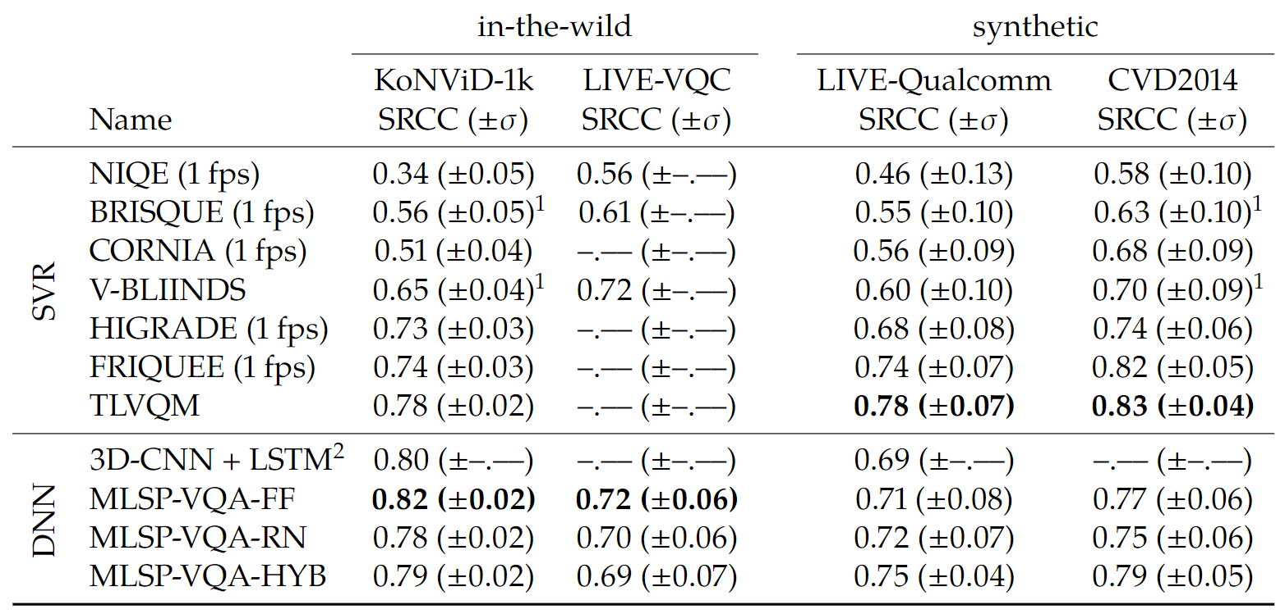
Deep Feature-based Prediction

Slide 16
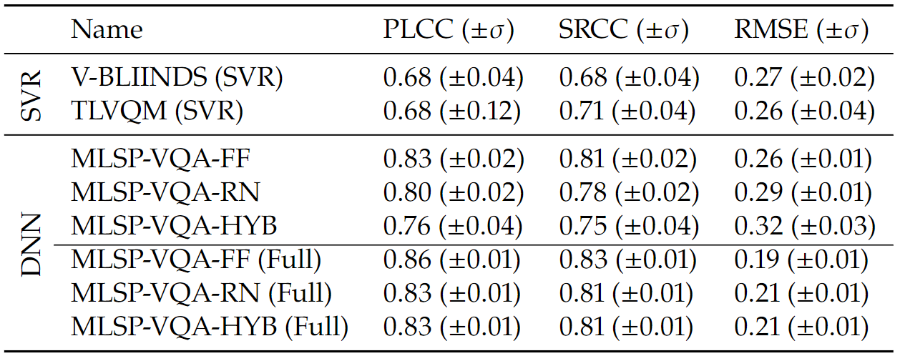
Deep Feature-based Prediction

Slide 17

Technical Quality Database Dilemma
Lack of data
Lack of annotations budget
Lack of powerful models
Transient meaning of quality scale

Slide 18
Budgeting Annotations
The impact of label precision on model performance

Slide 19
Analyzing Budget Distributions
KonVid-150k-A
  ∼153,000 videos
  5 ACR annotations per video
  Serves as low precision training set lllll
Budget: ∼965,000 annotations
KonVid-150k-B
  ∼1,550 videos
  ≥89 ACR annotations per video
  Serves as high precision
  training/validation/test set

Slide 20
Fixed Budget Experiment
Validation set: 250 videos with 100 ACR votes MOS
Test set: 250 videos with 100 ACR votes MOS
3 different training sets:
  1,000 videos with 100 ACR votes
  20,000 videos with 5 ACR votes
  100,000 videos with 1 ACR vote
100,000 annotations

Slide 21
Fixed Vote Budget
Votebudget
high
?
SROCC
more videos,
lower precision labels
fewer videos,
higher precision labels
low
Training MOS Votecount

Slide 22
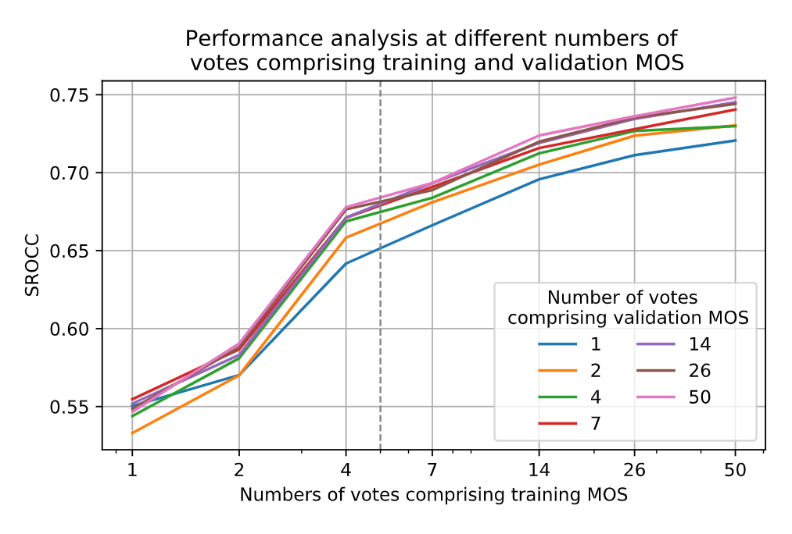
Variation of Training/Validation MOS
Notes:
At ~5 votes (1/10th of budget) bridging 66% of performance gap ~.12 of .18 difference from .55 to .73 SRCC

