Slide 1

Encoding complexity of short video sequences
Notes:
Introducton.
I will talk about perceptual video quality measurement within OTT in general and more specifically I will give a short overview of one of OPTICOM‘s newly launched product, PEVQ-S.
PEVQ-S is based on PEVQ, PEVQ is a full reference measurement algorithm, it was standarddized by VQEG in 2008 and a well established ITU standard for measuring E2E video quality for IPTV and streaming video.
PEVQ-S is extension of PEVQ for considering longer video length as commonly encountered in OTT video streaming sessions.

Slide 2
Context
Encoding
Complexity
Video
Quality
Notes:
Today we typically encounter scenarios where the internet content is viewd at a variety of end-user terminal, such as ......
With each type of device user may have different kind of expectation of the video quality. So, the perceived quality of same content on different devices would be different. Traditional QoE models are only for single type of display device, at times some models consider different display resolution, for example the VQEG hybrid project and the resulting standards, but this hardly capture the effect of different device size.
Traditional models confidently measure the MOS score for short videos, for example the legacy 10 second case. Typical Youtube videos, or watching a movie trailer on AIV is for example 3-4 mints long. Longer videos bring human perceptual effects such as recency and primacy effects, which were hardly considered in the traditional models predicting 10s MOS. Additionally, in the context of OTT we have the client adapting to the network bandwidth thus quality changes of time. In the upcoming slides I will describe how PEVQ-S handles these challenges.

Slide 3
What is encoding complexity?
Is it scene complexity?
  Often SI/TI is taken as a measure of scene complexity can we say SI/TI is a measure of encoding complexity?
Is it a universal quantity?
  Can we say a certain video is easy or difficult to encode for all codecs?
  What is the measurement scale of such a quantity?
What is the effect of technical parameters?
  Can we say that higher resolution, higher framerate videos are more complex?
Notes:
Today we typically encounter scenarios where the internet content is viewd at a variety of end-user terminal, such as ......
With each type of device user may have different kind of expectation of the video quality. So, the perceived quality of same content on different devices would be different. Traditional QoE models are only for single type of display device, at times some models consider different display resolution, for example the VQEG hybrid project and the resulting standards, but this hardly capture the effect of different device size.
Traditional models confidently measure the MOS score for short videos, for example the legacy 10 second case. Typical Youtube videos, or watching a movie trailer on AIV is for example 3-4 mints long. Longer videos bring human perceptual effects such as recency and primacy effects, which were hardly considered in the traditional models predicting 10s MOS. Additionally, in the context of OTT we have the client adapting to the network bandwidth thus quality changes of time. In the upcoming slides I will describe how PEVQ-S handles these challenges.

Slide 4
Encoding complexity
It is the inability of a video codec to compress a video sequence
  Encoding complexity is codec dependent
Can it be defined by characterizing the Rate-Quality curve of the video?
  A Full-Reference quality model can be used to compute the Rate-Quality function of a video
Notes:
Today we typically encounter scenarios where the internet content is viewd at a variety of end-user terminal, such as ......
With each type of device user may have different kind of expectation of the video quality. So, the perceived quality of same content on different devices would be different. Traditional QoE models are only for single type of display device, at times some models consider different display resolution, for example the VQEG hybrid project and the resulting standards, but this hardly capture the effect of different device size.
Traditional models confidently measure the MOS score for short videos, for example the legacy 10 second case. Typical Youtube videos, or watching a movie trailer on AIV is for example 3-4 mints long. Longer videos bring human perceptual effects such as recency and primacy effects, which were hardly considered in the traditional models predicting 10s MOS. Additionally, in the context of OTT we have the client adapting to the network bandwidth thus quality changes of time. In the upcoming slides I will describe how PEVQ-S handles these challenges.

Slide 5
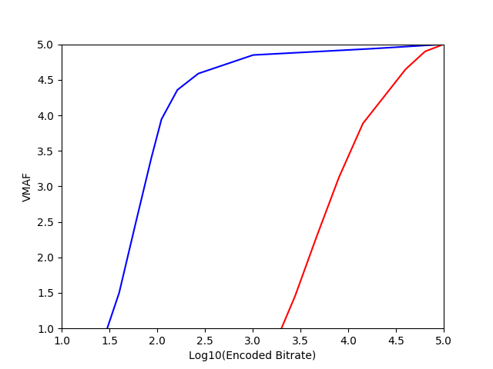
Encoding complexity
Snow-Cat: Dark, low spatial
detail, slow moving video seq
Marathon: Colorful, high
spatial detail, fast moving,
camera panning
Notes:
Today we typically encounter scenarios where the internet content is viewd at a variety of end-user terminal, such as ......
With each type of device user may have different kind of expectation of the video quality. So, the perceived quality of same content on different devices would be different. Traditional QoE models are only for single type of display device, at times some models consider different display resolution, for example the VQEG hybrid project and the resulting standards, but this hardly capture the effect of different device size.
Traditional models confidently measure the MOS score for short videos, for example the legacy 10 second case. Typical Youtube videos, or watching a movie trailer on AIV is for example 3-4 mints long. Longer videos bring human perceptual effects such as recency and primacy effects, which were hardly considered in the traditional models predicting 10s MOS. Additionally, in the context of OTT we have the client adapting to the network bandwidth thus quality changes of time. In the upcoming slides I will describe how PEVQ-S handles these challenges.

Slide 6
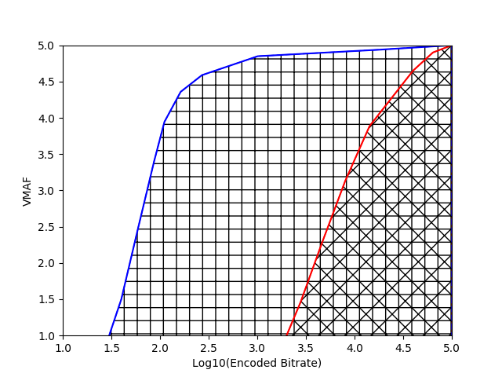
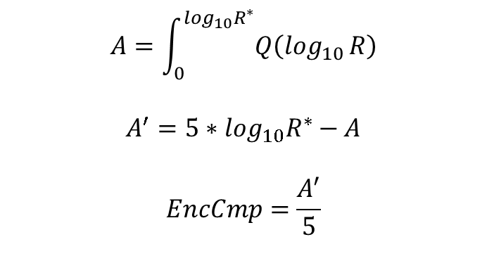
Video Quality based Encoding Complexity (VQEC)
$$A=\int_{0}^{\log_{10}R^{∗}}{Q\left(\log_{10}⁡R\right)}$$
$$A^{′}=5∗\log_{10}R^{∗}−A$$
$$EncCmp=\frac{A^{′}}{5}$$
Notes:
Today we typically encounter scenarios where the internet content is viewd at a variety of end-user terminal, such as ......
With each type of device user may have different kind of expectation of the video quality. So, the perceived quality of same content on different devices would be different. Traditional QoE models are only for single type of display device, at times some models consider different display resolution, for example the VQEG hybrid project and the resulting standards, but this hardly capture the effect of different device size.
Traditional models confidently measure the MOS score for short videos, for example the legacy 10 second case. Typical Youtube videos, or watching a movie trailer on AIV is for example 3-4 mints long. Longer videos bring human perceptual effects such as recency and primacy effects, which were hardly considered in the traditional models predicting 10s MOS. Additionally, in the context of OTT we have the client adapting to the network bandwidth thus quality changes of time. In the upcoming slides I will describe how PEVQ-S handles these challenges.

Slide 7
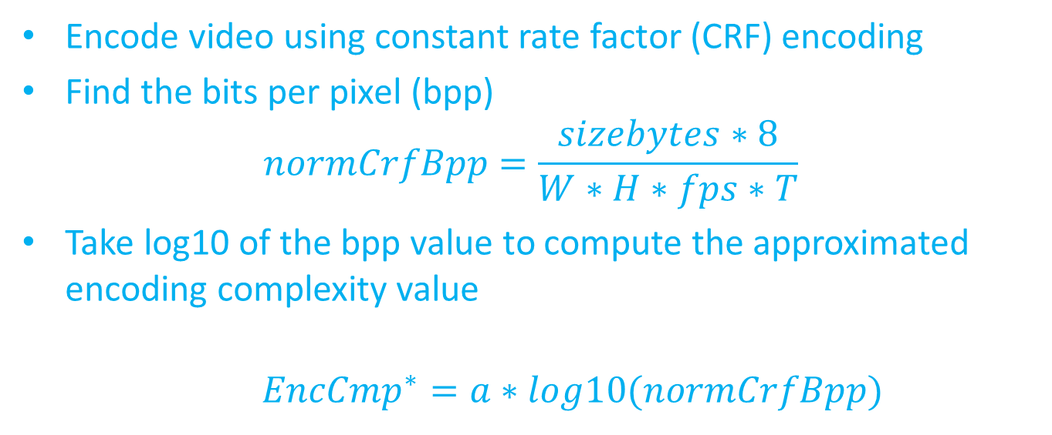
Approximating VQEC
Encode video using constant rate factor (CRF) encoding
Find the bits per pixel (bpp)
$$normCrfBpp=\frac{sizebytes∗8}{W∗H∗fps∗T}$$
Take log10 of the bpp value to compute the approximated encoding complexity value
${EncCmp}^{∗}=a∗log10(normCrfBpp)$
What CRF value to use??
Notes:
Today we typically encounter scenarios where the internet content is viewd at a variety of end-user terminal, such as ......
With each type of device user may have different kind of expectation of the video quality. So, the perceived quality of same content on different devices would be different. Traditional QoE models are only for single type of display device, at times some models consider different display resolution, for example the VQEG hybrid project and the resulting standards, but this hardly capture the effect of different device size.
Traditional models confidently measure the MOS score for short videos, for example the legacy 10 second case. Typical Youtube videos, or watching a movie trailer on AIV is for example 3-4 mints long. Longer videos bring human perceptual effects such as recency and primacy effects, which were hardly considered in the traditional models predicting 10s MOS. Additionally, in the context of OTT we have the client adapting to the network bandwidth thus quality changes of time. In the upcoming slides I will describe how PEVQ-S handles these challenges.

Slide 8
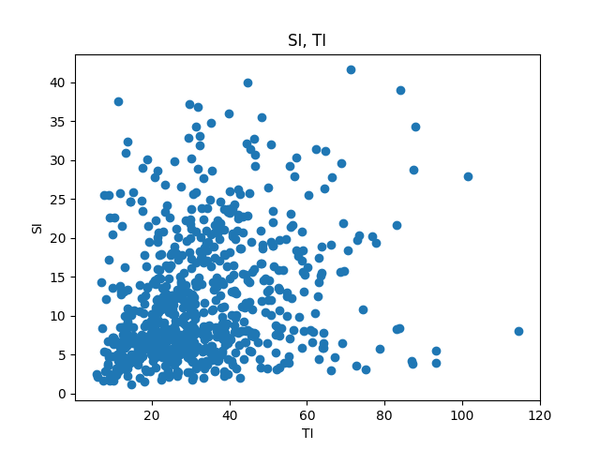
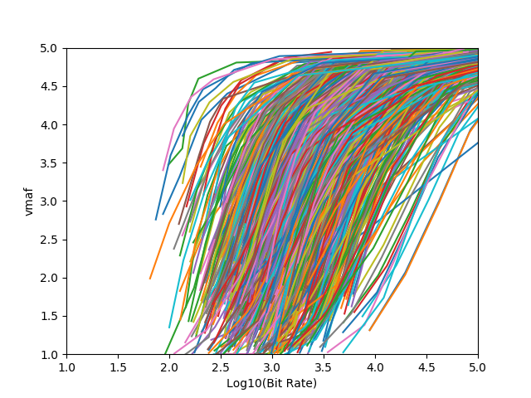
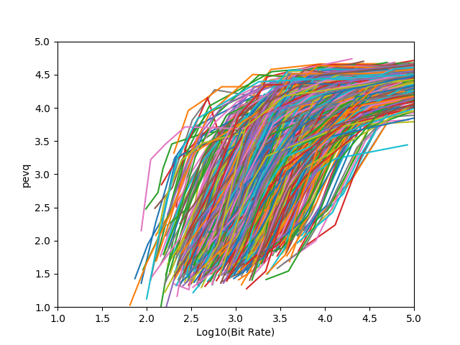
Exp. Evaluation (1/5) – 730 UHD SRCs
Constant QP coding
using x264
Notes:
Today we typically encounter scenarios where the internet content is viewd at a variety of end-user terminal, such as ......
With each type of device user may have different kind of expectation of the video quality. So, the perceived quality of same content on different devices would be different. Traditional QoE models are only for single type of display device, at times some models consider different display resolution, for example the VQEG hybrid project and the resulting standards, but this hardly capture the effect of different device size.
Traditional models confidently measure the MOS score for short videos, for example the legacy 10 second case. Typical Youtube videos, or watching a movie trailer on AIV is for example 3-4 mints long. Longer videos bring human perceptual effects such as recency and primacy effects, which were hardly considered in the traditional models predicting 10s MOS. Additionally, in the context of OTT we have the client adapting to the network bandwidth thus quality changes of time. In the upcoming slides I will describe how PEVQ-S handles these challenges.

Slide 9
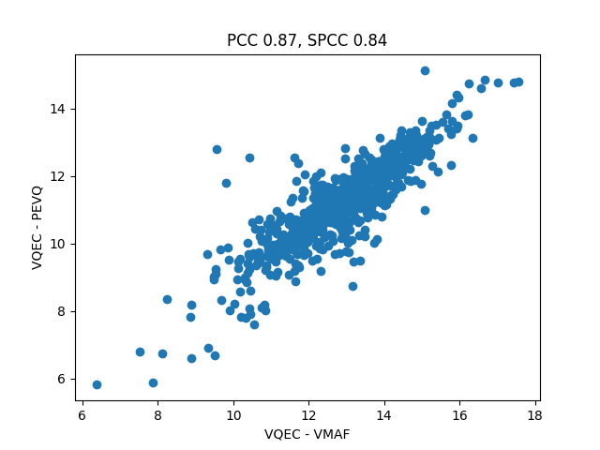
Exp. Evaluation (2/5) – VQEC (VMAF vs PEVQ)
Notes:
Today we typically encounter scenarios where the internet content is viewd at a variety of end-user terminal, such as ......
With each type of device user may have different kind of expectation of the video quality. So, the perceived quality of same content on different devices would be different. Traditional QoE models are only for single type of display device, at times some models consider different display resolution, for example the VQEG hybrid project and the resulting standards, but this hardly capture the effect of different device size.
Traditional models confidently measure the MOS score for short videos, for example the legacy 10 second case. Typical Youtube videos, or watching a movie trailer on AIV is for example 3-4 mints long. Longer videos bring human perceptual effects such as recency and primacy effects, which were hardly considered in the traditional models predicting 10s MOS. Additionally, in the context of OTT we have the client adapting to the network bandwidth thus quality changes of time. In the upcoming slides I will describe how PEVQ-S handles these challenges.

Slide 10
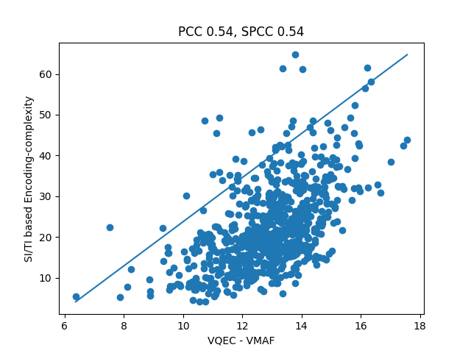
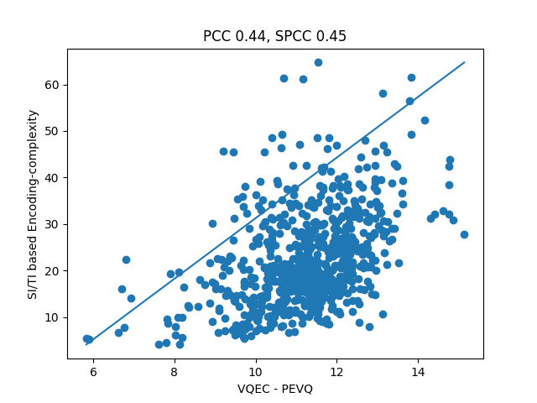

Exp. Evaluation (3/5) – SI/TI vs VQEC
$${VQEC}_{SITI}=0.5∗SI+0.5∗TI$$
Notes:
Today we typically encounter scenarios where the internet content is viewd at a variety of end-user terminal, such as ......
With each type of device user may have different kind of expectation of the video quality. So, the perceived quality of same content on different devices would be different. Traditional QoE models are only for single type of display device, at times some models consider different display resolution, for example the VQEG hybrid project and the resulting standards, but this hardly capture the effect of different device size.
Traditional models confidently measure the MOS score for short videos, for example the legacy 10 second case. Typical Youtube videos, or watching a movie trailer on AIV is for example 3-4 mints long. Longer videos bring human perceptual effects such as recency and primacy effects, which were hardly considered in the traditional models predicting 10s MOS. Additionally, in the context of OTT we have the client adapting to the network bandwidth thus quality changes of time. In the upcoming slides I will describe how PEVQ-S handles these challenges.

Slide 11
Experimental Evaluation (4/5) – X264 based CRF vs VQEC
Pearson CC
 | CRF 11 | CRF 17 | CRF 23 | CRF 29 | CRF 35 | CRF 41 | CRF 47
VMAF | 0.05 | 0.26 | 0.61 | 0.75 | 0.77 | 0.74 | 0.68
PEVQ | 0.06 | 0.26 | 0.57 | 0.70 | 0.73 | 0.72 | 0.68
Spearman CC
 | CRF 11 | CRF 17 | CRF 23 | CRF 29 | CRF 35 | CRF 41 | CRF 47
VMAF | 0.01 | 0.21 | 0.56 | 0.70 | 0.73 | 0.71 | 0.66
PEVQ | 0.04 | 0.23 | 0.54 | 0.68 | 0.72 | 0.73 | 0.70
Notes:
Today we typically encounter scenarios where the internet content is viewd at a variety of end-user terminal, such as ......
With each type of device user may have different kind of expectation of the video quality. So, the perceived quality of same content on different devices would be different. Traditional QoE models are only for single type of display device, at times some models consider different display resolution, for example the VQEG hybrid project and the resulting standards, but this hardly capture the effect of different device size.
Traditional models confidently measure the MOS score for short videos, for example the legacy 10 second case. Typical Youtube videos, or watching a movie trailer on AIV is for example 3-4 mints long. Longer videos bring human perceptual effects such as recency and primacy effects, which were hardly considered in the traditional models predicting 10s MOS. Additionally, in the context of OTT we have the client adapting to the network bandwidth thus quality changes of time. In the upcoming slides I will describe how PEVQ-S handles these challenges.

Slide 12
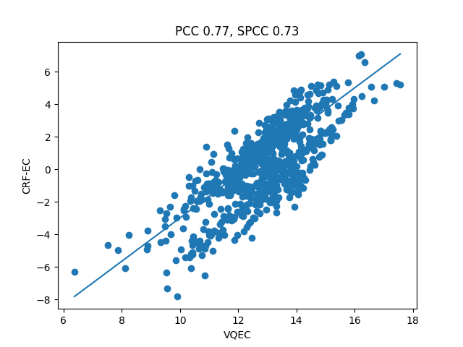
Exp. Evaluation (5/5) – X264 based CRF(35) vs VQEC
Notes:
Today we typically encounter scenarios where the internet content is viewd at a variety of end-user terminal, such as ......
With each type of device user may have different kind of expectation of the video quality. So, the perceived quality of same content on different devices would be different. Traditional QoE models are only for single type of display device, at times some models consider different display resolution, for example the VQEG hybrid project and the resulting standards, but this hardly capture the effect of different device size.
Traditional models confidently measure the MOS score for short videos, for example the legacy 10 second case. Typical Youtube videos, or watching a movie trailer on AIV is for example 3-4 mints long. Longer videos bring human perceptual effects such as recency and primacy effects, which were hardly considered in the traditional models predicting 10s MOS. Additionally, in the context of OTT we have the client adapting to the network bandwidth thus quality changes of time. In the upcoming slides I will describe how PEVQ-S handles these challenges.

Slide 13
CRF-EncComp for Compressed Video
CRF=35 | Pearson | Spearman
UHD – original FPS | 0.77 | 0.73
HD – original FPS | 0.75 | 0.72
1/4 UHD – original FPS | 0.71 | 0.68
1/4 UHD – 1/4 FPS | 0.70 | 0.67
CRF=35 | Pearson | Spearman
UHD – original FPS | 0.73 | 0.72
HD – original FPS | 0.73 | 0.72
1/4 UHD – original FPS | 0.70 | 0.71
1/4 UHD – 1/4 FPS | 0.67 | 0.67
Notes:
Today we typically encounter scenarios where the internet content is viewd at a variety of end-user terminal, such as ......
With each type of device user may have different kind of expectation of the video quality. So, the perceived quality of same content on different devices would be different. Traditional QoE models are only for single type of display device, at times some models consider different display resolution, for example the VQEG hybrid project and the resulting standards, but this hardly capture the effect of different device size.
Traditional models confidently measure the MOS score for short videos, for example the legacy 10 second case. Typical Youtube videos, or watching a movie trailer on AIV is for example 3-4 mints long. Longer videos bring human perceptual effects such as recency and primacy effects, which were hardly considered in the traditional models predicting 10s MOS. Additionally, in the context of OTT we have the client adapting to the network bandwidth thus quality changes of time. In the upcoming slides I will describe how PEVQ-S handles these challenges.

Slide 14
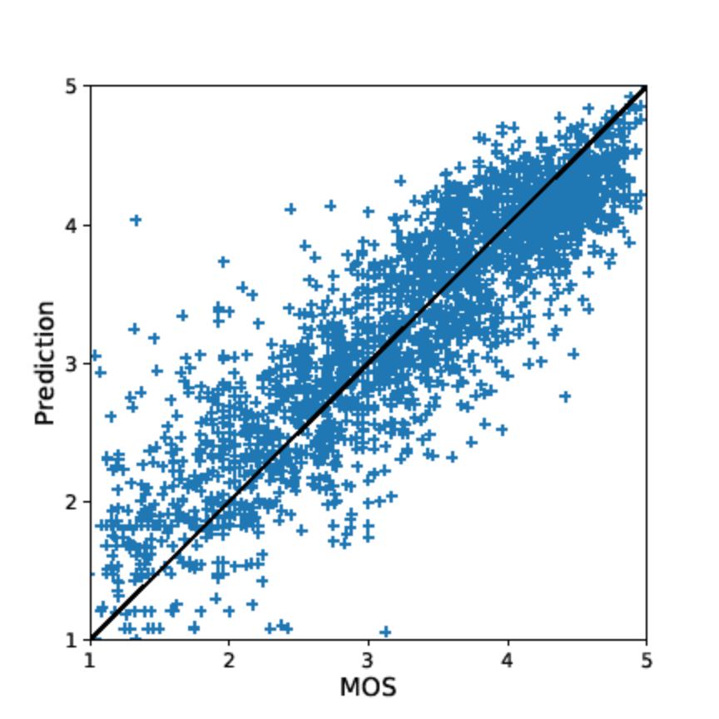
Application - Hybrid NR Metric
P.1204.5, Avg RMSE 0.440
ITU-T P.1204.5 Hybrid NR uses CRF based encoding complexity as a feature. P.1204.5 can be used to measure quality of videos encoded using H264, H265, VP9. Features: Codec, bitrate, framerate, resolution and coding complexity
CRF 23 using VP9 is used to determine an estimate of the encoding complexity of a short video
An update of P.1204.5 is planned for the AV1 codec
Notes:
Today we typically encounter scenarios where the internet content is viewd at a variety of end-user terminal, such as ......
With each type of device user may have different kind of expectation of the video quality. So, the perceived quality of same content on different devices would be different. Traditional QoE models are only for single type of display device, at times some models consider different display resolution, for example the VQEG hybrid project and the resulting standards, but this hardly capture the effect of different device size.
Traditional models confidently measure the MOS score for short videos, for example the legacy 10 second case. Typical Youtube videos, or watching a movie trailer on AIV is for example 3-4 mints long. Longer videos bring human perceptual effects such as recency and primacy effects, which were hardly considered in the traditional models predicting 10s MOS. Additionally, in the context of OTT we have the client adapting to the network bandwidth thus quality changes of time. In the upcoming slides I will describe how PEVQ-S handles these challenges.

