Slide 1
Why NR Metrics Fail:
A Comprehensive Analysis
November 2021
Margaret Pinson, mpinson@ntia.gov

Slide 2
VQEG Key Specifications for NR Metrics
Must provide root cause analysis (RCA)
  Actionable information, influence real-time workflow
  Only management cares about MOS
Broad scope of training data
  Camera capture, encoding, decoding, transcoding, scaling, aesthetics, artistic intent, image enhancement, monitor
User expectations change — NR metric can change with them
  User can modify the NR metric to ignore impairments
  For example, broadcasters want MOS to ignore artistic intent & aesthetics
Robust accuracy with minimum of operational restrictions
Key use cases
  VoD, live broadcast services, first responder, medical, computer vision, …

Slide 3
VQEG Brainstorming, Other Specifications
Open-source usage rights
One metric for images & video
Predict quality directly from camera
Extrapolate “what if” (e.g., bitrate change)
Real-time implementation
Degrades gracefully / don’t just fail
Warn user when moving outside of intended scope
Easily explained to naïve users
Self learning
Measure immediate quality response (short time window)
Compute confidence in rating
  Confidence interval or accuracy
Distortion flexibility (various impairments)
Non-static, multi-faceted model, can be adjusted for new applications & tasks
No hard coded constants
  At a minimum, least justify and explain
Scalable
  Frame size, resolution, frame rate, …
Robust response to new content

Slide 4
Unavoidable Constraints on MOSs
Subjective Testing
Types-1 Errors
Subject rating is a random process
Limited accuracy
Lab-to-lab
  0.85 to 0.99 Pearson correlation
  Expect around 0.96
5-level ACR confidence interval
  0.5 MOS for 24 subjects
  0.7 MOS for 15 subjects
Type-1 error increases as more NR metrics are compared with the datasets
100 media can only be used once to distinguish between 2 NR metrics
  K. Brunnström, S. Tavakoli and J. Søgaard

Slide 5
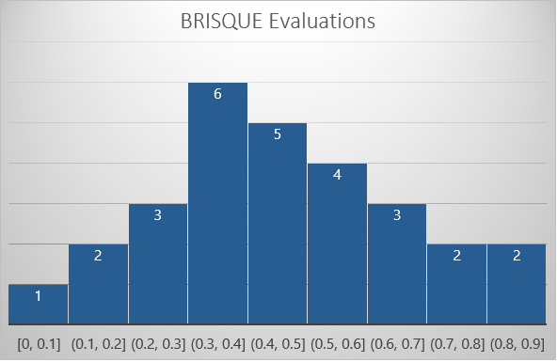
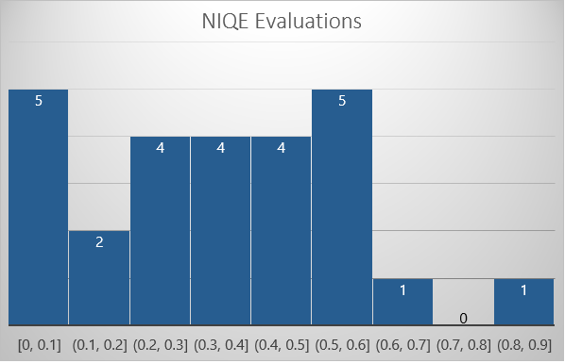
Published Evaluations on Modern Camera Systems
BRISQUE from developer: 0.90 & 0.94 Pearson correlation
NIQE from developer: 0.91 Pearson correlation
Pearson correlation from independent evaluations
Pearson correlation from independent evaluations

Slide 6
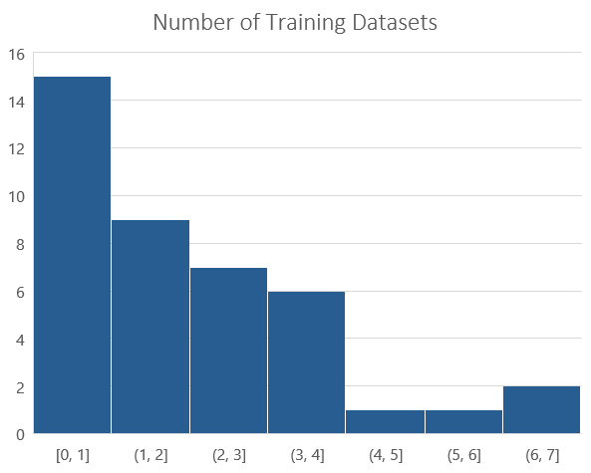
NR Metric Developer → Published Evaluation on Modern Cameras
NR Metric | Developer | Evaluators
BLIINDS-II | 0.93 | 0.11 to 0.60
BRISQUE | 0.90, 0.94 | 0.11 to 0.90
C-DIVIINE | 0.88 to 0.94 | 0.44 to 0.47
CPBD | 0.91 | 0.20 to 0.39
DIIVINE | 0.92 | 0.22 to 0.61
FRIQUEE | 0.63 to 0.97 | 0.33 to 0.60
NIQE | 0.91 | 0.09 to 0.84
QAC | 0.86 | 0.11 to 0.87
SEQ | 0.94 | 0.05 go 0.61
TLVQM | 0.77 to 0.85 | 0.29 to 0.68
V-BLIINDS | 0.88 to 0.75 | 0.12 to 0.72
VIIDEO | 0.65 | 0.05 to 0.62

Slide 7
Conclusions from Developers, Prior Evaluations
Most NR metrics are trained on very little data
  1 to 4 datasets
  Limited impairments
  Limited subject matter
  Exaggerated performance claims
Most NR metrics are evaluated on very little data
  1 dataset typical
  Unstable statistics
NR metrics must be trained and tested on a lot more data

Slide 8
My Analyses of NR metrics
12 Datasets
NR Metric vs MOS

Slide 9
My Analysis: 12 Datasets for NR Metric Training & Testing
Image Quality Analysis (IQA) for
User Generated Content (UGC)
Video Quality Analysis (VQA) for
User Generated Content (UGC)
Video Quality Analysis for (VQA) for Broadcast (BC)
IQA UGC
  BID, CCRIQ, CCRIQ2 & VIME1, CID2013, ITS4S2, LIVE-Wild (2016)
VQA UGC
  ITS4S3, ITS4S4, KoNViD-1K
VQA BC
  ITS4S, AGH/NTIA/Dolby, vqegHDcuts

Slide 10
Highest Accuracy Reported by Developer vs IQA UGC
ADMD
AGWN
BRISQUE
CPBD
dipIQ
HVS-MaxPol
JP2KNR
JNB
Log-BIQA
MaxPol
NR-PWN
NSS
PIQE
SpEED-NR
TDMEC
IQA UGC (6 datasets)
Pearson Correlation from Developer

Slide 11
Lowest Accuracy Reported by Developer vs ITS Evaluation
ADMD
AGWN
BRISQUE
CPBD
dipIQ
HVS-MaxPol
JP2KNR
JNB
Log-BIQA
MaxPol
NR-PWN
NSS
PIQE
SpEED-NR
TDMEC
IQA UGC (6 datasets)
Pearson Correlation from Developer

Slide 12
Summary of IQA UGC Scatter Plots
Scatter Plot Summary
Highest Average Pearson Correlation
IQA UGC Datasets
13 of 27 fail on unexpected conditions
  Crash or extreme outliers
8 of 27 had no discernable pattern (random scatter) for some or all datasets
17 of 27 had upper or lower triangle for some or all datasets
2 of 27 scatter around fit line consistently
  NIQE and 2stepQA-NR (based in NIQE)
  Both failed on unexpected conditions
0.55 for 2stepQA-NR
0.47 for HVS-MaxPol
0.36 for TDMEC
0.35 for MaxPol
0.33 for ADMD, dipIQ, NIQE

Slide 13
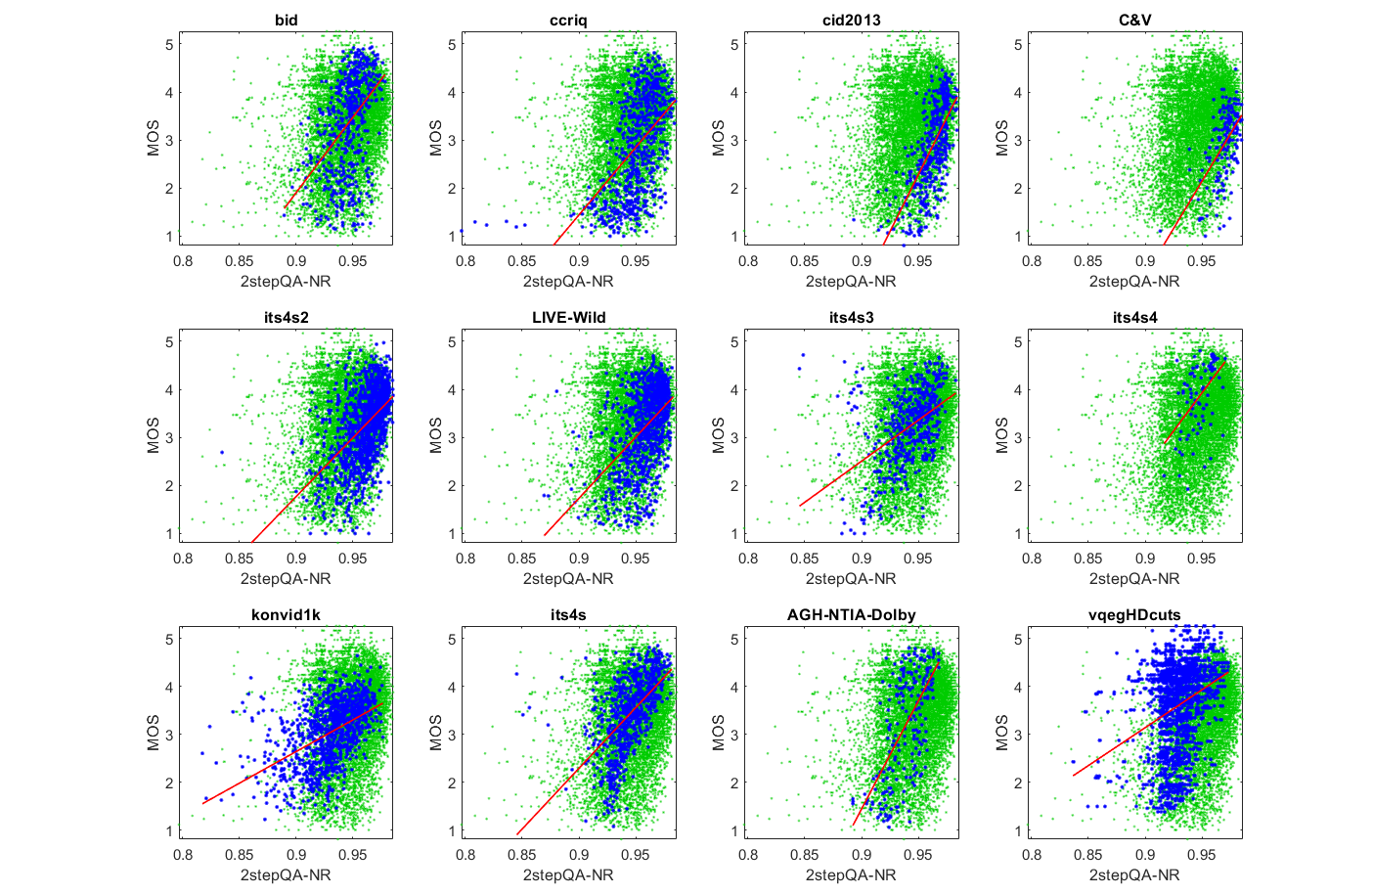
2stepQA-NR

Slide 14
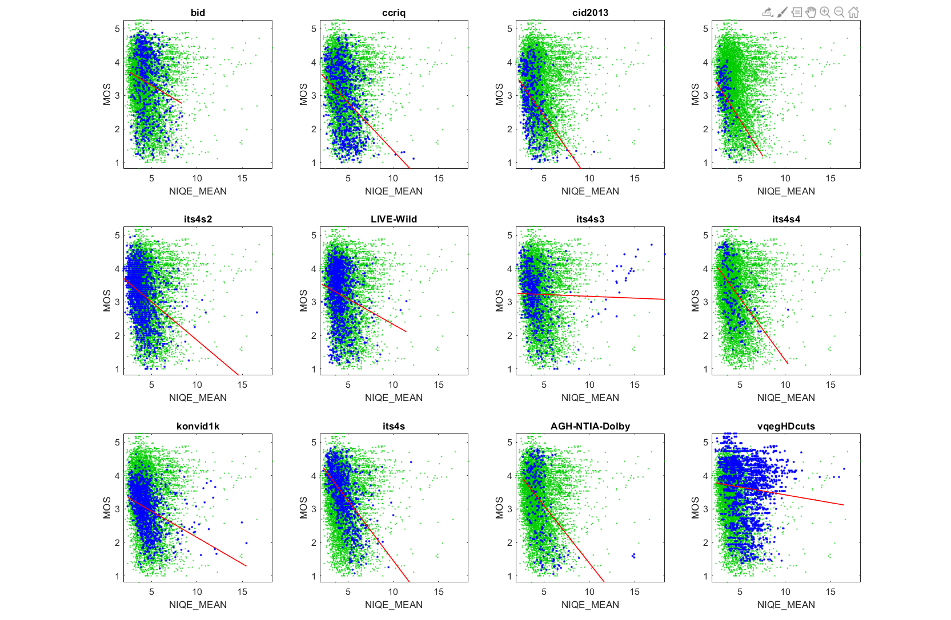
NIQE

Slide 15
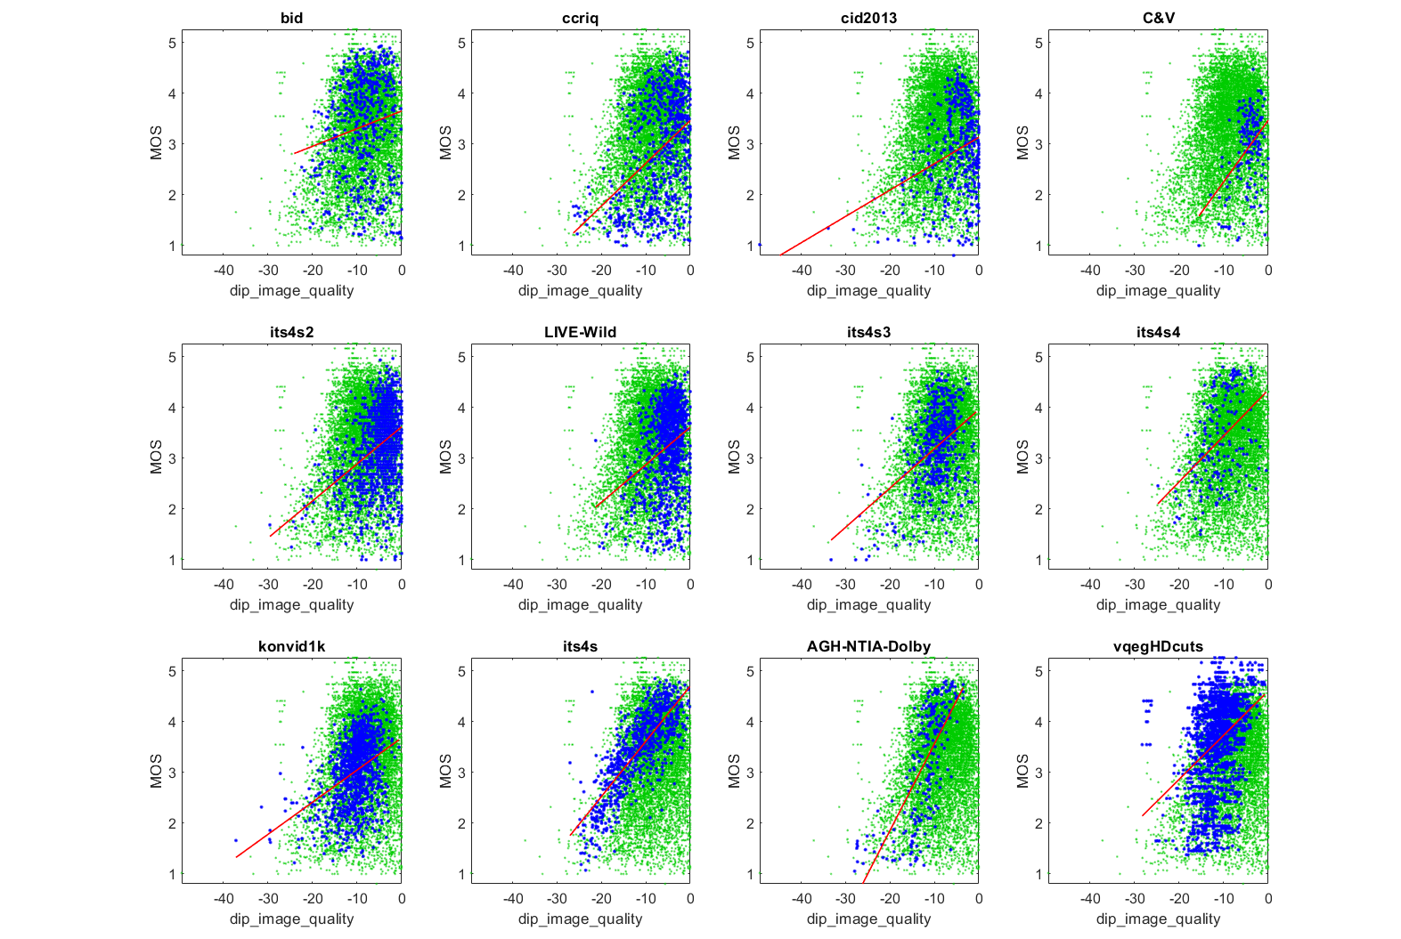
dipIQ

Slide 16
Designing NR Metrics for
Root Cause Analysis

Slide 17
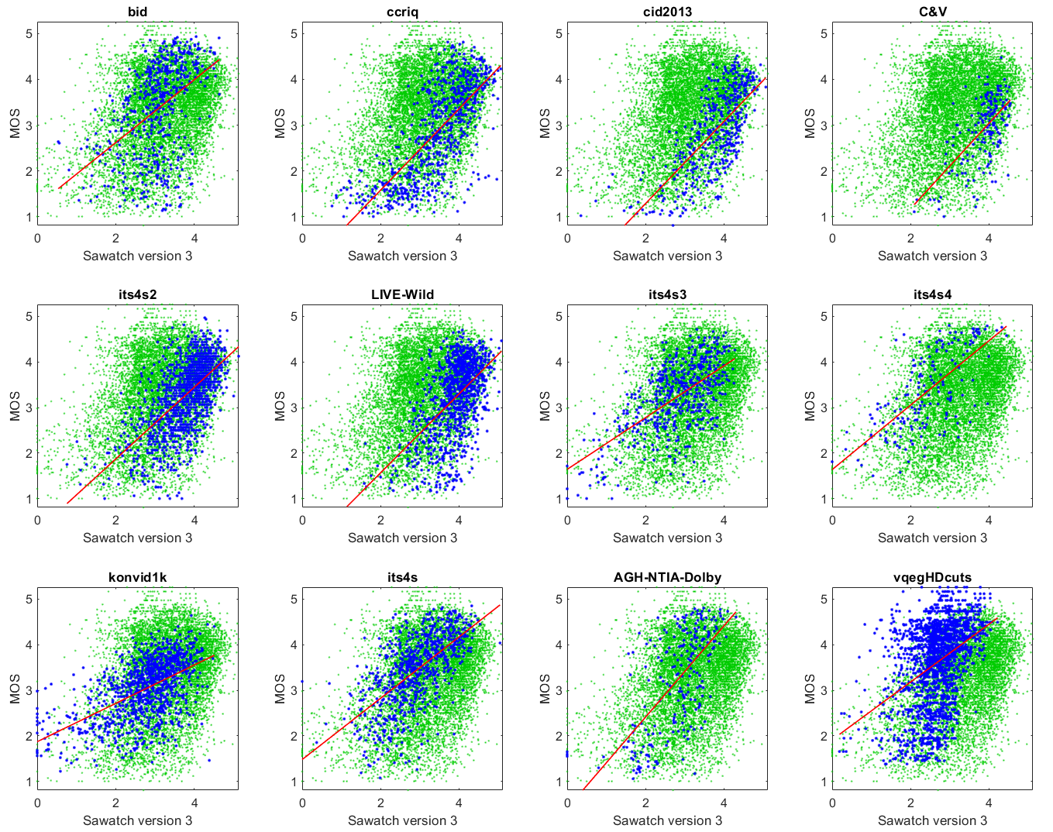
Sawatch Version 3
Training
  0.62 for IQA UGC
  0.62 for VQA UGC
  0.57 for VQA BC
Linear combination of 11 RCA
  Black level, blockiness, blur, color noise, fine detail, pan speed, jiggle, pallid, super saturation, white level,
  dipIQ (compression)
Other impairments ignored
Baseline metric for collaboration

Slide 18
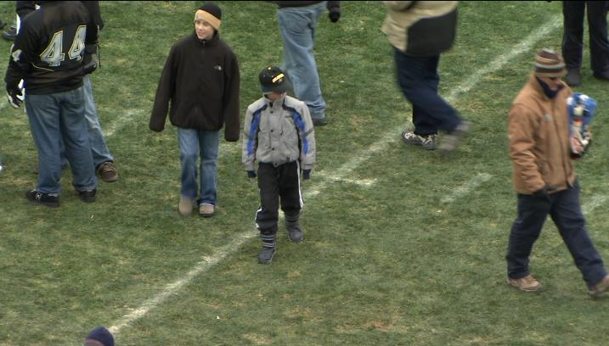
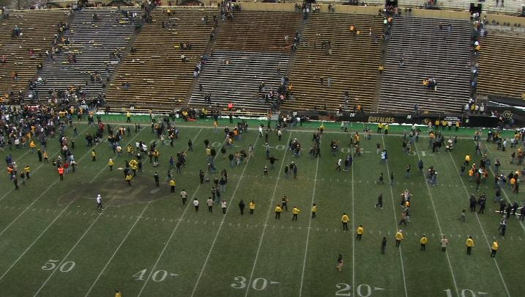
RCA Metrics
Accuracy changes with dataset
  Frequency and severity of impairment
  Use case → task, subject matter, impairments, camera viewpoint,
  subjects, …
  Dominant impairments
  Choice of subject matter
  Size of objects
  Range of quality
Impact changes with use case
  Accuracy: higher ↔ lower
  Weight: larger ↔ smaller
  Quality: degradation ↔ improvement
Public safety use case
distortions matter more for small objects
ITS4S dataset

Slide 19
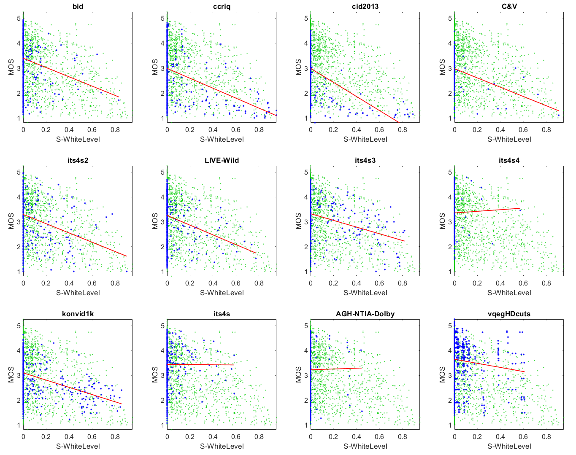
RCA Metric — White Ballance — UGC vs Professional
Penalizes media when the 98th percentile drops below 150
Accurate for UGC
  Lower triangle
  White balance problems = low quality
Inaccurate for broadcast datasets
  Professional videographers avoid
  white balance errors
  Artistic use of dark media
  looks like poor white balance
  Movie credits look like white balance errors

Slide 20
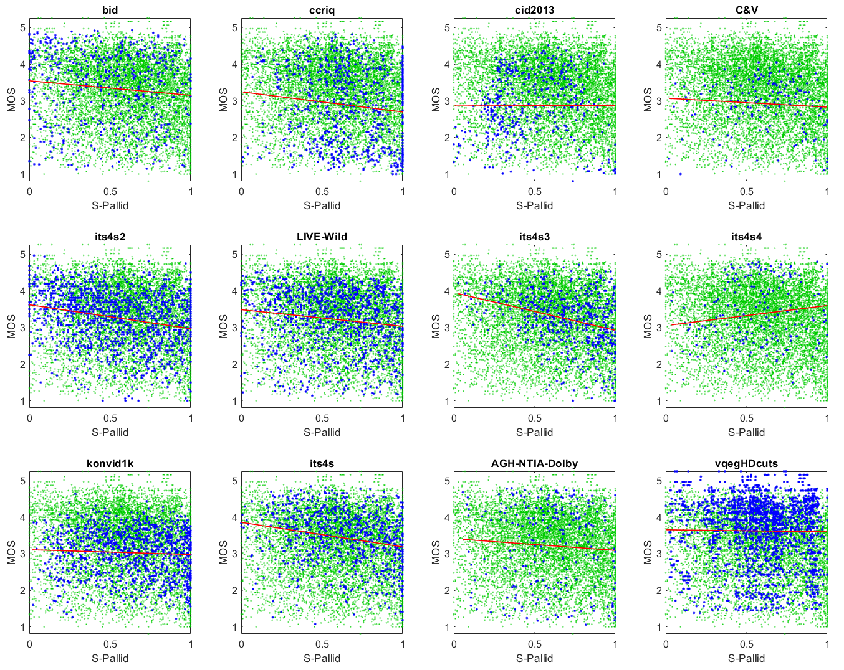
RCA Metric — Pallid — First Responders vs Entertainment
Extremely low spread of Cb or Cr values
Minor factor → lots of scatter plot noise
Accurate colors help first responders
  ITS4S2, ITS4S3, ITS4S
  Upper triangle
Inaccurate for datasets with
artistic use of muted colors

Slide 21
Overall Conclusions
NR metric analyses diverge because use cases and datasets contradict each other
We must identify (and differentiate) universal rules vs factors that change
NR metrics must
  Provide RCA
  Ease mechanism to remove impairment from MOS
Minimum of 10 datasets → 20 datasets → 30 datasets → ...
Baseline metric and framework for collaboration
  NRMetricFramework, https://github.com/NTIA/NRMetricFramework
  NR metric Sawatch
Performance goal — as accurate as a 1-person ad-hoc evaluation
  12.85% ≥ false ranking, https://www.its.bldrdoc.gov/publications/details.aspx?pub=3253

