Slide 1
NIST Enhancing Computer Vision for Public Safety Challenge Datasets
Carolina Whitaker, SURF Participant
#PSCR2021

Slide 2
Overview of Challenge
Dates: September 2020 – May 2021
Goal:
  Created a dataset of images or videos
  Proposed how to evaluate quality for computer vision applicatons
Can help future work in the development of no reference (NR) metric algorithms for computer vision applications

Slide 3




Winning Teams
Five winning entries
4 have allowed for the publication of their datasets on CDVL
1
Team CalAster 1
2
Team iAI Tech-NJIT
2
From CalAster, Inc
Published
From New Jersey Institute of Technology
Published
3
Team IUPUI 3
4
Team LIVE
From Indiana University – Purdue University Indianapolis
Published
From University of Texas, Austin
Published
5
Dr. Burak Ozer
Not Published

Slide 4
CalAster Team Dataset
1489 images in dataset taken only by mobile phone cameras
Classified using 5 fields:
  Mobile Camera
  Exterior or Interior
  Period of Day (only for exterior scenes)
  Weather (only for exterior scenes)
  Intensity
Resolution: 72 dpi
Team manually annotated each object in every image
Used 3 different algorithms to detect objects: Yolo v4, Detectron 2, and Retinanet

Slide 5
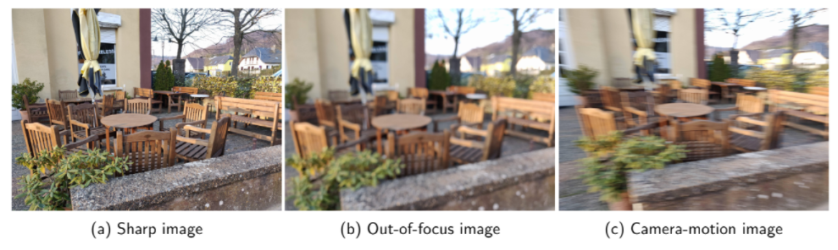
CalAster Team Example
Two types of impairment: out of focus and motion blur

Slide 6
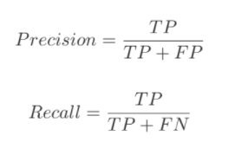
Failure Rate Assessment
From top to bottom: Using Retinanet, Yolo v4, Detectron 2 checking average precision and average recall
With the detailed manual annotation, this assessment can give insight into possible issues in already existing computer vision algorithms

Slide 7
Team iAI Tech-NJIT Dataset
300 short videos (≤ 5 seconds) from modern cameras
Classified with 19 different impairments and 35 combined impairments and camera type
  Illumination (10 types)
  Weather (3 types)
  Lens (4 types)
  Motion (2 types)
  Camera
Resolution: 720 p (166 videos) or 1080 p (134 videos)

Slide 8
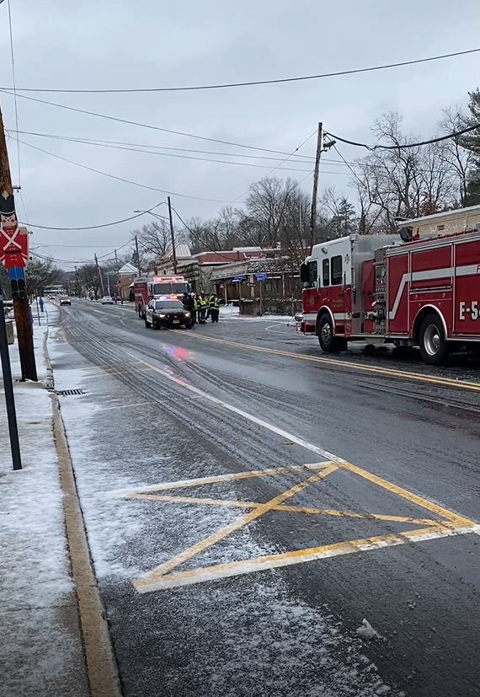
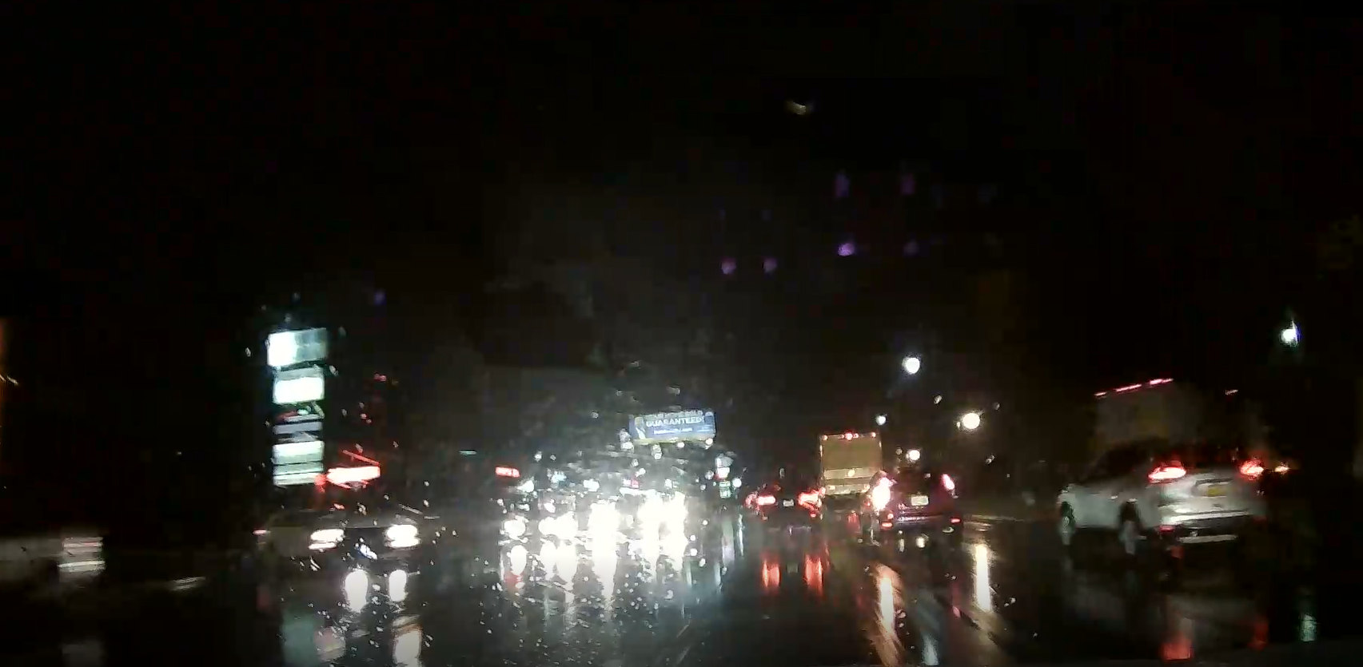
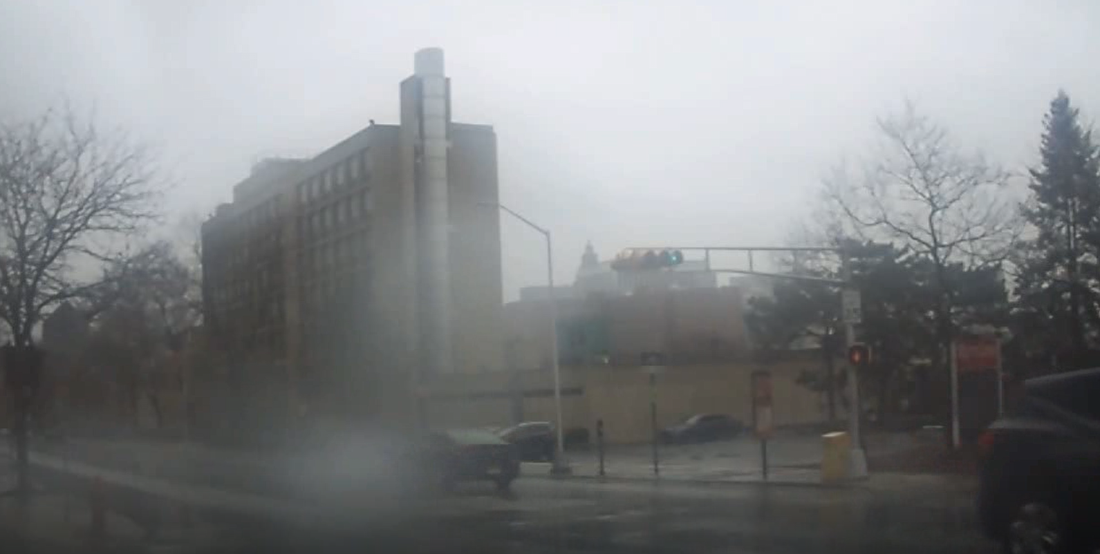
Team iAl Tech-NJIT Example
Night, rain, 1080 p, dashcam
Emergency lights, snow, 1080 p, body cam
Rain, drops on lense, 720 p, body cam

Slide 9
Failure Assessment
IAl Tech-NJIT used 5 different NR metric scores
  Blur
  Small Noise Patch
  Whole Frame Illumination
  Partial Frame Illumination
  Temporal

Slide 10
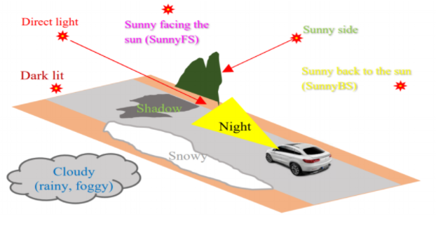
Team IUPUI Dataset
300 5-second HD video clips and 1169 high resolution images
Classified in 4 different categories
  Category 1: Type of camera and if it is a photo or video
  Category 2: Weather conditions
  Category 3: Illumination direction and intensity
  Category 4: Road status

Slide 11
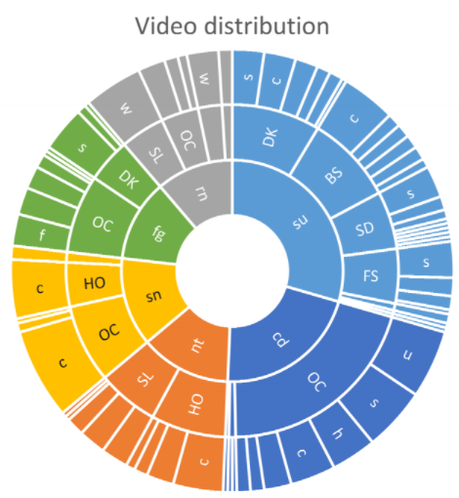
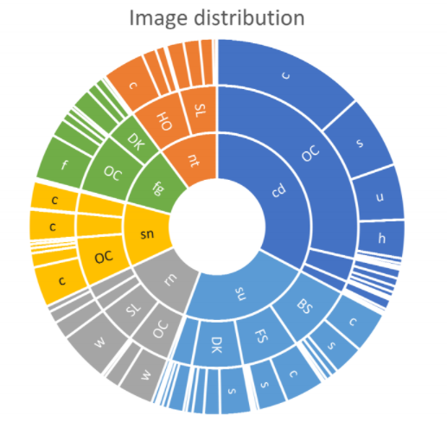
Team IUPUI Distribution

Slide 12
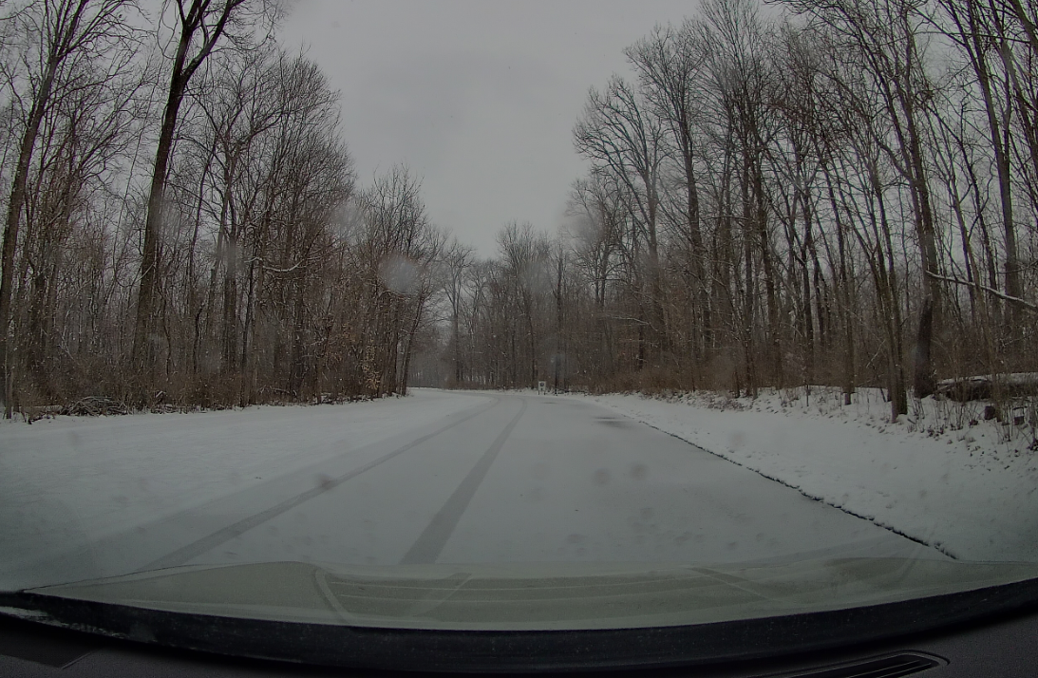
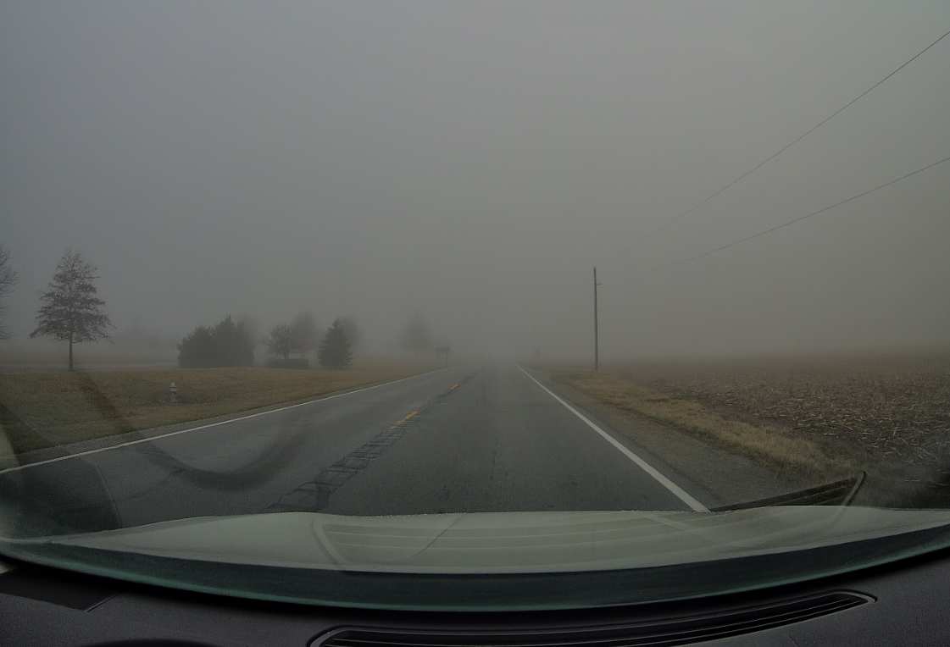
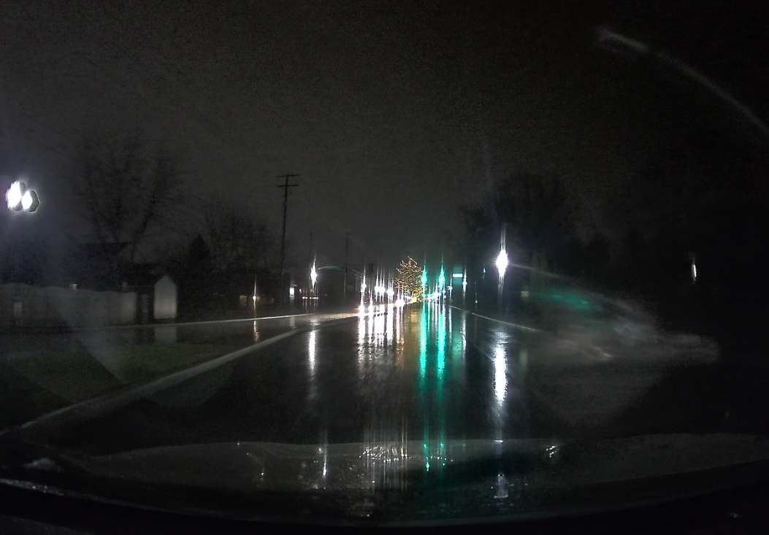
IUPUI Dataset Examples
Overcast Snowy Day
Overcast Foggy Day
Rainy Day at Night

Slide 13
Team LIVE Dataset
789 Images (3840 x 2160 pixels) taken with an iPhone 8
Category | Quantify | High | Low
Pristine | 172
Out of focus | 91
Night | 164
Oncoming Headlights | 65
Oily | 111
Motion Blur | 113 | 45 | 68
Direct Sunlight | 38 | 13 | 68
Rain | 108 | 19 | 89
Snow | 102 | 1 | 101

Slide 14

Failure Assessment
Used Yolo v3 to assess images to create a scalar value for accuracy
Failure Rate = 1 – accuracy score

Slide 15
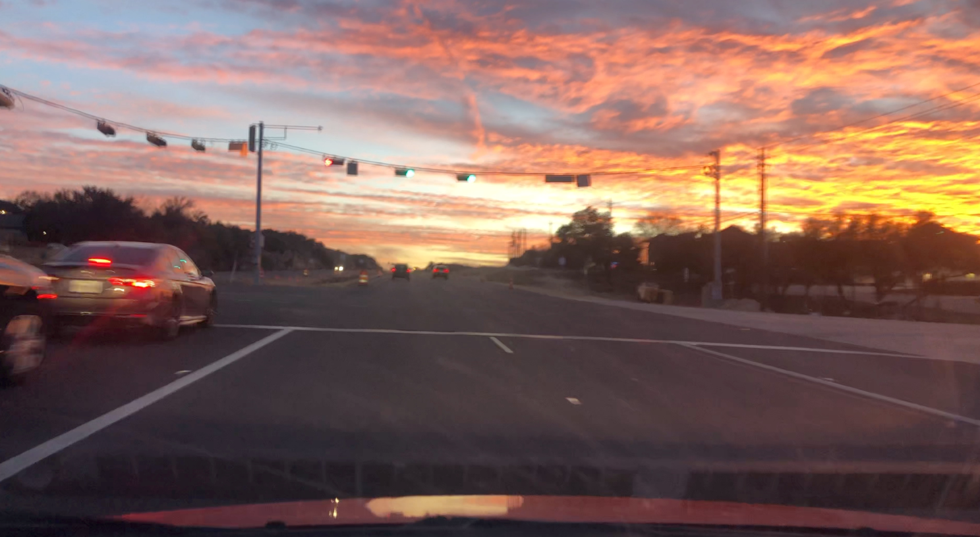
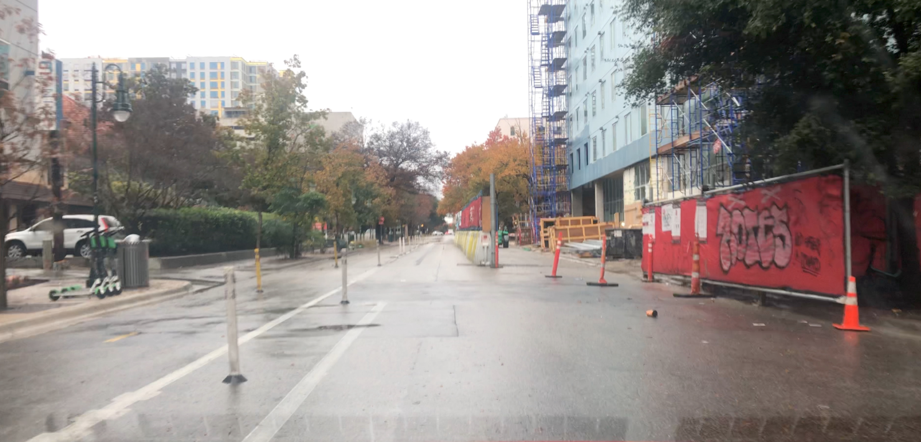
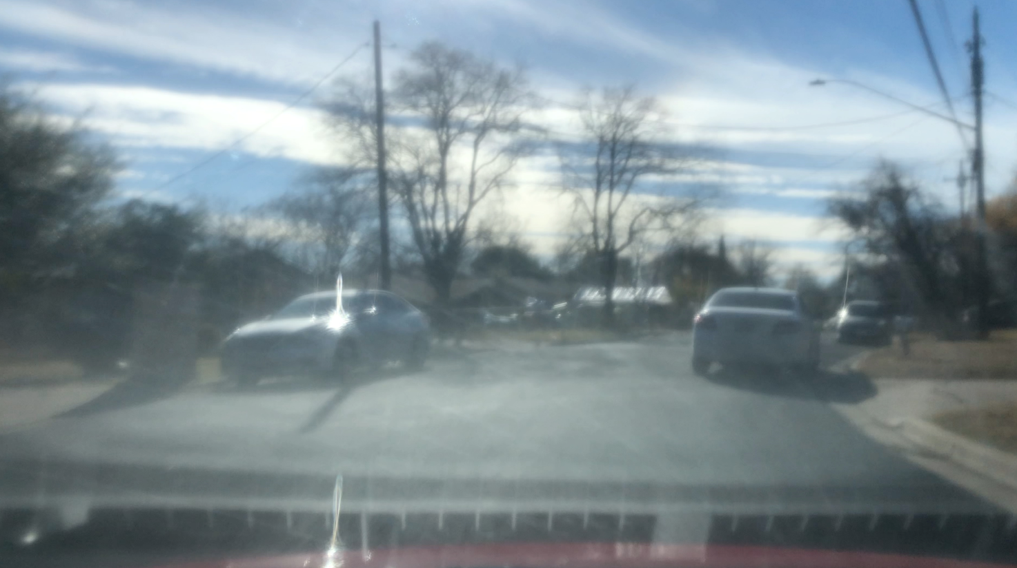
Team LIVE Dataset examples
Pristine Image
Rainy Image
Oily Image

Slide 16
Summary
All teams presented excellent datasets!
4 datasets are available now on CDVL (www.cdvl.org)
  LIVE RoadImpairs Image Dataset
  CalAster Motion and Out-of-focus Blurriness Dataset
  iAITech-NJIT Impairments Video Dataset
  IUPUIdrview Dataset, Images
  IUPUIdrview Dataset, Videos
Any questions?

