Slide 1


Impact of Spatial and Temporal Information on Video Quality and Compressibility
Werner Robitza^{1,2}, Rakesh Rao Ramachandra Rao², Steve Göring², Alexander Raake²
¹ AVEQ GmbH, Vienna, Austria
² Ilmenau University of Technology, Ilmenau, Germany
Video Quality Experts Group — 7-11 June, 2021

Slide 2

Intro
This presentation is a preview of an upcoming paper at QoMEX 2021
Online from June 14th-17th
https://qomex2021.itec.aau.at/

Slide 3
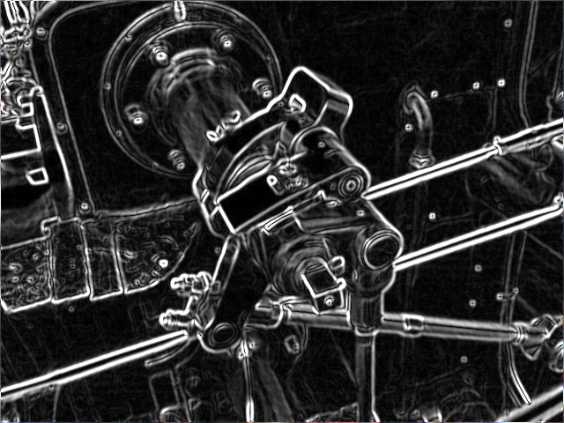
Spatial Information / Temporal Information
About SI and TI:
Defined in ITU-T Rec. P.910
Classify spatiotemporal complexity of video sequences
SI: Standard deviation of Sobel-filtered image
TI: A basic motion difference feature for adjacent frames
This contribution:
Related to ongoing VQEG NORM project
SI/TI frequently used for classifying sources for video quality tests
How well can SI/TI be used to gauge compressibility of a video?
By Simpsons contributor, CC BY-SA 3.0, https://commons.wikimedia.org/w/index.php?curid=8904663

Slide 4
This Contribution
Related to ongoing VQEG NORM project with different activities
  Usage for material with > 8 bit
  HDR
  …
In this contribution, however, focus on:
  SI/TI are frequently used for classifying sources for video quality tests
  Choosing the sources is important for codec development, subjective testing, etc.
How well can SI/TI be used to gauge compressibility of a video?

Slide 5
Working Hypothesis
Videos with higher SI/TI
should be harder to compress
Videos with higher SI/TI have lower quality when compressed under bitrate constraint
High SI/TI lead to lower quality
and lower compressibility
Compressibility of a source == achievable quality under bitrate constraints
Quality == subjective or “objective” MOS

Slide 6
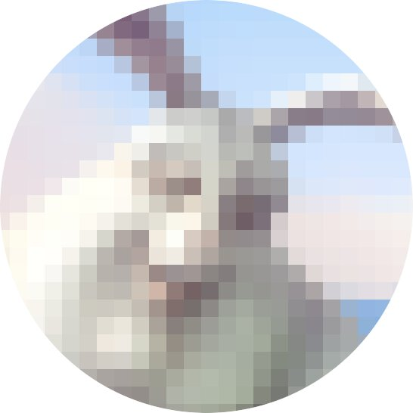








Our Approach
Calculate quality scores and bitrate ladder
(MOS, VMAF, ITU-T Rec. P.1204.3)
Video database
(AVT-VQDB-UHD1)
Sequences encoded for streaming
(H.264, H.265, VP9)
Calculate area under bitrate ladder as compressibility
Compressibility Score
SI/TI
Determine correlation
Source sequences
(Raw UHD-1, 8-10s)

Slide 7
Database and Features
AVT-VQDB-UHD1¹
Test 1: 180 PVSes
Tests 2 & 3 with overlapping PVSes → mapped into one “virtual” test called “test 2+3” with 320 PVSes
Test 4: includes FPS changes, therefore ignored
SI and TI scores
Per frame, averages, minimum/maximum²
Additionally: Criticality metric from Fenimore et al.³ that uses SI/TI
Video quality scores
Subjective MOS from ITU-T Rec. P.910-compliant lab tests
VMAF (4K model, v0.6.1); full-reference model
ITU-T Rec. P.1204.3; bitstream-based model⁴
¹ https://github.com/Telecommunication-Telemedia-Assessment/AVT-VQDB-UHD-1
² calculated via https://github.com/Telecommunication-Telemedia-Assessment/siti-tools
³ see Fenimore et al. (1998), Perceptual Effects of Noise in Digital Video Compression
⁴ calculated via https://github.com/Telecommunication-Telemedia-Assessment/bitstream_mode3_p1204_3

Slide 8
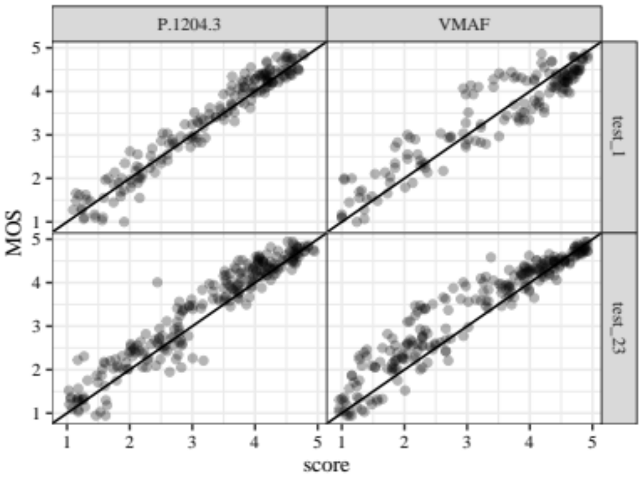
Data Preparations
Consistency checks:
  “Dancers_8s” contained possibly erroneous PVSes already at encoding stage, and was completely removed
  All VMAF scores for “water_netflix” sequence were erroneous and removed (possible frame offset)
  P.1204.3 scores for four PVSes were removed due to being extreme outliers (possible model bug)
How well do VMAF and P.1204.3 work?
  Very well — see plot on the right
  Pearson correlation between metric and MOS:
  P.1204.3: 0.96
  VMAF: 0.94

Slide 9
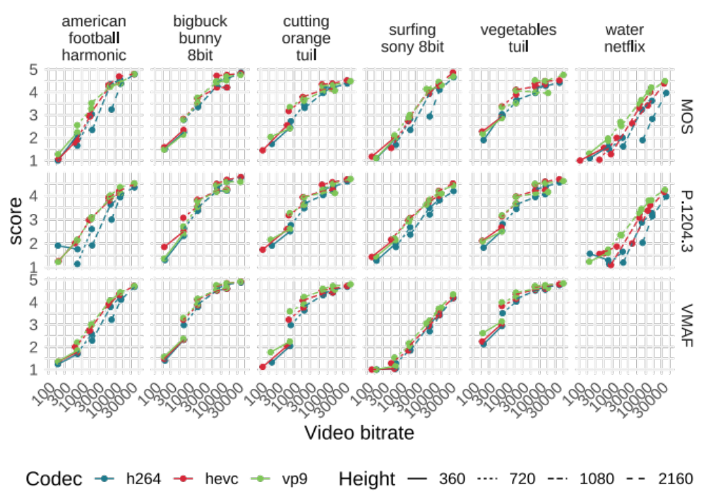
Determining Quality/Compressibility
Create bitrate ladder for each SRC, i.e. MOS against bitrate

Slide 10
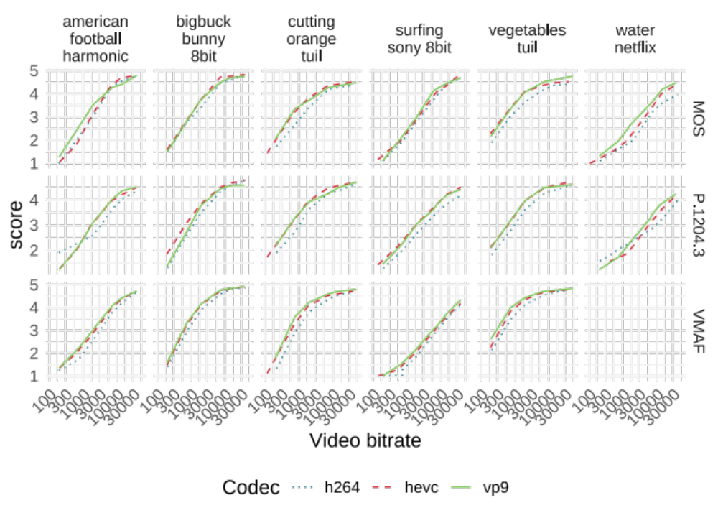
Determining Quality/Compressibility
Create bitrate ladder for each SRC, i.e. MOS against bitrate
Construct convex hull of ideal points

Slide 11
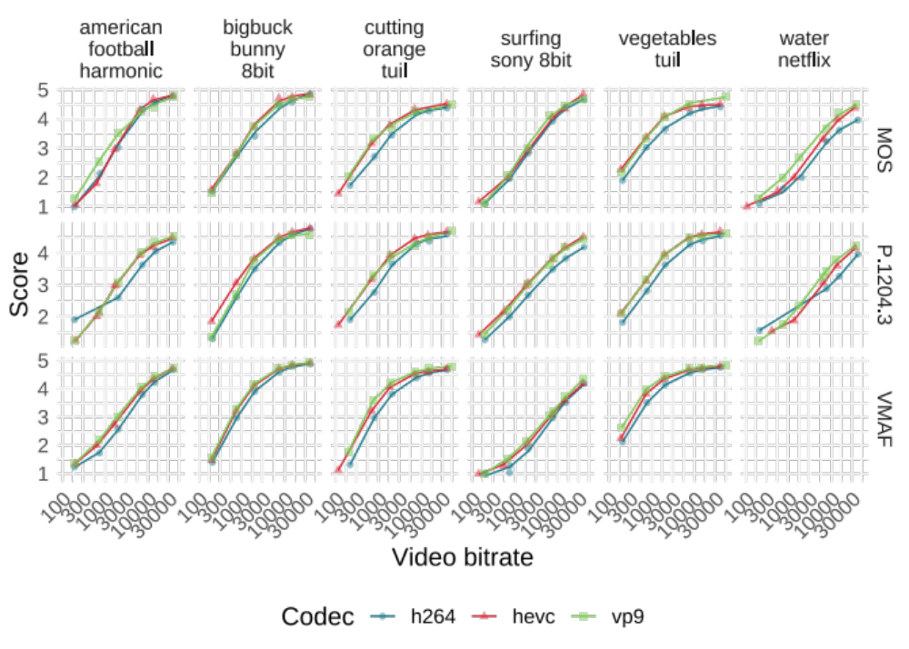
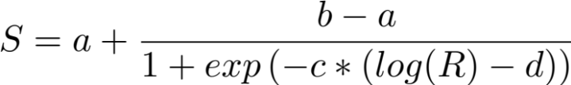
Determining Quality/Compressibility
Create bitrate ladder for each SRC, i.e. MOS against bitrate
Construct convex hull of ideal points
Fit sigmoid function¹ against hull
¹ based on: Hanhart et al. (2014), Calculation of average coding efficiency based on subjective quality scores

Slide 12
Determining Quality/Compressibility
Create bitrate ladder for each SRC, i.e. MOS against bitrate
Construct convex hull of ideal points
Fit sigmoid function against hull
Calculate are under each curve as quality/compressibility for that SRC/codec
Compressibility
1 number for each SRC/codec combination

Slide 13
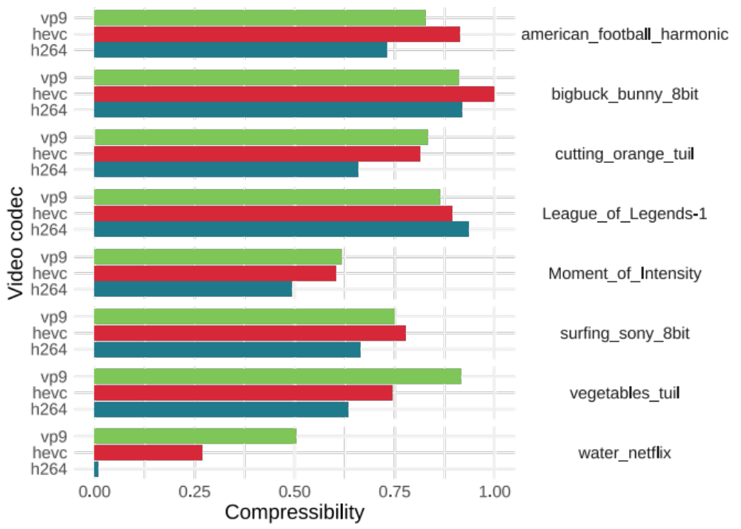
Compressibility
Each SRC and codec have different compressibility scores
Note:
Scores are normalized between 0 and 1 for this analysis (to be refined)
Scores are based on MOS here
Examples:
BBB is the easiest to compress, although used very often in tests
Netflix Water sequence is the hardest

Slide 14
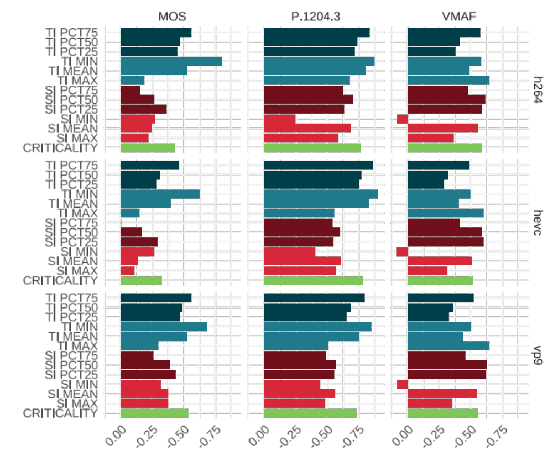
Correlations
TI features have higher correlation with compressibility than SI features
Minimum TI seems like a better correlated indicator than maximum TI
Mean SI correlates better than min/max
Criticality metric from Fenimore et al. has good correlation with compressibility
Features
Correlation with compressibility

Slide 15
Summary
Method to determine quality/compressibility of a given SRC and codec
  Construct convex hull
  Determine area under the curve
Results:
  SI/TI correlate with quality and compressibility
  Minimum TI is a useful indicator too (for short sequences)
Further research:
  Are there combinations of SI/TI that can be more useful?
  Determine compressibility as a single number on universal scale

Slide 16
Thank you!

