Slide 1
A Benchmarking Standard to bring
Quality, Bandwidth, and Latency into a Common Measurement Domain
Carnation Communications Inc.
Jimei University
PROPOSAL
Dr. Yendo Hu, Carnation Communications Inc.
Dr. Wu Yi Liang, Jimei University

Slide 2
The Inter-Dependencies between
Quality Bandwidth Latency
Quality
Tightly Coupled Relationship
Bandwidth
Latency

Slide 3
Six Classes of Influencing Parameters
Compression
Content
Quality
Implementation
Format
Bandwidth
Latency
Network
Protocol

Slide 4
Influencing Parameters
Compression Standards
MJPEG
MPEG2
H264
H256
VC9
AV1
Proprietary

Slide 5
Influencing Parameters
Content Examples
Talking Heads
Action
Stills
Film Credits
Landscapes
Fades
Grass

Slide 6
Influencing Parameters
Format Variations
1080i59
720p60
480p24
UHD@24
DCI@30
VGA
Custom

Slide 7
Influencing Parameters
Implementation Approaches
Software
Hardware
Hybrid
Offline/Realtime
Vender Specific
Proprietary

Slide 8
Influencing Parameters
Network Types
Wired Point-to-Point
Wireless Point-to-Point
Wireless Mesh
Satellite Contribution
Satellite Distribution
Cloud Point-to-Point
Cloud Bonding
OTT Distribution

Slide 9
Influencing Parameters
Protocols
TS ES
TS-FEC TS-ARQ
IP-UDP IP-TCP
IP-FEC IP-ARQ
IP-RTMP IP-SRT
IP-LLCMAF IP-LLHLS
IP-WebRTC

Slide 10
Proposal: Framing the Test Bench
Six Domains
Domains | Elements
Content | TBD defined set
format | TBD Pixel size / frame rate
Compression | TBD standards
Implementation | TBD classes
Network | TBD networks Wired point-to-point Wireless point-to-point IP Network
Protocol | IP-UDP IP-TCP TBD others

Slide 11
Proposal: Framing the Test Bench
Three Measurements
Measurements
Quality (PSNR)
Bandwidth
Latency

Slide 12
Proposal: Framing the Test Bench
Three Profiles
BASE
COMPRESSION
NETWORK

Slide 13
Proposal: Bounding the Scope Proposal
Base Profile
Compression
Content
Pre-defined Periodic
Implementation
Format
Network
Protocol

Slide 14
Proposal: Bounding the Scope Proposal
Compression Profile
Compression
Content
Pre-defined Periodic
Implementation
Format
Pre-defined by Content
Network
Wired Point-to-Point
Protocol
IP-UDP

Slide 15
Proposal: Bounding the Scope Proposal
Network Profile
Compression
H265
Content
Pre-defined Periodic
Implementation
VLC Open Source RT Encoder
Format
Pre-defined by Content
Network
Protocol

Slide 16
Proposal: EXAMPLE
Compression Profile
Domain | Bound | Device Under Test
Content | Star Wars Trailer
Compression |  | H265
Implementation |  | Qvidium 4K Codec
Format | 1080p24
Network | Wired Point-to-Point
Protocol | IP-UDP

Slide 17
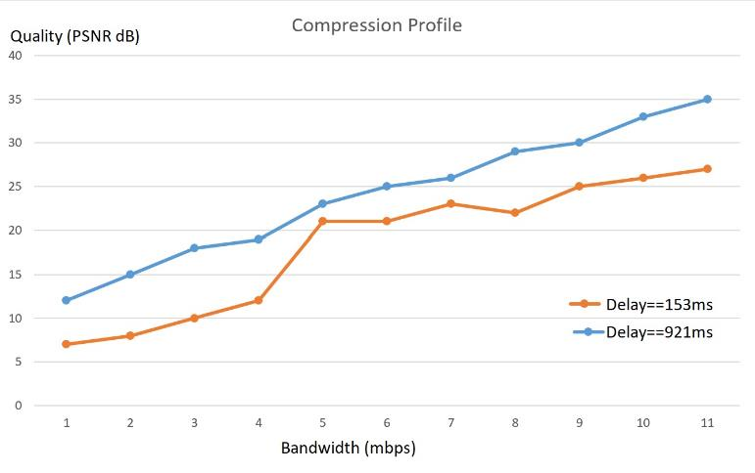
Proposal: EXAMPLE
Compression Profile Measurements

Slide 18
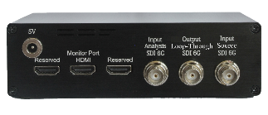
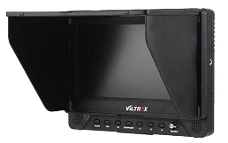

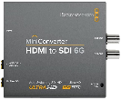

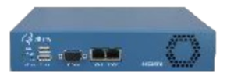

Example: Test Setup
SDI
HDMI
HDMI
USB3
SDI
SDI
Status
Configured for Decoding
Configured for Encoding
Notes:
Before I go into the netty grettis of the various elements, and explain the details of each. Lets take one step back, and answer the bigger question. So, which approach should we take? We can **** Either look at this through the various parameters that contribute to the latency, such as the compression, the network traffic, jitter the data travel time, … , or we can **** | **** take it from a more hardware approach, such as the camera, the encoder/decoders, the network switch, even the monitor. Well, I am kind of a visual physical guy, so, let’s take it from a mechanical perspective,**** it would also require less apriori knowledge of the various technical parameters to grasp the concept.

Slide 19
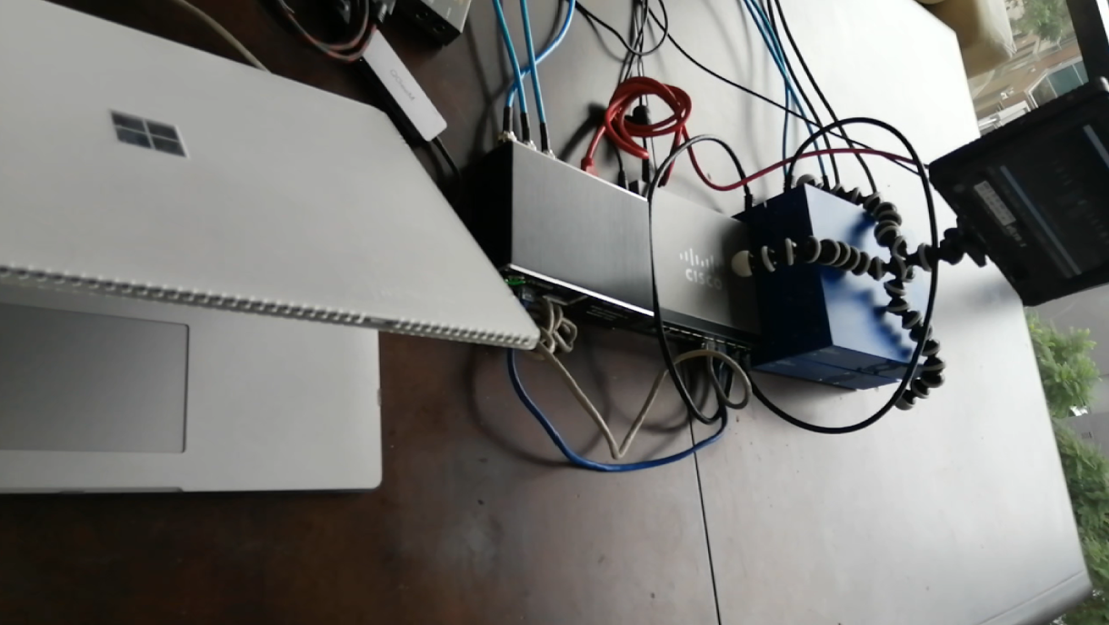
Example: Wiring Setup
Notes:
Before I go into the netty grettis of the various elements, and explain the details of each. Lets take one step back, and answer the bigger question. So, which approach should we take? We can **** Either look at this through the various parameters that contribute to the latency, such as the compression, the network traffic, jitter the data travel time, … , or we can **** | **** take it from a more hardware approach, such as the camera, the encoder/decoders, the network switch, even the monitor. Well, I am kind of a visual physical guy, so, let’s take it from a mechanical perspective,**** it would also require less apriori knowledge of the various technical parameters to grasp the concept.

Slide 20
Example: Parts List
CC3030 Carnation Communications Inc. SDI Video Latency + Quality
www.carnationcommunications.com
SG250-08 Cisco 8 Port Smart Switch with 8 Gigabit Ethernet
www.amazon.com
QVCodec4K QVCodec4K 4K/UHD-HDR HEVC Low Latency Encoder/Decoder
www.qvidium.com
B07Y6F74F1 QGeeM 4 in 1 USB-C to HDMI Adapter
www.amazon.com
CONVMBHS24K6G Blackmagic Design HDMI to SDI 6G Mini Converter
www.amazon.com
DC-70EX Viltrox 7" 4K HD 1024x600 HDMI/SDI/AV LCD Monitor
www.amazon.com

Slide 21
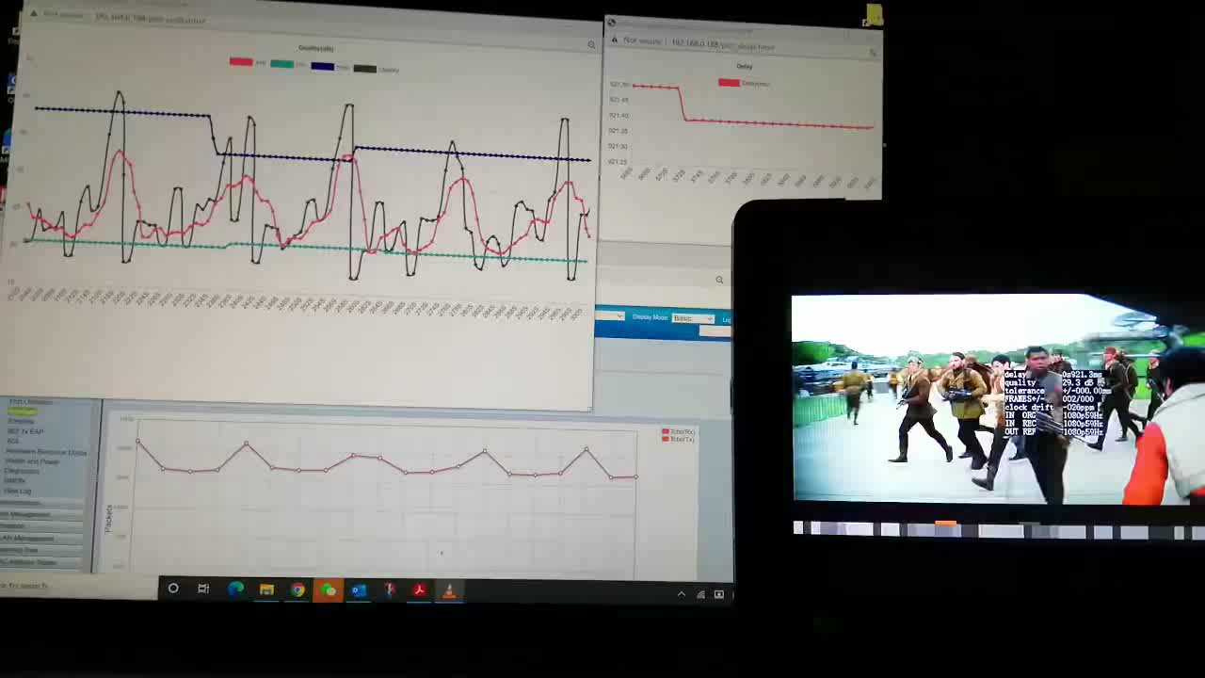
Example: Measurement
Please click link for a full Demo tutorial.
https://youtu.be/CVad5RhUsSk
Notes:
Before I go into the netty grettis of the various elements, and explain the details of each. Lets take one step back, and answer the bigger question. So, which approach should we take? We can **** Either look at this through the various parameters that contribute to the latency, such as the compression, the network traffic, jitter the data travel time, … , or we can **** | **** take it from a more hardware approach, such as the camera, the encoder/decoders, the network switch, even the monitor. Well, I am kind of a visual physical guy, so, let’s take it from a mechanical perspective,**** it would also require less apriori knowledge of the various technical parameters to grasp the concept.

Slide 22
Carnation Communications Inc.
Jimei University
Thank You

