Slide 1
Quality of Experience in Augmented Telepresence
Effects of viewing positions and depth-aiding augmentations
Elijs Dima
Realistic 3D, Mid Sweden University
June 11, 2021
Notes:
So, good afternoon or good morning, I am Elijs Dima, from the Realistic 3D research group at Mid Sweden University.
Today I’d like to give a quick summary of our findings regarding QoE aspects of Augmented Telepresence; I’ll try to keep this within 10 minutes so we have time.

Slide 2
Outline
QoE in AT:
    Motivation / Summary
    Investigation focus
  Test setup & design
  Main findings
Ongoing work: Augmented Remote Operation
  Background and brief information
Notes:
I’ll mainly cover one of our studies, specifically regarding QoE in augmented telepresence enabled by head-mounted displays.
and if there is time, I will touch on on an ongoing work with augmented remote operation systems that we are undertaking currently.

Slide 3
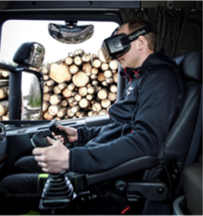
Quality of Experience in Augmented Telepresence
Problem summary
“Immersive telepresence” ⇒
Control view: 1st / 3rd pers.
    Env. Awareness: ↓ / ↑
    View mobility: ↑ / ↓
    Control accuracy: ↑ / ↓
Head-Mounted Displays
    Depth guess accuracy: ↓
[3a]
[62a, 62b]
Notes:
If we intend to have an immersive telepresence system for remotely controlling something, then the remote environment can be shown to the user in either 1st person or 3rd person view (like sitting in a cockpit vs. standing off to the side of a machine).
3rd person view tends to provide better awareness of the surrounding environment, which is good for safety. However, with a direct camera pass-through solution, the 3rd person view also leads to reduced view mobility, and the selected view position may affect control accuracy, e.g. if it is too far.
Further, for providing the immersive control interface, usually head mounted displays are used. HMD’s tend to reduce depth (distance) judgement accuracy, especially in setups with constrained FoV or limited viewpoint mobility, and setups where people do not get to experience the same environment in reality and through the headset. This altogether implies a potential problem in telepresence systems with immersive, 3rd person viewpoint

Slide 4
Quality of Experience in Augmented Telepresence
Investigation focus
3rd pers. view, HMD, remote controlling, with AT…
  Depth judgement compromised ⇒ remote control ↓
Impact of Viewing Positions?
Impact of Augmentations?
QoE: “… the degree of delight or annoyance of the user of an application or service. It results from the fulfillment of [their] expectations [w.r.t.] the utility and enjoyment of the application or service in light of user’s personality and current state.” [63a]
Notes:
In an augmented telepresence scenario with a fixed 3rd person view, HMD rendering, and remote controlling, the problems in depth judgement might lead to problems in the control ability.
To investigate this, we focused on how these two factors – the choice of viewing position and in-view augmentation – affect the user’s remote controlling ability in AT.
To address these questions, we performed a task-oriented QoE study with non-expert participants in a controlled lab environment.

Slide 5
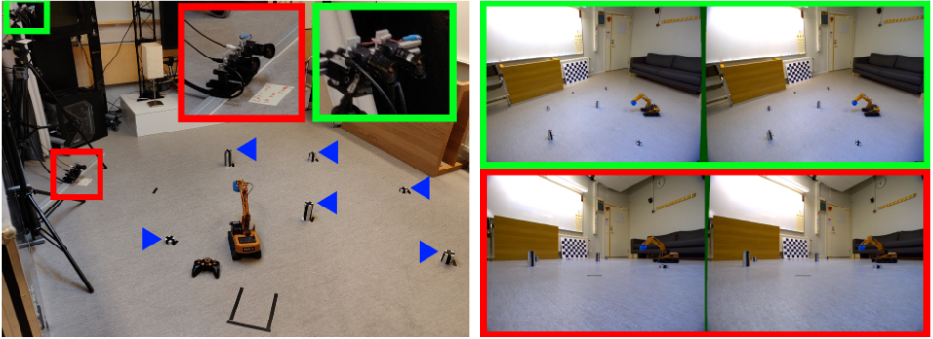
Quality of Experience in Augmented Telepresence
Test setup
Fixed viewpoints ⇒ “Ground view” / “Overhead view”
Fixed targets + remote control vehicle ⇒ “reach and touch” task
Notes:
Here are images of the test setup, with two stereo camera pairs providing a 3rd person side view and overhead view perspective.
The side view is closer to physical out-of-cockpit driving of crane vehicles, but the overhead view requires less of a dependence on depth perception to navigate to each target.
The task enabled by this system is a “reach and touch” task, i.e. the user would use the remote control to drive the vehicle to a selected target and use the arm to touch the target as accurately as they can.

Slide 6
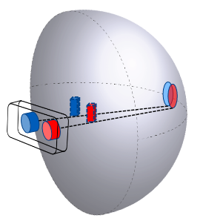
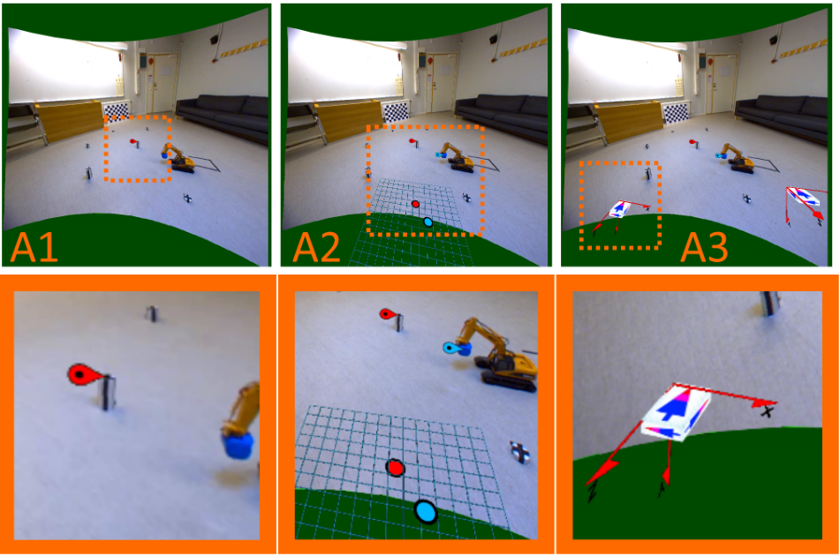
Quality of Experience in Augmented Telepresence
Test setup
Augmentations: Control (A1), Grid (A2), Box (A3)
Stereoscopic rendering for “in scene” augmentations
Notes:
Here are the three augmentations used in the study, a “control” that only highlights the active target that user must reach, and two assisting augmentations (grid and box) that indicate how far the remote control crane is from the active target.
All augmentations attached to in-scene objects, like the target indicator, are rendered stereoscopically, and consistent to the displayed camera views, in order to prevent the augmentations from giving a conflicting depth cue.

Slide 7
Quality of Experience in Augmented Telepresence
(Experiment flow for each participant)
Test design summary
Info + Consent form
Task: “reach and touch” targets
(as many as possible in 2 min)
Randomized test run order
SSQ (16 sympt., Kennedy et al. [66a])
Subj.: MOS (1 to 5 linear)
- Task Accomplishment
- Task Difficulty
- View Helpfulness
- Augmentation Helpfulness
Obj.: Nr. targets, Time to/near target, Touch precision
Simulator Sickness Questionnaire
Practice Run – Remote Controls
Practice Run – HMD fit & use
TEST RUNS | Aug 1 | Aug 2 | Aug 3
View o | A1_o | A2_o | A3_o
View g | A1_g | A2_g | A3_g
Simulator Sickness Questionnaire
Notes:
To summarize the test design, we set up an experimental task for participants to use the remote controlled vehicle to drive to and touch as many targets as possible in a single 2 minute run.
We used 6 test runs, to cover each combination of the augmentation and view-position stimuli.
Both the run order, and the order of picked targets inside each run, were randomized.
For taking the QoE control on user state during the experiment, we used the 16-symptom simulator sickness questionnaire by Kennedy et al.
For Assessing QoE, for each run we gathered participant opinion, on linear scale of 1 to 5, on their task accomplishment ability, perceived task difficulty, and the view and augmentation helpfulness.
We also tracked the task performance through the nr. of targets reached in each run, time taken to reach target and to touch each target, and the accuracy of the each touch.
The gathered results were analyzed through score aggregation, repeated-measures anova and bonferroni-corrected t-tests for determining significance of any potential difference caused by the input stimuli.

Slide 8
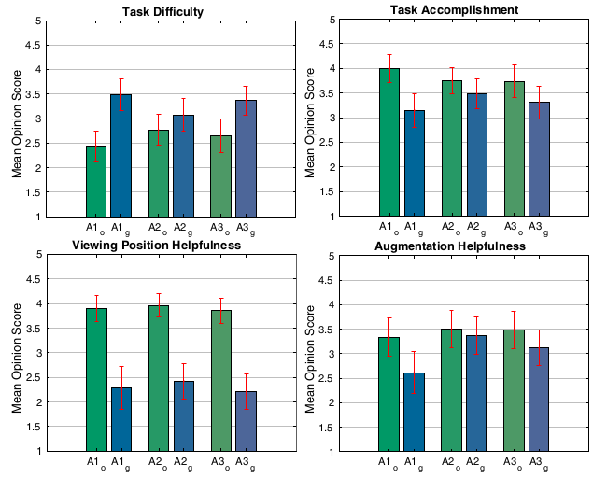
Quality of Experience in Augmented Telepresence
Investigation Results
27 Participants
Subjective:
View positions (o / g) → sign. diff, esp. given A1, A3
AR (A1 / A2 / A3) → only
in perceived “helpfulness” (A1, A2) and task diff. (A1, A2).
MOS and 95% ci for AR designs
(A1, A2, A3) and view positions (o, g)
Notes:
We had a total of 27 participants taking these tests.
In subjective metrics (meaning opinion scores), we saw a more significant difference between the viewing positions on all subjective metrics. The difference between specific augmentation designs was less pronounced, however the depth-aiding augmentations were rated as “fair” to “good” by the participants, suggesting at least a perceived positive benefit.

Slide 9
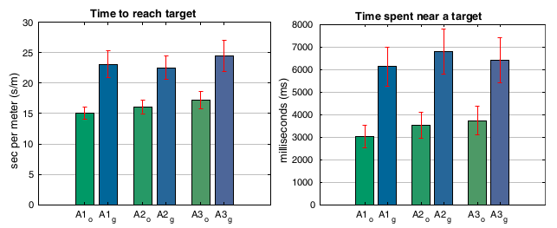
Quality of Experience in Augmented Telepresence
Investigation Results
27 Participants
Objective:
View positions (o / g) → significant
AR → no significant effect
Mean and 95% ci of times,
for AR designs (A1, A2, A3) and view positions (o, g)
Notes:
In objective metrics (meaning task performance), we again saw a significant difference between the two viewing positions, regardless of augmentation.
Here, the augmentations specifically did not seem show any significant differences, unlike in the subjective results.

Slide 10
Quality of Experience in Augmented Telepresence
Outcomes: QoE in AT
Viewing positions affect QoE in 3rd person AT
Position-assisting augmentations may
mitigate some effects from viewing positions
Contributions:
View Position Impact on QoE in an Immersive Telepresence System for Remote Operation (QoMEX 2019)
Joint Effects of Depth-aiding Augmentations and Viewing Positions on the Quality of Experience in Augmented Telepresence
(Quality and User Experience vol.5, 2020)
Notes:
From these results, we can draw two take-aways that affect augmented telepresence systems that provide third-person telepresence.
First, the system-defined viewing position of the remote environment has a strong effect on the user experience and on their task performance. Particularly worsening the experience as more emphasis is placed on depth perception through the hmd.
Secondly, we can say that in-view augmentations, that provide additional depth or positioning hints, seem to provide a perceived benefit to the users, even though the task performance is not improved.
This, then opens a question, is it worthwhile to allocate processing power (and rendering time) to generating augmented content for telepresence systems that don’t fully resolve the underlying problem (i.e. viewing perspective).
This study was first described in a QoMEX conf. Paper, and full details were published in QUEX journal, if anyone wants to take a further look.

Slide 11
Notes:
Now then, briefly moving on to the next work, on augmented remote operation systems.

Slide 12
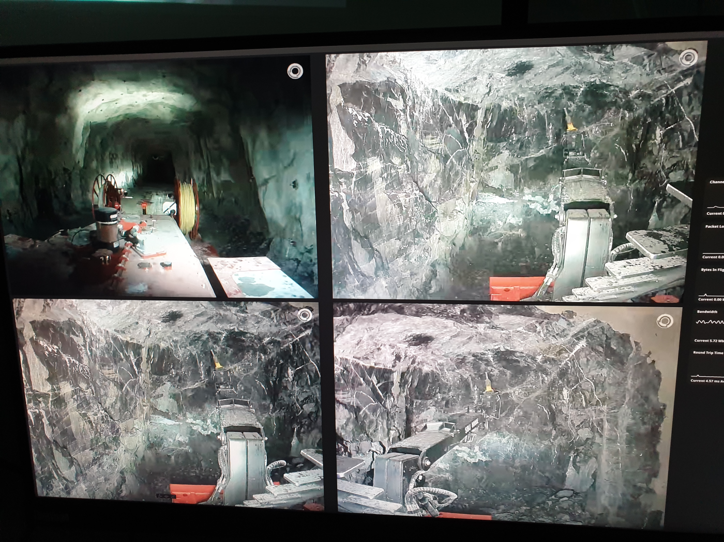
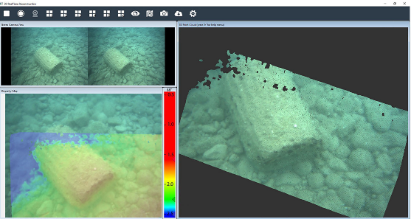
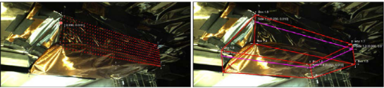
Augmented Remote Operation
Remote Operation Interfaces
Remote operation in mining: non-augmented interfaces
In other contexts, tend to
have additive augmentation:
[52a, 52b, 52c]
Notes:
This is a work we’re doing in collaboration with companies from the swedish mining industry, concerning the interfaces for remote operation.
Now, in mining, contemporary remote operation solutions are based on straightforward telepresence, meaning direct transmission of camera views from the remotely operated machinery.
In other, similar industries, augmentations are typically additive, in that extra information is used to insert virtual augmented elements into the presented view, and optionally show the 3D structure from another perspective.

Slide 13
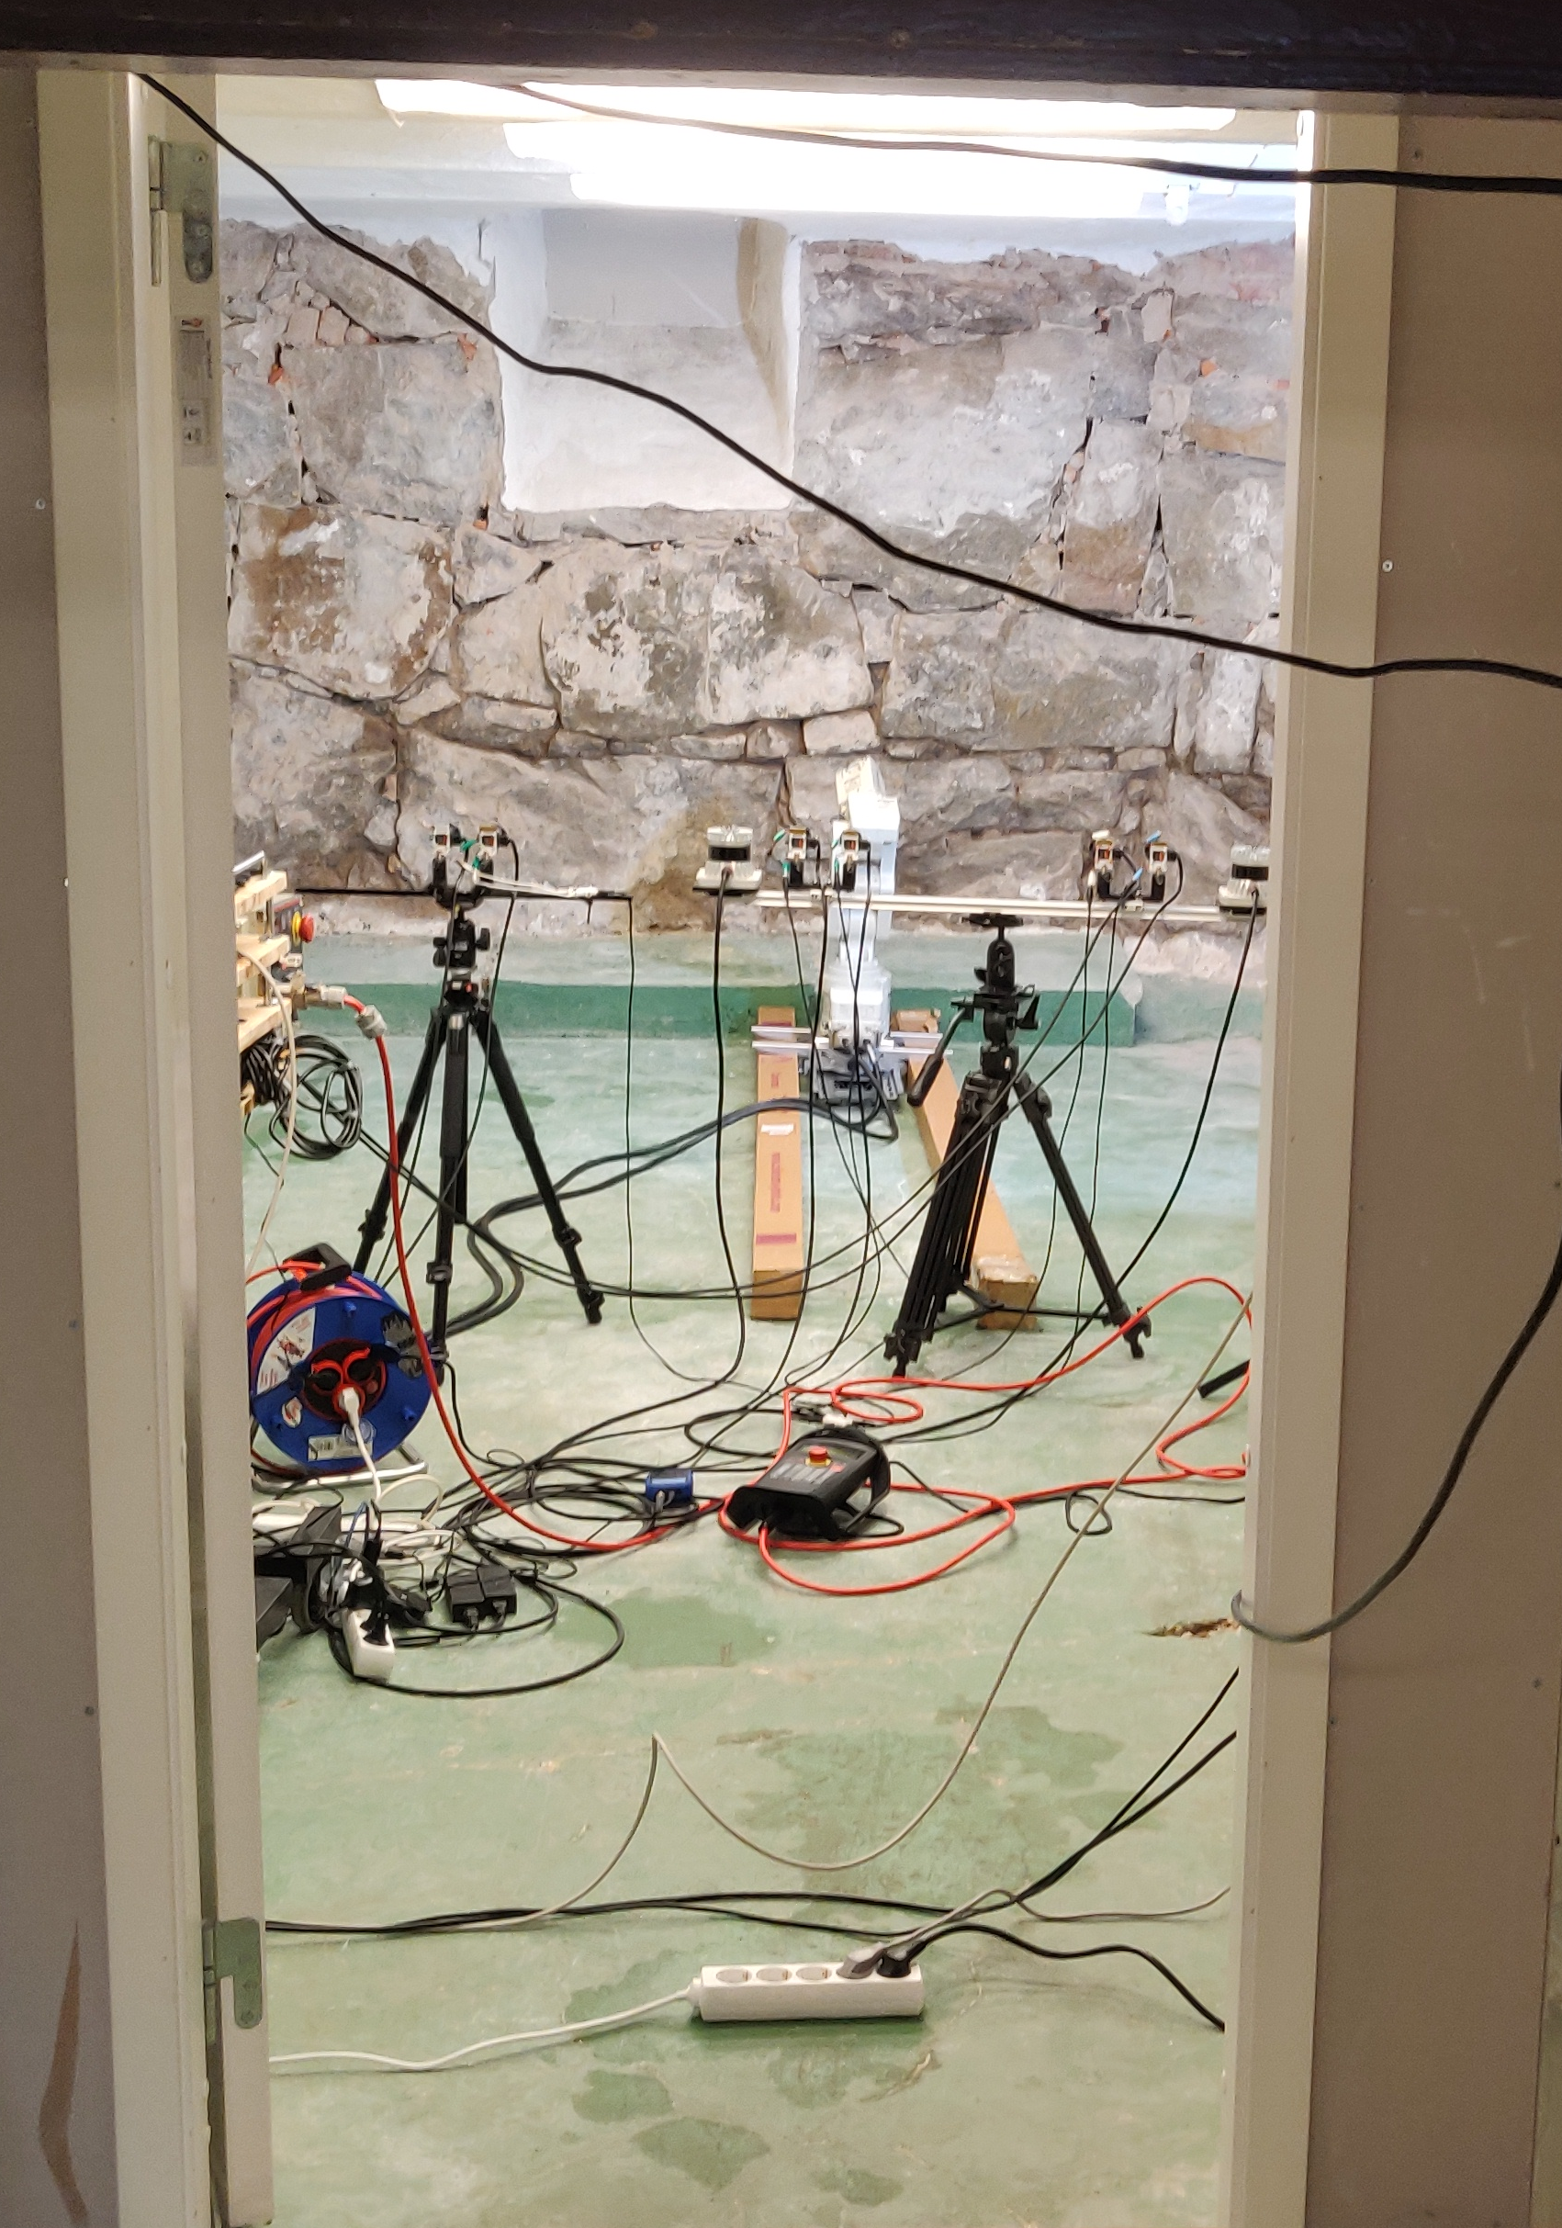
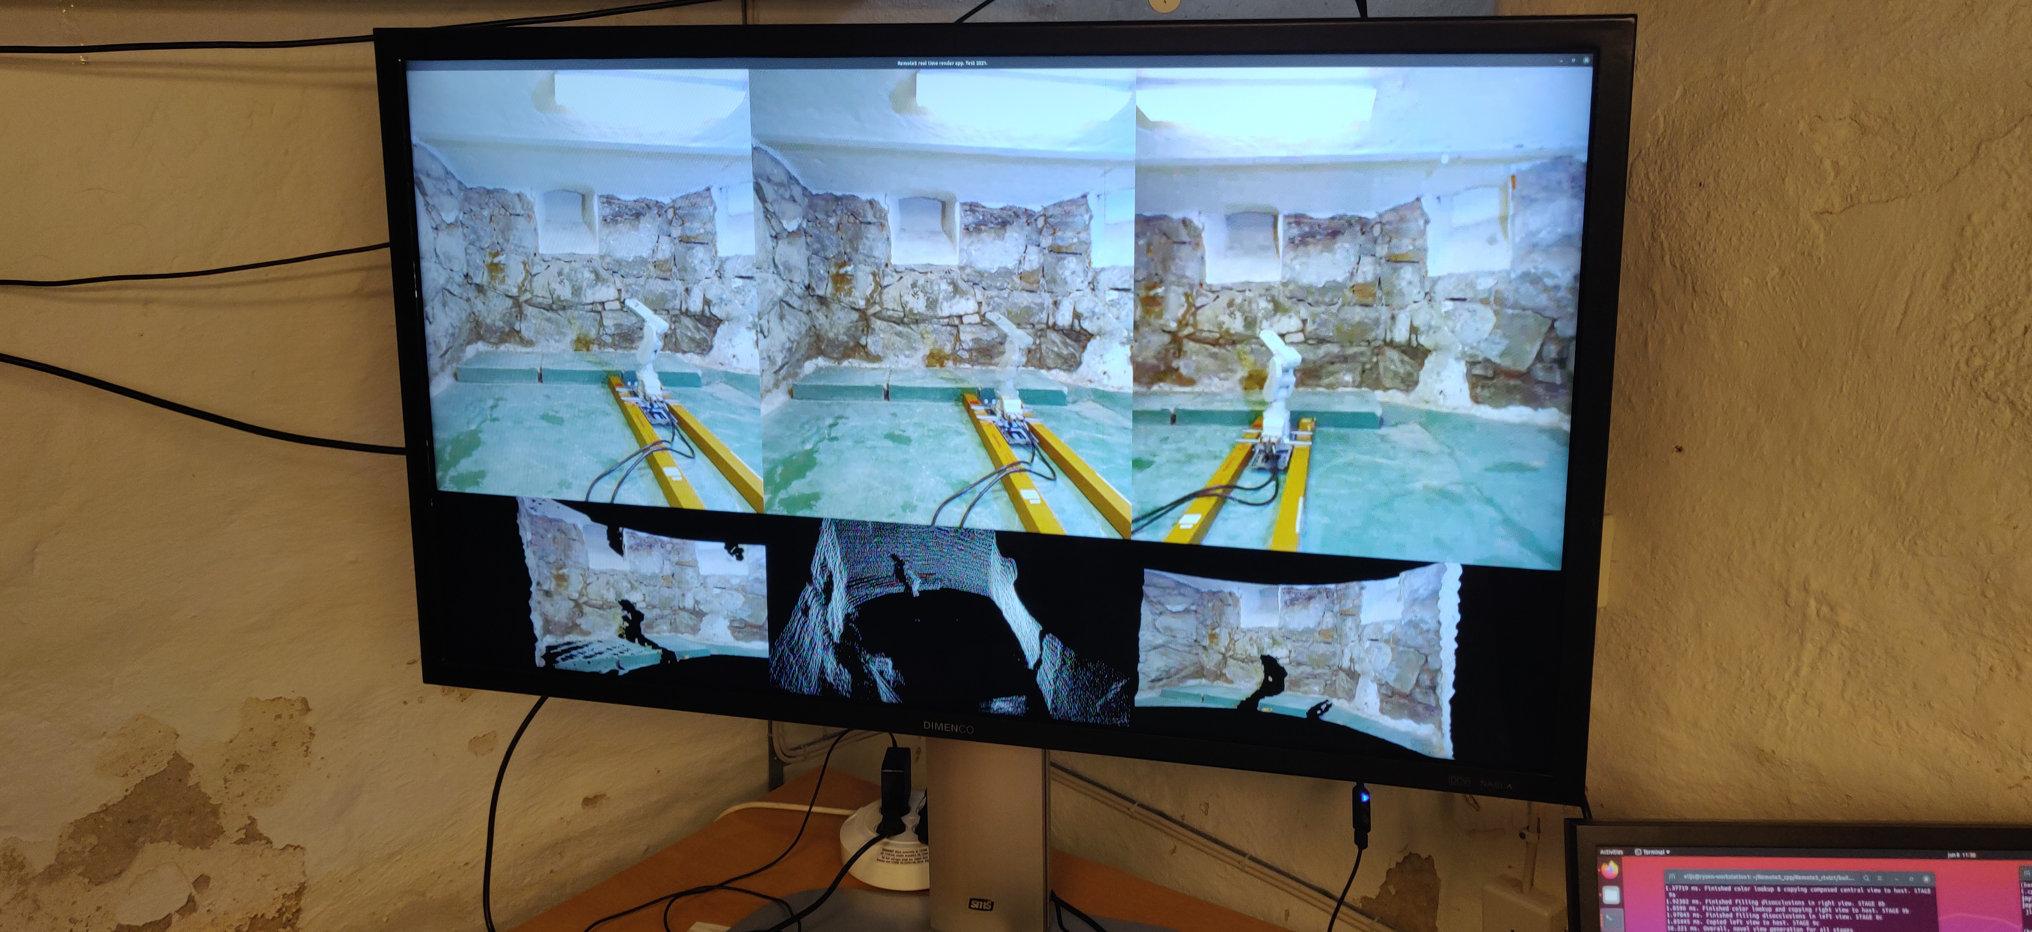
Augmented Remote Operation
Augmented Interface (“diminished” augmented reality)
Interface with novel-perspective views, occluder disocclusion
Notes:
For our approach, focusing on the mining context, we decided to use camera and lidar data to create an augmented telepresence interface that shows novel perspective views of the environment (indirect views in the image), as well as a disoccluded view with occluder removal, which acts as a diminished reality augmentation for that view.
Because of the application context, we wanted to first demonstrate the feasibility of this data fusion and rendering in real time without relying on environment pre-scanning, or large-patch inpainting, since that could lead to discrepancies between the environment and presented replica in the interface.

Slide 14
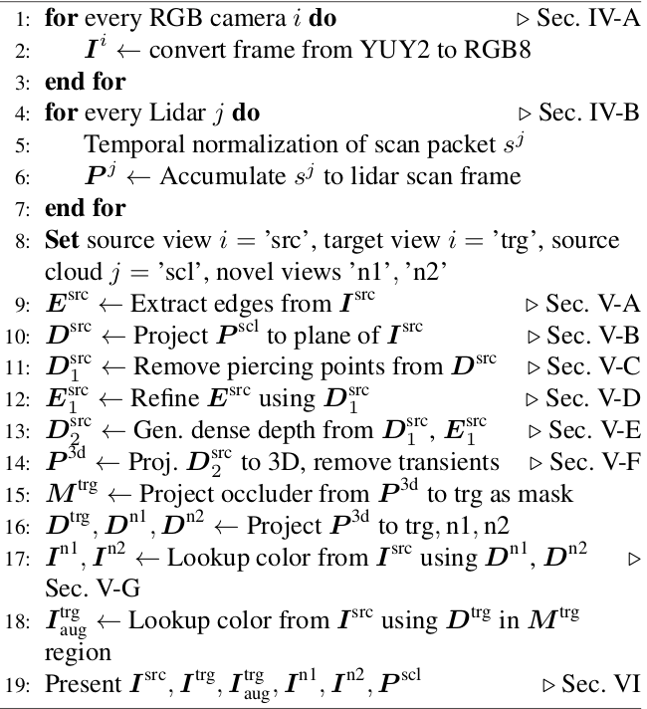
Augmented Remote Operation
Real-time rendering solution
High-level algorithm for view generation
t
Input
from sensors
Prepared frames
Edge extraction
Pre-processing
Sparse point projection
...
“Piercethrough”
point removal
Lidar noise
reduction
Depth edge masking
Depth upscaling
DIBR + color lookup
Prepared frames
Render image data
Notes:
A very high-level overview of the rendering process is shown here.
The core principle is, we use the sparse points from the lidar as the basis for scene geometry depth, which then is used for rendering the novel views via DIBR, or depth-based view reprojection.
The rendering algorithm is largely “memoryless”, meaning all operations are performed on frame-by-frame basis.
To avoid bottlenecking, these rendering steps occur in parallel with frame capture and pre-processing, which includes accumulation of the lidar scan frame and denoising.

Slide 15
Augmented Remote Operation
Outcomes: Augmented Remote Operation
End-to-end system that covers the whole processing chain,
from sensors to rendered views
Sparse lidar as basis for view generation and augmentation
Contribution:
Camera and Lidar-based View Generation for Augmented Remote Operation in Mining Applications
( IEEE Access 2021 vol. 8 [currently on early access] )
Ongoing:
Task-oriented testing of this interface with non-expert users
Notes:
So far, we have just published the technical part of this system, including details of the rendering, view generation, and lidar denoising algorithms;
And currently, we are doing a task-based user assessment of this interface; mainly we want to find out whether there is any significant improvement from the added elements (disoccluded view, novel perspective views) compared to just having the camera pass-through views.
Although, the pandemic restrictions are still complicating the test procedures and severely limiting the test volunteer counts… So we may need to perform other rounds of tests after the summer.

Slide 16
Thank you!
Realistic 3D, Mid Sweden University
  Prof. Mårten Sjöström, marten.sjostrom@miun.se
  Dr. Elijs Dima, elijs.dima@miun.se
RISE & Mid Sweden University
  Prof. Kjell Brunnström, kjell.brunnstrom@ri.se
Notes:
So, that concludes this summary, thank you for your time and attention.
These works were done in collaboration with prof. Brunnström, so please feel free to reach out to any of us for further details now or afterwards.

Slide 17
References
[12a] Sánchez, F., and Hartlieb, P. "Innovation in the Mining Industry: Technological Trends and a Case Study of the Challenges of Disruptive Innovation." Mining, Metallurgy & Exploration (2020): 1-15.
[44a] Matusik, W., and Pfister, H. "3D TV: a scalable system for real-time acquisition, transmission, and autostereoscopic display of dynamic scenes." ACM Transactions on Graphics (TOG) 23.3 (2004): 814-824.
[44b] Balogh, T., and Kovács, P. T. "Real-time 3D light field transmission." Real-Time Image and Video Processing 2010. Vol. 7724. International Society for Optics and Photonics, 2010.
[52a] Photo provided by Boliden AB.
[52b] Bruno, Fabio, et al. "Augmented reality visualization of scene depth for aiding ROV pilots in underwater manipulation." Ocean Engineering 168 (2018): 140-154.
[52c] Vagvolgyi, Balazs P., et al. "Scene modeling and augmented virtuality interface for telerobotic satellite servicing." IEEE Robotics and Automation Letters 3.4 (2018): 4241-4248.
[62a] Pointon, Grant, et al. "Judging action capabilities in augmented reality." Proceedings of the 15th ACM Symposium on Applied Perception. 2018.

Slide 18
References
[62b] Cutolo, Fabrizio, Umberto Fontana, and Vincenzo Ferrari. "Perspective preserving solution for quasi-orthoscopic video see-through HMDs." Technologies 6.1 (2018): 9.
[3a] Brunnström, Kjell, et al. "Quality of experience of hand controller latency in a virtual reality simulator." Electronic Imaging 2019.12 (2019): 218-1.
[63a] Brunnström, Kjell, et al. "Qualinet white paper on definitions of quality of experience." (2013).

Slide 19
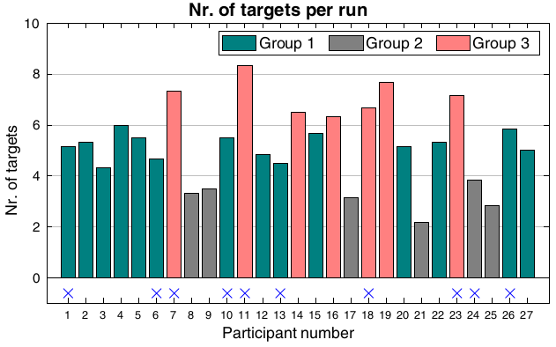
Augmented Remote Operation
QoE test – participant grouping in skills
Notes:
QOE test results – how participants were grouped into 3 groups according to their “skill” at the task

Slide 20
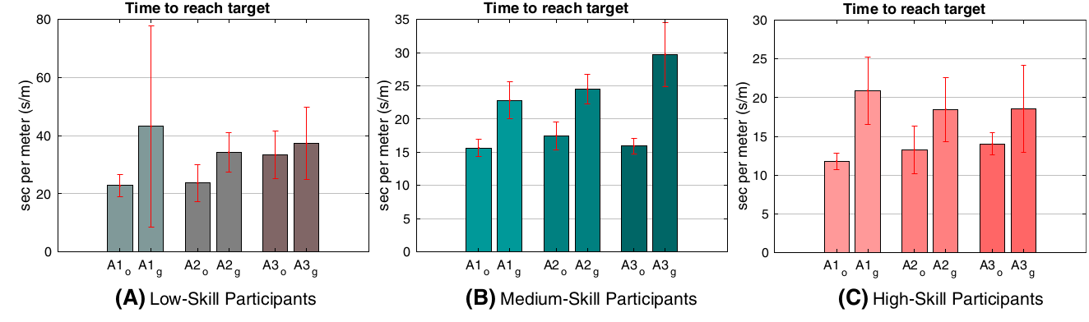
Augmented Remote Operation
QoE test – participant grouping in skills
From Anova, A3 reduced obj. performance relative to control (A1):
Low-skill: A1 / A3 (o); Medium-skill: A1 / A3 (g); High-skill: A1 / A3 (o).
Notes:
Results from individual groups, where some differences between augmentations can be found.

Slide 21
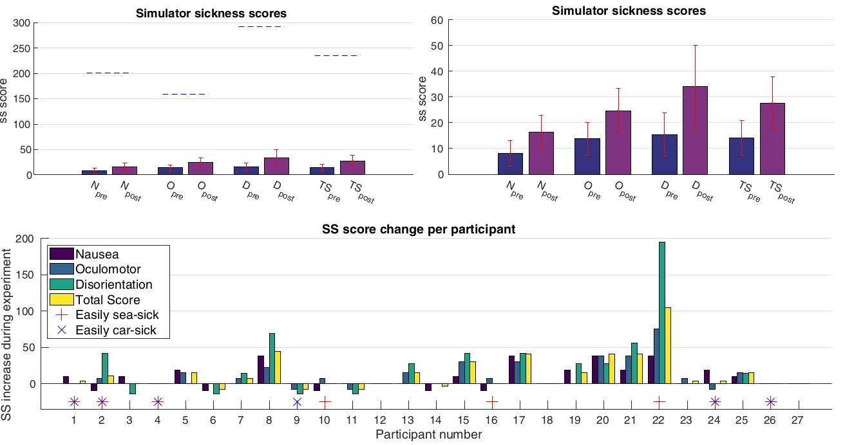
Augmented Remote Operation
QoE test – simulator sickness
Notes:
Simulator sickness results from the QoE tests (1st study). Though there is a slight increase in SS for some participants, the effect magnitude is negligible (with one exception), considering the absolute max for each SS scale.

