Slide 1
Evaluating the impact of delay on QoE in immersive interactive environments
Carlos Cortés, Pablo Pérez, and Narciso García
VQEG London 2021
ccs@gti.ssr.upm.es
Notes:
The experiment is being designed during my research stay at the Distributed and Interactive Systems in Netherlands. Under the supervision of Irene Vionla and Pablo Cesar

Slide 2
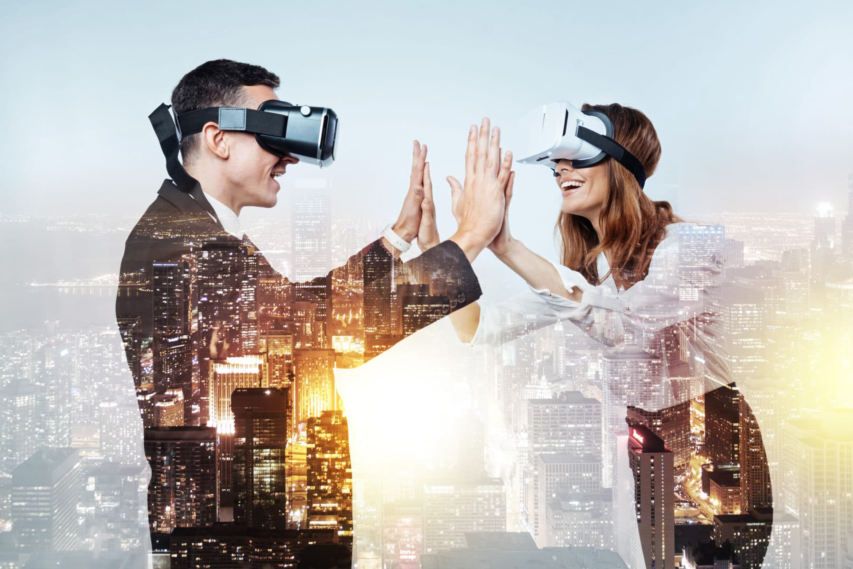
Index
  Task Design
  Immersive Interactive Environment
  Self Delay
  Network Delay
  Evaluation
  Conclusions
Notes:
We wanted to assess the delay impact on QoE in an interactive immersive environment in where two users can interact like in a telemeeting as skype, zoom or other teleconference system but in an inmmersive environment and assess the impact the delay

Slide 3
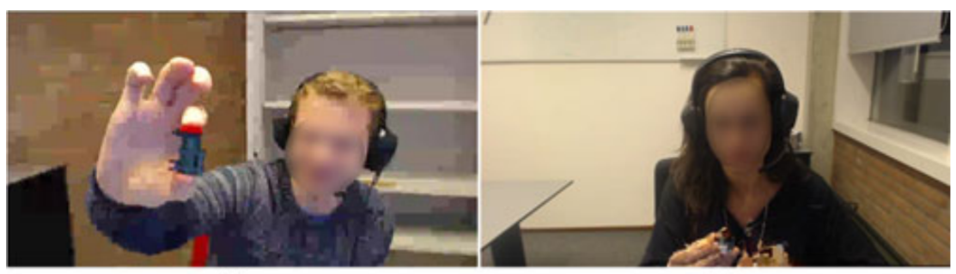
Task Design
Building Block task:
  P.920 Interactive test methods for audiovisual communications
  Both users have to collaborate for building a block
  One user has the block already built and has to guide the other user
M. Schmitt et al, “Towards Individual QoE for Multiparty Videoconferencing,” IEEE Trans. Multimedia, Jul. 2018.
Notes:
As we decided to use the paradigm of a telemeeting, we will base the task in the P.920 building block task.

Slide 4
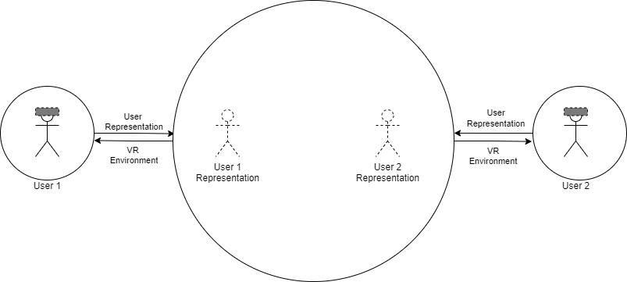
Immersive Interactive Environment:
Introduction
Immersive Interactive Environment:
  There are two users/actors/objects in two different places.
  Both representations will be placed in a virtual shared world
  So, each actor will be able to see each other in the shared world

Slide 5
Immersive Interactive Environment:
Local
Local Environment:
  The user can interact both with his self-representation and the local world
  Also the user may interact with real objects in his local world

Slide 6
Immersive Interactive Environment:
Remote
Remote environment:
  The user can interact with the virtual environment (e.g. looking different directions)
  Also the user may interact with virtual remote users/objects

Slide 7

Immersive Interactive Environment:
Introduction
Proposed experiment:
  Immersive Interactive Environment where the latency varies based on tasks
  Somehow (time or performance) evaluate “task accomplishment”
  Measure the performance, presence and the sickness using subjective questionnaires.

Slide 8
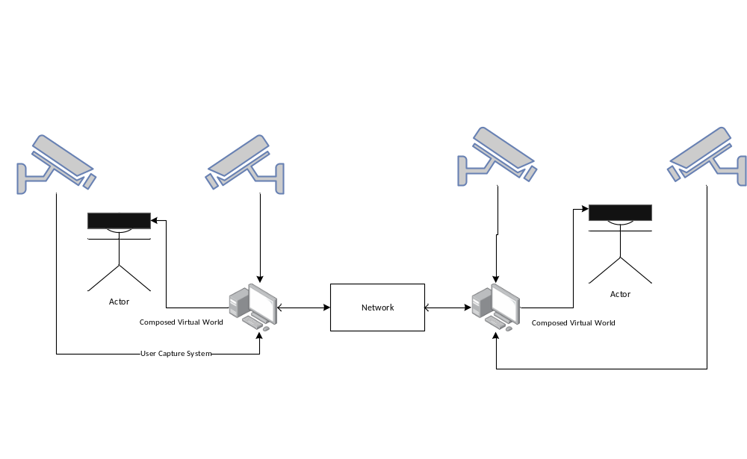
Immersive Interactive System:
System Diagram
Notes:
For the user representation capture I will use the VRToguether Pipeline That Pablo Cesar is going to explain in a next presentation. Using his VRToguether system for the user capture and the shared world

Slide 9
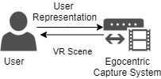
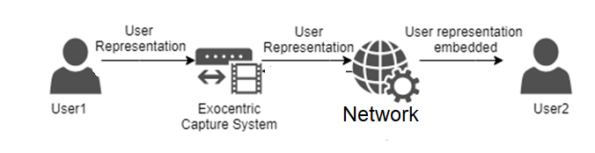
Immersive Interactive Environment:
Delay
Diagram of self-User M2P delay
Diagram of user to user M2P delay

Slide 10
Immersive Interactive System:
Self-Delay
Article | Study | Assessment | Values (ms) | Conclusion
M. Keetels et al. Experimental Brain Research, 2012 Exposure to delayed visual feedback of the hand changes motor-sensory synchrony perception | Tapping finger with delayed visual feedback | Question about delay | 0 - 200 | Brain can adapt fast
Loes C. J. van Dam et al. PLoS ONE, 2018 Effects of prolonged exposure to feedback delay on the qualitative subjective experience of VR. | Tracking a ball in VR | Presence, Agency, ownership | Delay and no delay | Users adapt his subjective assessment according to its accomplishment
M. Arif and S. Shimada, PLoS ONE, 2016 ‘Robot’ Hand Illusion under Delayed Visual Feedback: Relationship between the Senses of Ownership and Agency. | Watch delayed hand in a monitor | Presence, Agency, ownership | 0 - 400 | Less than 200ms is critical for multisensory adjustement
Cunningham, Journal of Vision, 2001 Driving in the future: Temporal visuomotor adaptation and generalization. | Drive a car in a videogame | Error in the trajectory | 130 - 430 | The users adapted to the self delay
A. Farshchiansadegh et al. Journal of Neurophysiology, 2015 Adaptation to visual feedback delay in a redundant motor task. | Cursor in virtual reality controlled by hand gestures (Glove) | Cursor error (distance) | 300 | Subjects adapted to visual feedback delay

Slide 11
Collaborative Telepresence:
Self-Delay
Requirements:
  The Self Delay is mainly adapted “fast” by the brain if the Delay values are below ~200 ms.
  We are going to vary only the delay network as the important delay.

Slide 12

Evaluation
Quality of Experience
  Subjective Assessment
    Tele meeting Questions (P.920)
    Sickness (Simulator Sickness Questionnaire)
    Presence (Presence and SocialVR Questionnaires)
  Performance
    Time to perform
    Number of interruptions
Notes:
The specific questions, delay conditions or test structure hasn’t been decided yet

Slide 13

Conclusions
Conclusions:
  We are designing an experiment for assessing delay impact on QoE in SocialVR
  We have decided to vary only the network delay
  The assessment will be Subjective and Objective
  The delay range will be around 200ms and 1500 ms

Slide 14
Evaluating the impact of delay on QoE in immersive interactive environments
Questions – Discussion – Debate - …
Grupo de Tratamiento de Imágenes (GTI)
Universidad Politécnica de Madrid
This work has been partially supported by the Ministerio de Ciencia, Innovación y Universidades (AEI/FEDER)
of the Spanish Government under project TEC2016-75981 (IVME)

