Slide 1
P.BBQCG overview
Interactive testing
VQEG meeting - June 8th 2021
David Lindero
Ericsson Research
2021-06-08

Slide 2

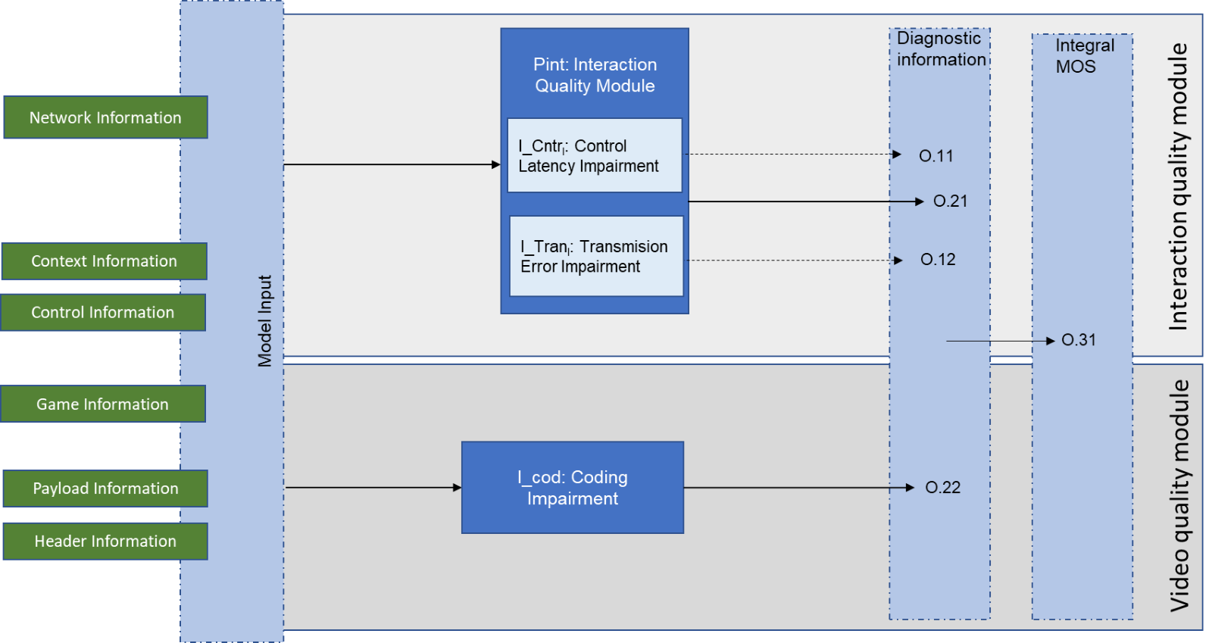
Part in the BBQCG model

Slide 3









Setup

Slide 4
Scope
Network impairments
    ”Manually” limiting bandwidth and adding static delay
    Introducing random packet delays and jitter
    Random patterns based on real networks, both cellular and wire
Rendering service will match bandwidth availability with resolution and compression rates.
Game titles
    Titles that cover both high and low degree of interactivity, but also high and low demands on the video codec
Input devices
    Keyboard and mouse first
    Controller and touch screen in the second round of testing

Slide 5
Test parameters - overall
90 s test condition/sequence duration
    Compromise of trying to fit in as many conditions in one session, while still being able to assess all the interesting dimensions in each sequence
1 game per subject
    Reducing overhead to switch games
24+ scores per condition and game, after screening

Slide 6
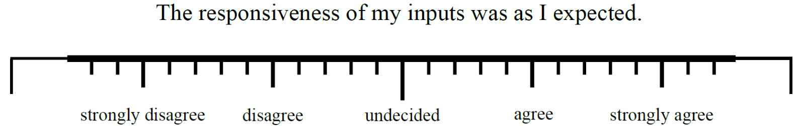
Test parameters -
Subjective quality dimensions
Overall gaming experience, video quality, and audio according to ITU-T Rec. P.809
Smoothness of video
Input quality (consisting of reactiveness, controllability, immediate feedback) using GIPS [b-Schmidt2021]
Player Experience (reduced items of GEQ only including immersion, positive and negative player experience) as shown in [b-Schmidt2021])
Player performance and acceptability according to ITU-T C.293
[b-Schmidt2021] S. Schmidt, “Assessing the Quality of Experience of Cloud Gaming Services”,
Ph.D. dissertation, submitted, Technische Universität Berlin, 2021.

Slide 7
Requirements testing
Lab (both interactive and passive)
  Self assessed sufficient gaming experience
  Snellen test for visual acuity
  Testing for normal hearing
Crowd (passive)
  Do they really have the equipment they say?
    Test-images (DCR test for resolution, contrast sensitivity etc)
    ”Non-value-charged” questions (not “can you see the difference”, but rather “is the image green or red”)

Slide 8
Thank you for listening!

