Slide 1
A brief introduction to the
Video Quality Experts Group
January 2023

Slide 2

VQEG — A Brief History
Formed in 1997 to advance the field of video quality assessment
Closely related to ITU-T and ITU-R study groups
  ITU-T SG9 (Broadband cable & TV)
  ITU-T SG12 (Performance, QoS and QoE)
  ITU-R WP6C (Programme production and quality assessment)
Historically, a primary focus on:
  Creation of test plans to develop and validate objective quality metrics
  Particular focus on defining the scope and subjective test methodology
  Statistical techniques for assessing model performance
  → recommending approaches/models to be standardized by ITU-R/ITU-T

Slide 3
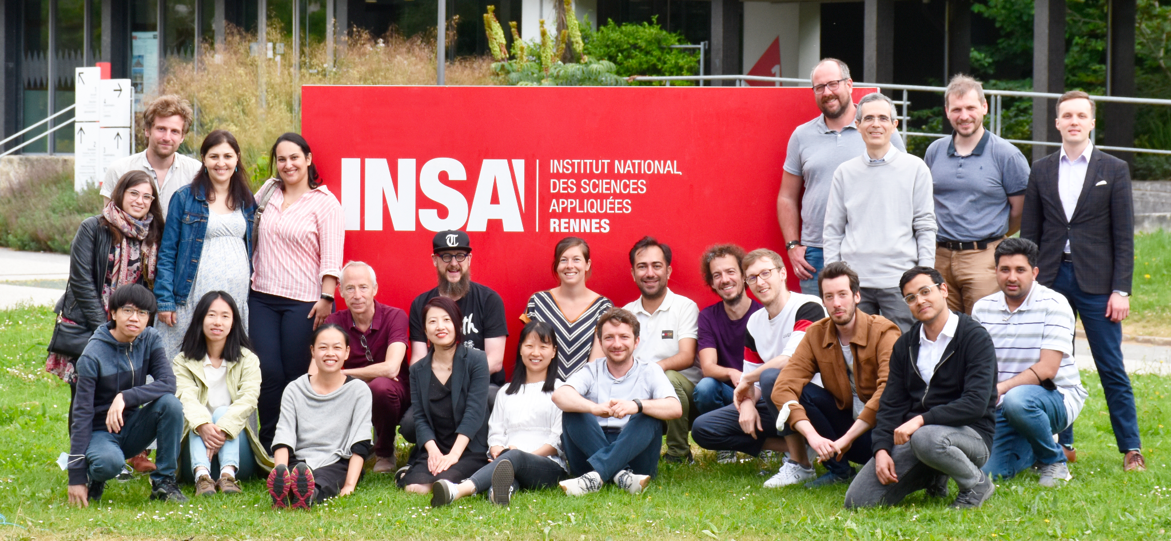
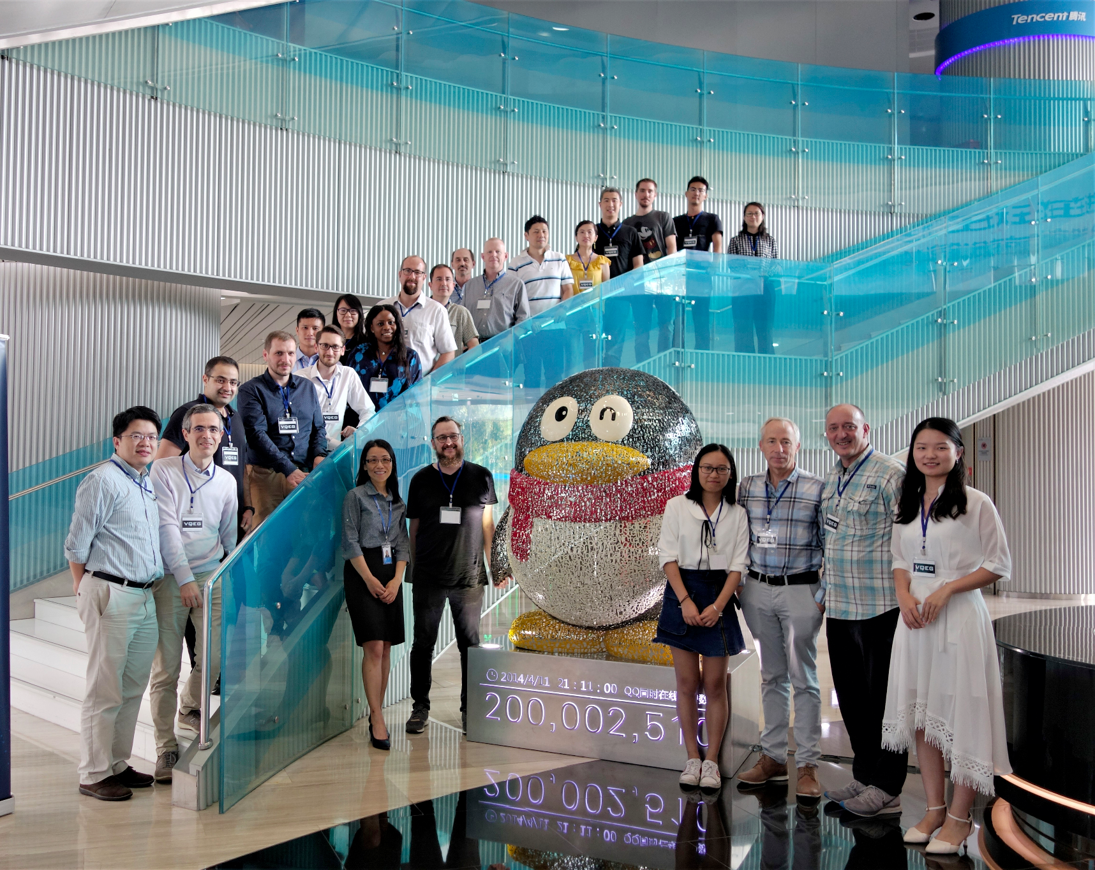
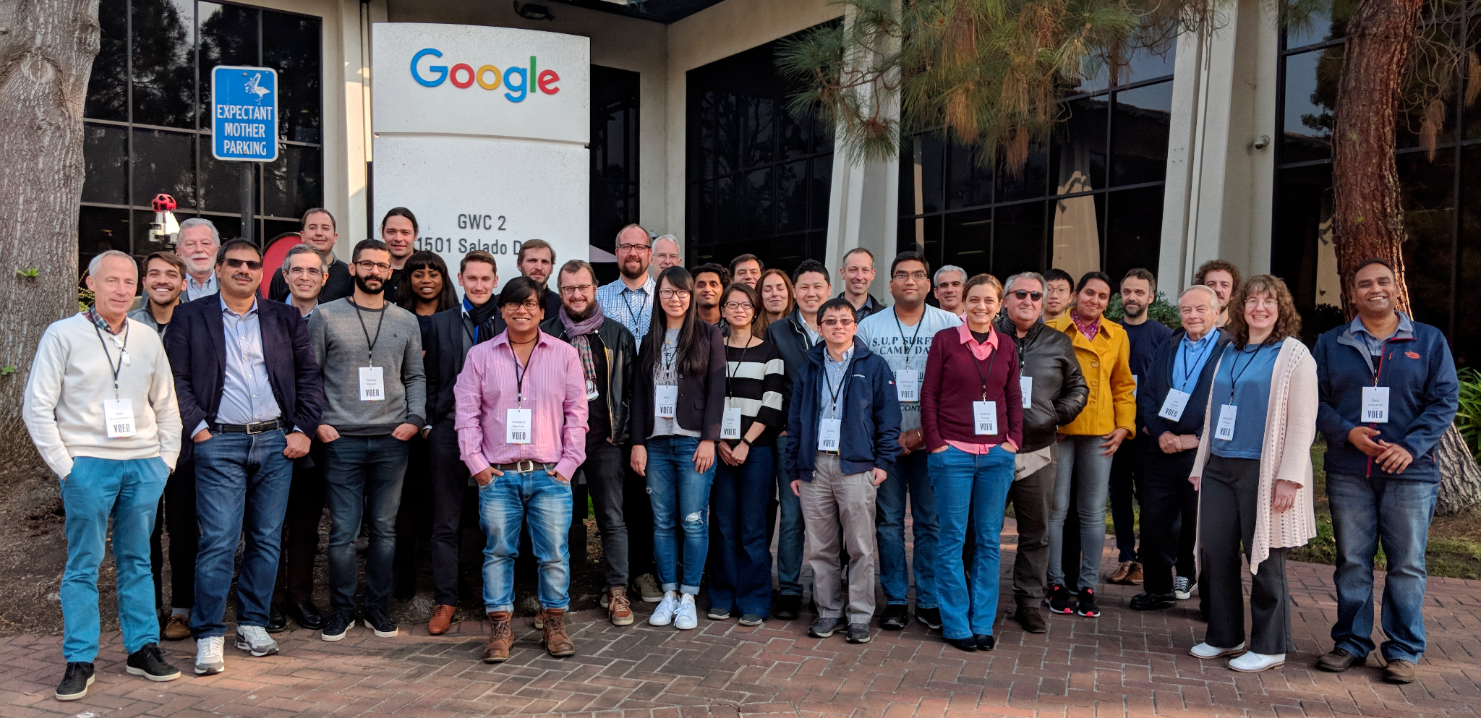
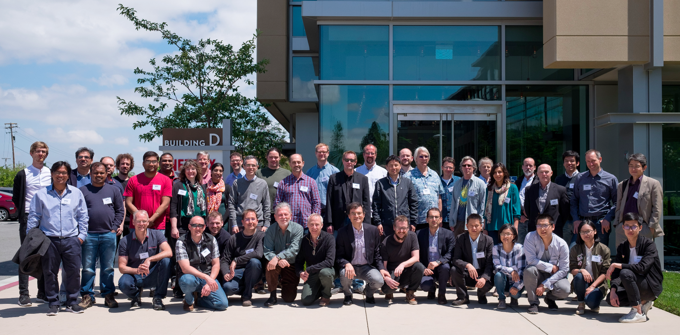
INSA Rennes, 2022
Wuhan Univ., Tencent, Shenzhen, 2019
Google, USA, 2019
Netflix, Los Gatos, 2017

Slide 4
How is it organized?
VQEG board
  Kjell Brunnström (RISE Research Institute of Sweden AB)
  Margaret Pinson (NTIA/ITS, USA)
Working groups
  Individual co-chairs per group
Bi-annual meetings
  Historically in-person, worldwide
  Now mostly online (due to COVID health and traveling restrictions)
Next meeting: May/June 2023 (tba)

Slide 5
Current Chairs & Co-Chairs
General chairs | Kjell Brunnström, Margaret Pinson
5G Key Performance Indicators (5GKPI) | Pablo Perez, Kjell Brunnström
Audiovisual HD (AVHD) | Shahid Satti, Silvio Borer, Ioannis Katsavounidis
Computer Graphics Imagery (CGI) | Saman Zadtootaghaj, Nabajeet Barman
Emerging Technologies Group (ETG) | Nabajeet Barman, Saman Zadtootaghaj
Human Factors for Visual Experiences (HFVE) | Maria Martini, (vacant)
Immersive Media Group | Jesus Gutierrez, Zhenzhong Chen, Pablo Perez
Implementers Guide for Video Quality Metrics (IGVQM) | Ioannis Katsavounidis, (vacant)
JEG Hybrid | Marcus Barkowsky, Glenn Van Wallendael, Enrico Masala
No Reference Metrics (NORM) | Ioannis Katsavounidis, Margaret Pinson, Werner Robitza, Cosmin Stejerean
Quality Assessment for Computer Vision Applications (QACoViA) | Mikolaj Leszczuk, Patrick Le Callet, Lu Zhang
Quality Assessment for Heath applications (QAH) | Lu Zhang, Lucie Lévêque, Meriem Outtas
Statistical Analysis Methods | Lucjan Janowski, Ioannis Katsavounidis, Zhi Li, Patrick Le Callet
Tools and Subjective Labs Setup Co-Chair | Glenn Van Wallendael, Werner Robitza
Video Archives Support | Femi Adeyemi-Ejeye

Slide 6
What’s nice about VQEG?
Free to join — no membership fees
No strict or complicated rules
  Consensus is often reached without lengthy voting procedures
Simple organization and hierarchy
  Chairs & co-chairs for different projects
  Anyone can propose or contribute a new project
Highly interactive meetings
  Anyone can present their ideas
  Focus on discussion time
Not a commercial venue
  No sales talks, no commercial advertising
Mixture between academia and industry

Slide 7
General Topics and Resources

Slide 8
Main Topics
General research on video QoE in various fields
Video quality model development
  Various types of models (hybrid/bitstream, no-reference, …)
  VQEG members may define the scope and test plan
Input to standardization forums
  … based on developed and validated models
Subjective tests & collection of subjective databases
  To develop and validate subjective test methodologies (“ILG” approach)
  To predict the performance of objective video quality models
Joint production of software tools
  Helper tools for conducting subjective tests
  Objective quality analysis
Exploration of new application areas
  Multimedia, 3DTV, gaming, VR/XR, …

Slide 9
Video Quality Model Development — Typical Approach
Test Plan
Training Databases
Model Training
Validation Databases
Data Analysis
Creation of scope and terms of reference
Definition of inputs/outputs
Rules for model submission and validation
Open call for participation to industry/academia
Joint development of subjective test databases
Conduction of tests by proponents or independent labs (“Independent Laboratory Group”, ILG)
Sharing of training data
Development of the models by proponents based on training data
Collaborative or in form of a competition — various advantages of either method
Submission of model candidates
Development of new databases with previously unknown content
Conduction of tests by different labs
Collection of validation data; merging with training data to form complete dataset
Validation of model performance according to predetermined statistical criteria
Suggestion of which models may be standardized → ITU-T contributions
→ historical approach — model development may now be iterative/collaborative or done within ITU-T itself

Slide 10
Model Development — Previous Projects
FRTV Phase 1:
  ITU-T Rec. J.144 (2003) – collection of full-reference models
Multimedia Phase 1:
  ITU-T Rec. J.246 and J.247 (2008) – Reduced- and full-reference models
HDTV Phase 1:
  Led to ITU-T Rec. J.341 and J.342 (2011) – Full- and reduced-reference models
  Five video datasets available
AVHD-AS:
  Joint project with ITU-T Study Group 12 P.NATS Phase 2
  UHD/4K, 60p, H.264, H.265, VP9
  Led to ITU-T P.1204 series (2021) – No-reference bitstream-based, pixel-based, no-reference hybrid
  IEEE Access Paper summarizing the effort

Slide 11

Input to Standardization Forums
Historically, VQEG has recommended model algorithms to become standardized
Based on performance against subjective data
Sometimes no models could be standardized due to low performance or unreliability (e.g., mostly the case with no-reference pixel-based models)
Newer VQEG projects have a more collaborative and iterative approach to developing algorithms
Contributions for subjective evaluation techniques

Slide 12
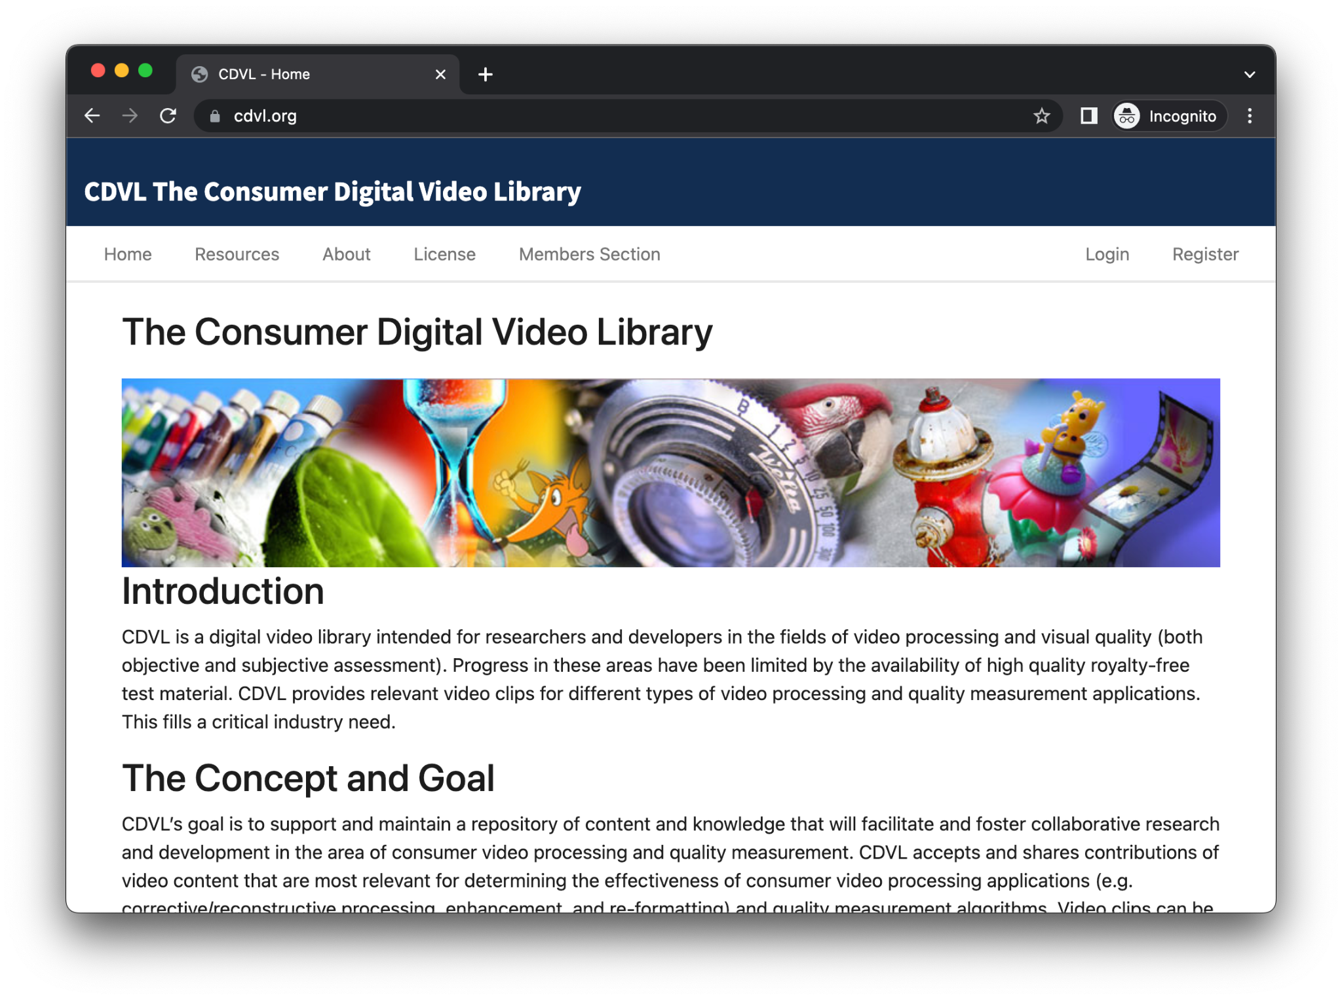
Video Datasets & CDVL
Consumer Digital Video Library
High-quality, royalty-free test material, mostly from previous VQEG projects
Another list of datasets on VQEG website

Slide 13
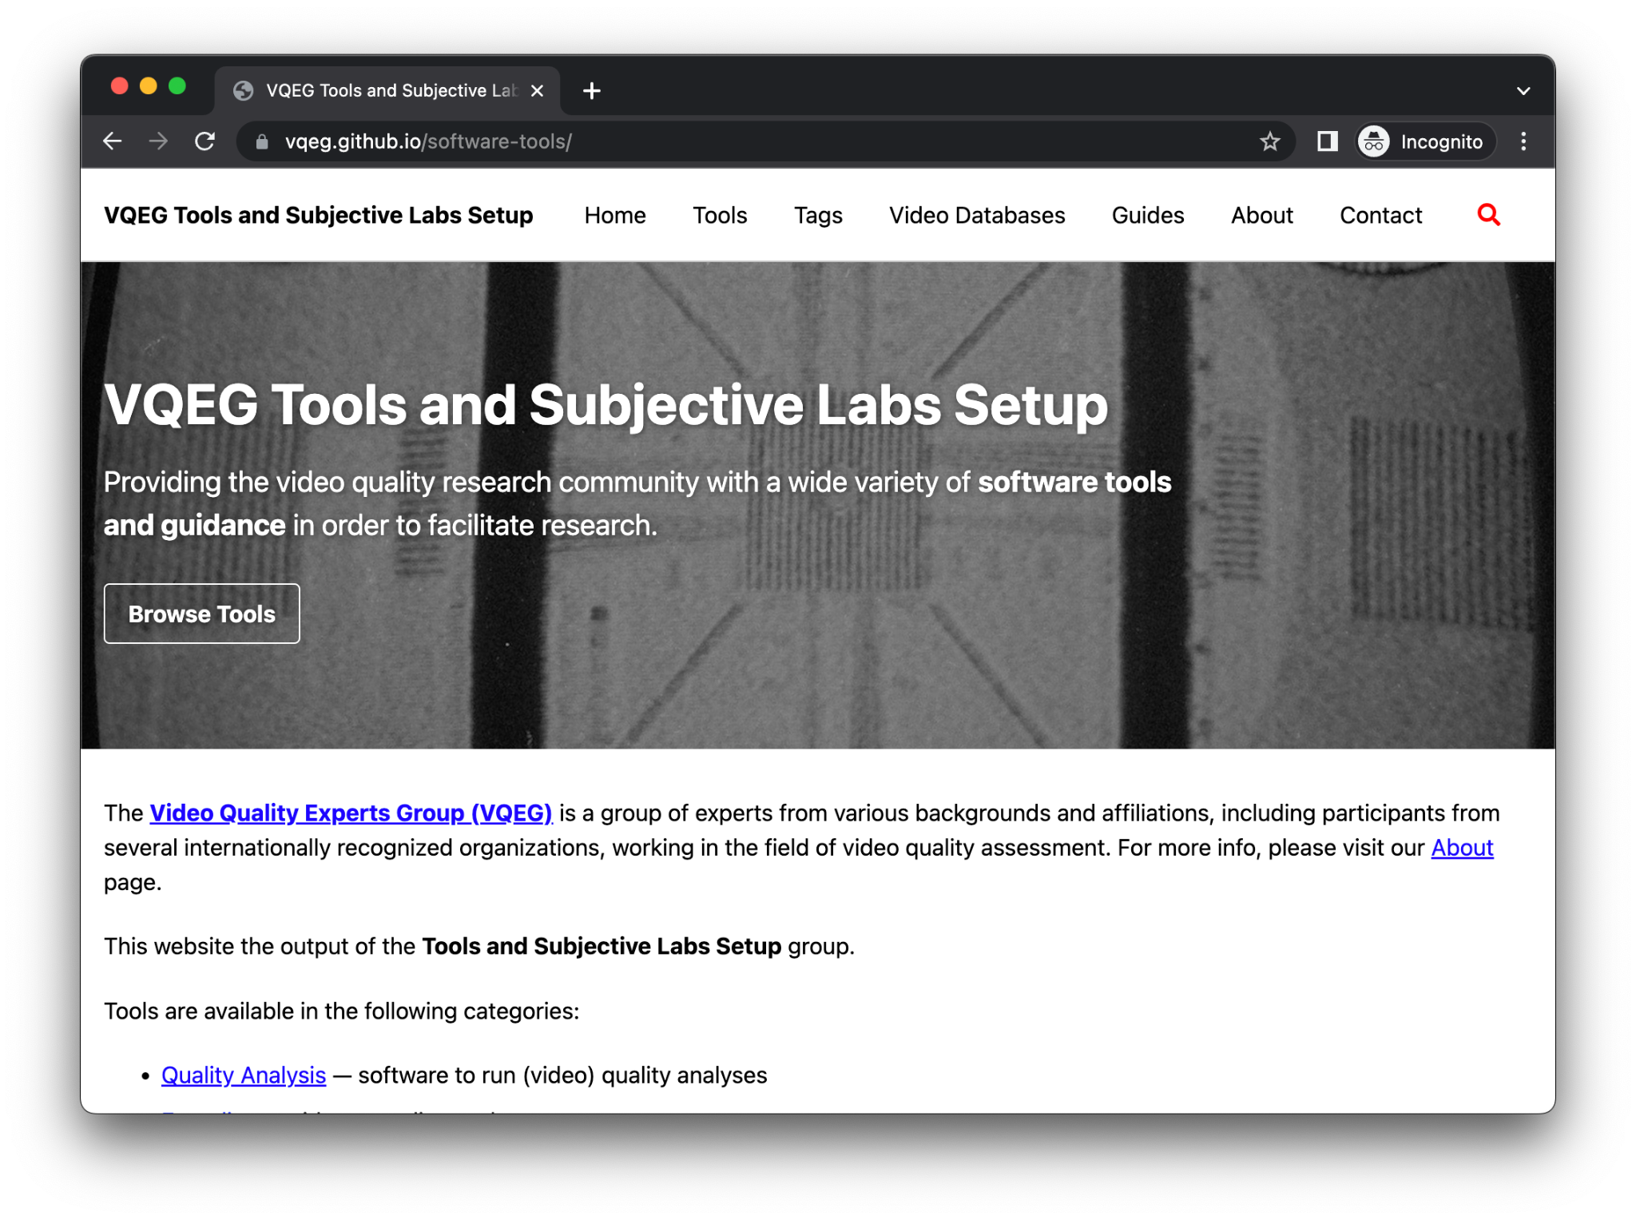
Software Tools
Public software tools repository
Various software packages developed over the years
Grouped by topic and searchable
  Quality Analysis
  Encoding
  Streaming
  Subjective Test Software
  Helper Tools
Please submit your tools! → https://github.com/VQEG/software-tools/

Slide 14

Dissemination
Extensive reports of previous subjective test and model development activities
  Can be found on VQEG website
  … even for historical activities
VQEG has contributed columns to SIGMM Records (ACM SIG Multimedia’s quarterly newsletter) with recent updates
  Latest issue: https://records.sigmm.org/2023/01/31/vqeg-column-vqeg-meeting-dec-2022/
  Detailed Summary of the December meeting

Slide 15
Current Activities
Details:
https://vqeg.org/projects-home/
https://vqeg.org/meetings-home/

Slide 16
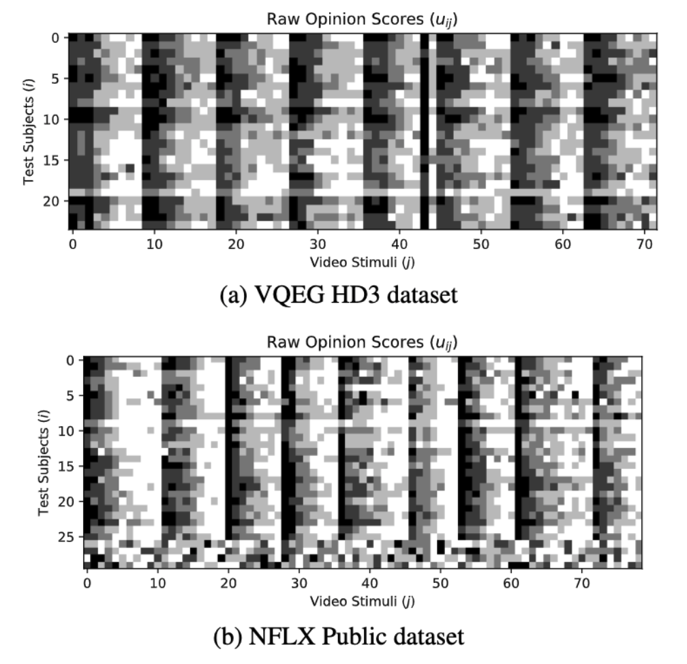
Statistical Analysis Methods (SAM)
Overview: Statistical Analysis Methods
Minutes: VQEG SAM Monthly
Developed a new ratings recovery method based on SUREAL
  How can you better recover “real” ratings from noisy subjective data?
Further additions to ITU-R BT.500-14 and ITU-T Rec. P.910/913
Revisions and merging of ITU-T Rec. P.913 and P.910
Li et al., 2020

Slide 17
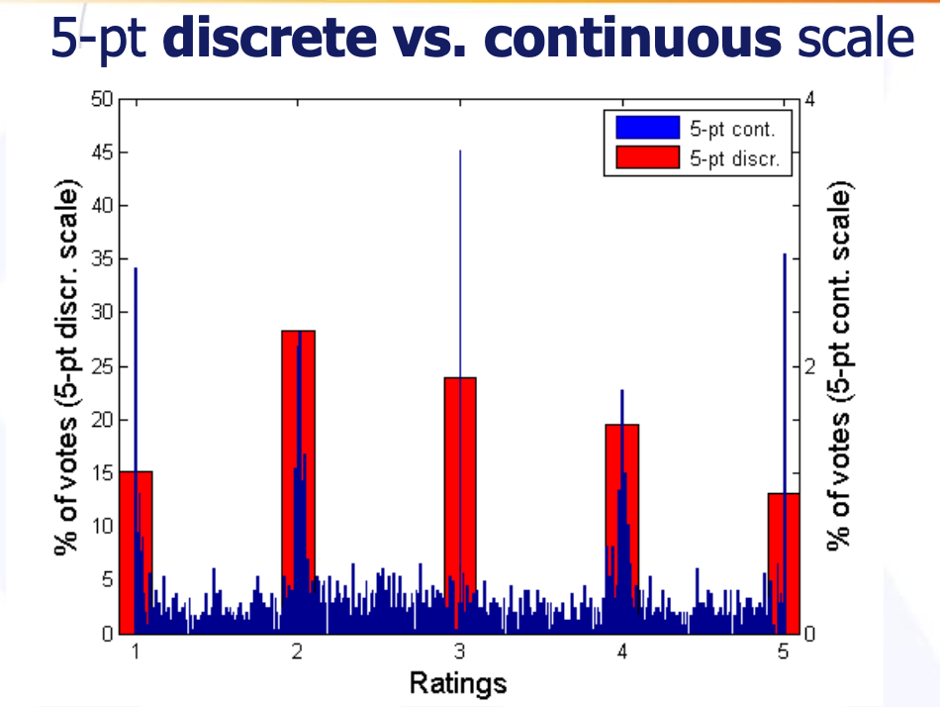
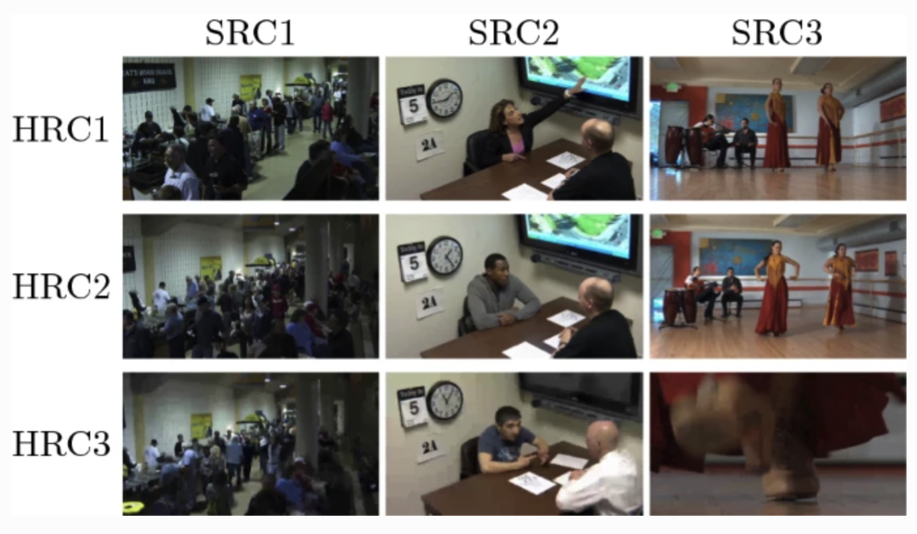
Statistical Analysis Methods (SAM) ctd.
Various historical activities related to designing and evaluating test methods
How to obtain the most valid and reliable ratings?
Examples:
  Comparison of different rating scales (2011 paper)
  Impact of the test environment on MOS (2012 paper)
  Experiments with unrepeated scenes (2019 paper)
Huynh-Thu et al., 2011
Janowski et al. 2019

Slide 18
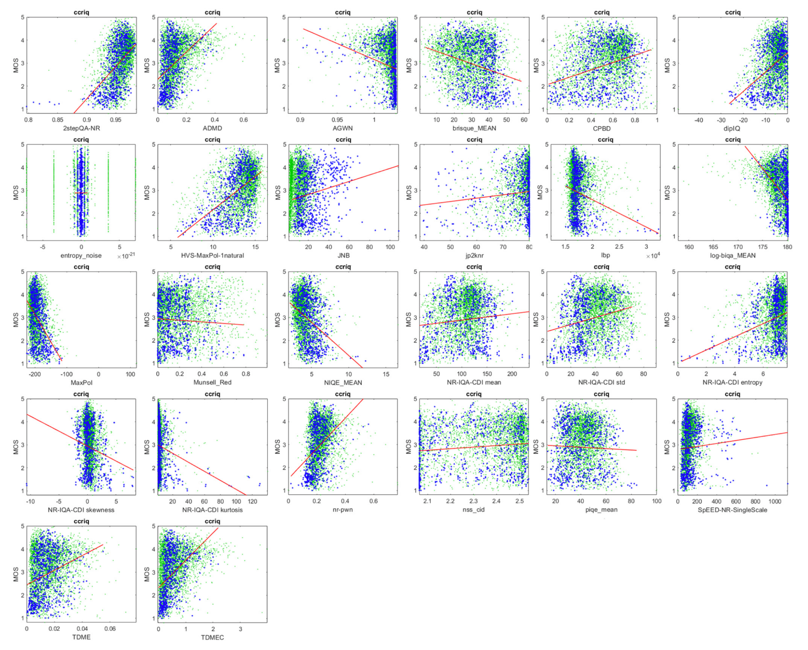
No-Reference Metrics (NORM)
Design of a no-reference pixel-based metric
Various resources for NR metrics
Collection of video datasets with new scope (e.g. security applications, user-generated content)
Open framework for collaborative development of no-reference quality indicators
Journal paper (2022) showing why NR metrics lack accuracy and reproducibility
Various NR metrics vs. dataset, Pinson, 2022

Slide 19
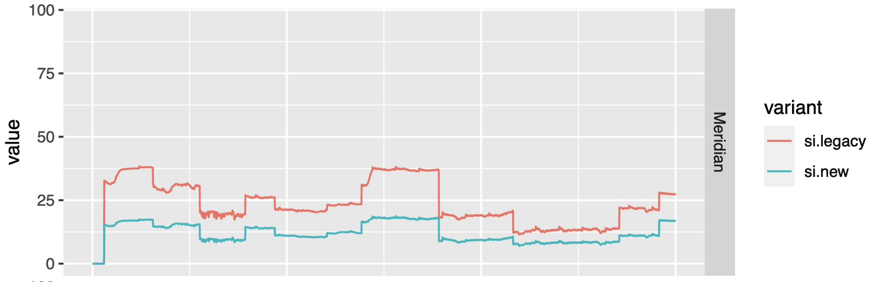
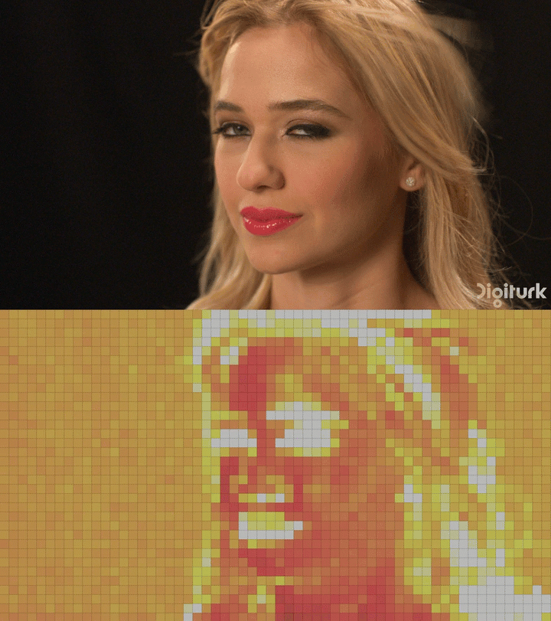
No-Reference Metrics (NORM) ctd.
Comparison of SI/TI scores
How can we determine the complexity of a video
before encoding it?
  Clarifying the use of Spatial and Temporal Information (SI, TI)
  → ITU-T P.910 was updated
  Siti-tools code released as open-source
  Taking into account motion using a motion search framework
  Integrating approaches like Video Complexity Analyzer
VCA metric output
Video quality metadata standard
  How to embed metadata on source/encoded video quality directly in containers or bitstreams
  Payload definition and liaison with MPEG and AOM (Alliance for Open Media)

Slide 20

Computer Generated Imagery (CGI)
Analyzing and evaluating of computer-generated content
  Creation of open source datasets
  Machine learning/deep learning based quality enhancement of gaming content
  Development of models and metrics for assessing gaming QoE
Aligned with ITU-T Study Group 12 work item “P.BBQCG”
  Developing a gaming QoE model that uses the bitstream metadata for video quality
  Interactive and passive subjective tests planned
Previous activities:
  Creation of various ITU-T recommendations
  ITU-T Rec. G.1032: Influence factors on gaming QoE
  ITU-T Rec. P.809: Subjective evaluation methods for gaming quality
  ITU-T Rec. G.1072: Opinion model for gaming applications

Slide 21
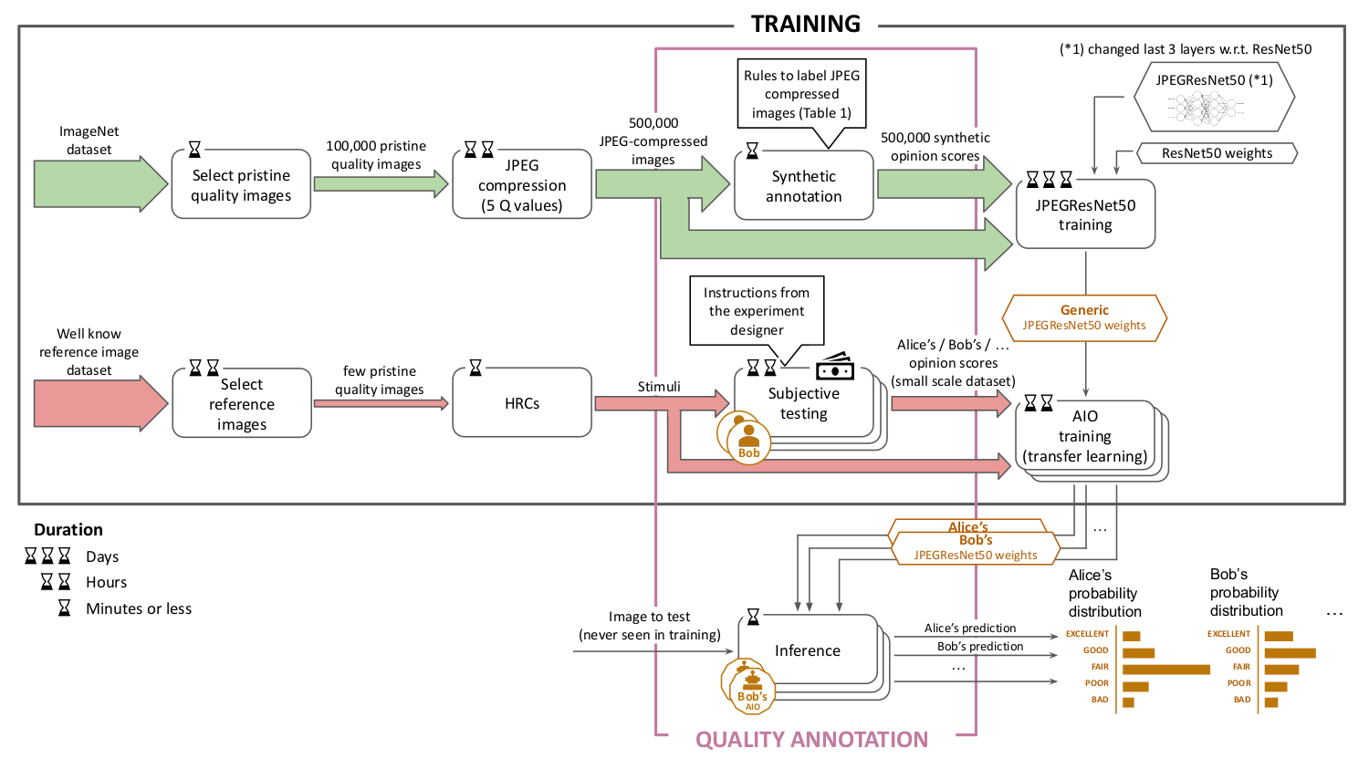
Joint Effort Group – Hybrid (JEG-Hybrid)
Project homepage
Original idea to develop a hybrid quality model, but activities evolved to become more diverse, more research-oriented
Research questions:
  Modeling single observer behavior in subjective
  experiments with neural networks
  → predicting individual quality ratings
  Modeling disagreement in video quality metrics
  Templates for publishing results in image/video
  quality assessment → reproducible research
Predicting individual quality ratings, Fotio T. et al., 2023

Slide 22
Implementer's Guide for Video Quality Metrics (IGVQM)
Create a guide on how to properly use video quality metrics
Working document available
  Currently moving part of the activities into JEG-Hybrid
Scope:
  Collect full-reference metrics and open-source solutions
  Highlight differences between metrics
  Determine temporal aggregation methods for image-based metrics (PSNR, SSIM)
  Mappings between nonlinear objective metrics and linear scales (e.g. 0-100)

Slide 23
Quality Assessment for Computer Vision Applications (QACoViA)
Methods for determining precision of computer vision approaches
Identifying the limits of computer vision methods with respect to the visual quality of the ingest
Recent highlights:
  Method for Assessing Objective Video Quality for Automatic License Plate Recognition Tasks
  Assessing Rail 8KUHD CCTV Forward Facing Video
  Comparing the Robustness of Humans and Deep Neural Networks on Facial Expression Recognition
  Video Coding for Machines: Large-Scale Evaluation of Deep Neural Networks Robustness to Compression Artifacts for Semantic Segmentation

Slide 24
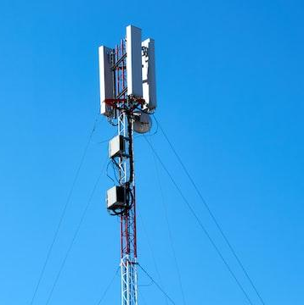
5G Key Performance Indicators (5GKPI)
Goals:
  Defining use cases for video in 5G
  Studying QoE aspects for video in mobility and industrial scenarios
  Identifying the relevant network KPIs and application-level video KPIs (e.g. picture quality, A/V sync, …)
  Building open datasets for algorithm testing and training
Recent highlights:
  ITU-T Technical Report GSTR.5GQoE (2022): Specific QoE requirements and required performance and features from the network

Slide 25
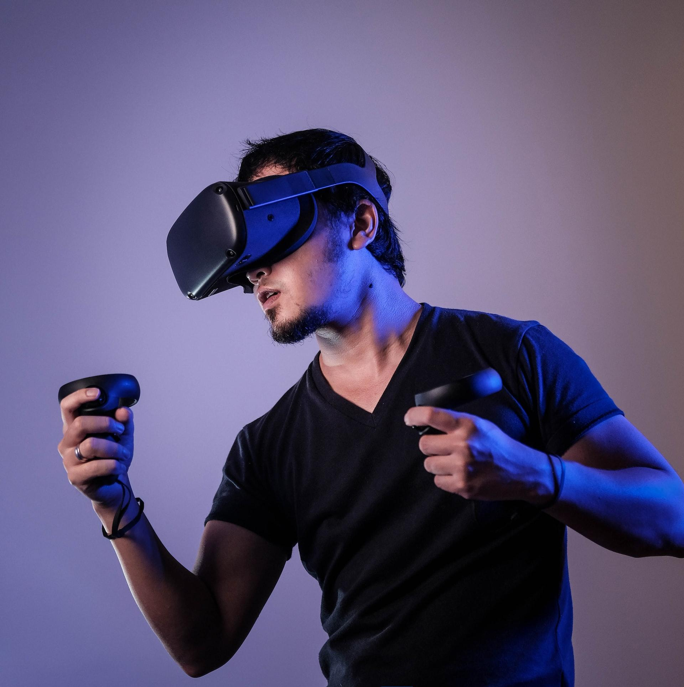
Immersive Media Group (IMG)
Quality assessment of immersive media
  360-degree content, virtual/augmented/extended reality, light field/plenoptic content, 3D content (stereo, multiview, FVV, etc.).
Goals: Baseline quality assessment of today’s systems
  Datasets of immersive media content
  QoE guidelines, subjective test methods, objective metrics, etc.
Activities:
  Finalized test plan on quality assessment of 360-degree videos → ITU-T P.919
  Ongoing test plan: Evaluation of immersive/interactive communication systems.
  Light field quality assessment

Slide 26
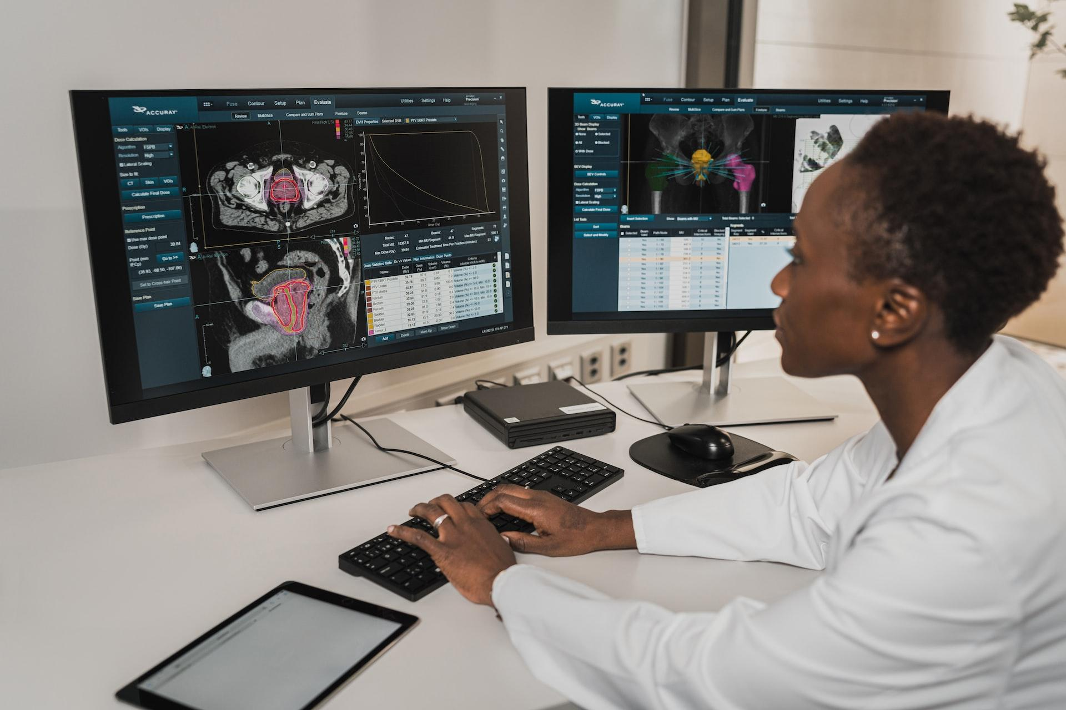
Quality Assessment for Health Applications (QAH)
Assemble databases for medical image and video quality, eye-tracking
Define subjective experiment methodologies for diagnostic or surgery tasks, eye tracking, …
Evaluate and develop quality metrics for medical imaging/video, visual attention prediction models, …
Study quality requirements and QoE for telemedicine

Slide 27
Emerging Technologies Group (ETG)
Newly formed group
AI-based technologies
  Super Resolution
  Learning-based video compression
  Enhancement, Denoising and other pre- and post-filter techniques
Greening of streaming
  Saving energy and its impact on visual quality
Blockchain in Media and Entertainment
Liaison with other standards activities
  3GPP, SVTA, CTA WAVE, UHDF, etc.
  MPEG/JVET

Slide 28
Summary

Slide 29
Summary
VQEG is a free-to-attend forum for video quality experts
Both academia and industry is invited to contribute
25 years of history with great achievements:
  Standardization of video quality models
  Development and application of subjective test procedures
  Collection of resources for video quality research (databases, software)
  Discussion of new and emerging technology

Slide 30

Getting Involved
Have a look at the projects page
Subscribe to the mailing lists
Join our regular working group online meetings
  Any contribution is welcome
  Bring your questions!
Take part in the bi-annual VQEG general meetings

