Slide 1
Mean Opinion Score and Ranked based Statistics
Babak Naderi | QU Lab – Technische Universität Berlin
15.12.2020 VQEG

Slide 2
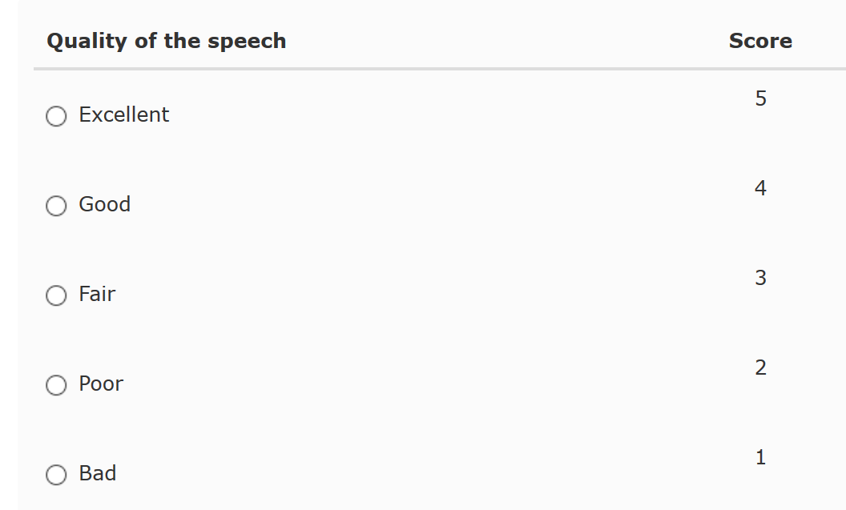
Mean Opinion Score (MOS)
Mean Opinion Score (MOS) presents the average opinion scores given by participants in a subjective test on a predefined scale.
MOS should be reported by complementary information like 95% Confidence Interval, and/or Standard deviation and number of votes
Absolute Category Rating (ACR) is the recommended and most popular method used in subjective tests.
In ACR method typically we use a 5-point discrete scale →

Slide 3
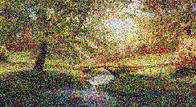


Mean Opinion Score (MOS) II
Assume 95% Confidence Interval = 0.15
for all cases
Do they have a same quality!?
Sample A
Sample B
MOS
MOS
Case 1
3.10
4.00
Yes / No / cannot say
Case 2
3.10
3.80
Yes / No / cannot say
Case 3
3.10
3.20
Yes / No / cannot say
Case 4
3.10
3.11
Yes / No / cannot say

Slide 4

Mean Opinion Score (MOS) III
MOS is a sensitive metric: minor change in one vote influences the resulting score
0.1 MOS differnce: 90% of subjects vote as before, but 10% changed their vote only by 1 point in ACR scale
0.01 MOS differnce: 99% of subjects vote as before, but 1% changed their vote only by 1 point in ACR scale
 | P 1 | P 2 | P 3 | P 4 | P 5 | P 6 | P 7 | P 8 | P 9 | P 10 |  | MOS
Sample A | 4 | 5 | 3 | 4 | 4 | 5 | 4 | 4 | 3 | 4 |  | 4
Sample B | 4 | 5 | 3 | 4 | 4 | 5 | 4 | 4 | 3 | 5 |  | 4.1
$$∆ MOS=0.1$$
Minor
change
All equal ratings
Does it really matter!?

Slide 5
Ranked based Statistics – Spearman’s Rank correlation (SPCC)
In Test B, difference between C2 and C5 is
|4.7059 - 4.7| = 0.0059
Conditions | Tests
 | A | B | C
C 1 | 3.2821 | 2.5761 | 2.5761
C 2 | 4.7377 | 4.7059 | 4.7059
C 3 | 3.8486 | 3.5717 | 3.5717
C 4 | 1.9 | 1.8538 | 1.8538
C 5 | 2.7951 | 4.7 | 4.7059
Conditions | Ranks
 | A | B | C
C 1 | 3 | 2 | 2
C 2 | 5 | 5 | 4.5
C 3 | 4 | 3 | 3
C 4 | 1 | 1 | 1
C 5 | 2 | 4 | 4.5
tied rank
SRCC (A, B) = 0.7 , SRCC (A, C) = 0.56

Slide 6
Ranked based Statistics – Spearman’s Rank correlation (SPCC)
Conditions | Tests
 | A | B | C
C 1 | 3.2821 | 2.5761 | 2.5761
C 2 | 4.7377 | 4.7059 | 4.7059
C 3 | 3.8486 | 3.5717 | 3.5717
C 4 | 1.9 | 1.8538 | 1.8538
C 5 | 2.7951 | 4.7 | 4.7059
4.71
0.4
SRCC (A, B) = 0.7 , SRCC (A, C) = 0.56

Slide 7
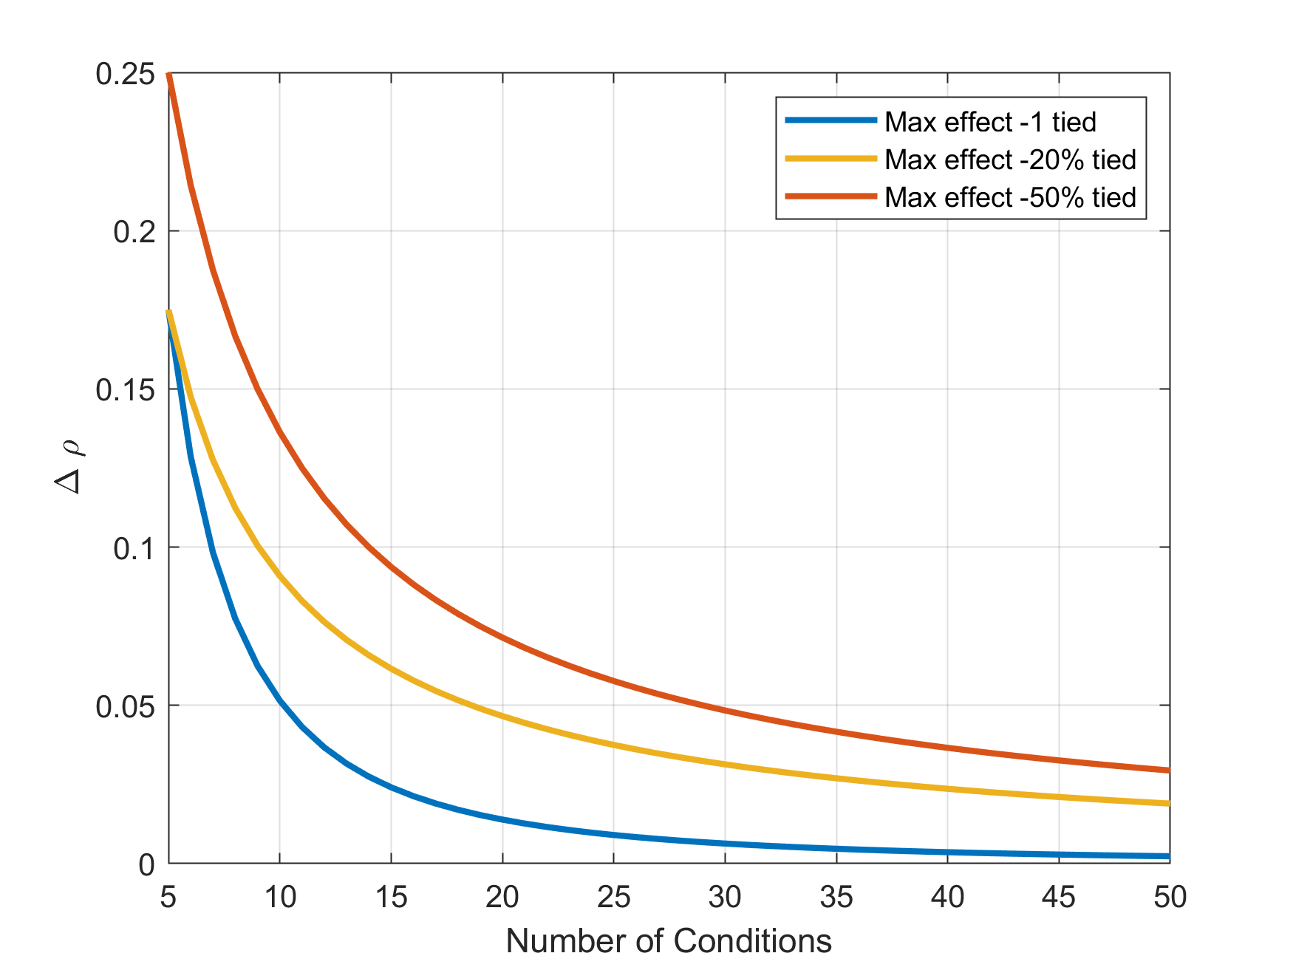
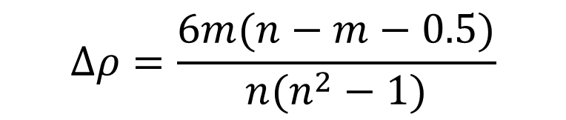
Spearman’s Rank correlation (SPCC)
The maximum difference in coefficient of Spearman’s rank correlation that can result by neglecting m tied ranks can be calculated with the following formula
$$∆ρ=\frac{6m(n−m−0.5)}{n(n^{2}−1)}$$
n: number of items

Slide 8
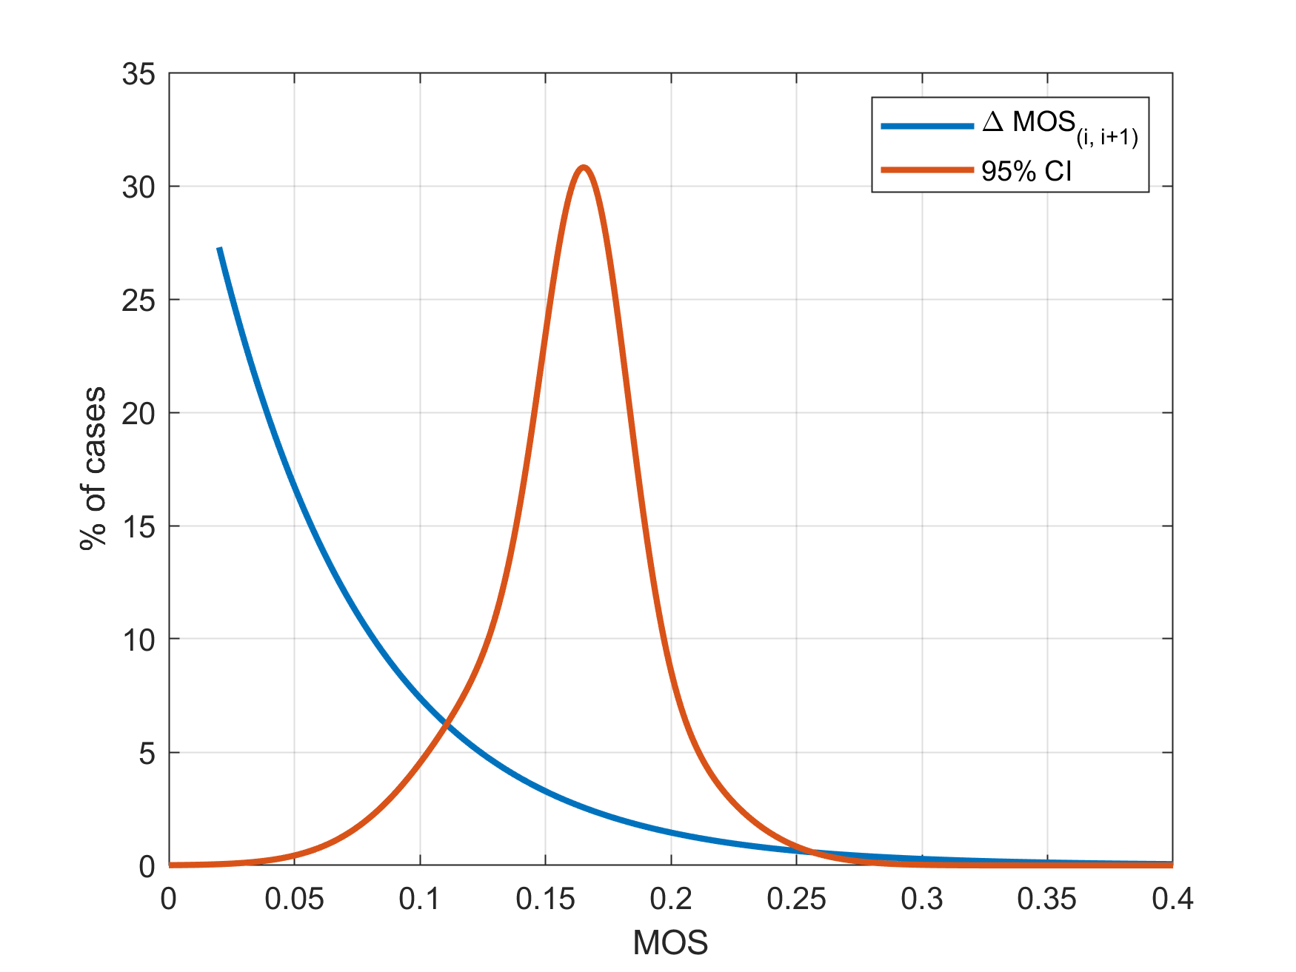
How plausible “very close” MOS values are?
We examined 18 datasets from domain of speech quality assessment, all subjective test conducted in laboratory based on the ITU-T Rec. P.800.
In 86% of cases, the absolute difference between two consecutive MOS values in a ranked order is smaller than the 95% CI of one of the conditions.
95% CI: If we sample the population 100 times, and each time calculate the MOS value, in at least 95 cases, the MOS value will be in the range of current 95%CI.

Slide 9
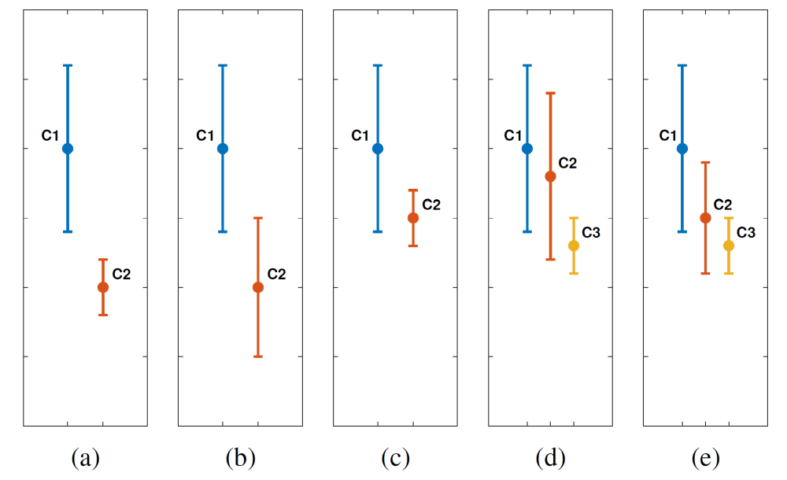
Now… MOS Transformation – redefine equal MOS values
Calculate rank by considering 95%CI
MOS Transformation rules are:
Two MOS values represent a tied rank when at least one of them is inside of the 95%CI of the other one. In that case, two MOS values create a set representing a tied rank (Fig. c).
A new MOS value can only be added to an existing set of a tied rank when it makes a tied rank with all members of that set.
When a MOS value (C2) can make a tied rank with two other MOS values (C1, and C3) but not altogether, then it joins to the closest MOS value (i.e. C3 on fig. e).
Round the resulting MOS± 95%CI values to two fraction digits.

Slide 10
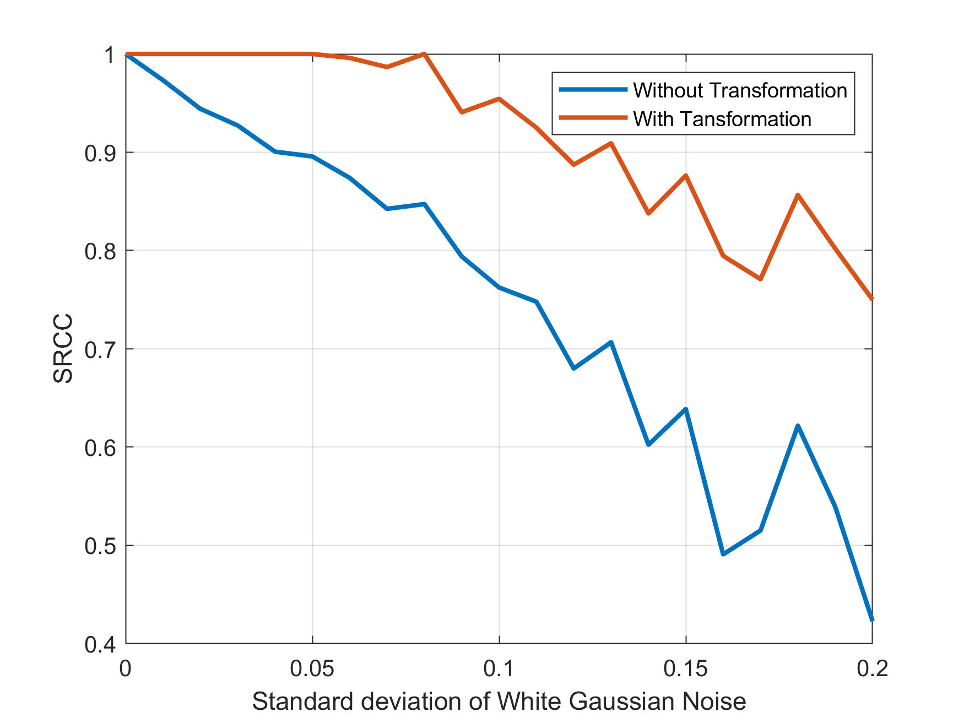
Simulation Study
Dataset: Speech quality assessment domain, conducted in lab, according to the ITU-T P.800, with 50 conditions. We took 10 conditions with highest MOS values (i.e. true MOS).
Simulation: generate White Gaussian Noise (µ =0, different STD) and added to the true MOS to make “noisy MOS” (1000 run per STD)
Calculate SRCC between true MOS and noisy MOS with and without our transformation
Figure shows the largest observed difference¹ in 1000 runs.
¹ Only positive difference is plotted

Slide 11
Conclusion
Rank based statistics can be misleading when used with MOS values.
  Correlations: Spearman’s and Kendall’s rank correlation
  Sig. tests: Mann-Whitney U Test, Wilcoxon signed-rank test, Kruskal-Wallis Test, Friedman Test
Use the transformation before applying any ranked based statistic.
An open-source implementation is provided for MATLAB, Python, and R
https://github.com/babaknaderi/MOS-transformation

Slide 12
Thank you for your attention!
Questions and comments?
More details:
B. Naderi and S. Möller, "Transformation of Mean Opinion Scores to Avoid Misleading of Ranked Based
Statistical Techniques," 2020 Twelfth International Conference on Quality of Multimedia Experience (QoMEX),
Athlone, Ireland, 2020.

