Slide 1
Confidence Intervals for Metrics and Subjective Tests
Margaret H. Pinson
mpinson@ntia.gov

Slide 2
Questions
When is a metric’s performance good enough?
When does a metric’s performance rise to that of subjective testing?
How do we explain a metric’s precision to naive users?

Slide 3
Decisions

Slide 4
Subjective Data
Ratings from 60 subjective tests
  ITU-R Rec. BT.500, ITU-T Rec. P.913, and ITU-T P.800
  2,331 subjects
  17,665 media files
  433,398 subject ratings
Media
  2,592 images (15%)
  7,959 speech samples (45%)
  6,445 silent videos (36%)
  669 audiovisual files (4%)
90 lab-to-lab comparisons
5-level ACR
ACR-HR, DSCQS, 100-level ACR, etc.

Slide 5
Strategy
Student’s t-test
Ratings
Confidence interval (CI)
Ratings vs Ratings
2 Labs
Student’s t-test
Error rates
confusion matrix
Student’s t-test
CI + error rates
Confidence interval
Equivalent to subjective test
MOS vs Metric
confusion matrix

Slide 6
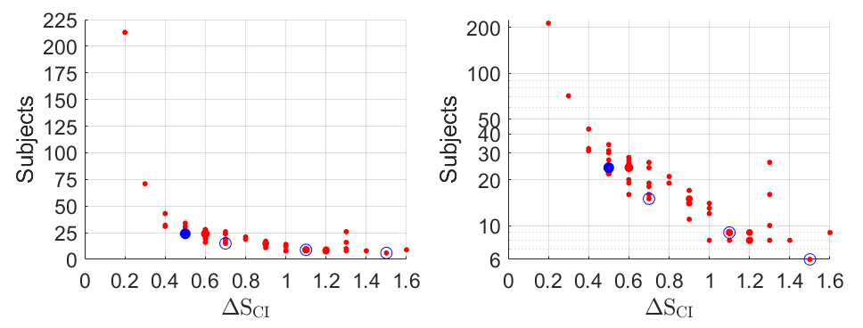
5-level ACR Confidence Interval
24 subjects = 0.5 MOS, 15 subjects = 0.7 MOS, 9 subjects = 1.1 MOS, 6 subjects = 1.5 MOS

Slide 7
Strategy
Student’s t-test
Ratings
Confidence interval (CI)
Ratings vs Ratings
2 Labs
Student’s t-test
Error rates
confusion matrix
Student’s t-test
CI + error rates
Confidence interval
Equivalent to subjective test
MOS vs Metric
confusion matrix

Slide 8
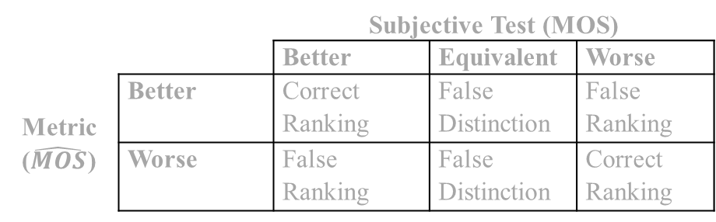
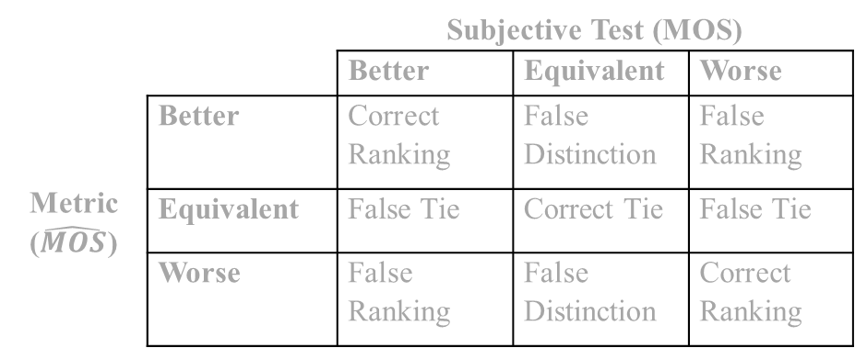
Confusion Matrices
 |  | Subjective Test (MOS)
 |  | Better | Equivalent | Worse
Metric ($\hat{MOS}$) | Better | Correct Ranking | False Distinction | False Ranking
 | Equivalent | False Tie | Correct Tie | False Tie
 | Worse | False Ranking | False Distinction | Correct Ranking
 |  | Subjective Lab 1
 |  | Better | Equivalent | Worse
Subjective Lab 2 | Better | Agree Ranking | Unconfirmed | Disagree
 | Equivalent | Unconfirmed | Agree Tie | Unconfirmed
 | Worse | Disagree | Unconfirmed | Agree Ranking
 |  | Subjective Test
 |  | Better | Equivalent | Worse
Ad-Hoc Evaluation or Pilot Test | Better | Correct Ranking | False Distinction | False Ranking
 | Worse | False Ranking | False Distinction | Correct Ranking
 |  | Subjective Test (MOS)
 |  | Better | Equivalent | Worse
Metric ($\hat{MOS}$) | Better | Correct Ranking | False Distinction | False Ranking
 | Worse | False Ranking | False Distinction | Correct Ranking

Slide 9
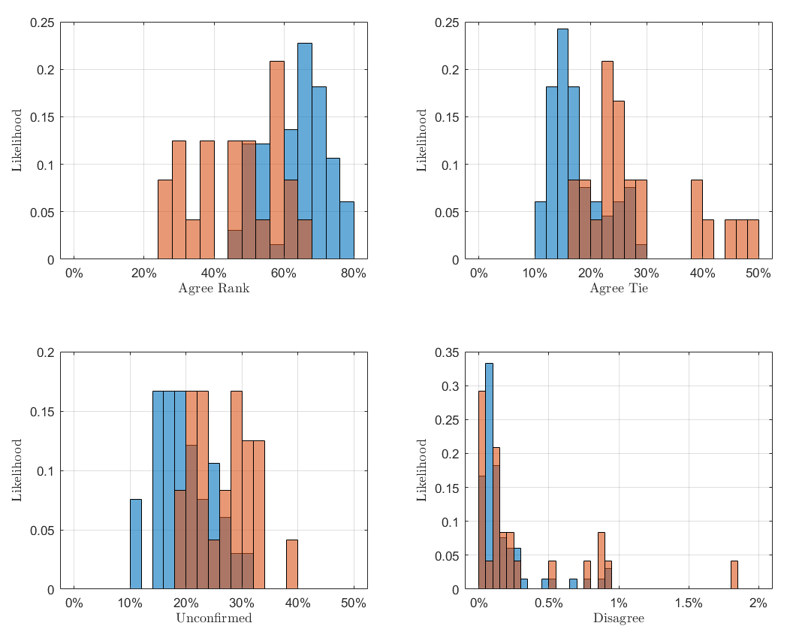
Lab to Lab
Blue = 66 well-designed tests
Tan = 24 narrow quality test
Dark brown = overlap

Slide 10
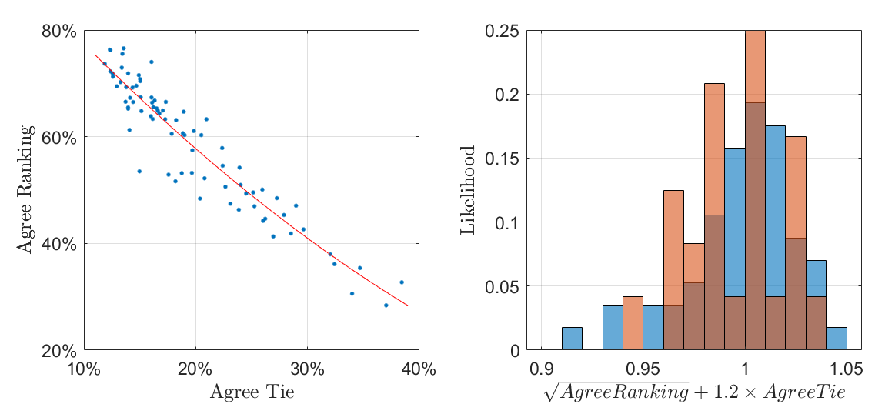
Gain Independence from Range of Quality
$$\sqrt{agree ranking}≈ −1.2×agree tie+1.0$$
$$concur=\sqrt{agree ranking}+1.2 ×agree tie$$

Slide 11
Lab-to-lab Conclusions
disagree is ≤ 1% and typically ≈0.17%
unconfirmed is ≤ 31% and typically ≈20%
concur ranges from 0.91 to 1.05
disagree and concur are minimally influenced by the range of quality in the dataset

Slide 12
Confusion Matrices
 |  | Subjective Test (MOS)
 |  | Better | Equivalent | Worse
Metric ($\hat{MOS}$) | Better | Correct Ranking | False Distinction | False Ranking
 | Equivalent | False Tie | Correct Tie | False Tie
 | Worse | False Ranking | False Distinction | Correct Ranking
 |  | Subjective Lab 1
 |  | Better | Equivalent | Worse
Subjective Lab 2 | Better | Agree Ranking | Unconfirmed | Disagree
 | Equivalent | Unconfirmed | Agree Tie | Unconfirmed
 | Worse | Disagree | Unconfirmed | Agree Ranking
 |  | Subjective Test
 |  | Better | Equivalent | Worse
Ad-Hoc Evaluation or Pilot Test | Better | Correct Ranking | False Distinction | False Ranking
 | Worse | False Ranking | False Distinction | Correct Ranking
 |  | Subjective Test (MOS)
 |  | Better | Equivalent | Worse
Metric ($\hat{MOS}$) | Better | Correct Ranking | False Distinction | False Ranking
 | Worse | False Ranking | False Distinction | Correct Ranking

Slide 13
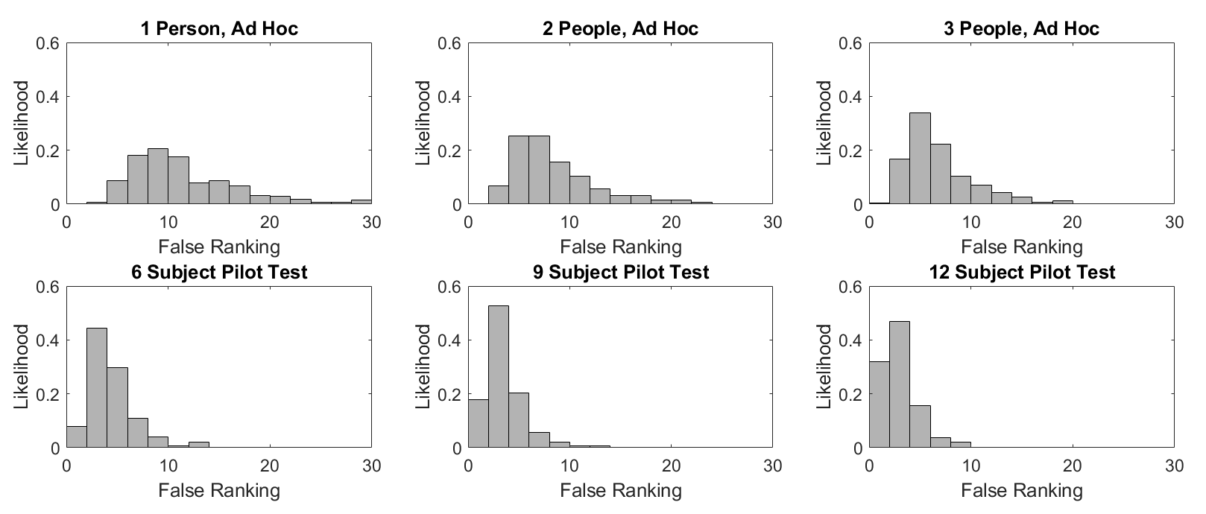
Ad-hoc Evaluations and Pilot Tests
 | 1 Person | 2 People | 3 People | 6 Subjects | 9 Subjects | 12 Subjects
Average | 11.4% | 8.5% | 6.8% | 4.4% | 3.5% | 3.0%
Range | 3% to 30% | 2% to 26% | 1% to 21% | 1% to 17% | 1% to 13% | 0% to 10%

Slide 14
Ad-hoc Evaluations and Pilot Tests
 | 1 Person | 2 People | 3 People | 6 Subjects | 9 Subjects | 12 Subjects
Average | 11.4% | 8.5% | 6.8% | 4.4% | 3.5% | 3.0%
Range | 3% to 30% | 2% to 26% | 1% to 21% | 1% to 17% | 1% to 13% | 0% to 10%

Slide 15
Strategy
Student’s t-test
Ratings
Confidence interval (CI)
Ratings vs Ratings
2 Labs
Student’s t-test
Error rates
confusion matrix
Student’s t-test
CI + error rates
Confidence interval
Equivalent to subjective test
MOS vs Metric
confusion matrix

Slide 16
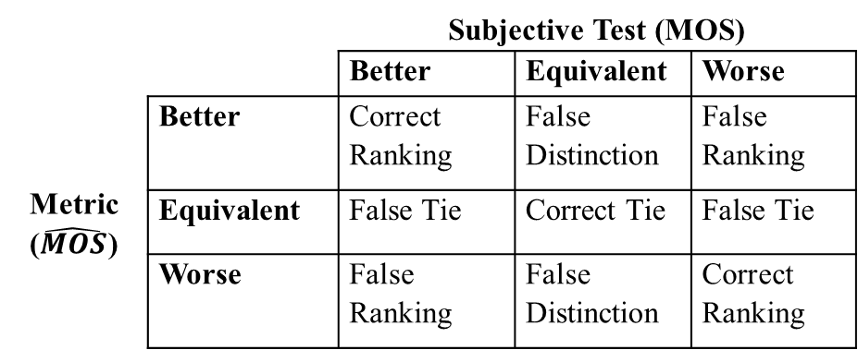
Confusion Matrices
 |  | Subjective Test (MOS)
 |  | Better | Equivalent | Worse
Metric ($\hat{MOS}$) | Better | Correct Ranking | False Distinction | False Ranking
 | Equivalent | False Tie | Correct Tie | False Tie
 | Worse | False Ranking | False Distinction | Correct Ranking
 |  | Subjective Lab 1
 |  | Better | Equivalent | Worse
Subjective Lab 2 | Better | Agree Ranking | Unconfirmed | Disagree
 | Equivalent | Unconfirmed | Agree Tie | Unconfirmed
 | Worse | Disagree | Unconfirmed | Agree Ranking
 |  | Subjective Test
 |  | Better | Equivalent | Worse
Ad-Hoc Evaluation or Pilot Test | Better | Correct Ranking | False Distinction | False Ranking
 | Worse | False Ranking | False Distinction | Correct Ranking
 |  | Subjective Test (MOS)
 |  | Better | Equivalent | Worse
Metric ($\hat{MOS}$) | Better | Correct Ranking | False Distinction | False Ranking
 | Worse | False Ranking | False Distinction | Correct Ranking

Slide 17
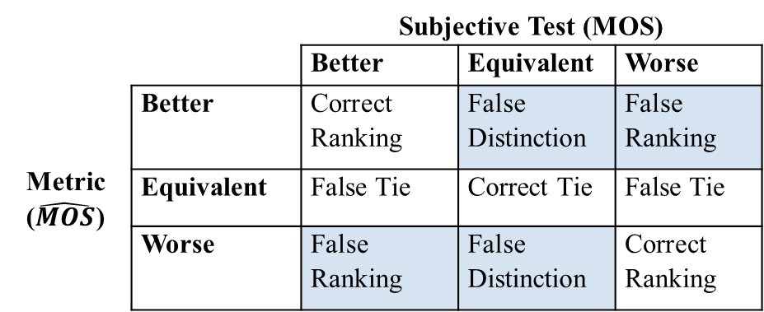
Confidence Intervals for Metrics
Compare conclusions
Avoid bias
  0.5 CI for 24 subjects, 5-level ACR
  Not Student’s t-test
Error rates similar to subjective test
  CIs used to make decisions
Metric rates ≈ subjective tests rates
  Ideal CI ΔM where (false ranking ≤ 1%) and (false distinction ≤ 10%)
  Practical CI ΔM where (false ranking + false distinction) ≤ 16.5%
 |  | Subjective Test (MOS)
 |  | Better | Equivalent | Worse
Metric ($\hat{MOS}$) | Better | Correct Ranking | False Distinction | False Ranking
 | Equivalent | False Tie | Correct Tie | False Tie
 | Worse | False Ranking | False Distinction | Correct Ranking

Slide 18
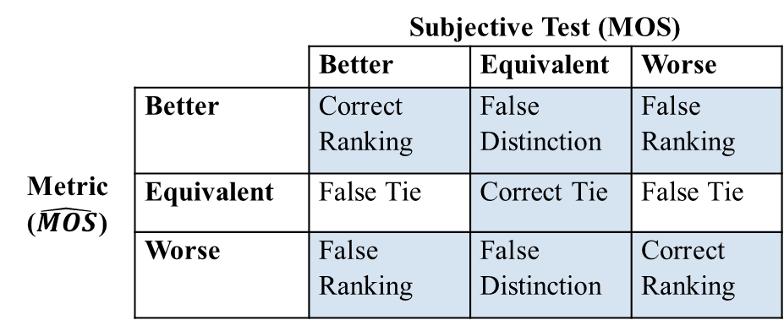
Metric Equivalent to Subjective Test?
Use ideal CI or practical CI to make decisions
  Limits % false ranking and % false distinction
concur ≥ 0.91
  Limits % correct ranking and % correct tie
Ignore false tie
  Inoffensive error
  No defensible limit
Error rates and correct decisions similar to subjective test
  CIs used to make decisions
 |  | Subjective Test (MOS)
 |  | Better | Equivalent | Worse
Metric ($\hat{MOS}$) | Better | Correct Ranking | False Distinction | False Ranking
 | Equivalent | False Tie | Correct Tie | False Tie
 | Worse | False Ranking | False Distinction | Correct Ranking

Slide 19
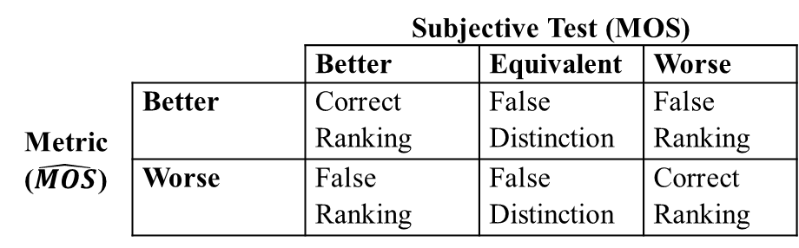
Confusion Matrices
 |  | Subjective Test (MOS)
 |  | Better | Equivalent | Worse
Metric ($\hat{MOS}$) | Better | Correct Ranking | False Distinction | False Ranking
 | Equivalent | False Tie | Correct Tie | False Tie
 | Worse | False Ranking | False Distinction | Correct Ranking
 |  | Subjective Lab 1
 |  | Better | Equivalent | Worse
Subjective Lab 2 | Better | Agree Ranking | Unconfirmed | Disagree
 | Equivalent | Unconfirmed | Agree Tie | Unconfirmed
 | Worse | Disagree | Unconfirmed | Agree Ranking
 |  | Subjective Test
 |  | Better | Equivalent | Worse
Ad-Hoc Evaluation or Pilot Test | Better | Correct Ranking | False Distinction | False Ranking
 | Worse | False Ranking | False Distinction | Correct Ranking
 |  | Subjective Test (MOS)
 |  | Better | Equivalent | Worse
Metric ($\hat{MOS}$) | Better | Correct Ranking | False Distinction | False Ranking
 | Worse | False Ranking | False Distinction | Correct Ranking

Slide 20
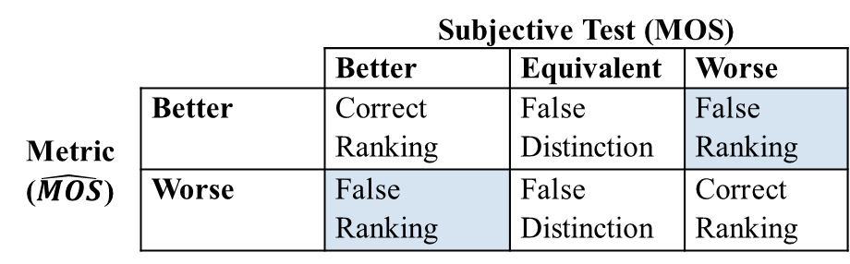
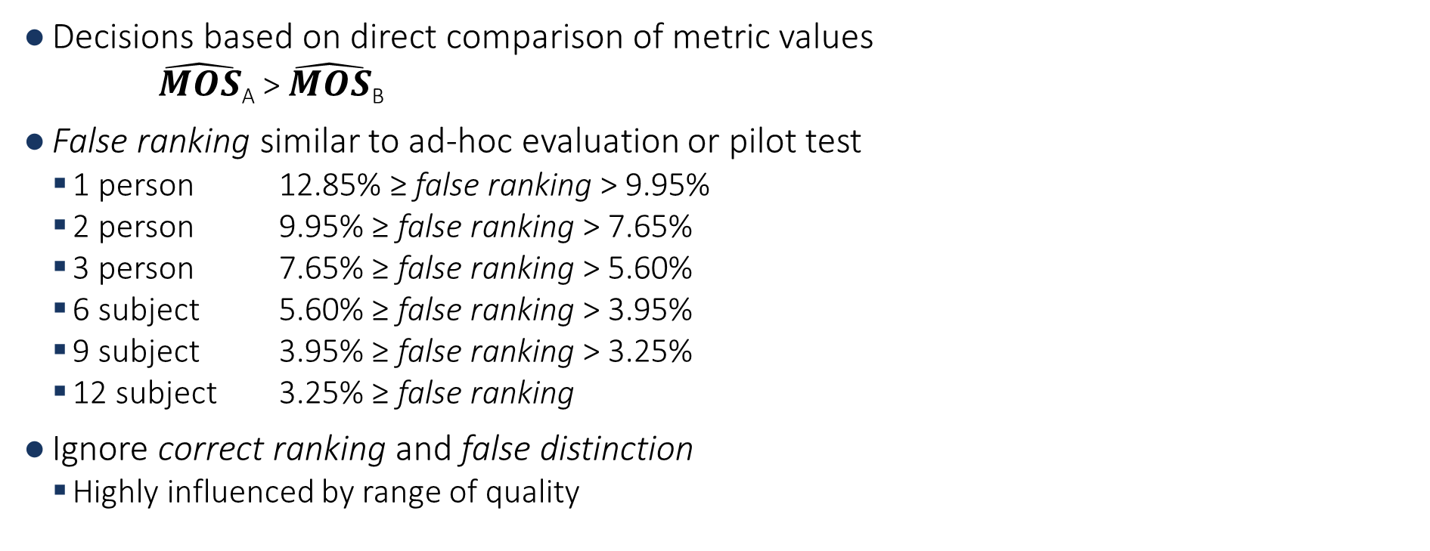
Equating a Metric to a Number of People
Decisions based on direct comparison of metric values
  $\hat{MOS}$_{A} > $\hat{MOS}$_{B}
False ranking similar to ad-hoc evaluation or pilot test
  1 person 12.85% ≥ false ranking > 9.95%
  2 person 9.95% ≥ false ranking > 7.65%
  3 person 7.65% ≥ false ranking > 5.60%
  6 subject 5.60% ≥ false ranking > 3.95%
  9 subject 3.95% ≥ false ranking > 3.25%
  12 subject 3.25% ≥ false ranking
Ignore correct ranking and false distinction
  Highly influenced by range of quality
 |  | Subjective Test (MOS)
 |  | Better | Equivalent | Worse
Metric ($\hat{MOS}$) | Better | Correct Ranking | False Distinction | False Ranking
 | Worse | False Ranking | False Distinction | Correct Ranking

Slide 21
Statistical Method
Confidence intervals for subjective tests
  Ideal CI ≈ 24 subjects
  Practical CI ≈ 15 subjects
Equivalence to subjective testing
  CIs used for decision making
Equate metric to a number of people
  Otherwise
% false ranking = new statistic for training & evaluating metrics
Need
MOS: well-designed test,
5-level ACR method

Slide 22
More Information
Code
  ci_calc.m, ci_calc.py
  NRMetricFramework repository
  https://github.com/NTIA/NRMetricFramework
Technical Report
  Margaret Pinson, “Confidence intervals for subjective tests and objective metrics that assess image, video, speech, or audiovisual quality,” TR-21-550
  https://www.its.bldrdoc.gov/publications/details.aspx?pub=3253

