Slide 1

Quality Assessment for Health Applications (QAH)
A new project since 09/2020

Slide 2
Participants of our 1st meeting on 26/11/2020
First name | Last name | Institute | Country
Lu | Zhang | INSA Rennes | France
Meriem | Outtas | INSA Rennes | France
Hantao | Liu | Cardiff University | UK
Luis | Cruz | University of Coimbra (UC), Portugal and Instituto de Telecomunicações (IT) | Portugal
Nabajeet | Barman | Kingston University, London | UK
Lucie | Lévêque | Gustave Eiffel University, Lyon | France
Femi | Adeyemi-Ejeye | University of Surrey | UK
Aladine | chetouani | université d'Orléans - Délégation CNRS L2S | France
Jesús | Gutiérrez | Universidad Politécnica de Madrid | Spain
Antonio | Pinheiro | Univerisdade da Beira Interior & Instituto de Telecomunicacoes | Portugal
Shanmukh Reddy | Manne | IIT Hyderabad | India
Jorge | Caviedes | Arizona State University | USA
Notes:
12

Slide 3
Goals
Assemble all the existing publicly accessible databases on medical quality
Construct some new databases for different tasks jointly
Use deep learning for QAH as well as visual attention
Explainable AI for ophthalmology, microscopy quality assessment
Metrics and models supporting interpretability for diagnosis
QoE in telemedicine
Provide methodologies, recommendations and guidelines for subjective test of medical image quality assessment
Notes:
Medical images provide image-based information for diagnose & treat diseases. Medical image quality should be assessed not just on the images themselves but on the diagnostic task performance.
While it has been poorly addressed by natural image quality assessment community, task-based approaches are fundamental and popular in the context of medical imaging. The underlying paradigm is to quantify the quality of a particular image by its effectiveness with respect to its intended task.

Slide 4

Do you want to join us?
Subscribe to QAH : qah@vqeg.org
Fill the google doc:
https://docs.google.com/spreadsheets/d/1ckjc67QKOc9NyKcRZRTBLh1SU4fuGyxFUCdEaWtBOdg/edit#gid=0

Slide 5
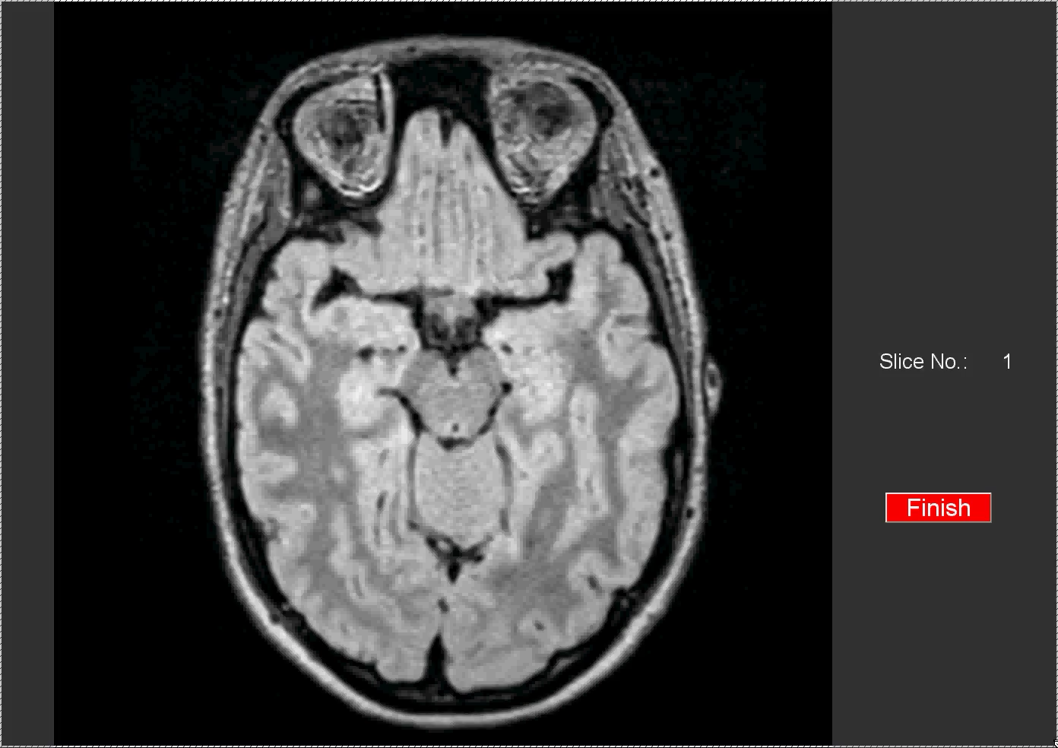
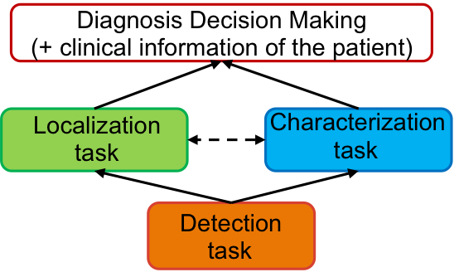
Subjective quality assessment of medical images
MOS-based approach
Task-based approach
Methodologies: ACR, SSCQS, DSCQS, SAMVIQ…
Question on the: overall quality, noise disturbance, contrast, contour, texture…
Final score: Mean Opinion Score
Question: to perform a diagnostic task.
Final score: AUC (area under the ROC curve), area under the JAFROC curve…

