Slide 1

On the Subjective Assessment of the Perceived Quality of Medical Images and Videos
Dec. 2020
Lucie Lévêque¹, Meriem Outtas²,
Lu Zhang², Hantao Liu³
¹ Université Gustave Eiffel, Lyon, France
² INSA, Rennes, France
³ Cardiff University, Cardiff, United Kingdom

Slide 2
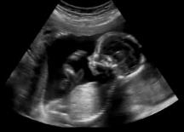
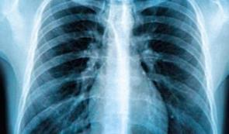
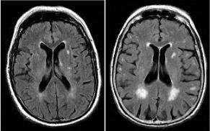
Introduction
US
Medical imaging
  Radiology (1 billion exams per year)
  Cardiology
  Pathology
  Ophthalmology
  + advances in telemedicine
  = large amounts of visual content
X-ray
MRI

Slide 3
Introduction
Background
Distortions or artifacts may be induced
  Acquisition, processing, compression, transmission, display
  May affect perceived quality and diagnostic quality
Quality of Experience (QoE)
  Degree of delight or annoyance of the user of
  an application or a service*
  Clinical success
*P. Le Callet et al.,
Qualinet White Paper 2012

Slide 4
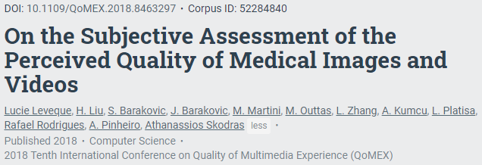
Introduction
Objective
Minimise clinical errors caused by poor image quality
  Medical image perception research
  Understand how medical professionals perceive the quality of distorted medical images and videos
  Review of the methodologies
  used in the literature for
  psychovisual experiments

Slide 5
Review of the methodologies
Subjective quality assessment
*ITU-R BT. 500-13, 2002
ITU-R BT. 1788, 2007
ITU-R BT. 500-13, 2012
Methodologies suggested by the ITU*
  Single or multi stimulus
  Quality or distortion scale
  Discrete or continuous scale
Developed with and for natural images
but also used with medical contents
Excellent
Good
Fair
Poor
Bad

Slide 6
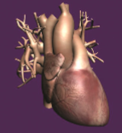
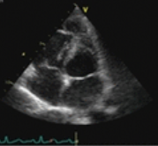
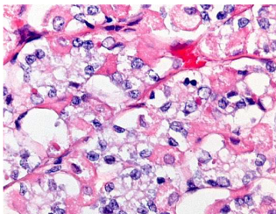
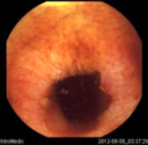

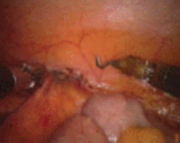

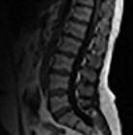
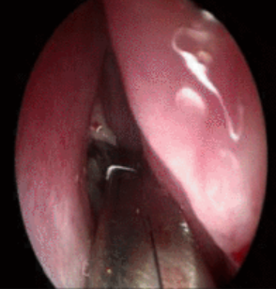
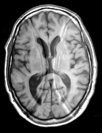
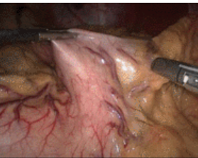
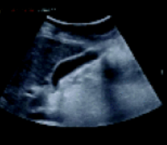
Twelve studies
6
Kara et al., 2017 ¹ | 3D heart images
Platisa et al., 2013 ² | Pathology images
Tulu et al., 2008 ³ | Ophthalmology videos
Suad et al., 2013 ⁴ | MR images
Chaabouni et al., 2014 ⁵ | Endoscopic videos
Munzer et al., 2014 ⁶ | Endoscopic videos
Razaak et al., 2014 ⁷ | Ultrasound Videos
Usman et al., 2017 ⁸ | Endoscopic videos
Nouri et al., 2010 ⁹ | Telesurgery videos
Chow et al., 2016 ¹⁰ | MR images
Liu et al., 2016 ¹¹ | MR images
Lévêque et al., 2017 ¹² | Ultrasound videos

Slide 7
Single stimulus methods
 | Kara et al. ¹ 3D heart images | Platisa et al. ² Pathology images | Tulu et al. ³ Ophthalmology videos
Independent variables | Angular resolution, light field reconstruction | Scene (12), distortion type | Delay (5), jitter (5), packet loss ratio
Method | ACR | ACR | SSCQS
Scoring scale | Overall quality, D (10-pt) | Overall quality, blur and noise disturbance, contrast, colour sat., D (6-pt) | Overall quality, clinical decision-making capability, C
Participants | 8 medical, 12 non-medical | 6 expert, 7 trainee, 11 non-medical | 15 medical
Statistical analyses | Regression analysis | MOS, ANOVA | ANOVA
Main findings | Observers more sensitive to degradations in texture | Different observer profiles differently rate perceived image quality | Quality depends on which critical frames the viewer is able to see and work with

Slide 8
Multi stimulus methods
 | Suad et al. ⁴ MR images | Chaabouni et al. ⁵ Endoscopic videos | Munzer et al. ⁶ Endoscopic videos
Independent variables | Distortion type (5) | Scene (4), bit rate (11) | Scene, resolution (4), constant rate factor (6)
Method | DSIS | DSCQS | DSCQS
Scoring scale | Overall quality, D (5-pt) | Overall quality, C | Overall quality, semantic quality, C
Participants | 15 medical | 14 medical | 37 medical
Statistical analyses | Not specified | Correlations, regression analysis | Not specified
Main findings | Quality affected by different types of distortions and noise | Video can be lossy up to a threshold while maintaining observer satisfaction | May be further compressed than current practice while maintaining overall and semantic quality

Slide 9
Multi stimulus methods
 | Razaak et al. ⁷ Ultrasound videos | Usman et al. ⁸ Endoscopic videos | Nouri et al. ⁹ Telesurgery videos
Independent variables | Scene (9), bit rate (8) | Scene (10), quantisation parameter (8) | Scene (4), bit rate (5-8)
Method | DSCQS | DSCQS | DSCQS
Scoring scale | Overall quality, diagnostic quality, C | Overall quality, diagostic quality, C | Overall quality
Participants | 4 medical, 16 non-medical | 19 non-expert, 6 expert | 7 expert
Statistical analyses | Correlations, regression analysis | Correlations | Regression analysis
Main findings | Recommendations on HEVC compression thresholds to keep diagnostic accuracy | A maximum value for HEVC QP was recommended for endoscopic video | Lossy compression could be used up to a certain threshold while preserving perceived quality

Slide 10
Multi stimulus methods
 | Chow et al. ¹⁰ MR images | Liu et al. ¹¹ MR images | Lévêque et al. ¹² Ultrasound videos
Independent variables | Distortion type (6), distortion level (5) | Image content, distortion type (7), energy (5) | Scene (4), encryption (2), bit rate (3)
Method | SDSCE | SDSCE | SAMVIQ
Scoring scale | Overall quality, C | Overall quality, C | Overall quality, C
Participants | 28 medical | 18 expert | 17 medical
Statistical analyses | T-test, correlations, regression analysis | ANOVA | ANOVA
Main findings | Perceived quality strongly affected by rician noise and Gaussian white noise | Content influences impact of artifacts, distortions with a flat spectral power density are more annoying | Impact of visual content and compression configuration is significant

Slide 11
Discussion
Single vs. multi stimulus
Single stimulus methods
  +: quick
  +: avoid potential vote inversion
  -: score drift
New methods combine advantages of single and double
stimulus methods (SAMVIQ*)
*F. Kozamernik et al.
SMPTE Motion Imaging Journal 2005

Slide 12
Discussion
QoE influential factors (IFs)
System IFs
  Content/media-related IFs (scene, distortion, etc) well-dealt
  Network and device-related IFs forgotten
Context IFs
  Different environments/conditions but with no consideration
  Applications, clinical factors, requirements, data, modalities…
Human IFs
  Low-level processing (physical, emotional): not considered
  High-level processing (demographic): considered

Slide 13
Discussion
*ITU-R BT.500-11, 2012
Statistical analyses
Dubious scores
  Outlier detection and subject exclusion procedure* (5/12)
Medical context
  Participants consistent in scoring?
  ANOVA: compare groups by expertise (3/12)
Correlation analysis: evaluate existing quality metrics (4/12)
Regression analysis: define quality thresholds (2/12)

Slide 14
Bibliography
[1] P. Kara, P. Kovacs, S. Vagharshakyan, M. Martini, S. Imre, A. Barsi, and T. Balogh, “Perceptual Quality of Reconstructed Medical Images
on Projection-Based Light Field Displays”, eHealth 360, pp. 476-483, 2017.
[2] L. Platisa, L. Van Brantegem, Y. Vander Haeghen, C. Marchessoux, E. Vansteenkiste, and W. Philips, “Psycho-visual evaluation of image
quality attributes in digital pathology slides viewed on a medical color LCD display”, Proceedings of SPIE Medical Imaging, vol. 8676, 2013.
[3] B. Tulu, and S. Chatterjee, “Internet-based telemedicine: An empirical investigation of objective and subjective video quality”, Decisions Support Systems, vol. 45, pp. 681-696, 2008.
[4] J. Suad, and W. Jbara, “Subjective quality assessment of new medical image database”, International Journal of Computer Engineering
and Technology, vol. 4, pp. 155-164, 2013.
[5] A. Chaabouni, Y. Gaudeau, J. Lambert, J.-M. Moureaux, and P. Gallet, "Subjective and objective quality assessment for H.264 compressed medical video sequences”, Proceedings of the 4th International Conference in Image Processing, pp. 1-5, 2014.
[6] B. Münzer, K. Schoeffmann, L. Böszörmenyi, J. Smulders, and J. Jakimowicz, "Investigation of the Impact of Compression on the
Perceptual Quality of Laparoscopic Videos," IEEE 27th International Symposium on Computer-Based Medical Systems, pp. 153-158, 2014.
[7] M. Razaak, M. Martini, and K. Savino, “A study on quality assessment for medical ultrasound video compressed via HEVC”, IEEE Journal of biomedical and health informatics, vol. 18, pp. 1552-1559, 2014.
[8] M. A. Usman, M. R. Usman, and S. Shin, "Quality assessment for wireless capsule endoscopy videos compressed via HEVC: From
diagnostic quality to visual perception", Computers in Biology and Medicine, vol. 91, pp. 112-134, 2017.
[9] N. Nouri, D. Abraham, J. Moureaux, M. Dufaut, J. Hubert, and M. Perez, "Subjective MPEG2 compressed video quality assessment:
Application to tele-surgery", IEEE International Symposium on Biomedical Imaging: From Nano to Macro, pp. 764-767, 2010.
[10] L. Chow, H. Rajagopal, R. Paramesran, and Alzheimer's Disease Neuroimaging Initiative, "Correlation between subjective and objective assessment of magnetic resonance (MR) images", Magnetic Resonance Imaging, vol. 34, pp. 820-831, 2016.
[11] H. Liu, J. Koonen, M. Fuderer, and I. Heynderickx, "The relative impact of ghosting and noise on the perceived quality of MR images",
IEEE Transactions on Image Processing, vol. 25, pp. 3087-3098, 2016.
[12] L. Lévêque, W. Zhang, P. Parker, and H. Liu, “The Impact of Specialty Settings on the Perceived Quality of Medical Ultrasound Video”,
IEEE Access, vol. 5, pp. 16998-17005, 2017.

Slide 15
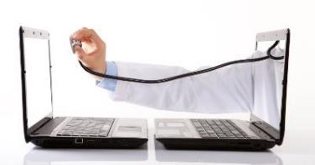
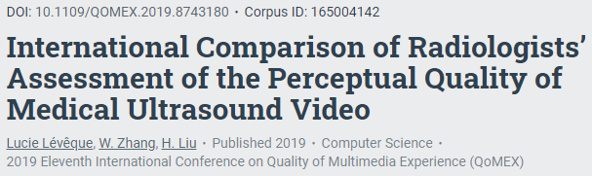
New study
*National Research Council,
The National Academies Press, 1996
Telemedicine
Remote medical practice using information
and communication technologies to improve access to care*

Slide 16
Introduction
Background
Tele-assistance: more demanding circumstances
Transmission and use of medical videos
Real-time
Distortion in visual signal
Perceived quality modified*
Impact on the medical practice
*L. Lévêque et al.,
IEEE Access, 2017

Slide 17
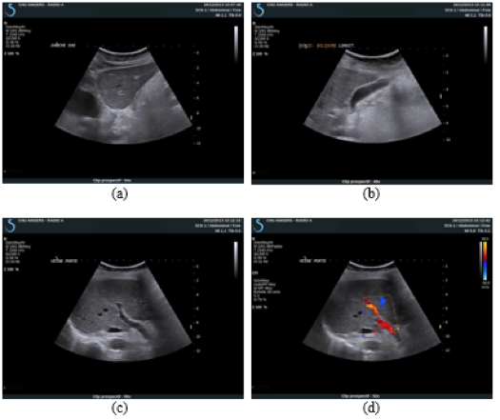

Video quality assessment
Stimuli
Four source videos
Hepatic ultrasound
No pathology
12 seconds
1920×1080 pixels
25 fps

Slide 18

Video quality assessment
Stimuli
Videos compressed using 2 recognised codecs:
3 videos created for each source using H.264
4 videos created for each source using HEVC
Database of 32 stimuli
(4 source stimuli
+ 28 compressed stimuli)

Slide 19
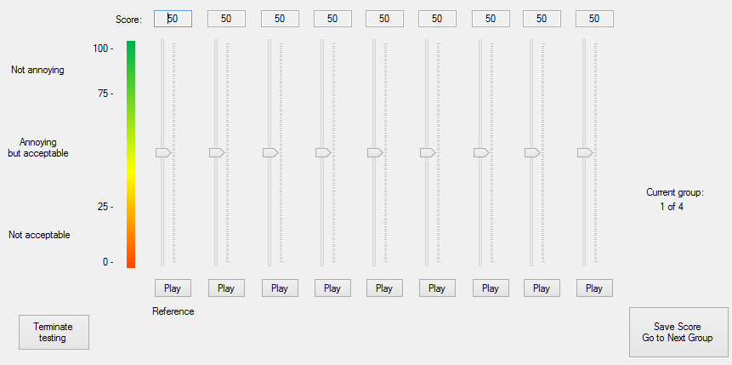
Video quality assessment
*F. Kozamernik et al.,
SMPTE Motion Imaging Journal,
2005
Methodology
SAMVIQ* modified to take into account radiologists’ needs

Slide 20

Video quality assessment
Participants
8 expert radiologists from Angers University Hospital, France
5 expert radiologists from Xi’an Children’s Hospital, China
Radiology reading room (controlled environment)
Dell UltraSharp 27’’, calibrated to DICOM GSDF
60 cm viewing distance

Slide 21

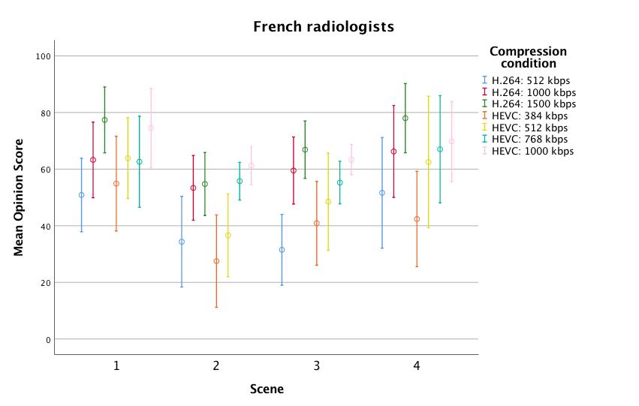
Results
Hello
Factor | df | F | p-value
Radiologist | 7 | 1.365 | 0.266
Scene | 3 | 3.645 | 0.029
Compression | 6 | 21.520 | <0.001

Slide 22

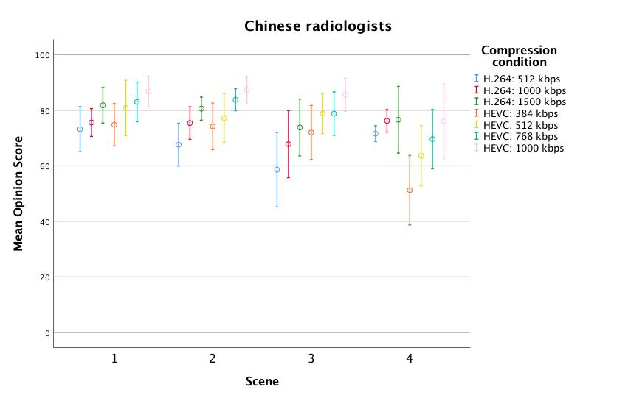
Results
Hello
Factor | df | F | p-value
Radiologist | 4 | 0.878 | 0.502
Scene | 3 | 4.014 | 0.034
Compression | 6 | 17.731 | <0.001

Slide 23
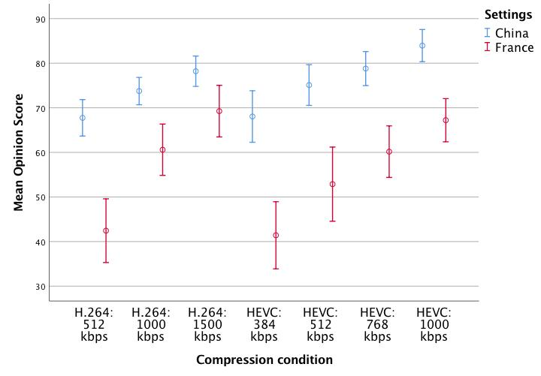

Results
Comparison
Hello

Slide 24
Conclusions
Presentation of methodologies used for the subjective
assessment of medical images and videos
Recommendations for future studies
  Incorporate clinical IFs
  Carefully select observers (expertise level/specialty)
  Use outlier detection methods, transform raw scores
International comparison: French and Chinese radiologists
differently perceive distortion (French scored lower)

Slide 25



Thank you for your attention ☺
lucie.leveque@univ-eiffel.fr
Video Quality Experts Group
Quality Assessment for Health Applications (QAH)

