Slide 1



Methods for Objective Video Quality Assessment in Recognition Tasks
Mikołaj Leszczuk (AGH), Lucjan Janowski (AGH), Jakub Nawała (AGH)
Atanas Boev (Huawei)

Slide 2

Outline
Introduction
Preparation of required experimental set-up and research plan
Acquisition of existing Source Reference Circuits (SRC)
Preparation of Hypothetical Reference Circuits (HRC)
Preparation of Processed Video Sequences (PVS)
Recognition experiment
Quality experiment
Development of new objective video quality assessment model
Conclusions

Slide 3
Introduction

Slide 4
Introduction (1/2)
Metrics for overall Quality of Experience (QoE) successfully used for video processing systems quality evaluation:
  Full-Reference (FR) ones
  No-Reference (NR) ones
However, not appropriate for recognition tasks analytic in Target Recognition Video (TRV)
Estimation of video processing pipeline performance still posing research challenge in Computer Vision (CV) tasks
Need for an objective video quality assessment method for recognition tasks

Slide 5
Introduction (2/2)
Here showing possibility to deliver objective video quality assessment method for TRV
Implemented as prototype software being a proof/demonstration
Method trained and tested on representative set of video sequences
Describing new innovative approach proposal used by software

Slide 6
Preparation of Required Experimental Set-up and Research Plan

Slide 7
Research Plan
SRC
HRC
PVS
Recognition
Quality
Model
Implementation

Slide 8
Scenarios
Facial Recognition (FR)
Object Recognition (OR)
Automatic License-Plate Recognition (ALPR)

Slide 9
Acquisition of Existing Source Reference Circuits (SRC)

Slide 10
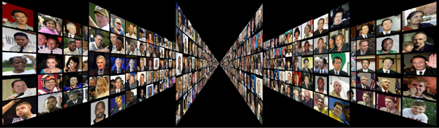
FR Scenario:
LFW Face Database
Resolution: 250✖️250
Count:
  13,233 images of 5,749 different people
  1,680 people with 2 or more images

Slide 11
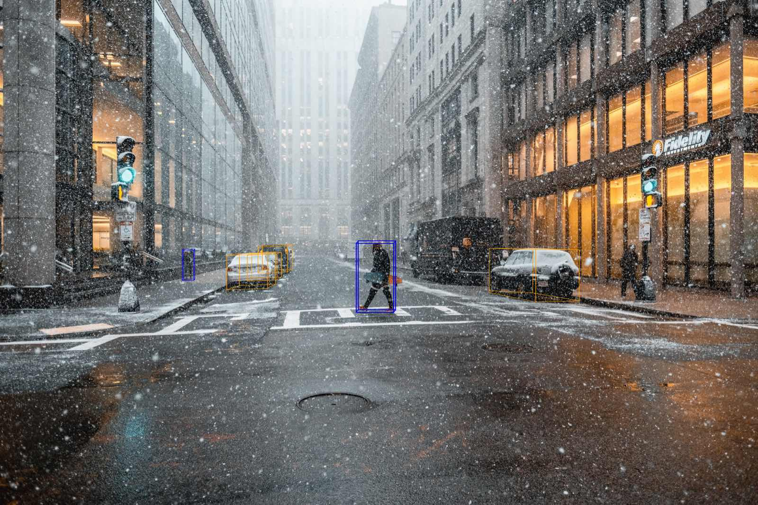
OR Scenario:
Aptiv Mobility nuScenes Dataset
Resolution: 1600✖️900 (HD+)
Count:
  v1.0-mini-CAM_FRONT sweeps images
  1,938 frames in total:
    4 Boston scenes
    4 Singapore scenes

Slide 12
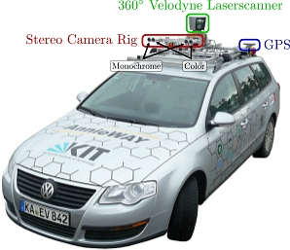
OR Scenario:
KITTI Vision Benchmark Suite
Resolution: 1242✖️375
Count:
  3 categories:
    “City” – 18 sequences
    “Residential” – 13 sequences, and
    “Road” – 7 sequences
  Duration:
    From 28 frames (00:02 minutes)
    To 809 frames (01:20 minutes)
  Synced + rectified image_02 data (7,480 frames in total)

Slide 13
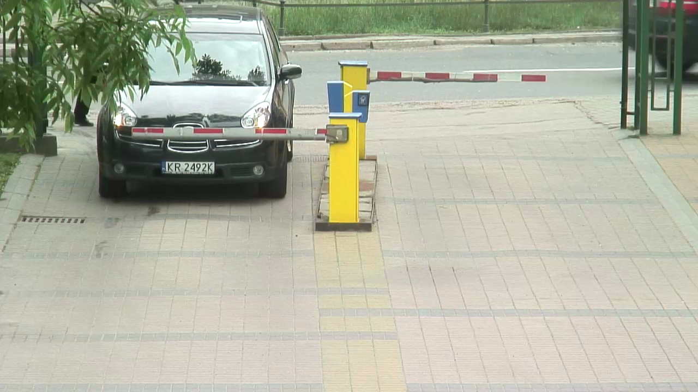
ALPR Scenario:
AGH Parking Database Video Library
Resolution: 1280✖️720 (HD)
Count:
  31 video sequences
  Each one containing approximately 500 frames
  Approximately 15,500 frames in total

Slide 14
Selected SRC as Glance
Scenario | Database | #SRC (training, validation, test) | ≈#Objects/#SRC
FR | LFW | 120 | 1
OR | nuScenes KITTY | 60 60 | 4.14 3.85
ALPR | AGH | 120 | 1

Slide 15
Preparation of Hypothetical Reference Circuits (HRC)

Slide 16
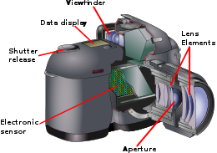
Distortion Model
Illuminance
Weather conditions
Optics (e.g., aperture defocus)
Sampling
Sensor (noise)
To zdjęcie, autor: Nieznany autor, licencja: CC BY-SA

Slide 17
HRC
Gaussian Noise
Over/Under-Exposure (Photography)
Motion Blur
Snow
Droplets
JPEG
Defocus (Blur)

Slide 18
Preparation of Processed Video Sequences (PVS)

Slide 19
Which Distortions Go to
Which Scenario?
HRC | #HRC | FR | OR | ALPR
Gaussian Noise | 6 | ✓ | ✓ | ✓
Defocus (Blur) | 6 | ✓ | ✓ | ✓
Over/Under-Exposure (Photography) | 12 | ✓ | ✓ | ✓
Motion Blur | 6 | ✓ | ✓ | ✓
Snow | 2 | ✗ | ✓ | ✓
Droplets | 1 | ✗ | ✓ | ✓
Motion Blur vs. Gaussian Noise | 5 | ✓ | ✓ | ✓
Over-Exposure vs. Gaussian Noise | 5 | ✓ | ✓ | ✓
Under-Exposure vs. Motion Blur | 5 | ✓ | ✓ | ✓
JPEG | 19 | ✓ | ✓ | ✓
#PVS |  | 6720 | 7080 | 7080

Slide 20
Recognition Experiment

Slide 21
Recognition Tools
Facial Recognition (FR)
Object Recognition (OR)
Automatic License-Plate Recognition (ALPR)

Slide 22
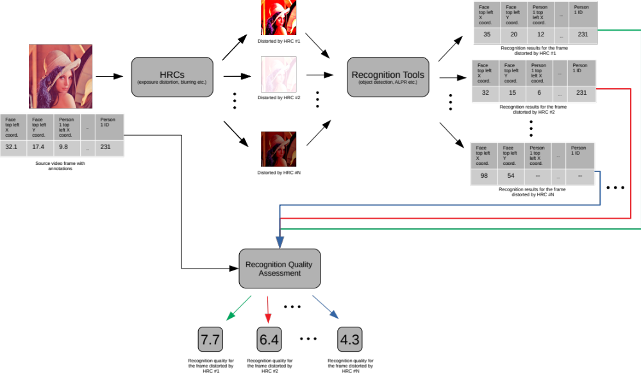
Flowchart Presenting Processing Pipeline of Recognition Experiment

Slide 23
Quality Experiment

Slide 24
Quality Indications
Authors | Algorithm Name(s) | Language | Time [s]
VQ AGH VQIs | Commercial Black, Blockiness, Block Loss, Blur, Contrast, Exposure, Interlacing, Noise, Slicing, Spatial Activity, Temporal Activity | C/C++ | 0.12
LIVE | BIQI | MATLAB | 1.60
LIVE | BRISQUE | MATLAB | 1.67
LIVE | NIQE | MATLAB | 3.92
LIVE | OG-IQA | MATLAB | 5.72
LIVE | FRIQUEE | MATLAB | 40.79
LIVE | IL-NIQE | MATLAB | 10.70
UMIACS | CORNIA | MATLAB | 7.71
BUPR | HOSA | MATLAB | 0.43
Total |  |  | 72.66

Slide 25
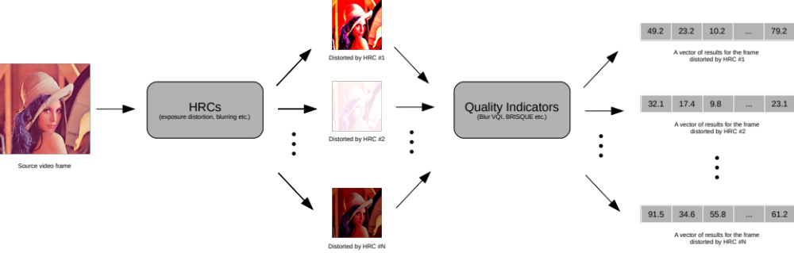
Flowchart Presenting Processing Pipeline in Quality Experiment

Slide 26
Development of New Objective Video Quality Assessment Model…
…For Recognition Tasks

Slide 27
Development of New Objective Video Quality Assessment Model
Recognition
Quality
Model

Slide 28
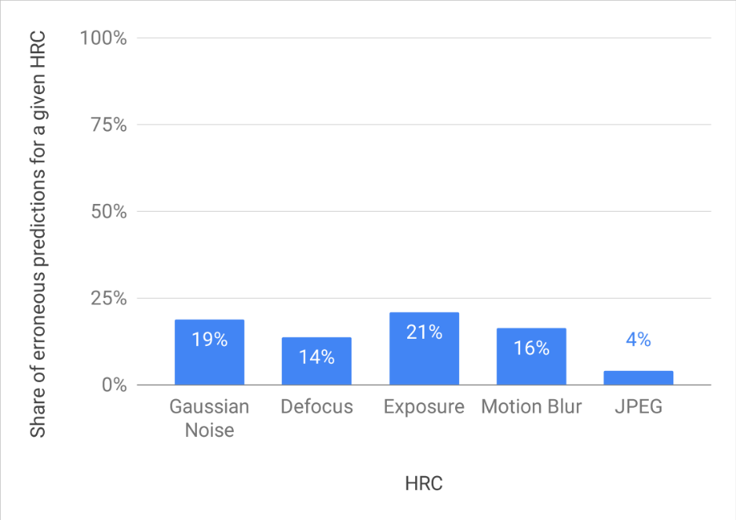
General Results Received for
FR
 | Precision | Recall | F-Measure
All Indicators | 0.893 | 0.846 | 0.869
AGH Indicators | 0.870 | 0.791 | 0.829

Slide 29
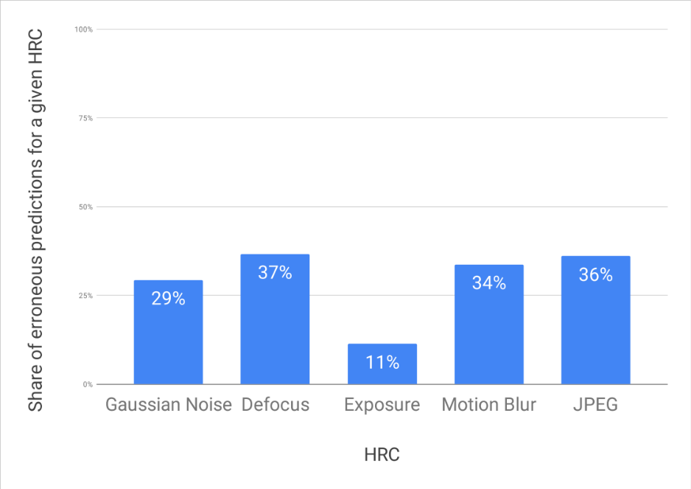
General Results Received for
ALPR
 | Precision | Recall | F-Measure
All Indicators | 0.779 | 0.776 | 0.777
AGH Indicators | 0.768 | 0.759 | 0.764

Slide 30
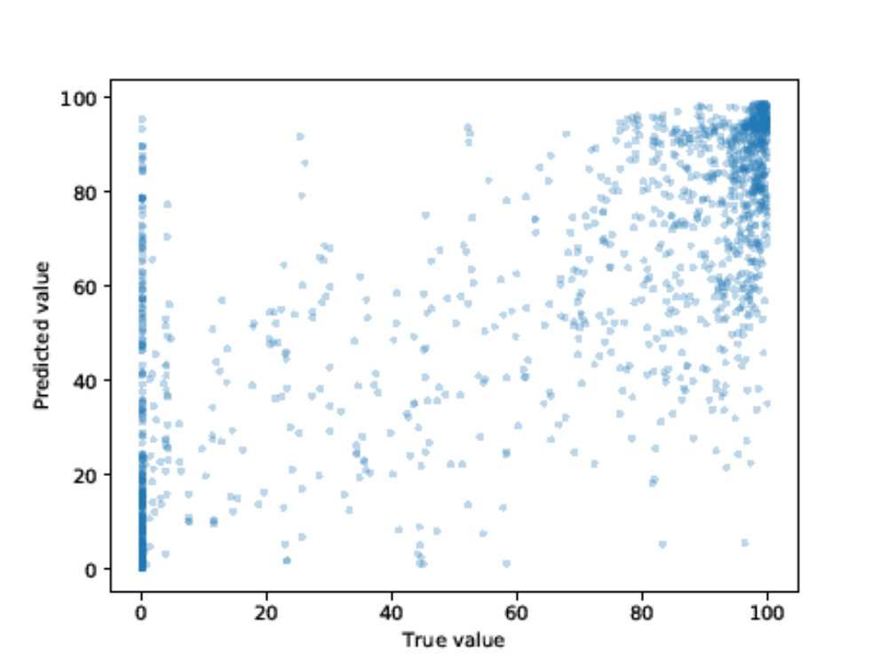
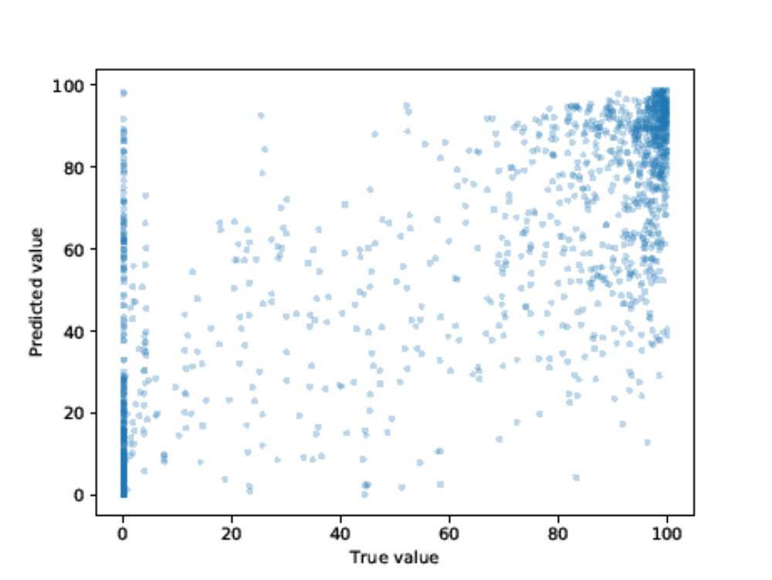
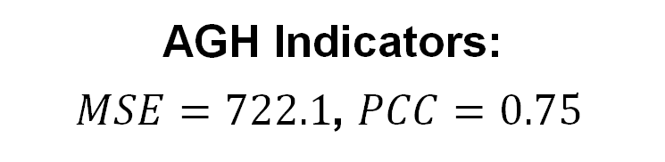
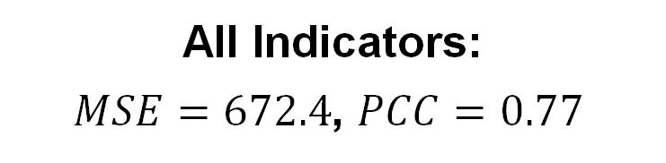
General Results Received for
OR
All Indicators:
$MSE=672.4$, $PCC=0.77$
AGH Indicators:
$MSE=722.1$, $PCC=0.75$

Slide 31
Conclusions

Slide 32
Conclusions
Conventionally using metrics for general QoE, both FR ones and NR ones in video processing systems for video quality evaluation
Unfortunately, these metrics not appropriate for recognition tasks in video analytics (TRV)
Therefore, correct estimation of video processing pipeline performance – still significant research challenge in CV tasks
As response to this need, goal of research: method trained and tested on representative set of video sequences
Prototype software: proof/demonstration of new proposal concept of objective video quality assessment method for recognition tasks
Further plans: Just Noticeable Degradation (JND) for Computer Vision (CV) performance

Slide 33
Outline

