Slide 1
Improvements on Subjective Experiment Data Analysis Process: An Update
Zhi Li, Christos Bampis, Lukas Krasula, Netflix
Lucjan Janowski, AGH
Ioannis Katsavounidis, Facebook
Q19 Interim Meeting, VQEG Fall 2020

Slide 2
Outline
Background and motivation
Proposed methodology
Progress since ITU-T SG12 C470 (April 2020)
  New comparison results with BT.500 / P.913
  Interpreting the limitations of BT.500 / P.913
  Update on the calculation of confidence intervals
  Runtime analysis
ITU Proposals

Slide 3
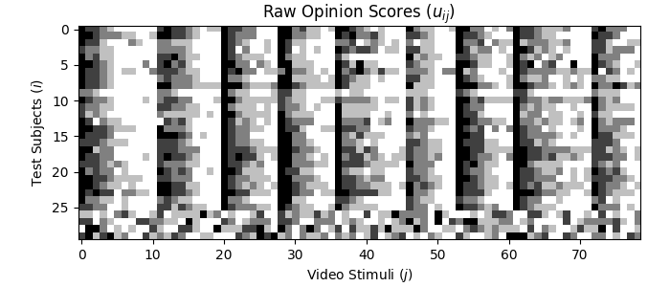
Raw opinion scores are noisy and unreliable
Subject bias
Black: lowest score
White: highest score
Last 4 Outliers
Would MOS or DMOS be good enough?
Corrective mechanisms
  Subject outlier rejection
  Subject bias removal
*NFLX Public Dataset

Slide 4
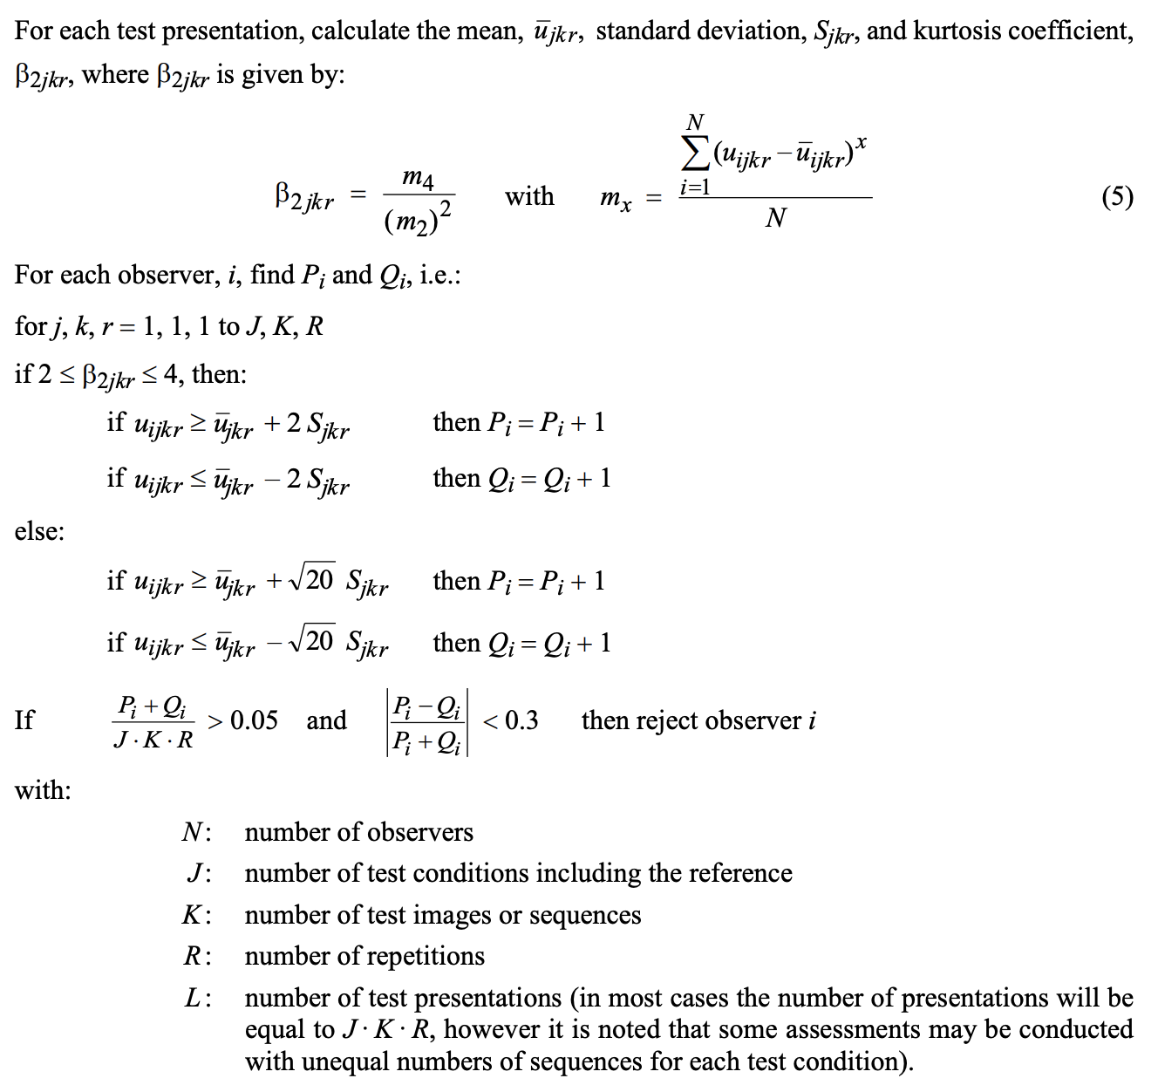
Prior Art: Subject Outlier Rejection (ITU-R BT.500)
Video by video, the algorithm counts the number of instances when a subject’s opinion score deviates by a few sigmas (i.e. std’s)
Subject by subject, if the occurrences are more than a fraction, reject the subject
1.
2.

Slide 5
Limitations of BT.500-Style Subject Outlier Rejection
Subject bias
Black: lowest score
White: highest score
Last 4 are outliers
All scores corresponding to rejected subjects are discarded - an overkill
Often only identifies a subset of outliers
  In the example above, only subjects #26, #28, #29 were rejected*
Hard-coded parameters / thresholds:
  Not very interpretable
  May not be suitable for all conditions
*To be discussed in a later slide why only 3 out 4 outliers detected

Slide 6
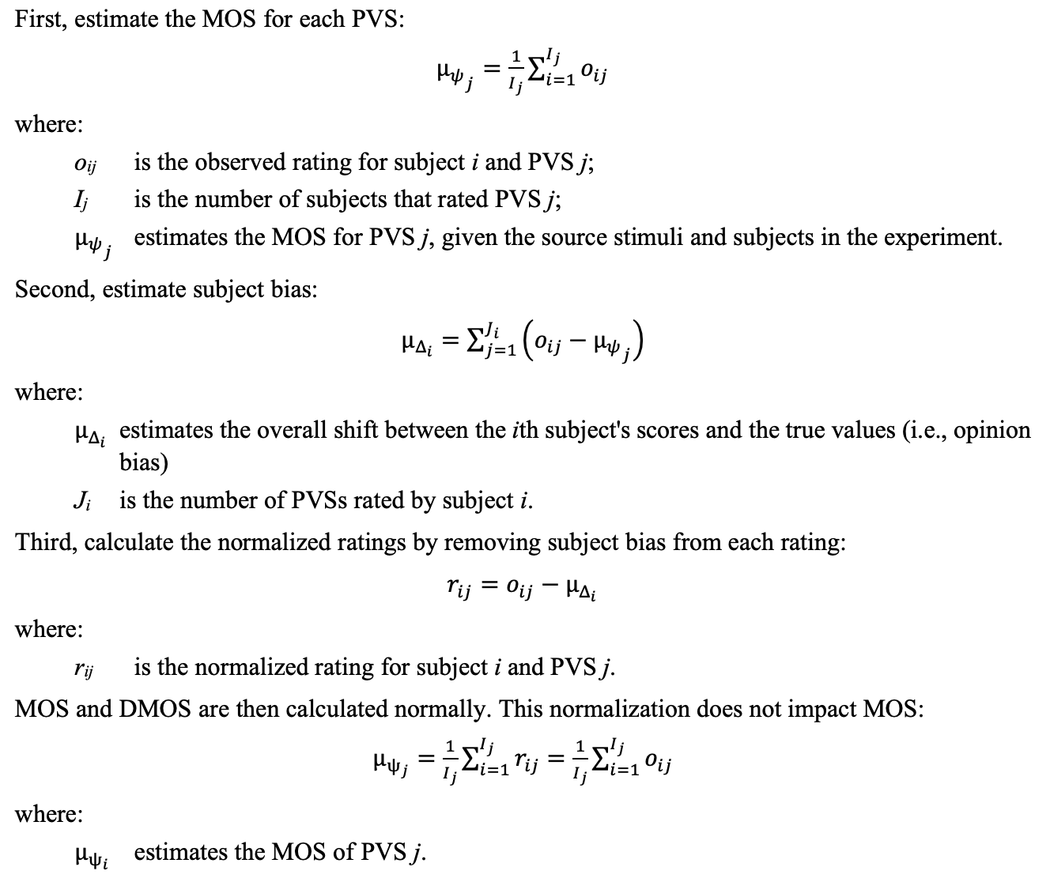
Prior Art: Subject Bias Removal (ITU-T P.913)
Video by video, estimate MOS by averaging over subjects
Subject by subject, estimate subject bias by comparing against MOS
Video by video, estimate MOS again based on bias-removed opinion scores (often combined with BT.500-style subject rejection)
3.
1.
2.
Notes:
P.913 can often be combined with BT.500-style subject rejection. Yet, by doing so, it poses similar weakness as BT.500.

Slide 7
Can we do better?

Slide 8
Can we do better?
Insight #1:
  The subject outliers do NOT have to be rejected as a whole
  Instead, we can model them as having large “inconsistencies”
    “Soft” rejection
    Avoid hard decision and hard coded parameters
Insight #2:
  The subject bias removal and subject outlier rejection do NOT have to be carried out in separate steps, which leads to sub-optimality
  Instead, we can incorporate “bias” and “inconsistency” in one model and jointly solve the model parameters in one step
Our proposal:
  A simple yet effective model to account for:
    Subject bias
    Subject inconsistency
      Outliers as a special case with very large inconsistencies
  Jointly solve the model parameters via maximum likelihood estimation (MLE)

Slide 9

Other Considerations (for Standardization)
Reality
Model
Strike a delicate balance between reality and model simplicity
  Other candidates:
    PVS/Content ambiguity [Janowski&Pinson’15, Li&Bampis’17]
    Environmental influences
    Continuous vs. discrete scales [Janowski et al’19]
    Fringe effect of scales
  The proposed model accounts for two of the most dominant effects
    Subject bias
    Subject inconsistency
Notes:
It is possible to consider other candidates in the model, to make it closer to reality. But the more complicated the model, the more difficult for it to be accepted, and the solution becomes more time consuming.

Slide 10
Other Considerations (for Standardization)
Old Standard
New Standard
For easy acceptance, new standard should NOT be a paradigm shift
  A good approach is to encompass prior standard as a special case
Solution must be intuitive
  Each model parameter should carry explicit meaning
  Each solution step should be highly interpretable
Solution should be widely applicable to different subjective methodologies
  ACR / ACR-HR
  DCR (DSIS)
  Continuous (DSCQS) / discrete scales
Solution should be fast and stable

Slide 11
Outline
Background and motivation
Proposed methodology
Progress since ITU-T SG12 C470
  New comparison results with BT.500 / P.913
  Interpreting the limitations of BT.500 / P.913
  Update on the calculation of confidence intervals
  Runtime analysis

Slide 12

Proposed Model*
Raw Opinion
Score
True
Quality
Subject
Bias
Subject
Inconsistency
U_{ijr} - Opinion score of subject i, stimulus j and repetition r
𝜓_{j} - true quality of stimulus j
𝛥_{i} - bias of subject i
𝜐_{i} - inconsistency (std) of subject i
X - i.i.d. normal random variables, X ~ N(0, 1)
*The model is a simplified version of [Li&Bampis’17] without considering the ambiguity of content. Compared to the original, the solution to the simplified model is faster and more stable.

Slide 13
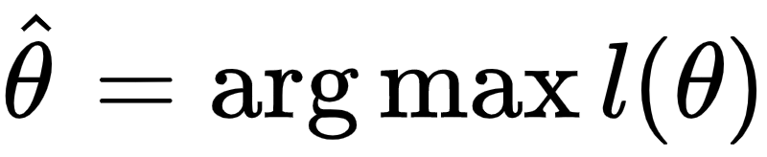
Solving the Model Parameters via Maximum Likelihood Estimation (MLE)
Given raw opinion scores {U_{ijr}}
The task is to solve for the free parameters 𝜃 = ({𝜓_{j}}, {𝛥_{i} }, {𝜐_{i} })
Define log-likelihood function l(𝜃)
Numerically solve to maximize the log-likelihood function
Example problem size:
  # observations: 300 (stimuli) * 30 (subjects) = 9000
  # parameters:
    True quality scores 300
    Subject bias 30
    Subject inconsistency 30

Slide 14
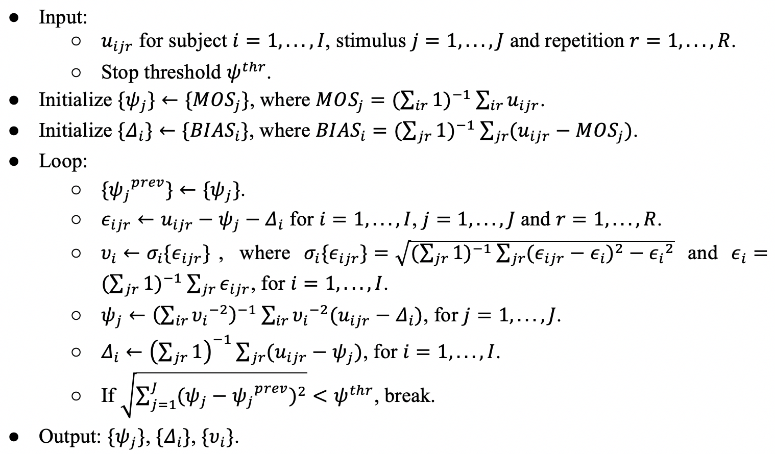
Proposed Solver
Video by video, estimate MOS by averaging over subjects
Subject by subject, estimate subject bias by comparing against the MOS
In a loop:
  Subject by subject, estimate subject inconsistency as the std of the residue of raw scores
  Repeat step 1 (with weighting).
  Repeat step 2.
  If solution stabilizes, break
Alternating Projection (AP) Solver

Slide 15
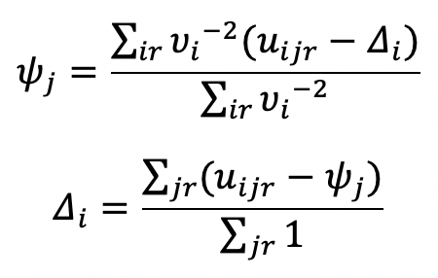

Proposed Solver - Interpretation
Strong intuition behind the updating steps
P.913 subject bias removal is a special case of the proposed solver in the following sense:
  The P.913 solver is not iterative
  The true quality in P.913 is not weighted by “subject consistency”
True quality are weighted by “subject consistency” (𝜐_{i}⁻²) after the subject bias (𝛥_{i}) is removed. The “subject consistency” is the inverse of the (squared) subject inconsistency (𝜐_{i}²)*.
“Subject Consistency”
Subject bias (𝛥_{i}) as the mean of the opinion scores after the true quality (𝜓_{j}) removed.
Subject inconsistency as the standard deviation of the estimation residue (𝜖_{i}).
*In practical implementation, we add a small ε to make the denominator non-zero.

Slide 16
Summary of Each Method Compared
BT.500 - keep or reject subjects
P.913 - remove subject bias, keep or reject subjects
Proposed AP - weigh subjects by consistency

Slide 17
When Will the Proposed Method Be Most Valuable?
When faced with uncertainties
  Crowdsourcing
  Cross-lab study
  Analyzing a new technology
  New rating scale may confuse subjects
  Inexperienced person designing the test
  Media contain multiple confounding impairments
  Distracting test environment
  Unusual experiment design may have unintended consequences
When BT.500 and P.913 give contradictory subject rejections

Slide 18
Outline
Background and motivation
Proposed methodology
Progress since ITU-T SG12 C470
  New comparison results with BT.500 / P.913
    Scatter plots between proposed and BT.500/P.913
    Analyze a crowdsourcing dataset: correlation with partial data
    Cross-lab study on VQEG FRTV Phase I datasets
  Interpreting the limitations of BT.500 / P.913
  Update on the calculation of confidence intervals
  Runtime analysis

Slide 19
Scatter plots:
Proposed AP vs. BT.500
Proposed AP vs. P.913
More Datasets in the Appendix

Slide 20
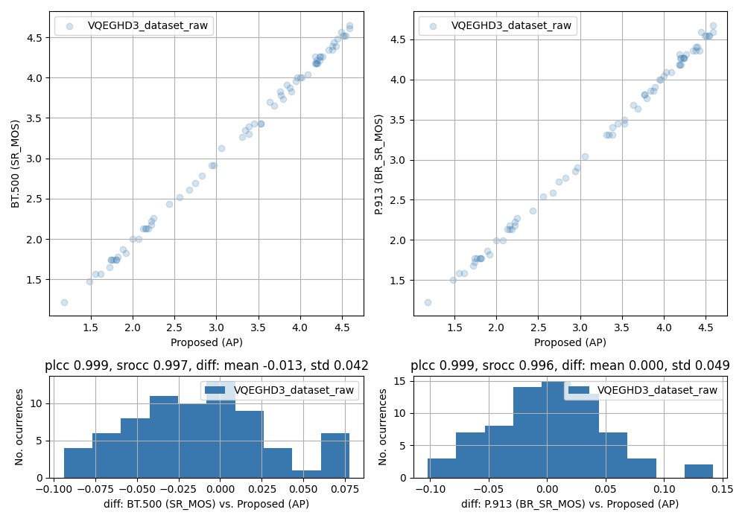
Recovered Quality Score - Proposed vs. BT.500/P.913
VQEG HD3 (Lab Study)

Slide 21
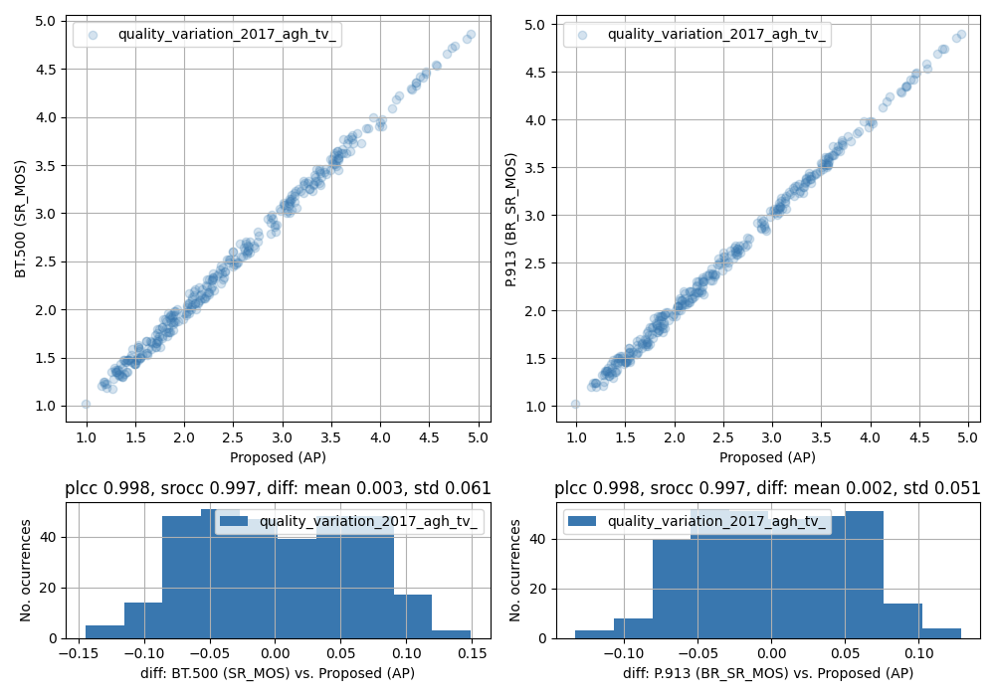
Recovered Quality Score - Proposed vs. BT.500/P.913
Quality Variation 2017 AGH TV Dataset (Lab Study)

Slide 22
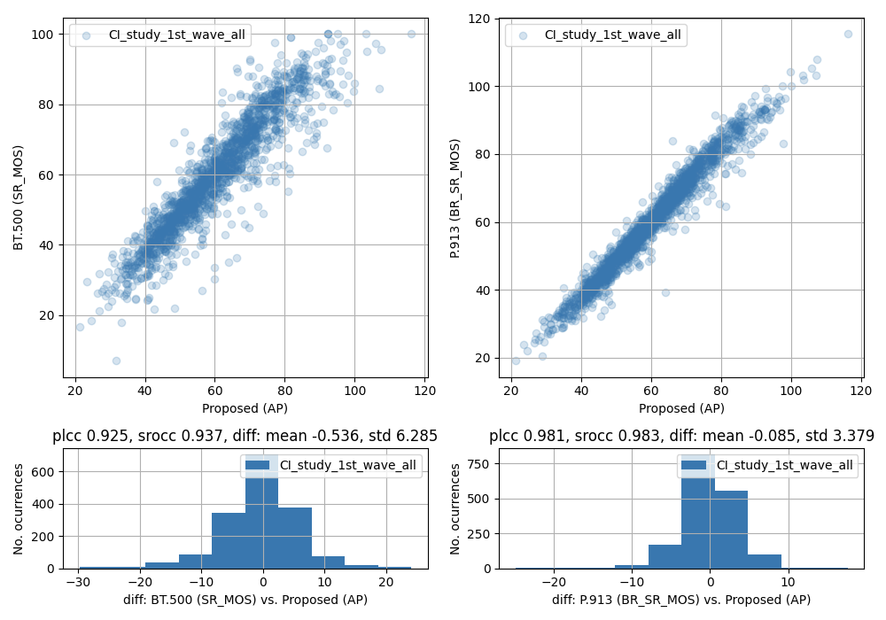
Recovered Quality Score - Proposed vs. BT.500/P.913
CI Study 1st Wave Dataset* (Crowdsourcing Study)
*The 1st wave dataset is a small pre-test, with certain PVSs having only one raw score.

Slide 23
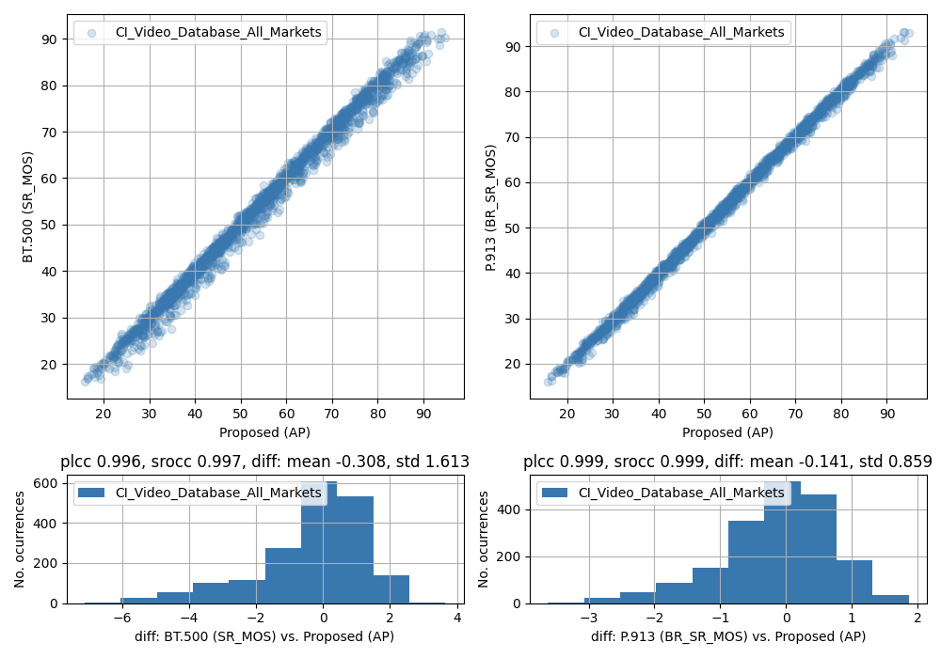
Recovered Quality Score - Proposed vs. BT.500/P.913
CI Study 2nd Wave Dataset* (Crowdsourcing Study)
*The 2nd wave dataset is a large test with a minimum 108 scores per PVS.

Slide 24
Observations on the correlation between the proposed and BT.500 / P.913 methods
For lab results, the recovered scores from the proposed and BT.500/P.913 are highly correlated
For crowdsourcing results, the recovered score from the proposed and BT.500/P.913 can deviate, but will improve as the subject size increases

Slide 25
Analyze a crowdsourcing dataset:
Scheme X with y% data,
vs. Scheme X with 100% data
X = BT.500, P.913, Proposed
y = 50, 25, 10

Slide 26
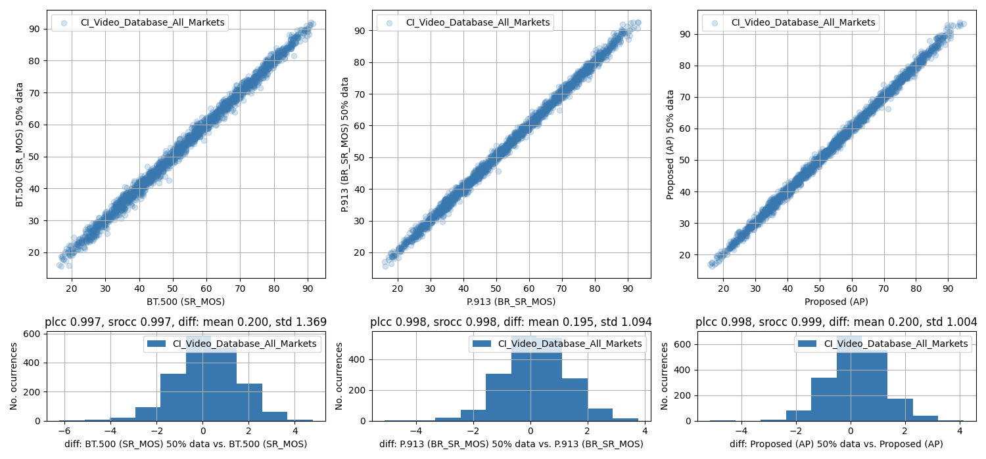
CI Study 2nd Wave Dataset* (Crowdsourcing Study)
100% Data vs. 50% Data

Slide 27
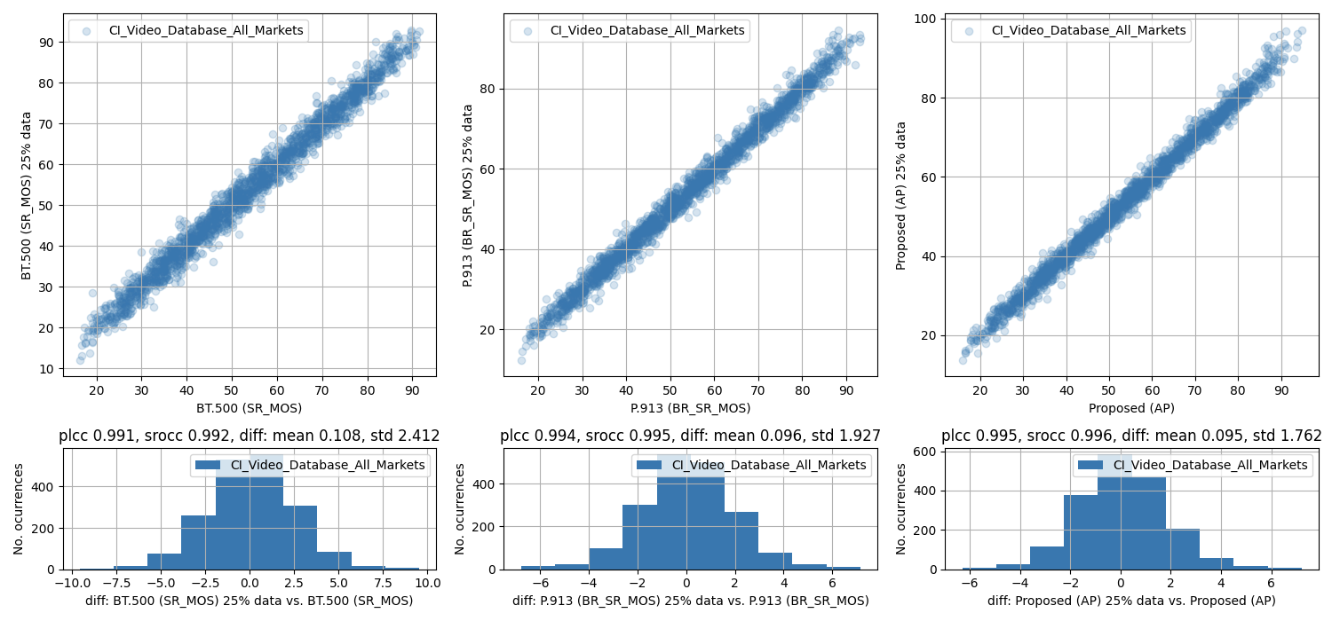
CI Study 2nd Wave Dataset* (Crowdsourcing Study)
100% Data vs. 25% Data

Slide 28
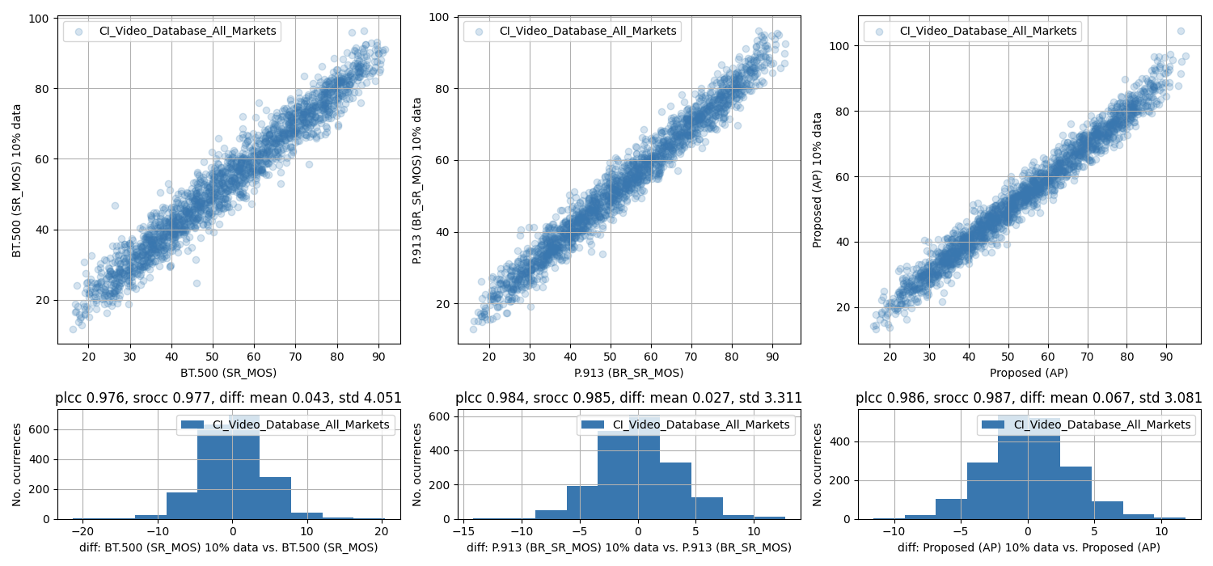
CI Study 2nd Wave Dataset* (Crowdsourcing Study)
100% Data vs. 10% Data

Slide 29
Observations on the correlation between scores recovered from the full data and partial data
On the crowdsourcing dataset we have tested, the proposed AP method is doing better (yielding higher correlation and lower variance compared to the final score) than P.913, and P.913 is doing better than BT.500.

Slide 30
Analyze VQEG FRTV Phase I Datasets:
Cross-Lab Comparison

Slide 31
VQEG FRTV Phase I Datasets
Four datasets:
  525 Line Low
  525 Line High
  625 Line Low
  625 Line High
In total 8 labs participated in the test
Each dataset is evaluated by 4 of the 8 labs
We evaluate the resulting Pearson Linear CC (PLCC) across labs

Slide 32
PLCC Across Labs
VQEG FRTV Phase I - 525 Line Low
Lab | 1 | 4 | 6 | 8
1 | 1.0 | 0.944 | 0.9438 | 0.9485
4 | 0.944 | 1.0 | 0.9577 | 0.9411
6 | 0.9438 | 0.9577 | 1.0 | 0.9443
8 | 0.9485 | 0.9411 | 0.9443 | 1.0
Lab | 1 | 4 | 6 | 8
1 | 1.0 | 0.9504 | 0.9427 | 0.95
4 | 0.9504 | 1.0 | 0.9556 | 0.9406
6 | 0.9427 | 0.9556 | 1.0 | 0.9447
8 | 0.95 | 0.9406 | 0.9447 | 1.0
Lab | 1 | 4 | 6 | 8
1 | 1.0 | 0.9523 | 0.9492 | 0.9588
4 | 0.9523 | 1.0 | 0.9574 | 0.9454
6 | 0.9492 | 0.9574 | 1.0 | 0.9487
8 | 0.9588 | 0.9454 | 0.9487 | 1.0
BT.500
P.913
Proposed AP
Colored: Best among three methods

Slide 33
PLCC Across Labs
VQEG FRTV Phase I - 525 Line High
Lab | 1 | 4 | 6 | 8
1 | 1.0 | 0.8908 | 0.9002 | 0.9151
4 | 0.8908 | 1.0 | 0.8815 | 0.8505
6 | 0.9002 | 0.8815 | 1.0 | 0.8756
8 | 0.9151 | 0.8505 | 0.8756 | 1.0
Lab | 1 | 4 | 6 | 8
1 | 1.0 | 0.8889 | 0.903 | 0.9063
4 | 0.8889 | 1.0 | 0.8679 | 0.834
6 | 0.903 | 0.8679 | 1.0 | 0.8747
8 | 0.9063 | 0.834 | 0.8747 | 1.0
Lab | 1 | 4 | 6 | 8
1 | 1.0 | 0.9068 | 0.9118 | 0.9155
4 | 0.9068 | 1.0 | 0.8763 | 0.8231
6 | 0.9118 | 0.8763 | 1.0 | 0.8331
8 | 0.9155 | 0.8231 | 0.8331 | 1.0
BT.500
P.913
Proposed AP
Colored: Best among three methods

Slide 34
PLCC Across Labs
VQEG FRTV Phase I - 625 Line Low
Lab | 2 | 3 | 5 | 7
2 | 1.0 | 0.7435 | 0.913 | 0.9149
3 | 0.7435 | 1.0 | 0.8125 | 0.7055
5 | 0.913 | 0.8125 | 1.0 | 0.9004
7 | 0.9149 | 0.7055 | 0.9004 | 1.0
Lab | 2 | 3 | 5 | 7
2 | 1.0 | 0.7649 | 0.9084 | 0.9043
3 | 0.7649 | 1.0 | 0.8408 | 0.7559
5 | 0.9084 | 0.8408 | 1.0 | 0.9055
7 | 0.9043 | 0.7559 | 0.9055 | 1.0
Lab | 2 | 3 | 5 | 7
2 | 1.0 | 0.8149 | 0.9264 | 0.923
3 | 0.8149 | 1.0 | 0.875 | 0.8047
5 | 0.9264 | 0.875 | 1.0 | 0.9184
7 | 0.923 | 0.8047 | 0.9184 | 1.0
BT.500
P.913
Proposed AP
Colored: Best among three methods

Slide 35
PLCC Across Labs
VQEG FRTV Phase I - 625 Line High
Lab | 2 | 3 | 5 | 7
2 | 1.0 | 0.7904 | 0.8538 | 0.8182
3 | 0.7904 | 1.0 | 0.818 | 0.8363
5 | 0.8538 | 0.818 | 1.0 | 0.8694
7 | 0.8182 | 0.8363 | 0.8694 | 1.0
Lab | 2 | 3 | 5 | 7
2 | 1.0 | 0.7646 | 0.7949 | 0.7377
3 | 0.7646 | 1.0 | 0.8263 | 0.8341
5 | 0.7949 | 0.8263 | 1.0 | 0.8495
7 | 0.7377 | 0.8341 | 0.8495 | 1.0
Lab | 2 | 3 | 5 | 7
2 | 1.0 | 0.8296 | 0.8184 | 0.8004
3 | 0.8296 | 1.0 | 0.8254 | 0.8604
5 | 0.8184 | 0.8254 | 1.0 | 0.8742
7 | 0.8004 | 0.8604 | 0.8742 | 1.0
BT.500
P.913
Proposed AP
Colored: Best among three methods

Slide 36
Observations from VQEG FRTV Phase I Dataset
Statistically, the proposed AP method yields better consistency (higher PLCC) across labs than BT.500 and P.913

Slide 37
Outline
Background and motivation
Proposed methodology
Progress since ITU-T SG12 C470
  New comparison results with BT.500 / P.913
  Interpreting the limitations of BT.500 / P.913
  Update on the calculation of confidence intervals
  Runtime analysis

Slide 38
NFLX Public Dataset
Black: lowest score
White: highest score
Last 4 Outliers

Slide 39
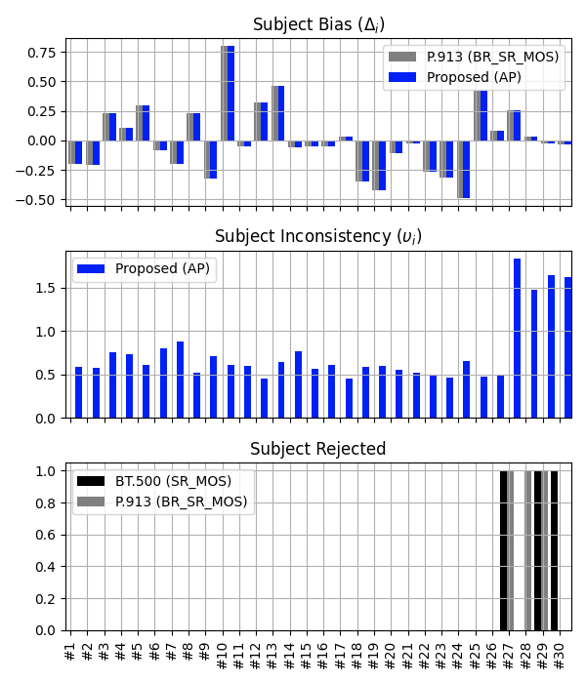
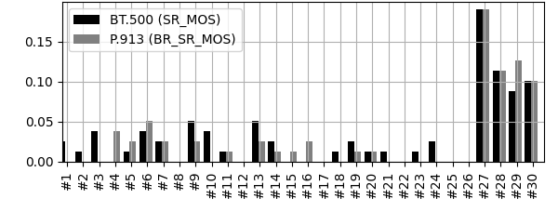
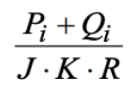
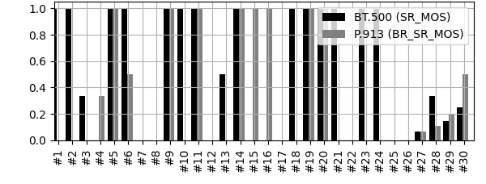
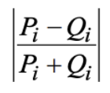
NFLX Public Dataset
(BT.500 subject rejection)
Rejected
Notes:
Upper left: the scatter plot of the proposed MLE approach vs BT.500 and P.913. The correlation is actually fairly good.
Lower left: the visualization of the raw scores. White is 5, black is 1. There are obviously a few subjects positively and negatively biased, manifested as the whitish and blackish horizontal stripes. When looking at the stripes vertically, for any particular video stimuli, I can definitely spot variations across subject, but they seems to be quite benign gaussian random variability centered around a mean. I cannot spot a clear bi-modal or multimodal distribution.
Upper right two plots: the recovered quality scores, one without CI and the other with CI.
Lower right two plots: the recovered subject bias and inconsistency, one without CI and the other with CI. The third subplot shows the subject rejection result by BT500 and P913. Interestingly, BT500 doesn't reject any subjects from your dataset, but P913 rejects 5. This can be explained by that the subjects without bias removal (P913) would contribute large variations in BT500, resulting in large sigmas, hence the threshold for subject rejection in BT500 is quite large.
I have a few questions regarding your dataset:
1) Can the PVSes be ground by content? It is unclear from the file names.
2) Have there been a pre-training before the test?

Slide 40
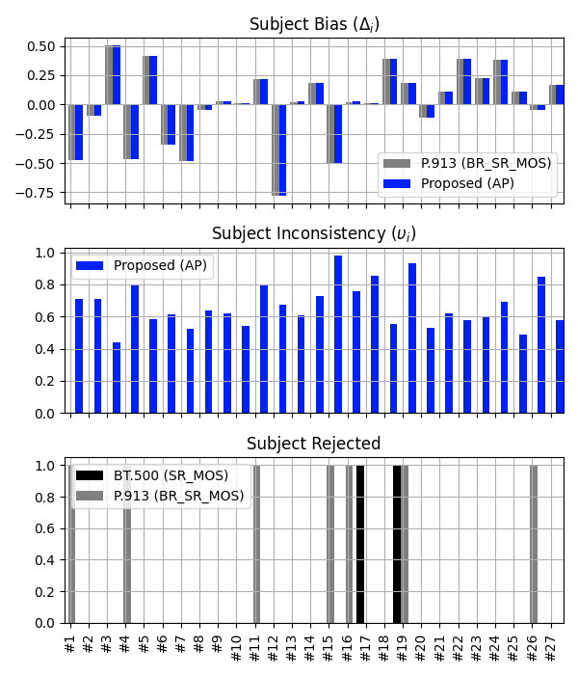
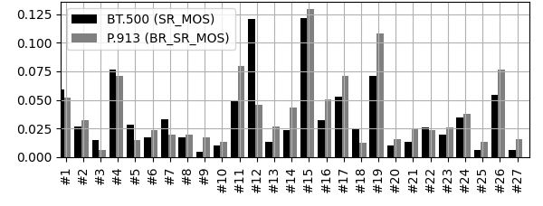
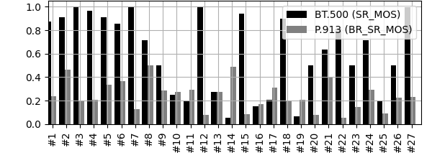
its4s_NTIA Dataset
(BT.500 subject rejection)
Rejected
Notes:
Upper left: the scatter plot of the proposed MLE approach vs BT.500 and P.913. The correlation is actually fairly good.
Lower left: the visualization of the raw scores. White is 5, black is 1. There are obviously a few subjects positively and negatively biased, manifested as the whitish and blackish horizontal stripes. When looking at the stripes vertically, for any particular video stimuli, I can definitely spot variations across subject, but they seems to be quite benign gaussian random variability centered around a mean. I cannot spot a clear bi-modal or multimodal distribution.
Upper right two plots: the recovered quality scores, one without CI and the other with CI.
Lower right two plots: the recovered subject bias and inconsistency, one without CI and the other with CI. The third subplot shows the subject rejection result by BT500 and P913. Interestingly, BT500 doesn't reject any subjects from your dataset, but P913 rejects 5. This can be explained by that the subjects without bias removal (P913) would contribute large variations in BT500, resulting in large sigmas, hence the threshold for subject rejection in BT500 is quite large.
I have a few questions regarding your dataset:
1) Can the PVSes be ground by content? It is unclear from the file names.
2) Have there been a pre-training before the test?

Slide 41
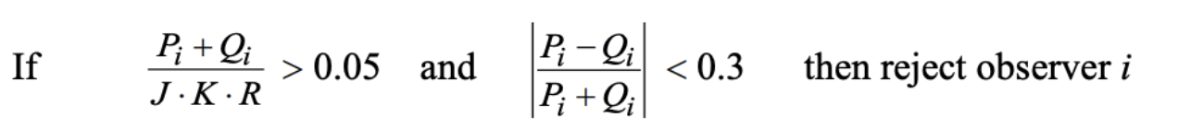
Observations on BT.500 and P.913
The hard-coded rules (the outlier % detection and skewness detection) can cause missing outliers
BT.500 and P.913 often yield contradictory results
P.913’s rejection result is more consistent than BT.500 with the subjects with large inconsistency predicted by the proposed AP method

Slide 42
Outline
Background and motivation
Proposed methodology
Progress since ITU-T SG12 C470
  New comparison results with BT.500 / P.913
  Interpreting the limitations of BT.500 / P.913
  Update on the calculation of confidence intervals
  Runtime analysis

Slide 43
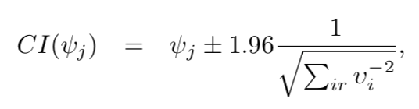
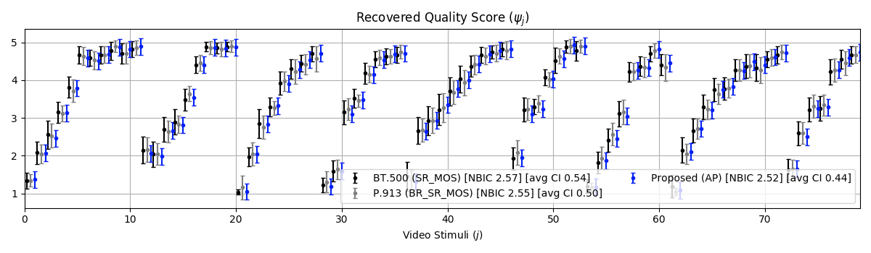
Confidence Intervals (CI) of Quality Scores
Estimated CI based on Cramer-Rao bound:
The previously proposed method results in equal CI lengths for all quality scores !

Slide 44
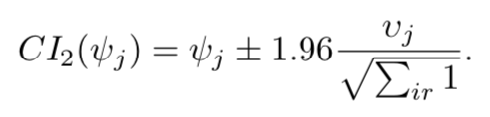


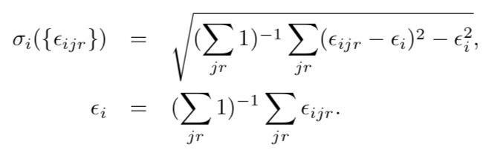
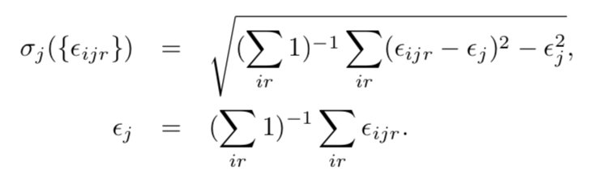
Revised CI Formula - AP vs. AP2
AP
AP2

Slide 45
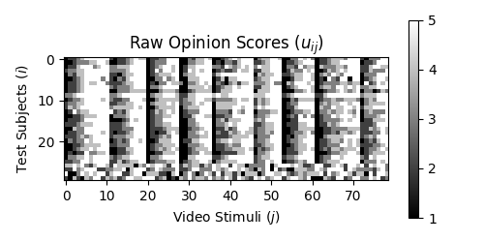
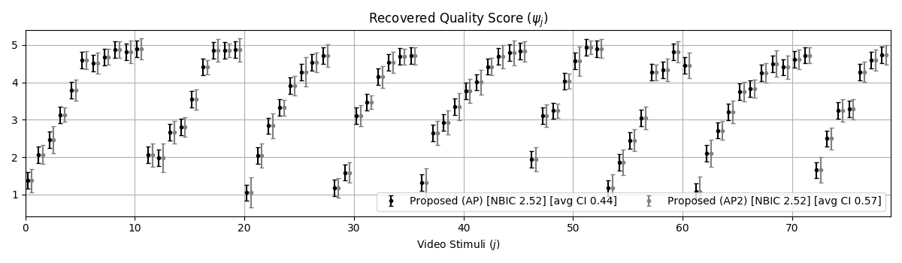
NFLX_pub - AP vs. AP2
AP has equal CI length while AP2 has unequal CI length

Slide 46
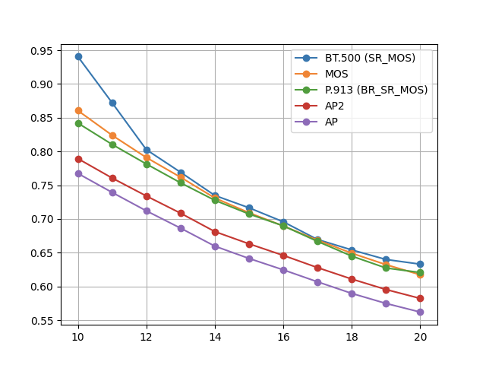
Average CI length vs. Subject numbers
Quality Variation 2017 AGH TV Dataset (Lab Study)
Average CI Length
Number of Subjects
*Each point is an average of 100x randomly selecting a given number of subjects.

Slide 47
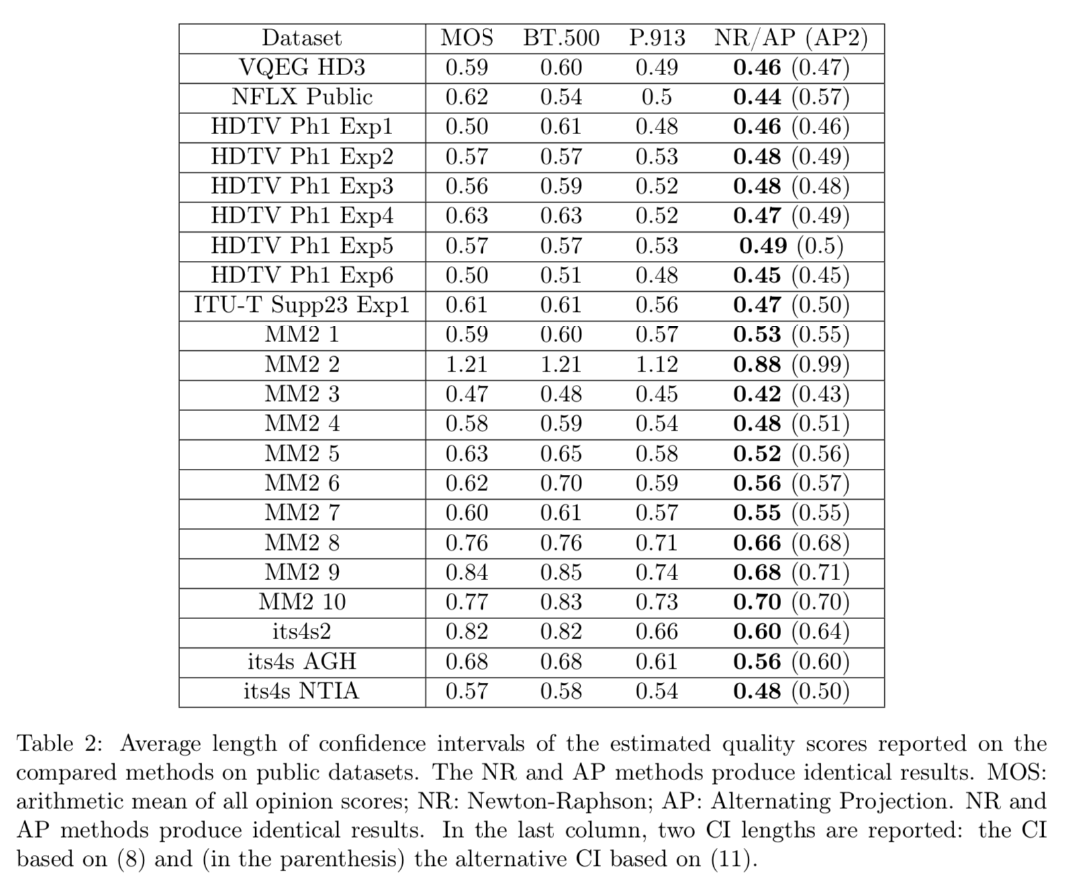
Average
CI length

Slide 48
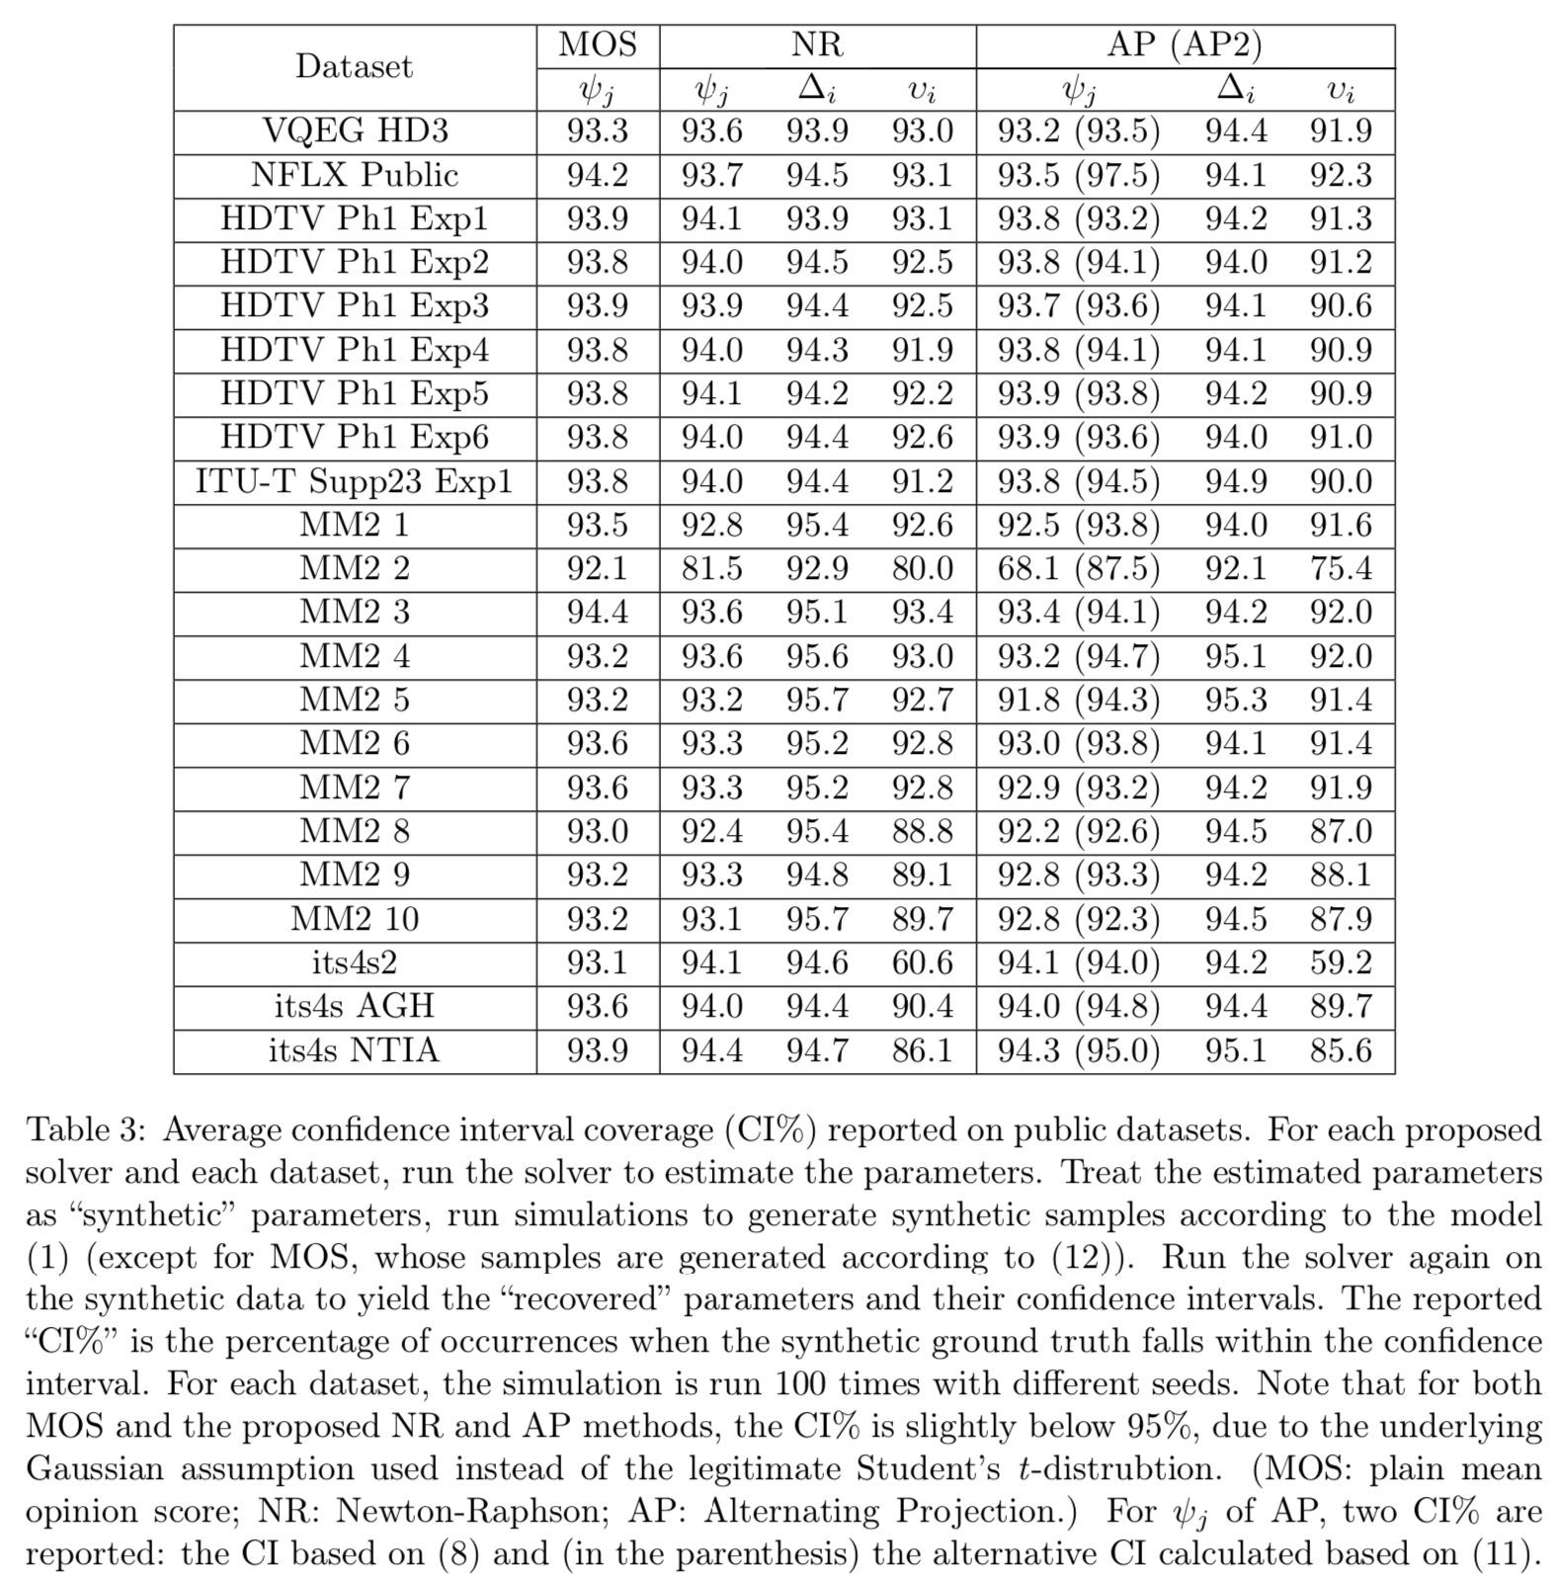
Confidence
Interval
Validation*
*Using synthetic data generated from each model, the CI should match closely to 95%.

Slide 49
Outline
Background and motivation
Proposed methodology
Progress since ITU-T SG12 C470
  New comparison results with BT.500 / P.913
  Interpreting the limitations of BT.500 / P.913
  Update on the calculation of confidence intervals
  Runtime analysis

Slide 50
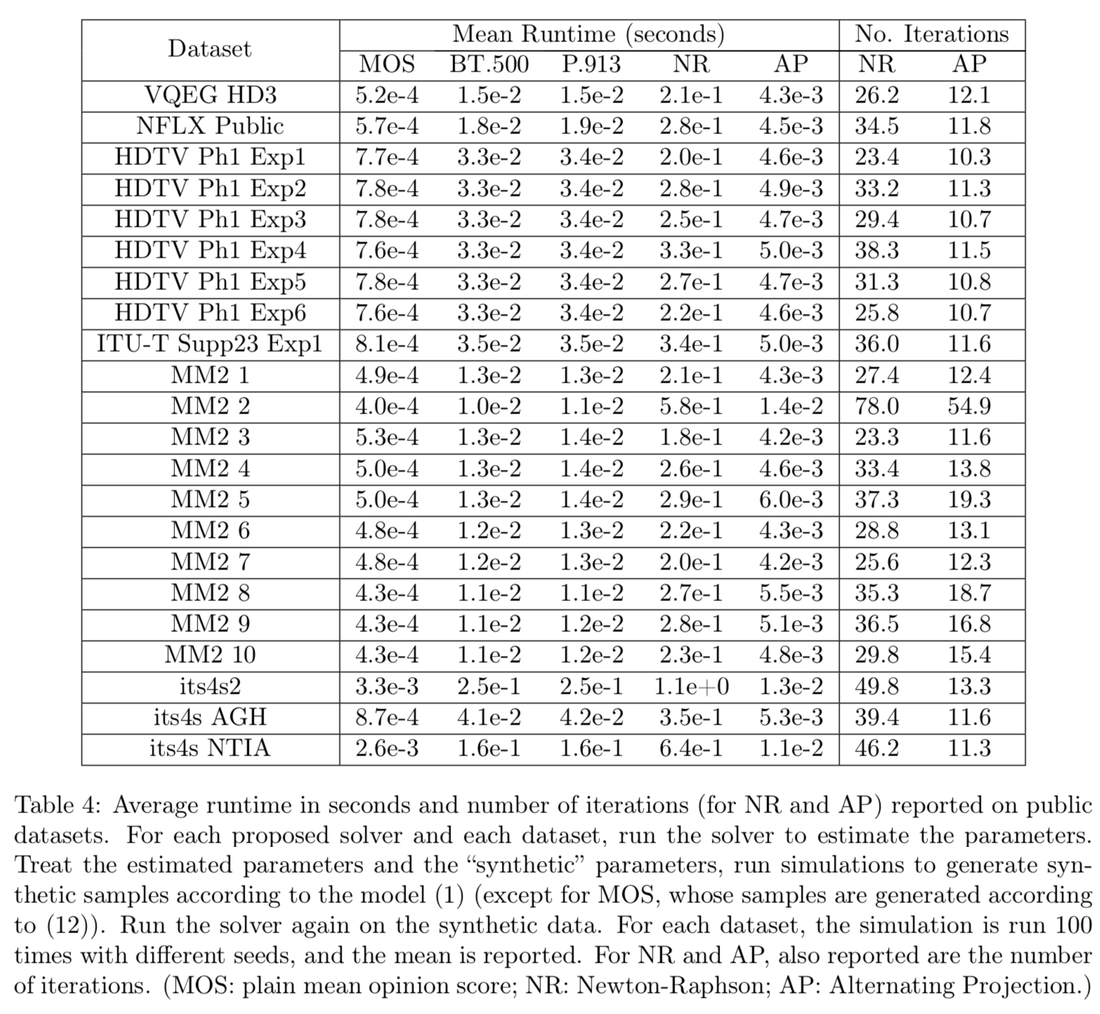
Runtime Analysis

Slide 51
Conclusions
Recommendations for subject experiment data analysis process such as ITU-R BT.500 and ITU-T P.913 are not without their own limitations
We propose new model and the corresponding MLE-based solver, which can be considered as a generalization of P.913, with the following advantages:
  Better model-data fit
  Tighter confidence intervals (hence less #subjects required)
  Better robustness against subject outliers
  Negligible runtime increase - similar to BT.500/P.913
  Absence of hard coded parameters / thresholds
  Auxiliary information on test subjects
We propose to standardize the AP method (with confidence interval calculated as in AP2) in recommendation P.913 (and in the future, BT.500)

Slide 52
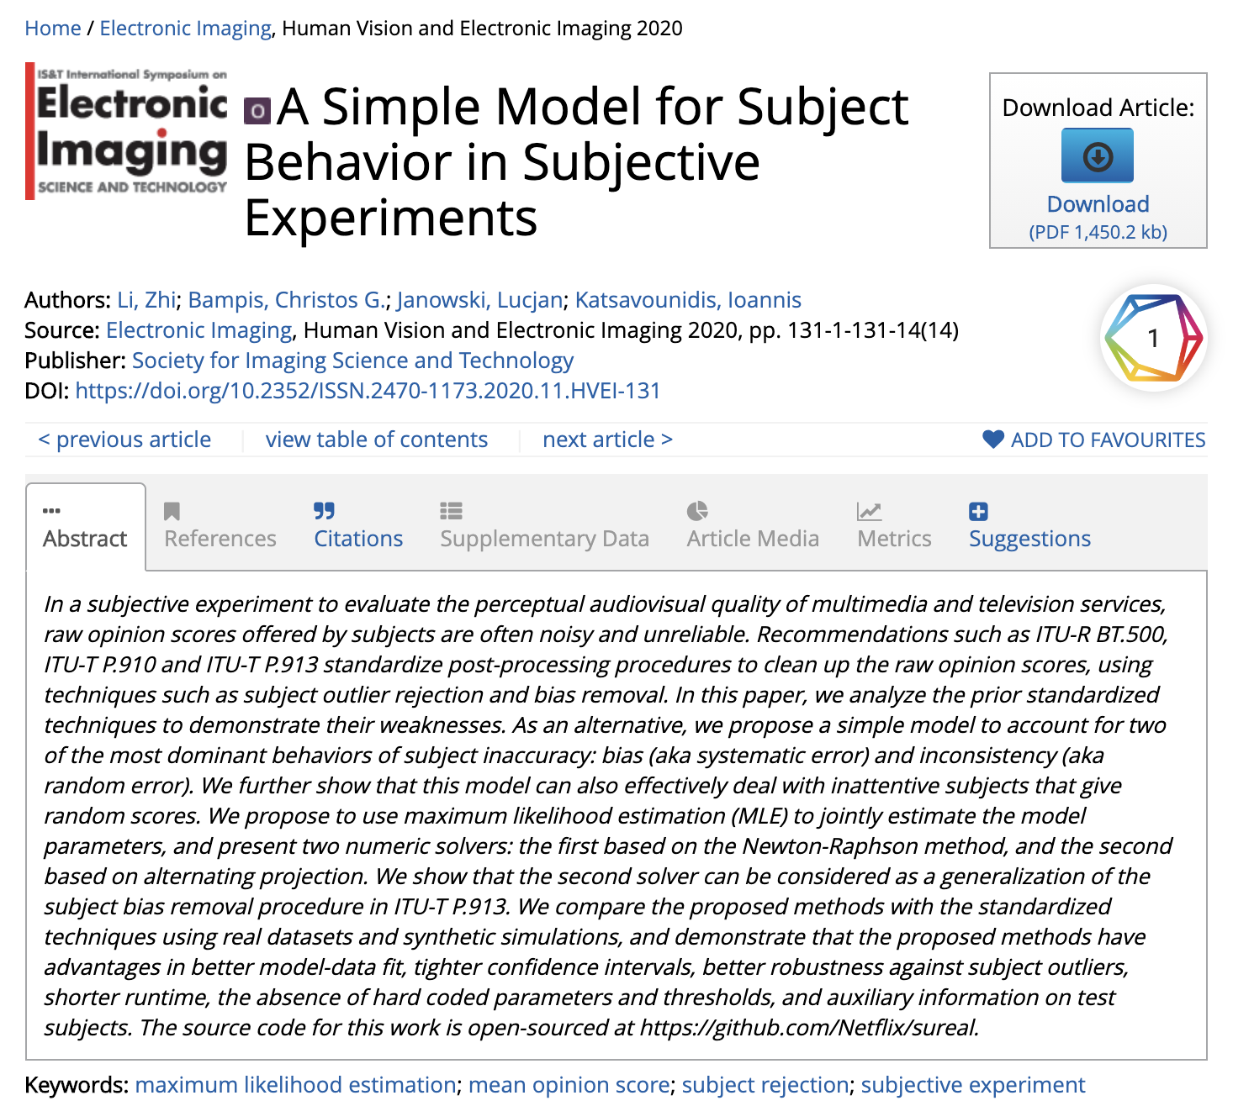
Publication &
Open Source Code
Publication available at: https://www.ingentaconnect.com/contentone/ist/ei/pre-prints/content-ei2020-hvei-131
Source code - free and open-sourced - can be found at https://github.com/Netflix/sureal

Slide 53
Backup Slides

Slide 54
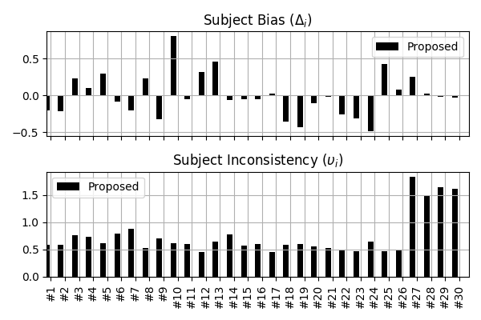
Sample Recovery Results
*NFLX Public Dataset

Slide 55
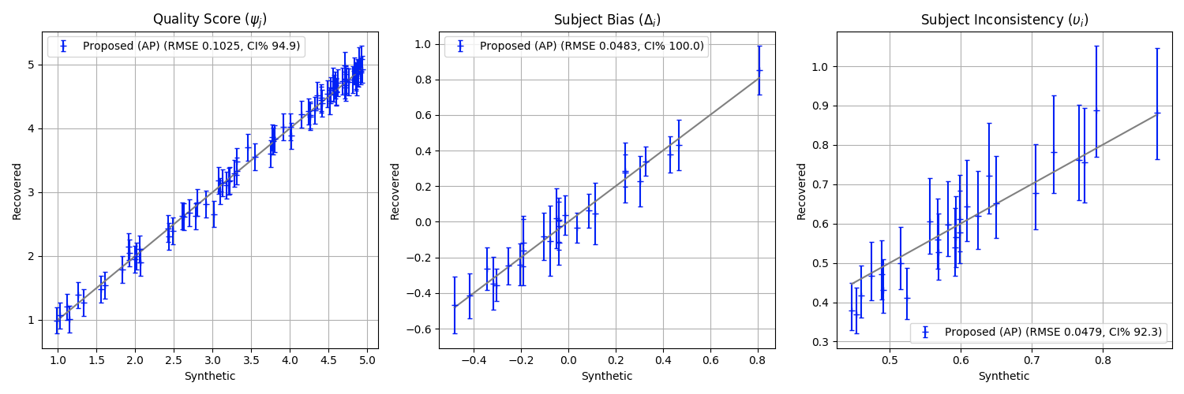
Solver Accuracy Validation
Using Synthetic Data
Synthetic data generation
  Take NFLX Public dataset, run solver to estimate parameters
  Treat the estimated parameters as synthetic “ground truth”, run simulations to generate synthetic samples according to the proposed model
  Run solver on the generated samples to recover the parameters again
SR: subject rejection; BR: bias removal; MOS: mean opinion score; RMSE: root mean squared error

Slide 56
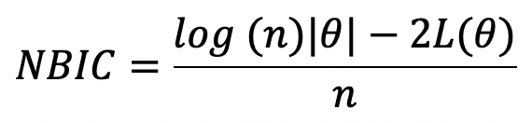
Model-Data Fit Validation
Using Bayesian Information Criterion
BIC is a criterion for model fitting, balancing between:
  The degree of freedom (number of parameters)
  The goodness of fit (log-likelihood function)
Use “normalized” BIC (NBIC) to compare across datasets
  |𝜃| - the number of model parameters
  n - the number of observations (i.e. raw opinion scores)
  L(𝜃) - log-likelihood function

Slide 57
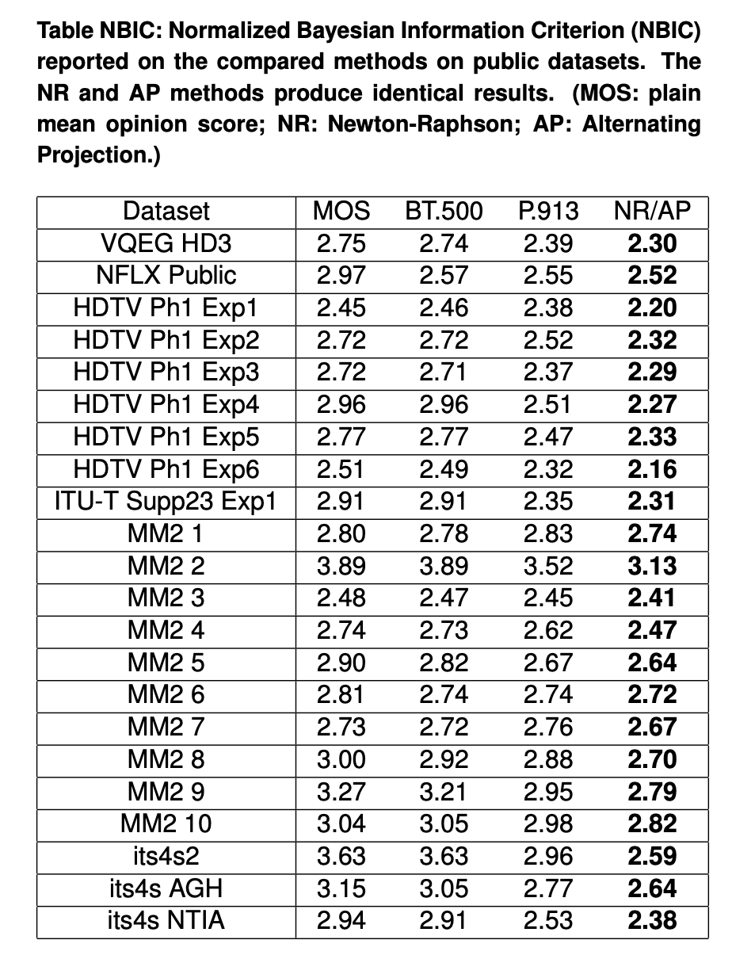
Normalized Bayesian Information Criterion (NBIC)*
*The model with the smallest
NBIC is preferred.

Slide 58
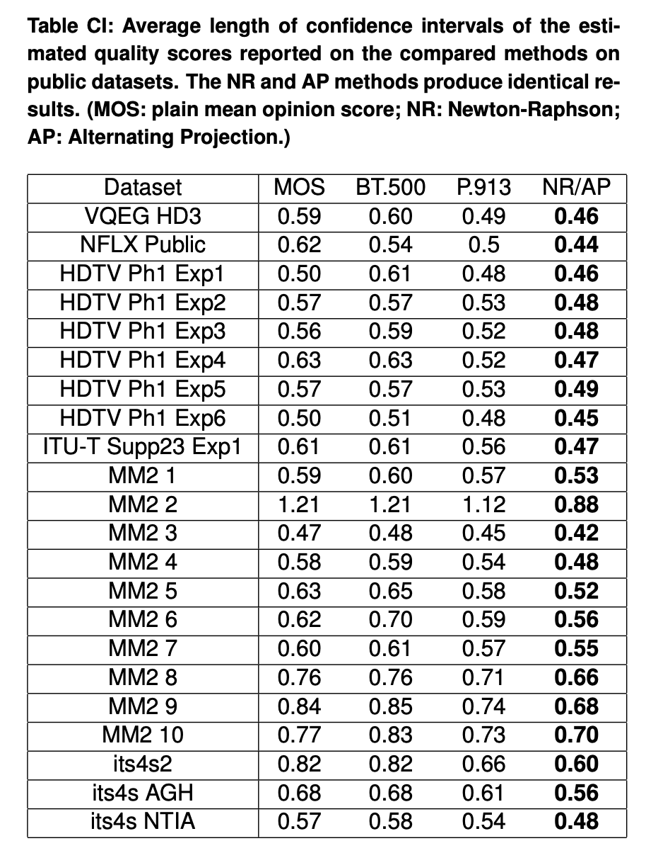
Confidence intervals of Estimated Quality Scores

Slide 59
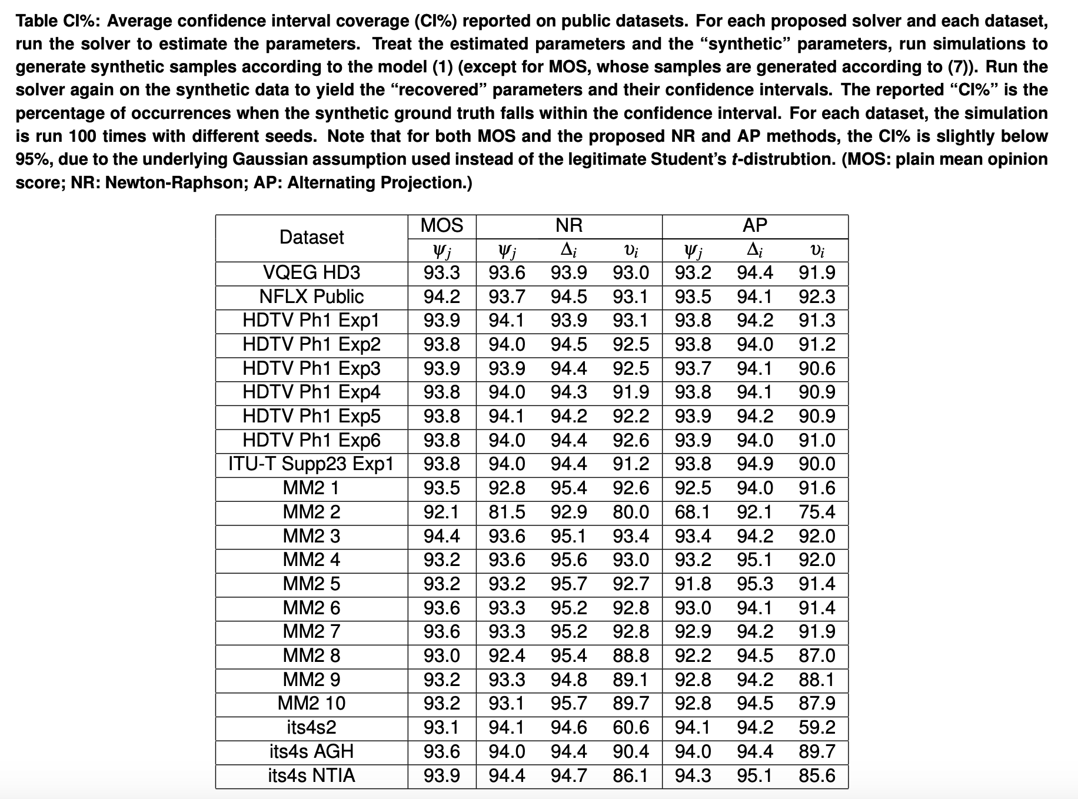
Confidence Interval Validation*
*Using synthetic data generated from each model, the CI should match closely to 95%.

Slide 60
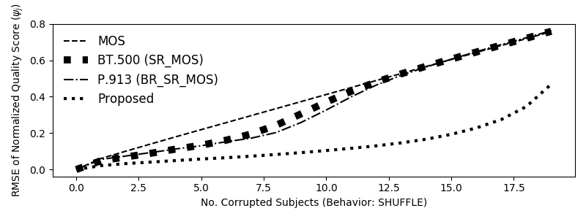
Robustness Against Subject Outliers
Worse
Better
Random behavior: a subject’s scores are shuffled among themselves
Y-axis: RMSE with respect to clean case
SR: subject rejection; BR: bias removal; MOS: mean opinion score; RMSE: root mean squared error

Slide 61
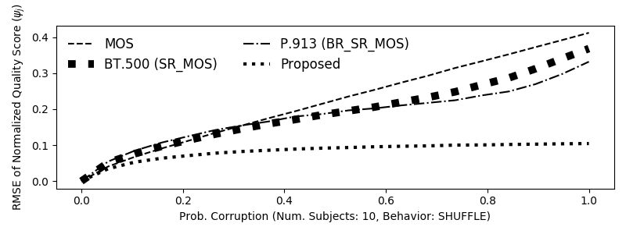
Robustness Against Increasing Corruption Probability
Worse
Better
10 random subjects are corrupted, with corruption probability varying from 0.0 to 1.0
Y-axis: RMSE with respect to clean case
SR: subject rejection; BR: bias removal; MOS: mean opinion score; RMSE: root mean squared error

Slide 62
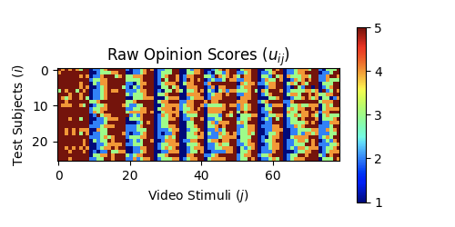
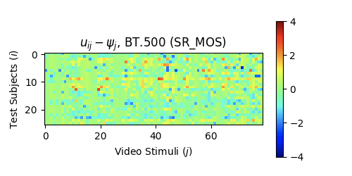
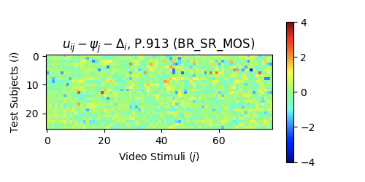
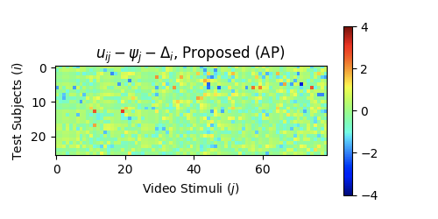
Model Residue Visualization
NFLX Public Dataset (Lab Study)
Raw Scores
Model Residue (BT.500)
Model Residue (P.913)
Model Residue (Proposed)
For a good scheme, the residue should look like random noise
Notes:
Upper left: the scatter plot of the proposed MLE approach vs BT.500 and P.913. The correlation is actually fairly good.
Lower left: the visualization of the raw scores. White is 5, black is 1. There are obviously a few subjects positively and negatively biased, manifested as the whitish and blackish horizontal stripes. When looking at the stripes vertically, for any particular video stimuli, I can definitely spot variations across subject, but they seems to be quite benign gaussian random variability centered around a mean. I cannot spot a clear bi-modal or multimodal distribution.
Upper right two plots: the recovered quality scores, one without CI and the other with CI.
Lower right two plots: the recovered subject bias and inconsistency, one without CI and the other with CI. The third subplot shows the subject rejection result by BT500 and P913. Interestingly, BT500 doesn't reject any subjects from your dataset, but P913 rejects 5. This can be explained by that the subjects without bias removal (P913) would contribute large variations in BT500, resulting in large sigmas, hence the threshold for subject rejection in BT500 is quite large.
I have a few questions regarding your dataset:
1) Can the PVSes be ground by content? It is unclear from the file names.
2) Have there been a pre-training before the test?

Slide 63
Scatter plot: Proposed vs. BT.500/P.913
More Datasets

Slide 64
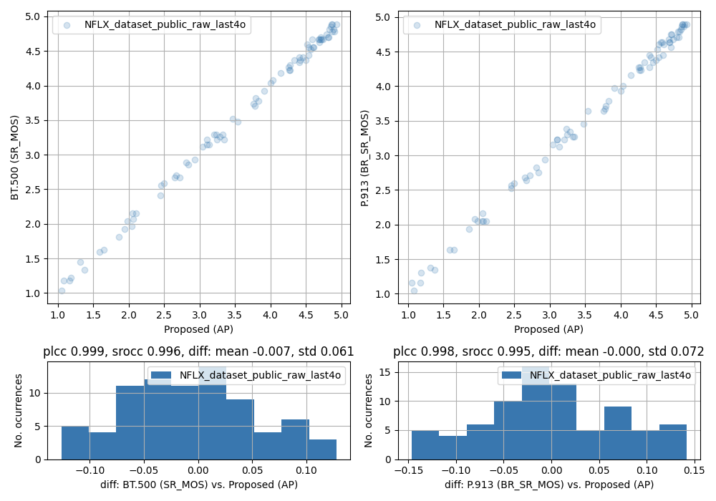
Recovered Quality Score - Proposed vs. BT.500/P.913
NFLX Public Dataset (Lab Study)

Slide 65
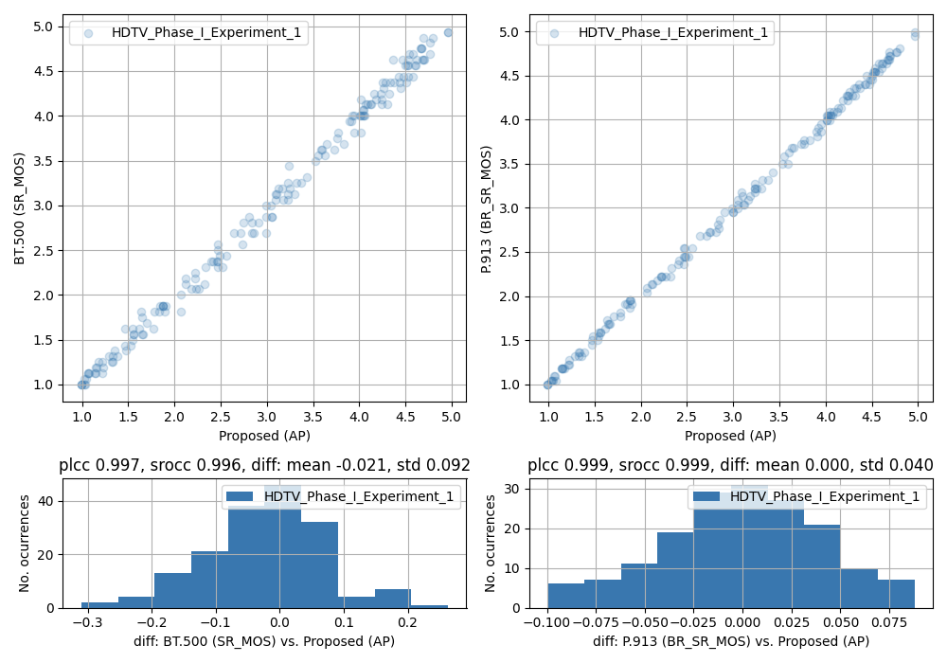
Recovered Quality Score - Proposed vs. BT.500/P.913
VQEG HDTV Phase I Exp 1 (Lab Study)

Slide 66
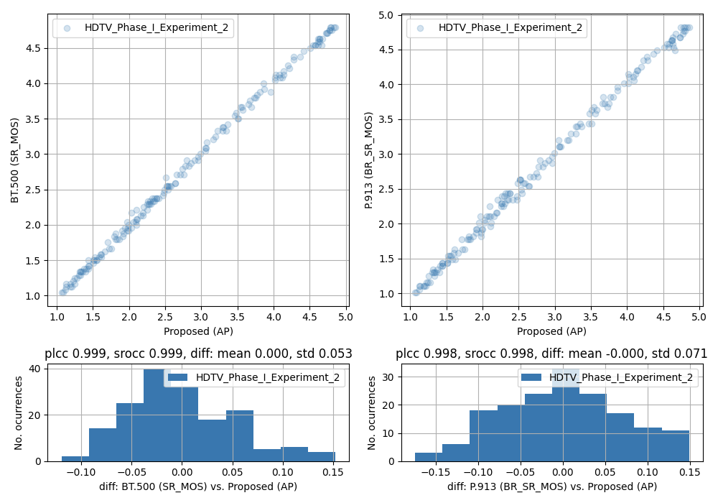
Recovered Quality Score - Proposed vs. BT.500/P.913
VQEG HDTV Phase I Exp 2 (Lab Study)

Slide 67
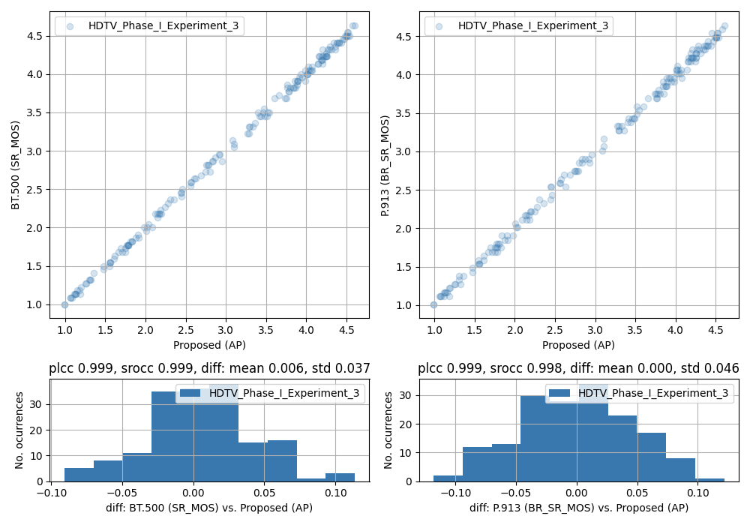
Recovered Quality Score - Proposed vs. BT.500/P.913
VQEG HDTV Phase I Exp 3 (Lab Study)

Slide 68

Recovered Quality Score - Proposed vs. BT.500/P.913
VQEG HDTV Phase I Exp 4 (Lab Study)

Slide 69

Recovered Quality Score - Proposed vs. BT.500/P.913
VQEG HDTV Phase I Exp 5 (Lab Study)

Slide 70

Recovered Quality Score - Proposed vs. BT.500/P.913
VQEG HDTV Phase I Exp 6 (Lab Study)

Slide 71

Recovered Quality Score - Proposed vs. BT.500/P.913
ITU-T Supp 23 Experiment 1 BNR - Audio (Lab Study)

Slide 72

Recovered Quality Score - Proposed vs. BT.500/P.913
MM2 1 (Lab Study)

Slide 73

Recovered Quality Score - Proposed vs. BT.500/P.913
MM2 2 (Lab Study)

Slide 74

Recovered Quality Score - Proposed vs. BT.500/P.913
MM2 3 (Lab Study)

Slide 75

Recovered Quality Score - Proposed vs. BT.500/P.913
MM2 4 (Lab Study)

Slide 76

Recovered Quality Score - Proposed vs. BT.500/P.913
MM2 5 (Lab Study)

Slide 77

Recovered Quality Score - Proposed vs. BT.500/P.913
MM2 6 (Lab Study)

Slide 78

Recovered Quality Score - Proposed vs. BT.500/P.913
MM2 7 (Lab Study)

Slide 79

Recovered Quality Score - Proposed vs. BT.500/P.913
MM2 8 (Lab Study)

Slide 80

Recovered Quality Score - Proposed vs. BT.500/P.913
MM2 9 (Lab Study)

Slide 81

Recovered Quality Score - Proposed vs. BT.500/P.913
MM2 10 (Lab Study)

Slide 82

Recovered Quality Score - Proposed vs. BT.500/P.913
its4s2 (Lab Study)

Slide 83

Recovered Quality Score - Proposed vs. BT.500/P.913
its4s2 AGH (Lab Study)

Slide 84

Recovered Quality Score - Proposed vs. BT.500/P.913
its4s2 AGH NTIA (Lab Study)

Slide 85

Recovered Quality Score - Proposed vs. BT.500/P.913
Quality Variation 2017 Ghent Dataset (Lab Study)

Slide 86

Recovered Quality Score - Proposed vs. BT.500/P.913
Quality Variation 2017 AGH Tablet Dataset (Lab Study)

Slide 87

Recovered Quality Score - Proposed vs. BT.500/P.913
AS2015 UPM w/ audio (Lab Study)

Slide 88

Recovered Quality Score - Proposed vs. BT.500/P.913
AS2015 UPM w/o audio (Lab Study)

Slide 89

Recovered Quality Score - Proposed vs. BT.500/P.913
AS2015 ACREO w/o audio (Lab Study)

Slide 90

Recovered Quality Score - Proposed vs. BT.500/P.913
VQEG FRTV Phase I 525 line low (Lab Study)

Slide 91

Recovered Quality Score - Proposed vs. BT.500/P.913
VQEG FRTV Phase I 525 line high (Lab Study)

Slide 92

Recovered Quality Score - Proposed vs. BT.500/P.913
VQEG FRTV Phase I 625 line low (Lab Study)

Slide 93

Recovered Quality Score - Proposed vs. BT.500/P.913
VQEG FRTV Phase I 625 line high (Lab Study)

Slide 94
Recovered Result by the Proposed Method
More Datasets

Slide 95




VQEGHD3_dataset_raw

Slide 96



NFLX_public_last4outliers

Slide 97




HDTV_Phase_I_Experiment_1

Slide 98




HDTV_Phase_I_Experiment_2

Slide 99




HDTV_Phase_I_Experiment_3

Slide 100




HDTV_Phase_I_Experiment_4

Slide 101




HDTV_Phase_I_Experiment_5

Slide 102




HDTV_Phase_I_Experiment_6

Slide 103




ITU-T_Supp_23_Experiment_1_BNR

Slide 104




MM2_1

Slide 105




MM2_2

Slide 106




MM2_3

Slide 107




MM2_4

Slide 108





MM2_5

Slide 109




MM2_6

Slide 110




MM2_7

Slide 111




MM2_8

Slide 112




MM2_9

Slide 113




MM2_10

Slide 114




its4s2

Slide 115




its4s_AGH

Slide 116




its4s_NTIA

Slide 117




quality_variation_2017_ghent

Slide 118




quality_variation_2017_agh_tablet

Slide 119




quality_variation_2017_agh_tv

Slide 120



upm_acreo_as2015_upm_with_audio_dataset

Slide 121



upm_acreo_as2015_upm_without_audio_dataset

Slide 122



upm_acreo_as2015_acreo_without_audio_dataset

Slide 123



vqeg_frtv_p1_525_line_low_dataset

Slide 124



vqeg_frtv_p1_525_line_high_dataset

Slide 125



vqeg_frtv_p1_625_line_low_dataset

Slide 126



vqeg_frtv_p1_625_line_high_dataset

