Slide 1
No Reference Metric Research Paradigm
Margaret H. Pinson
mpinson@ntia.gov

Slide 2
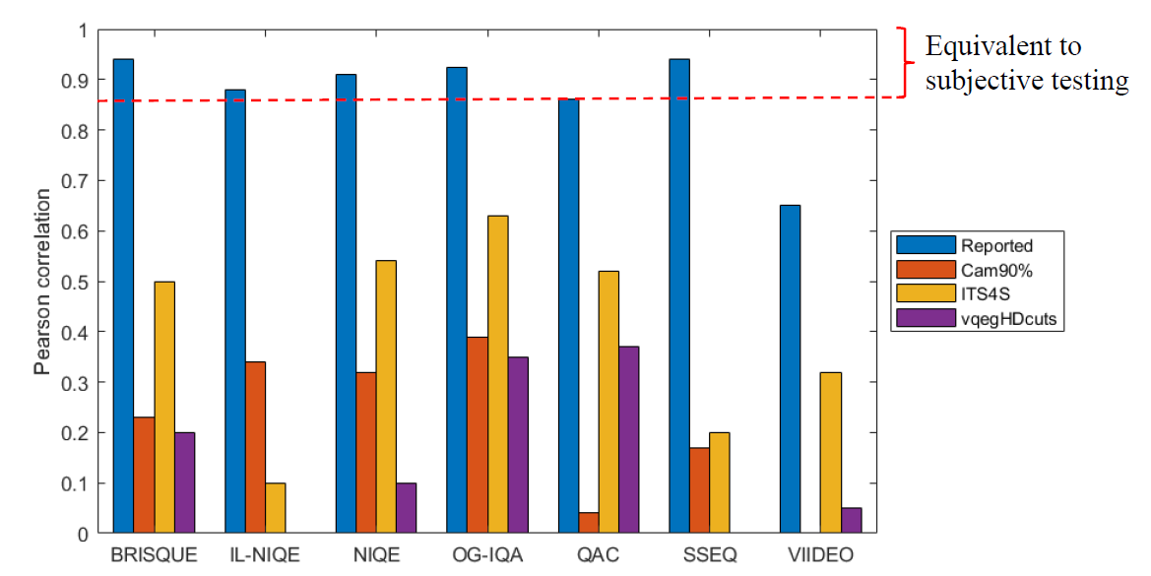
Prior Work—Limited Scope, No Camera Impairments
unglamorous,
Limit scope
  Simplify, few impairments
  External validity problems
  Visual patterns differ
VQEG validation test
  FR, RR, Hybrid, …
  Good quality SRC
Expand scope?
  Not observed
Margaret H. Pinson, "Analysis of No-Reference Metrics for Image and Video Quality of Consumer Applications," NTIA Technical Memo TM-20-547, Jan. 2020

Slide 3
NR Metric Design Problems
Current Resources
Design Challenges
NORM design specifications
12 datasets
  4,655 images, camera capture
  1,989 videos, camera capture
  3,188 videos, simulated broadcast
NR Metric Framework
Significance test
Diverse researchers
  Unfocused, different applications
Root cause analysis (RCA)
Incremental improvement
MOS is a function of application
  Simple way to adjust (recipe)
Broad scope
  Camera impairments
  Modern cameras
  Videographer
  Any scene
  Diverse applications

Slide 4
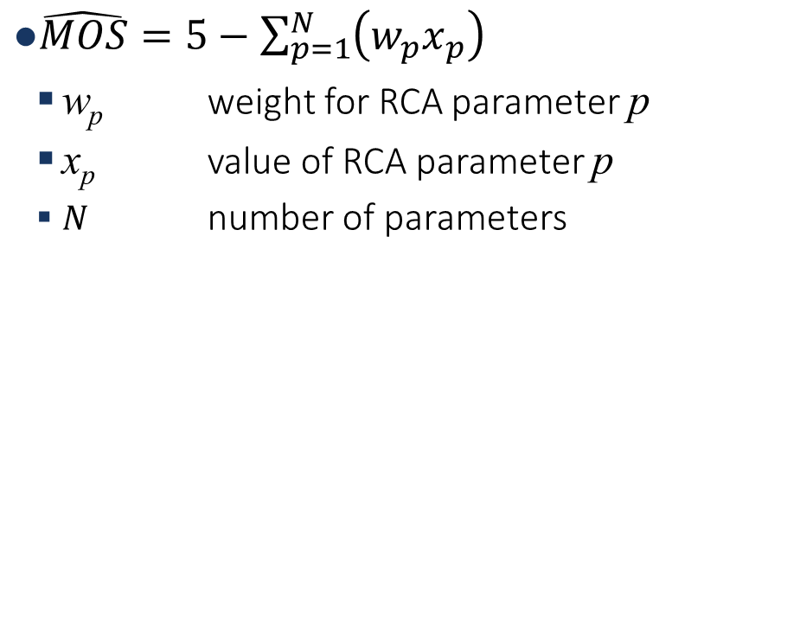
From RCA to $\hat{MOS}$
$\hat{MOS}=5−\sum_{p=1}^{N}{\left(w_{p}x_{p}\right)}$
  w_{p} weight for RCA parameter p
  x_{p} value of RCA parameter p
  $N$ number of parameters
Functional programming
Split the research effort by impairment
Ignore impairment: w_{p} = 0
Include
  Image & video
  Camera capture (1st)
  Compression (2nd)
Exclude
  Temporal integration
  Transmission errors

Slide 5
How to Train RCA?
RCA Challenges
RCA Training Strategies Evaluated
MOS influenced by multiple impairments
Datasets have different impairments
  Type
  Severity
  Relevance
  → application specific factor
Pearson correlation misleading
Challenge dataset
  Explore one impairment
  Minimize other impairments
Look at scatter plots

Slide 6
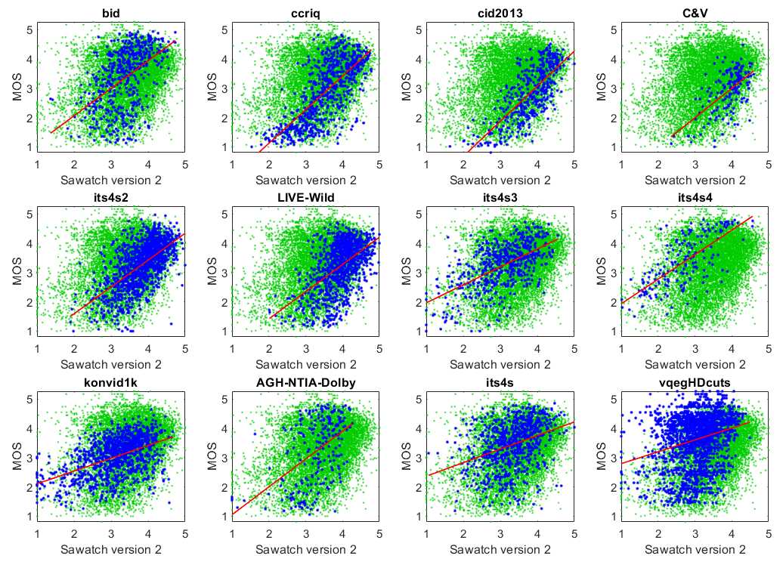
Sawatch Version 2
Image Dataset, Camera Capture | Pearson Correlation | False Ranking
BID | 0.50 | 19%
CCRIQ | 0.72 | 12%
CID2013 | 0.75 | 11%
CCRIQ2 & VIME1 | 0.58 | 15%
ITS4S2 | 0.63 | 12%
LIVE-Wild | 0.53 | —
Video Dataset, Camera Capture | Pearson Correlation | False Ranking
ITS4S3 | 0.58 | 15%
ITS4S4 | 0.72 | 11%
KonViD-1K | 0.50 | 15%
Video Dataset, Compression | Pearson Correlation | False Ranking
AGH/NTIA/Dolby | 0.50 | 21%
ITS4S | 0.36 | 21%
vqegHDcuts | 0.26 | 25%

Slide 7
RCA Scatter Plot — Scatter Around a Line
5
MOS
1
0
(min)
1
(max)
RCA Parameter

Slide 8
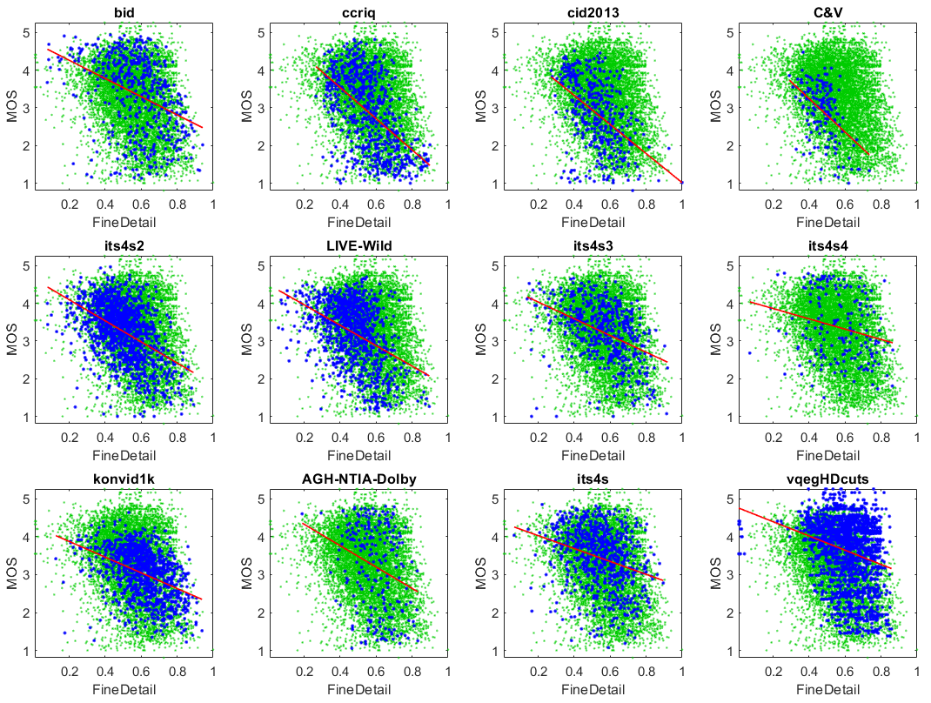
Fine Detail w_{p} = 0.50
Image Dataset, Camera Capture | Pearson Correlation
BID | 0.38
CCRIQ | 0.53
CID2013 | 0.49
CCRIQ2 & VIME1 | 0.47
ITS4S2 | 0.47
LIVE-Wild | 0.42
Video Dataset, Camera Capture | Pearson Correlation
ITS4S3 | 0.43
ITS4S4 | 0.23
KonViD-1K | 0.42
Video Dataset, Compression | Pearson Correlation
AGH/NTIA/Dolby | 0.27
ITS4S | 0.30
vqegHDcuts | 0.25

Slide 9
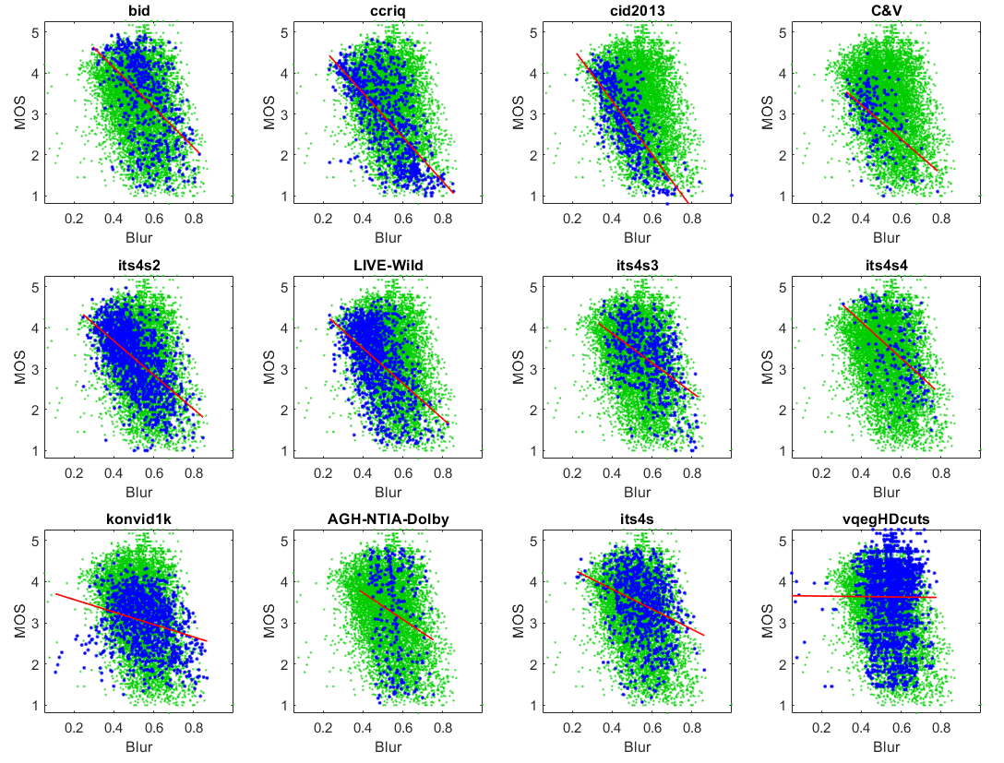
Blur w_{p} = 0.80
Image Dataset, Camera Capture | Pearson Correlation
BID | 0.49
CCRIQ | 0.66
CID2013 | 0.75
CCRIQ2 & VIME1 | 0.49
ITS4S2 | 0.60
LIVE-Wild | 0.50
Video Dataset, Camera Capture | Pearson Correlation
ITS4S3 | 0.50
ITS4S4 | 0.51
KonViD-1K | 0.28
Video Dataset, Compression | Pearson Correlation
AGH/NTIA/Dolby | 0.21
ITS4S | 0.31
vqegHDcuts | 0.01

Slide 10
RCA Scatter Plot — Lower Triangle
5
MOS
1
RCA Parameter
0
(min)
1
(max)

Slide 11
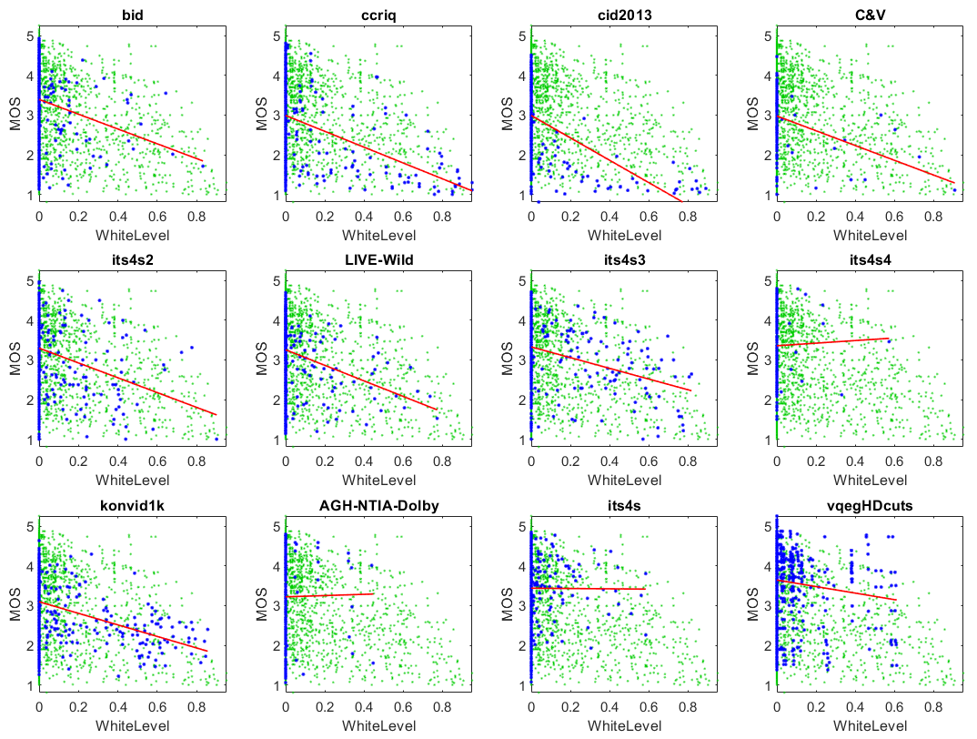
White Level w_{p} = 0.25
Image Dataset, Camera Capture | Pearson Correlation
BID | 0.16
CCRIQ | 0.33
CID2013 | 0.48
CCRIQ2 & VIME1 | 0.32
ITS4S2 | 0.20
LIVE-Wild | 0.18
Video Dataset, Camera Capture | Pearson Correlation
ITS4S3 | 0.31
ITS4S4 | 0.02
KonViD-1K | 0.34
Video Dataset, Compression | Pearson Correlation
AGH/NTIA/Dolby | 0.01
ITS4S | 0.00
vqegHDcuts | 0.22
Professional videographers

Slide 12
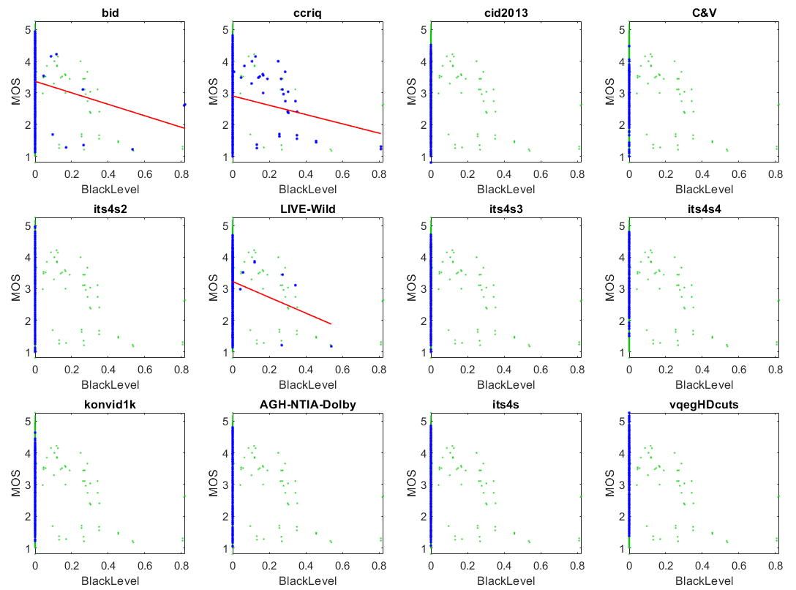
Black Level w_{p} = 0.25
Image Dataset, Camera Capture | Pearson Correlation
BID | 0.11
CCRIQ | 0.10
CID2013 | —
CCRIQ2 & VIME1 | —
ITS4S2 | —
LIVE-Wild | 0.07
Video Dataset, Camera Capture | Pearson Correlation
ITS4S3 | —
ITS4S4 | —
KonViD-1K | —
Video Dataset, Compression | Pearson Correlation
AGH/NTIA/Dolby | —
ITS4S | —
vqegHDcuts | —

Slide 13
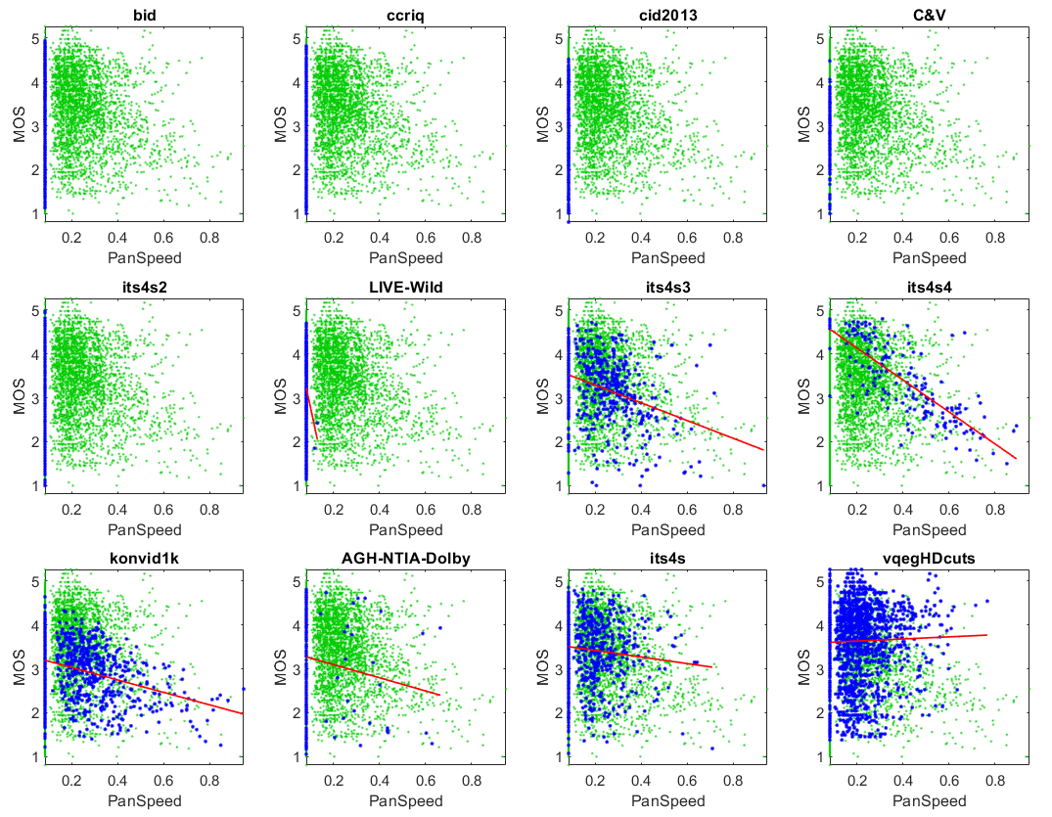
Pan Speed w_{p} = 0.70
Image Dataset, Camera Capture | Pearson Correlation
BID | —
CCRIQ | —
CID2013 | —
CCRIQ2 & VIME1 | —
ITS4S2 | —
LIVE-Wild | —
Video Dataset, Camera Capture | Pearson Correlation
ITS4S3 | 0.35
ITS4S4 | 0.79
KonViD-1K | 0.34
Video Dataset, Compression | Pearson Correlation
AGH/NTIA/Dolby | 0.13
ITS4S | 0.10
vqegHDcuts | 0.03
Challenge dataset

Slide 14
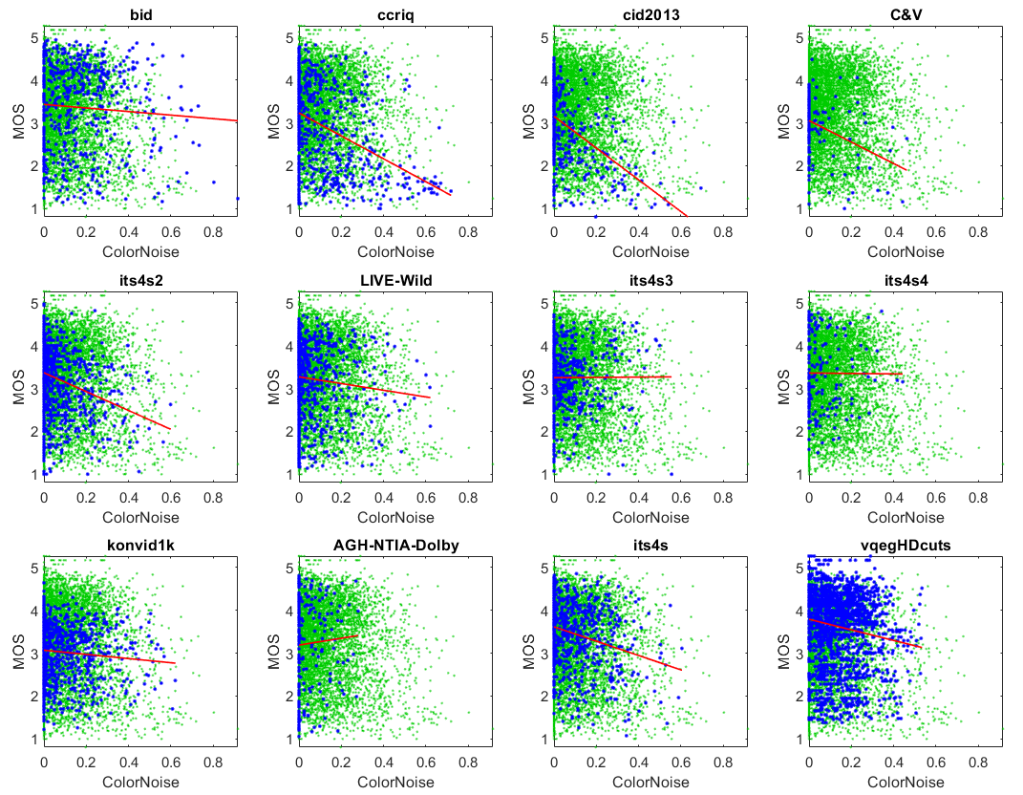
Color Noise w_{p} = 0.35
Image Dataset, Camera Capture | Pearson Correlation
BID | 0.07
CCRIQ | 0.41
CID2013 | 0.49
CCRIQ2 & VIME1 | 0.34
ITS4S2 | 0.26
LIVE-Wild | 0.09
Video Dataset, Camera Capture | Pearson Correlation
ITS4S3 | 0.00
ITS4S4 | 0.01
KonViD-1K | 0.09
Video Dataset, Compression | Pearson Correlation
AGH/NTIA/Dolby | 0.05
ITS4S | 0.25
vqegHDcuts | 0.15

Slide 15
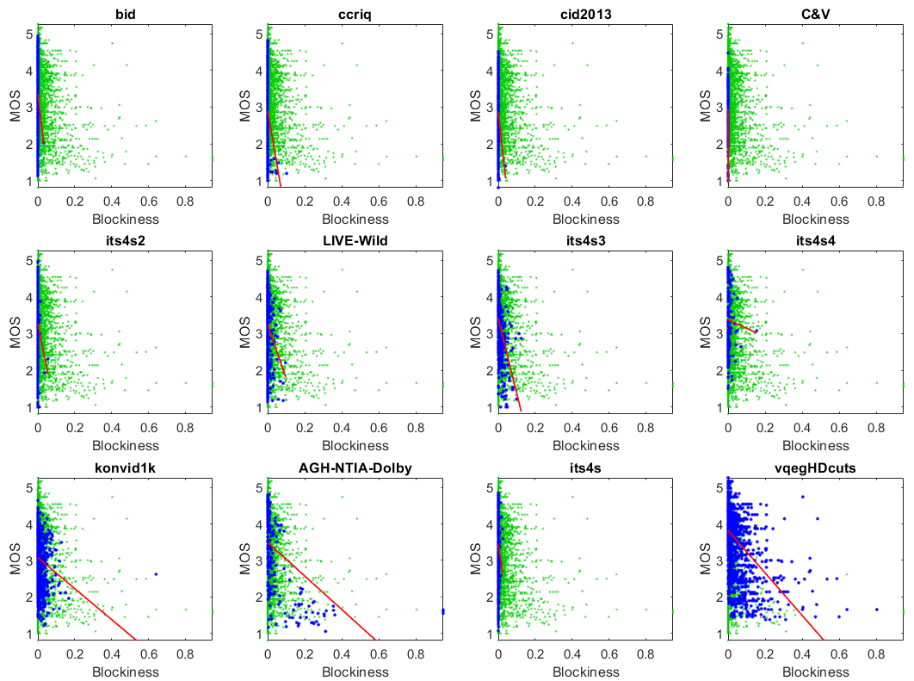
Blockiness w_{p} = 0.80
Image Dataset, Camera Capture | Pearson Correlation
BID | 0.06
CCRIQ | 0.16
CID2013 | 0.10
CCRIQ2 & VIME1 | 0.25
ITS4S2 | 0.07
LIVE-Wild | 0.15
Video Dataset, Camera Capture | Pearson Correlation
ITS4S3 | 0.45
ITS4S4 | 0.04
KonViD-1K | 0.18
Video Dataset, Compression | Pearson Correlation
AGH/NTIA/Dolby | 0.54
ITS4S | 0.09
vqegHDcuts | 0.44

Slide 16
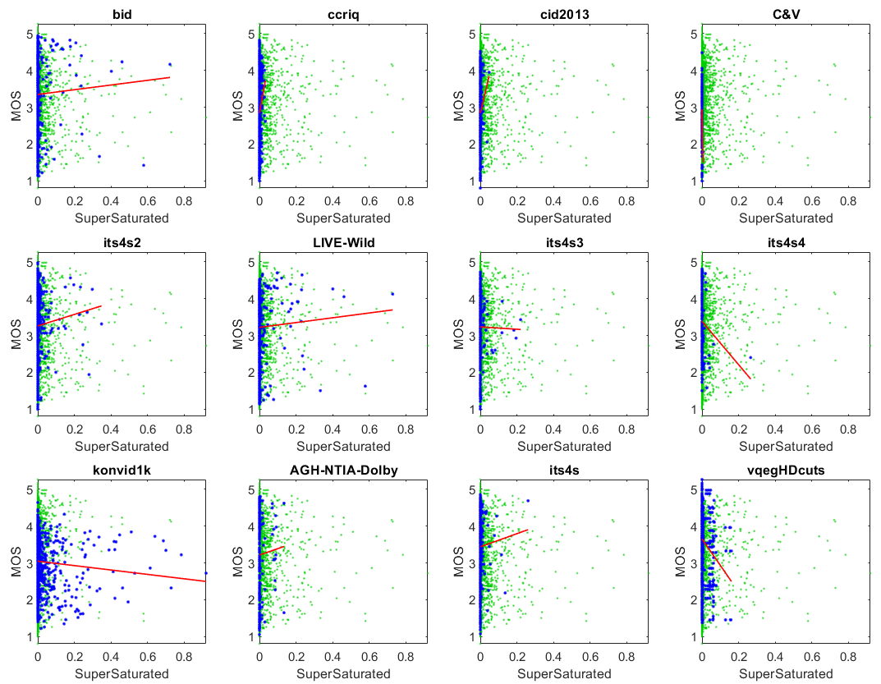
Super Saturation w_{p} = 0.05
Image Dataset, Camera Capture | Pearson Correlation
BID | 0.04
CCRIQ | 0.12
CID2013 | 0.09
CCRIQ2 & VIME1 | 0.17
ITS4S2 | 0.05
LIVE-Wild | 0.03
Video Dataset, Camera Capture | Pearson Correlation
ITS4S3 | 0.01
ITS4S4 | 0.14
KonViD-1K | 0.08
Video Dataset, Compression | Pearson Correlation
AGH/NTIA/Dolby | 0.03
ITS4S | 0.03
vqegHDcuts | 0.11

Slide 17
RCA Scatter Plot — Upper Triangle
5
MOS
1
0
(min)
RCA Parameter
1
(max)

Slide 18
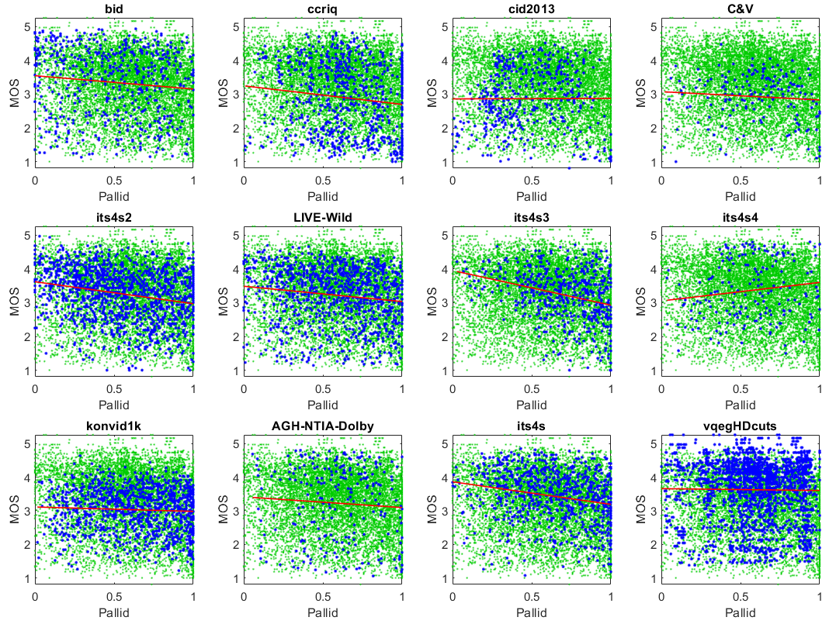
Pallid w_{p} = 0.05
Image Dataset, Camera Capture | Pearson Correlation
BID | 0.11
CCRIQ | 0.13
CID2013 | 0.00
CCRIQ2 & VIME1 | 0.08
ITS4S2 | 0.24
LIVE-Wild | 0.15
Video Dataset, Camera Capture | Pearson Correlation
ITS4S3 | 0.30
ITS4S4 | 0.15
KonViD-1K | 0.05
Video Dataset, Compression | Pearson Correlation
AGH/NTIA/Dolby | 0.07
ITS4S | 0.22
vqegHDcuts | 0.01
Public safety

Slide 19
Can You Contribute?
https://github.com/NTIA/NRMetricFramework

