Slide 1
Comparing full-reference video quality metrics using cluster analysis
Dariusz Grabowski
AGH University of Science and Technology
VQEG Dec. 2020

Slide 2
Question
Why different full-reference metrics rate the same video samples differently?
Are there any explicit video traits that might cause an odd behaviour?

Slide 3
Goals
To find a way to compare scores of different full-reference metrics against each other
To find a way to establish which video traits - “input parameters” - might cause given metrics to behave differently for the same video samples.

Slide 4
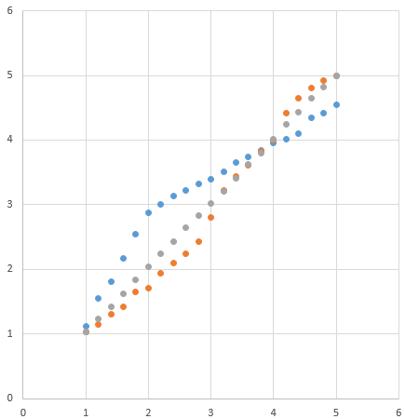
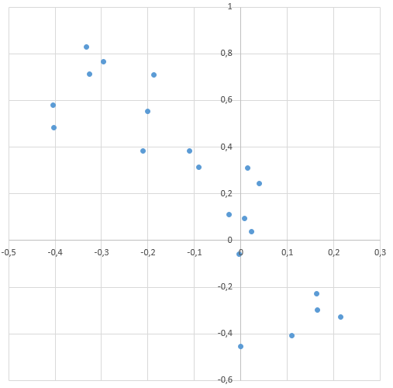
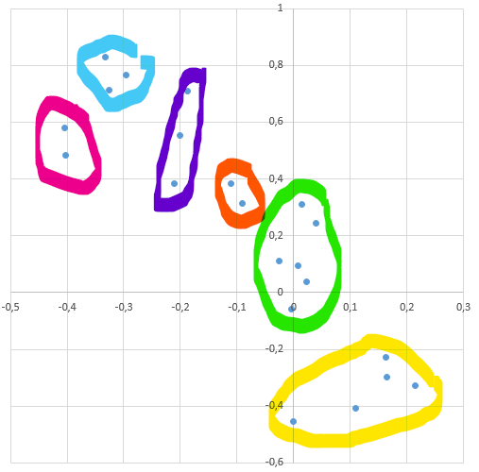
The idea
1. Score all the video samples with different metrics
2. Compare the scores
3. Look for clusters.

Slide 5
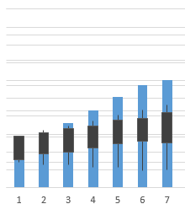
The idea
4. Compare distribution of the input parameters (i.e. TI, SI, QP, bitrate, resolution, etc.) inside the clusters with their general distribution.
5. Find the outstanding traits - the ones with a narrow distribution within the cluster, but the wide distribution for all the videos.
6. Check if there actually is any kind of relation between the trait value and the score difference.

Slide 6
The data
The video quality scores have been provided by Sky UK in anonymised formats to JEG-Hybrid and the Academic Parties for analysis.
47 video sequences - 30 “Movies” and 17 “Sports”
Different framerates - 25, 29.97, 50 and 59.94 FPS
Different resolutions - 288p, 432p, 540p, 720p and 1080p (16:9 aspect ratio)
Different bitrates 365, 730, 1100, 2000, 3000, 4500, 6000, 7800 -
8 versions of each source video gives up to 376 distinct samples
8 objective metrics score per sample, 4 metrics being compared
108 non-zero “input parameters” per sample

Slide 7
Input parameters
category (“Movie” or “Sports”)
resolution
framerate
bitrate
non-reference metrics (TI, SI, CU, CV, contrast)
coding parameters (% intra, % inter, % skip, etc.)
number of CUs (Coding Units)
Motion Vector value (x, y)
Quantization Parameter (QP)

Slide 8
Compared metrics
VMAF - served as a reference metric, open source
VIF - open source metric
VQuk - one of the proprietary metrics
VQit_tv - one of the proprietary metrics

Slide 9
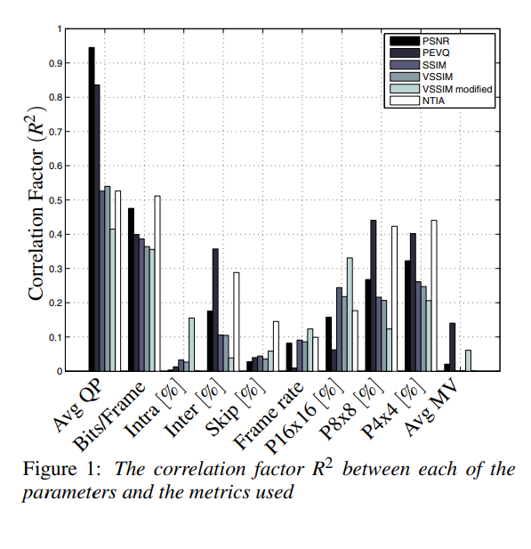
Expectations
QP and bitframe play a big role for some of full-reference metrics, so they might also have some meaningful impact here.
C. Keimel, M. Klimpke, J. Habigt and K. Diepold, "No-reference video quality metric for HDTV based on H.264/AVC bitstream features," 2011 18th IEEE International Conference on Image Processing, Brussels, 2011, pp. 3325-3328, doi: 10.1109/ICIP.2011.6116383.

Slide 10
The analysis

Slide 11
Tools
Python 3 custom script
  Pandas - for all the data transformation
  Scikit-learn - for different clustering algorithms
  Plotly - to plot all the scatterplots and boxplots
MS Excel

Slide 12
Transforming the scores to the common scale
VMAF - (0-100) - as a reference metric, no score transformation is needed.
VIF - (0-1) - normalized linearly in ranges 0-0.16-0.27-0.4-0.56-1.00.
VQuk - (1-5) normalized linearly in range 1-5.
VQit_tv - (1-5) normalized linearly in range 1-5.
All the scores have been transformed to a VMAF-like scale from 0 to 100.
All the input parameters were normalized using min-max normalization, as the there is no need to preserve their exact values at this stage.

Slide 13
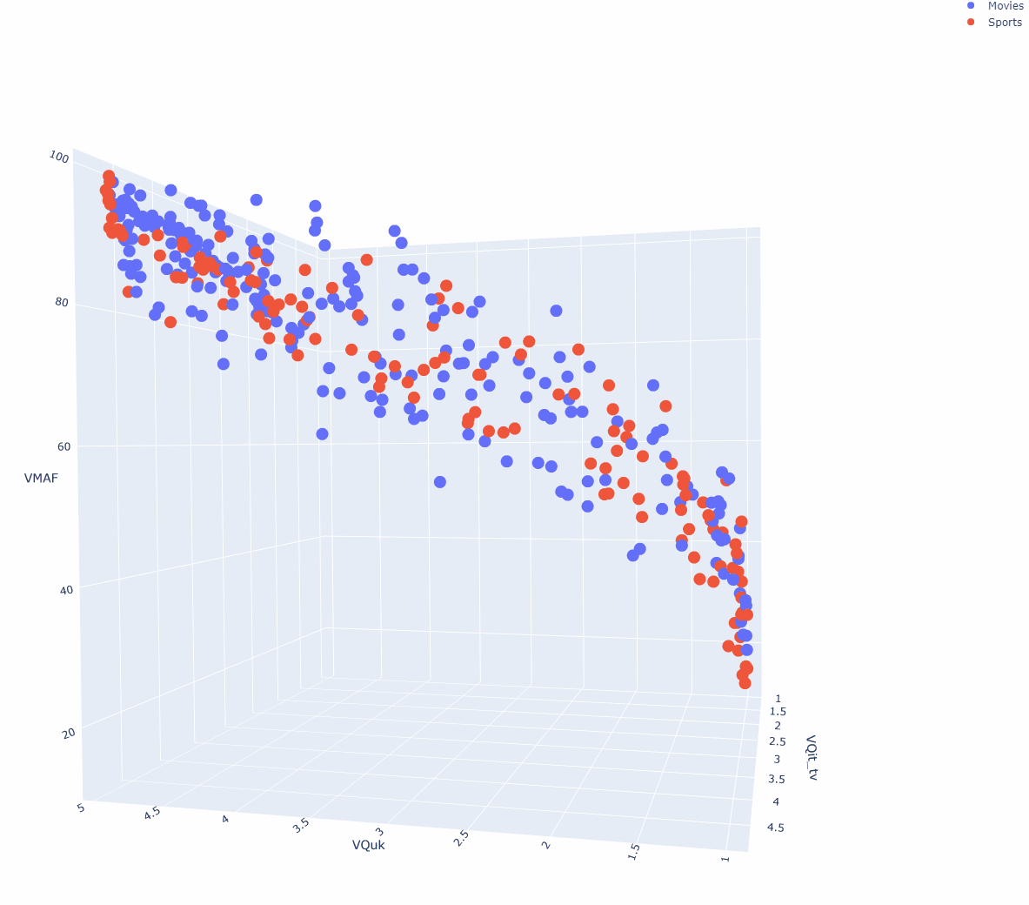

The scores

Slide 14
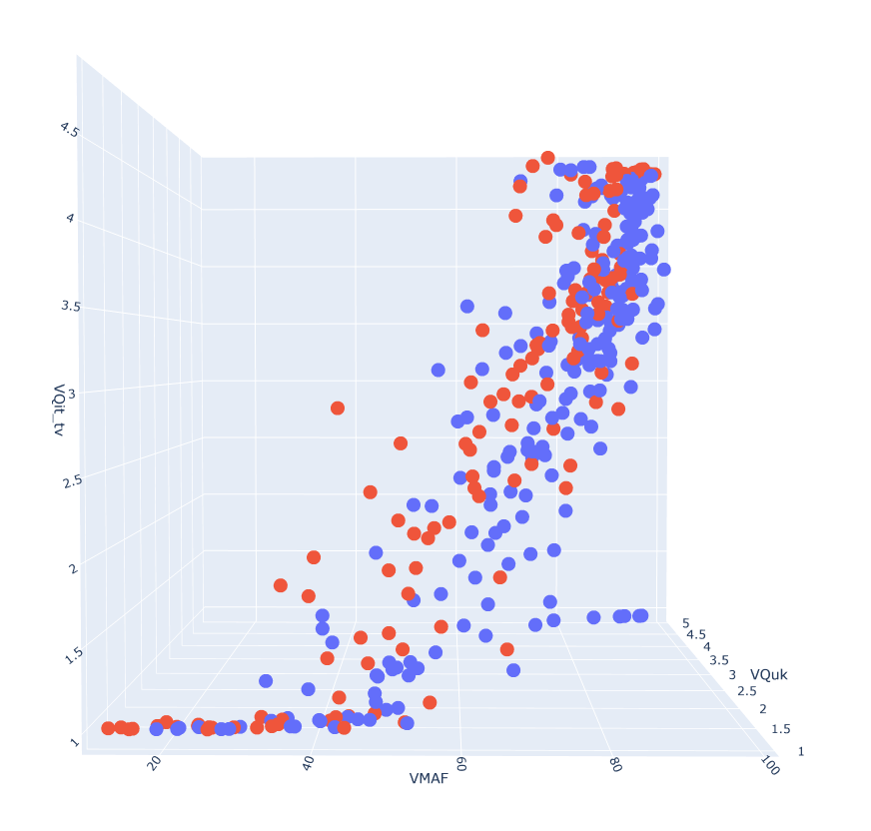
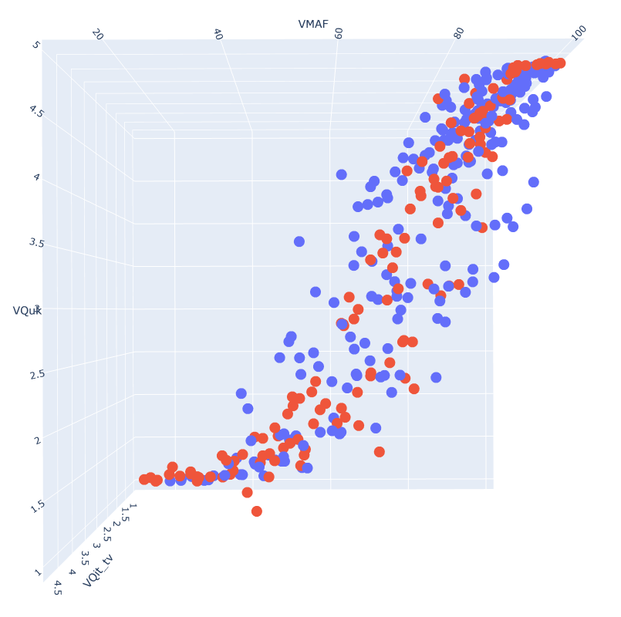
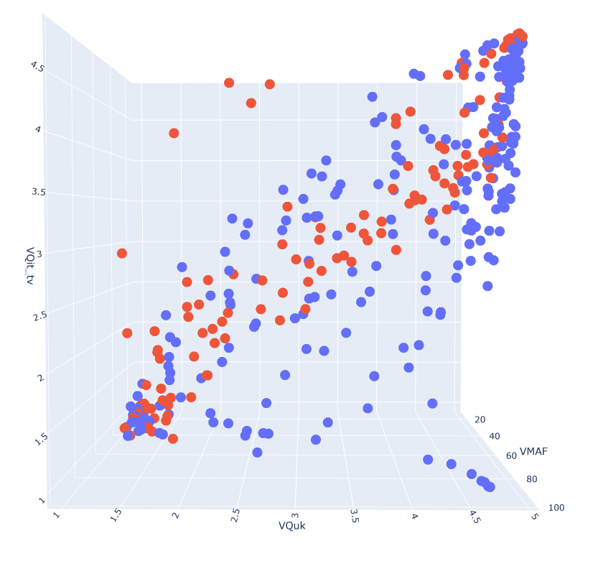
The scores

Slide 15
Clusters - expectations
Clusters should:
be distinctive
be big enough, to contain data points belonging to different videos, not just a single video with different framerates/resolution
It would be helpful if algorithm decide on a number of clusters itself.

Slide 16
Tested clustering methods:
K-Means
Mean Shift
Agglomerative
Affinity
Birch
Spectral
DBSCAN
OPTICS

Slide 17
Clustering method | Number of clusters | Silhouette Coefficient | Calinski-Harabasz | Davies-Bouldin | Mixed score
K-Means | 9 | 0.33 | 211.53 | 0.89 | 78.43
Mean Shift | 6 + 1 (noise) | 0.34 | 65.38 | 1.57 | 14.15
Agglomerative | 9 | 0.30 | 180.52 | 0.91 | 59.51
DBSCAN | 3 + 1 (noise) | 0.35 | 20.91 | 2.94 | 2.48
OPTICS | 3 + 1 (noise) | -0.32 | 10.19 | 1.46 | -2.23
Spectral Clustering | 5 | 0.26 | 181.61 | 1.07 | 44.13
Affinity Propagation | 20 | 0.28 | 175.21 | 0.99 | 49.55
Birch | 5 | 0.33 | 181.66 | 0.97 | 61.80

Slide 18
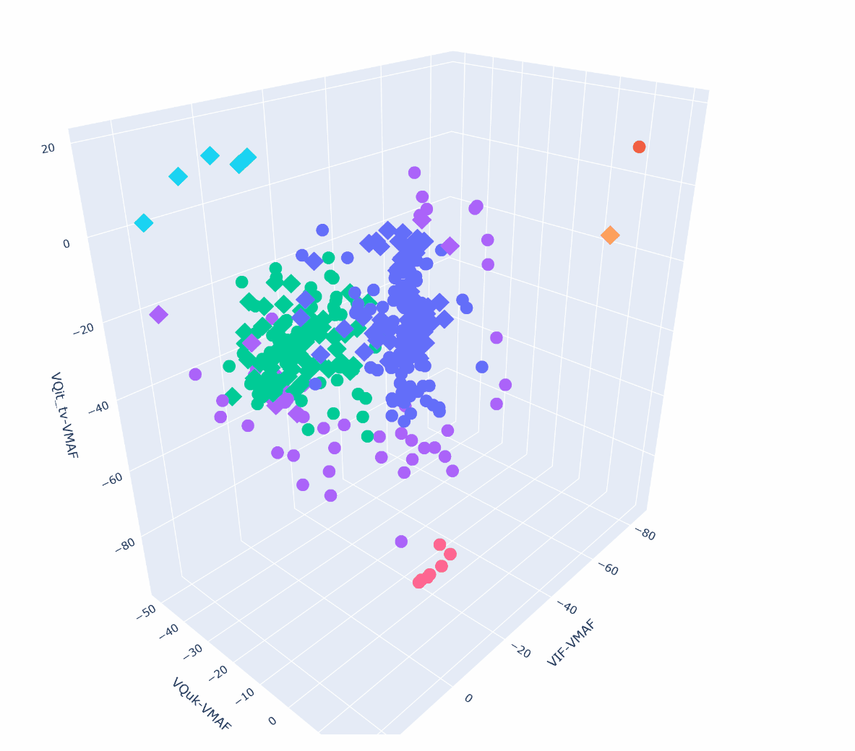
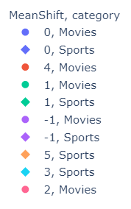
Example -
MeanShift clusters

Slide 19
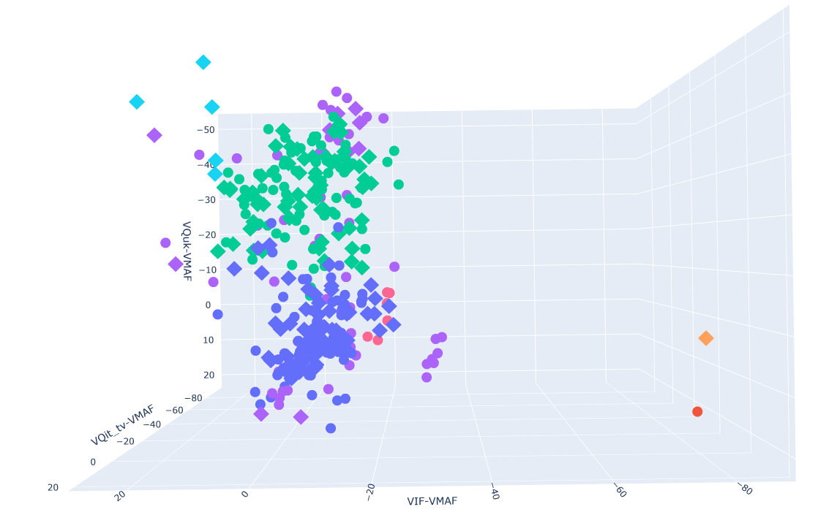
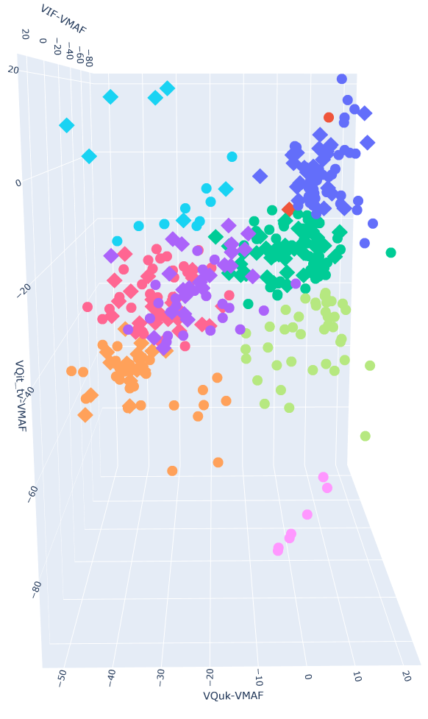
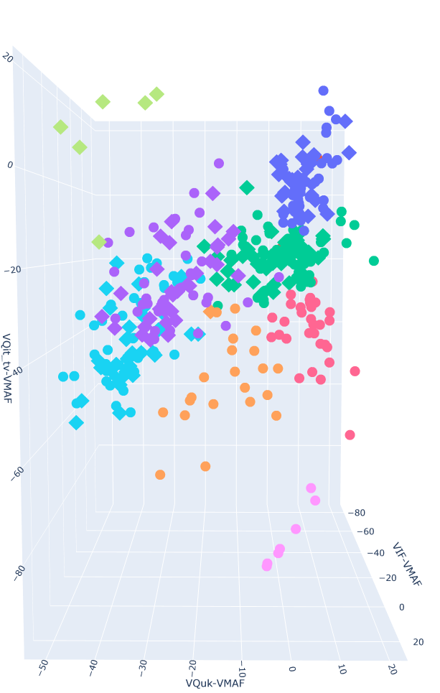
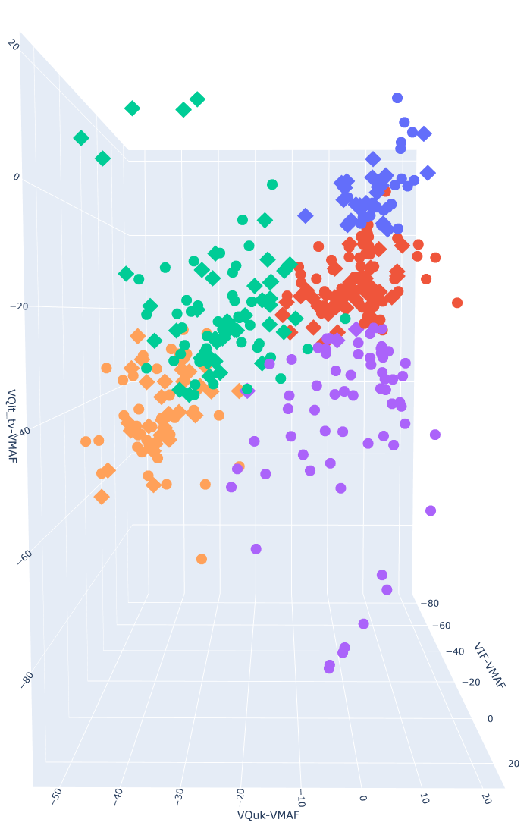
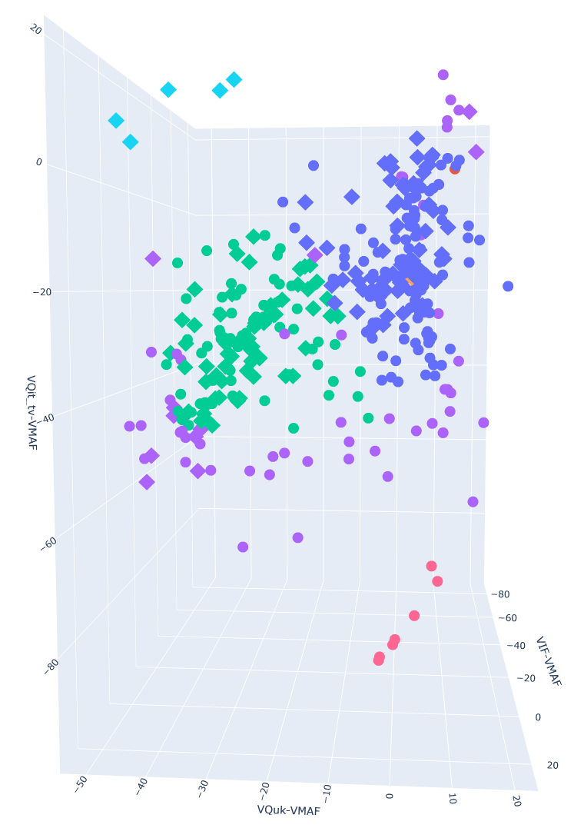
Relative scores clustered
K-Means
Agglomerative
Spectral
MeanShift

Slide 20
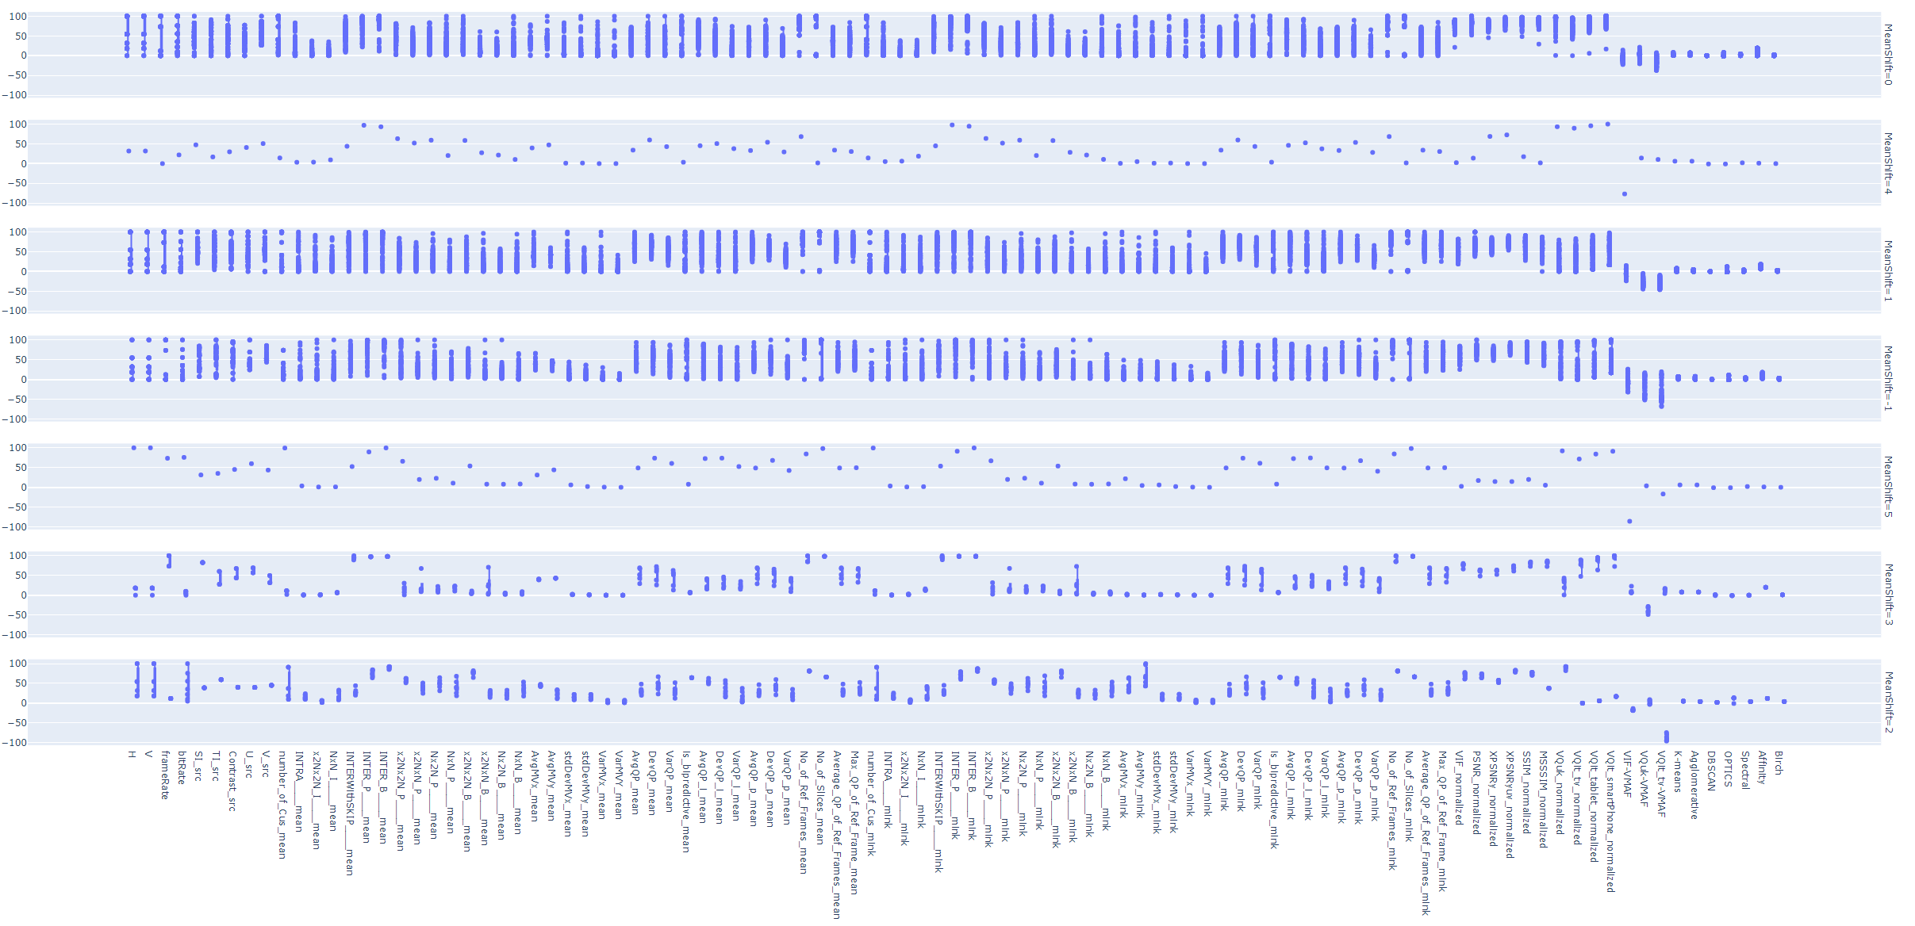
0
4
1
-1
5
3
2

Slide 21
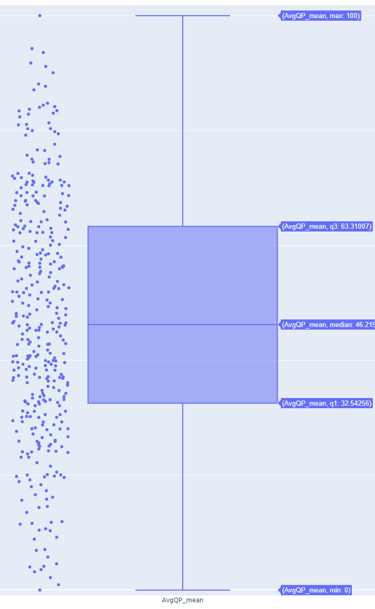
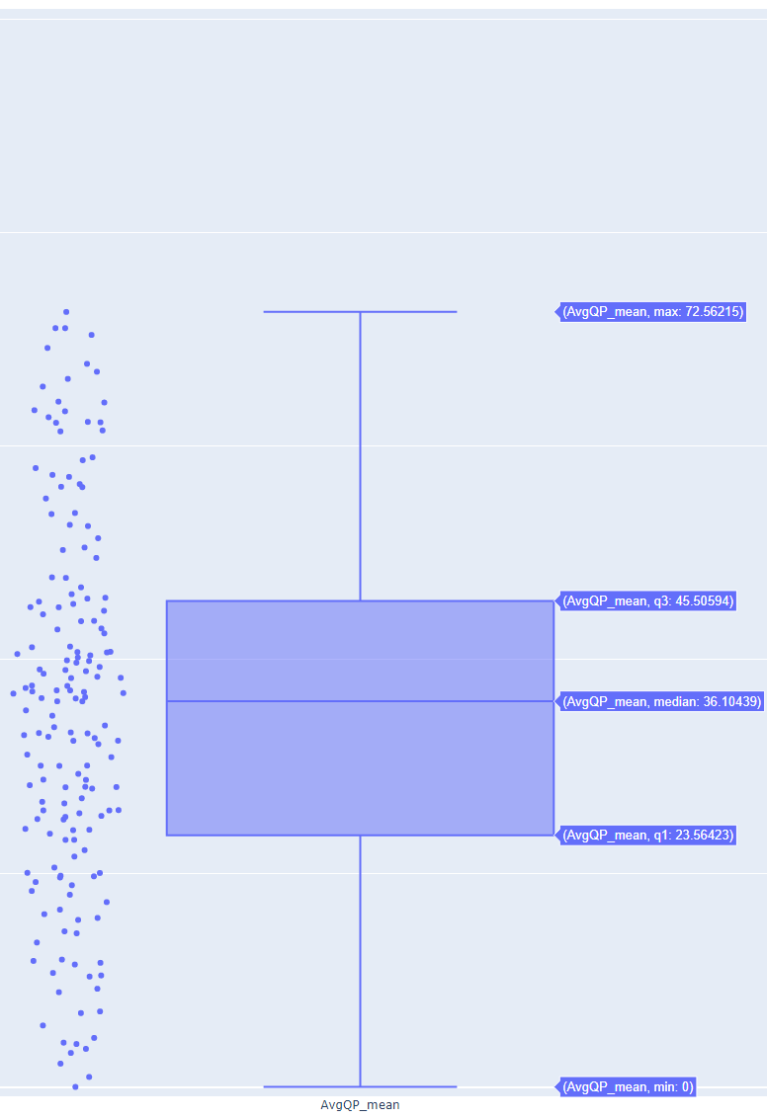
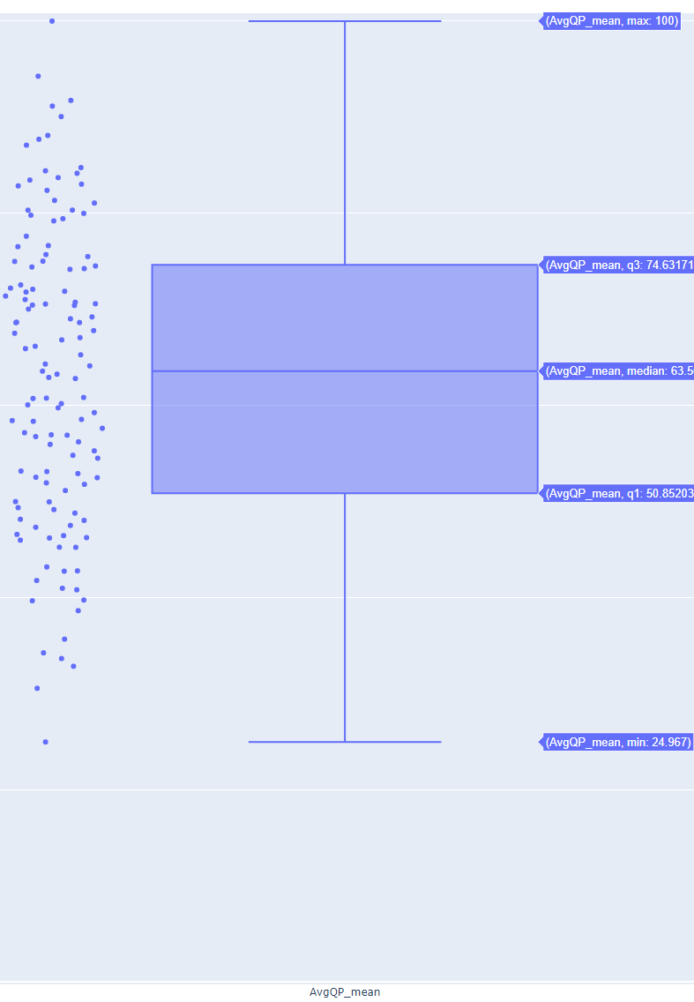
AvgQP_mean
All data
Cluster 0
Cluster 1

Slide 22
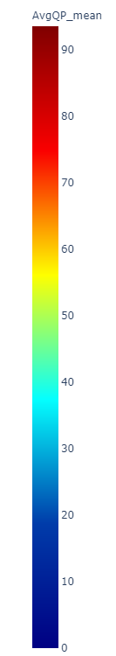
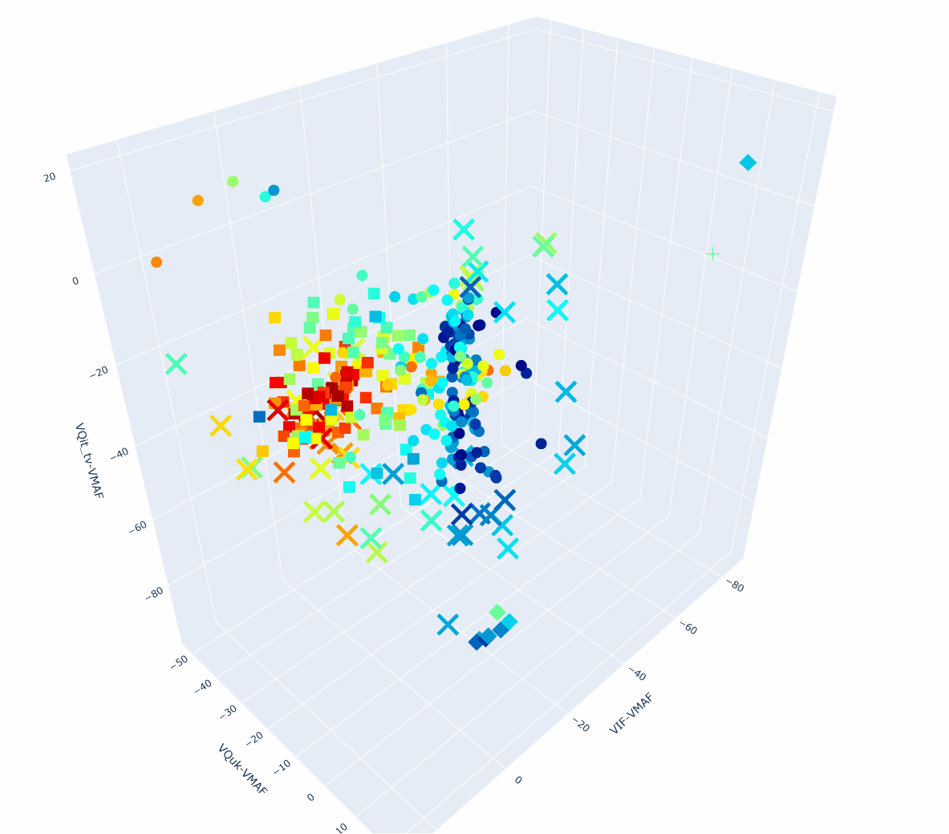
Avg_QP_mean

Slide 23
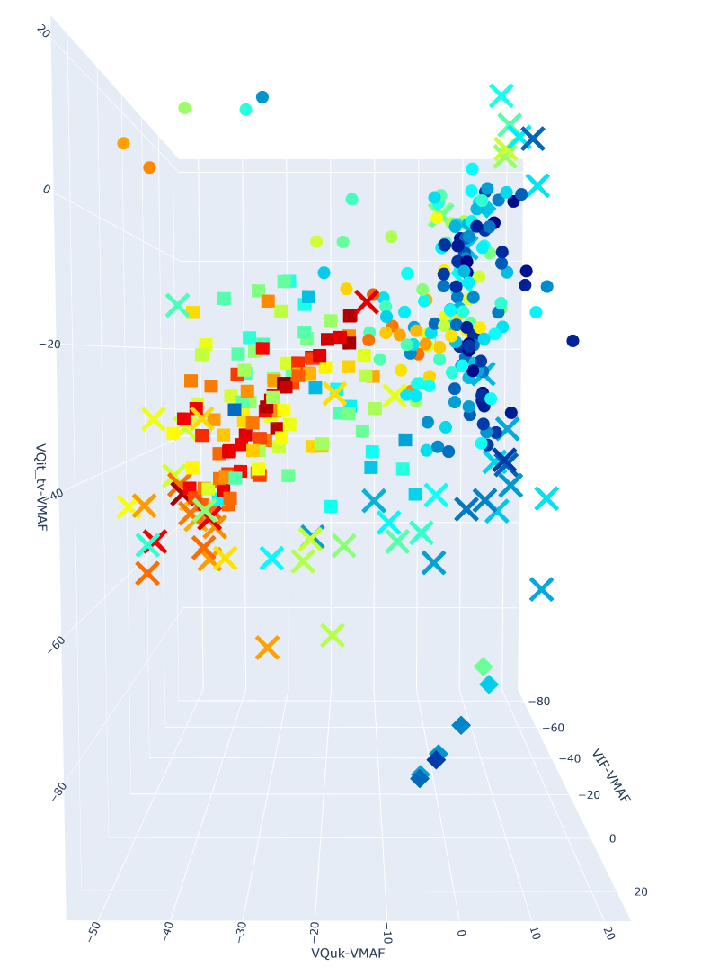
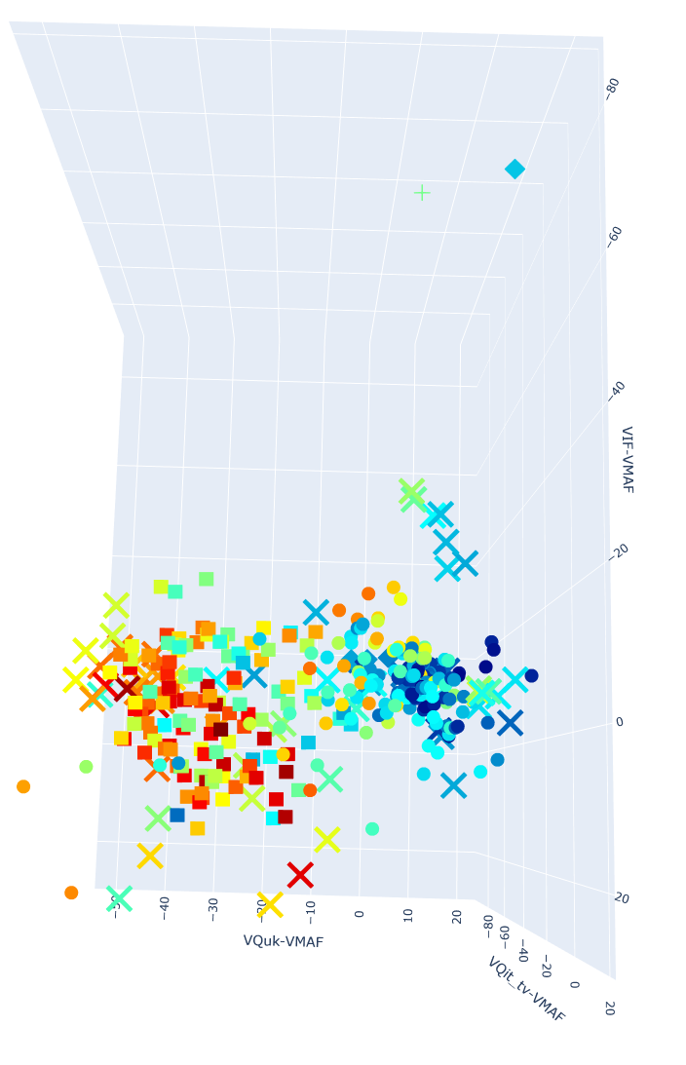

Slide 24
Findings on data
VIF shows a high level of agreement with VMAF
VQit and VQuk returns lower ratings than VMAF in general
VQit and VQuk agree when AvgQP is high and both return much lower scores than VMAF, when VMAF tends to oversee that parameter
When AvgQP is low, VQuk tends to agree with VMAF more.
It’s hard to pinpoint why VQit rates most of the samples much lower than VMAF and VQuk Number of CUs, resolution or bitrate might be good candidates.

Slide 25
Findings on the method
Clustering relative scores might help finding samples with different traits based on their relative score, giving some idea on how the given metrics judge different samples.
It would be the best to compare objective metrics with a subjective metric as a reference metric
Different clustering algorithms may produce different number of clusters with varying size. Clusters need to be big enough to contain any significant data, but also should be well-separated from others, so they can be expected to have some distinct traits.

Slide 26
Thank you for your attention!

