Slide 1


Perceptual Characterization of 3D Graphical Contents based Visual Attention patterns
Mona Abid, Matthieu Perreira Da Silva and Patrick Le Callet
25.09.2019
QoEVMA : 1st Workshop on Quality of Experience (QoE) in Visual Multimedia Applications
Perceptual Characterization of 3D Graphical Contents based on Attention Complexity Measures
Mona Abid, Matthieu Perreira Da Silva, Patrick Le Callet, International Conference ACM Multimedia, 2020.
Workshop on Quality of Experience (QoE) in Visual Multimedia Applications

Slide 2
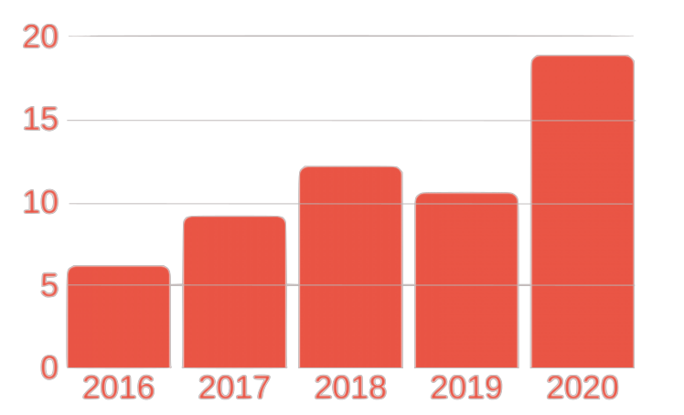
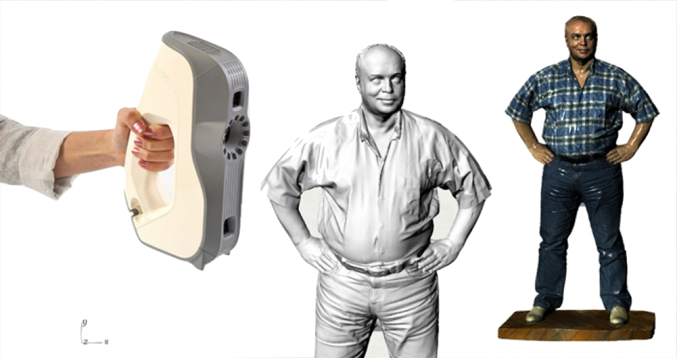
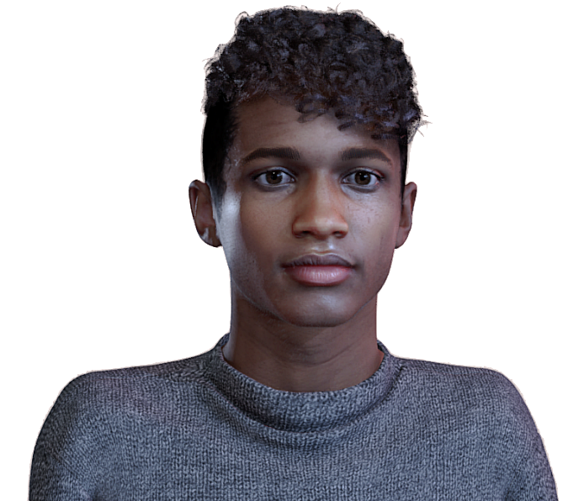
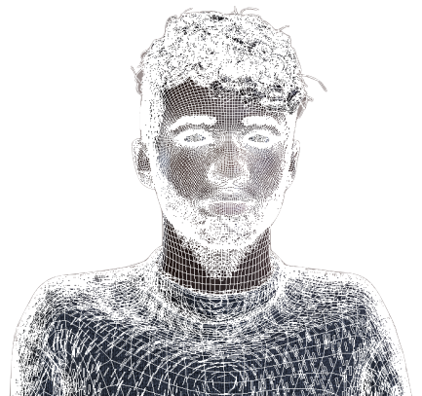
Context
Forecast AR & VR Market size Worldwide
(billion U.S $)
3D Graphical Contents are used in many applications:
Autonomous driving
Security
Entertainment
3D Graphics acquisition and representation
www.adaptive-3d.fr
sketchfab.com
Mesh representation
Point cloud representation

Slide 3
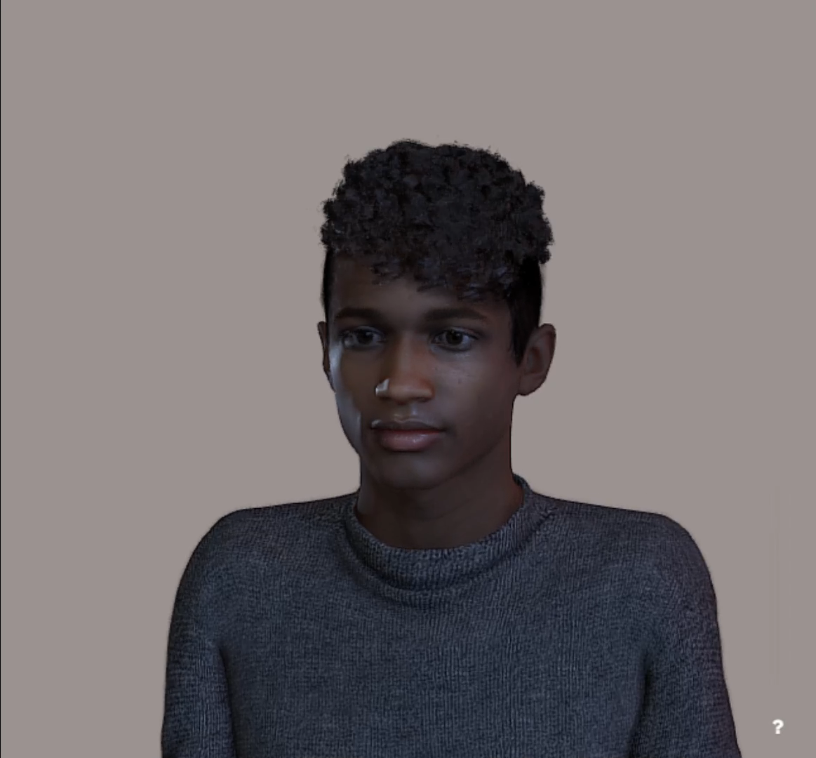
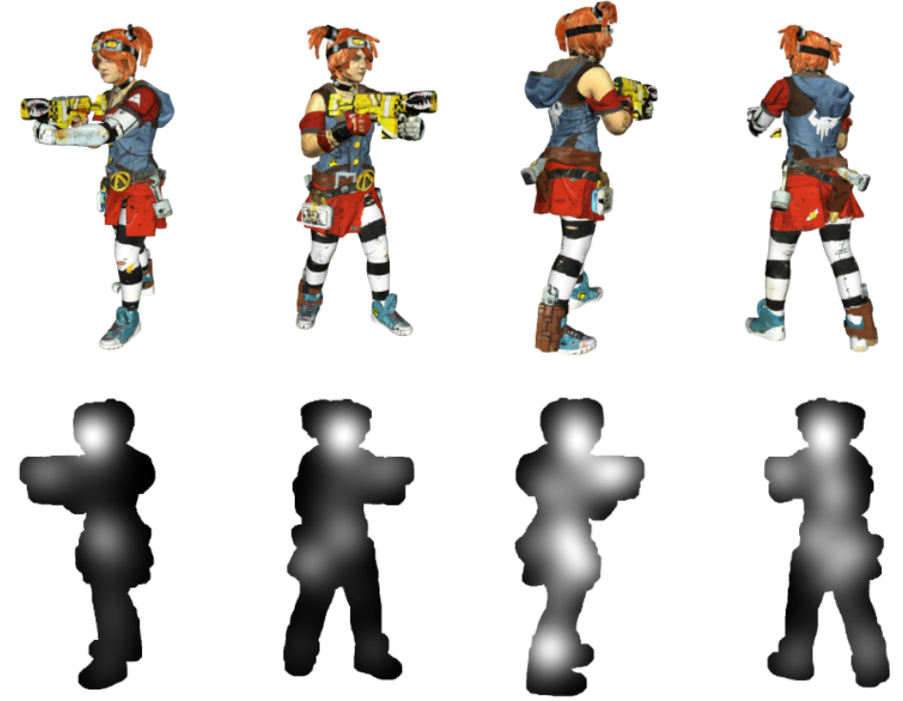
Context
Advantages of 3D graphics technology
Interactive 3D rendering / visualization
Field display for VR
Constraint
sketchfab.com
Very large amount of data for storage and transmission
Need of simplification
Problem statement
Evaluate the simplification algorithms → need a varied dataset
Criteria → Color, form, depth, geometry (curvature, etc)
How to quantify where people looked at ?
Aim
In our study case, our criteria is based on what it perceived by the human visual system → Visual Attention Complexity (VAC)

Slide 4
Research Questions
& Contributions
I. How can we perceptually characterize 3D graphical objects?
Contribution:
Investigate Visual Attention Complexity for 3D objects
→ Subjective study
II. Can we predict the Visual Attentional Complexity of 3D graphical content?
Contribution:
Suggest an objective predictor of VAC for 3D contents
→ Objective predictor
Use case in mind: content selection
Notes:
In this work we:
Invesigated a way to perceptually characterize graphical objects based on VAC measurement
Suggested an objective predictor of such measure

Slide 5

Subjective study
I. Can 3D Graphical Content be characterized
based on visual attention complexity measure?
Visual attention complexity consists on evaluating human gaze data dispersion as a criteria of complexity.
.
Steps
start
1. Data collection: Eye-tracking experiment
2. Visual Attention Complexity measure VAC-3DGC
3. Results analysis
Notes:
To answer this question:
we first conducted/ran an eye-tracking experiment to collect the human eye data.
Then we computed visual attention complexity measure on the subjective data.
We finally analyzed the obtained Results

Slide 6
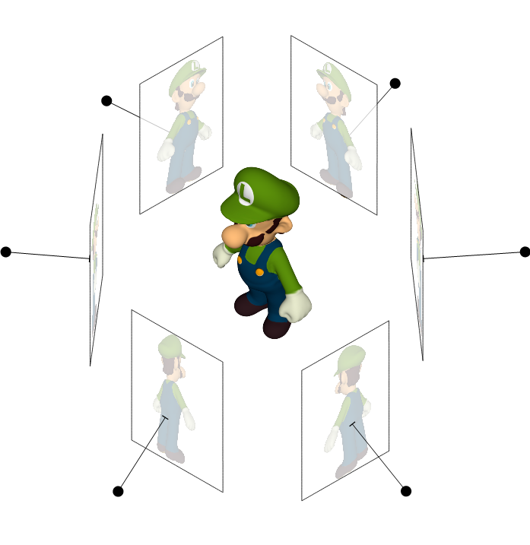
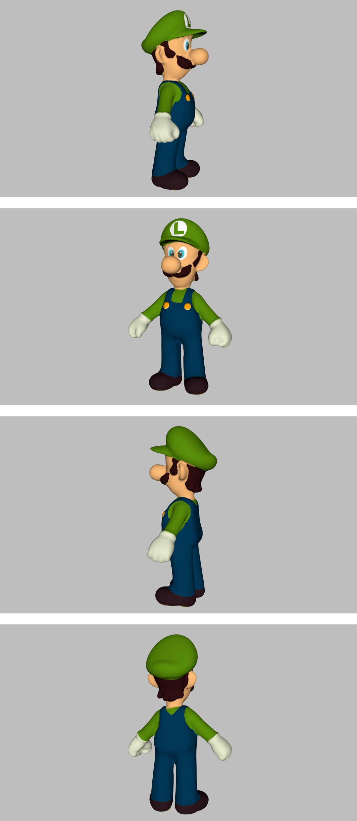
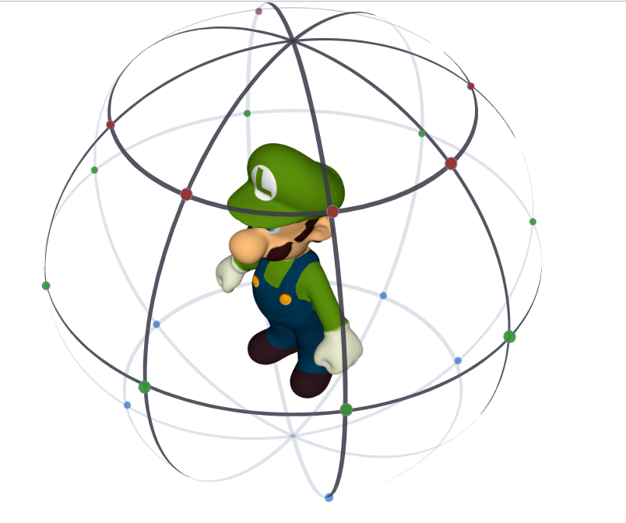
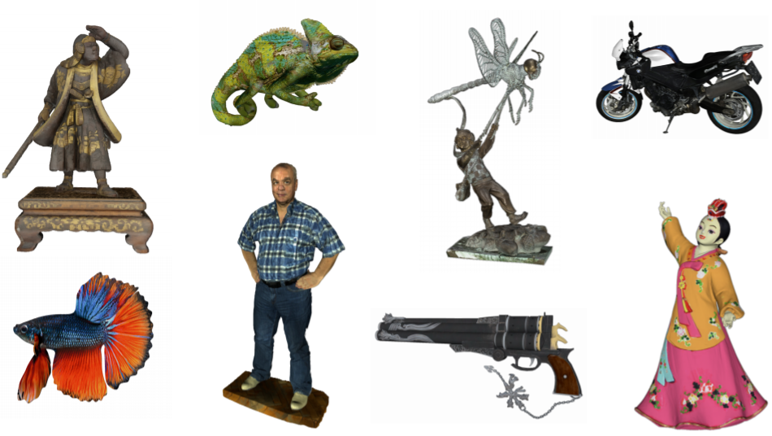
Subjective study
1. Eye-tracking experiement
Stimuli generation
Viewpoints selection
3D object
21 high resolution 3D objects : different semantic categories
(objects, human figures, animals, art, characters)
Rendered views
(4 viewpoints)
21 objects x 4 viewpoints = 84 rendered views

Slide 7
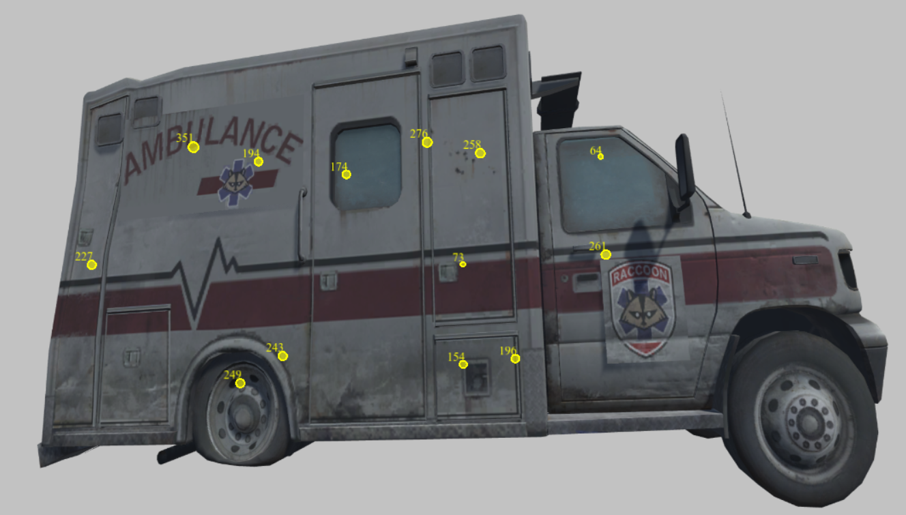
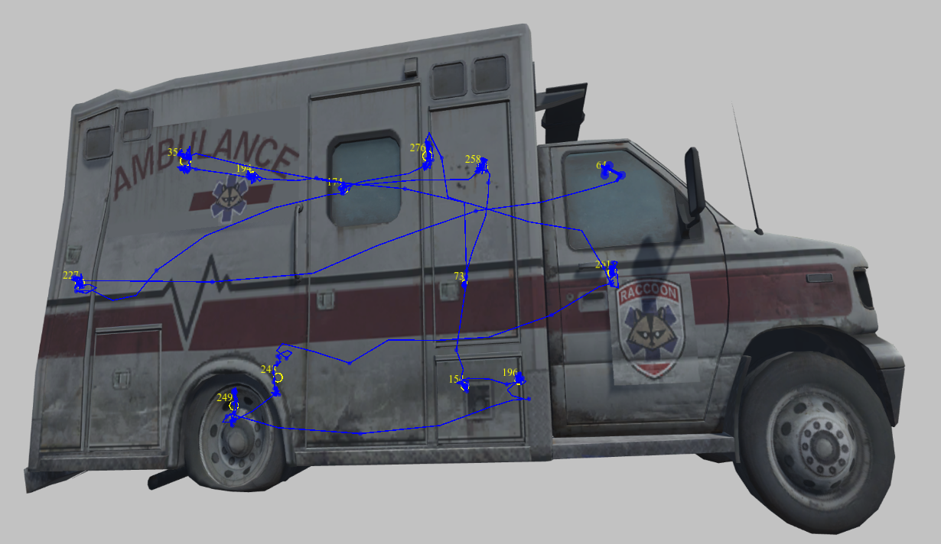
Subjective study
1. Eye-tracking experiement
Apparatus and participants:
Used device: EyeLink 1000 Plus remote mode & Full HD monitor screen
30 participants with normal, corrected-to-normal vision
E.g. Eye-tracking data
Extracted fixations points
Jerks: rapid eye movements
Dataset + Collected gaze data : gitlab.univ-nantes.fr/E18E421U/3dgc-dataset

Slide 8
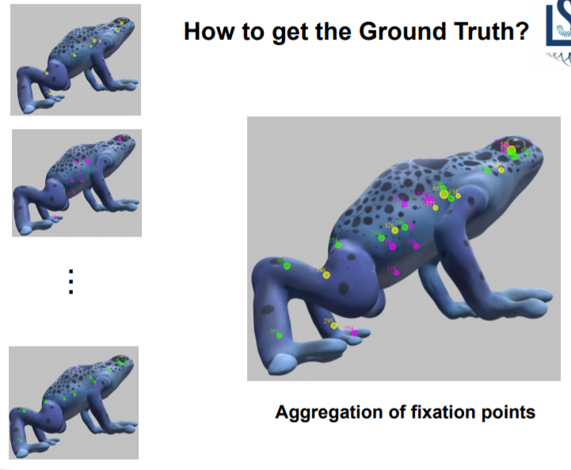
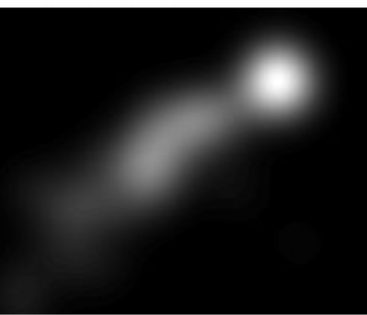

Subjective study
Data processing
Ground-truth Saliency map computation
…
Visual Attention Complexity computation
Saliency map
N observers
Evaluation
Comparaison

Slide 9
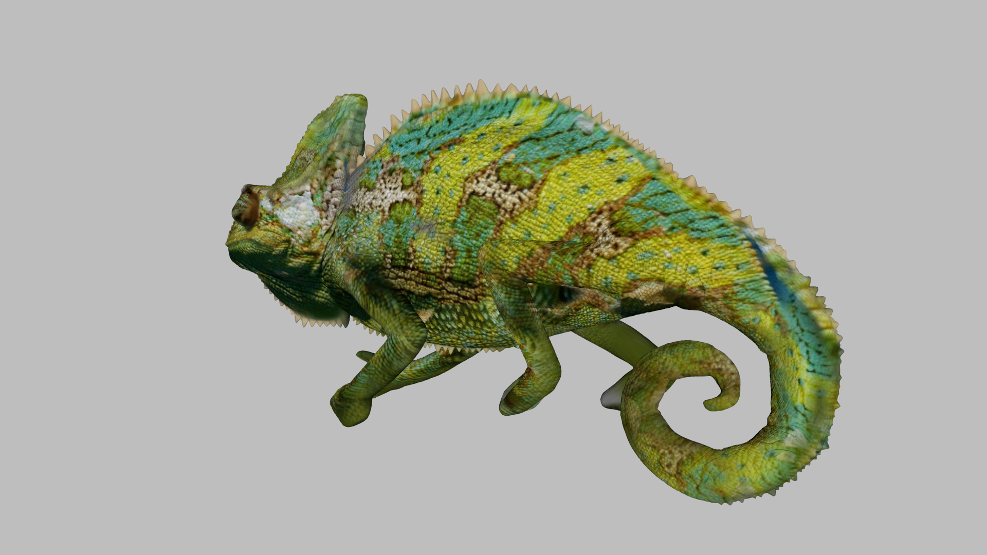

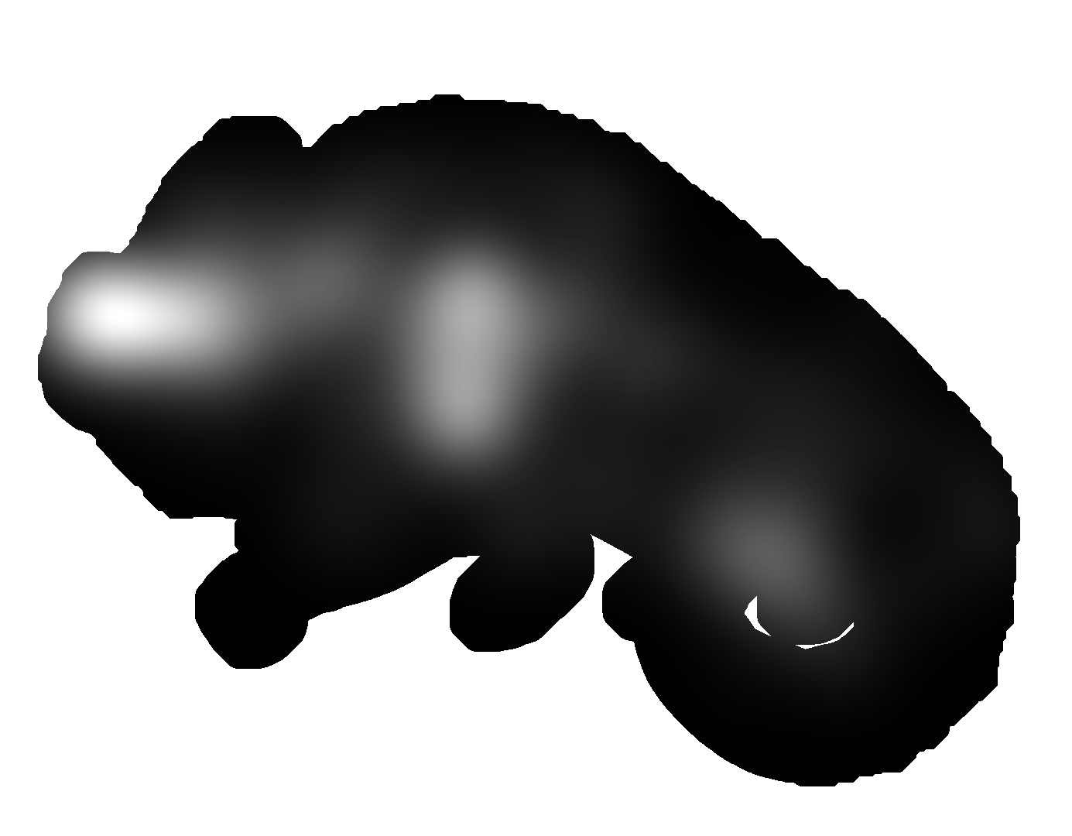
Subjective study
2. Visual Attention Complexity measure: VAC-3DGC
Visual attention complexity in 2D context:
  Entropy of the saliency maps: “A Saliency Dispersion Measure for Improving Saliency-Based Image Quality Metrics,” , W Zhang and al. IEEE Trans. CSVT 2018.
    ↓Entropy, saliency is concentrated → Focused images
    ↑Entropy, saliency is diffused → Exploratory images
Adaption to the rendered 3D objects:
The shape information of the 3DGC → Integrated in the expriment design.
The size of the visible surface of 3DGC → Consider a mask that depends on the viewing conditions and apply a surface-wise ratio.
Stimuli
Saliency map
Visible surface

Slide 10
Subjective study
3. Results analysis
Lowest VAC-3DGC value
Highest VAC-3DGC value
Rendered 4 views
Masked saliency information
VAC-3DGC values
15.96 | 15.88 | 19.30 | 18.25

Slide 11
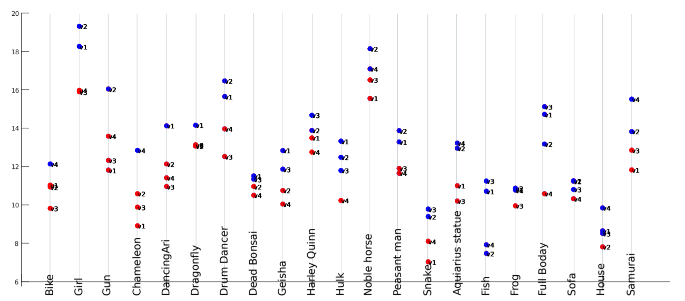
Subjective study
3. Results analysis
Variability of the VAC values:
Clustering → k nearest neighbour algorithm
    High VAC-3DGC
    Low VAC-3DGC
VAC-3DGC values along different 3D graphics across the 4 viewpoints
VAC-3DGC values
Graphical objects

Slide 12
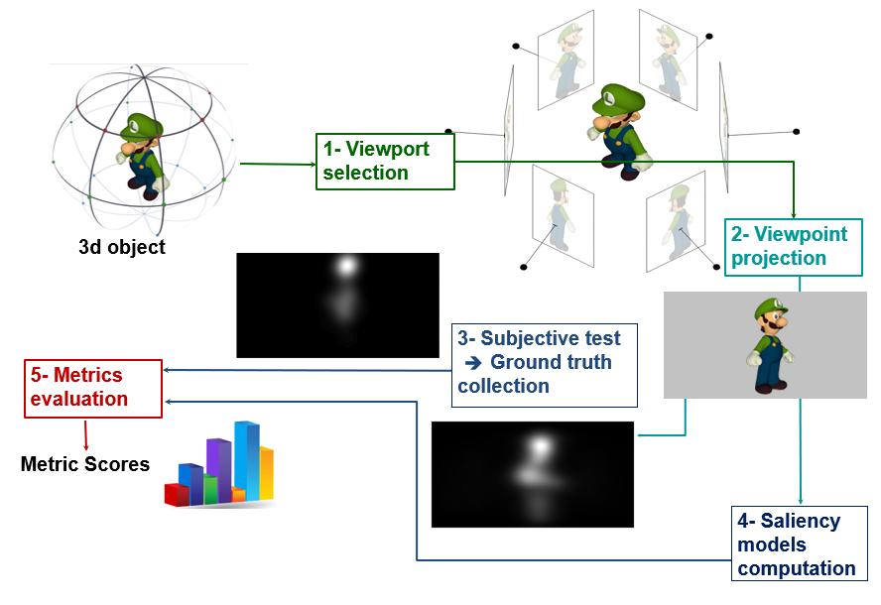

Subjective study
vi
Recap
Viewpoints selection
3D object
Gaze data collection & processing
Subjective measure
Subjective VAC values
VAC-3DGC measure
Issue: if there is no human Gaze data available

Slide 13
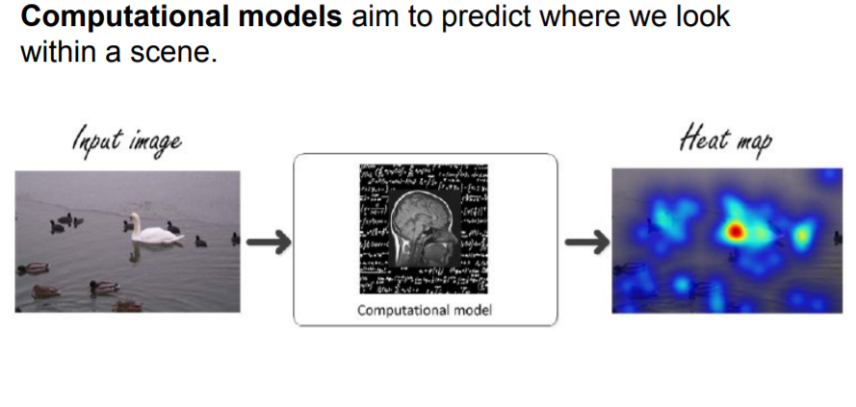
Objective predictor
2. Can saliency models be used as VAC objective predictor?
1. About saliency models
2. Objective predictor based on VAC-3DGC
3. Results

Slide 14


Objective predictor
2. Can saliency models be used as VAC objective predictor?
vi
Viewpoints selection
3D object
Saliency models computation
Objective predictor
VAC-3DGC measure
Saliency models aim to mimic the human visual system.

Slide 15
Objective predictor
Objective predictor based on VAC-3DGC
Viewpoints selection
3D object
Saliency models computation
Eye data collection & processing
Is Visual Attention Complexity of the predicted saliency maps a good estimator?
Computed saliency map
Ground-truth saliency map
Visual Attention Complexity computation
Visual Attention Complexity computation
Objective values
Subjective
measure
Evaluation
Comparaison

Slide 16
Objective predictor
Results
v1
v2
v3
v4
Obj.i
X 21
21 objects x 4 viewpoints = 84 views
v1
v2
v3
v4
Obj.1
Obj.2
Obj.3
Obj.4
Obj.i
Obj.21
View-wise
84 Subjective view-wise values
84 Objective view-wise values
Correlation Coefficient
Computational model | SALICON | SAM-RESNET | SAM-VGG
PCC: GT vs Comp.model | 0.72 | 0.52 | 0.50

Slide 17


Objective predictor
Results
$$m_{obj.i}$$
v1
v2
v3
v4
$m_{obj.i}$ : 4 views mean value
Obj.i
Obj.1
Obj.2
Obj.3
Obj.4
Obj.i
Obj.21
Object-wise
21 Subjective object-wise values
21 Objective object-wise values
Correlation Coefficient
Computational model | SALICON | SAM-RESNET | SAM-VGG
PCC: GT vs Comp.model | 0.81 | 0.52 | 0.45

Slide 18
Conclusion
Take away
Visual Attention Complexity indicator can be used for content characterization to:
Design relevant subjective quality assessment tests
Validate and benchmark algorithms that impact human visual attention (compression, streaming, etc).
Analyze the results from objective quality metrics
Subjective study:
Dataset + Eye-tracking data: gitlab.univ-nantes.fr/E18E421U/3dgc-dataset
Adapt VAC measure for 3DGC
Objective predictor
  Saliency models outputs seem promising
  Analysis: View-wise & Object-wise
On-going work:
Study VAC usefulness to predict the view of interest of 3D objects
Motivation of VAC, how to manage level of details ? If we know in advance what are the more complex viewpoints we apply / more or less simplification techniques
Notes:
This predictor can be useful in Quality of Experience (QoE) studies: to balance content selection when benchmarking 3DGC processing techniques (e.g., rendering, coding, streaming, etc.) for human panel studies or ad hoc key performance indicator, and also to optimize the user's QoE when rendering such contents.

Slide 19

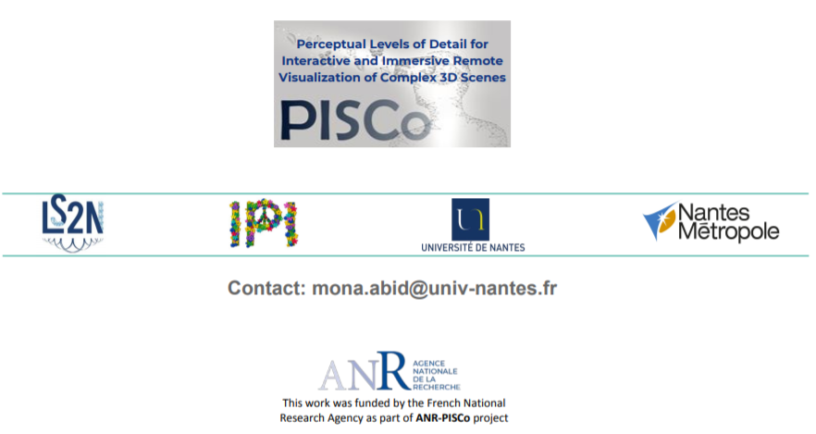
Thank you for your attention !

Slide 20
Objective predictor
vi
Viewpoints selection
3D object
Saliency models computation
Objective predictor
VAC-3DGC measure
1. About saliency models
*
Saliency models aim to mimic the human visual system.
Conventional
Deep learning
Performance of saliency models are not disucussed in this wrok
* https://saliency.tuebingen.ai
Notes:
Review citation
Without fine tuning on graphical contents
Keep in mind that you con consider other saliency models
https://saliency.tuebingen.ai

