Slide 1
Tele-operated Driving Use Cases
Yunpeng Zang (Ericsson)
5GAA ToD Work Item
VQEG 5G-KPI Session, 16 Dec. 2020

Slide 2



Driving Connected Mobility Forward
5GAA bridges the automotive and telecommunication industries in order to address society’s connected mobility and road safety needs with applications such as automated driving, ubiquitous access to services, integration into intelligent transportation and traffic management
Automotive Industry
Vehicle Platform, Hardware
and Software Solutions
telecommunications
Connectivity and Networking
Systems, Devices and Technologies
5GAA unites today 133 members from around the world working together on all aspects of C-V2X including technology, standards, spectrum, policy, regulations, testing, security, business models and go-to-market
Notes:
5GAA is a global, cross industry organisation that brings together the voices of the automotive and telecommunications industries.
The association is composed of 7 distinct and interrelated working groups that define and develop end-to-end solutions for future mobility and transportation services.
5GAA unites and -through discussion, debate, analysis and use cases- drives consensus and alignment between all key stakeholders. Through 5GAA our two industries are able to speak as one global, integrated voice.
We believe that C-V2X is the ultimate technology solutions to bring safety on all Roads in Europe and benefit from the support of the complete mobility ecosystem!

Slide 3
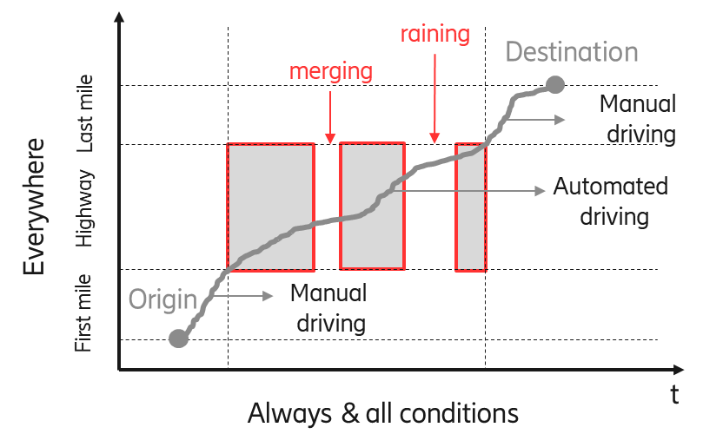
Tele-operated Driving (ToD) Service for Automated Vehicles
  Tele-operated Driving: Part of or all of the dynamic driving tasks are performed by a remote driver on a sustained basis.
  Operational Design Domain (ODD)*: Operating conditions under which a given driving automation system or feature thereof is specifically designed to function, including, but not limited to, environmental, geographical, and time-of-day restrictions, and/or the requisite presence or absence of certain traffic or roadway characteristics.
* Defined in SAE J3016, Jun 2018
Tom Alkim, Connected & Automated Driving in the NL, Rijkswaterstaat, Nov. 2017
Notes:
================== Reference information ===================
SAE J3016-2018: Taxonomy and Definitions for Terms Related to Driving Automation Systems for On-Road Motor Vehicles
SAE J3016-2018: “3.29.1.2 REMOTE DRIVER: A driver who is not seated in a position to manually exercise in-vehicle braking, accelerating, steering, and transmission gear selection input devices (if any) but is able to operate the vehicle. ”
SAE J3016-2018: “3.13 DYNAMIC DRIVING TASK (DDT): All of the real-time operational and tactical functions required to operate a vehicle in on-road traffic, excluding the strategic functions such as trip scheduling and selection of destinations and waypoints, and including without limitation:
Lateral vehicle motion control via steering (operational);
Longitudinal vehicle motion control via acceleration and deceleration (operational);
Monitoring the driving environment via object and event detection, recognition, classification, and response preparation (operational and tactical);
Object and event response execution (operational and tactical);
Maneuver planning (tactical); and
Enhancing conspicuity via lighting, signaling and gesturing, etc. (tactical).”
SAE J3016-2018: “3.29.1.1 [CONVENTIONAL] DRIVER: A driver who manually exercises in-vehicle braking, accelerating, steering, and transmission gear selection input devices in order to operate a vehicle.
NOTE: A conventional driver is assumed to be seated in what is normally referred to as “the driver’s seat” in automotive contexts, which is a unique seating position that makes in-vehicle input devices (steering wheel, brake and accelerator pedals, gear shift) accessible to a (human) driver. ”
U.S. CA., DMV 13 CCR§ 228.06: “(b) In addition to the requirements specified in subsection (a), for vehicles that do not require a driver, the manufacturer shall also certify that the vehicle complies with all of the following: (1) A communication link between the vehicle and the remote operator, if any, to provide information on the vehicle's location and status and allow two-way communication between the remote operator and any passengers, if applicable, should the vehicle experience any failures that would endanger the safety of the vehicle's passengers or other road users while operating without a driver.”

Slide 4
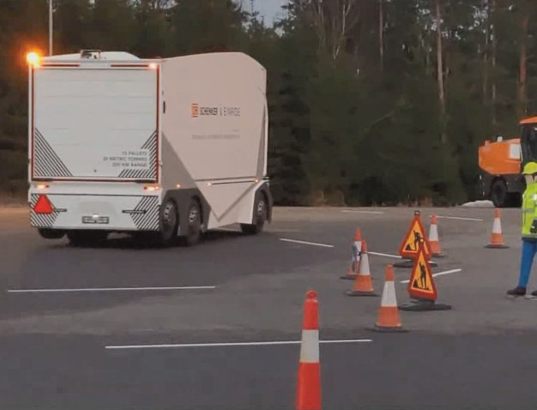
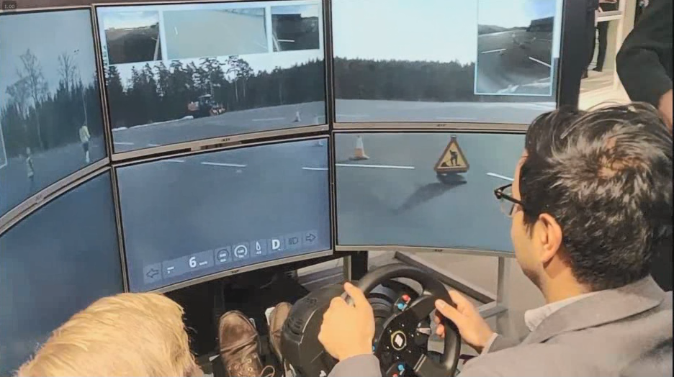
Tele-operated Driving (ToD) Service for Automated Vehicles
Why ToD?
  Functional consideration: one way to provide fallback for
  automated driving system (ADS) failure* or operational
  design domain (ODD) exit* of Autonomous Vehicles (AVs)
  Economic consideration: allocate one driver to more than one vehicles; decouple physical presence of driver and vehicle;
  Safety consideration: avoid stalled AVs due to ADS failure or unresponsive drivers
  And more … e.g. logistics at sea-ports, saving parking space,
  road traffic efficiency
Photos source: Ericsson, Einride, Telia, DB Schenker
https://www.youtube.com/watch?v=mWu53vAdtYE
* Defined in SAE J3016, Jun 2018
Notes:
===================== Reference info. ==========================
SAE J3016-2018: “3.29.1.2 REMOTE DRIVER: A driver who is not seated in a position to manually exercise in-vehicle braking, accelerating, steering, and transmission gear selection input devices (if any) but is able to operate the vehicle. ”
SAE J3016-2018: “3.13 DYNAMIC DRIVING TASK (DDT): All of the real-time operational and tactical functions required to operate a vehicle in on-road traffic, excluding the strategic functions such as trip scheduling and selection of destinations and waypoints, and including without limitation:
Lateral vehicle motion control via steering (operational);
Longitudinal vehicle motion control via acceleration and deceleration (operational);
Monitoring the driving environment via object and event detection, recognition, classification, and response preparation (operational and tactical);
Object and event response execution (operational and tactical);
Maneuver planning (tactical); and
Enhancing conspicuity via lighting, signaling and gesturing, etc. (tactical).”
SAE J3016-2018: “3.29.1.1 [CONVENTIONAL] DRIVER: A driver who manually exercises in-vehicle braking, accelerating, steering, and transmission gear selection input devices in order to operate a vehicle.
NOTE: A conventional driver is assumed to be seated in what is normally referred to as “the driver’s seat” in automotive contexts, which is a unique seating position that makes in-vehicle input devices (steering wheel, brake and accelerator pedals, gear shift) accessible to a (human) driver. ”
U.S. CA., DMV 13 CCR§ 228.06: “(b) In addition to the requirements specified in subsection (a), for vehicles that do not require a driver, the manufacturer shall also certify that the vehicle complies with all of the following: (1) A communication link between the vehicle and the remote operator, if any, to provide information on the vehicle's location and status and allow two-way communication between the remote operator and any passengers, if applicable, should the vehicle experience any failures that would endanger the safety of the vehicle's passengers or other road users while operating without a driver.”

Slide 5
Types of Tele-Operated Driving
ToD Type (Role of ToD operator when engaging in the act of driving) | Act of Driving
 | Strategic Operation (Travel planning, route and itinerary selection) | Dynamic Driving Task (DDT)
 |  | Tactical Operation (Object and Event Detection and Response OEDR) | Operational Operation (Sustained lateral and longitudinal vehicle motion control)
0 (No Role) | In-vehicle user or system | In-vehicle user or system | In-vehicle user or system
1 (Dispatcher) | ToD operator | In-vehicle user or system | In-vehicle user or system
2 (Indirect Controller) | ToD operator | ToD operator | In-vehicle user or system
3 (Direct Controller) | ToD operator | ToD operator | ToD operator
Based on the role of the remote operator when engaging in the act of driving:
ToD Type 0: role of Monitoring, i.e. no role in the act of driving.
ToD Type 1: role of Dispatcher, strategic level operations of driving.
ToD Type 2: role of Indirect Controller, strategic and tactical levels.
ToD Type 3: role of Direct Controller, strategic, tactical and operational levels. (In this case, the in-vehicle user or system is not engaged in the act of driving.)
* Tele-operated Driving (ToD) – Use Cases and Technical Requirements, 5GAA Technical Report, July 2020 (URL)

Slide 6
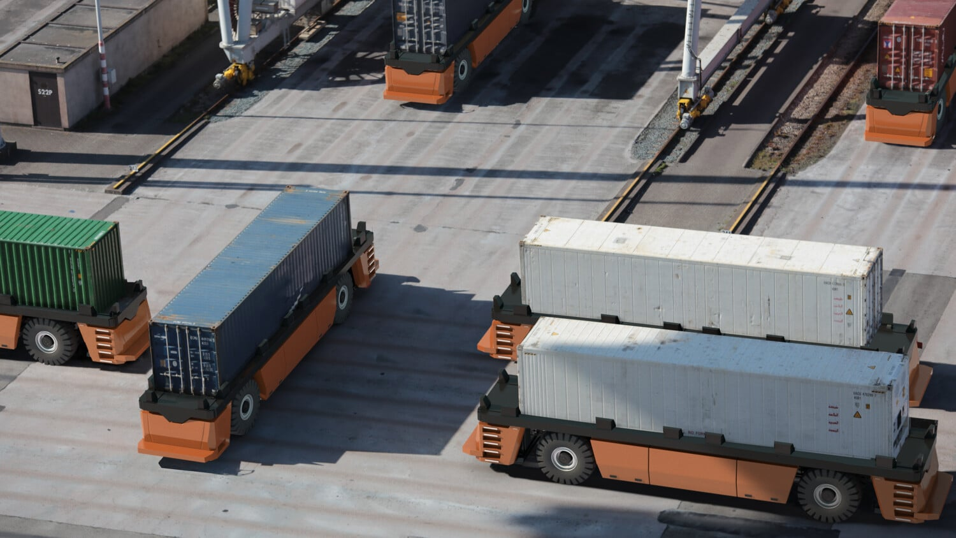
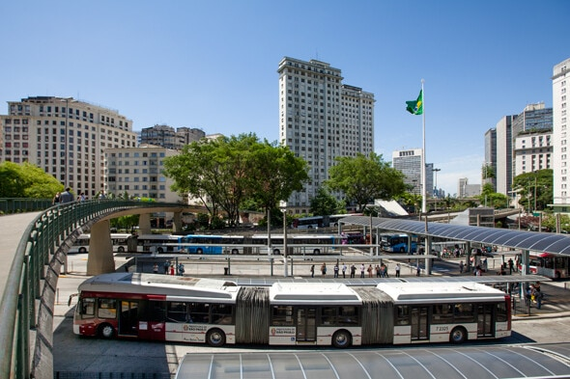
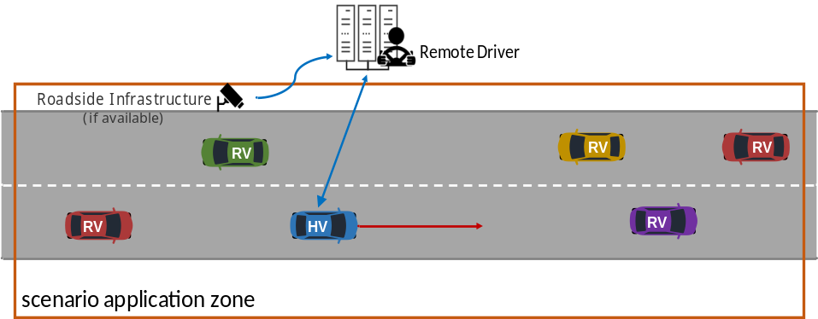
Example ToD Use Case:
Tele-operated Driving Support
ToD service for a short period of time when the automated vehicle faces a situation where uncertainty is high for the decision making
Two user stories
  I: ToD Type 2 (Indirect Control): trajectory or instructions for driving
  II: ToD Type 3 (Direct Control): remote steering
Typical scenarios
  Confined areas
  Predetermined routes
5GAA Technical Report, Tele-operated Driving (ToD) – Use Cases and Technical Requirements, Jul. 2020 (URL)
5GAA White Paper, C-V2X Use Cases Volume II: Examples and Service Level Requirements, Oct. 2020 (URL)
Notes:
An autonomous vehicle (e.g. passenger cars, or even a vehicle that performs dedicated tasks in very complex environments, e.g. snow ploughing, cleaning, loading and unloading) may detect a highly uncertain situation and cannot make the appropriate decision for a safe and efficient manoeuvre. In this case the autonomous vehicle can ask for the support of a remote driver in order to resolve the difficult situation and then switch back to the normal autonomous driving mode without the remote driving support.

Slide 7





Architecture and event flow
Event Flow (after establishing an authenticated and secure communication channel between the vehicle and the remote operator)
  The vehicle provides high-quality video streams and its status information (e.g. speed, location, destination)
  If available, secondary information from road infrastructure is accessed to obtain a more holistic view of the situation
  The remote driver analyses the situation and selects the appropriate trajectory and/or the manoeuvre instructions that will help the HV to resolve the corresponding situation where the uncertainty is high
  The remote driver sends to the vehicle trajectory and/or manoeuvre instructions, which are executed according to the vehicle’s on-board security checks
Infrastructure
Sensors*
Comm. Unit
Mobile Network
RAN
Vehicle
CORE
Control Room
Sensors**
Backend Network
Remote Operator Console***
Vehicle Control System
Comm. Unit
Typical comm. performance requirements (vehicle speed < 50 km/h)†
  Service level latency:
    Type 3: 100 ms UL + 20 ms DL
    Type 2: 100 ms UL + 200 ms DL
  Data rate UL: 36 Mb/s (Video + Objects)
  Data rate DL:
    Type 3: 400 kb/s
    Type 2: 25 kb/s
  Reliability
    UL: 99%, DL: 99.999%
Actuators
*Infrastructure sensors: Video, audio, etc.
**Vehicle sensors: Video camera, Radar, Lidar, ultrasonic, audio, positioning, etc.
***Remote Operator Console incl. at least HMI, remote control rig, remote driver
DL: downlink, i.e. remote operator to vehicle
UL: uplink, i.e. vehicle to remote operator
† 5GAA White Paper, C-V2X Use Cases Volume II: Examples and Service Level Requirements, Oct. 2020 (URL)

Slide 8
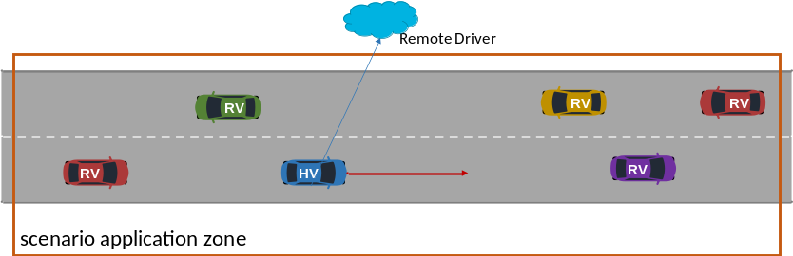
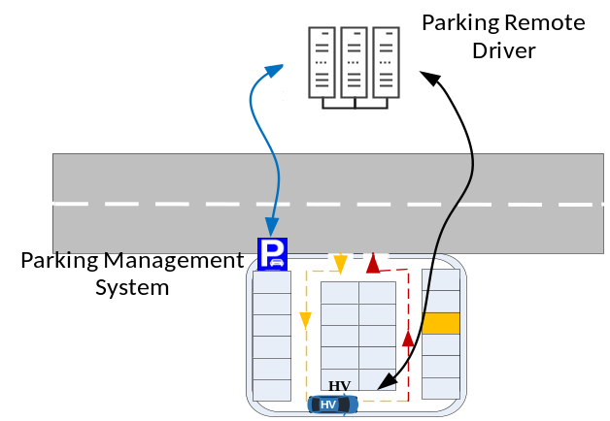
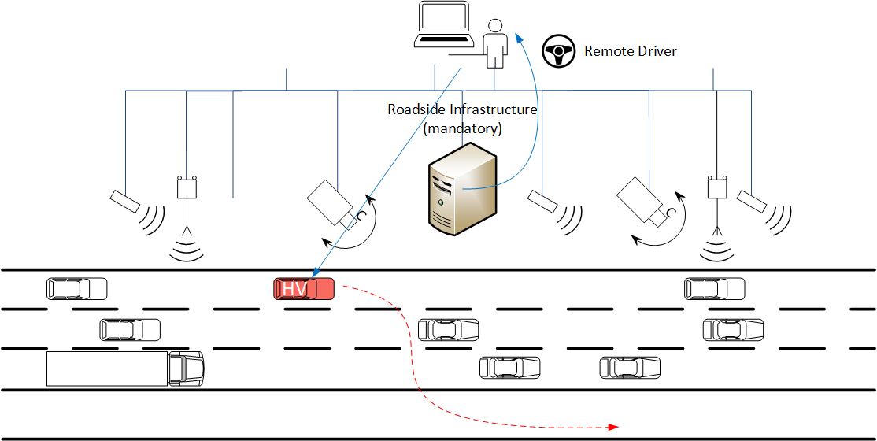
Other ToD Use Cases
ToD to the Destination
Tele-operated Driving to the Destination
  A remote driver takes control of the vehicle and drives it in an efficient and safe manner, from the current location to the destination, when for example the local driver has a temporary health issue.
Tele-operated Driving for Automated Parking
  Enables vehicle parking using remote driving without the presence of the passengers.
Infrastructure based Tele-Operated Driving
  Enables the remote driver to support the vehicle remotely in the absence of sensor data from the vehicle itself, by relying on sensors at the infrastructure.
ToD for Automated Parking
5GAA Technical Report, Tele-operated Driving (ToD) – Use Cases and Technical Requirements, July 2020 (URL)
Infrastructure based ToD
Notes:
An autonomous vehicle (e.g. passenger cars, or even a vehicle that performs dedicated tasks in very complex environments, e.g. snow ploughing, cleaning, loading and unloading) may detect a highly uncertain situation and cannot make the appropriate decision for a safe and efficient manoeuvre. In this case the autonomous vehicle can ask for the support of a remote driver in order to resolve the difficult situation and then switch back to the normal autonomous driving mode without the remote driving support.

Slide 9
Tele-operated Driving Services and Video Quality
Video quality and latency have safety impacts on ToD with human remote operators.
Common understanding about relation between video quality and ToD performance
Functional safety and video quality
Video quality requirements of different ToD types
Influences from environments and vehicle speed
  Valet parking
  ToD on highway

Slide 10
Thank you!

