Slide 1
“Special Session on QUality assessment for computer vision AnD immeRsIVe medIa Applications (QUADRIVIA 2020)”
Mikołaj Leszczuk
March 2020

Slide 2
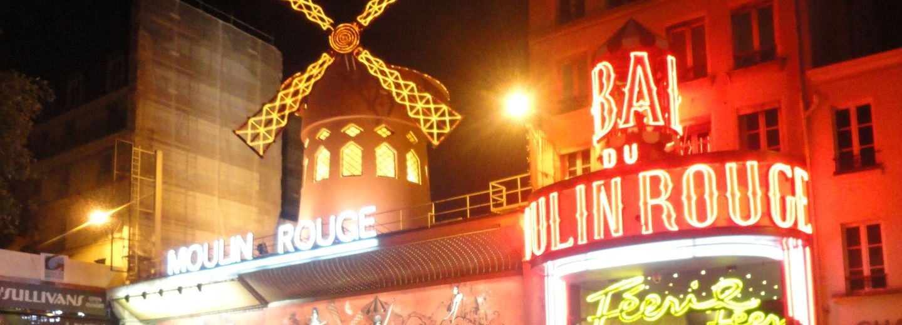
QUADRIVIA
Special Session
“Special Session on QUality assessment for computer vision AnD immeRsIVe medIa Applications”
Related VQEG projects/groups:
  Quality Assessment for Computer Vision Applications (QACoViA)
  Immersive Media Group (IMG)

Slide 3


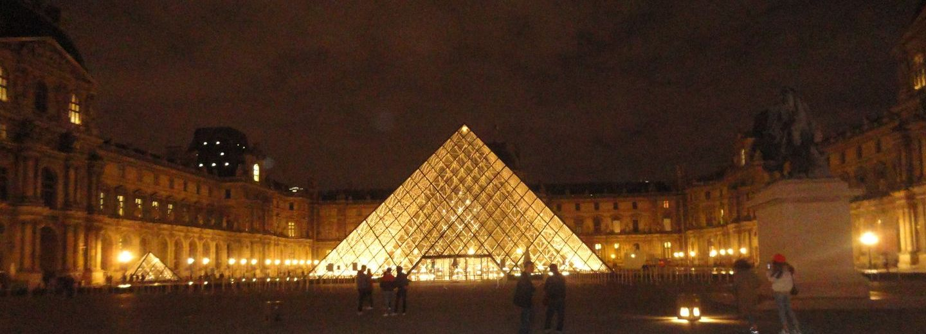
About Host Conference
The 12th edition of International Conference on Multimedia & Network Information Systems (MISSI)
Paris – France; 26-28 August, 2020
https://missi.pwr.edu.pl/

Slide 4
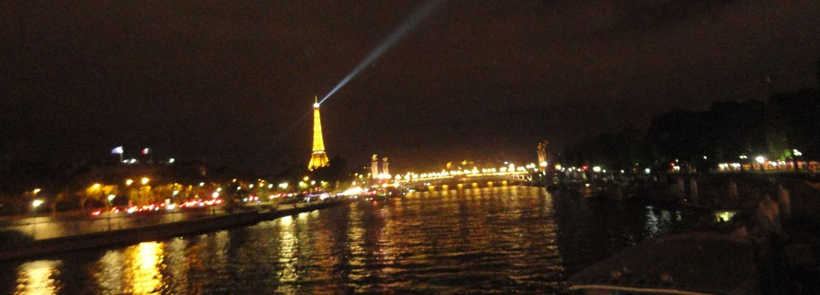
QUADRIVIA Committee
🇺🇸 Philip Corriveau
🇫🇷 Jesús Gutiérrez
🇧🇩 Rossi Kamal
🇵🇱 Jakub Nawała
🇵🇱 Mikołaj Leszczuk
🇺🇸 Amy Reibman

Slide 5

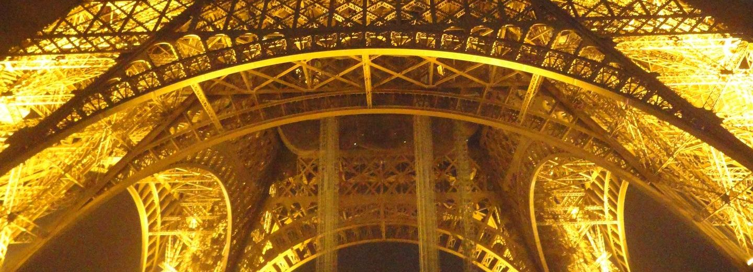
Proceedings and
Post-Conference Publications
IEEE Open Journal of Circuits and Systems (IEEE CAS)
International Journal of Intelligent Information and Database Systems (IJIIDS)
Journal of Intelligent & Fuzzy Systems (JIFS)
Signal, Image and Video Processing (SIVP)
…

Slide 6
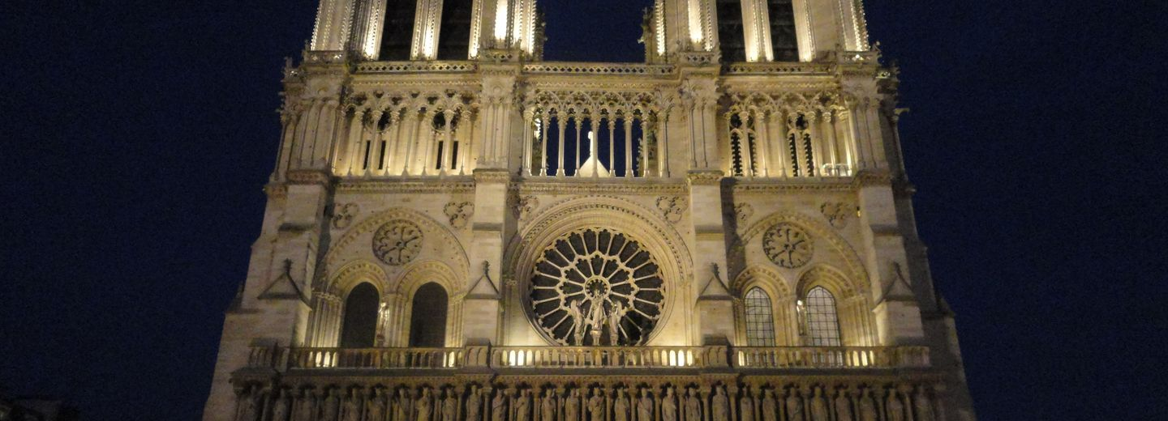
Important Dates
Paper submission deadline: 15 March 2020
Extended paper submission deadline: ??? 2020
Notification of acceptance:
20 April 2020
Registration and payment:
10 May 2020
Final paper deadline:
15 May 2020
Conference:
26-28 August 2020

