Slide 1
Updates on the ITU-T Activities with Respect to Gaming Quality Assessment
Steven Schmidt
Quality and Usability Lab – Berlin Institute of Technology
VQEG Meeting - Seattle, USA, 2020

Slide 2

What is Cloud Gaming?
Spatial quality (QP)
Temporal quality (Frame Rate)
Bit Rate
Player
Game
Server
Display
System
Video Encoder
Ordinary
Online
Gaming
Game
Engine
Game
Server
Video Decoder
Game
Engine
Game Input Device
Cloud (Server)
Client
Latency + Packet Loss
Limited bandwidth
Network Characteristic

Slide 3
What are we working on?
User satisfaction for cloud gaming services
  Network provider: network planning / infrastructure
  Service provider: resource distribution
Understanding how to assess gaming QoE and its underlying multidimensional space
Investigating relevant influencing factors on gaming QoE
Predicting gaming QoE

Slide 4
What is Gaming Quality of Experience?
User
System
Context
Influencing
factors
Experience
Playing style
Intrinsic motivat.
Static factors
Dynamic factors
Game genre
Game structure
Game rules
Server
Channel
Player & device
Physic. & social
environment
Extrinsic motivat.
Service factors
Hedonic Pragmatic
Aesthetics
Novelty
Output quality
Interactive
behavior
Input
quality
Learnability
Intuitivity
Appeal
Interaction quality
Playing quality
Quality features
Tension
Challenge
Competence
Quality of Experience (QoE)
Positive
affect
Negative
affect
Immersion
Flow
Player experience
Acceptability
[1]

Slide 5

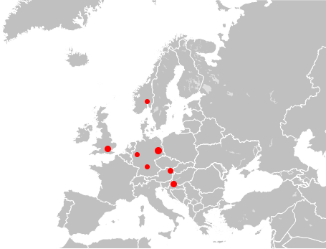
Standardization Activities
[2]
Creation of 3 work items in ITU-T SG-12
ITU-T Rec. G.1032 (10/2017) – G.QoE-gaming:
  Influence factors on gaming quality of experience
ITU-T Rec. P.809 (05/2018) – P.GAME:
  Subjective evaluation methods for gaming quality
ITU-T Rec. G.1072 (02/2020) – G.OMG:
  Opinion model predicting gaming quality of experience
  for cloud gaming services
[3]
[4]
[5]

Slide 6
New work items in ITU-T SG-12
P.CROWDG (established during last ITU meeting)
  Subjective evaluation of gaming qual​ity with a crowdsourcing approach
G.OMMOG (established during last ITU meeting)
  Opinion Model for Mobile Online Gaming applications
Propose for next meeting
  Monitoring model predicting gaming quality of experience
  for cloud gaming services
We would be very glad if
you join this activity

Slide 7
New ITU work item: G.OMMOG
Mobile Online Gaming using interactive multiplayer games
  No offline games or low sensitive games
  Genres: MOBA, Battle Royal, Sport, Shooting
Impairment model structure similar to G.OMG
Influence of Delay (and Jitter) as well as Packet Loss (and bursts)
Combination of 16 network conditions per game
Target group: advanced users but non-professionals
Submission of first draft: April 2020

Slide 8
Challenges to build Gaming QoE model
Large number of system influence factors
  Encoding and network
  Protocols / error handling
  Devices (displays and inputs)
User factors: casual and pro gamer (target group?)
Strong impact of game content on gaming QoE
Long stimulus duration required: at least 90 seconds for interaction quality
Many quality features to assess (see taxonomy)
Environment: controlled lab vs. home environment

Slide 9
What do we have / know already
How to assess broad range of quality features more effectively
  Different test paradigms: interactive and passive tests
  How to control for influence factors
Datasets of interactive and passive tests (GPU accelerated encoding)
  Interactive: 12 games using delay, framerate, packet loss, encoding grid points
  Passive: 21 games using bitrate, resolution, framerate, packet loss
Game content must be considered better
Influence of packet loss strongly depends on the implementation of service

Slide 10
Subjective Test Design for interactive studies
Intro
Stimulus
Rating
Post
15 min
1.5 min
3 min
10 min
1 reference
+ 3 framerates
+ 5 frame loss rates
+ 5 delays
+ 3 bitrates (comparison)
100 minutes
per participant
per game
600 hours for 12 games and 30 participants
17 conditions

Slide 11
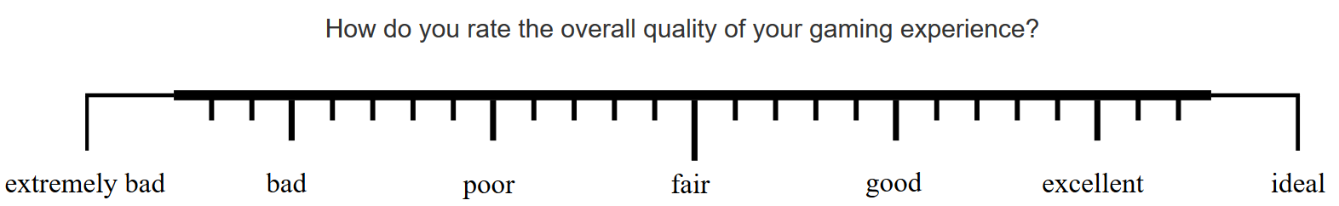
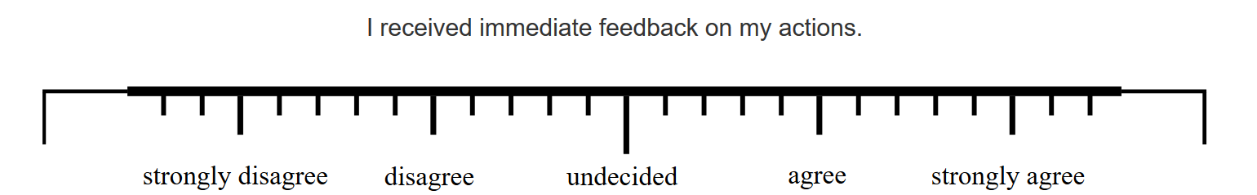
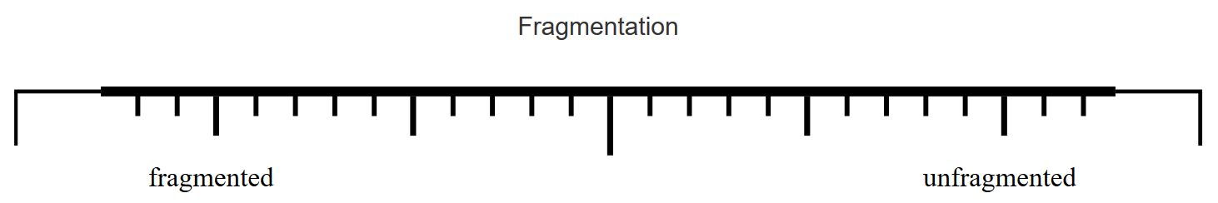
ITU-T Rec. P.809 used for G.1072

Slide 12
Structure of ITU-T Rec. G.1072

Slide 13
Quality Impairments used in ITU-T Rec. G.1072
$$R_{QoE}=R_{max}−0.79⋅I_{VQ_{trans}}−0.9⋅I_{VQ_{cod}}−0.2⋅I_{TVQ}−0.6⋅I_{IPQ_{frames}}−0.84⋅I_{IPQ_{delay}}$$
$$I_{TVQ}=d_{1}+d_{2}⋅{FR_enc}^{2}−d_{3}⋅FR_enc+d_{4}⋅Log(FrameLossRate)$$
$$FrameLossRate=\frac{FR_{enc}−Avg_{FPS}}{FR_{enc}}⋅100$$
$${Avg}_{FPS}=FR_enc⋅\exp\left(\left(d_{5}+ d_{6}⋅FR_{enc}+ d_{7}⋅Bitrate⋅FR_{enc}\right)⋅ \left(d_{8}⋅Delay − d_{9}\right)⋅PL\right)$$
This parameter is valuable for QoE prediction but strongly depends on system => can be monitored

Slide 14
Impact of game content on model performance (G.1072)
PLCC: 0.82, RMSE: 0.47 PLCC: 0.89, RMSE: 0.33

Slide 15
Call for New ITU work item
Development of monitoring model for cloud gaming QoE
  Long and short stimuli
  Interactive and passive tests
  Multiple codec, hardware encoding => use of video metrics
  Bitstream header based and payload based => content impact
  Collaborative work item, no patent and no competition
  So far, we received interest from three academic partners, two industrial partners
  Email us if you are interested to join

Slide 16

Thank you for your Attention!
Updates on the ITU-T Activities
with Respect to Gaming Quality Assessment
Steven Schmidt (steven.schmidt@tu-berlin.de)
We are always searching for collaborations ☺
Visit
www.qu.tu-berlin.de
for more information.

Slide 17
References
[1] S. Möller, S. Schmidt, and J. Beyer, “Gaming taxonomy: An overview of concepts and evaluation methods for computer gaming qoe,” in Quality of Multimedia Experience (QoMEX), 2013 Fifth International Workshop on, 2013.
[2] S. Möller, S. Schmidt, and S. Zadtootaghaj, “New ITU-T Standards for Gaming QoE Evaluation and Management,” in Quality of Multimedia Experience (QoMEX), 2018 Tenth International Workshop on, 2018.
[3] ITU-T Recommendation G.1032, “Influence factors on gaming quality of experience,” International Telecommunication Union, Geneva, 2017.
[4] ITU-T Recommendation P.809, “Subjective Evaluation Methods for Gaming Quality,” International Telecommunication Union, Geneva, 2018.
[5] ITU-T Recommendation G.1072, “Opinion Model Predicting Gaming QoE for Cloud Gaming Services,” International Telecommunication Union, Geneva, 2020.
[6] F. Schiffner and S. Möller, “Direct Scaling & Quality Prediction for perceptual Video Quality Dimensions,” in 2018 Tenth International Conference on Quality of Multimedia Experience (QoMEX), 2018, pp. 1–3.

Slide 18
Conditions used to model Interaction Quality
  480p: 1, 2, 4 mbps
  720p: 1, 2, 50 mbps
  1080p: 2, 4, 6, 50 mbps
  Frame Rate: 60, 30, 20, 10 fps
  Frame Loss Rate: 0, 10, 15, 25, 30 %
  Delay: 0, 25, 50, 100, 200, 400 ms
Spatial Video Quality
(blockiness: fragmentation, unclearness)
Temporal Video Quality
(jerkiness: discontinuity)

Slide 19
Assessed Quality Features
  Overall Quality
  Video Quality (overall and dimensions by Schiffner)
    Fragmentation, Discontinuity, Noisiness, Unclearness, Suboptimal Luminosity
  Audio Quality
  Input Quality: Responsiveness, Controllability, Immediate Feedback
  Player Experience: iGEQ (Immersion, Flow, Tension, Challenge, Competency, positive and negative Affect)
  Performance and Acceptance
    31 items (~3 minutes)
[6]

Slide 20
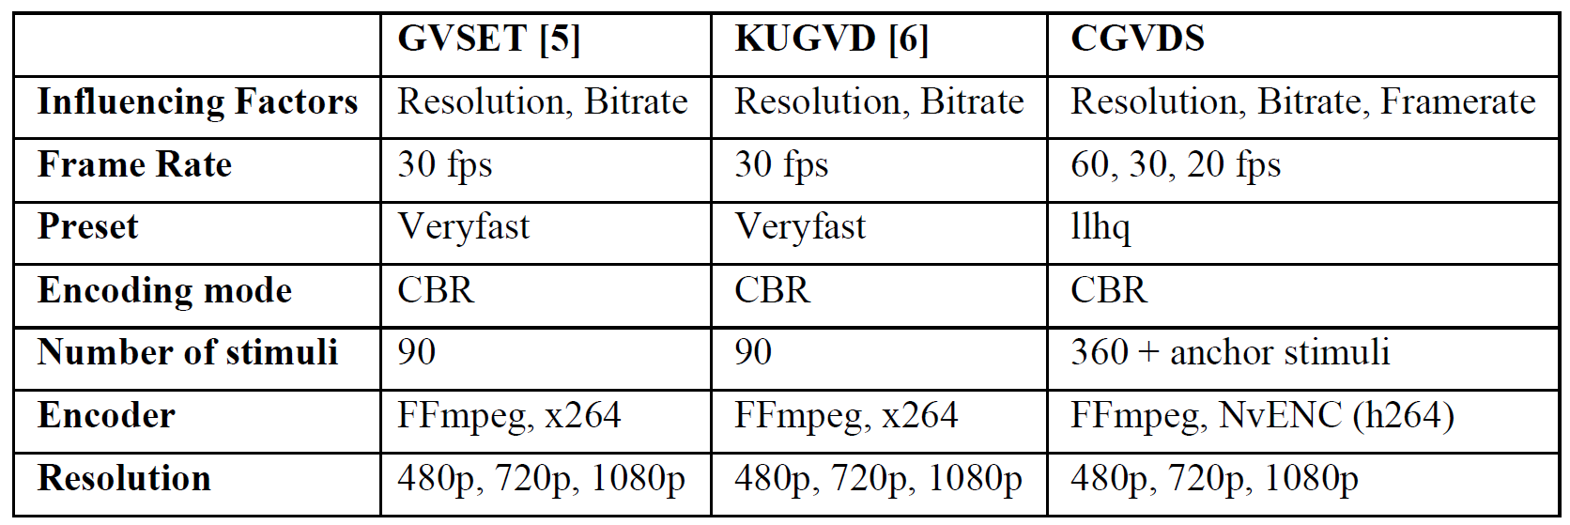
Datasets using passive video quality assessment
Three large passive video quality datasets

