Slide 1
Multi-dimension aesthetic assessment for game image: a subjective test
Presenter: Junle WANG
Tencent Games
Mar. 09, 2020, VQEG Meeting

Slide 2

Self-introduction
Junle WANG
  Working on computer vision, data science in video game, game AI
Tencent: More than WeChat and QQ
  Currently the largest video game company in the world
  Own Riot Games, big part of Supercell and Epic games, small part of Bluehole, Activision Blizzard, Ubisoft and so on.
  Focus on mobile game

Slide 3
Overview
Background
A subjective test on mobile game image aesthetic assessment
Result

Slide 4
What we do to evaluate a game?
Visual analysis (subjective scoring, 5 scales, similar ACR)
  Overall score
  Color(harmony, colorfulness)
  Fineness
  Distant view
  Interaction effect
  Lighting/shadow effect
  Model size consistency
  Action/movement
  Image style
  Visual Effect
  …
Audio (subjective scoring, 5 scales)
Immersive(questionnaire)
Control (objective + subjective scoring)
Mobile performance (objective, i.e. CPU, FPS, Memory, Temperature)
less subjective
less prior knowledge
less top-down related factors

Slide 5
Background
Image Aesthetic Assessment
  Application:
    Selection of photos/cover images
    Image enhancement
  Challenge
    Higher level and more subjective factors
    Usually no reference
  Progress
    Either by specific rules, or by neural network
    Natural content / photographic (AADB, AVA, …)
    Little study is about CG, particular video game image
Our motivation
  Game evaluation
  Game design
  Anormal detection
  Game image quality assessment and cloud gaming

Slide 6
Challenges
Personal preference on game
Different picture styles
  Pixelization style
  Simple style
  Realistic style
Influence of UI
VFX
Always evolving

Slide 7
Experiment
Stimuli
  100 games collected from Play Store
    Some game types are filtered out：
      Casino
      Teaching
      AR/MR
      Q&A challenge
  1091 screenshot images in total
    Some images are filtered out:
      UI for setup,
      Advertising image included,
      Natural content,
      OS image related

Slide 9
Experiment
Task
  Evaluate each image based on four dimensions
    Fineness
    Colorfulness
    Color harmony
    Overall score
  Observers are asked to give a 1 to 5 score to each dimension

Slide 10
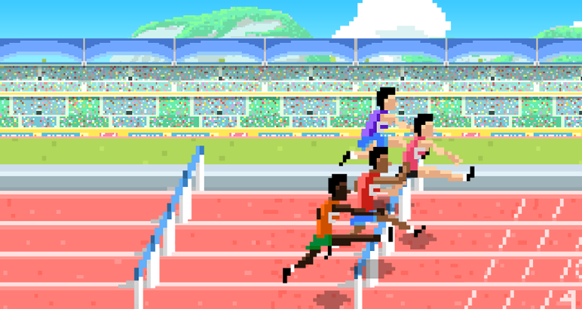
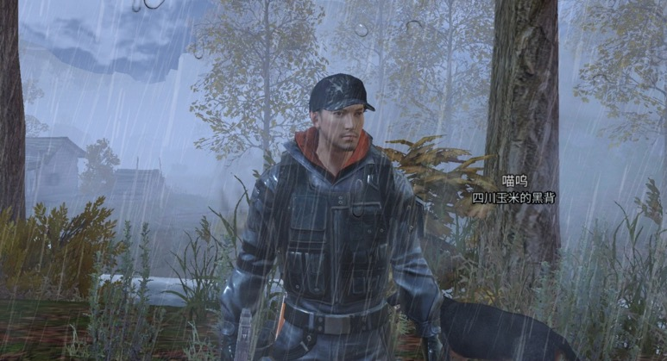
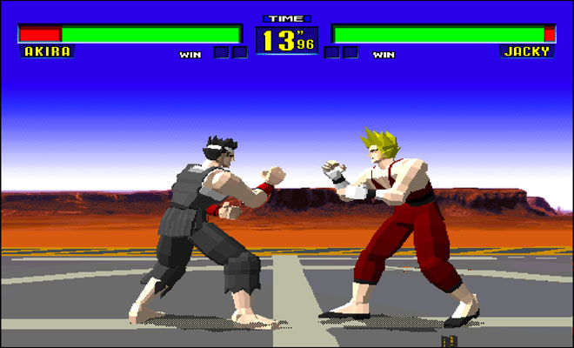
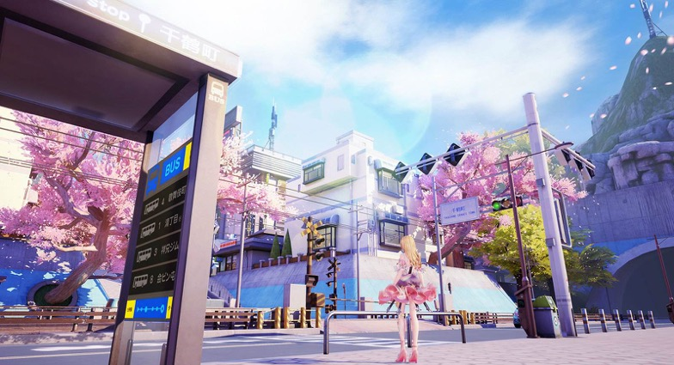
Fineness
Do you think the details are enough and clearly presented?
Score 1
Score 5

Slide 11
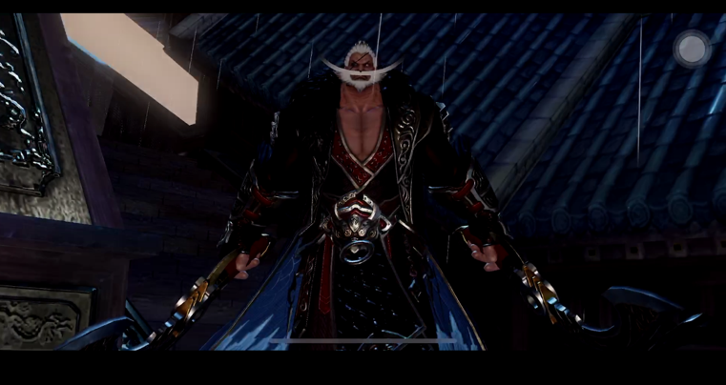
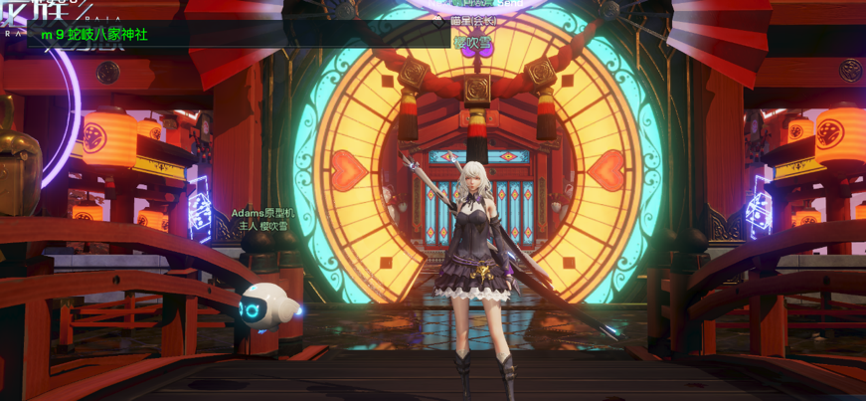
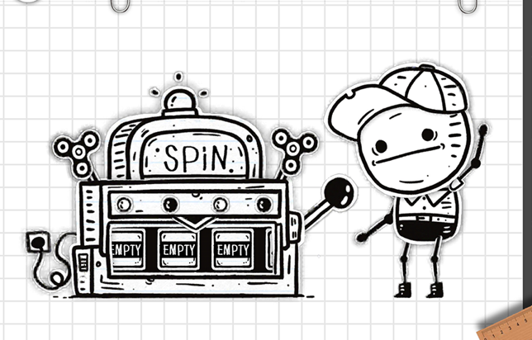
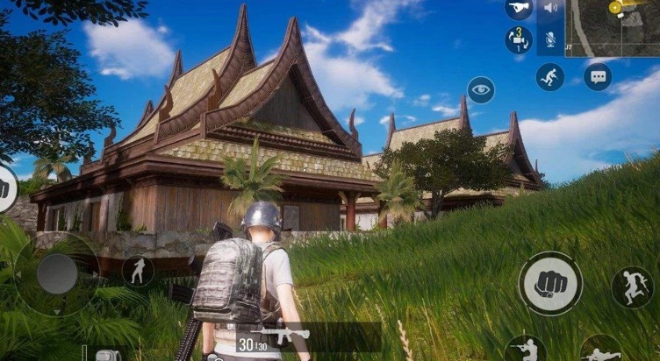
Colorfulness
Score 1
Score 5

Slide 12
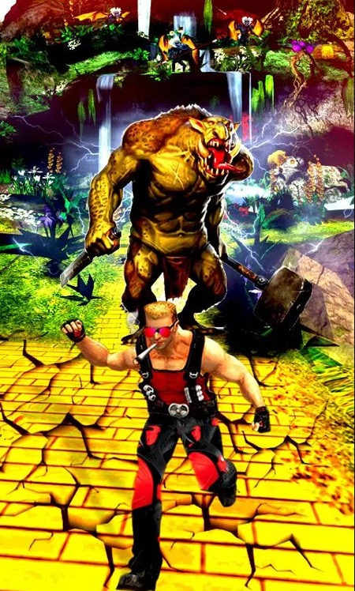


Color harmony
Do you feel comfortable/pleasant about the collocation of color?
Score 1
Score 5

Slide 13
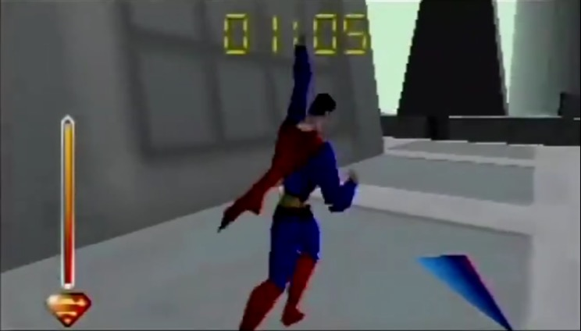
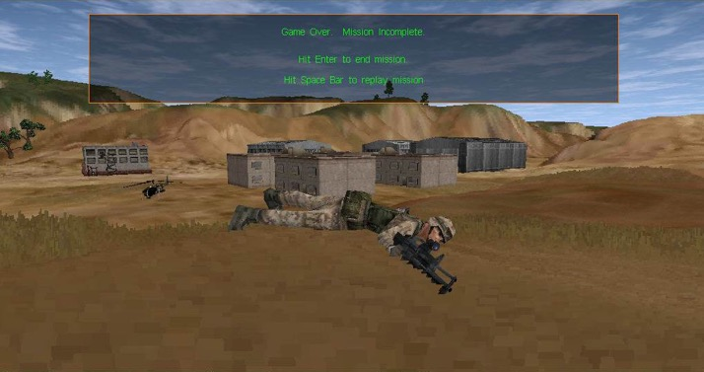
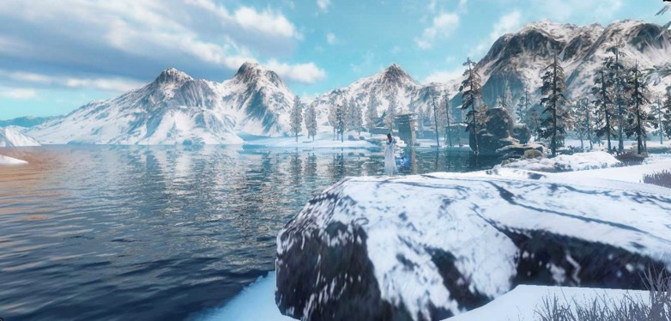
Overall score
Score 1
Score 5

Slide 14
Experiment
Participants
  12 observers, 9 male and 3 female
    an ongoing task, more observers will join
  Game testers
    Not designers, not artist, not working in game evaluation
Environment
  Indoor, office environment
  Display：HP P223A
Procedure
  Adjust image size to simulate the visual field of mobile phone
    5.9 inch at a 33.95-cm viewing distance
  Evaluate four dimensions at the same time

Slide 15
Analysis
  Score distribution
 | Fineness | Colorfulness | Harmony | Overall
Confidence interval | 0.550 | 0.512 | 0.542 | 0.547

Slide 16
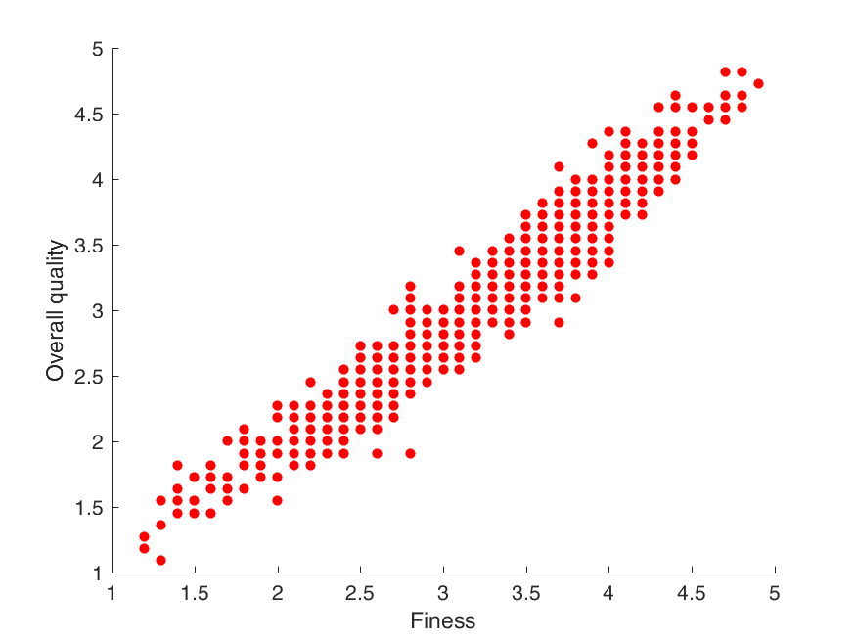
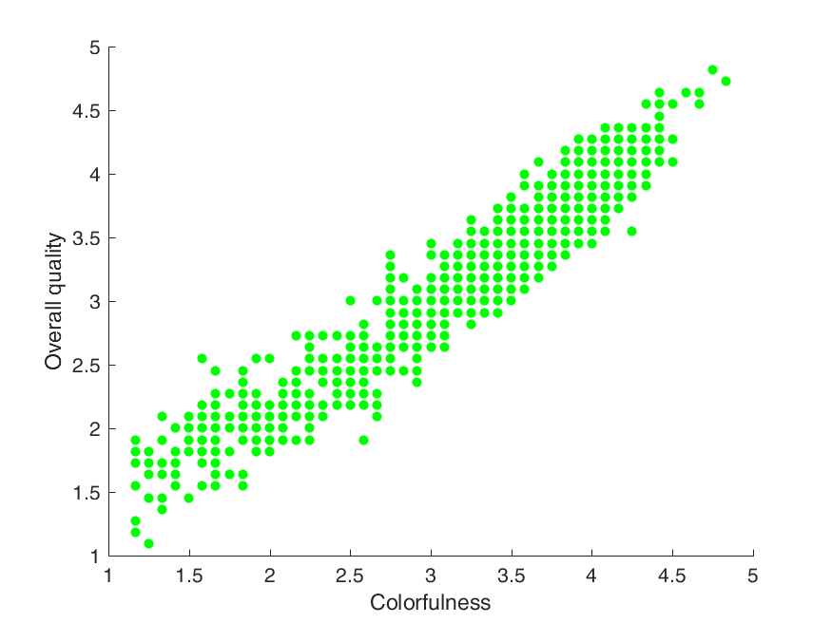
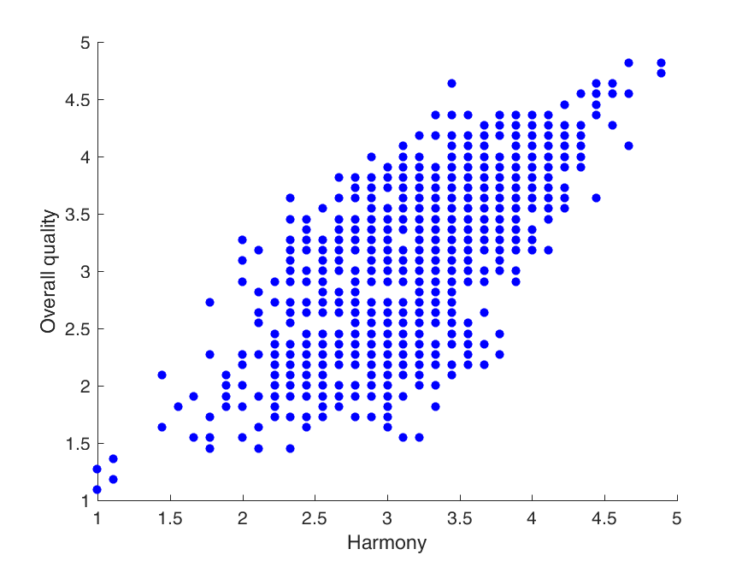
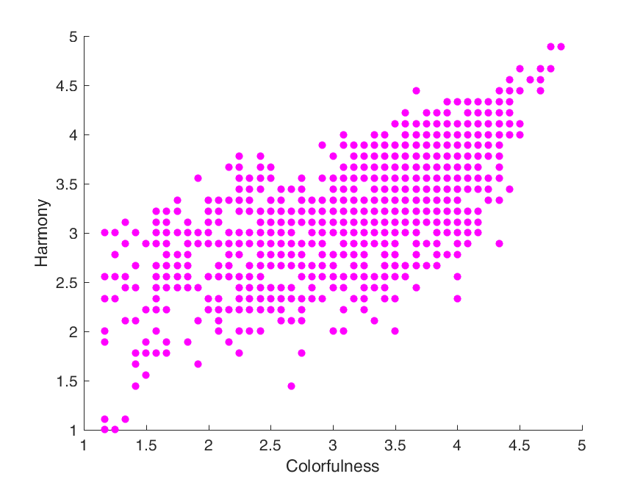
Analysis
Correlation of MOS among dimensions
Overall Quality
Harmony
CC=0.971
CC=0.960
CC=0.741
CC=0.696
Fineness
Colorfulness
Harmony
Colorfulness

Slide 17
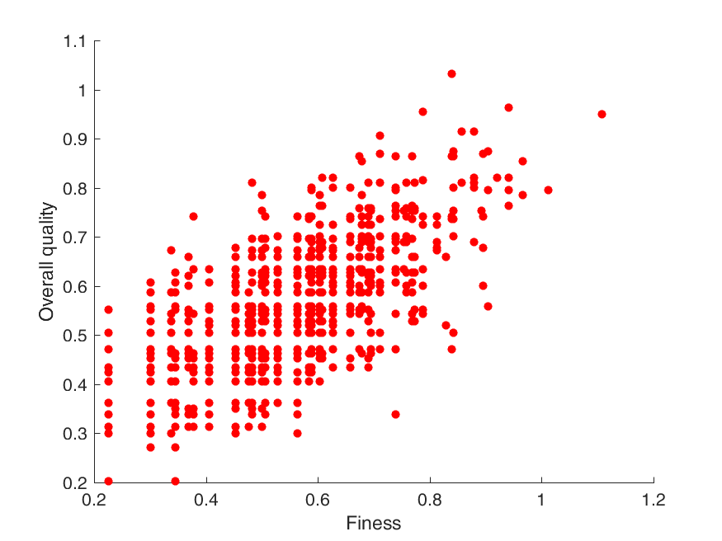
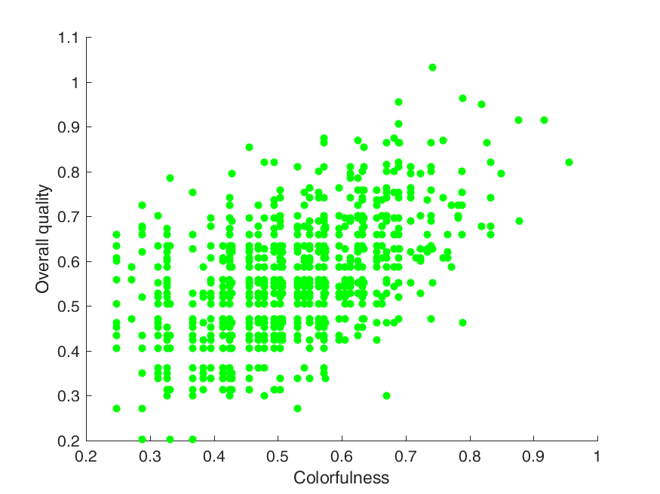
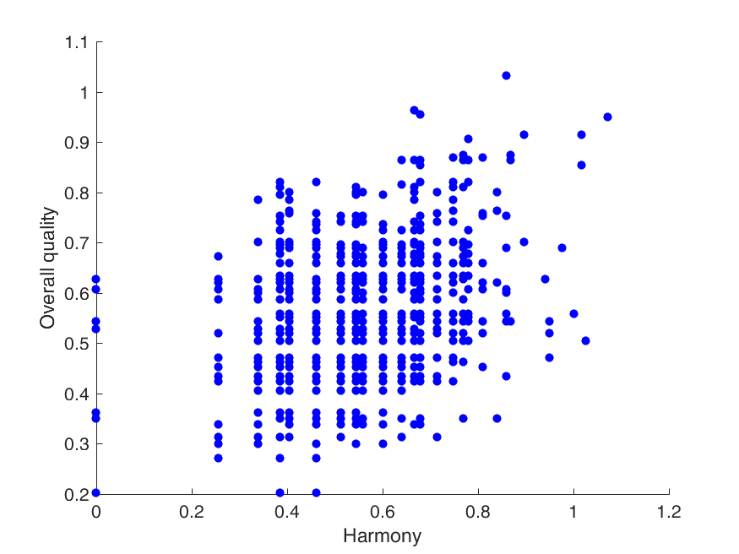
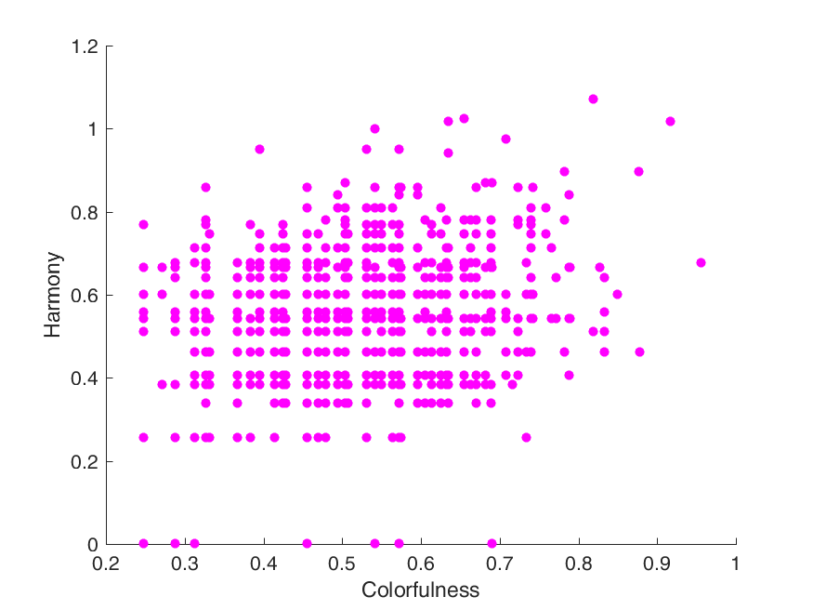
Analysis
Correlation of confidence interval between dimensions
  Agreement among the observers
Overall Quality
Harmony
CC=0.684
CC=0.518
CC=0.318
CC=0.189
Fineness
Colorfulness
Harmony
Colorfulness

Slide 18
Analysis
Performance of objective metrics
PCC | fineness | colorfulness | harmony | overall_score
CPBD[1] | 0.58084924 | 0.60560647 | 0.43386353 | 0.52565376
NIMA[2] | 0.1547595 | 0.14222089 | 0.30302161 | 0.14776166
[1] Narvekar, Niranjan D., and Lina J. Karam. "A no-reference image blur metric based on the cumulative probability of blur detection (CPBD)." IEEE Transactions on Image Processing 20.9 (2011): 2678-2683.
[2] Talebi, Hossein, and Peyman Milanfar. "NIMA: Neural image assessment." IEEE Transactions on Image Processing 27.8 (2018): 3998-4011.

Slide 19
Future work
Some more dimensions to evaluate?
Objective metrics?
Other suggestions?

