Slide 1
Software Framework for NR Metric Research
Margaret H Pinson
NTIA/ITS
mpinson@ntia.doc.gov
+1 303-497-3579

Slide 2
Problem—Need Support Tools
Data—identify training datasets
Logistics—large data, researchers who lack programmer support
Repeatability—running someone else’s NR metric
Collaboration—combining NR metrics
Analysis—compare and contrast performance
Verification—10% data not used for training
Novices—getting started, avoiding common mistakes

Slide 3
NRMetricFramework
Explain NR metric design goals, from VQEG discussions
  Root cause analysis (RCA)
Dataset logistics
  Identify openly available datasets
  Dataset structure
  Import & export
Standard interface for coding NR metrics
  Spatial impairment (image or video frame)
  Temporal impairments (pair of video frames)
  3D metrics (entire video sequence)
Calculate on multiple datasets
Analyze

Slide 4
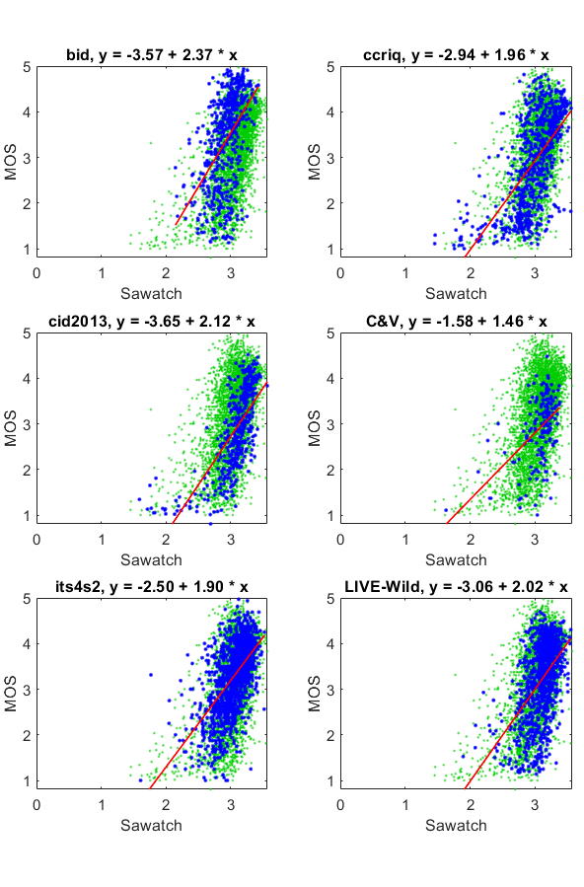
Baseline NR Metric
NR metric “Sawatch”
  Camera capture of images, 0.57 correlation on average
  Camera capture of video, 0.46 or 0.54 correlation
Intent
  Demonstrate framework
  Baseline for future development
  Collaborate, replace, improve
  Family of metrics

Slide 5
NRMetricFramework
MATLAB
Octave
  Looking good, but analysis still underway
  Differences in calculations, likely from rounding
  Slower
  Issues reading videos other than uncompressed AVI

Slide 6
Missing Pieces
Python implementation
Just noticeable difference (JND) analysis techniques
Bitstream reader
  Quantization parameter (QP), quantization scale (QS), motion vectors (MV)
Independent metric
  Intentionally omitted
  Framework is designed for researchers, not end users
More datasets
  Available but not imported
  UGC from YouTube, Qualcomm LIVE, CVD 2014, …
Previously published NR metrics
  Code
  Performance evaluation

Slide 7
Where to Download
https://github.com/NTIA/NRMetricFramework/releases
See wiki pages for help and tutorials
Freely available

