Slide 1
Summary of Prior Discussions
Margaret H Pinson
NTIA/ITS
mpinson@ntia.doc.gov
+1 303-497-3579

Slide 2
Computer Generated
Consumer Generated Content
Public Safety
Computer
Vision
Broadcast
traditional
NR metric

Slide 3
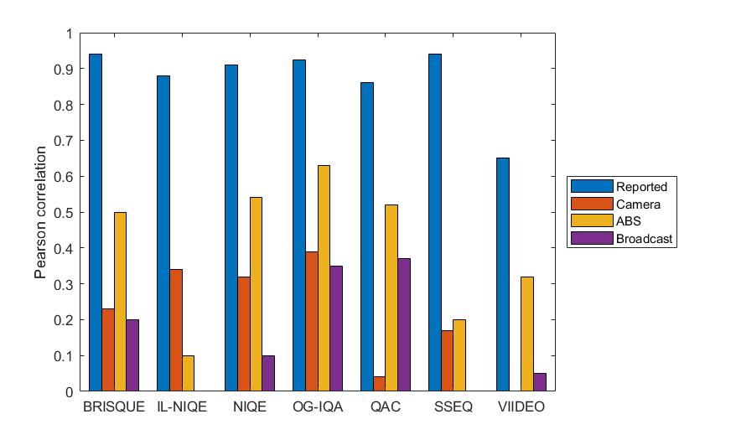
NR Metric Performance
Narrow Scope → Broad Scope*
Subjective testing
lab-to-lab correlations
* This is not a fair validation of the metrics for their intended use case.

Slide 4
Industry Specifications?

Slide 5

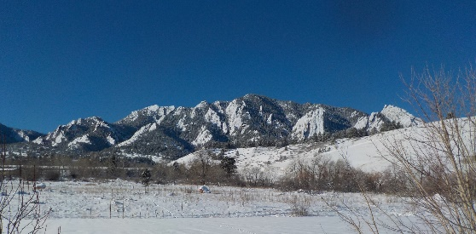
Millions of user generated contents each day
Inconsistent, unpredictable media
Arbitrary consumption
Compression critical
NR metric
Upload to YouTube
Transcode
Record, process, edit, compress

Slide 6
End-to-end Broadcast Workflow
Professional live camera capture
Outside broadcast truck
Incoming source input
Headend
Encoder output
Transcoder output
Packager output
Incoming content from 3rd party
Encrypt output
Origin output
CDN output
Player output
Client device output
NR metric
proposed measurement points

Slide 7
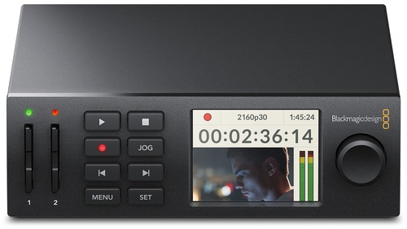
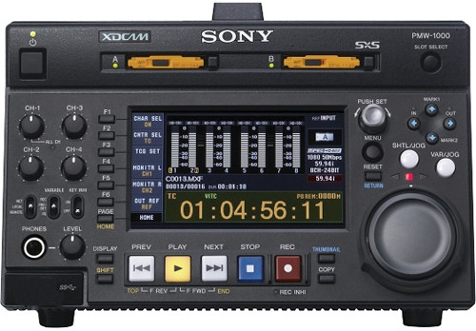


Video Encoder Use Case
Video encoder feedback loop
  Choose encoding options
  Optimal tradeoffs
Minimum: 64×64 pixels, 2 frames
Blackmagic Design HyperDeck Studio Mini
Sony PMW-1000 XDCAM SxS
NR metric
video coder
Datavideo HDR-70 HDD Recorder
AJA Ki Pro Rack

Slide 8
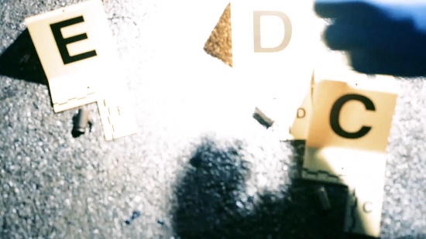
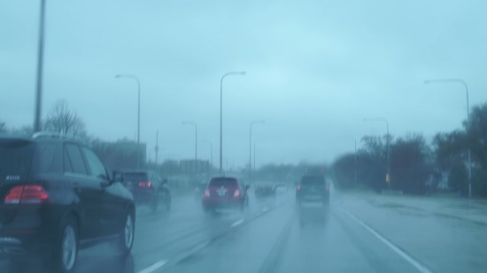
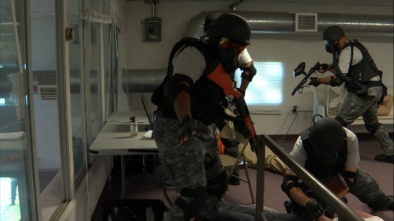
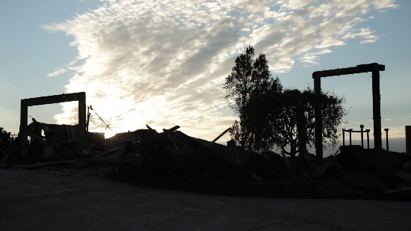
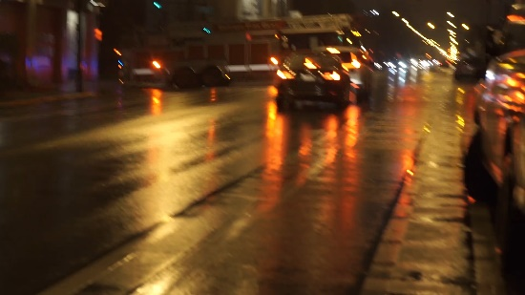
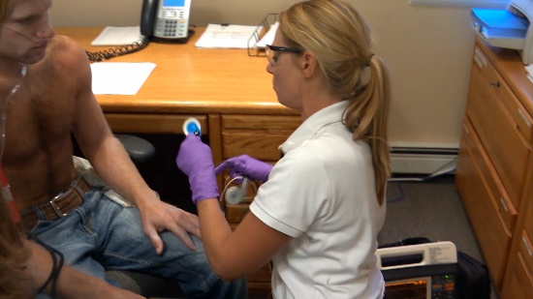

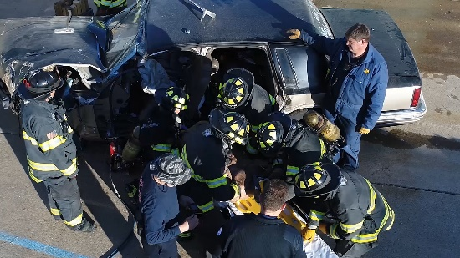

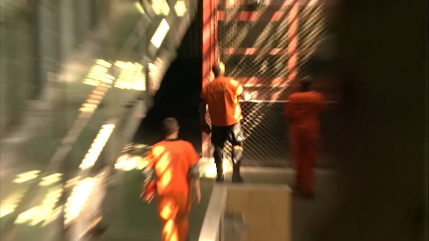
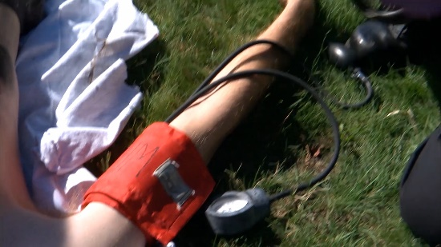

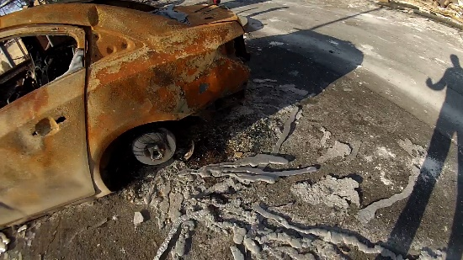
First Responders
Transient event & difficult environment
NR Metric → ensure quality for task
  Consumer cameras
  Intelligent networks
  Priority access

Slide 9
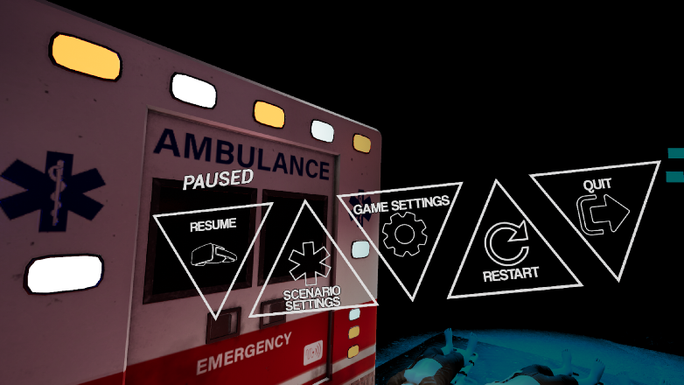
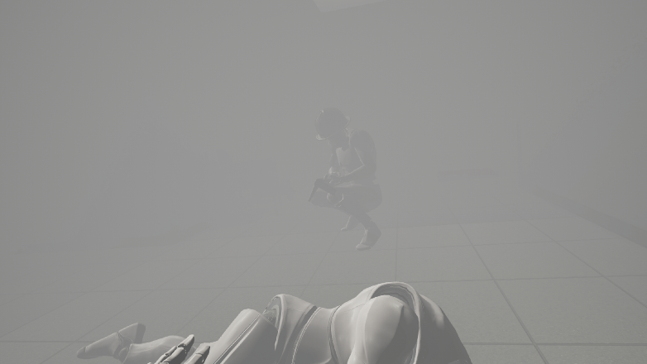
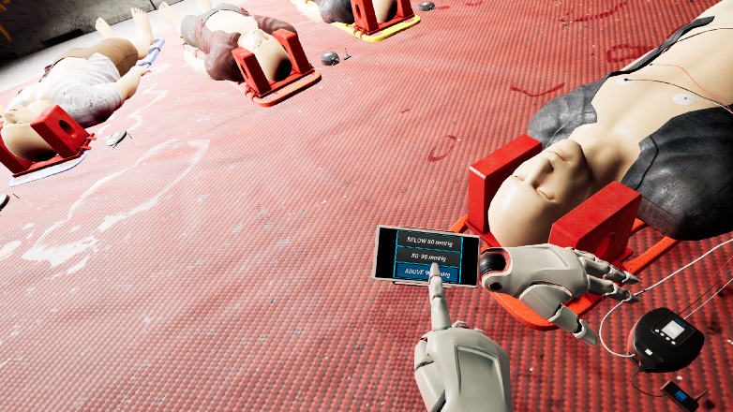
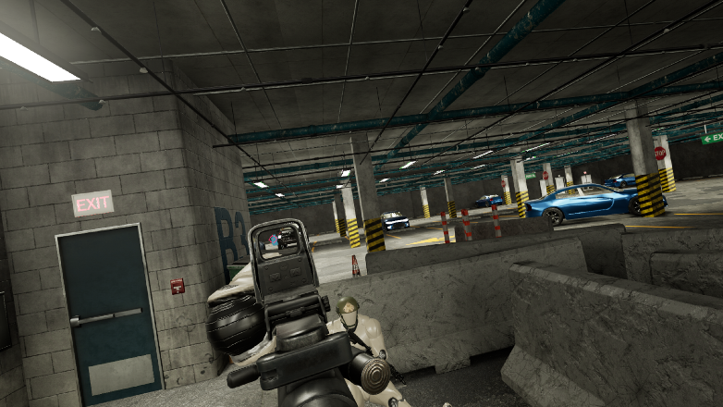
Real-time Computer Graphics
Rendering Decisions
Lag
Resolution
Frame rate
Detail
Compression bit-rate

Slide 10
Computer Vision
Real-time camera feedback loop
  Focus
  Zoom
  Exposure
  Bit-rate
Predict success / failure of analytic
  Reduce false detection rate
Detect and respond
  Mark areas where camera cannot “see”
  Image processing to remove impairments
Computer vision
Camera
NR Metric

Slide 11
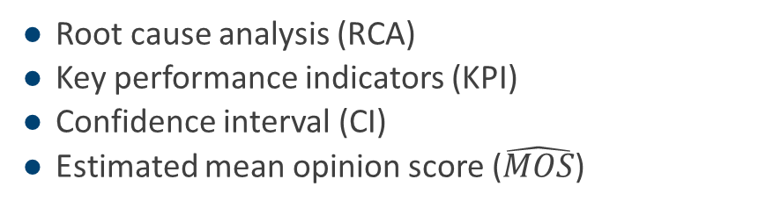
Action
RCA
CI
$$\hat{MOS}$$
(𝑀𝑂𝑆) ̂
KPI
Root cause analysis ($\text{RCA}\text{)}$
Key performance indicators (KPI)
Confidence interval (CI)
Estimated mean opinion score ($\hat{MOS}$)

Slide 12
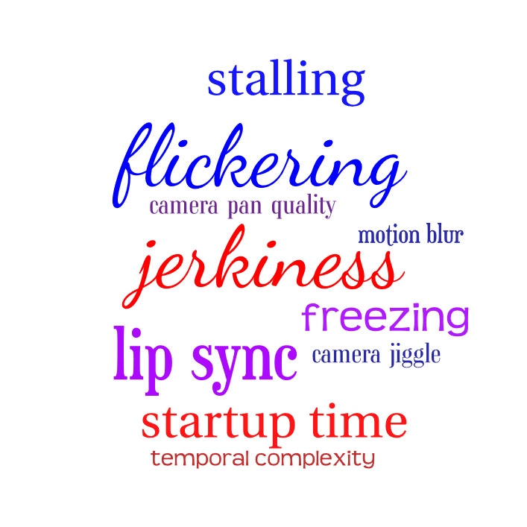
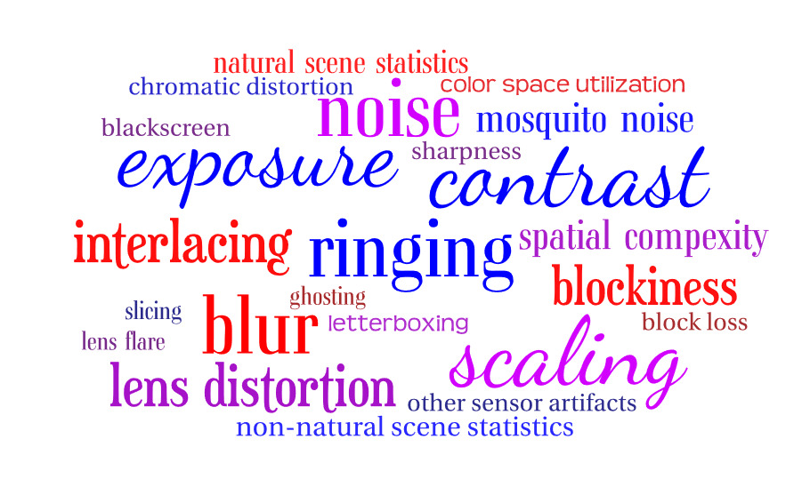
Key Performance Indicators

Slide 13
Broadcast Use Case — KPI & RCA
Excessive motion blur
Noise frame
Transmission medium
Low quality de-interlacing
Excessive compression
Blur
Macro-blockiness
Upscaling
Blur
Ringing
RTP packet loss
Rebuffering
Startup lag
Video stream misconfigured
Black screen
Test signal
Jagged edges
Camera misconfigured

Slide 14
Questions?

