Slide 1
5GKPI
Next Steps
Online Plenary Meeting
13-03-2020

Slide 2
5GKPI
What’s next?
Contribution to ITU-T standardization?
  Competition vs collaboration?
  Interest in Q13? Others?
Explore generation of open/reference datasets?
  Leverage existing and future 5G assets of participating members
  With what purpose?

Slide 3
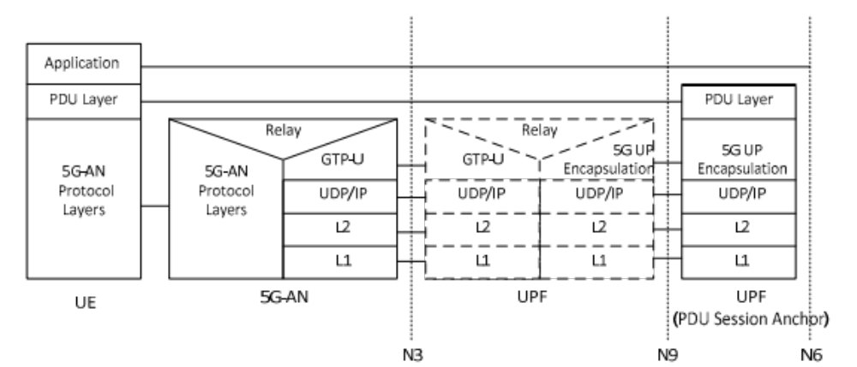





The trip of an IP packet
5G User Data Plane
≈ IP
5G Radio Access Network
5G Core (Tunneling and QoS)
Resource grid:
Scheduling of
~150 blocks
~20-160 bytes
each ms (or less)
MEC
UE (Phone)
gNB (Base Station)
Core
Internet

Slide 4
The trip of an IP packet
Network Conditions
N Terminals (UE) with different
Traffic patterns
Channel quality
5G Core (Tunneling and QoS)
Resource scheduling:
Maximize total throughput
User fairness
QoS policies
QoS policies can be applied in the 5G Core
5G Radio Access Network
UE (Phone)
gNB (Base Station)
Internet
Core
MEC

Slide 5
5GKPI
Possible next steps
Use Cases
ABR in mobility
Live ABR
Vehicle / machinery control
Advanced Telepresence
Augmented Reality
…
Network Conditions
Network configuration (scheduling, QoS, etc.)
Public internet vs dedicated slices
Static vs mobility
Number of users
...
Data Sets
Network KPIs: signal level, SNR, scheduling…
Transport KPIs: tcp goodput…
Application KPIs: buffer underrun…
Subjective QoE
Field vs lab vs simulations
Competitive Tasks
Design a reference network model (e.g. to develop ABR algorithms)
Design a parametric model / opinion model
…

