Slide 1
Using Pair Comparison Data for Objective Metrics Testing and Training
VQEG Meeting Shenzhen
…and combining it with data from other types of experiments
Lukas Krasula
14-18 October 2019

Slide 2
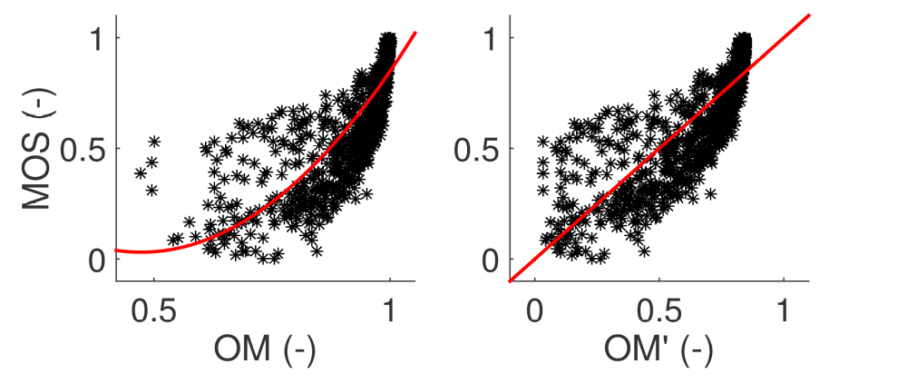
How do we benchmark objective image/video quality metrics?
Mean Opinion Scores (MOS) vs objective metric scores (OM)
Monotonicity – KRCC, SROCC
Linearity – PLCC
Accuracy – RMSE, OR

Slide 3
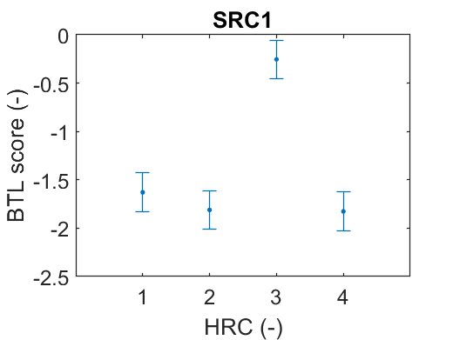
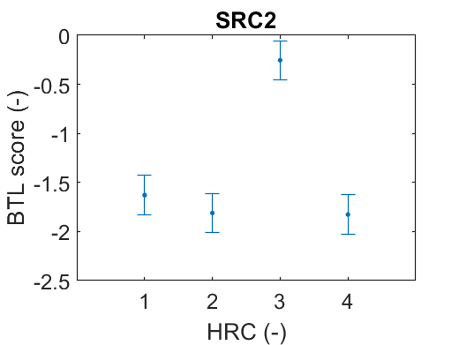

Outcomes of pair comparison experiments
Pair Comparison Matrices
Scores from a Scaling Model
SRC1 | HRC1 | HRC2 | HRC3 | HRC4
HRC1 | X | 15 | 9 | 3
HRC2 | 5 | X | 3 | 4
HRC3 | 11 | 17 | X | 12
HRC4 | 17 | 16 | 8 | X
SRC2 | HRC1 | HRC2 | HRC3 | HRC4
HRC1 | X | 15 | 9 | 3
HRC2 | 5 | X | 3 | 4
HRC3 | 11 | 17 | X | 12
HRC4 | 17 | 16 | 8 | X
SRC3 | HRC1 | HRC2 | HRC3 | HRC4
HRC1 | X | 15 | 9 | 3
HRC2 | 5 | X | 3 | 4
HRC3 | 11 | 17 | X | 12
HRC4 | 17 | 16 | 8 | X
No cross-content information -> classical approach is not very suitable!

Slide 4



What information do we actually have?
For each meaningful pair we know…
  …if one stimulus in the pair has been preferred over the other with statistical significance
  …which of the stimuli has been preferred (in case there is a significant difference)
I look much
better! ☺
Are we even different?
Are we even different?
He does look much better! ☹

Slide 5


How can we use it for benchmarking the metrics?
We want a metric to…
  …give closer scores for qualitatively similar pairs and distant scores for significantly different pairs
  …give higher score for significantly preferred stimulus
No significant difference in preferences
Left image preferred with statistical significance
OM = 0.80
OM = 0.75
OM = 0.80
OM = 0.45
|ΔOM| = 0.05
|ΔOM| = 0.35
ΔOM is irrelevant
ΔOM = +0.35

Slide 6
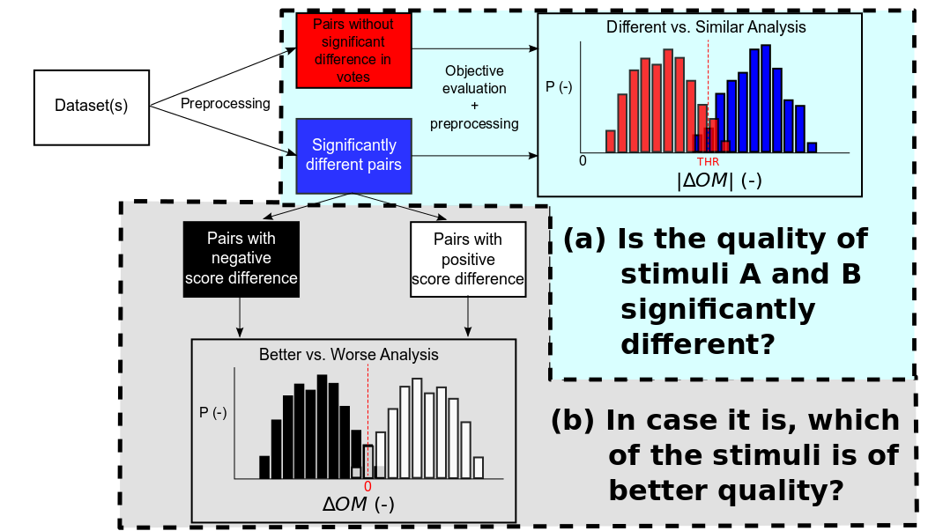
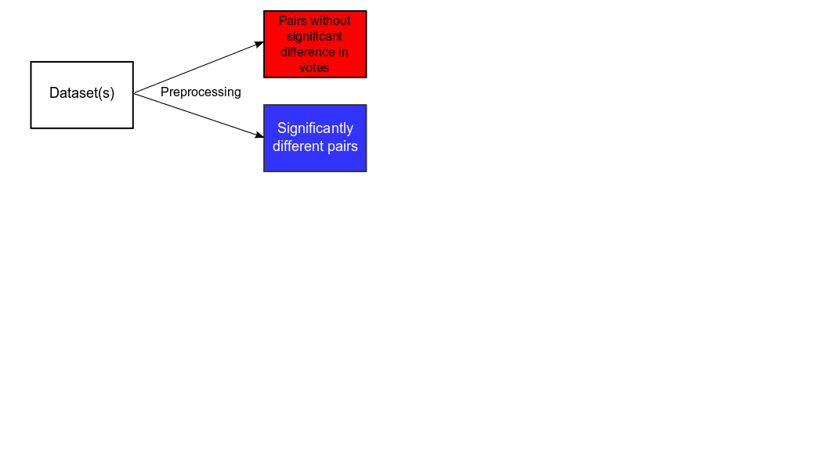

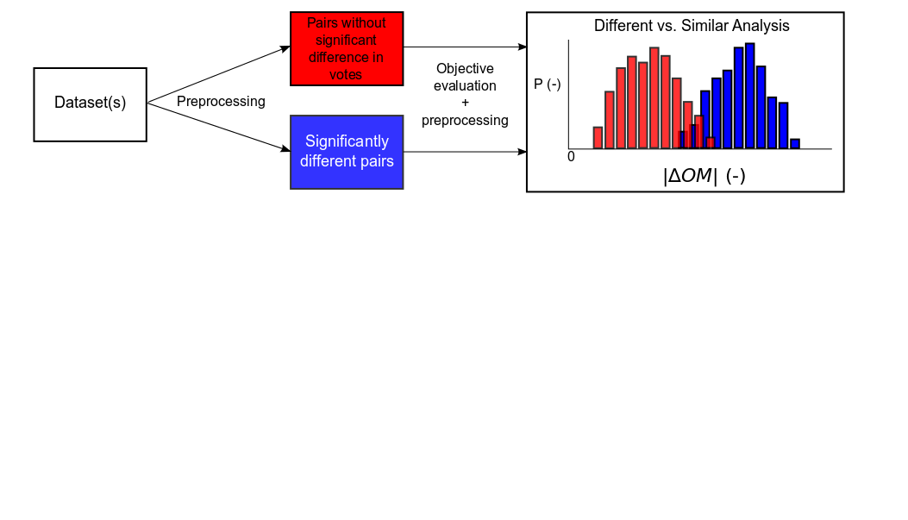
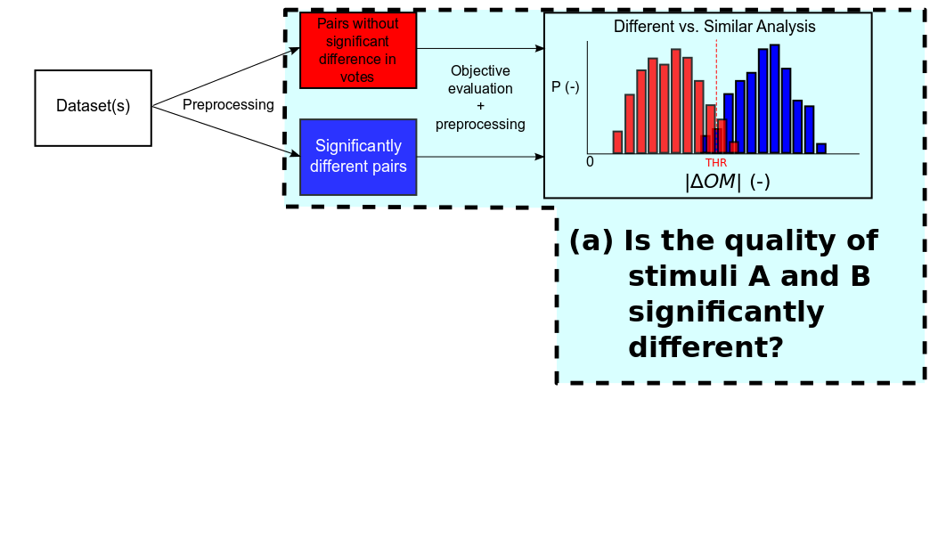
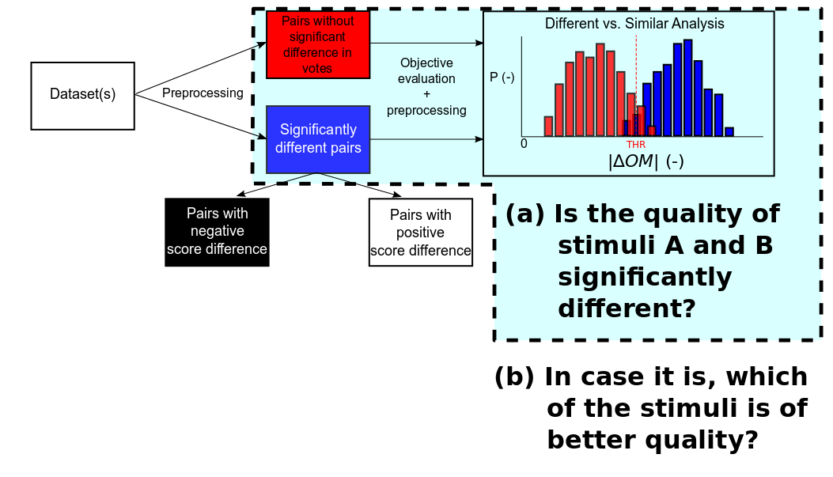
How do we quantify these abilities of a metric?
ROC Analysis
To quantify the separation of the distributions
ROC Analysis
To quantify the separation of the distributions
Percentage of correct
classification
[1] Hanhart et al. – How to Benchmark Objective Quality Metrics from Paired Comparison Data?, QoMEX2016

Slide 7

Summary
From the subjective experiment, we know…
  …if one stimulus in the pair has been preferred over the other with statistical significance
  …which of the stimuli has been preferred (in case there is a significant difference)
We want a metric to…
  …give closer scores for qualitatively similar pairs and distant scores for significantly different pairs
  …give higher score for significantly preferred stimulus
We have a way to measure it:
But this doesn’t
have to be specific
to pair comparison,
does it…?
This Photo by Unknown Author is licensed under CC BY-SA

Slide 8
Is the methodology applicable on other experiments?
From the subjective experiment, we know…
  …if one stimulus in the pair has been preferred over the other with statistical significance
  …which of the stimuli has been preferred (in case there is a significant difference)
This is true for outputs of experiment using ANY subjective procedure!
Example: ACR
  Use t-test to determine whether any two MOS values are statistically significantly different
  Calculate ΔMOS(i,j) = MOS(i) – MOS(j) for all significantly different stimuli i and j
The answer is YES… and it brings advantages!
  Considering uncertainty of the subjective votes (i.e. confidence intervals of the MOS values)
  No mapping of objective scores to subjective data
  Allows for combining data from different experiments, regardless the subjective procedure
[2] Krasula et al. – On the accuracy of objective image and video quality models: New methodology for performance evaluation, QoMEX2016

Slide 9
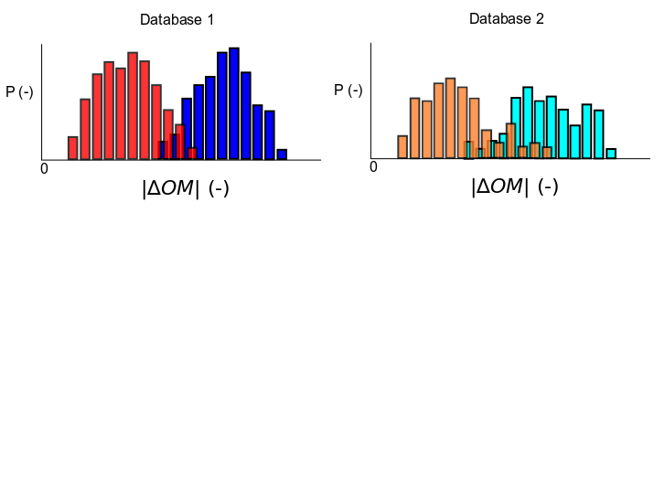
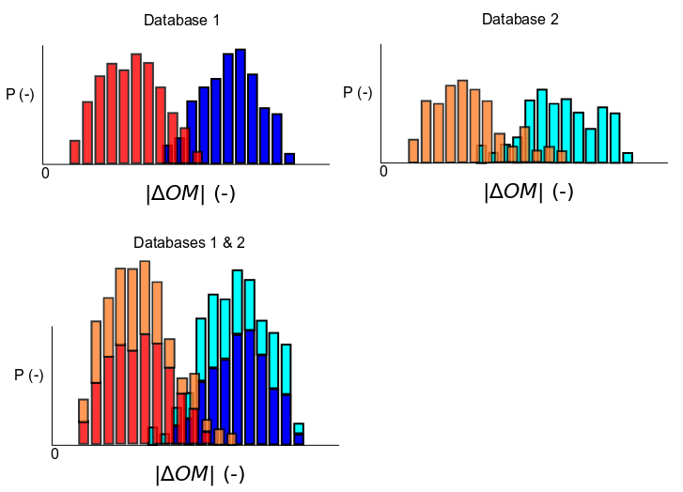
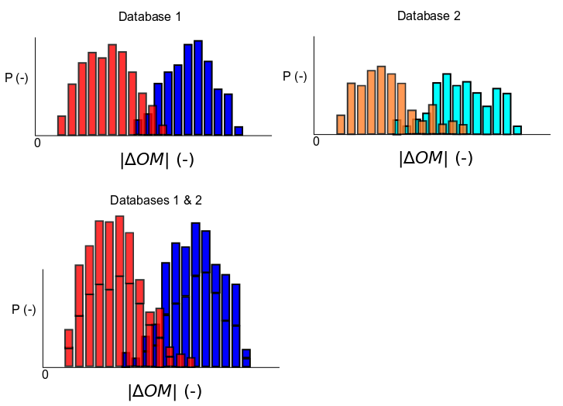
Combination of different datasets
Same analyses
Same statistical comparisons
No mapping

Slide 10
Summary
The methodology can be used for:
  Benchmarking of objective metrics regardless the subjective procedure used for data annotation
  Large-scale benchmarking of objective metrics on combination of multiple databases
  Large-scale training of objective metrics
    Combining databases enables increasing number of datapoints in orders of magnitude (deep learning?)
    A proof of concept using the methodology together with neural networks is described in [3]
[3] Krasula et al. – Training Objective Image and Video Quality Estimators Using Multiple Databases,
IEEE Transactions on Multimedia 2019

Slide 11
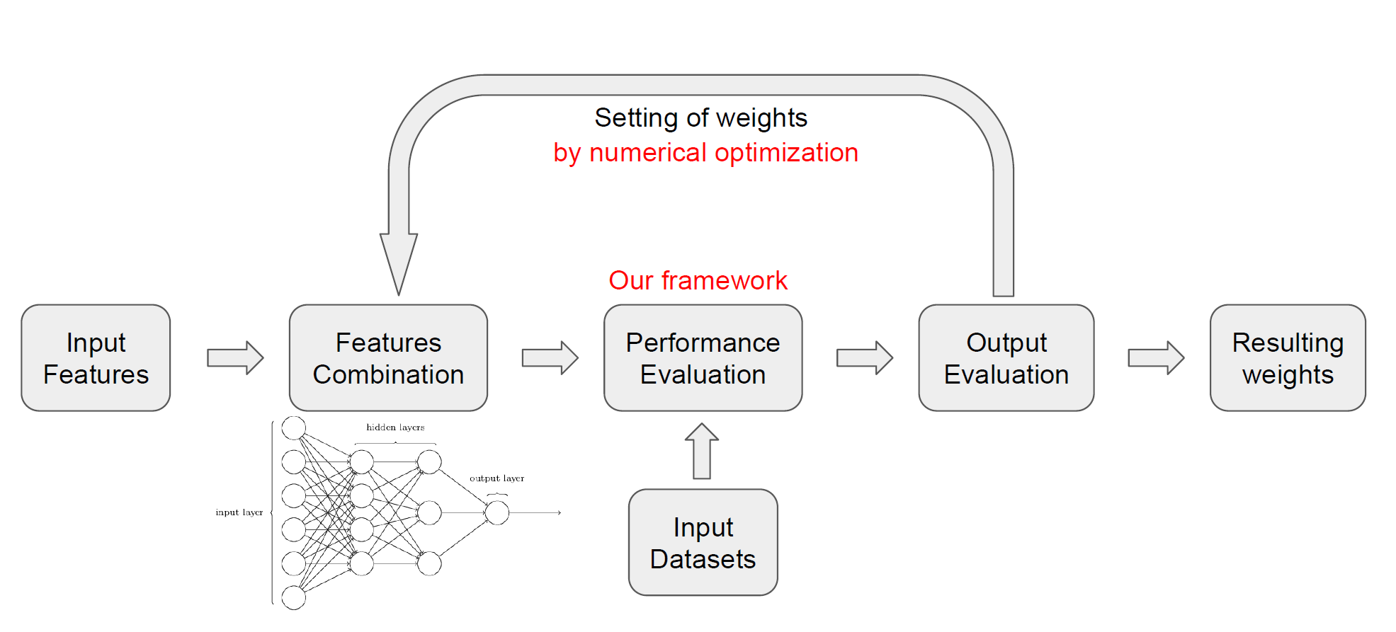
Training objective metrics on multiple databases
20 databases
3,606 videos
6 different subjective procedures
  ACR, DSIS, SSCQE, SAMVIQ, and PC
Proof of concept
  Shallow NN with the methodology as a cost function
  Conservative training strategy
  Significant improvement in overall metric’s performance
[3] Krasula et al. – Training Objective Image and Video Quality Estimators Using Multiple Databases,
IEEE Transactions on Multimedia 2019

